Slide 1
Computer Hardware
& Networking
Ikuru K

Slide 2
Outline
Hardware
  What is hardware
  Clock
  When to suspect failure
Networks
  Mac address
  IP address
  DNS

Slide 3
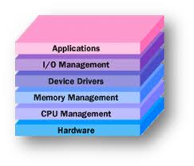
Where is Hardware?
Hardware is the underlying thing that the programmer eventually controls.

Slide 4
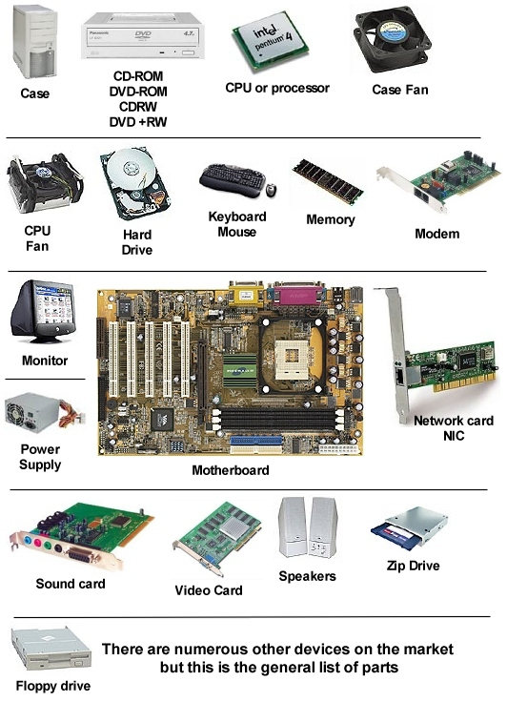
What is inside a c omputer?

Slide 5

What do we need to know about computer hardware?
All computer hardware is governed by a clock
-> higher frequency, higher performance, higher power consumption.

Slide 6
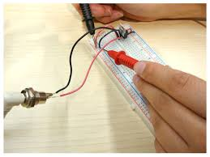
What do we need to know about computer hardware?
All computer hardware are driven by electricity
-> always check power and ground before suspecting hardware failure.

Slide 7
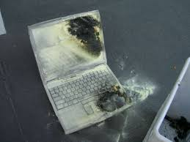
What do we need to know about computer hardware?
Hardware failure
->Application failure
Some code can destroy hardware.
(usually prevented by hardware design)

Slide 8
When to suspect hardware failure?
Unusually Hot
Program behaves differently with same initial conditions, same inputs

Slide 9
Future reference
Want to design/prototype hardware?
Check out FPGA or logic simulators

Slide 10
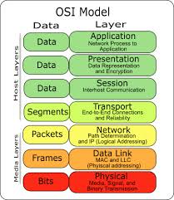
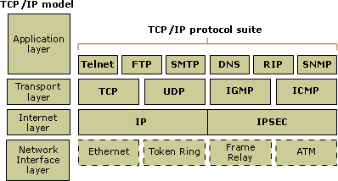
Network

Slide 11
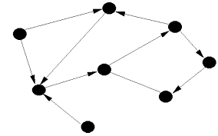
Network ~ Graph

Slide 12
Mac address
Used to identify a node on the network
Cmd->getmac

Slide 13
IP address
Global IP address
http://www.whatismyip.com/
Private IP address
ipconfig

Slide 14
DNS
Map a url to an IP address
Cmd-> nslookup google.com

Slide 15
Who owns the internet?
Guesses?
Google?
ICANN?
Yahoo?
TCS?

Slide 16
Thank you

