Slide 1
Coding seminar
Lesson 5: Instrument control – PyVISA
Ikue Hirata, PhD
ikue.hirata@iit.it

Slide 2
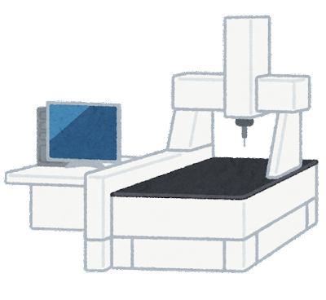

Contents
PyVISA

Slide 3

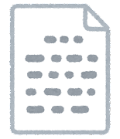
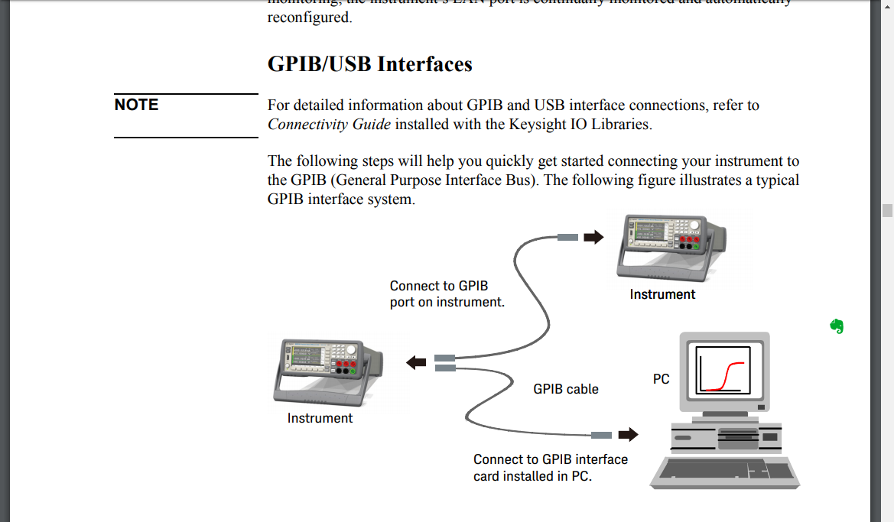

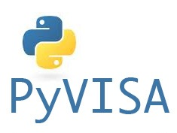
System flow
Visual Basic,
C, LabView
VISA:
Virtual Instrument Software Architecture
Your Python code
: wrapper

Slide 4
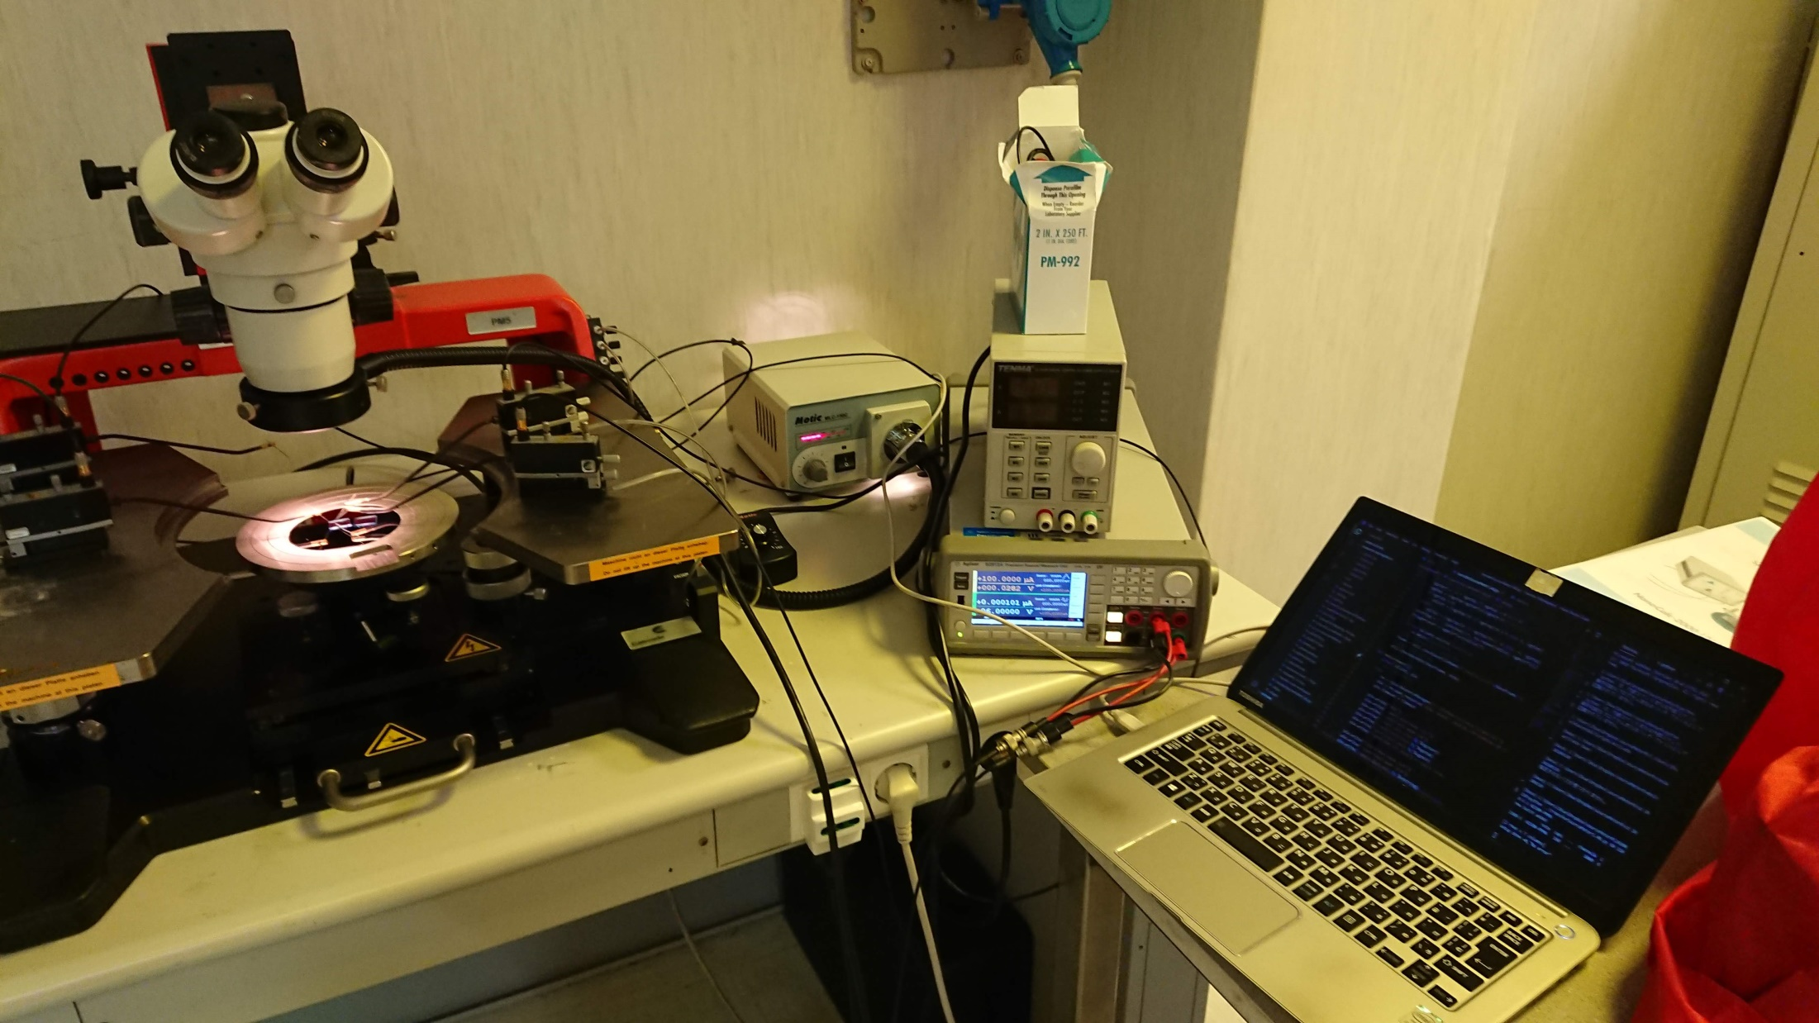
Instrument setup
Measuring device
Agilent Source Meter
PC

Slide 5
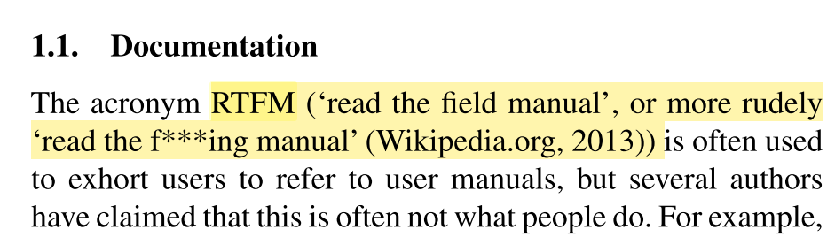
The first thing to do: RTFM
[1] A.L. Blackler, R. Gomez, V. Popovic, M.H. Thompson, Life Is Too Short to RTFM: How Users Relate to Documentation and Excess Features in Consumer Products, Interact. Comput. 28 (2016) 27–46. doi:10.1093/iwc/iwu023.

Slide 6
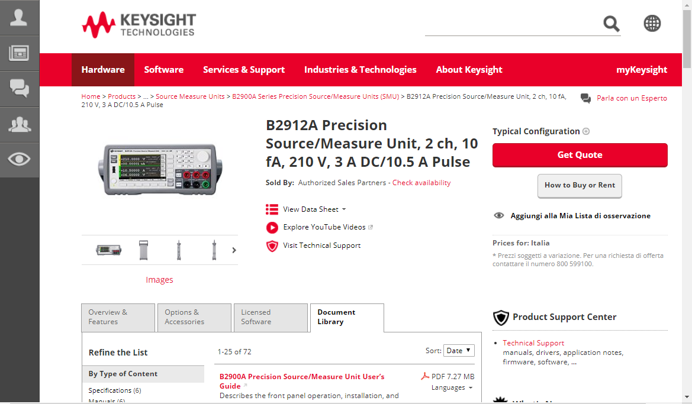
Find the manual
https://www.keysight.com/en/pd-1983602-pn-B2912A/precision-source-measure-unit-2-ch-10-fa-210-v-3-a-dc-105-a-pulse?pm=PL&nid=-33504.978798&cc=IT&lc=ita

Slide 7
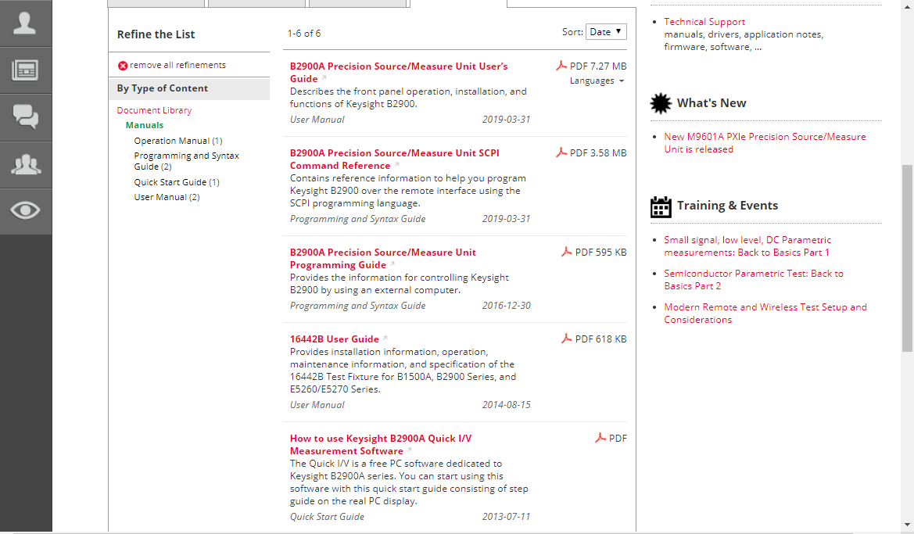
3 important documents
User Manual
Programming and Syntax Guide

Slide 8

Check the interface: GPIB/USB/LAN

Slide 9
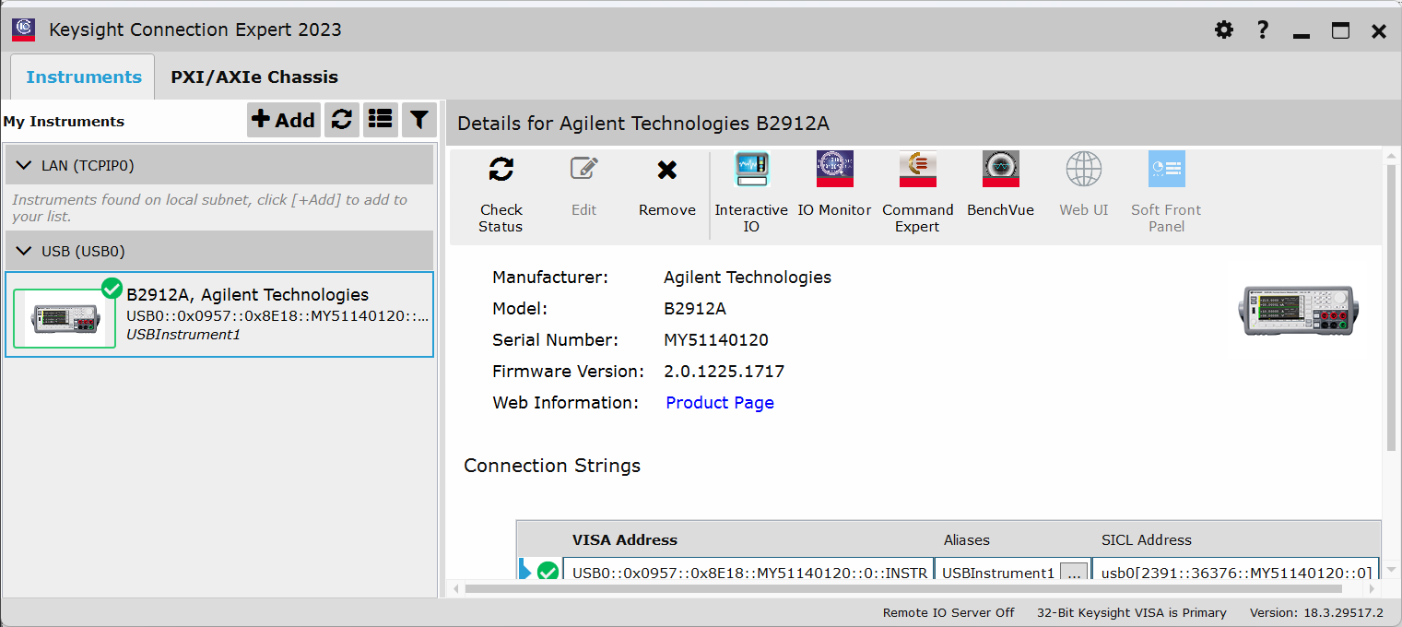
Install VISA interface

Slide 10
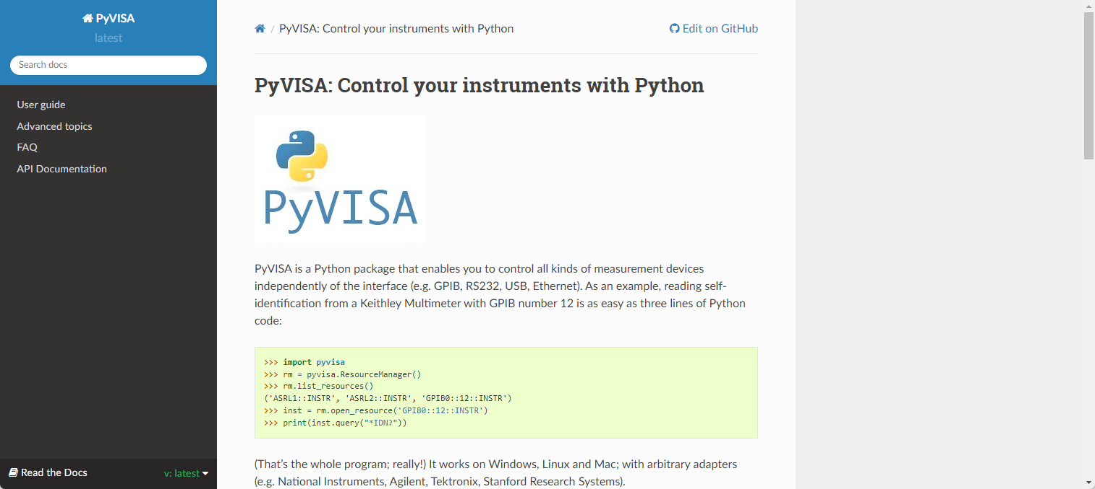
PyVISA
https://pyvisa.readthedocs.io/en/latest/

Slide 11
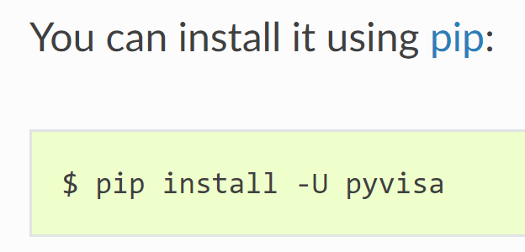
Install PyVISA

Slide 12
Measurement procedure
Open instrument
Parameters setup
Voltage, sweep direction, etc.
Send setup data to instrument
Run measurement
Get result from instrument
Save

Slide 13
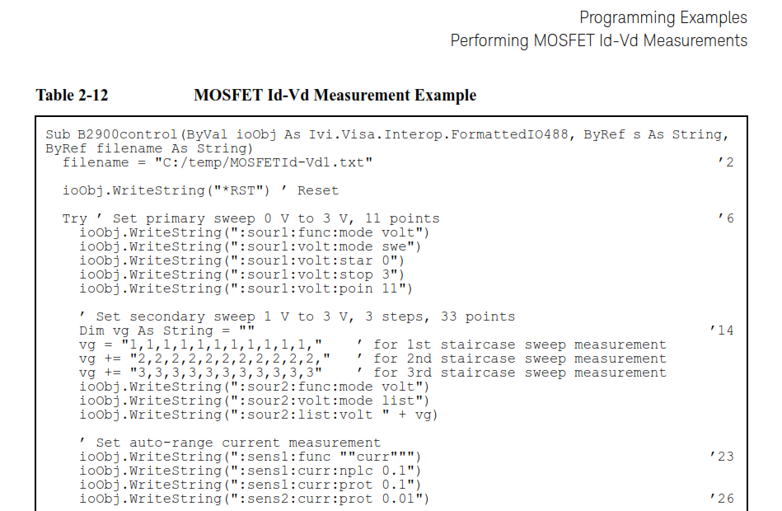
Setup: commands to send?
pia.write(COMMAND)

Slide 14
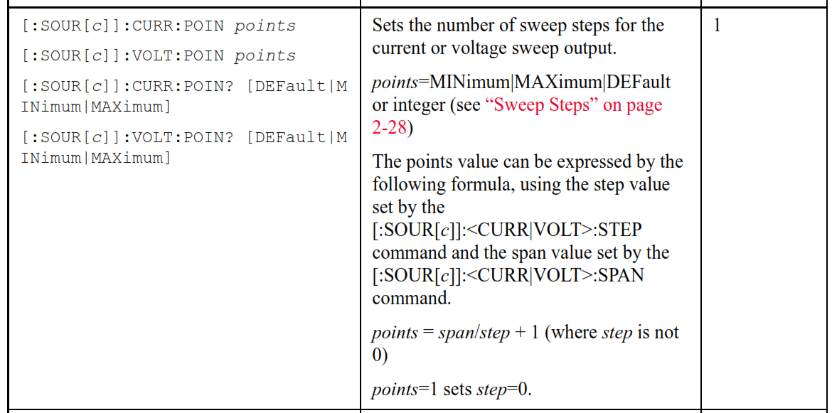
Find in manuals

Slide 15
Measurement procedure
Open instrument
Parameters setup
Voltage, sweep direction, etc.
Send setup data to instrument
Run measurement
Get result from instrument
Save
→ pia = rm.open_resource()
→ pia.write(commands)
→ pia.write(“:TRIG”)
→ pia.write(“FETC?”)

Slide 16
Study by yourself
PyVISA official document
https://pyvisa.readthedocs.io/en/latest/index.html
Manuals of instruments of your choice

