Slide 1
IMDb Top 250 Movies Analytics Project
An End-to-End Data Pipeline and Visualization Report

Slide 2
1. Project Overview
Objective: The objective of this project was to analyze IMDb’s Top 250 movies to uncover patterns and insights about the most acclaimed films of all time. This end-to-end project involved data scraping, cleaning, enrichment, and visualization to support exploratory and storytelling analytics.
Tools: Selenium, Pandas, SQL Server, Power Query, Power BI.
Approach: End-to-end workflow from data scraping to dashboarding.

Slide 3
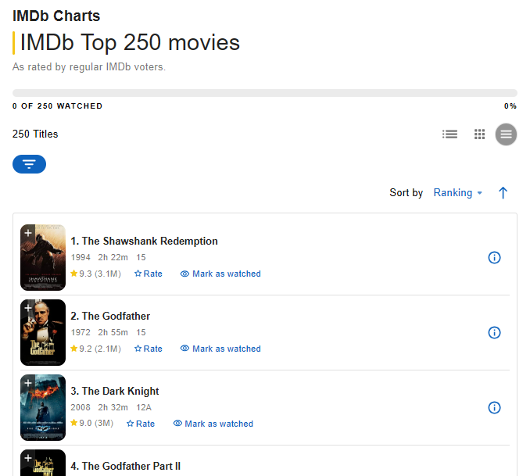
2. Web Scraping with Selenium
Scraped IMDb Top 250 page using Python Selenium.
Extracted fields: title, imdb_rating, year_released, director, Top casts, runtime, etc.
Stored raw data in CSV for further processing.

Slide 4
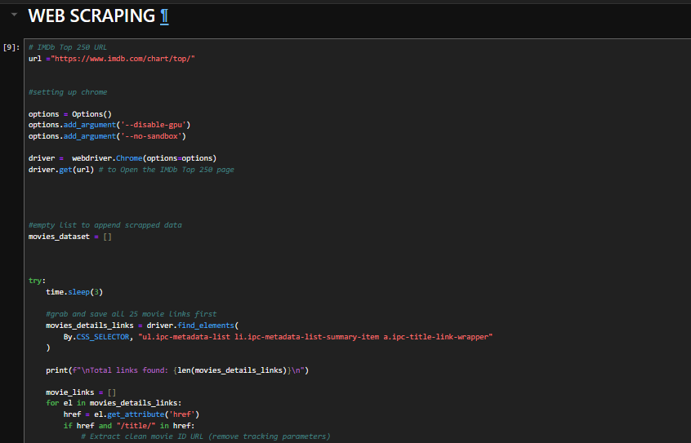

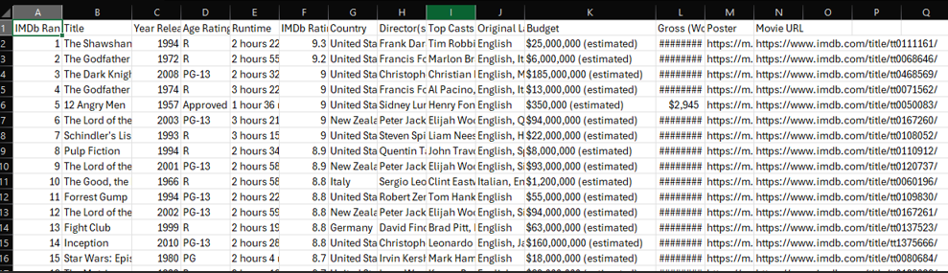
2b. Web Scraping with Selenium

Slide 5



3. Data Cleaning & Enrichment in Jupyter
Used pandas to clean and standardize data.
Handled different currency, and standardized into One currency ('USD')
Enriched runtime, and currency formats ( for budgets and Gross/Revenue field), renamed some columns

Slide 6

4. SQL Loading
Loaded cleaned data to MS SQL Server for structured storage.
Ensured proper datatypes and indexing.
Data Cleaning: Replaced wrong values in ‘Age_rating’ column.

Slide 7
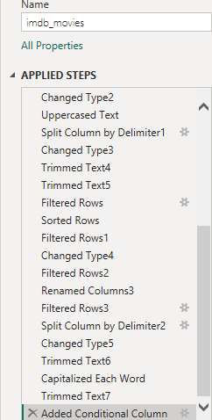
5. Power Query Preparation
Connected SQL to Power BI using Power Query.
Performed renaming, splitting, filtering, and null handling.
Argumentation: Added a ‘Decade_Released’ column. For the decade that the movie was releaseds

Slide 8
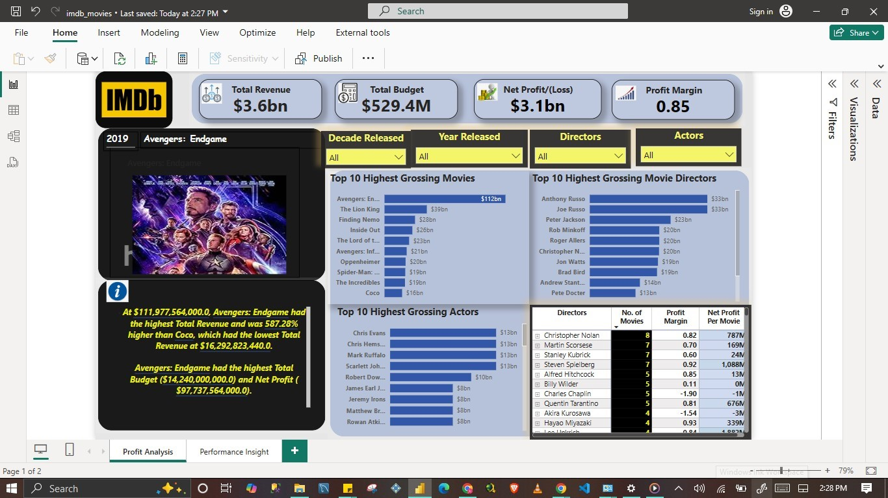
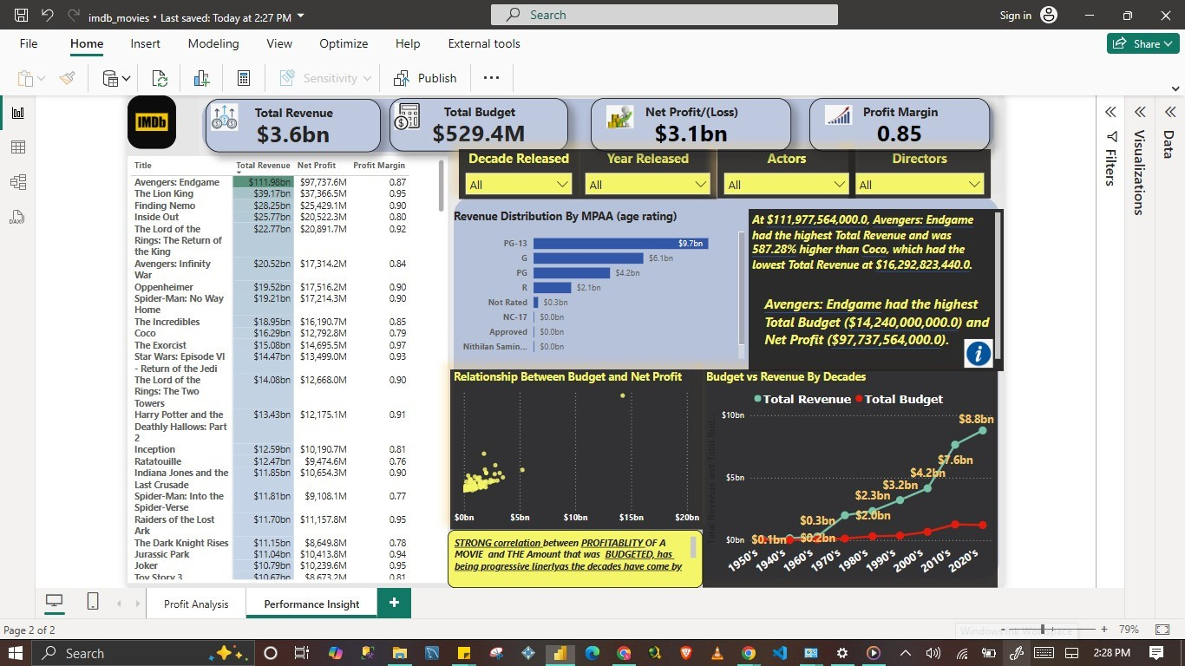
6. Power BI Dashboard
Created interactive visuals across 2 pages.
Visuals: Director & Actor frequency, Revenue trends, Budget and Revenue relationships etc.
Added filters by ‘Decade Released’, ‘Year released’, Actors, and Director.

Slide 9
7. Key Questions & Insights
Christopher Nolan has the most frequently appearing directors
PG-13 is the most dominate amongst the MPAA age-rated grades across the Top 250.
The Russo Brothers (Anthony Russo and Joe Russo) were the highest grossing Directors, with Peter Jackson in 3rd place.
The Highest Grossing Movie is the 'Avengers: Endgame' Released in 2019.

Slide 10
8. Conclusion
Completed an end-to-end data pipeline and analytics flow.
Showcased how public data can be turned into business insights.
Tech stack: Selenium, Pandas, SQL, Power BI

