Slide 1
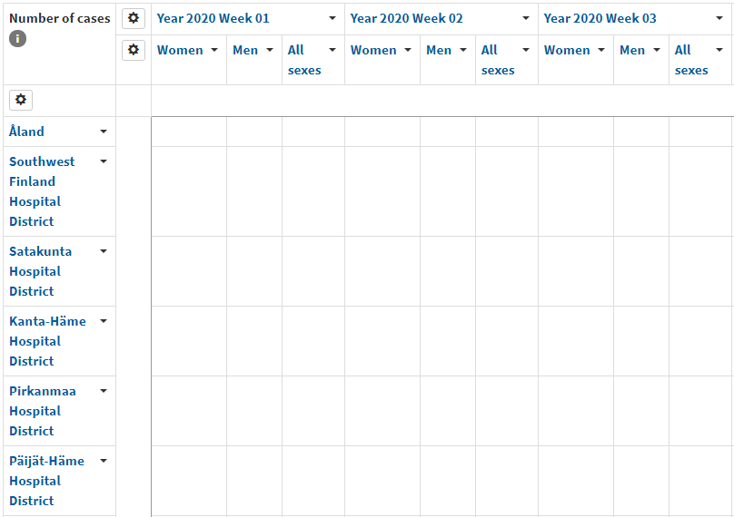
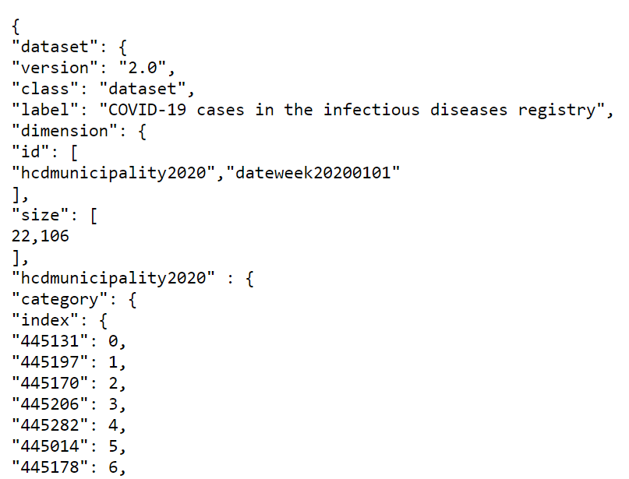
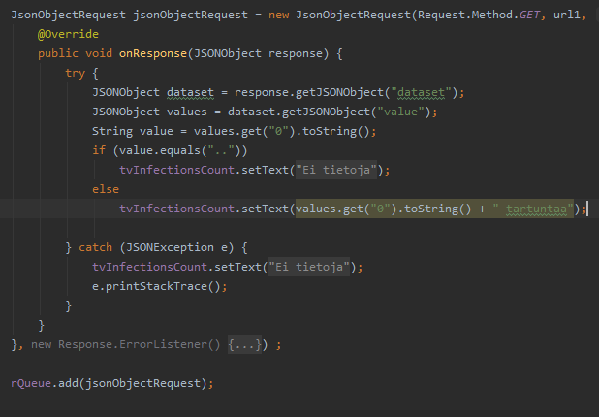
COVID-19 Statistics Mobile App
Iikka Kuha TVT19SPO
Information Technology
Introduction
This project is a simple experimentation on a one-way API between Android Studio/Volley and public JSON-formatted statistics.
Objectives
The Android application should be small with a fairly understandable user interface. With a couple text inputs the user could search information about the COVID infections on specific areas or cities within selected timelines.
Getting this information would be done with a request that gathers and splits data from THL’s public data interface (THL = Finnish institute for health and welfare).
FIGURE 1. JSON from THL’s API
Methods
I used a library called ‘Volley’ in Android Studio to make JSON object requests to the API. A request URL has 3 parameters: location, time and measure SIDs (measure stands for a type of measure, in this project I used the ‘COVID case’ measure).
As you open the app it automatically requests a list of every key:value pairs of areas and weeks.
Another request is made when an area is selected from a dropdown list. This request returns every city pair within that area.
And finally, a third request is made when you hit ’search’ and this time the objective is to return the value
(aka number of infections) in the chosen location and week.
FIGURE 2. a JSON object request
Results
The JSON objects turned out to be a more complex version of data tables called ‘JSON-stat’ and this required
a bit more researching to somewhat understand it. Basically this ‘stat’ version of JSON supports multiple dimensions (and subdimension) to spread data in various ways.
All in all, I got every UI component and JSON search-logic to work as intended.
FIGURE 3. Cubic view of data. Area dimension contains cities and week dimension contains days
Conclusions
I’d say the project was a success! I learned a lot about JSON and fiddling with a real API gave valuable experience on a realistic way of gathering data for your application.
References
1.Android Studio: Link
2. THL’s API info: Link
3. JSON-stat: Link
Software Application Project
Date of Publication: 2021, February
Instructors: Teemu Korpela

