Slide 1
InSynth tool proof translation and (Scala) code generation
and integration into the Eclipse IDE
Professor:
Viktor Kuncak
Mentor:
Tihomir Gvero
Student:
Ivan Kuraj
Notes:
Mention that integration with the Eclipse IDE will soon to come, focus was on code generation

Slide 2
Motivation
Tool overview
Tool design
Evaluation
Future work

Slide 3
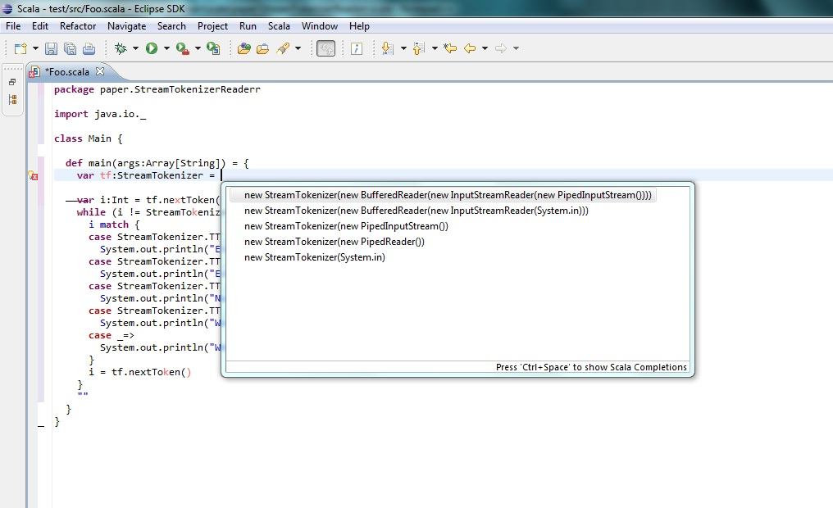
Eclipse code suggestions and “quick fixes”
Motivation
Notes:
Remind that Tihomir already presented the tool
The tool was basically an older version

Slide 4
Motivation
Tool overview
Tool design
Evaluation
Future work

Slide 5


InSynth – Software Synthesis tool
Goal is to suggest multiple meaningful expressions at a given program point
  code snippets in an IDE
What is InSynth
Notes:
Sw synthesis - automatically deriving code from specifications
Related tools that search code – require user effort, obstructive
It goes to scala not to binary but since the expressions need to be correct... the picture like such is fine

Slide 6
Interaction with developers
  within the IDE
Type inhabitation problem
  without parametric polymorphism
Program scope and API
Constrained, weighted search
  return useful and valid expressions
Features of InSynth
Notes:
Interactive – fast, responsive
In simply typed lambda calculus + polymorphism
Valid expression – typecheck
Useful – smallest weights more useful, should recognize pattern
Algorithm is EXPTIME, hard problem
With Scala + Eclipse = top notch feature!!

Slide 7
Motivation
Tool overview
Tool design
Evaluation
Future work

Slide 8
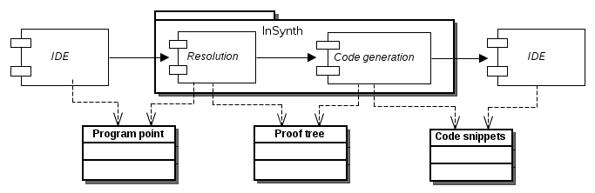
Input
  program point and its environment
Output
  code snippets
Overview
Notes:
Program point actually tells us the type to synthesize
IDE and compiler actually

Slide 9
Resolution
Notes:
Program point actually tells us the type to synthesize

Slide 10
Resolution
Notes:
Program point actually tells us the type to synthesize

Slide 11
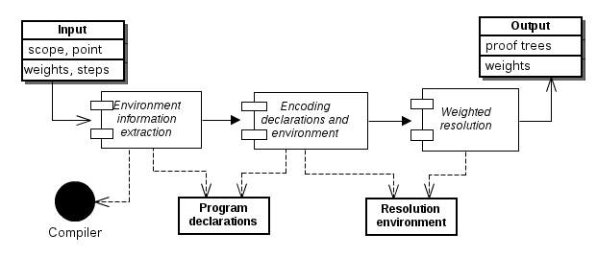
Resolution

Slide 12
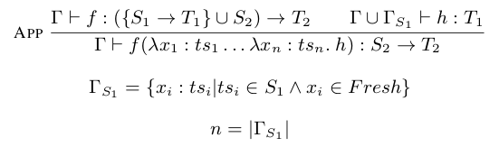
SCALA DECLARATIONS | TYPE ASUMPTIONS
val l: List[Int ] | l: { } → List(Int)
def m1(a: Int, b:Int, c:Char): String | m1: {Int, Char} → String
def m2(g : Int, f: Int=>Boolean): String | m2: {Int, {Int} → Boolean} → String
class A extends B | c: {A} → B
One rule:
  application
  abstraction
Resolution
Notes:
Neglects: Arity, order arguments, currying
Probably familiar notation : premise + conclusion
As InSynth progresses we seem to have less rules :)

Slide 13
SCALA DECLARATIONS | TYPE ASUMPTIONS
val l: List[Int ] | l: { } → List(Int)
def m1(a: Int, b:Int, c:Char): String | m1: {Int, Char} → String
def m2(g : Int, f: Int=>Boolean): String | m2: {Int, {Int} → Boolean} → String
class A extends B | c: {A} → B
One rule:
  application
  abstraction
Resolution
Notes:
Everything as a function
Probably familiar notation : premise + conclusion
As InSynth progresses we seem to have less rules :)

Slide 14
Input
  program point and its environment
Output
  code snippets
Overview
Notes:
Program point actually tells us the type to synthesize
IDE and compiler actually

Slide 15
Input
  proof trees from the resolution
Output
  code snippets
Code generation
Notes:
We focused on the code generation

Slide 16
Expressiveness
  can we be complete?
Constrained, weighted transform
  return appropriate expressions fast
Efficiency
  interaction, responsiveness
Flexibility
  adding policies, languages
Goals
Notes:
Complete for declarations with only ground types
Synthesizes large set of lambda functions
Flexibility: another languages, pattern recogntion, parallel execution, incremental cooperation

Slide 17
Code generation
Notes:
Program point actually tells us the type to synthesize

Slide 18
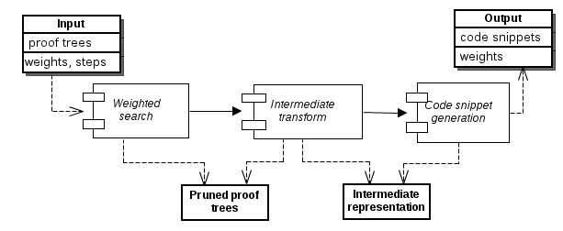
Code generation
Notes:
Program point actually tells us the type to synthesize
Steps – after some time (steps) the program should return solutions so far

Slide 19
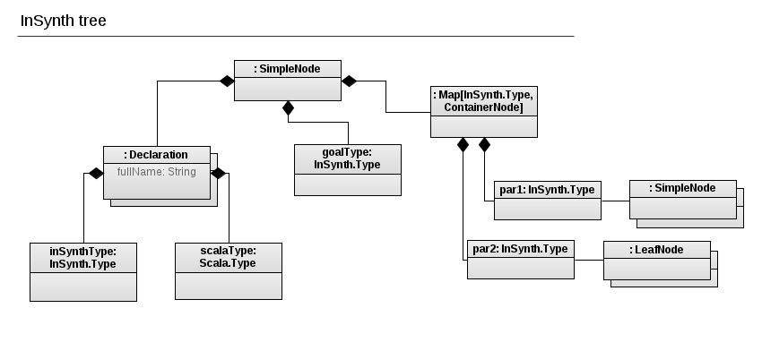
Input
  proof trees from the resolution
  expressions with given type and weight
Code generation
Notes:
Everything a function
Just a simplified representation and added Scala declarations
Resolution only guarantess that we can synthesise an expression with those elements but not also how can we do that

Slide 20
Weighted search
Notes:
Program point actually tells us the type to synthesize

Slide 21
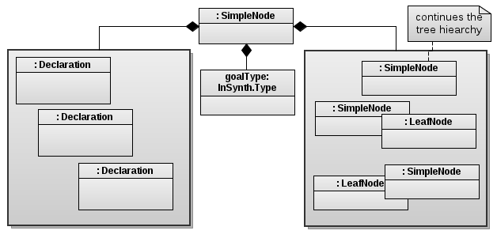
Goals
  extract only the best combinations
  employ policies
  incremental search
Weighted search
Notes:
Only limited number
More advanced policies on weighting
Incremental, together with user interaction, and inSynth work in parallel

Slide 22
Goals
  extract only the best combinations
  employ policies
  incremental search
Weighted search
Notes:
Only limited number
More advanced policies on weighting
Incremental, together with user interaction, and inSynth work in parallel
Even for simple case InSYnth can return 1000s of expressions
Prunes subtrees to avoid subsequent transformation steps on them
Very similar to a worklist algorithm

Slide 23
Intermediate transform
Notes:
Program point actually tells us the type to synthesize

Slide 24
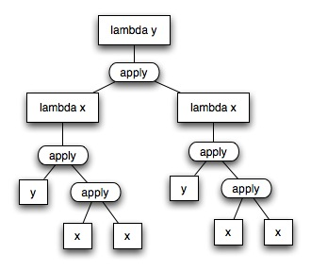
Input
  pruned proof trees
Output
  intermediate representation
Goals
  completeness
  modularity
Intermediate transform
Notes:
Everything a function
Just a simplified representation and added Scala declarations
Modularity: other languages, perhaps subject to analyzers

Slide 25
Snippet generation
Notes:
Program point actually tells us the type to synthesize

Slide 26

Input
  intermediate trees
Output
  set of code snippets
…………………………………………………………………………………………………………………………………………………………………………………………………………………………………
…………………………………………………………………………………………………………………………………………………………………………………………………………………………………
…………………………………………………………………………………………………………………………………………………………………………………………………………………………………
…………………………………………………………………………………………………………………………………………………………………………………………………………………………………
Goals
  valid code
  “pretty” code
Snippet generation
Notes:
Valid code – should typecheck and return the expression we need at the program point
Pretty – should be factored, formatted and used sugar to be as pretty as possible

Slide 27
Motivation
Tool overview
Tool design
Evaluation
Future work

Slide 28
val S:(Int=>(Char=>String))=>(Int=>Char)=>Int=>String
= ?
Synthesis example
Notes:
Formal proof of the transform (induction on the expression tree)
How to see it works? Dealing with SKI
SKI no abstraction
R = S ( K (S I) ) K
R x y =
S ( K (S I) ) K x y =
K (S I) x (K x) y =
S I (K x) y =
I y (K x) y =
y (K x) y = y x

Slide 29
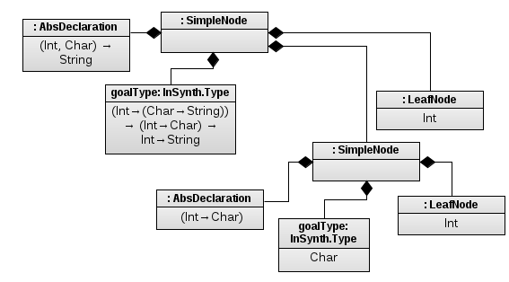
val S:(Int=>(Char=>String))=>(Int=>Char)=>Int=>String
= ?
Resolution
Resolution
Notes:
Formal proof of the transform (induction on the expression tree)
How to see it works? Dealing with SKI
SKI no abstraction
R = S ( K (S I) ) K
R x y =
S ( K (S I) ) K x y =
K (S I) x (K x) y =
S I (K x) y =
I y (K x) y =
y (K x) y = y x

Slide 30
val S:(Int=>(Char=>String))=>(Int=>Char)=>Int=>String
= ?
Weighted search
Resolution
Weighted search
Notes:
Will not do anything actually (since only one combination is found)

Slide 31
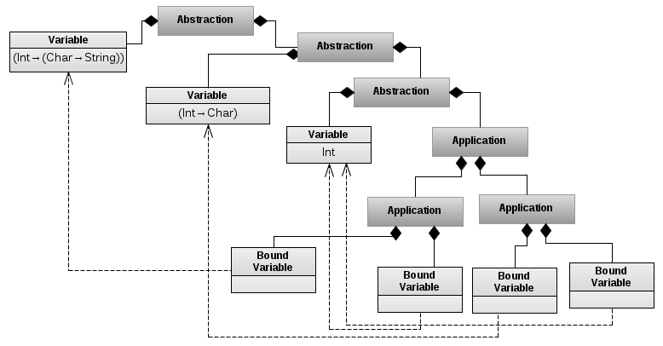
val S:(Int=>(Char=>String))=>(Int=>Char)=>Int=>String
= ?
Weighted search
Resolution
Intermediate
Intermediate transform
Notes:
Formal proof of the transform (induction on the expression tree)
How to see it works? Dealing with SKI
SKI no abstraction
R = S ( K (S I) ) K
R x y =
S ( K (S I) ) K x y =
K (S I) x (K x) y =
S I (K x) y =
I y (K x) y =
y (K x) y = y x

Slide 32
val S:(Int=>(Char=>String))=>(Int=>Char)=>Int=>String
= ?
Weighted search
Resolution
Intermediate
({(var_1: ((Int) => ((Char) => String)))
=>
{
(var_2: (Int) => Char)
=>
{ { (var_3: Int) => { (var_1:((Int) => (Char) => String)) (var_3: Int) ((var_2: ((Int) => Char)) (var_3: Int)) } } }
}
})
Snippets
Snippet generation
Notes:
Formal proof of the transform (induction on the expression tree)
How to see it works? Dealing with SKI
SKI no abstraction
R = S ( K (S I) ) K
R x y =
S ( K (S I) ) K x y =
K (S I) x (K x) y =
S I (K x) y =
I y (K x) y =
y (K x) y = y x

Slide 33
Expressiveness
  can we be complete?
Constrained, weighted transform
  return appropriate expressions fast
Efficiency
  interaction, responsiveness
Flexibility
  adding policies, languages
Goals achieved?
Notes:
Complete for declarations with only ground types
Synthesizes large set of lambda functions
Flexibility: another languages, pattern recogntion, parallel execution, incremental cooperation

Slide 34
Expressiveness and soundness
  formal proof
    by induction on the proof tree
  SKI combinators
    I : (I x) = x
    K: (K x y) = x
    S: (S x y z) = (x z (y z))
SKI calculus is Turing complete
  argument reversal, R = S ( K (S I) ) K
  fix point, Y = S (K x) (S I I), for some x
Correctness?
Notes:
Formal proof of the transform (induction on the expression tree)
How to see it works? Dealing with SKI
SKI no abstraction
R = S ( K (S I) ) K
R x y =
S ( K (S I) ) K x y =
K (S I) x (K x) y =
S I (K x) y =
I y (K x) y =
y (K x) y = y x

Slide 35
Efficiency
  interaction with user and InSynth resolution
  incremental
Useful snippets
  weighted combination search
  valid expressions
  presentable format
Flexibility
  modular design
InSynth = ?
Are we practical?
Notes:
Useful :
expressions that will type check – valid
Convenient – weight, policies
Presentable format – refactoring (can be assisted from IDE)
Efficiency:
Searches N best combinations
Can ask user or resolution for more information
Flexibility:
Add new policies (for weights)
Add new languages

Slide 36
Motivation
Tool overview
Tool design
Evaluation
Future Work

Slide 37
Fully integrate with Eclipse
Snippet pattern matching
  using existing Scala codebase
Polymorphism
  bounded quantification
Give InSynth to the community
  improve according to the feedback
Future work
Notes:
Scaka IDE – official plugin

