Slide 1

Tihomir Gvero, Ruzica Piskac, Viktor Kuncak

Slide 2

Search for method composition in large and complex libraries
  Substantial effort
  Obstructing
Software Synthesis = automatically deriving code from specifications
InSynth - a tool that suggests multiple meaningful expressions at a given program point

Slide 3
Software Synthesis = automatically deriving code from specifications
InSynth – a tool for synthesis of code fragments (snippets)
  interactive
    getting results in a short amount of time
    multiple solutions – a user needs to select
  component based
    assemble program from given components (local values, API)
  partial specification
    hard constraints – type constraints
    soft constraints - find the components “most likely” to be useful

Slide 4

Implemented for Scala language
Input:
  Partial Scala program – visible declarations
  Program point – desired type
Output:
  Code snippets – expression with desired type
Runs synthesis algorithm to find candidate snippets
Supports ground and function types
Generates snippets with lambda functions
Type
Information

Slide 5

def fopen(name:String):File = { ... }
def fread(f:File, p:Int):Data = { ... }
var currentPos : Int = 6
var fname : String= “text.txt”
...
def getData():Data = ?

Slide 6
def fopen(name:String):File = { ... }
def fread(f:File, p:Int):Data = { ... }
var currentPos : Int = 6
var fname : String= “text.txt”
...
def getData():Data =
fread(fopen(fname), currentPos)

Slide 7



Slide 8


Encoding and adding
declarations and desired type
into environment
Find
all visible
declarations
…………………………………………………………………………………………………………………………………………………………………………………………………………………………………
Synthesis algorithm with weights
Program point
Max steps
Code snippets
Notes:
Input:
a partial Scala program
a program point
maximum number of resolution steps
traverse program syntax tree
create the clauses (Encode them in FOL)
assign the weights
a minimal weight clause and resolve it with all applicable clauses
If we derive a contradiction (empty clause),
extract its proof tree
until
the clause set becomes saturated or the given threshold on the resolution steps is exceeded.
Finally, we reconstruct terms from the proof trees, and create the code snippets.
snippets are further tested by invoking a test case

Slide 9

Given a set of types T and a set of expressions E, a type environment is a set
Γ = {e₁ : τ₁, e₂ : τ₂, ... , e_{n} : τ_{n}}
e : τ is a type assumption
Let C = {c/_{n}, ...} be a set of symbols. The elements of arity zero are called constants.
The set of all ground and function types is defined by the following grammar:
T_{g} ::= C(T_{g}, ..., T_{g}) | S_{g} → T_{g}
S_{g} ::= {T_{g}, …, T_{g}}
Notes:
We introduce predicate hasType to describe that value v is of type T : hasType(v, T ).
We use Hindley-Milner type description and
interpret ! with the special function symbol arrow
encode polymorphism (parametric types) using universally quantified variables.

Slide 10

SCALA DECLARATIONS | TYPE ASUMPTIONS
val l: List[Int ] | l: { } → List(Int)
def m1(a: Int, b:Int, c:Char): String | m1: {Int, Char} → String
def m2(g : Int, f: Int=>Boolean): String | m2: {Int, {Int} → Boolean} → String
class A extends B | c: {A} → B
The query is encoded as a type assumption
  query: {τ}→⊥
  and added to the type environment.
Symbols query and ⊥ are fresh and not used for any other encoding
The goal is to find an inhabitant of the type ⊥
Notes:
We introduce predicate hasType to describe that value v is of type T : hasType(v, T ).
We use Hindley-Milner type description and
interpret ! with the special function symbol arrow
encode polymorphism (parametric types) using universally quantified variables.

Slide 11

Composition:
Γ f:S1 → T1 Γ g:S2 → T2 T1 ∈ S2
Γ g ° f: S1 ∪ (S2 / {T1}) → T2
Application:
Γ a:S1 → T1 Γ f:{S2 → T1} ∪ S3 → T2 S1 ⊆ S2
Γ f(a): S3 → T2

Slide 12

Complexity
  EXPTIME
Expressiveness
  Complete for declarations with only ground types
  Synthesizes large set of lambda functions
Efficiency
  Generates useful set of snippets in short amount of time
  Backward search
  Weights
Notes:
We introduce predicate hasType to describe that value v is of type T : hasType(v, T ).
We use Hindley-Milner type description and
interpret ! with the special function symbol arrow
encode polymorphism (parametric types) using universally quantified variables.

Slide 13

Symbol weights
Low
High
Method and field symbols
Local symbols
API symbols
Term weights
  Knuth-Bendix ordering
Type assumption weights
  Sum of all terms’ weight in type assumption
Collecting weights from a code corpus
Notes:
To begin with, we define an ordering on the symbols and to
each symbol we assign the weight. This ordering and weights are defined as
follows: the user preferred symbols have the smallest weight and are the greatest.
They are followed by the local symbols occurring in the method. The remaining
symbols of the corresponding class have greater weight than the local symbols.
Finally, the symbols of the greatest weight are those which do not occur in the
class. Those are symbols coming from various API and library methods.

Slide 14

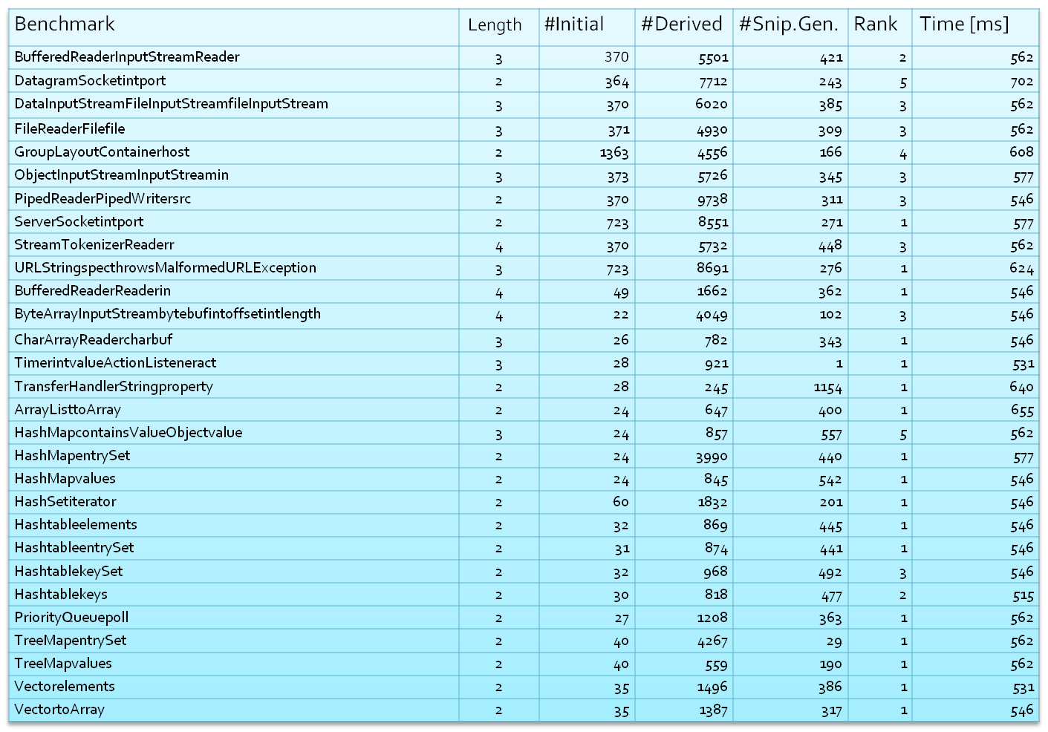

Slide 15

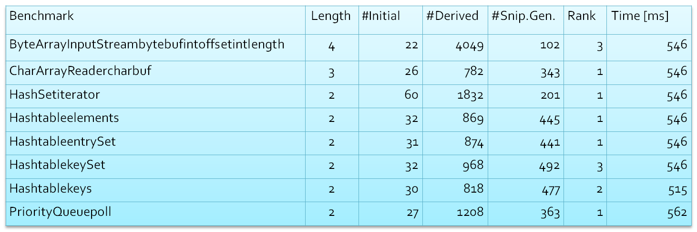
100 examples
  Desired expression appears in 76 examples among top 5 snippets
  As the top snippet in 53 examples

Slide 16

InSynth - interactively deployed synthesis tool:
  Synthesizes arbitrary expression trees from local and API declarations
  Generates expressions with lambda functions
  Support for subtyping
  Weights indicating preferences
We have found InSynth to be fast enough and helpful in synthesizing meaningful code fragments
http://lara.epfl.ch/w/insynth

Slide 17
Thank you

