Slide 1
Project 1
Aviation Analysis

Slide 2
Aviation Dataset
The dataset dataset provides a detailed and comprehensive collection of aviation dataset which will help us determine which aircraft are the lowest risk for the company to start in this new aviation business.
It encompases a wide range of information and from this, the stakeholder is interested to uncover trends and insights regarding aviation accidents in the USA and in international waters from 1962 to 2023.

Slide 3
Features
Event.Id: Unique identifier for each aviation event (accident or incident).
Investigation.Type: Specifies whether the event was classified as an Accident or an Incident.
Accident.Number: An identifier unique to accidents (may not apply to all incidents).
Event.Date: The date on which the event occurred.
Location: The city, region, or specific area where the event took place.
Country: The country in which the event occurred.
Latitude and Longitude: Geographic coordinates of the event's location.
Airport.Code and Name: IATA or ICAO recognized code and Name of the airport
Injury.Severity: Categorization of the event based on injuries sustained
Aircraft.Damage: Description of the damage to the aircraft
Aircraft.Category: Classification of the aircraft
Registration.Number: The aircraft’s tail number
Make and Model: Manufacturer of the aircraft and specific model

Slide 4
Features…Cont
Amateur.Built: Indicates whether the aircraft was built by amateurs
Number.of.Engines and Type:Specifies the number of engines on the aircraft and the type
FAR.Description: Refers to the Federal Aviation Regulations (FAR) under which the flight was conducted.
Schedule: Specifies whether the flight was Scheduled or Non-scheduled.
Purpose.of.Flight: The primary purpose of the flight
Air.Carrier: The name of the airline or operator involved in the event.
Injuries: The number of injuries resulting from the event. Fatal/serious/minor/uninjured
Weather.Condition: Description of the tool used to check the weather during the event
Broad.Phase.of.Flight: General phase of flight during the event
Report.Status: Indicates the status of the event report
Publication.Date: The date on which the event report was published.

Slide 5
Business Goal
Understanding Aviation risks:
Identify key factors that influence flight accidents, such as year, instrument use,location engines, purpose…
Identifying Trends:
Explore patterns in accidents across various countries, period…
Recommendations
Provide actionable recommendations to minimize the accidents and fatalities .

Slide 6
Questions to Address:
Does evolution of time has an influence on the number of accidents?
Is purpose of the aircraft a contributing factor to accidents?
Is the weather instrument in use to measure the condition a contributing factor?
Does the number of engines a contributing factor?

Slide 7
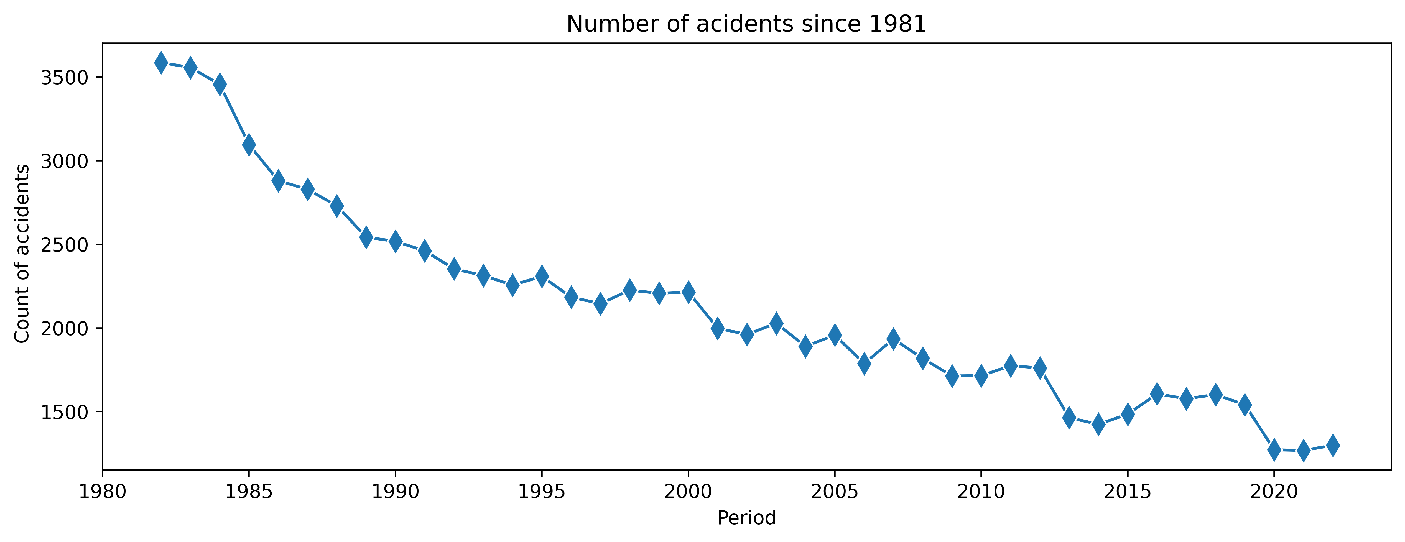
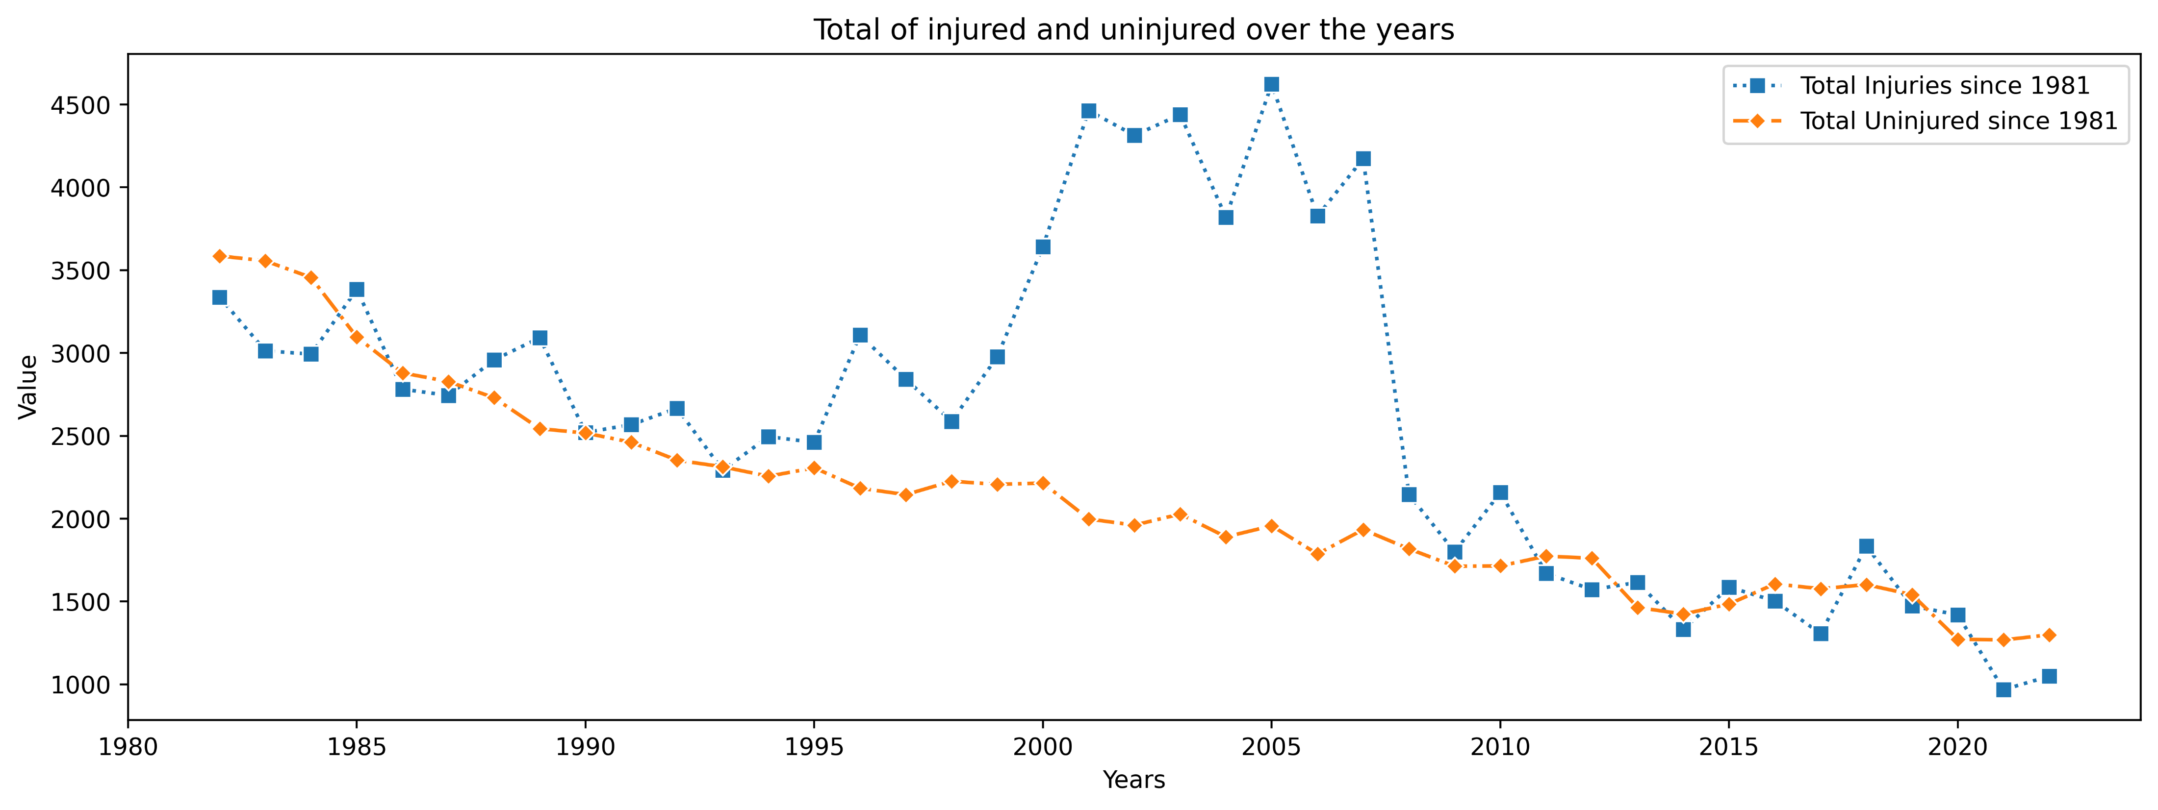
Findings – Evolution over Time
From the analysis on evolution of time, we find that generally, there has been significant decrease in accidents over time.
We take note that there has been significant improvement in Technology, this could have contributed greatly to this observation.
We also note, when you drill down countrywise, this phenomena is not standard and different patterns can be observed.
In addition, we note that the number of uninjured decreased over time as a result of decreased accidents.
Refer Aviation Data | Tableau Public

Slide 8
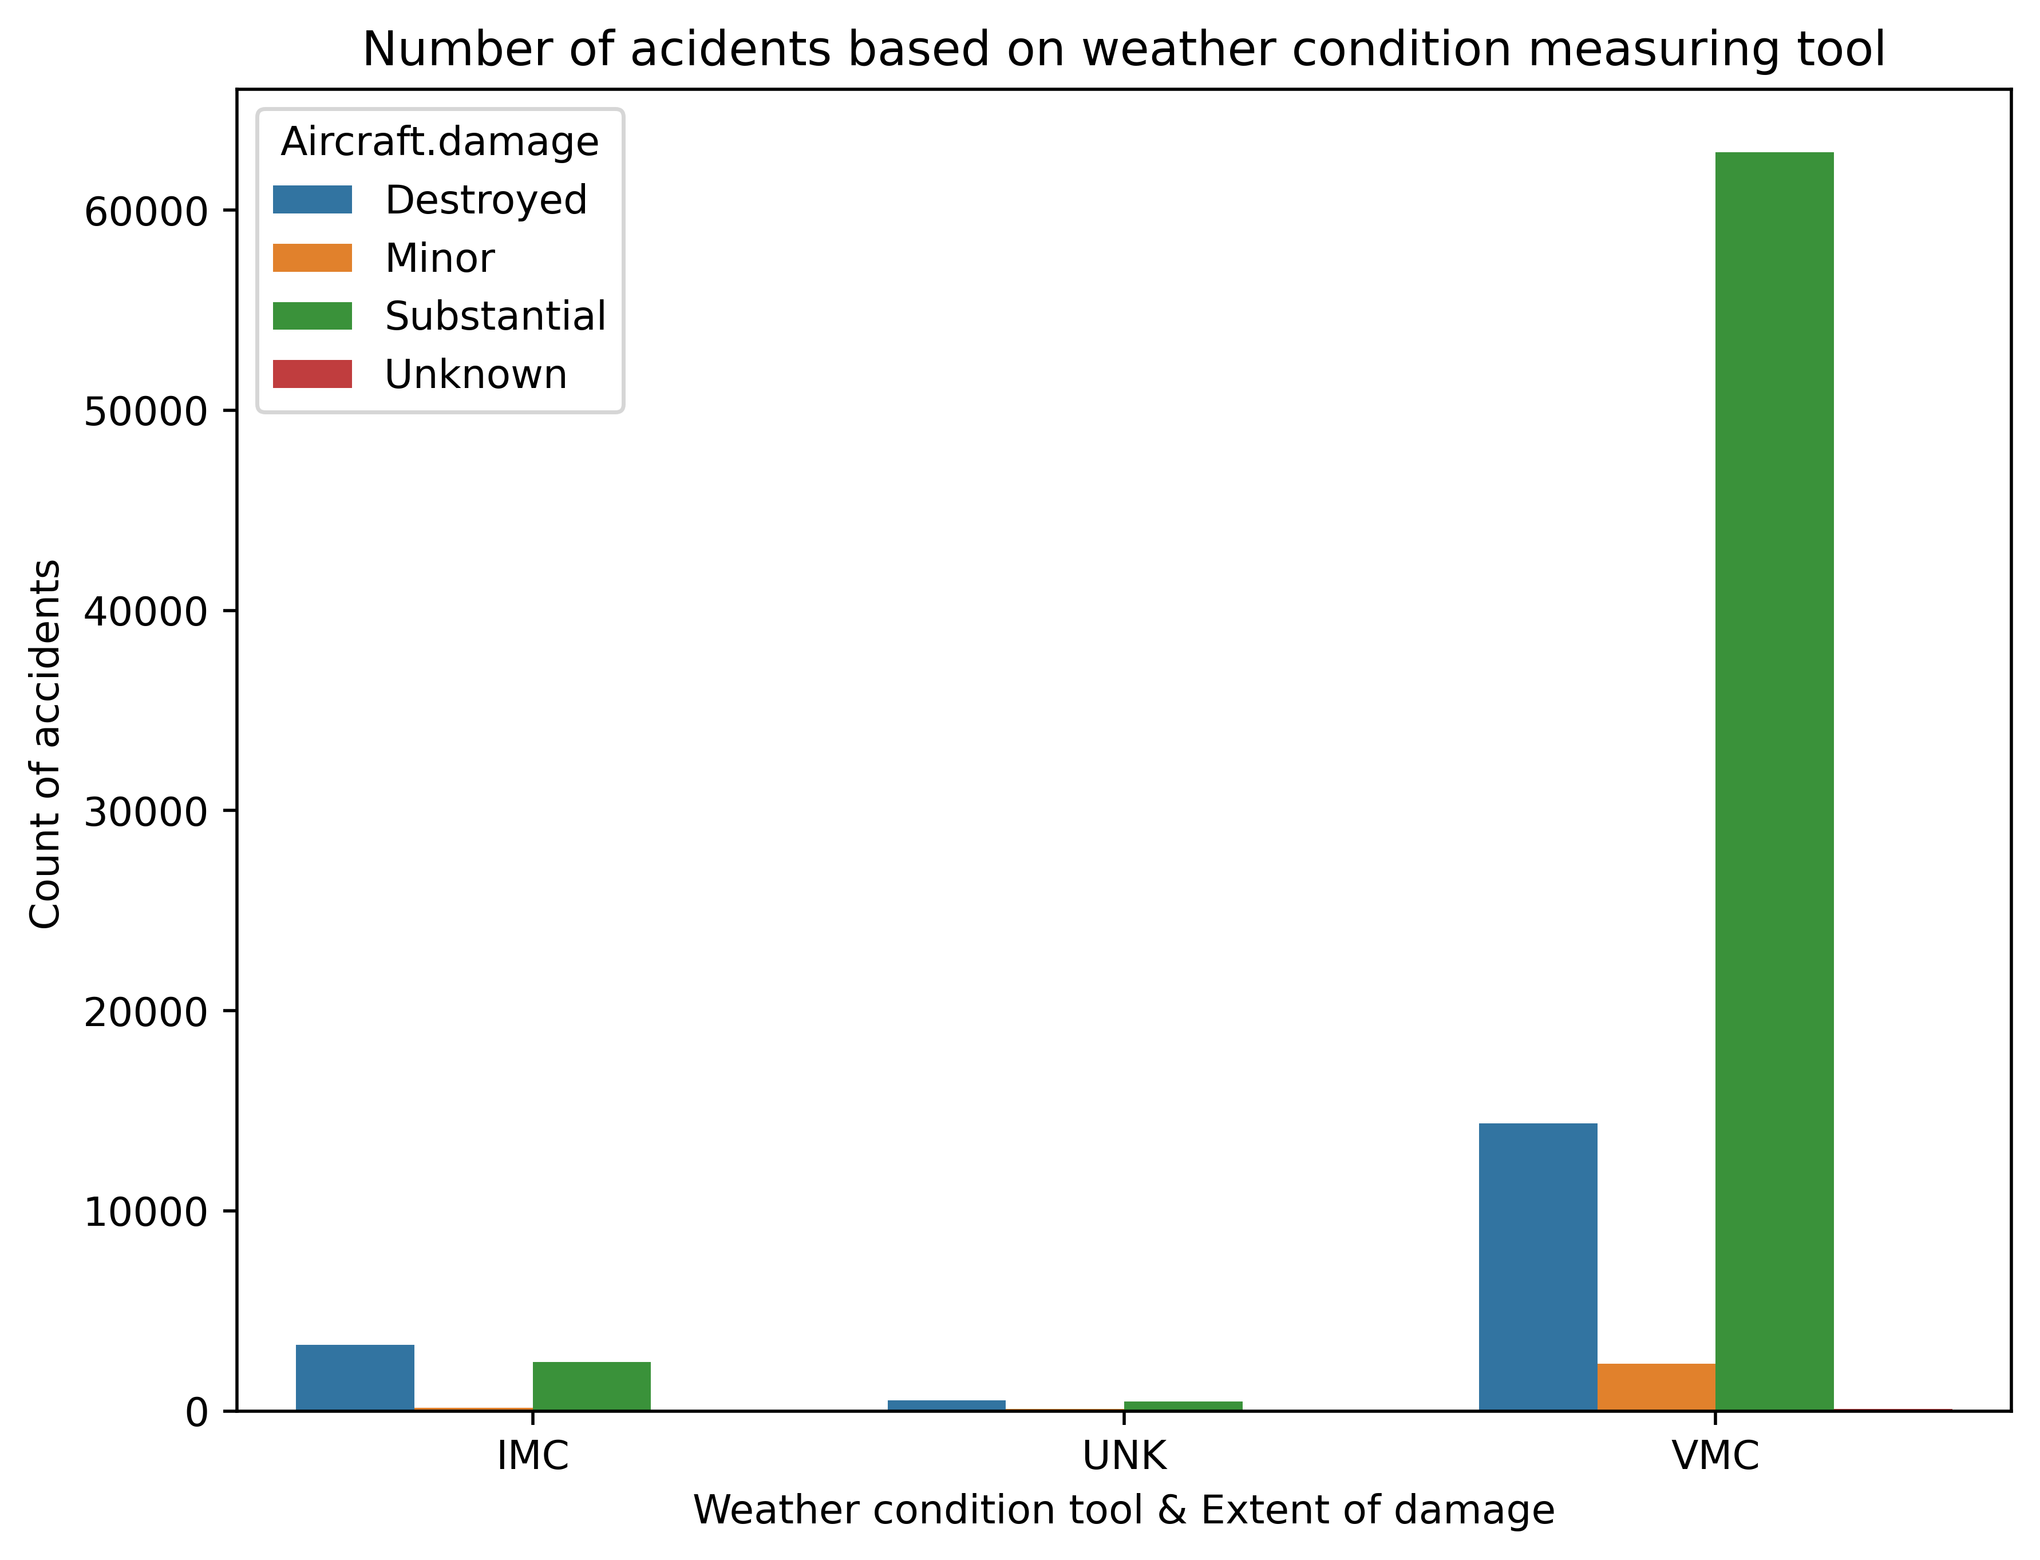
Findings – Weather Instrument in use
We realize that quite a number of accidents are triggered by the selection of the weather condition instrument use. Majority of the accidents occurred when Pilots decided to visually determine the weather conditions in place of he instrument cluster.
Accidents resulting from this were majorly substantial and we note that in as much the instrument cluster linked accidents were few, majority suffered total destruction.
Refer Aviation Data | Tableau Public

Slide 9
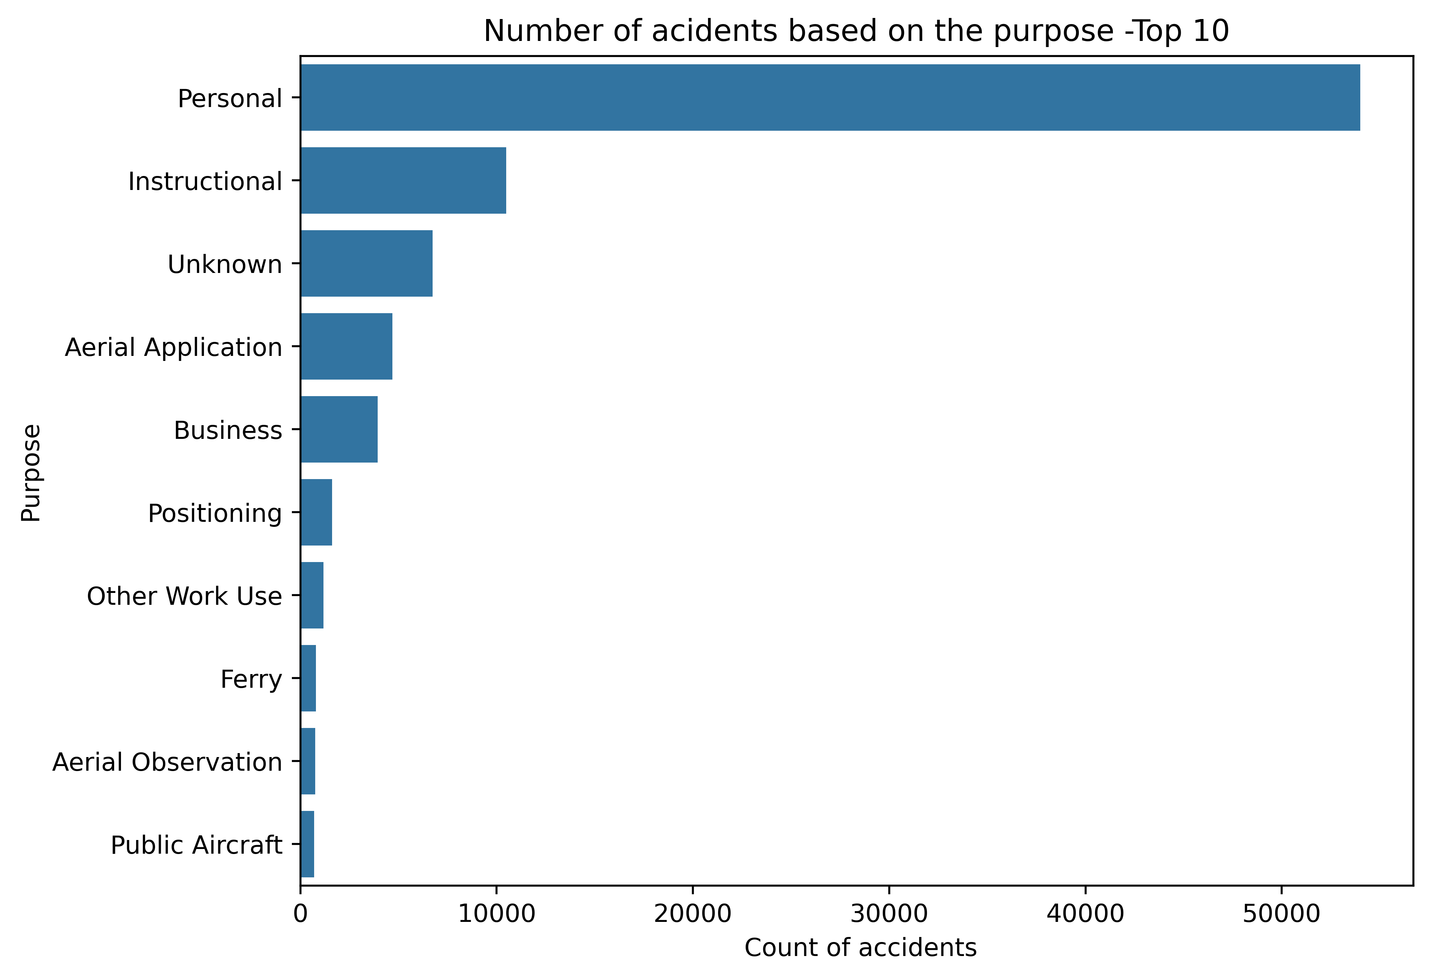
Findings – Purpose of use
Focusing on the purpose of the aircraft, we note that personal use, which often were built by amateur led in the number of accidents. This is followed closely by instructional which is expected cognizant of the fact that this are learners.
Refer Aviation Data | Tableau Public

Slide 10
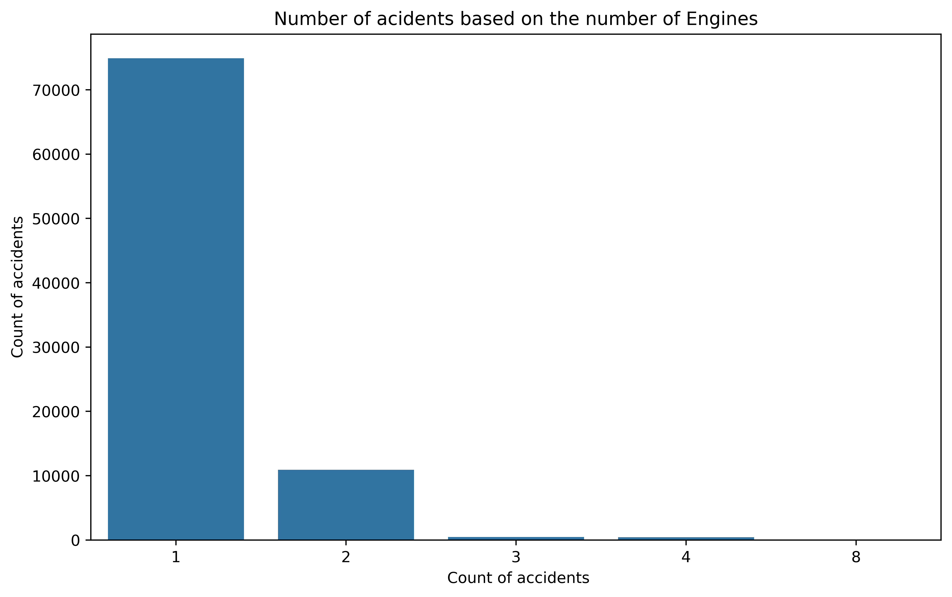
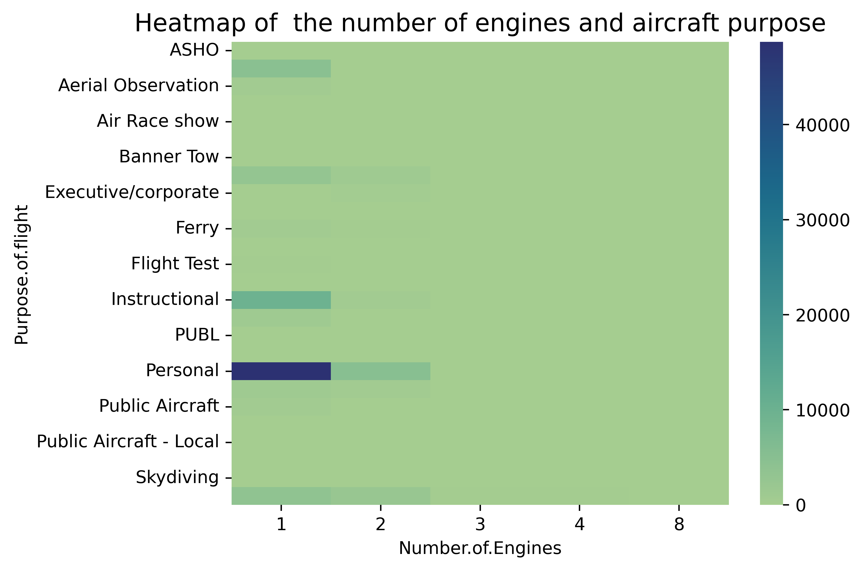
Findings – Number of Engines & combination with Purpose
Looking at the number of engines in the aircraft, we notice that, with increase in number of engines, there is undisputable decrease in the accidents
Further exploration on the number of engine vs the use, it is evident that we have very little data as you increase the number of engines and clearly, majority of this business are dominant on 1 or 2 engines.

Slide 11
Recommendations
The decrease in aviation accidents since since after 1981 is encouraging, but there are countries that one needs to deploy more measures to safeguard life and business. In high-accident states, there should be a concerted effort to increase surveillance and regulatory enforcement activities to mitigate the risks associated with aviation accidents.
Based on the fact that we had a high visual determining of weather, it is an indication that many accidents happened on a good weather, provoking pilots to use their eyes/visual for decision making. It is imperative to reinforce guidance and adherence to protocals when in the sky unless it is unavoidable.

Slide 12
Recommendations … Con’t
The purpose came out as a big contributing factor in the number of accidents. Looking at the business model our stakeholder is interested in, business/commercial purpose seem to be in line with decreased accidents.
At of the look of things, increased number of engines is a guarantee in eradication of accidents. While it would have a potential implication on the cost as well, this can better concluded when cost is in play

Slide 13

Thank You!

Slide 14
References
Learning Python 5th Edition –O’Reilly
Youtube tutorials - Dataschool
Class work

