Slide 1
Project 3
Classification Project – H1N1 and Seasonal Flu Vaccines

Slide 2
H1N1 and Seasonal Flu Vaccines
As the world struggles to vaccinate the global population against COVID-19, an understanding of how people’s backgrounds, opinions, and health behaviors are related to their personal vaccination patterns can provide guidance for future public health efforts. Your audience could be someone guiding those public health efforts.It encompases a wide range of information and from this, the stakeholder is interested to uncover trends and insights regarding aviation accidents in the USA and in international waters from 1962 to 2023.
In this exercise, the goal is to predict whether people got H1N1. The part of seasonal flu is ignored.

Slide 3
Features
The dataset has both categorical variables and numerical variables
The numerical variables are further split into binary and ordinal values
In the exercise we try to convert all the dataset into numerical language and further scale it between zero and one

Slide 4
Business Goal
Understanding H1N1 Virus infection:
Identify key factors that influence one contracting h1n1 virus.
Identifying Trends:
Explore patterns across various categorical variables and their influence in contracting h1n1 virus
Recommendations
Provide actionable recommendations to on whether given various features, we can be able to classify whether someone had h1n1 or the seasonal flu.

Slide 5
Questions to Address:
Understand if gender has any influence on whether one is likely to contract the virus
Understand if Race has any influence on contracting the virus
Determine if Age is a factor in contacting the virus

Slide 6
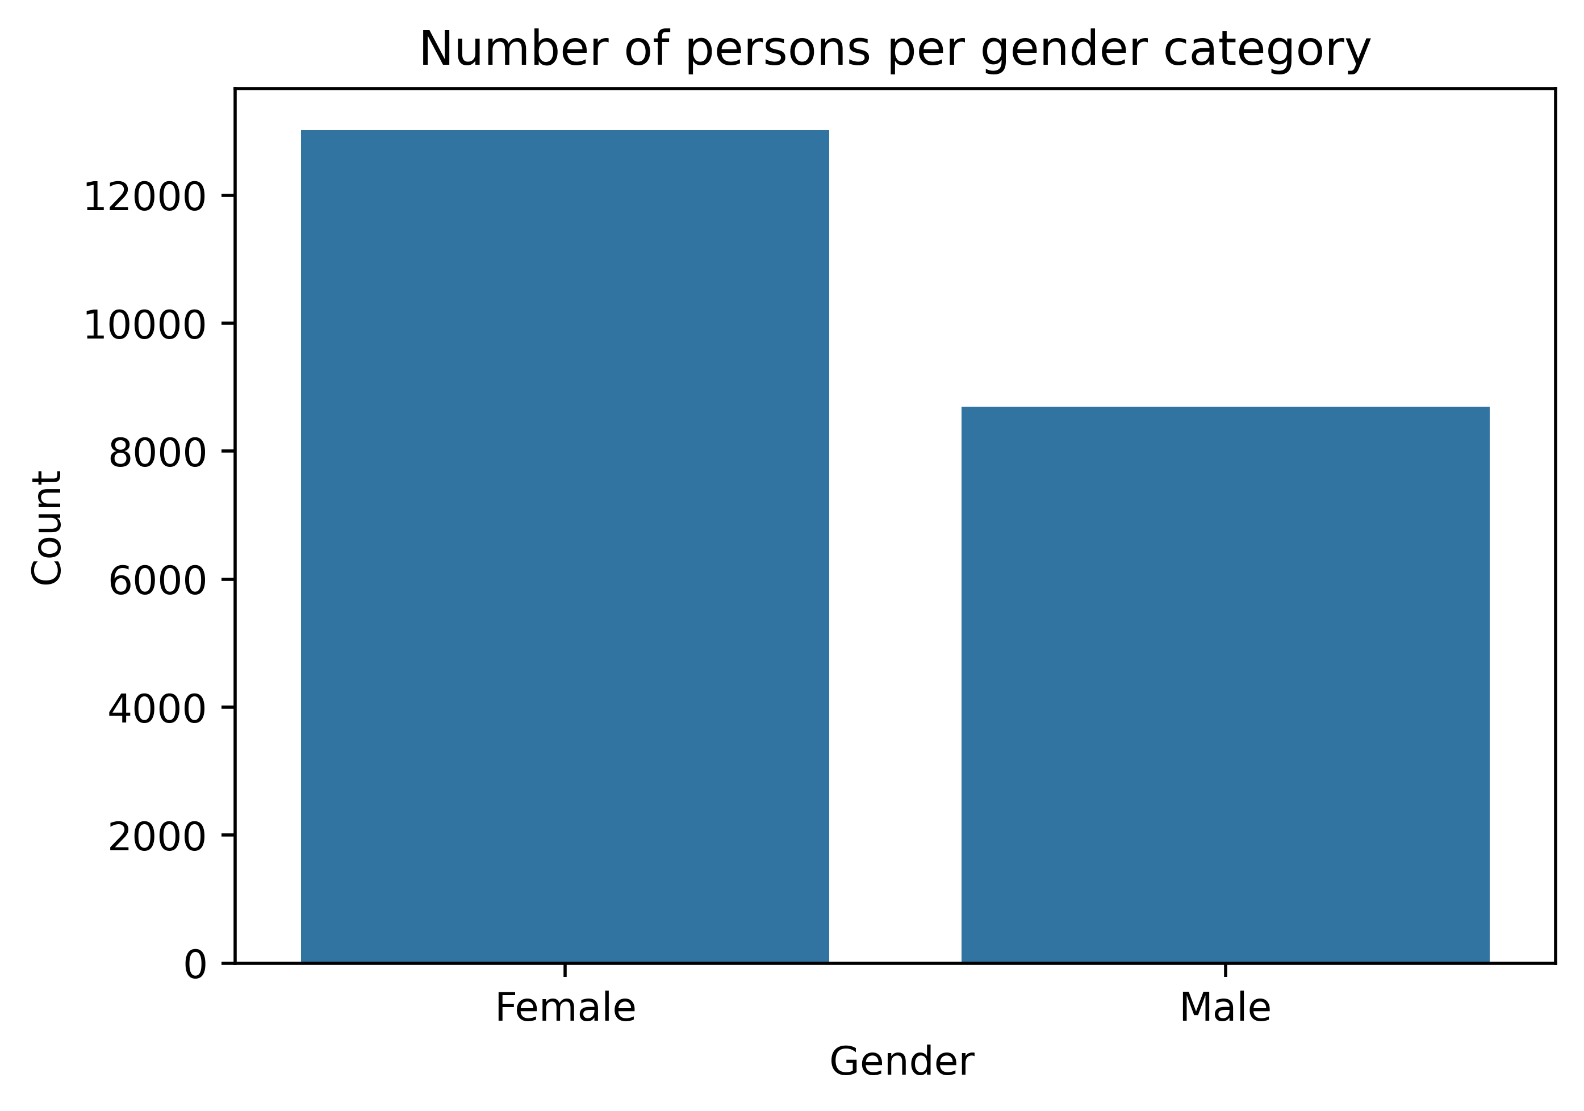
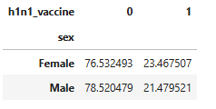
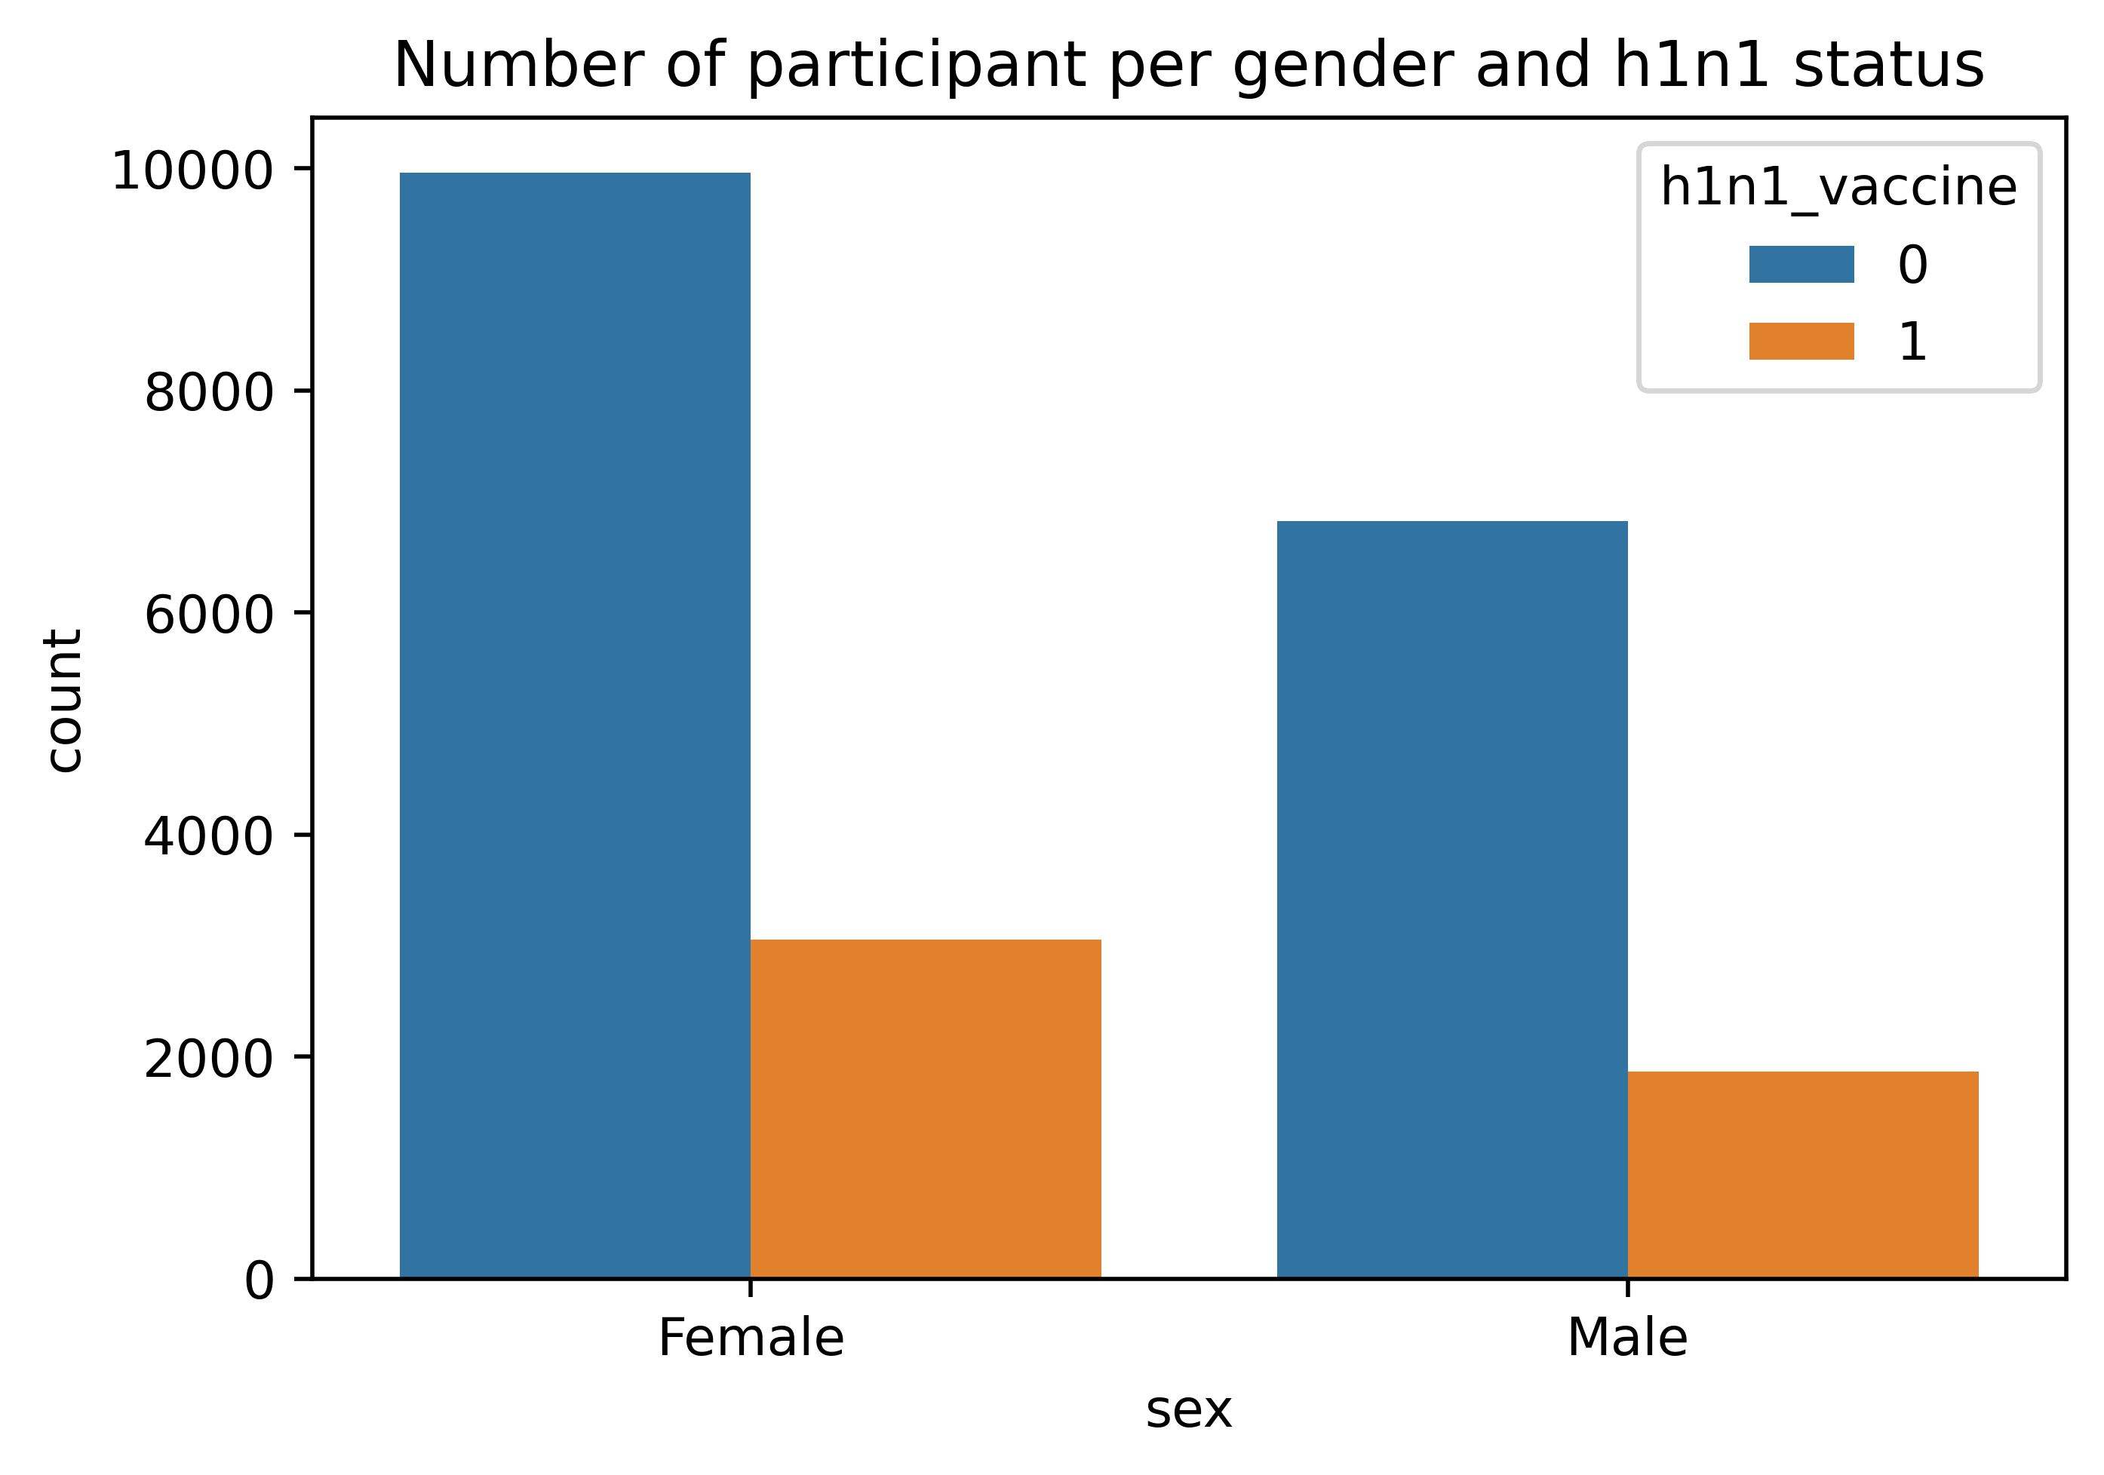
Findings – Is gender a factor in contracting the virus?
From the Gender factor analysis, we find that Female were the majority in the study. However, this does not imply that they contracted h1n1 more than the male counterpart.
Infact from the below pivot we note each gender contributed an almost equal proportion to h1n1_virus. i.e female and male each contributed between 20-24% with h1n1 and 75-79% without h1n1

Slide 7
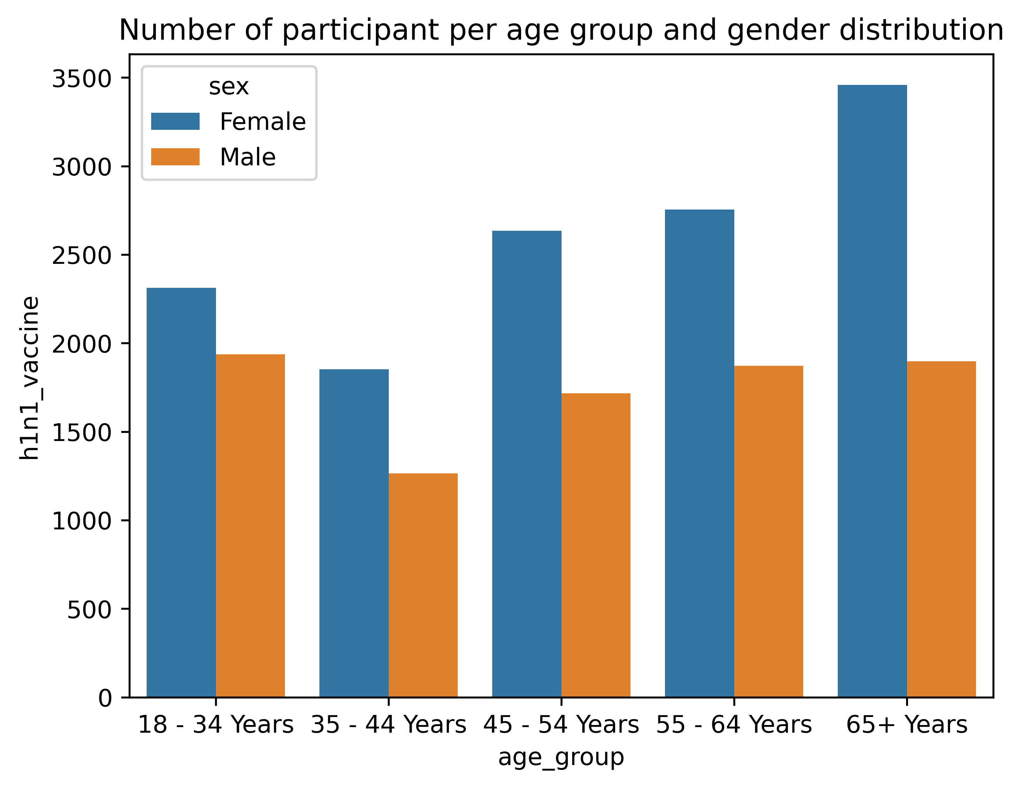
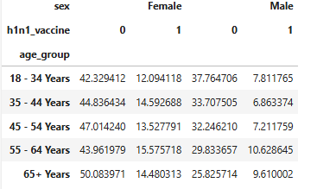
Findings – Age
Analyzing age with a combination of gender, among all the age_groups, 55-64 males had the highest h1n1_vaccine contraction, while 65+ Females had the highest proportion of zero contraction of h1n1.
The below pivot illustrate the proportions

Slide 8
Conclusion
Our models could not achieve desirable results.
This being health related data, our goal would have to focuss on Recall(Sensitivity) so as not to miss out on any opportunity that had H1N1 and wrongly classified.
This implies we had many sick patients misclassified as healthy.In all, the recall was way too low and this can not help in making the correct prediction.
As earlier mentioned above during EDA, we noticed the imbalance and this is what makes this model not to perform any better.
This is because the model tends to predict the most occuring value in our target variable.

Slide 9
Recommendation
Use the SMOTE (Synthetic Minority Over-sampling Technique) approach to handle our imbalanced dataset.
More can be read on how to go about this issue and whether more complex model can be of any help in future.Our models could not achieve desirable results.

Slide 10
References
Learning Python 5th Edition –O’Reilly
Youtube tutorials - Dataschool
Class work

