Slide 1
BASED MARKET LAB
How the product works
Company-first research · latest SEC 10-K / 10-Q · multi-model AI · unlock with USDC on Base
Pay: test 0.00001 Sepolia · real $0.10 Base · agent · Host: Vercel HTTPS (Farcaster) · private engine
Closed source · public presentations only · free example frozen: COIN · 23 Jul 2026

Slide 2
What it is
BasedMarketLab turns a stock ticker into a clear company research report — business, strengths, risks, cash facts from SEC, longer-term story — then unlocks the full package with BasedSettler (real path: $0.10 USDC on Base).
Company first
SEC + charts
Built on Base
Business, health, opportunity, watch-outs — not a day-trading terminal.
Latest 10-K + 10-Q only. Charts & buy zones as secondary context.
BasedSettler: test · real $0.10 · agent. Wallet connect · on-chain unlock.
BasedMarketLab · Built on Base · Closed product
2 / 14

Slide 3
End-to-end user journey
1
Choose
Enter ticker (e.g. COIN). Optional company name.
2
Research
Public web + latest SEC 10-K/10-Q, or your AI key for a deeper write-up.
3
Confirm
Check ticker + resolved company name before pay.
4
Unlock
BasedSettler: test (Sepolia) · real $0.10 Base · or agent rail.
5
Report
Company · Full · Price chart · Predictions · PDF / library.
BasedMarketLab · Built on Base · Closed product
3 / 14

Slide 4
Two ways to build research
PUBLIC WEB + SEC (no AI key)
YOUR AI KEY (optional)
Default path
Deeper company story
• Latest SEC 10-K + 10-Q only (auto)
• Gemini, Groq, OpenRouter, OpenAI, xAI…
• Real OCF / cash / revenue facts
• Key stays on the user’s device
• Public market feeds + company context
• Professional evaluation, no CYA fluff
• One full-history chart still builds
• If AI fails / quota: falls back to web+SEC
• No AI key required for this path
• Same report layout either way
BasedMarketLab · Built on Base · Closed product
4 / 14

Slide 5
BasedSettler — three unlock modes
Same product · pick test, real, or agent at checkout
Test
Real
Agent
0.00001 USDC
$0.10 USDC
AgentKit rail
Base Sepolia (testnet). Free faucet coins. Safe to practice wallet flow.
Base mainnet. Real USDC to shop wallet. Production unlock for the full report.
BasedSettler agent path. Agent wallet pays USDC when configured.
BasedMarketLab · Built on Base · Closed product
5 / 14

Slide 6
Free example — frozen COIN
Symbol
COIN · Coinbase Global
As of
23 July 2026 — pack does not change when users generate COIN
Contents
Company report · chart · prediction markets · library-style sample
Why freeze
Demo stays stable for presentations, Farcaster, and sales walkthroughs
Paid path
Generate any ticker after BasedSettler unlock (test / real / agent)
BasedMarketLab · Built on Base · Closed product
6 / 14

Slide 7
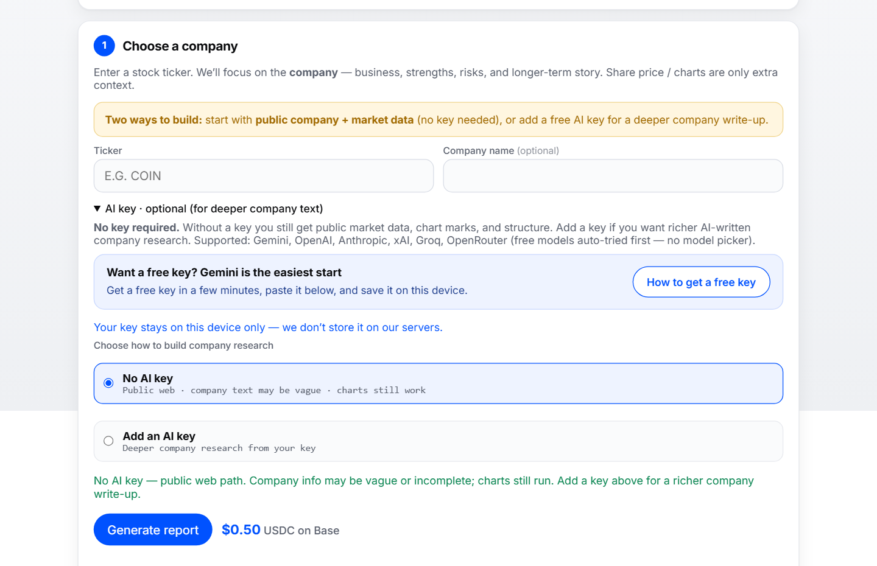
Step 1 — Choose a company
Ticker · optional AI key · Generate · BasedSettler unlock
BasedMarketLab · Built on Base · Closed product
7 / 14

Slide 8
Step 2 — Confirm company & unlock
Confirm company
Connect wallet
User ticks YES on ticker + resolved name (e.g. COIN → Coinbase Global).
MetaMask / Coinbase Wallet — Base mainnet (8453) or Sepolia for test.
Pay via BasedSettler
On-chain verify
Real: $0.10 USDC on Base. Test: 0.00001 Sepolia. Agent: AgentKit rail.
App verifies the tx, then unlocks generate → full report package.
BasedMarketLab · Built on Base · Closed product
8 / 14

Slide 9
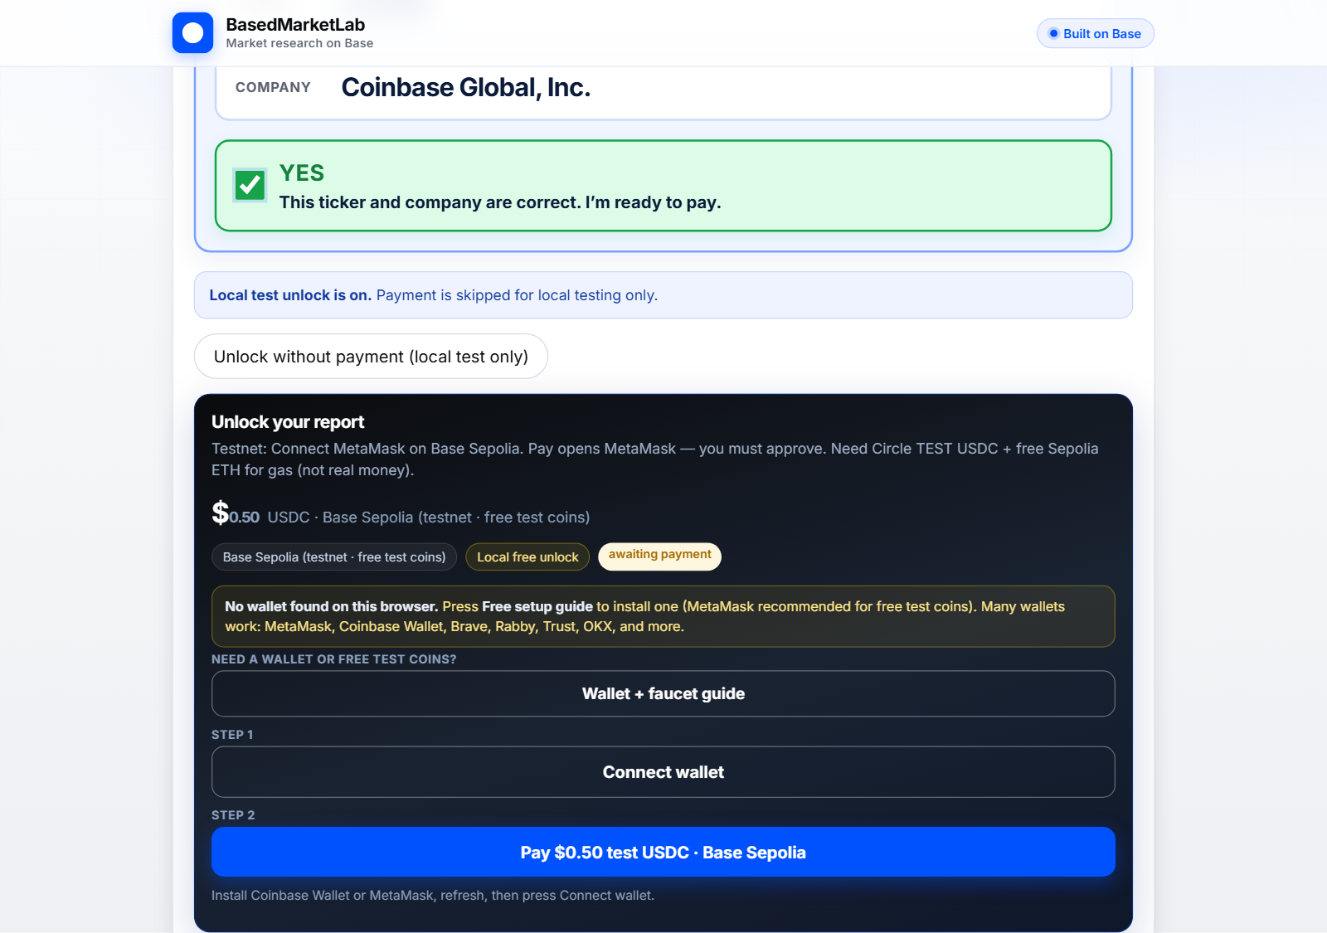
Unlock UI — wallet checkout
Confirm company → connect wallet → test / real $0.10 / agent on BasedSettler
BasedMarketLab · Built on Base · Closed product
9 / 14

Slide 10
What the buyer gets
Company
Bottom line, business, strong / weak, watch-outs, market phase, word guide.
Full company report
Glance → what they do → opportunity → how business is doing → risks → put-together.
Price chart
Full-history chart with buy/sell marks — secondary context, not the main product.
Prediction markets
Side context cards (company / macro-style questions).
PDF & library
Download PDF; re-open saved reports anytime from Your reports.
BasedMarketLab · Built on Base · Closed product
10 / 14

Slide 11
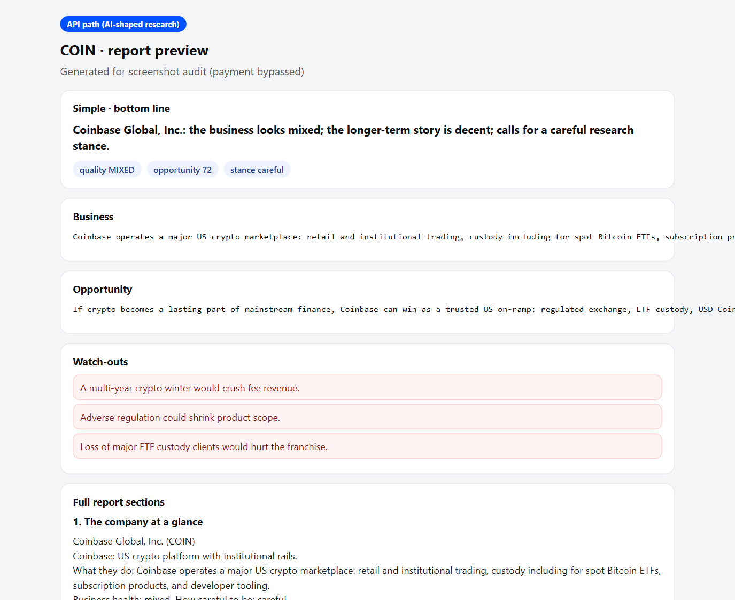
Sample report — Company tab
Bottom line · business · strengths / watch-outs · market phase
BasedMarketLab · Built on Base · Closed product
11 / 14

Slide 12
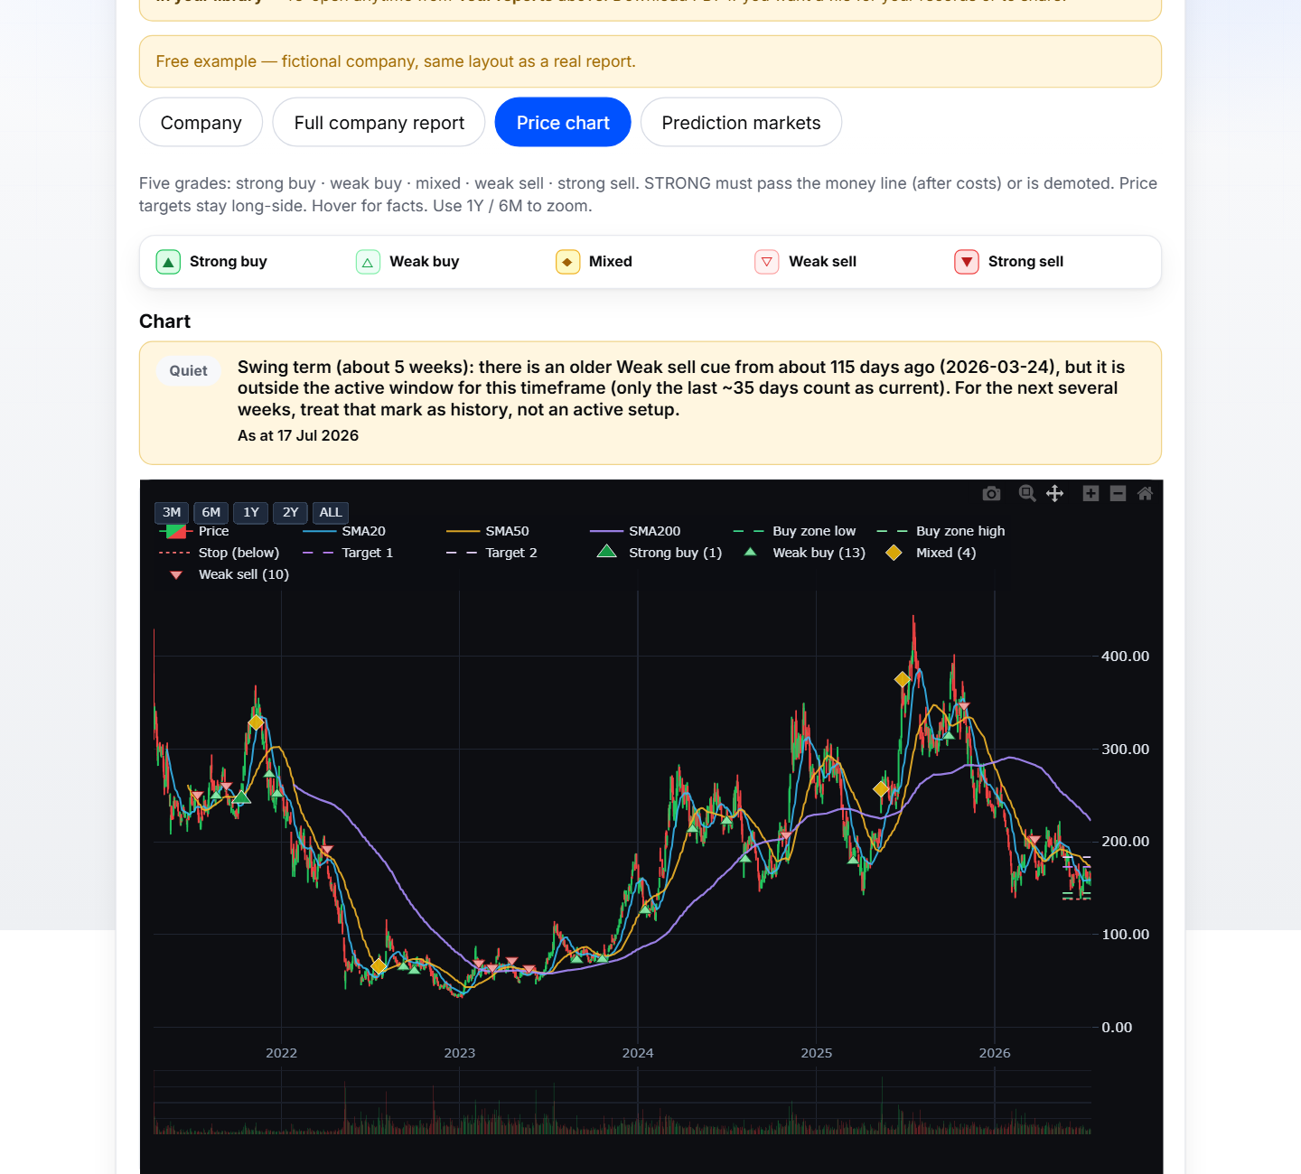
Price chart — context only
Supports the company story — not a day-trading terminal
BasedMarketLab · Built on Base · Closed product
12 / 14

Slide 13
Where it runs · closed source
Private engine
Vercel (public URL)
Farcaster
Closed product
Python app (private)
Vercel proxies HTTPS
BasedSettler + SEC
HTTPS + Farcaster
Opens straight into app
No public source repo
Mini App / Frame
fc:miniapp meta
ready() splash · feed share
CLI deploy only
No public GitHub app code
Presentations separate
Key design choices
AI keys stay with the user · Research on server · BasedSettler verifies USDC · Free COIN example frozen · Product source private · GitHub (if any) is presentations only.
BasedMarketLab · Built on Base · Closed product
13 / 14

Slide 14
One sentence
BasedMarketLab is company research first, charts second, paid in USDC on Base.
Path: ticker → SEC + web/AI research → confirm → BasedSettler (test / $0.10 real / agent) → report.
Built on Base · Closed product · Vercel (public) · private engine · Presentations public only

