Slide 1
ENGI 301 Weather, News, and SMS Updates: All in One Place Proposal
10/20/19 – revised 10/24/19
Irene Kwon

Slide 2
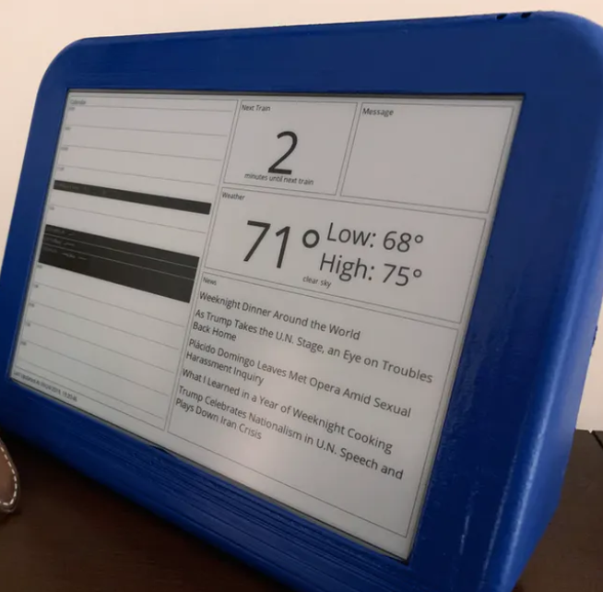
Background Information
Weather, news, and texts updater/viewer
Want to have an LCD screen that displays:
Weather (high and low of day)
News (headlines)
Texts received from phone (SMS)
To connect to the wifi, we connect using a wifi dongle:
https://www.hackster.io/beaglefriends-octavosystems/pocketbeagle-alexa-0425b6
https://www.hackster.io/logan-baldridge/spotify-pod-streaming-music-to-the-pocketbeagle-57a180
Existing technology:
https://www.hackster.io/johnjones4/dresser-top-dashboard-913ed3
Originally for Raspberry Pi
Libraries: Pillow (has different widgets)
Improvement on this: want to receive/display SMS texts on phone
Existing dashboard for news (but uses Raspberry Pi)

Slide 3
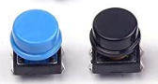
User Interface
Buttons
To press through all the different updates
Two buttons
One for powering off
One for pressing through the different updates
Power On
LCD Screen
Scroll Through
*Rough idea of hardware aspect of device

Slide 4
System Block Diagram
USBA Female Breakout
GPIO
Button
Wifi/Bluetooth Dongle
USB1
GPIO
Button
PocketBeagle
Power Bank
4.8A
SPI
LCD Screen

Slide 5
Power Block Diagram
3.3V
USBA Female Breakout
GPIO 59
Button
Wifi/Bluetooth Dongle
5V
VIN_USB1
GPIO 58
3.3V
Button
PocketBeagle
Power Bank
4.8A
3.3V
3.3V P1_14
LCD Screen

Slide 6
Components / Budget
Component | Need to Buy | Cost
PocketBeagle | No | $25
SD Card | No | $8
Edimax USB Wifi Dongle | No | $15
Adafruit 2.2" Color TFT LCD | Yes | $20
INIU Portable Charger, 10000mAh Power Bank, 4.8A High-Speed | Yes | $20
INISparkFun USB Type A Female Breakout (2, 15 kohm pull-down resistors may be needed U Portable Charger, 10000mAh Power Bank, 4.8A High-Speed | No | $4.50
Cylewet 25Pcs 12x12x7.3mm Momentary Tact Tactile Push Button Switch Touch Switch Micro Switch 4 Pins SMD PCB with Cap for Arduino (Pack of 25) CYT1009 *but only need 2 buttons | Maybe | $7.89

