Slide 1
UVM COMPONENT CONNECTION TRUNG PHAM

Slide 2
AGENDA
OVERVIEW
UVM_SEQUENCER
UVM_DRIVER
UVM_MONITOR
UVM_AGENT
UVM_SCOREBOARD
UVM_ENV
UVM_TEST

Slide 3
1. OVERVIEW
* UVM test environment example:
DUT : This is target of UVM checking. In this example. coasia_approval module [DUT] decide who will be chosen to go Korea by English certification and their submit.
TESTBENCH TOP : The top block will create instances of the DUT and the virtual interface will act as a bridge between them. Top have duties :
-> Connecting the DUT to the test class
-> Generating the clock for the DUT.
-> Registering the interface in the UVM factory
-> Run test
Interface : The interface is a module that holds all the signals of the DUT. The monitor, the driver and the DUT are all going to be connected to this module.
Seq_item_export
Seq_item_port
coasia_interface

Slide 4
2. UVM_SEQUENCER
A block that generates sequences of bits to be transmitted to the DUT, this block is going to be named sequencer
Usually sequencers are unaware of the communication bus, they are responsible for generating generic sequences of data and they pass that data to another block that takes care of the communication with the DUT. This block will be the driver.

Slide 5
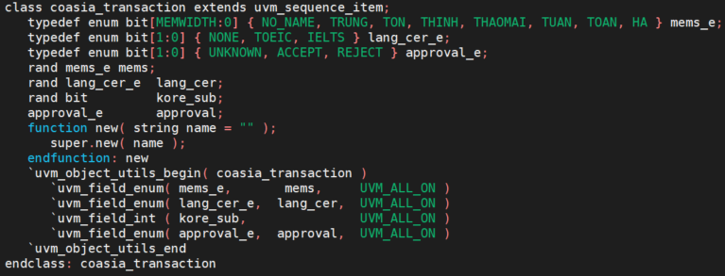
2. UVM_SEQUENCER
For example , I defines simple transaction : one_coasia_transaction
4 variables

Slide 6
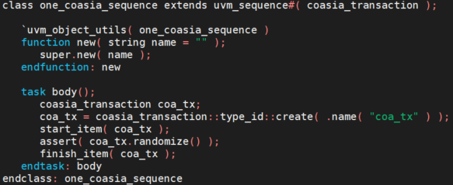
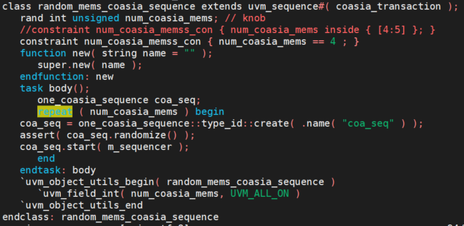
2. UVM_SEQUENCER
Simple sequence with one or many transactions
Use 1 transaction
Or many transactions

Slide 7
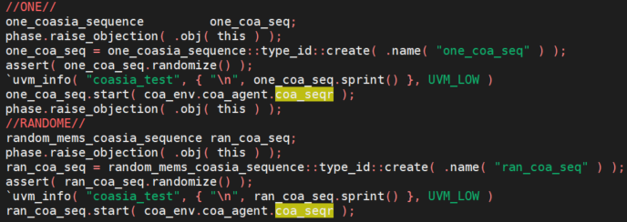
2. UVM_SEQUENCER
Define sequencer as below :
The connection between the sequence and the sequencer is made at the test block :

Slide 8
3. UVM_DRIVER
Driver maintains activity with the DUT by feeding it data generated from the sequencers, it doesn’t do any validation of the responses to the stimuli.
The driver pulls transactions from the sequencer and sends them repetitively to the interface.
So we need connect the driver to the signal interface and get the item data from the sequencer, drive it to the interface and wait for the DUT execution.

Slide 9
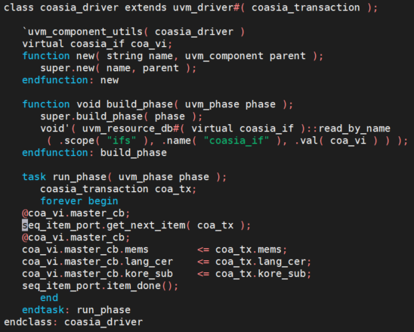
3. UVM_DRIVER
This is example for driver :
- Connect with interface
- run_phase do following steps :
+ Get seq_item
+ Drive the sequence item to the bus
+ Send the next sequence item

Slide 10
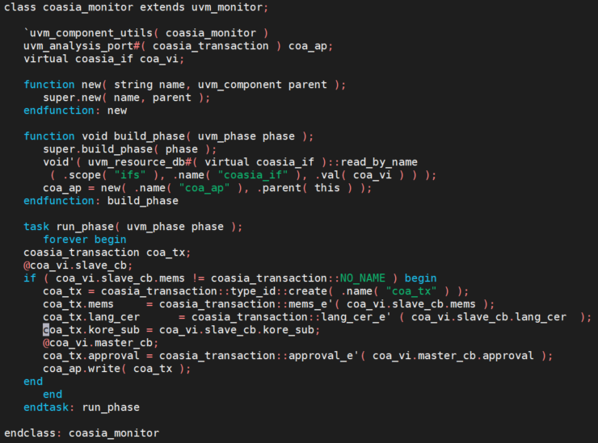
4. UVM_MONITOR
We need another block that listens to the communication between the driver and the DUT and evaluates the responses from the DUT. This block is the monitor.
Monitors sample the inputs and the outputs of the DUT, collect transactions from the virtual interface and use the analysis ports to send those transactions to the scoreboard
They may try to make a prediction of the expected result and send the prediction and result of the DUT to another block, the scoreboard, in order to be compared and evaluated.

Slide 11
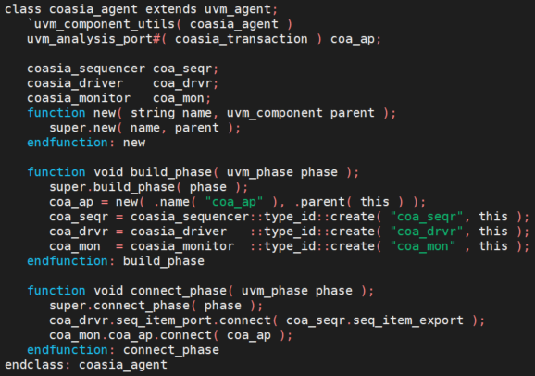
5. UVM_AGENT
Usually, sequencers, drivers and monitors compose an agent. An agent and a scoreboard compose an environment.
An agent doesn’t require a run phase, there is no simulation code to be executed in this block but there will be a connect phase, besides of the build phase.
We will construct the monitors, the sequencer and the driver in the build phase. We will also need to create analysis port (coa_ap), will act as proxy for the monitor to be connect to an external scoreboard through the agent’s port.

Slide 12
5. UVM_SCOREBOARD
The scoreboard is a crucial element in a self-checking environment, it verifies the proper operation of a design at a functional level.
At this example, I have 2 way to check the result of DUT at scoreboard.
By using UVM_FIFO (uvm_tlm_analysis_fifo #(generic_transaction) generic_fifo) with write() from monitor get() method from fifo
By using uvm_subscriber with [function void write(transaction t); ] to sample transaction

Slide 13
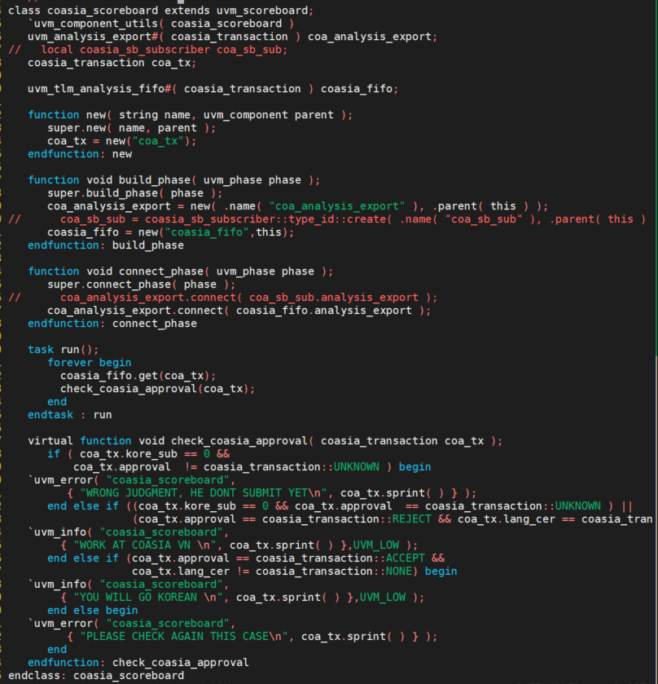
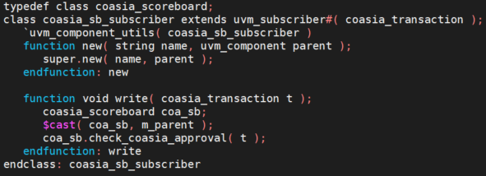
5. UVM_SCOREBOARD
Source code for reference.

Slide 14
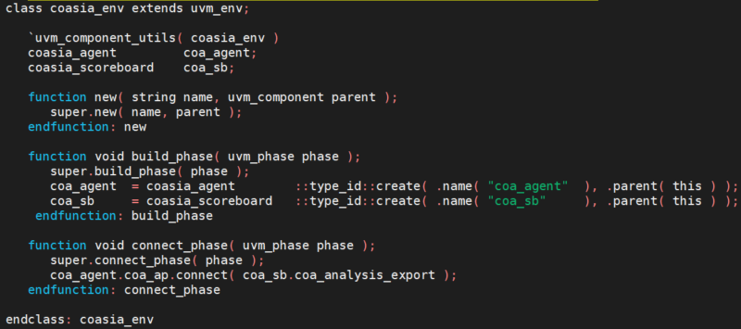
6. UVM_ENV
The env is a very simple class that instantiates the agent and the scoreboard and connects them together.

Slide 15
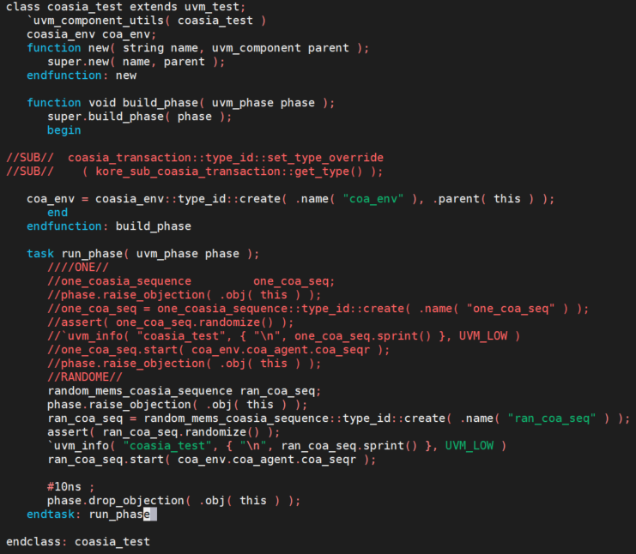
7. UVM_TEST
All these blocks are controlled by a greater block denominated of test. The test block controls all the blocks and sub blocks of the testbench.
This means that just by changing a few lines of code, we could add, remove and override blocks in our testbench and build different environments without rewriting the whole test.
Test have 2 purposes : Create env block and connect sequencer to the sequence.

