Slide 1
UVM COMPONENT TRUNG PHAM

Slide 2
AGENDA
Overview
Phasing and Execution Control
Hierarchy Information Function
UVM Component Utilities
UVM Configuration Mechanism
Factory Convenience Methods
Hierarchical Reporting Control

Slide 3
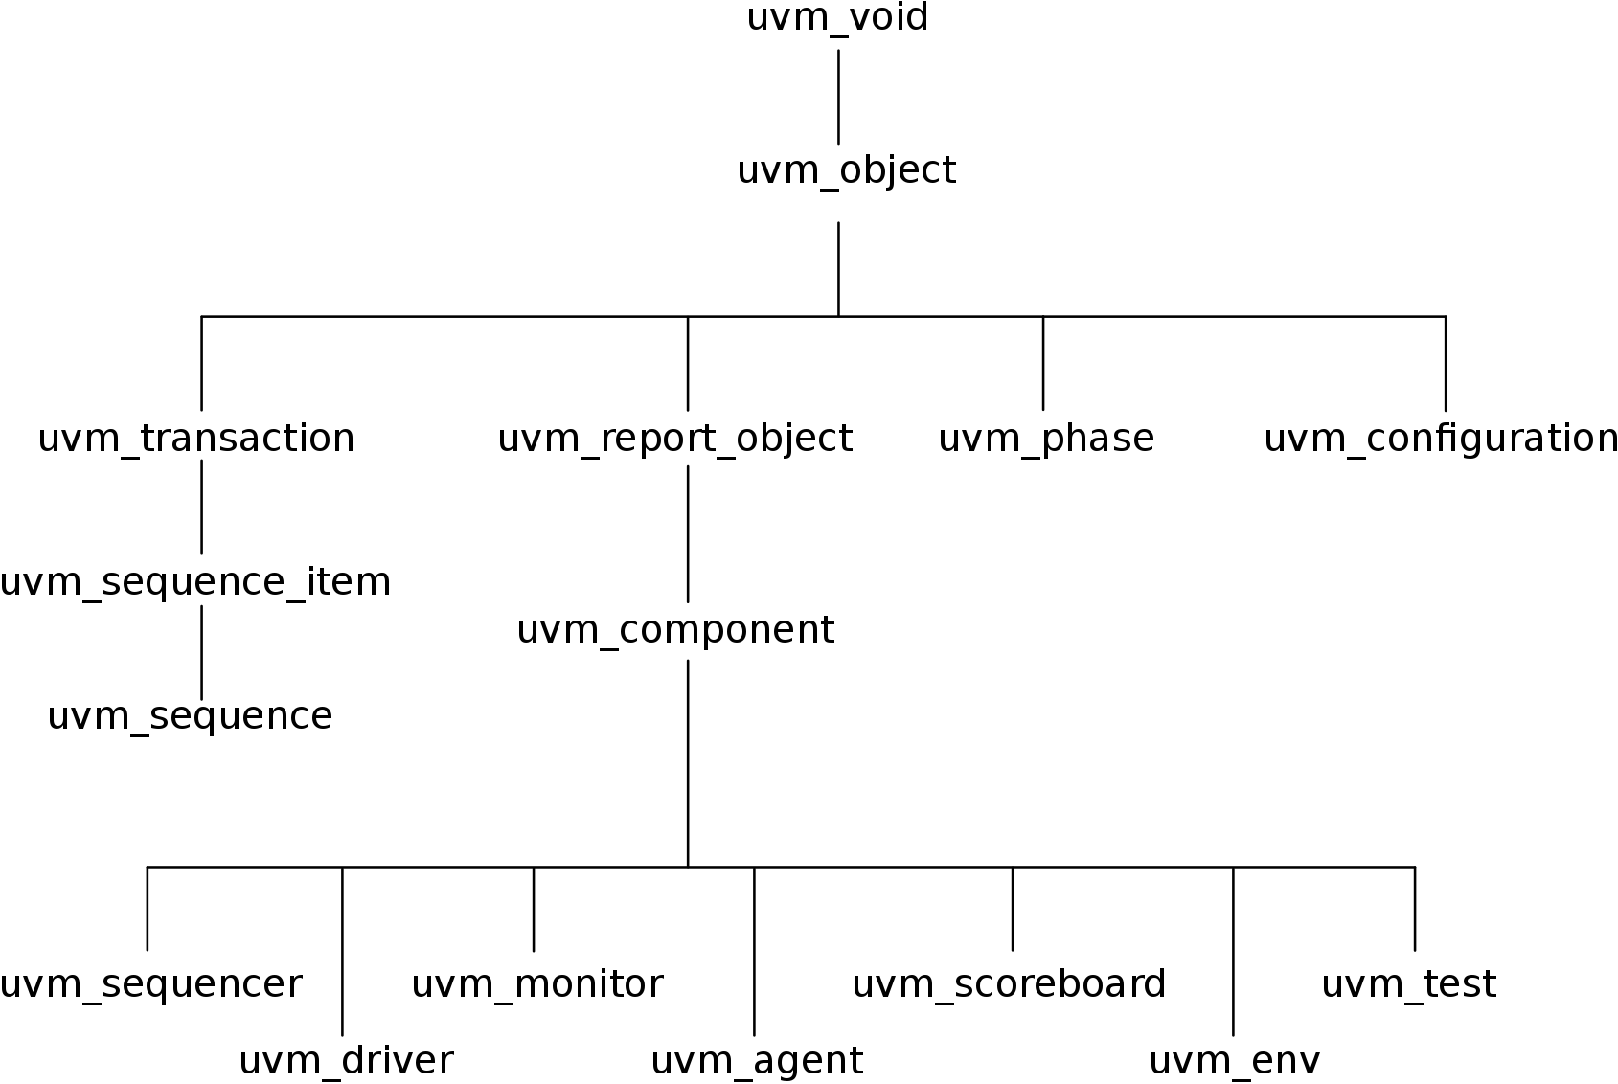
1. OVERVIEW
* Partial UVM class tree :
* Class Declaration :
The uvm_component class is the root base class for UVM components.
In addition to the features inherited from uvm_object and uvm_report_object, uvm_component provides the following interfaces:
Simulation Phases Method : Phase test flow that all components follow.
Hierarchy Information Function : Searching and traversing the component hierarchy
Configuration Methods : Configuring component topology and other parameters ahead of and during component construction
Factory Convenience Methods : The factory is used to create new components and other objects.
Hierarchical Reporting Control : All messages, warning, errors are processed through this interface
Virtual class uvm_component extends uvm_report_object

Slide 4
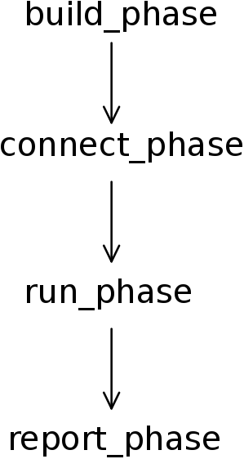
2. Simulation Phase Methods
- All the UVM phase names end with *_phase suffix :
build_phase() is used to construct components of the hierarchy. For example, the build phase of the agent class will construct the classes for the monitor, for the sequencer and for the driver.
connect_phase() is used to connect the different sub components of a class. Using the same example, the connect phase of the agent would connect the driver to the sequencer and it would connect the monitor to an external port.
end_of_elaboration_phase() is to ensures that all of your connections and references are properly setup from the connect_phase(). This phase is helpful for print() method of the top env to display the complete testbench architecture.
start_of_simulation_phase() is to avoid zero time dependencies as component start-up. Component initializations can be done in this phase.
run_phase() is the main phase of the execution, this is where the actual code of a simulation will execute.
And at last, report_phase() is the phase used to display the results of the simulation.

Slide 5
3. Hierarchy Information Function
Because the component tree is static throughout the simulation, components are aware of their hierarchy location and can query for their parent class, child class, or their location within the hierarchy.
Some of the function that the uvm_component class provides are:
get_parent() : Returns a handle to this component’s parent, or null if it has no parent.
get_full_name() : Returns the full hierarchical name of this object.
get_children() : This function populates the end of the children array with the list of this component’s children.

Slide 6
4. UVM Component Utilities
- UVM component based class eshould contain one of following component utility macro forms:
`uvm_component_utils(TYPE) for single components with no field macros
`uvm_component_utils_begin(TYPE) / `uvm_component_utils_end for single components with field automation macros
`uvm_component_param_utils(TYPE) for parameterized components with no field macros
`uvm_component_param_utils_begin(TYPE) / `uvm_component_param_utils_end for parameterized components with fields automation macros

Slide 7
5. UVM Configuration Mechanism
The UVM provides a flexible configuration mechanism that allow configuring run-time attributes and component topology without derivation or use of the factory.
The configuration of component attributes is achieved by way of the set/get API with the following syntax :
Ex: uvm_config_db# (int)::set (this, “”, “num_slave”, 2);
Argument description:
cntxt : search point component.
inst_name : a hierarchical path to a component instance.
field_name : the name of the field that need to be configured.
value : the value to be assigned to the field. The type of value will be the parameterization type, T. For uvm_config_object::set(), the type is uvm_object. For uvm_config_int::set(), the type is uvm_bitstream_t
Class uvm_config_db# (type T=int) extends uvm_resourse_db# (T) ;
static function bit set ( uvm_component cntxt, string inst_name, string field_name, T value);
static function bit get ( uvm_component cntxt, string inst_name, string field_name, ref T value);
endclass

Slide 8
5. UVM Configuration Mechanism
Another recommended API is a loosely typed above.
Differences is typdef on top of the existing one :
Properties that are registered as UVM fields using the uvm_field_* macros are automatically updated by the component super.build_phase() method. These properties can then used to determine the build_phase() execution for the component.
Can also use the manual uvm_config_db::get() method to get the configuration values before the child component is created (or before the child component is needed)
uvm_config_int::set( uvm_component cntxt, string inst_name, string field_name, T value);
uvm_config_object::set( uvm_component cntxt, string inst_name, string field_name, T value);
uvm_config_string::set( uvm_component cntxt, string inst_name, string field_name, T value);
typdef uvm_config_db#(uvm_bitstream_t) uvm_config_int
typdef uvm_config_db#(uvm_object) uvm_config_object
typdef uvm_config_db#(string) uvm_config_string

Slide 9
6. Factory Convenience Methods
The factory method is a classic software design pattern used to create generic code, deferring to run time the exact specification of the object that will be created. In functional verification, introducing class variation is frequently needed. For example, in many tests, you might want to derive from the generic data item definition and add more constraints or fields to it; or you might want to use the new derived class in the entire environment or only in a single interface; or perhaps you must modify the way date is sent to the DUT by deriving a new driver. The factory allows you to substitute the verification component without having change existing code.
The System Verilog UVM Class Library provides a build-in central factory that allows:
- Controlling object allocation in the entire environment or for specific objects.
- Modifying stimulus data items, as well as infrastructure components( for ex, a driver)

Slide 10
7. Hierarchical Reporting Control
Here are four basic reporting functions that can be used with different verbosity levels :
can be either info, error, warning, fatal. UVM has six levels of verbosity : UVM_NONE, UVM_LOW, UVM_MEDIUM, UVM_HIGH, UVM_FULL, UVM_DEBUG .
Note that the VERBOSITY_LEVEL is only required for uvm_report_info. Usage of uvm_report_fatal will exit the simulation.
uvm_report_* ("TAG", $sformatf ("[Enter the display message]"), VERBOSITY_LEVEL);
uvm_report_info (get_type_name (), $sformatf ("None level message"), UVM_NONE);
uvm_report_info (get_type_name (), $sformatf ("Low level message"), UVM_LOW);
uvm_report_info (get_type_name (), $sformatf ("Medium level message"), UVM_MEDIUM);
uvm_report_info (get_type_name (), $sformatf ("High level message"), UVM_HIGH);
uvm_report_info (get_type_name (), $sformatf ("Full level message"), UVM_FULL);
uvm_report_info (get_type_name (), $sformatf ("Debug level message"), UVM_DEBUG);
uvm_report_warning (get_type_name (), $sformatf ("Warning level message"));
uvm_report_error (get_type_name (), $sformatf ("Error level message"));
uvm_report_fatal (get_type_name (), $sformatf ("Fatal level message"));

