Slide 1
Capstone Project CHECKPOINT 1
Project name: Marketing for Financial Services
Batch: B
Group: B1

Slide 2
Team Members and Contributions
Task 1.1 and 1.3
    Prakhar Bhagwat
    Gautami Mathur
    Ilaa Raghupathi Vasishtha
Task 1.2
    Priyanka V
    Mohammed Rashid K

Slide 3
Problem Statement
DB Bank is a large public sector bank which has branches across the cities and provides various services like savings accounts, current account, term deposits, personal loans, home loans etc. to customers. The bank has conducted a campaign to market their term-deposit scheme.
The challenge is for the bank officials to target the right people for a successful campaign.
Approach
The approach taken is to analyse various details like profession, income, age, education, etc. of the customers. Also, analysing the possibility of any existing loans, credit history, etc. gives the economic status of the customer, which, in turn, helps in understanding whether the person is capable of depositing money into term-deposit scheme of the bank.
Hence, a comprehensive data analysis using Python enables us to understand the data which can further be processed to create predictive model for generating greater success rate for the campaign.

Slide 4
Dataset Dictionary
Bank Client Data:
Customer id : Unique customer id
custAge: Age of the customer.
profession: type of job
marital: marital status
schooling: Educational qualification
default: has credit in default?
housing: has housing loan?
loan: has personal loan?
State_Code: Code representing unique state name
Region_Code: Code representing unique Region name
City_Code: Code representing City of the customer
Postal_Code: Postal code of the area to which the customer belongs to.
Data Related with the Last Contact of the Current Campaign:
contact: contact communication type
month: last contact month of year
day_of_week: last contact day of the week
campaign: number of contacts performed during this campaign and for this client (includes last contact)
pdays: number of days that passed by after the client was last contacted from a previous campaign (999 means client was not previously contacted)
previous: number of contacts performed before this campaign and for this client
poutcome: outcome of the previous marketing campaign
Data Related to Social and Economic Context Attributes
emp.var.rate: employment variation rate - quarterly indicator
cons.price.idx: consumer price index - monthly indicator
cons.conf.idx: consumer confidence index - monthly indicator
euribor3m: euribor 3-month rate - daily indicator
nr.employed: number of employees - quarterly indicator
Target Variable:
responded - has the client subscribed a term deposit?

Slide 5


Task 1.1 : Data Manipulation using Python
1.1.1 Analysis of percentage turnout of marketing campaign
Count of number of people who responded “Yes” or “No” respectively
It is inferred that 11.35% of the population responded positively.

Slide 6
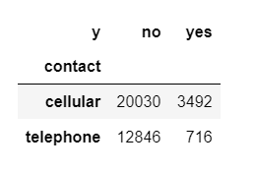
1.1.2 Right mode to contact the customers (Telephone or Cellular)
INFERENCE: Cellular mode of communication proved to generate more successful responses over telephone mode of communication.

Slide 7
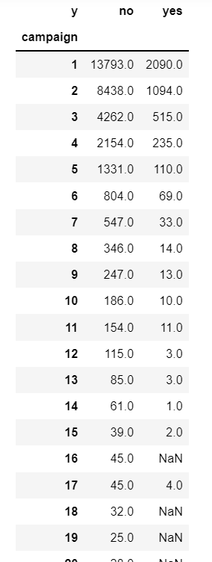
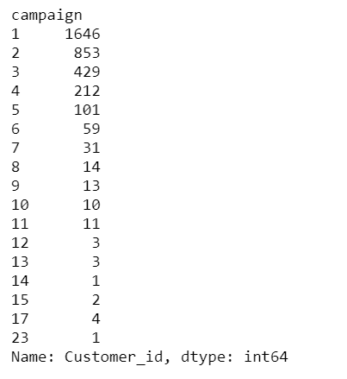
1.1.3 Analysis on Attempts made to turn a person into Successful Depositor (D)
INFERENCE: 3393 people responded 'Yes' for the current campaign but 'No' for the previous one.
Out of these, 1646 people got converted in the 1st attempt, and 853 people in the 2nd attempt. It can be inferred that people who agree to deposit generally agree in 1st few attempts.
INFERENCE: While there were 13,793 negative responses in the first attempt of contacting a customer, 2090 positive responses were reported. It is also noticed that most number of positive responses came when a person was contacted only once.

Slide 8
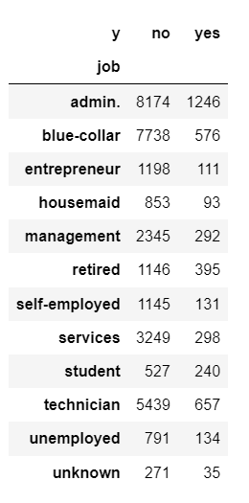
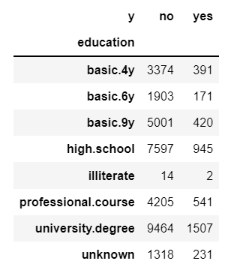
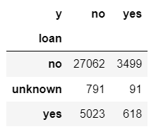
1.1.4 Personal Data Analysis and its Impact on the Campaign’s Success.
Univariate Analysis based on the ‘loan’ variable – indicates how loans affect the success rate of the campaign
Univariate Analysis based on the ‘education’ variable – indicates how the education of the customer affects the success rate of the campaign
Univariate Analysis based on the ‘job’ variable – indicates how the job/profession of the customer affects the success rate of the campaign

Slide 9
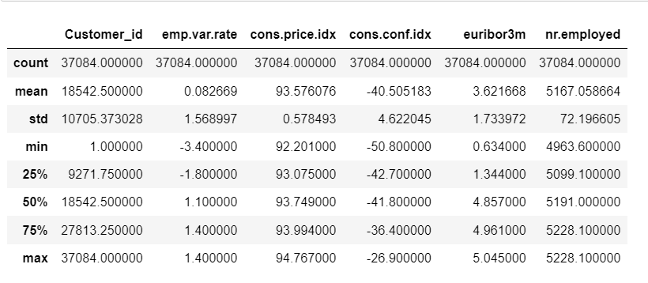
1.1.5 Socio-Economical Analysis of the Customers
INFERENCE:
- The average Consumer Price Index (CPI) is 93.57 and Standard Deviation of CPI is 0.58.
- The average Employment Variation Rate is 0.08 and Standard Deviation of EVR is 1.57.
- The average Consumer Confidence Index (CFI) is -40.5 and Standard Deviation of CFI is 4.62.

Slide 10
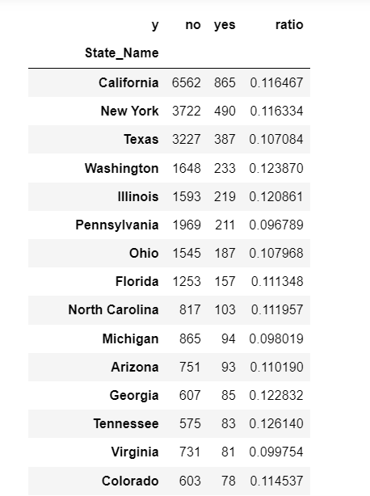
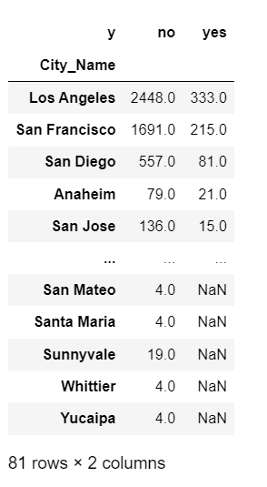
1.1.6 Demographic Analysis of the Marketing Campaign using the Master Files
INFERENCE: It is found that California State has maximum turnout for favorable response with 856 people responding 'Yes'. Within California, Los Angeles has the maximum turnout with 333 people responding 'Yes'.

Slide 11
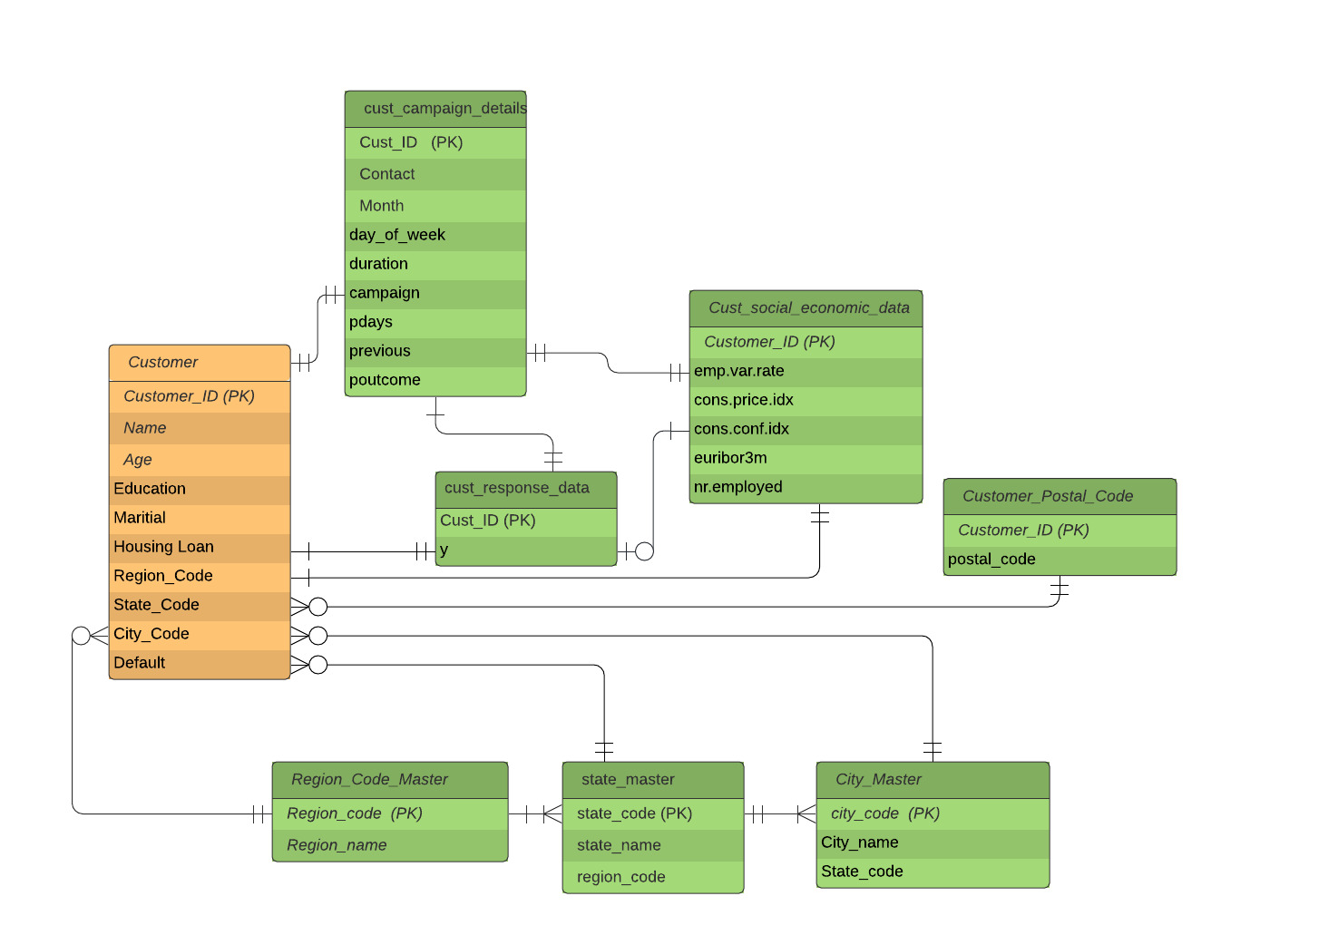
Task 1.2 : SQL-Oracle
Stage 1:
ER Diagram

Slide 12
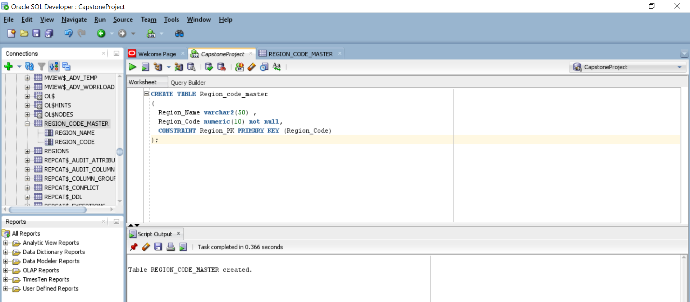
Creating Tables using the Identified Relationships

Slide 13
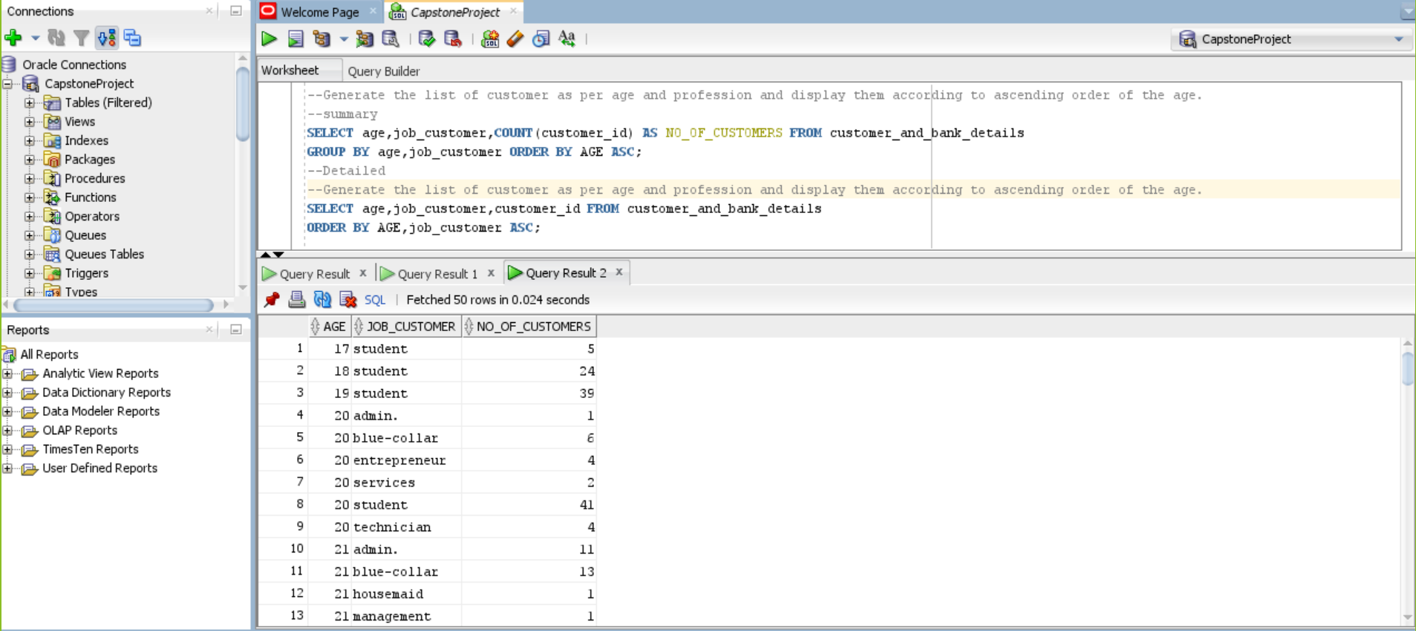
1.2.1 Generate the list of Customers as per Age and Profession and Display them according to Ascending Order of the Age.

Slide 14
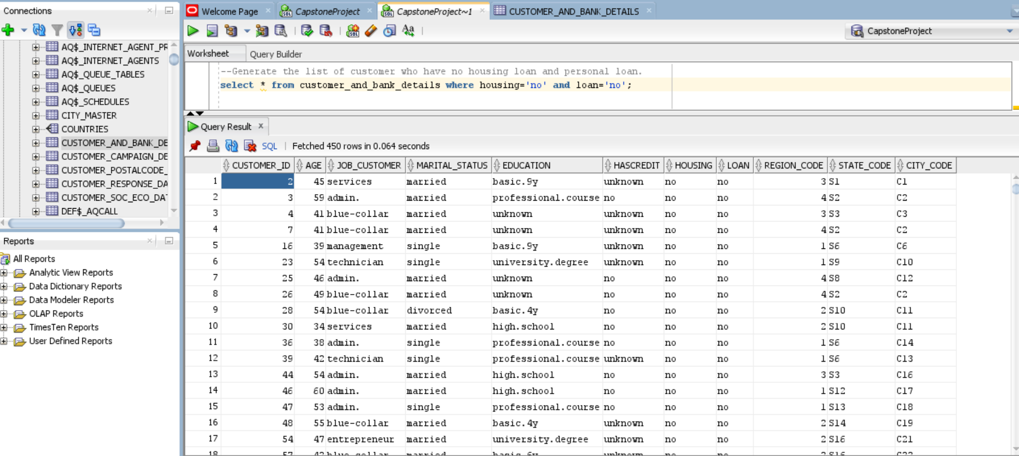
1.2.2 Generate the list of Customers who have No Housing Loan and Personal Loan.

Slide 15
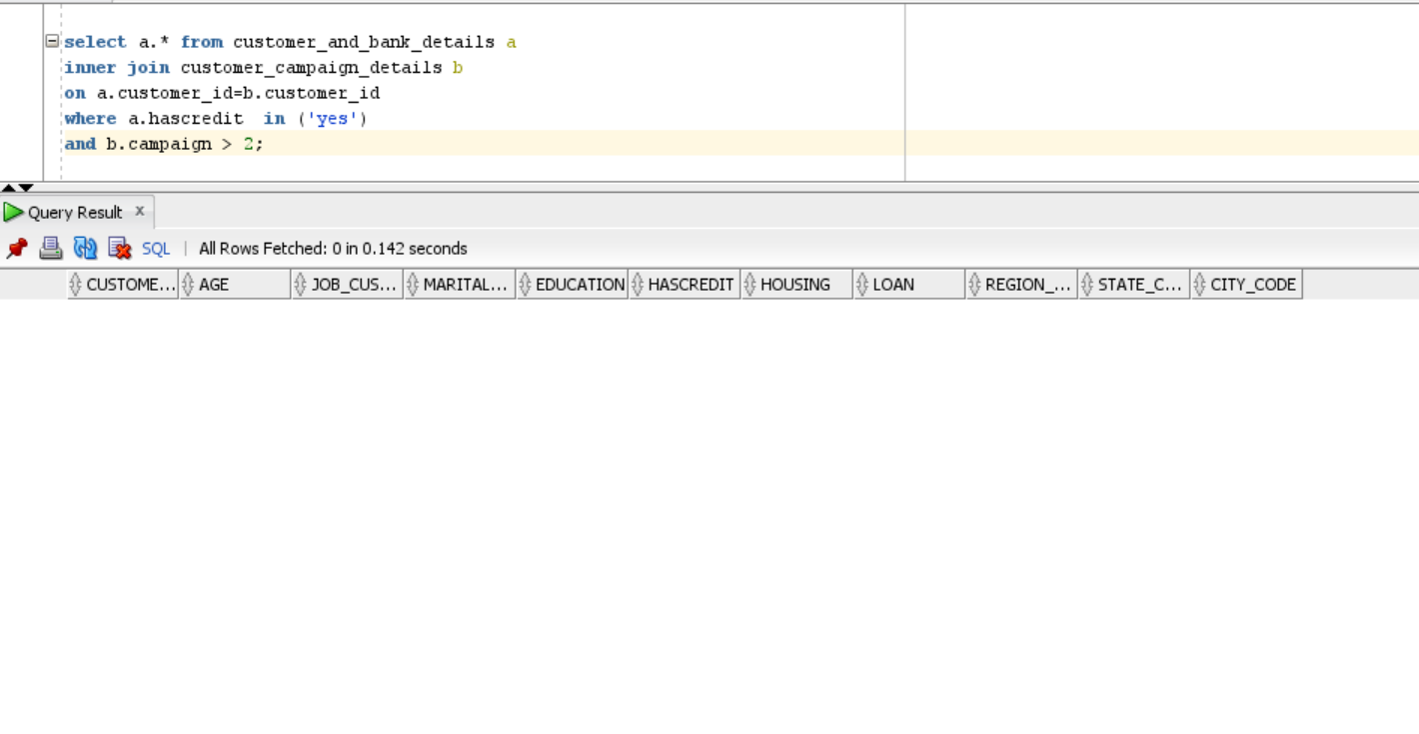
1.2.3 Generate the list of Customers who have Credit and have been Contacted more than 2 times During the Campaign.

Slide 16
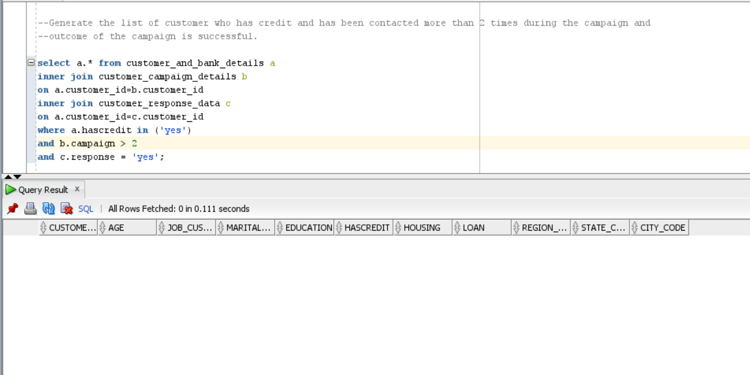
1.2.4 Generate the list of Customers who have credit and have been Contacted more than 2 times During the Campaign and the Outcome of the Campaign is Successful.

Slide 17
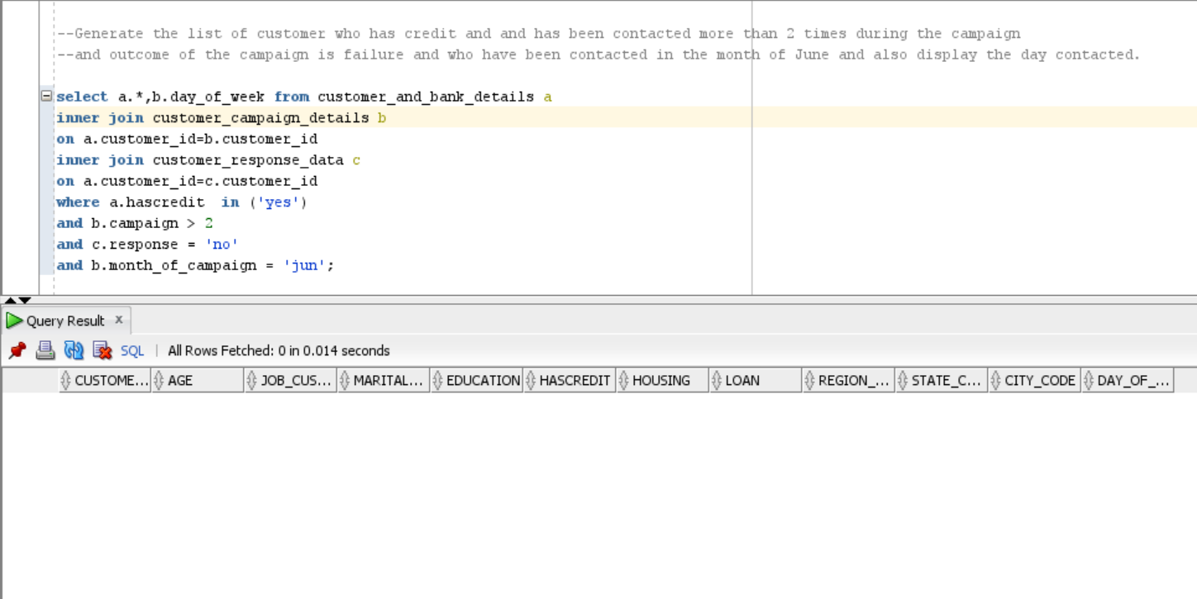
1.2.5 Generate the list of Customers who have Credit and have been Contacted more than 2 times During the Campaign and the Outcome of the Campaign is a Failure and who have been Contacted in the Month of June. Also, Display the Day Contacted.

Slide 18
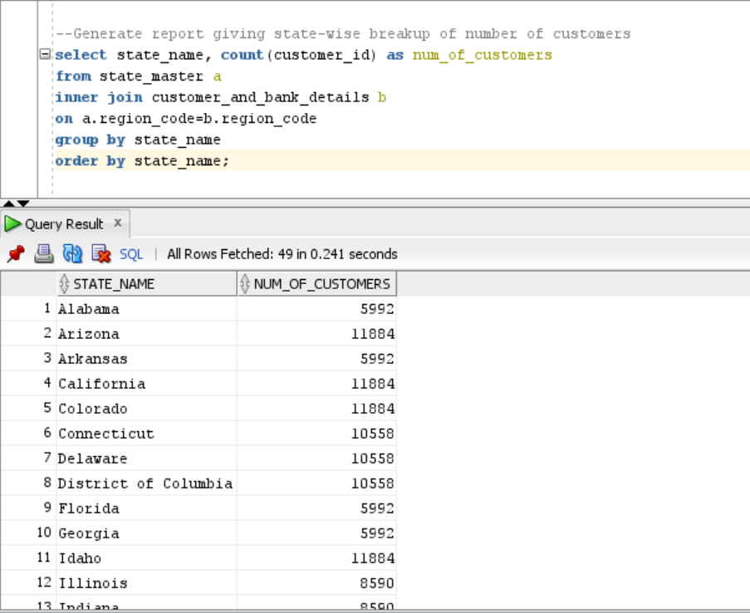
1.2.6 Generate a Report giving State-Wise Breakup of Number of Customers.

Slide 19
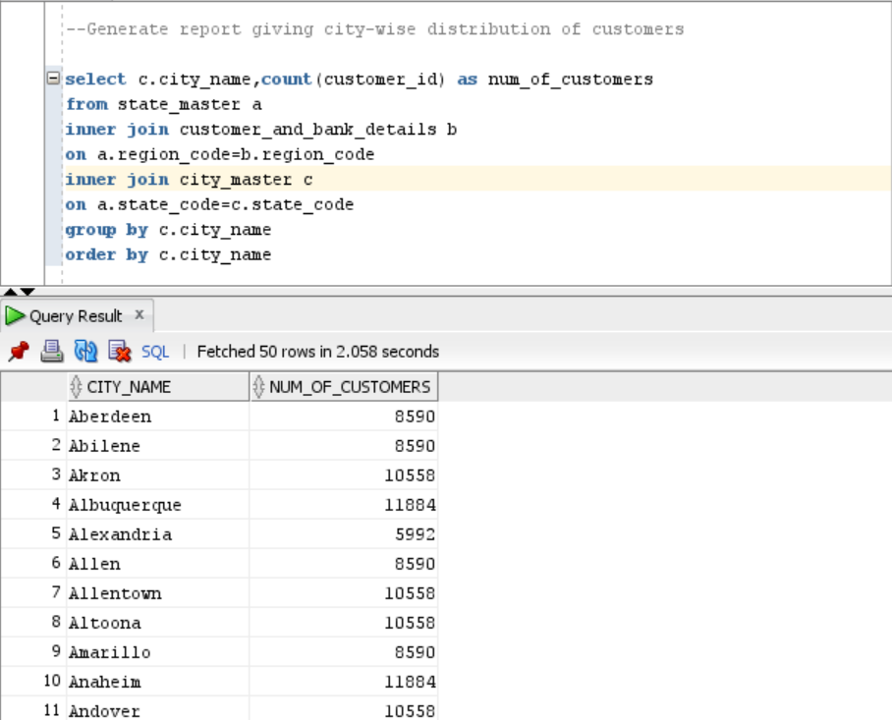
1.2.7 Generate a Report giving City-Wise Distribution of Customers

Slide 20
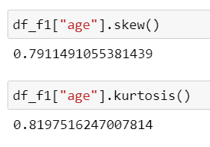
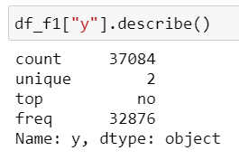
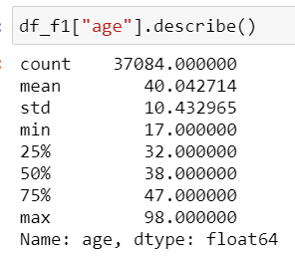
Task 1.3 : Statistical Analysis using Python
  1.3.1 Descriptive Statistics for both Numerical and Categorical Data and drawing a Few Insights from them.
Data Description for Categorical Variable
INFERENCE: Since the kurtosis has a positive value, it is an indication that the data distribution is Leptokurtic.
Since the skew value>0, the data distribution is positive-skewed.
Data Description for Numerical Variable

Slide 21


1.3.2 Perform relevant hypothesis testing : Z-Test, Chi-Square Test
Chi-Square Test
Z-Test
Since p-value > 0.05, there isn’t enough evidence to reject the null hypothesis.
Thus, the mean of the age sample is same as the mean of the age dataset.
Since p-value < 0.05, null hypothesis is rejected.
Thus, the there is a significant correlation between marital status and education.

Slide 22
THANK YOU

