Slide 1

How to create an R package
SGSA Workshop
December 2nd, 2020
Ian Laga

Slide 2


Hadley Wickham and Jenny Bryan’s R Packages
This workshop is an abridged version of their book, creating a minimal working R package
https://r-pkgs.org/
Packages we need:
devtools
roxygen2
usethis
Packages we want:
styler

Slide 3
This presentation
Create an R package with:
2 functions with the man page
A readme
A vignette
A DESCRIPTION file
A package man page
Test files
How to submit a package to CRAN

Slide 4
Note
It’s useful to create packages for your own research, even if you aren’t submitting it to CRAN or publishing it anywhere
Helps you keep data and work files in the same place
Can integrate it with GitHub
Check changes with test files
Write documentation so it is easier to understand when coming back to it

Slide 5
Part 1: How to Create an R Package

Slide 6
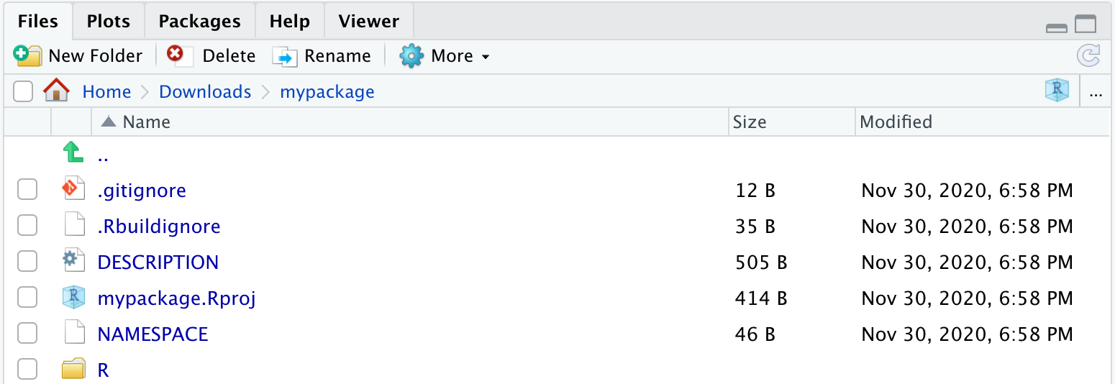
Step 1: create_package()
usethis::create_package(“path/to/package/pkgname”)
This creates a project with a .Rproj extension
Open the .Rproj file to access your package at a later time

Slide 7
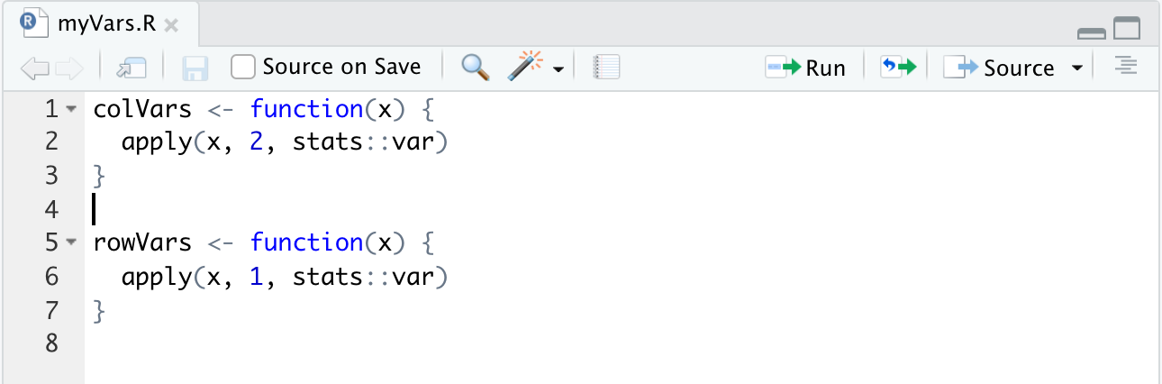
Step 2: Create your functions
Packages are made up of (almost entirely) functions
Can either create a script and save it inside or the R/ subdirectory of your package, or just use usethis::use_r(“functionName”)
For this workshop, let’s create functions that calculate column and row variances.

Slide 8
Step 3: Test your package
We can test our package by loading all the functions using devtools::load_all()
Cmd+Shift+L (macOS), Ctrl+Shift+L (Windows, Linux)
Build pane’s More … menu
Build > Load All
This is equivalent to running library(), it loads all the functions
We can test the compilation of the entire package using devtools::check()
Can also run the check button from the Build pane

Slide 9
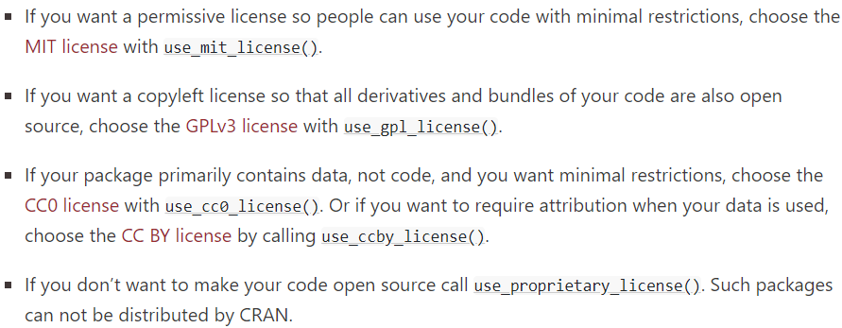
Step 5: Edit the description file
Use Ctrl + . and type DESCRIPTION to find the file or open it in the file pane.
Fill in all the missing information.
Close the file
Change license by typing usethis::use_mit_license(“Firstname Lastname”) (or whoever you want to have the license under)
You can now open the new LICENSE file

Slide 10
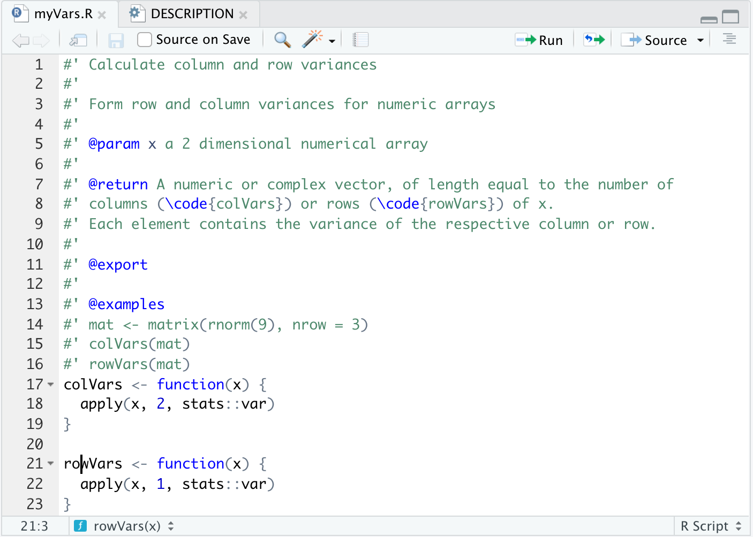
Step 6: Add documentation
Add function documentation using
Code > Insert roxygen skeleton
Make sure your curser is on a function
First sentence is the title
Second paragraph is the description
Third and subsequent paragraphs go into the details
Run devtools::document() to preview your file
Can now do help(myFunction)

Slide 11
Step 7: Test Install
Run devtools::install() to install your package to your library.
Try using colVars and rowVars on random matrices.
Everything should be like a normal R package now

Slide 12
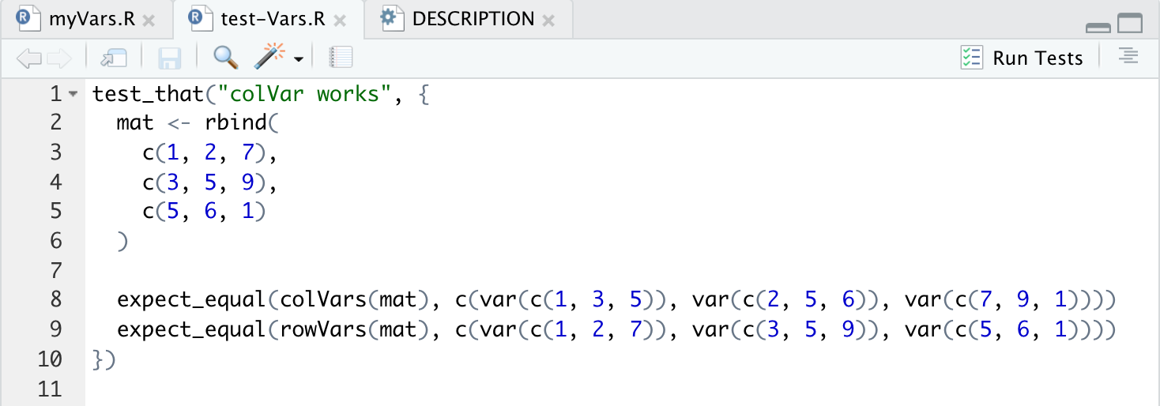
Step 8: Writing Tests
You should write tests to make sure that your package still works properly.
Tests should use your package and compare results to some expected result
First, use usethis::use_testthat() to initialize some test files.
Use usethis::use_test(“Vars”) to initialize a test file for the Vars functions.
Write your test function
Run library(testthat)
Run devtools::test() to see test results for all tests
Tests are automatically checked when running check()

Slide 13
Step 9: Importing functions from other packages
Suppose we are using glmer() from the “lme4” package
We need to let our package know we need functions from lme4
Run use_package(“lme4”) or usethis::use_package(“lme4”, “Suggests”).
This adds “lme4” to the Imports or Suggests field in the DESCRIPTION file
Can add specific version numbers after the name (e.g. lme4 (>= 1.1-25)
You should use lme4::glmer() when using it in your package
Never include library(lme4) in your package. This is bad practice and will get your package rejected from CRAN immediately
Imports implies that these packages need to be present for your package to work. They are installed with your package.
Suggests means the package is used for a datasets, or a test, or only one minor function needs to package, etc. (These are not installed automatically)

Slide 14
Step 10: Build your package
After running devtools::check() again to make sure there are no problems with your package, you can compile your package into a tar.gz file (called “source tarballs”) using devtools::build()
This makes it easy to send to people (and upload to CRAN)
You can also compile binary packages using devtools::build(binary = TRUE)
There are sometimes files which you don’t want to include in the build, and this is what the .Rbuildignore file is for.
You can find out more details about this online if needed

Slide 15
Check your package often
Your workflow should look something like the following:
Edit one or more files below R/
devtools::document()
devtools::load_all()
Run some examples interactively (normal debugging and checking)
devtools::test()
devtools::check()

Slide 16
Vignettes
Vignettes are useful if you want an in-depth tutorial to your package
Vignettes can be created in using Sweave, Markdown, or other engines
usethis::use_vignette(“my-vignette”)
You can browse vignettes by running browseVignettes()

Slide 17
Part 2: Submitting to CRAN

Slide 18
Submitting to CRAN
Need to select a version number (typically 0.1.1 or 0.0.1)
In development, you can select the version number 0.0.0.9000
CRAN has a lot of policies for packages, like spelling and formatting
e.g. never use T to represent TRUE
Submission Checklist: https://cran.r-project.org/submit.html
There is a web service to check the compilation of your package before submission
CRAN Policies: https://cran.r-project.org/submit.html
Link for submission: https://cran.r-project.org/submit.html

Slide 19
Part 2: Final Comments

Slide 20
Other things to consider
You can create a website for your package with pkgdown
https://pkgdown.r-lib.org/
If you are putting your package on GitHub, you should now initialize your README.md file with usethis::use_readme_rmd()
The available::available(“name”) function from the “available” package can check if your name is reasonable
Try not to interfere with your users R session
E.g. Don’t use library(), require(), source()
Be careful with par(), setwd(), etc.
There are ways to clean up after yourself if you do use functions from the second list

Slide 21
Thank you!

