Slide 1


Geplog – GENI - SUK
Queries
Articles
Pre-order and purchase
.
18 nov. 2021 by jp kuntz

Slide 2


Keyboard’s shorcuts « F »
F3 : Exit without saving
F5 : Save
F4 : Call choice list
F2 : Start query mode
Shift+F2 : Execute query

Slide 3
Queries
Many screens will show you lists, it is possible to filter and order that list.
You see a list, put your cursor on one field
F2 > Enter your criterias > Shift + F2
Wildcard characters :
% matches any string of zero or more characters except null.
_ matches any single character.

Slide 4
Queries by example
Find an article knowing just partially its name
You may query the code and/or designation.
Go to Article/Item > Articles’list
Press F2 to enter query mode
In the field designation input %knowncode%
Execute query and get results : Shift+F2
Note : You can filter any list by creating a query.
Read the online help for more instructions on queries
You can query one or more columns from the list.…

Slide 5
Queries step by step example
Your question :
PRE-COM 36 – confirm all material in stock in Pinon (unitised material for the whole job)
Refers to the email sent in return by Benoit MUNIER, there is a pdf file with the number of the Pre-Cde/ reservation
18 nov. 2021 by jp kuntz

Slide 6
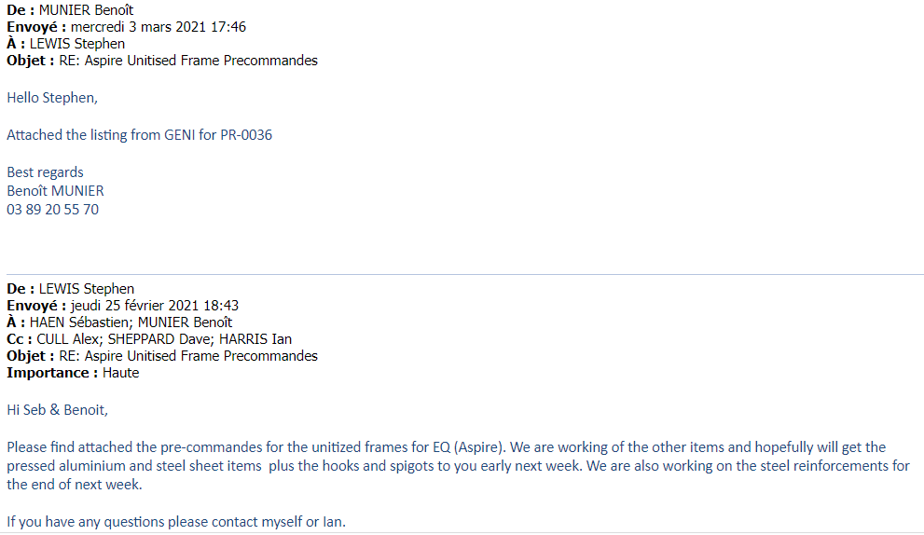
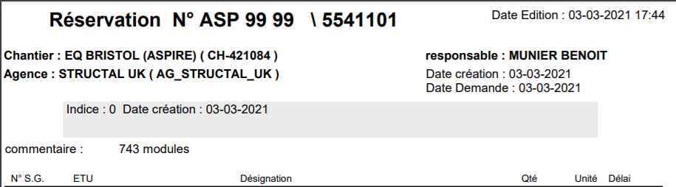
Queries by example
Your question :
PRE-COM 36 – confirm all material in stock in Pinon (unitised material for the whole job)
Refers to the email send in return by Benoit MUNIER, there is a pdf file with the number of the Pre-Cde/ reservation

Slide 7
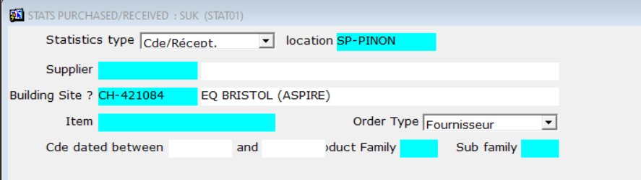
PRE-COM 36 ?
The reservation in geplog is referred as 5541101
Go to Purchase (Achats usine) > Stats purchased received
Fill the form with , at minimum
  Site : SP-PINON
  Project : CH-421084
  Go to the end of criterias by pressing Tab until you see a list showing up.

Slide 8

PRE-COM 36 ?
You see every orders for project CH-421084,
you need to filter that list.
The purchase departement use to write in a field called "internal comment", the reservation number, sometime your pre-cde number.
Press F2 to enter query mode
In the field Int. comment ( the last one on the right) input %5541101%
Execute query and get results by pressing : Shift+F2
You have now every orders for resa 5541101, you may export the list to excel by clicking on

Slide 9
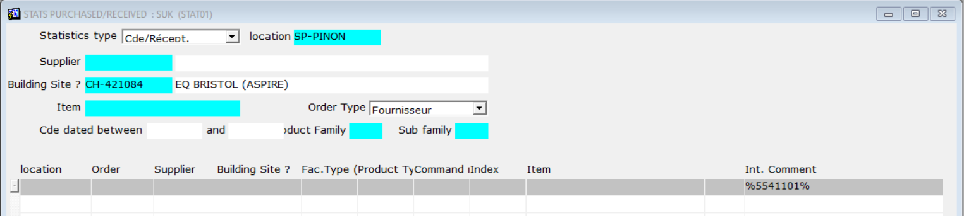
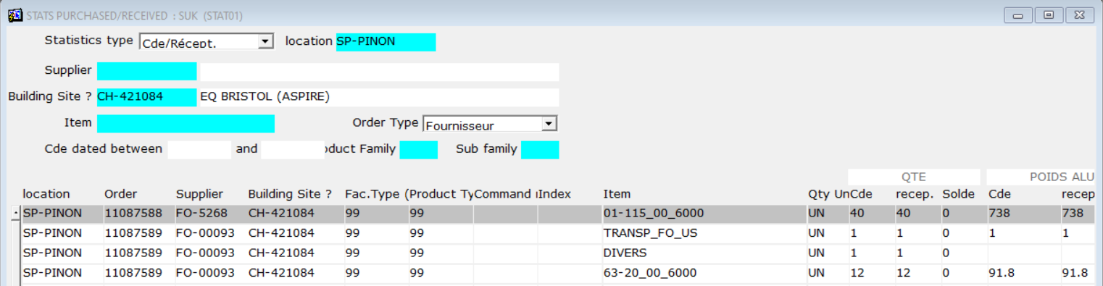
PRE-COM 36 ?

Slide 10
PRE-COM 36 ?
You can now examine for every item
Order number, qty ordered, receveid, pending, etc.

Slide 11

Needs more ?
Go to the Online Help
Public drive : data > link : GENI HELP (UK)
or press F1
when you are in a screen of GENI/GEPLOG

