Slide 1
Quicksort

Slide 2
PROJECTS?
Brief details
What DS concepts will be used?

Slide 3
In Mergesort, we do the two recursive calls before working on the whole array; In Quicksort, we do the two recursive calls after working on the whole array.
Idea is to split the list around a “pivot” element.
It is a randomized algorithm, because it randomly shuffles the array before sorting it.

Slide 4
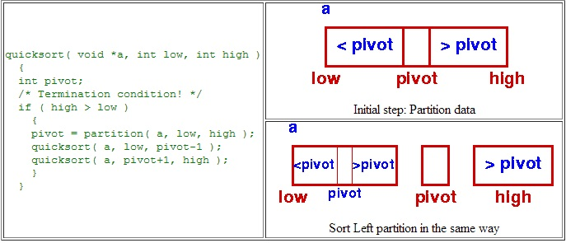

Slide 5
function quicksort(array)
if length(array) ≤ 1
return array // an array of zero or one elements is already sorted
select and remove a pivot element pivot from 'array’
create empty lists less and greater //In some cases, another auxiliary array is used.
for each x in array
if x ≤ pivot then append x to less
else append x to greater
return concatenate(quicksort(less), list(pivot), quicksort(greater)) // two recursive call

Slide 6
Any element can be chosen as the pivot element, but we usually chose the first element.
Naïve pivot

Slide 7
public static void sort(a)
{
StdRandom.shuffle(a); // Eliminate dependence on input.
sort(a, 0, a.length - 1);
}
private static void sort(a, int lo, int hi)
{
if (hi <= lo) return;
int j = partition(a, lo, hi); // Partition.
sort(a, lo, j-1); // Sort left part a[lo .. j-1].
sort(a, j+1, hi); // Sort right part a[j+1 .. hi].
}

Slide 8
private static int partition(a, int lo, int hi)
{
int i = lo, j = hi+1; // left and right scan indices
v = a[lo]; // partitioning item
while (true)
{ // Scan right, scan left, check for scan complete, and exchange.
while (less(a[++i], v)) if (i == hi) break;
while (less(v, a[--j])) if (j == lo) break;
if (i >= j) break;
exch(a, i, j);
}
exch(a, lo, j); // Put v = a[j] into position
return j; // with a[lo..j-1] <= a[j] <= a[j+1..hi].
}

Slide 9
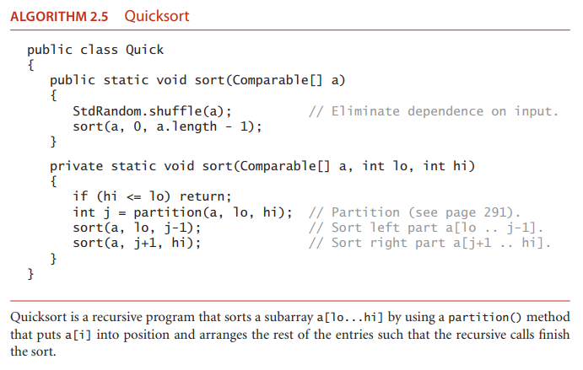

Slide 10
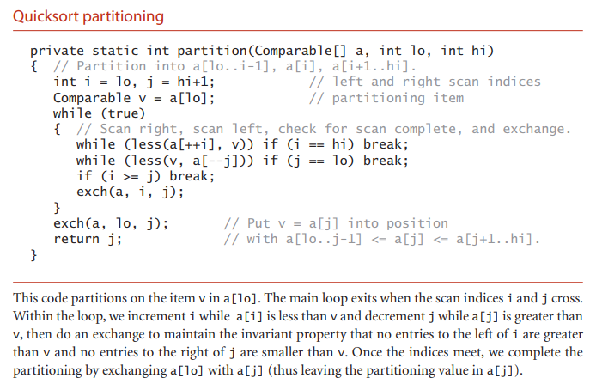

Slide 11
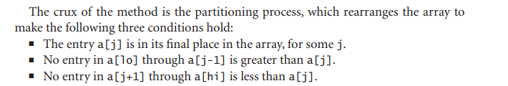

Slide 12
Best pivot?
An item which will divide the array equally into n/2, n/2 in each recursion
O(nlogn)

Slide 13
Worst case
O(n^2)
What happens if an array is already sorted and we select the 1st element as the pivot?

Slide 14
Improvements
Cutoff to insertion sort
E.g. Replace the statement if (hi <= lo) return; in sort() with a statement that invokes insertion sort for small subarrays:
if (hi <= lo + M)
{ Insertion.sort(a, lo, hi); return; }
The optimum value of the cutoff M is system-dependent, but any value between 5 and 15 is likely to work well in most situations

Slide 15
Median-of-three partitioning.
The best pivot would be one which divides the total elements into n/2, n/2 elements. This would be the median. But with additional cost of calculating the median.
Best improvements result from choosing a sample of size 3 and then partitioning on the middle item.
According to Sedgewick, median of the first, middle and last element of the partition

Slide 16
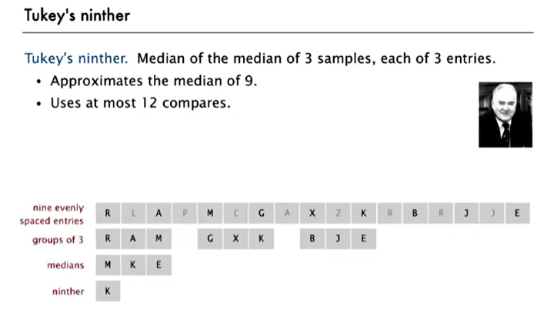

Slide 17
If there are duplicate values in the list?
If we can check all are duplicates, there will be no need for further recursive calls.

Slide 18
Mergesort = O(nlogn)
Quicksort = O(nlogn)
Quicksort is better because it uses less space (no auxiliary array needed)
Quicksort is faster as well. WHY? (Assignment)

