Slide 1
Lecture-5

Slide 2
We’ll Learn Today
Recursion
Recursion vs. Iteration
Preprocessor Directives

Slide 3
Introduction
Function calls
Invoking functions
Provide function name and arguments (data)
Function performs operations or manipulations
Function returns results
Function call analogy:
Boss asks worker to complete task
Worker gets information, does task, returns result
Information hiding: boss does not know details

Slide 4
Hierarchical boss function/worker function relationship.

Slide 5
Simple Function
Example:
void beep(void);
void main(void)
{
printf(“Testing of UDF…..”);
beep();
beep();
}
void beep(void)
{
printf(“\a”);
}

Slide 6
Recursion
Recursive functions
Functions that call themselves
Can only solve a base case
Divide a problem up into
What it can do
What it cannot do
What it cannot do resembles original problem
The function launches a new copy of itself (recursion step) to solve what it cannot do
Eventually base case gets solved
Gets plugged in, works its way up and solves whole problem

Slide 7
Recursion vs. Iteration
Repetition
Iteration: explicit loop
Recursion: repeated function calls
Termination
Iteration: loop condition fails
Recursion: base case recognized
Both can have infinite loops
Balance
Choice between performance (iteration) and good software engineering (recursion)

Slide 8
Fibonacci Series using for loop
class Main {
public static void main(String[] args) {
int n = 10, firstTerm = 0, secondTerm = 1;
System.out.println("Fibonacci Series till " + n + " terms:");
for (int i = 1; i <= n; ++i) {
System.out.print(firstTerm + ", ");
// compute the next term
int nextTerm = firstTerm + secondTerm;
firstTerm = secondTerm;
secondTerm = nextTerm;
}
}
}

Slide 9
Recursion
Example: factorials
5! = 5 * 4 * 3 * 2 * 1
Notice that
5! = 5 * 4!
4! = 4 * 3! ...
Can compute factorials recursively
Solve base case (1! = 0! = 1) then plug in
2! = 2 * 1! = 2 * 1 = 2;
3! = 3 * 2! = 3 * 2 = 6;

Slide 10
for(i=1;i<=num;i++) f=f*i; | static int factorial(int n) { if (n == 0) return 1; return n * factorial(n - 1); }

Slide 11
Recursion

Slide 12
Sum 10 nums
public class Main {
public static void main(String[] args) {
int result = sum(10);
System.out.println(result);
}
public static int sum(int k) {
if (k > 0) {
return k + sum(k - 1);
} else {
return 0;
}
}
}
10 + sum(9)
10 + ( 9 + sum(8) )
10 + ( 9 + ( 8 + sum(7) ) )
...
10 + 9 + 8 + 7 + 6 + 5 + 4 + 3 + 2 + 1 + sum(0)
10 + 9 + 8 + 7 + 6 + 5 + 4 + 3 + 2 + 1 + 0

Slide 13
Recursion
public class RecursiveJavaFactorialProgram {
public static void main(String args[]) {
long nFactoriral = factorialProgram(9);
System.out.println(nFactoriral);
}
/* Java factorial program with recursion. */
public static long factorialProgram(long n) {
if (n <= 1) {
return 1;
} else {
return n * factorialProgram(n - 1);
}
}
}

Slide 14
Example Using Recursion: The Fibonacci Series
Fibonacci series: 0, 1, 1, 2, 3, 5, 8...
Each number is the sum of the previous two
Can be solved recursively:
fib( n ) = fib( n - 1 ) + fib( n – 2 )
Code for the fibonacci function
long fibonacci( long n )
{
if (n == 0 || n == 1) // base case
return n;
else
return fibonacci( n - 1) + fibonacci( n – 2 );
}

Slide 15
Example Using Recursion: The Fibonacci Series
Set of recursive calls to function Fibonacci
f( 3 )
return
f( 2 )
+
f( 1 )
return
f( 1 )
+
f( 0 )
return 1
return 1
return 0

Slide 16
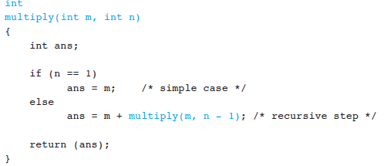
Write a program that performs integer multiplication using + operator.

Slide 17
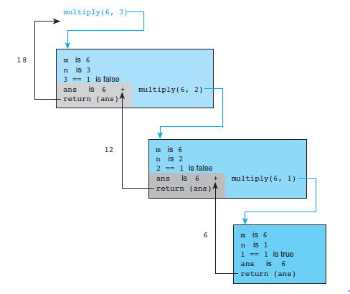
Tracing

Slide 18
1. Direct Recursion
2. Indirect Recusion
1. Direct Recursion: These can be further categorized into four types:
Tail
Head Recursion
Linear Recursion
Tree Recursion

Slide 19
Tail recursion
Tail recursion is a special form of recursion in computer programming where a function calls itself as its last action before returning a result. In other words, in a tail-recursive function, the recursive call is the last operation performed in the function before it exits.

Slide 20
Tail recursion has some important benefits:
1. Optimization: Some programming languages and compilers can optimize tail-recursive functions to use constant stack space. This optimization is known as "tail call optimization" or "tail call elimination." It avoids the risk of stack overflow errors that can occur in non-tail-recursive functions with deep recursion.

Slide 21
2. Readability: Tail-recursive functions are often more readable and easier to understand than their non-tail-recursive counterparts because the logic is structured in a way that resembles an iterative process.

Slide 22
Here's an example of a tail-recursive function in the programming language Python that calculates the factorial of a number:
public static int tailRecursion(int n) {
if (n <= 1) {
return n;
} else {
int innerResult = tailRecursion(n - 1);
return tailRecursion(innerResult - 1);
}
}

Slide 23
In this example, the `factorial` function is tail-recursive because the recursive call (`factorial(n - 1, n * accumulator)`) is the last operation performed before returning a result, and there is no need to accumulate intermediate results in each recursive call. This allows for efficient use of stack space and makes the code more straightforward to follow.

Slide 24
Head Recursion
Head recursion is a form of recursion in computer programming where a function performs its recursive call(s) at the beginning of the function, before any other operations or computations. In contrast to tail recursion, where the recursive call is the last action in the function, head recursion occurs at the start of the function's execution.
public static int headRecursion(int n) {
if (n <= 1) {
return n;
} else {
int innerResult = headRecursion(n - 1);
return n + innerResult;
}
}

Slide 25
Tail recursion | Head recursion
def factorial_tail_recursive(n, accumulator=1): if n == 0: return accumulator else: return factorial_tail_recursive(n - 1, n * accumulator) # Example usage result = factorial_tail_recursive(5) print(result) # Output: 120 | def factorial_head_recursive(n): if n == 0: return 1 else: recursive_result = factorial_head_recursive(n - 1) return n * recursive_result # Example usage result = factorial_head_recursive(5) print(result) # Output: 120

Slide 26
Indirect recursion
A group of functions calling each other in a cycle. E.g, Function A calls Function B, which calls Function C, and eventually, Function C calls Function A again

Slide 27
public class EvenOddChecker {
public static boolean isEven(int n) {
if (n == 0) {
return true;
} else {
return isOdd(n - 1);
}
}
public static boolean isOdd(int n) {
if (n == 0) {
return false;
} else {
return isEven(n - 1);
}
}
}

Slide 28
Binary recursion
Binary Recursion: Binary recursion occurs when a function makes two recursive calls in each step of the recursion. This often arises in divide-and-conquer algorithms, such as binary search or merge sort.

Slide 29
// Base case: If the left index is greater than the right index, the element is not found.
if (left > right)
return -1;
// Calculate the middle index.
// If the target is smaller than the middle element, search the left half of the array.
if (arr[mid] > target) {
return binarySearch(arr, target, left, mid - 1);
}
// If the target is larger than the middle element, search the right half of the array.
return binarySearch(arr, target, mid + 1, right);
}
int[] sortedArray = {1, 3, 5, 7, 9, 11, 13, 15, 17};
int result = binarySearch(sortedArray, target, 0, sortedArray.length - 1);

Slide 30
Nested recursion
Nested recursion happens when a function calls itself with a recursive call that includes the result of another recursive call.

Slide 31
public class NestedRecursionExample {
public static int fibonacci(int n) {
if (n <= 1) {
return n;
} else {
return fibonacci(fibonacci(n - 1)) + fibonacci(n - 2);
}
}
public static void main(String[] args) {
int n = 5;
int result = fibonacci(n);
System.out.println("Fibonacci(" + n + ") = " + result);
}
}

Slide 32
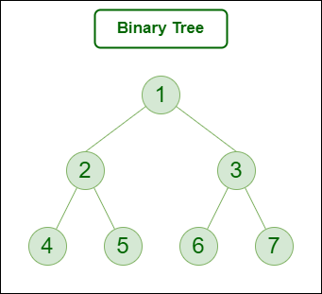
Tree Recursion
Tree Recursion: Tree recursion is commonly used in problems related to tree-like data structures. In tree recursion, a function may make multiple recursive calls to process subtrees or branches of a tree.

Slide 33
class TreeNode {
int value;
TreeNode left;
TreeNode right;
TreeNode(int value) {
this.value = value;
this.left = null;
this.right = null;
}
}

Slide 34
public static int sumOfTree(TreeNode root) {
// Calculate the sum of values in the left and right subtrees
if (root == null) {
return 0;
} else {
int leftSum = sumOfTree(root.left);
int rightSum = sumOfTree(root.right);
// Add the current node's value to the sum of its subtrees
return root.value + leftSum + rightSum;
}
Call:
int treeSum = sumOfTree(root);

Slide 35
Recursion Practice Questions
Display following pattern:
a
a b
a b c
a b c d
a b c d e
Get the character and display until he/she hits the enter key. Finally show the count of total typed characters.

Slide 36
Backtracking
Backtracking can be defined as a general algorithmic technique that considers searching every possible combination in order to solve a computational problem.
There are three types of problems in backtracking –
Decision Problem – In this, we search for a feasible solution.
Optimization Problem – In this, we search for the best solution.
Enumeration Problem – In this, we find all feasible solutions.

