Slide 1
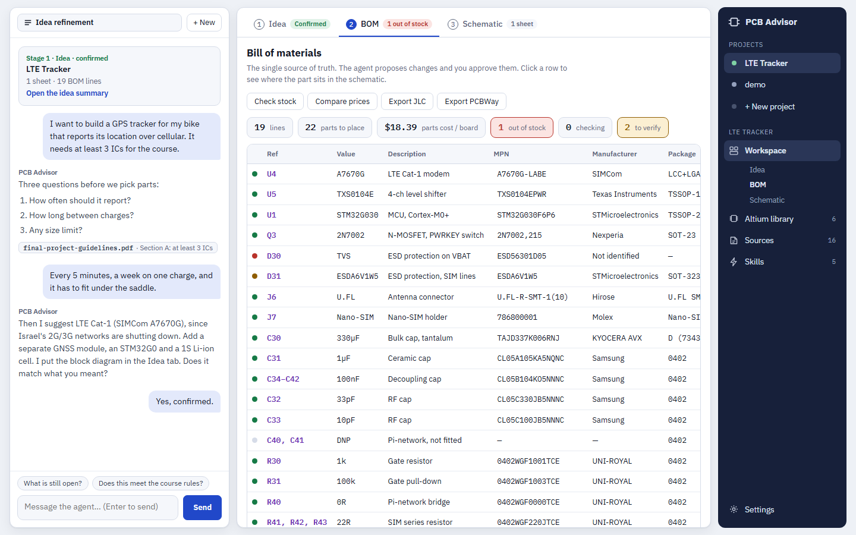
localhost:8765/?project=lte-tracker
AI FOR HARDWARE ENGINEERING
PCB Advisor
Grounded AI Assistance for Altium PCB Design
Prepares verified inputs. Audits manufactured outputs. Zero shortcuts.
Student: Ilia Shalem (עילי שלם)
Lecturer: Avihai Aharon
PCB Design Course 27525

Slide 2
THE PROBLEM
The Late Feedback Trap
Design errors compound silently until discovered at the manufacturer.
01
Concept
Specs & Power
02
Parts
Stock & Sourcing
03
Library
Symbols & Footprints
04
Schematic
Wiring & Pinouts
05
Layout
Placement & Routing
06
Fabrication
DFM & Assembly
CRITICAL FLAW: 80% of student failures are discovered at Stage 06 during manufacturer review.
Out-of-stock chips, mismatched footprints, and unrouted pins force weeks of complete re-spins.
Late Footprint Discovery
Package mismatches (e.g. A7670C vs G) caught only after full routing is finished.
DFM Scanner Noise
Online fab checkers flag dozens of harmless false positives, obscuring real defects.
Scattered Altium Knowledge
Essential layout rules and calculator formulas are buried across manuals and forums.
pcb-advisor · Ilia Shalem · Avihai Aharon (Course 27525) · Slide 01

Slide 3
PRODUCT PHILOSOPHY
A Mentor, Not an Auto-Pilot
Prepares what enters Altium. Audits what leaves it.
01 PRE-ALTIUM
Input Preparation
— Live JLCPCB stock verification
— Unified footprint & 3D model library
— Pre-calculated 50Ω impedance rules
— Clear power & debug specs
02 THE STUDENT
Core Engineering
— Schematic capture & net labeling
— Component placement & floorplanning
— Trace routing & via transitions
— Ground & power copper pours
— 100% Student Decision Making
The tool never clicks the mouse or routes traces for the student.
03 POST-ALTIUM
Audit & Verification
— Schematic audit against datasheets
— Decoupling cap proximity inspection
— Gerber, Drill & CPL validation
— DFM false-positive filtering
pcb-advisor · Ilia Shalem · Avihai Aharon (Course 27525) · Slide 02

Slide 4
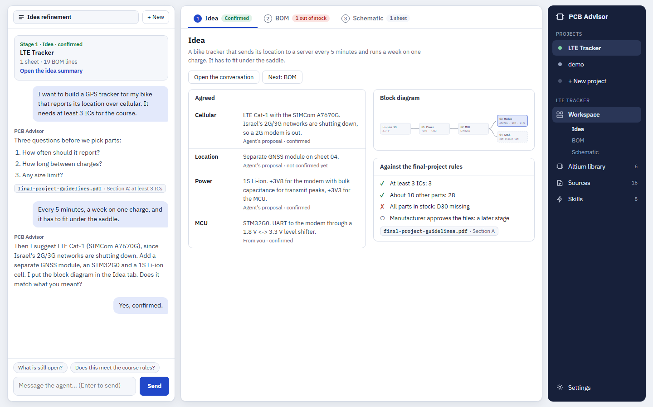
STAGE 01: CONCEPT
Automated Course Rules & Feasibility Audit
Validates requirements against official guidelines before drawing a wire.
PCB Advisor — Idea Refinement & Course Guidelines
01 Syllabus Compliance
Audits project against official course guidelines (e.g. verifying >=3 ICs and ~10 parts count).
02 Feasibility Inquiry
Grounded chat refines power budget, battery life, and size constraints upfront.
03 Block Architecture
Synthesizes confirmed requirements into an agreed subsystem block diagram.
pcb-advisor · Ilia Shalem · Avihai Aharon (Course 27525) · Slide 03

Slide 5
STAGE 02: PARTS & SOURCING
Unified Workspace & Live BOM Intelligence
Real-time distributor stock queries connected to Altium project files.
PCB Advisor — Bill of Materials & Stock Audit
01 Live Distributor Stock
Queries real-time JLCPCB availability and flags out-of-stock parts (e.g. D30) before routing.
02 Grounded AI Assistant
Context-aware chat answers Altium questions, citing official course and datasheet rules.
03 One-Click Proposal Flow
The AI proposes parametric fixes (e.g. cheaper alternatives), and the student explicitly approves.
pcb-advisor · Ilia Shalem · Avihai Aharon (Course 27525) · Slide 04

Slide 6
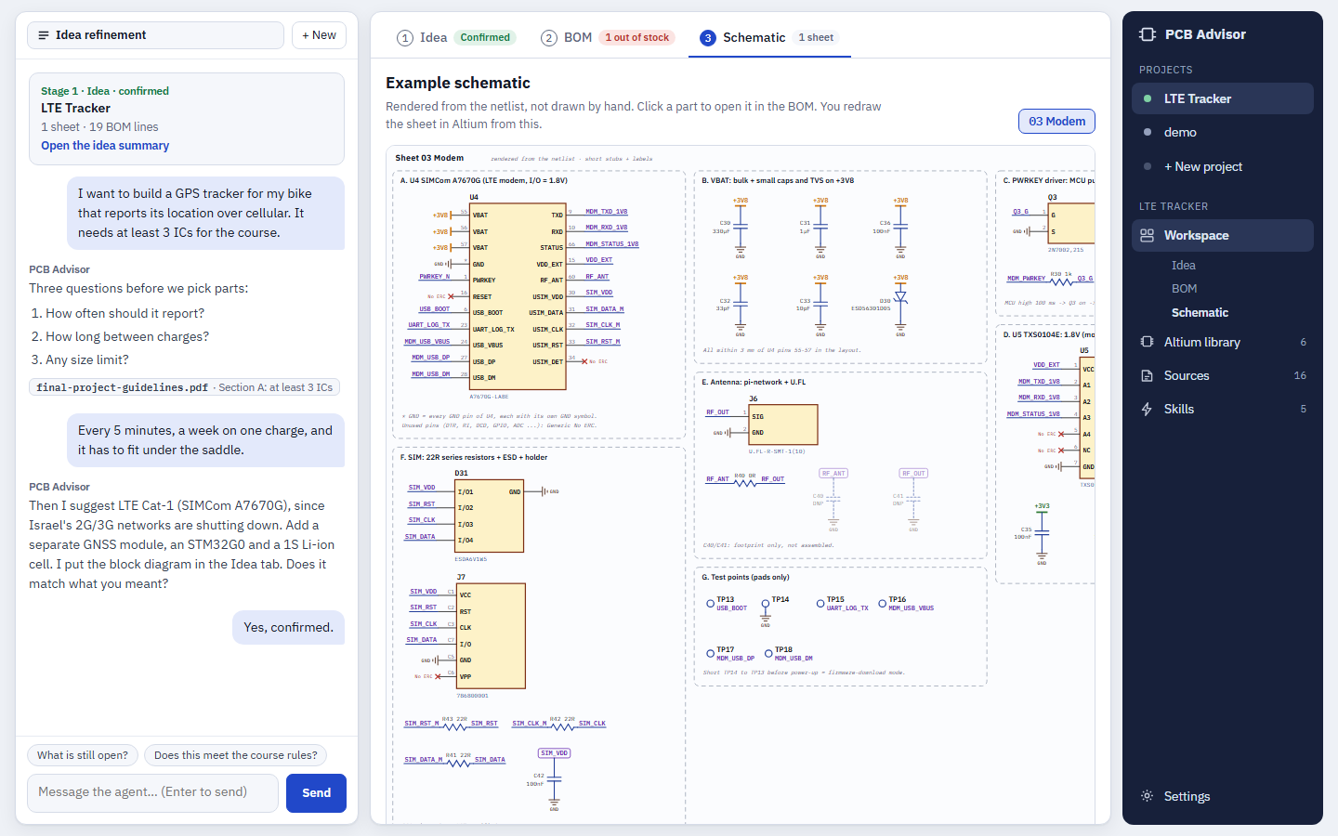
STAGE 04: SCHEMATIC
Automated Netlist & Datasheet Auditing
Extracts schematic connectivity and verifies pin constraints against datasheets.
PCB Advisor — Netlist Visualizer & Pin Auditor
01 Netlist-Driven Render
Generates clear circuit views directly from Altium connectivity without GUI scraping.
02 Pin-by-Pin Validation
Verifies decoupling caps, power rails (VBAT 3.8V), and ESD protection per component specs.
03 Zero Hallucinations
Every recommendation is backed by a verified citation from local manufacturer PDF files.
pcb-advisor · Ilia Shalem · Avihai Aharon (Course 27525) · Slide 05

Slide 7
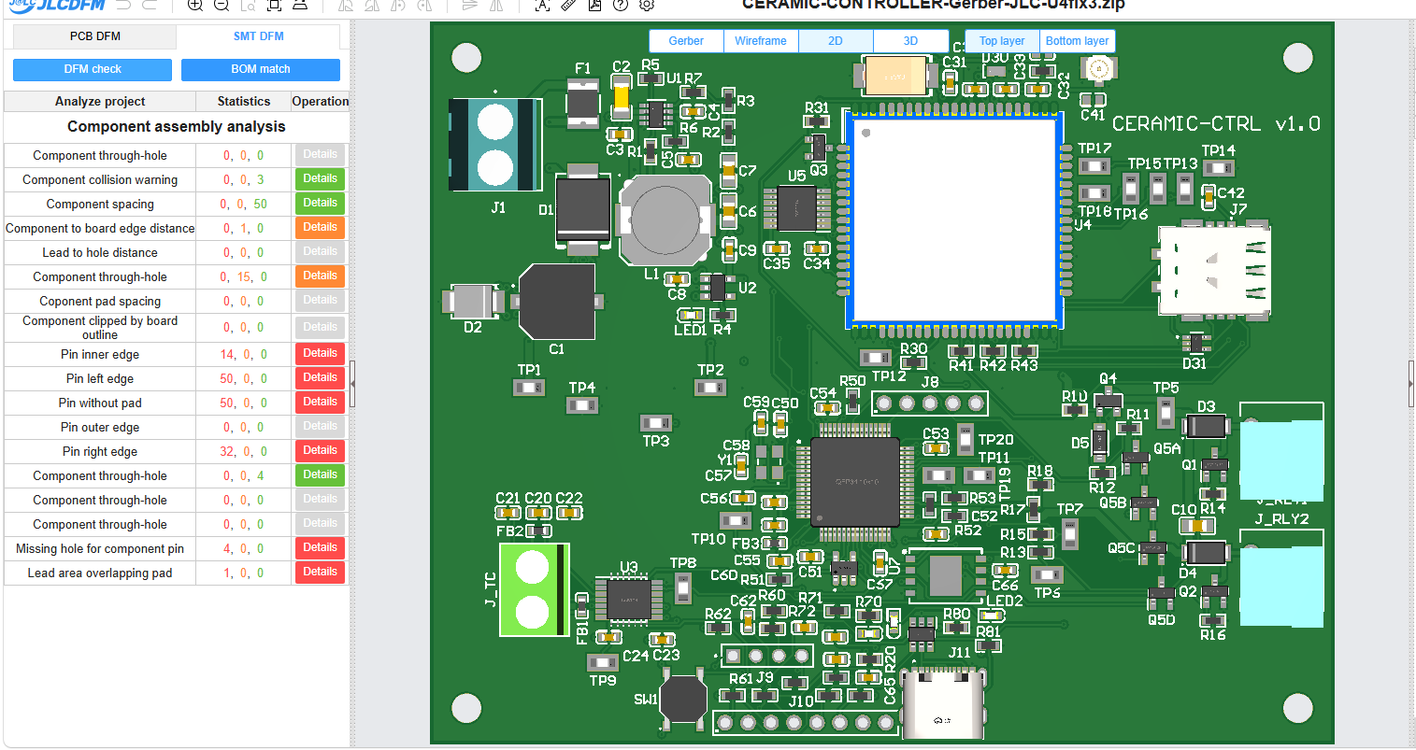
STAGE 06: FABRICATION
Distinguishing Real Defects from Fab Noise
JLCDFM generates dozens of harmless alarms. The tool separates signal from noise.
JLCDFM Viewer — Automated SMT Assembly Analysis
REAL DEFECTS ELIMINATED
— Board outline on copper (48 -> 0)
— Thin silkscreen lines (12 -> 0)
— Component CPL rotation mismatches
FALSE POSITIVES FILTERED
— 146 LGA pin warnings: Generic 3D model vs actual SIMCom spec.
— Pad spacing alerts: Power vias on the exact same electrical net.
— Through-hole offset: Connector preview anchor artifact.
pcb-advisor · Ilia Shalem · Avihai Aharon (Course 27525) · Slide 06

Slide 8
VALIDATION
Empirical Benchmark: 12 Real Incidents
Evaluated against actual failure logs from a 4-layer industrial kiln controller.
12 / 12
Incidents Evaluated
Derived from student design logs
REAL INCIDENT (KILN PROJECT) | ACTUAL DISCOVERY | PCB ADVISOR WARNING
Cellular Modem Footprint (A7670C vs G) | Stage 06 (Fab Review) | Stage 03 (Library Match)
11 Missing BOM Component Matches | Stage 06 (Order Upload) | Stage 02 (BOM Ingestion)
High-Cost Extended Flash ($19.40) | Stage 06 (Quote Check) | Stage 02 ($4.10 Alternative)
Inverted Power Terminal Block (J1) | Stage 05 (3D Check) | Stage 05 (Connector Audit)
Board Outline Plotted on Copper Layers | Stage 06 (DFM Error) | Stage 06 (Pre-Upload Check)
3 Stages
Earlier Detection
Caught at BOM/Sch instead of Fab
0 Defects
Final Hardware
100% First-pass yield achieved
pcb-advisor · Ilia Shalem · Avihai Aharon (Course 27525) · Slide 07

Slide 9
SYSTEM ARCHITECTURE
Local, Deterministic, Zero Institutional Cost
Designed for institutional compliance, speed, and privacy.
01
Native File Parser
READ-ONLY LOCAL CAD ACCESS
Directly parses binary .PcbDoc and .SchDoc files on disk.
• Zero Altium GUI automation
• Zero mouse clicking
• Completely safe: Cannot corrupt original project files.
02
Local CLI Engine
STUDENT-DRIVEN RUNTIME
Operates through the student's existing CLI session (Claude Code / Antigravity).
• $0 Cost to the University
• No API keys stored on servers
• 100% Local data privacy.
03
Grounded Truth Base
VERIFIED SPECIFICATIONS
All AI reasoning is constrained by deterministic sources.
• Live JLCPCB stock endpoint
• Local manufacturer PDF datasheets
• Course design guidelines.
pcb-advisor · Ilia Shalem · Avihai Aharon (Course 27525) · Slide 08

Slide 10
COURSE ALIGNMENT
Frequently Asked Questions & Defense
Direct answers to key pedagogical and evaluation considerations.
Does it replace the student's work?
No. The student manually places components, routes copper traces, and draws the schematic in Altium. The tool acts strictly as an automated Teaching Assistant.
What if the AI hallucinates?
Every claim is grounded in verified documentation. Recommendations without an exact datasheet table or course citation are prohibited from being displayed.
Why not use generic ChatGPT?
Generic LLMs cannot parse local binary .PcbDoc files, check live distributor stock endpoints, or inspect custom Altium integrated libraries.
Who pays and what about privacy?
Zero cost to the university. The system runs locally through the student's personal CLI environment. No private project files leave the computer.
pcb-advisor · Ilia Shalem · Avihai Aharon (Course 27525) · Slide 09

