Slide 1

LIVING
Livability maps and prediction
Tomiris Gilazh
David Leitritz
Ilaria Francesca Lunardelli

Slide 2
CONTENTS
What is Livability score
Background literature
Research aim and questions
Overview of Livability score
Data
Methodology
Results
Discussion: findings
Discussion: limitations
Discussion: future work
Reproducibility and ethnical considerations
References

Slide 3
WHAT IS LIVABILITY SCORE
Leefbaarometer (Livability Meter) – an instrument that provides an estimate of livability based on a large number of characteristics of the residential environment.
Is intended to provide a picture of where livability is expected to be good or poor; is a monitoring instrument
Environment
Housing
Amenities
Social cohesion
Safety
Source: Leefbaarometer 3.0 Instrumentontwikkeling https://www.leefbaarometer.nl/resources/LBM3Instrumentontwikkeling.pdf

Slide 4
BACKGROUND LITERATURE
Concept of ‘livability’ is very fluid and changes over time (Kaal, 2011; Mandemakers et al., 2021).
Livability meter is meant to reflect what people value. The model includes variables that are objective measures of environment. However, the dimensions are selected based on survey from 2018 and housing market choices data 2019-2022 (Mandemakers et al., 2021).
Limitations: - potential outdatedness of the opinions from 2018 and doesn’t include them in the model; - poor representativeness of housing market choices as fewer people are able to purchase houses and the first-time buyers age has been increasing (CBS, 2026; Lennartz et al., 2019); - the dimensions are not necessarily comprehensive – based on the availability of data

Slide 5
RESEARCH AIM & OBJECTIVES
We aim to investigate which predictors available from survey and administrative data can predict the livability scores.
Objectives:
- Use Exposome, Firmbackbone, LISS to explore predictors for livability that match the Livability meter dimensions and also go beyond;
Compare “objective” and “subjective” livability.

Slide 6
RESEARCH QUESTIONS
What alternative model using administrative data can predict livability score in the Netherlands?
What alternative model using survey data can predict livability score in the Netherlands?
What are the differences between predicted (administrative and survey-based) and official livability scores?

Slide 7
LIVABILITY SCORE
OVERVIEW OF DIMENSIONS (more details in the following slide)
VISUALIZATION in Shiny Dashboard
Environment
Housing
Amenities
Social cohesion
Safety

Slide 8
Environment |  | Housing | Amenities | Social cohesion | Safety
Natural environment | Infrastructure
Air quality Noise pollution Non-ionizing radiation Feels like temperature/heat stress Flooding Groundwater nuisance/soil subsidence Earthquakes Flood depth Proximity to forest/green space Air quality Proximity to landscape attractive for recreation Variety of landscapes | Proximity to (through) roads Proximity to rail infrastructure Traffic safety Car density Proximity to wind turbines Proximity to high-voltage pylons Quality of walking and cycling paths Mixed-use development Vacancy of non-residential real estate Walkability | Housing vacancy Building density Foundation problems Mixing of ownership structures Energy quality Home ownership Specific poorly maintained segments Home ownership in relation to insufficient income Use of solar panels Share of listed buildings Renovations of homes Overcrowding Housing types | (Public) transport Shops/retail Education Care and support Hospitality/social gatherings Leisure, culture, etc. Sports facilities Track accessibility | (Diversity by) life stage Social cohesion Tuition rate Population density Population development | Registered crimes Perceived safety Perceived nuisance

Slide 9




DATA
Wave 18 (2025)
Core studies: Social Integration & Leisure
Work & School
Health
Housing
Air pollution 2023
Light exposure and walkability from 2020
Food environment
Urbanicity 2015
Administrative-demographic data on PC6 level (2025)
Firmbackbone – InnovatieSpotter
Aggregated indicators of innovative economic activities on PC4 level (Q1 2026)

Slide 10
METHODOLOGY
ML modelling: Predicting “Official” livability scores from 2024 on PC4 level
2 Datasets:
Objective predictors (EXPOSOME + admin + InnovatieSpotter)
70 variables, 4,056 PC4
Subjective predictors (LISS panel)
83 variables, 1,900 PC4

Slide 11
METHODOLOGY
ML preprocessing:
Nzv removal
High-correlation removal
Median imputation
Train-test split (80-20)
ML training
5-fold CV
Hyperparameter tuning
2 models (Elastic Net & Random forest)

Slide 12
RESULTS
Best performing model: Objective predictors, random forest
RMSE: 1.99 (train); 5.51 (test)
MAE: 1.43 (train); 4.02 (test)
Visualization of differences predicted vs. actual livability on Shiny dashboard

Slide 13
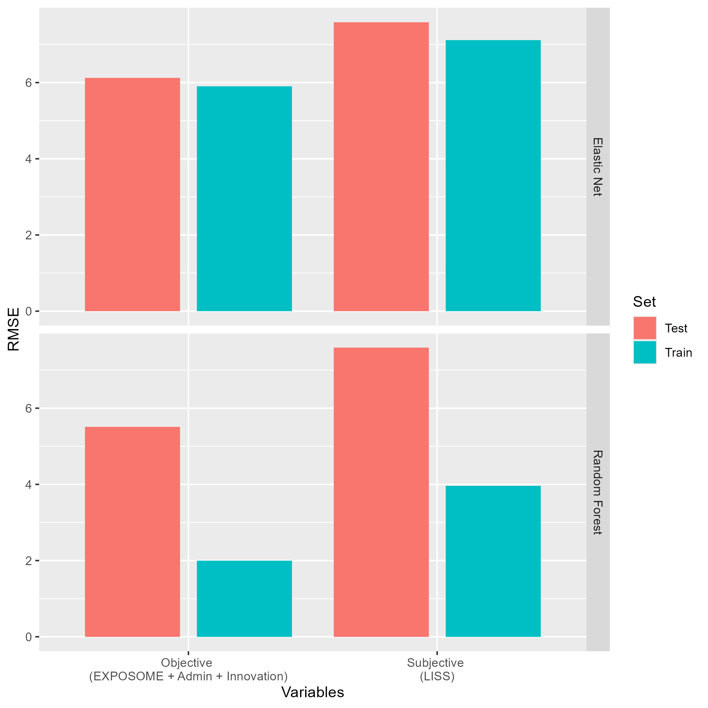
RMSE per model

Slide 14
DISCUSSION: Findings
Both objective and subjective measures predict similar livability scores
Predictions not far off from the “official scores” despite limited data
Good design of the government model
Strength: Pipeline can be used to conduct further validation of scores with more (diverse) input data

Slide 15
DISCUSSION: Limitations
Limited to available variables and years in admin data (LISS, Exposome, InnovatieSpotter)
Smaller sample size in LISS, especially when aggregating per PC4 (often less than 10 people per neighbourhood, less available PC4s)
Approximating measures for livability dimensions based on our own interpretation due to lack of metadata documentation for livability score
InnovatieSpotter indicators created very ad hoc (lacking theoretical foundation)

Slide 16
DISCUSSION: Future work
Feature importances of ML models: Which variables drive predictions of livability?
Feed more diverse data into pipeline (E.g. from GECCO consortium (neighborhood), CBS (administrative statistics)
Predict sub-dimensions of livability scores?
Weights?

Slide 17
Reproducibility
Measures taken for reproducibility:
Detailed comments in the scripts;
Readme file with detailed steps and required software and packages including their versions;
Uploaded to Zenodo;
Apache 2.0 licence.

Slide 18
Ethical considerations
Carefulness in interpreting data, especially when referring to areas with low livability scores;
Statistical disclosure control – not outputting any individual-level or sensitive data

Slide 19
REFERENCES
CBS, Centraal Bureau voor de Statistiek. (2026). Fewer young people entering the housing market. https://www.cbs.nl/en-gb/news/2026/17/fewer-young-people-entering-the-housing-market
Kaal, H. (2011). A conceptual history of livability: Dutch scientists, politicians, policy makers and citizens and the quest for a livable city. City, 15(5), 532–547. https://doi.org/10.1080/13604813.2011.595094
Lennartz, C., Baarsma, B., & Vrieselaar, N. (2019). Exploding house prices in urban housing markets: Explanations and policy solutions for the Netherlands. In Hot property: The housing market in major cities (pp. 207-221). Cham: Springer International Publishing.
Mandemakers, J., Leidelmeijer, K., Burema, F., Halbersma, R., Middeldorp, M. & Veldkamp, J. (2021). Leefbaarometer 3.0 Instrumentontwikkeling. https://www.leefbaarometer.nl/resources/LBM3Instrumentontwikkeling.pdf

