Slide 1

Department of Electronics and Communication Engineering
B.E – ECE ( II Year B Section)
CORE COURSE PROJECT ZEROTH REVIEW - AY 2025-26 EVEN SEMESTER
MEMS MICROPHONE DIGITISATION
Presented By |  | Under the Guidance of
NAME MAYURKANTHAN ILAM BHARATHI M | REG NO 24EC0114 24EC0066 | DR.S.AATHILAKSHMI.
 |  | Assistant Professor / ECE Department

Slide 2

CONTENTS
INTRODUCTION
LITERATURE SURVEY
PROBLEM IDENTIFICATION & OBJECTIVES
PROPOSED SYSTEM MODEL
SOFTWARE TOOLS
CONCLUSION
Chennai Institute of Technology | ECE | Core course project | Review | 8/1/2026 | <number>

Slide 3
INTRODUCTION
MEMS capacitive microphones are widely used in smartphones, smart speakers, wearables, hearing aids, and voice-controlled IoT devices. Acoustic pressure causes diaphragm displacement in these microphones, resulting in capacitance variations that must be accurately converted into digital signals for audio processing. Conventional microphone readout circuits operate on a constant-charge principle, requiring high-voltage sensor biasing, charge pumps, and voltage-domain signal processing, which increase power consumption, silicon area, noise susceptibility, and limit scalability for always-on applications. To overcome these limitations, this project proposes a time-encoded capacitance-to-digital converter (CDC) based on a switched-capacitor feedback oscillator, which directly converts microphone capacitance variations into digital form without sensor biasing or intermediate voltage conversion, enabling a low-power, compact, and CMOS-scalable microphone-to-digital interface.
Chennai Institute of Technology | ECE | Core course project | Review | 8/1/2026 | <number>

Slide 4
LITERATURE SURVEY
Several capacitance-to-digital conversion techniques have been reported in the literature for MEMS sensor readout:
SAR-Based CDCs offer good energy efficiency but suffer from limited resolution and linearity due to capacitor mismatch and calibration requirements.
Sigma-Delta (ΣΔ) CDCs provide high resolution and excellent noise shaping but require complex analog blocks such as integrators and amplifiers, resulting in high power consumption and large silicon area.
Zoom and Incremental CDCs combine SAR and ΣΔ techniques but involve multi-bit DACs and complex control logic, increasing design complexity
Eliminates sensor biasing
Avoids voltage-domain processing
Improves linearity and robustness.
Chennai Institute of Technology | ECE | Core course project | Review | 8/1/2026 | <number>

Slide 5
Company Name
PROBLEM IDENTIFICATION & OBJECTIVES
Existing microphone-to-digital conversion systems face the following problems:
Large Charge Pumps
MEMS microphones require high bias voltages (10–20 V), implemented using charge pumps that consume significant power and area.
High-Ohmic Biasing Circuits
Constant-charge operation requires giga-ohm resistors, creating high-impedance nodes that are sensitive to noise and leakage.
Multiple Analog Processing
Poor Scalability and Power Efficiency
Analog-heavy architectures do not scale well with CMOS technology and are unsuitable for always-on audio systems.
Chennai Institute of Technology | ECE | Core course project | Review | 8/1/2026 | <number>

Slide 6
PROPOSED SYSTEM MODEL
A constant current source charges an integration capacitor, creating a steadily increasing voltage. This current is generated using a bandgap reference (BGR), which keeps the current stable even when temperature, supply voltage, or process conditions change. This ensures consistent and reliable system operation.
A switched-capacitor feedback network, which includes the MEMS microphone capacitance, periodically removes charge from the integration capacitor. The amount of charge transferred depends on the microphone capacitance, which varies with sound pressure.
An operational transconductance amplifier (OTA) monitors the integration node and provides the required gain to maintain stable feedback. The OTA keeps the system operating around a fixed bias point, improving linearity and reducing the effect of circuit nonidealities.
The feedback loop controls a ring oscillator, whose frequency automatically adjusts to balance the charge added by the current source and the charge removed by the switched-capacitor network. When sound changes the microphone capacitance, the oscillator frequency changes accordingly.
Chennai Institute of Technology | ECE | Core course project | Review | 8/1/2026 | <number>

Slide 7
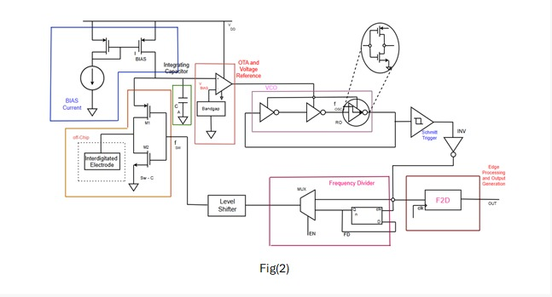
PROPOSED SYSTEM MODEL
Schmitt trigger, which removes noise and slow edges by producing sharp logic transitions with hysteresis. This reduces distortion and timing jitter.
Chennai Institute of Technology | ECE | Core course project | Review | 8/1/2026 | <number>

Slide 8
SOFTWARE TOOLS
Cadence Virtuoso – Circuit schematic and layout design
Cadence Spectre – Transient and noise analysis
Layout using cadence
Pre layout and post layout verification
Chennai Institute of Technology | ECE | Core course project | Review | 8/1/2026 | <number>

Slide 9
APPLICATION
The proposed CDC is ideally suited for digital MEMS microphones used in:
Smart speakers
Smartphones
Wireless earbuds
Hearing aids
Voice-controlled IoT
The elimination of charge pumps and voltage amplifiers makes the architecture highly efficient for low-power audio applications where moderate resolution and robustness are more critical than ultra-high precision.
Chennai Institute of Technology | ECE | Core course project | Review | 8/1/2026 | <number>

Slide 10
CONCLUSION
This project presents a time-encoded capacitance-to-digital converter as an efficient solution for microphone-to-digital signal conversion. By eliminating large charge pumps, high-ohmic biasing circuits, and voltage-domain processing, the proposed CDC significantly reduces power consumption, silicon area, and design complexity. The switched-capacitor feedback mechanism improves linearity and robustness, making the architecture well suited for low-power, always-on audio and human–machine interface applications.
Chennai Institute of Technology | ECE | Core course project | Review | 8/1/2026 | <number>

Slide 11
Queries ??
Chennai Institute of Technology | ECE | Core course project | Review | 8/1/2026 | <number>

Slide 12

Chennai Institute of Technology | ECE | Core course project | Review | 8/1/2026 | <number>

