Slide 1



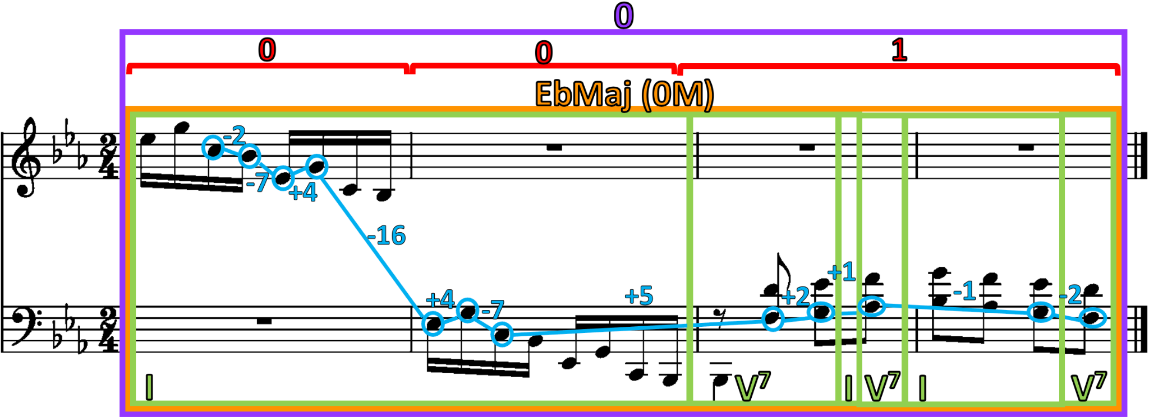
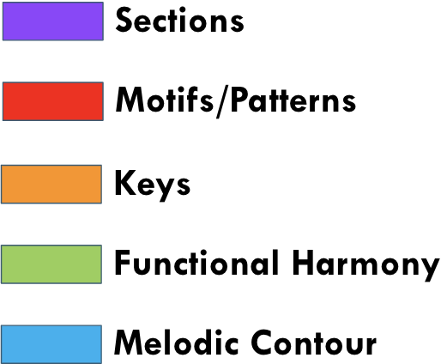
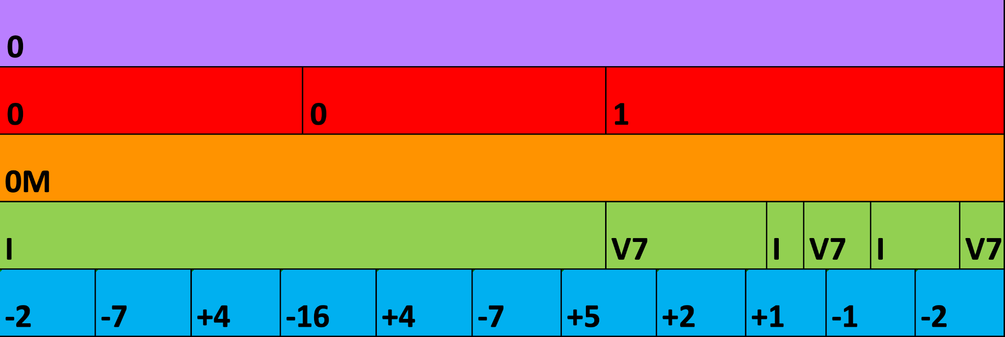
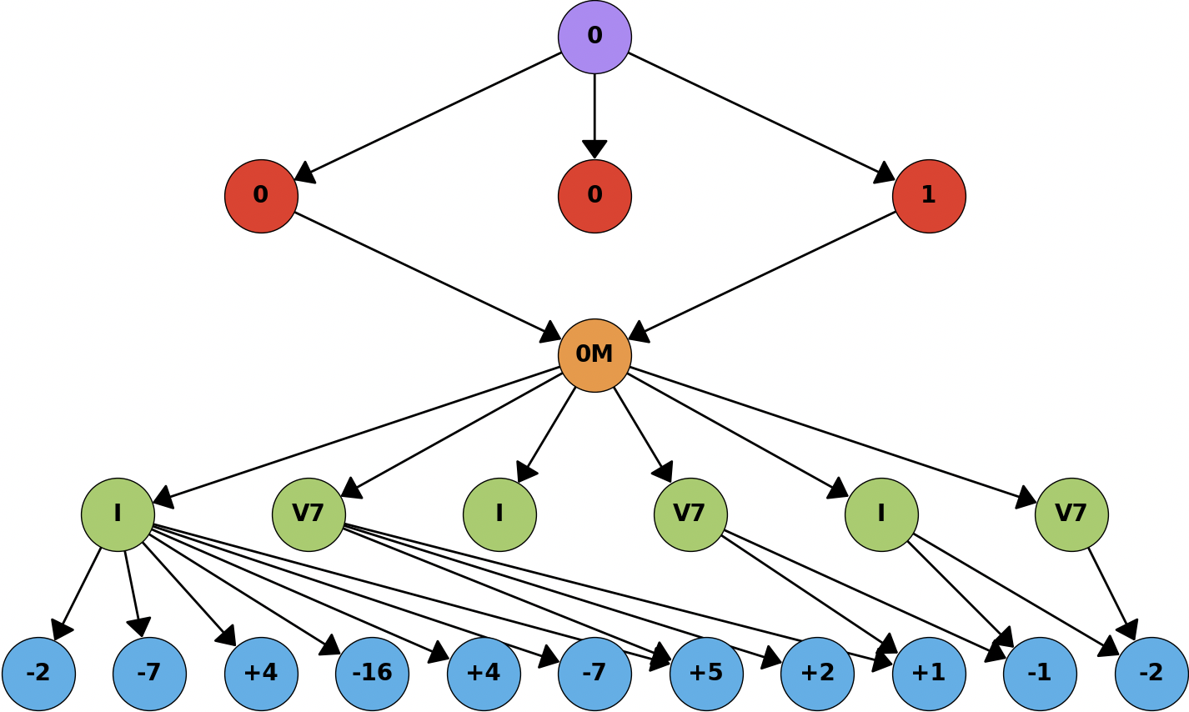
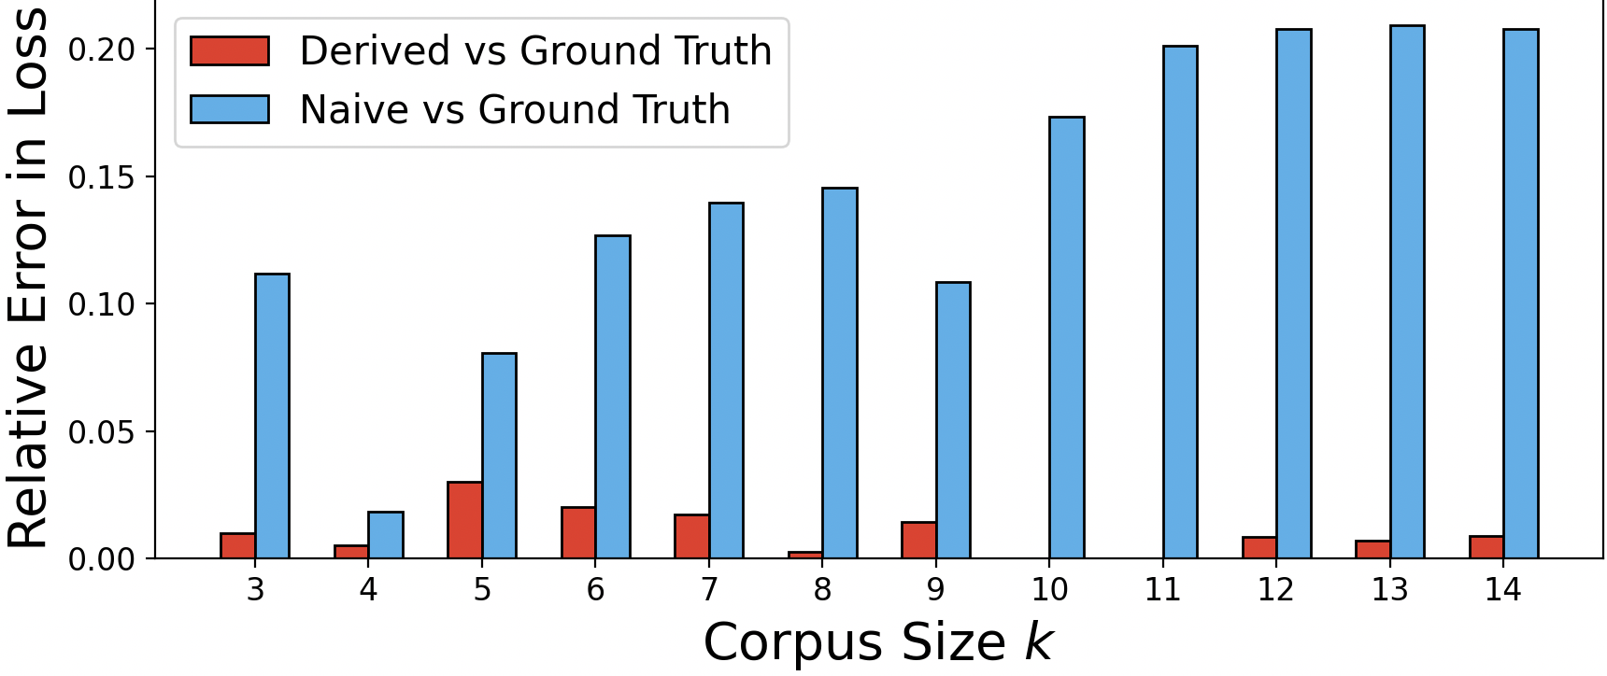
Synthesizing Composite Hierarchical Structure from Symbolic Music Corpora
Ilana Shapiro ¹, Ruanqianqian Huang ¹, Zachary Novack ¹, Cheng-i Wang ², Hao-Wen Dong ¹, Taylor Berg-Kirkpatrick ¹, Shlomo Dubnov ¹, Sorin Lerner ¹
¹ UC San Diego, Department of Computer Science and Engineering, La Jolla, CA, USA
²AudioShake, San Francisco, CA, USA
Motivation.
Contributions.
Music decomposes into a unified hierarchical system of interacting levels of structure
How do melodies relate to harmonies?
Such structure isn’t guaranteed in symbolic music generation (and other kinds of sequence data as well!)
Users have little ability to interact with such constraints
RQ: How can we synthesize interpretable structural constraints from corpora of symbolic music data?
We propose a graph data structure to encapsulate complete hierarchical, relational structure from symbolic music data.
We use this data structure to derive representative structure from corpora of symbolic music data using stochastic and SMT optimization techniques.
Overview of Method.
Step 1: STG Data Structure.
Step 1: Develop an interpretable structural representation of individual items (i.e. music pieces)
Step 2: Define a distance metric between these representations
Step 3: Construct the “centroid” (i.e. median) of the set of representations under this distance metric
Structural Temporal Graph (STG)
Step 2: Structural Distance.
k-partite directed acyclic graph
Unified meta-representation of complete music structure
Decomposes the data into a hierarchy of increasingly granular structural features (e.g. harmony labels) as nodes.
Ordered/temporal relationships between adjacent level nodes (features) are edges
Naively, distance between STGs is Graph Edit Distance (GED) -> but this is NP-Hard!
Idea: take NP-Hard part of GED (the optimal graph alignment problem) and offshore to simulated annealing, a stochastic optimization process
Once two STGs are near-optimally aligned, directly compute edit distance from their adjacency matrices
We call this resulting metric structural distance
Step 3: Finding the Centroid STG.
Step 3.1: Construct Approximate Centroid.
Step 3.2: Graph Repair with SMT.
Goal: construct centroid STG structurally summarizing an STG corpus (i.e. find the generalized median graph)
Two nested NP-Hard combinatorial optimization problems: structural distance, and minimization over these distances
Offshore each NP-Hard part to simulated annealing (SA): solve with nested SA over structural distances
But result may not be a valid STG
Encode the STG’s structure as rules in quantifier-free first-order logic formulae
Use the SMT solver Z3’s optimizer to project the approximate centroid graph onto the nearest structurally valid STG that satisfies all rules
i.e. search for the valid STG that’s as close as possible to the approximate centroid
Result: final, valid centroid STG
Start with base STG G
Generate 11 corpora of synthetic STGs, all equidistant from G (ground-truth centroid by construction)
Generate derived centroid for each corpus with our algorithm
Compare with naïve centroid (best STG already in corpus)
Derived centroids had less than 3% error from ground truth, 17.23x better than naïve
Summary of Results.
Conclusion
Derived centroid STGs fulfill their objective of minimizing structural distance over their respective corpora
Centroid approaches true generalized median STG
Confirms the centroid serves as representative structural constraints for its corpus
Relative error in loss: comparing derived vs ground-truth centroid to naive vs ground-truth centroid

