Slide 1
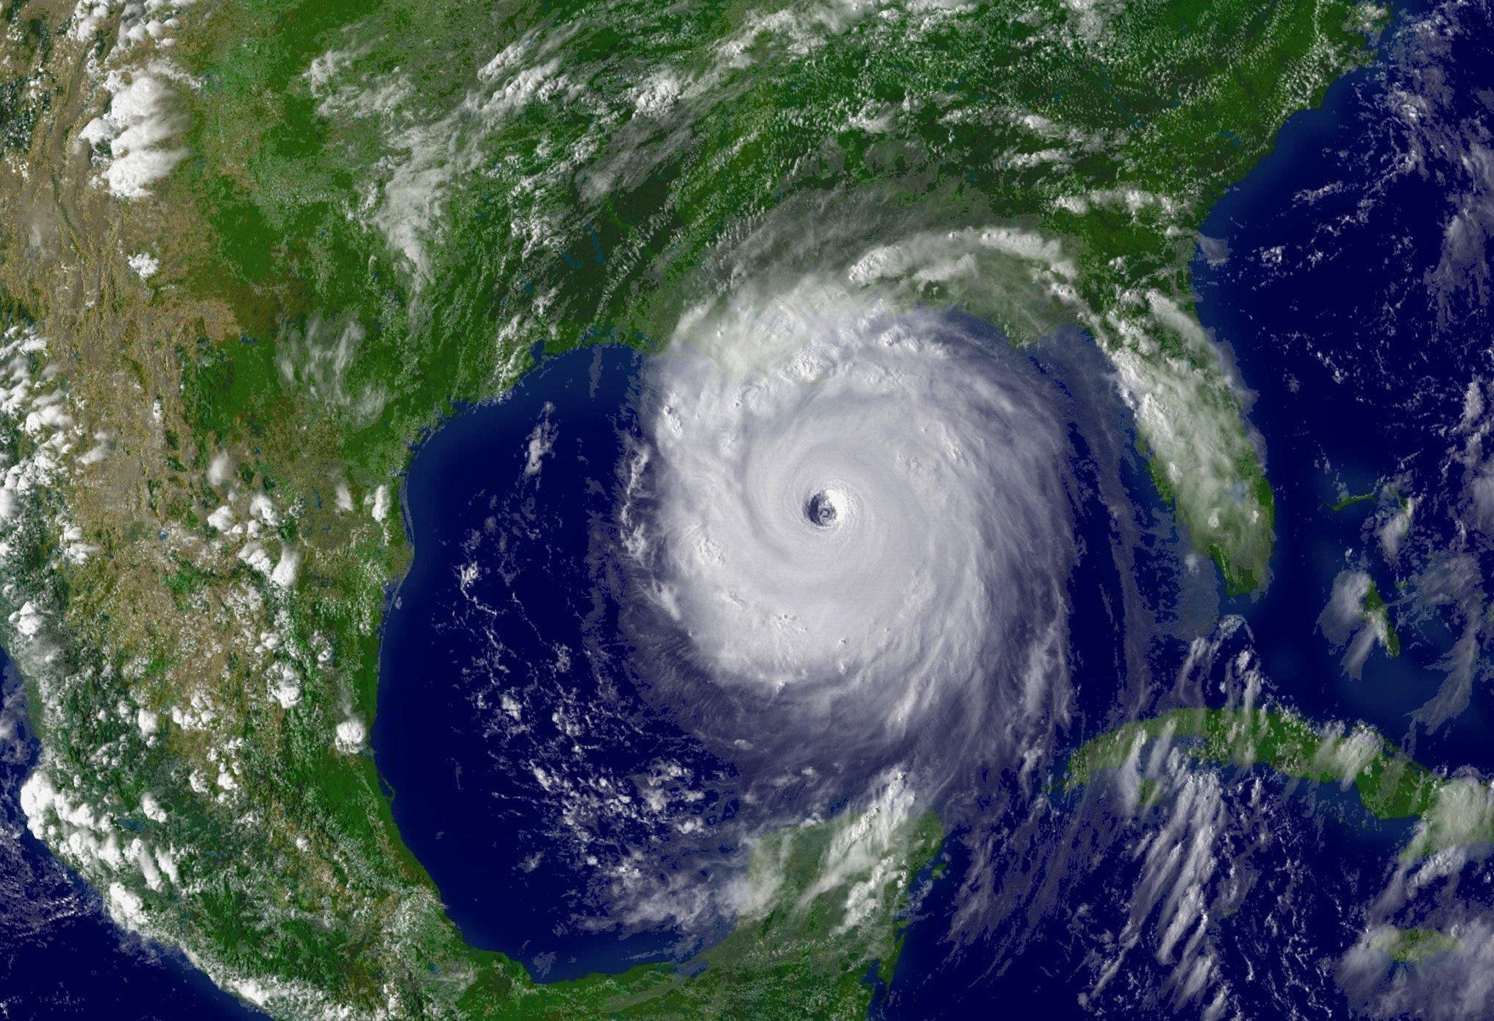
HURRICANES!
we love oceans. oceans are important. woo!
save the world.

Slide 2
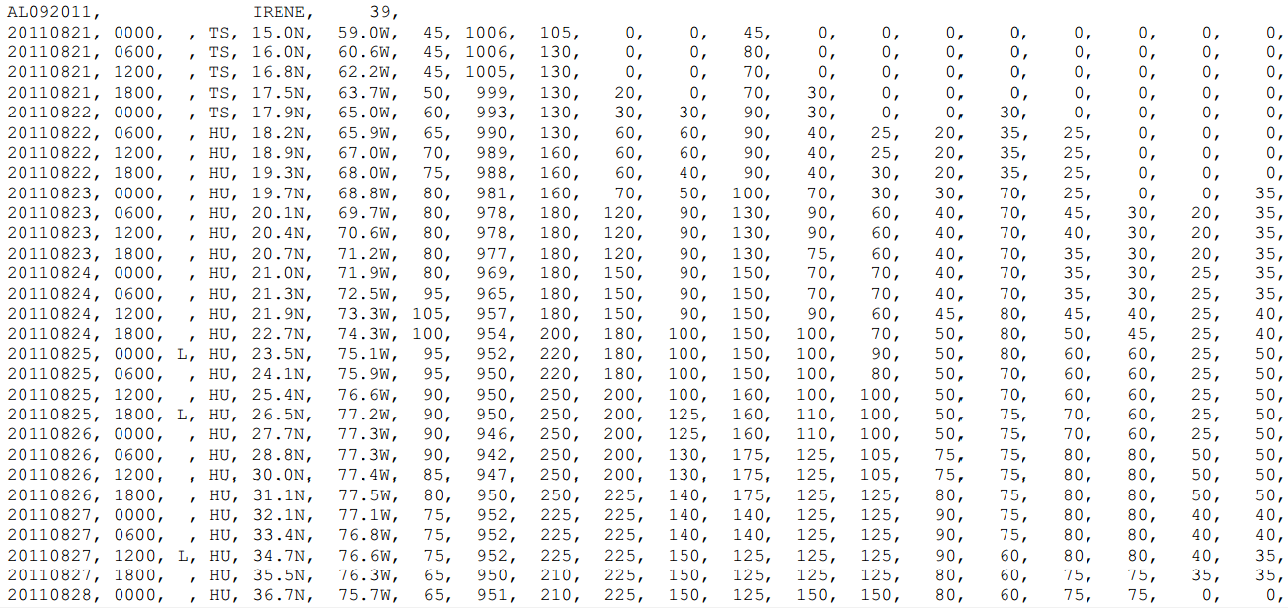
Dataset

Slide 3
Design
MAP
Filters

