Slide 1
Classification
by Ilanchezhian.J
https://github.com/ilanj

Slide 2
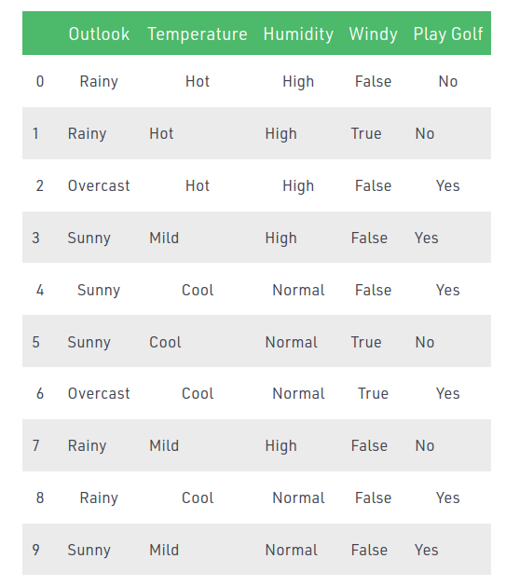
Naive Bayes

Slide 3
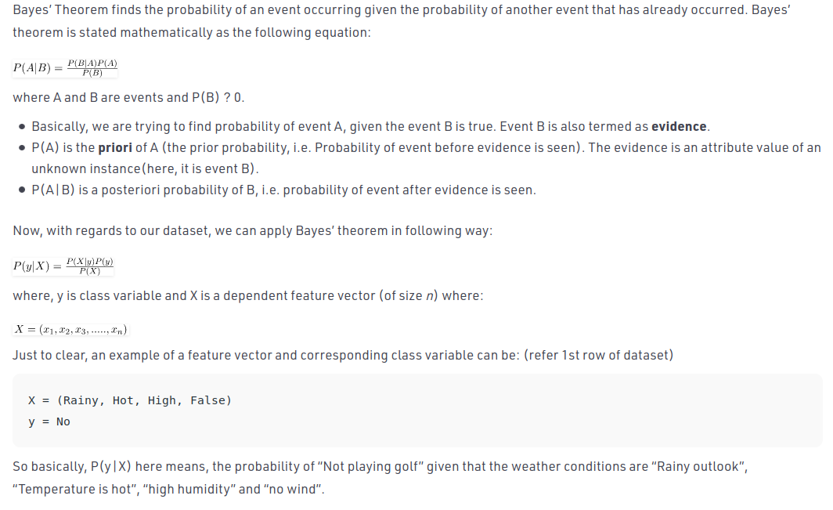
Bayes Theorem

Slide 4
Random Forest Classifier
As the name suggests, "Random Forest is a classifier that contains a number of decision trees on various subsets of the given dataset and takes the average to improve the predictive accuracy of that dataset." Instead of relying on one decision tree, the random forest takes the prediction from each tree and based on the majority votes of predictions, and it predicts the final output.
The greater number of trees in the forest leads to higher accuracy and prevents the problem of overfitting.

Slide 5
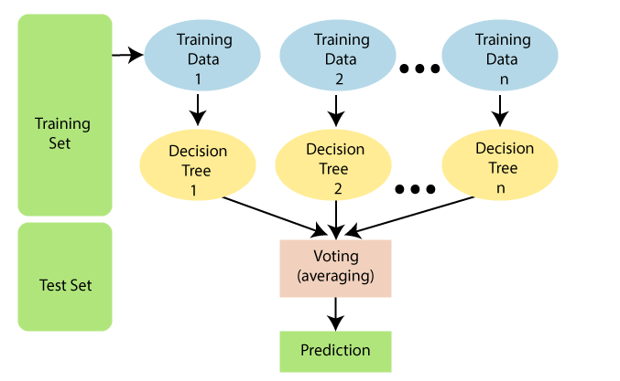
RF Classifier .. Cont..

Slide 6
KNN
Step-1: Select the number K of the neighbors
Step-2: Calculate the Euclidean distance of K number of neighbors
Step-3: Take the K nearest neighbors as per the calculated Euclidean distance.
Step-4: Among these k neighbors, count the number of the data points in each category.
Step-5: Assign the new data points to that category for which the number of the neighbor is maximum.
Step-6: Our model is ready.

Slide 7
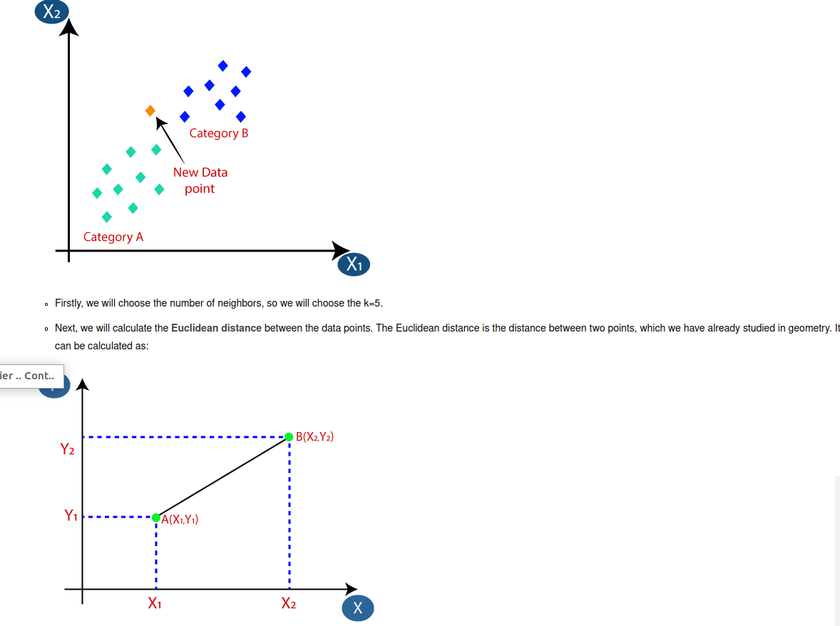

Slide 8
Decision Tree Algorithm
In a Decision tree, there are two nodes, which are the Decision Node and Leaf Node. Decision nodes are used to make any decision and have multiple branches, whereas Leaf nodes are the output of those decisions and do not contain any further branches.
The decisions or the test are performed on the basis of features of the given dataset.
It is a graphical representation for getting all the possible solutions to a problem/decision based on given conditions.

Slide 9
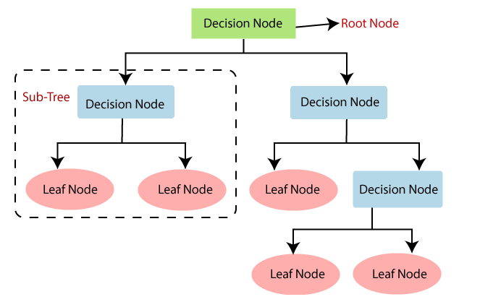

Slide 10
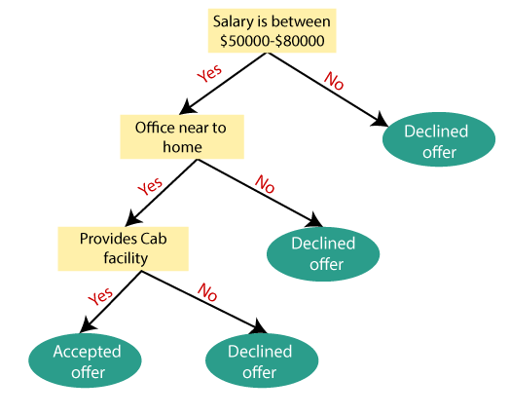

Slide 11
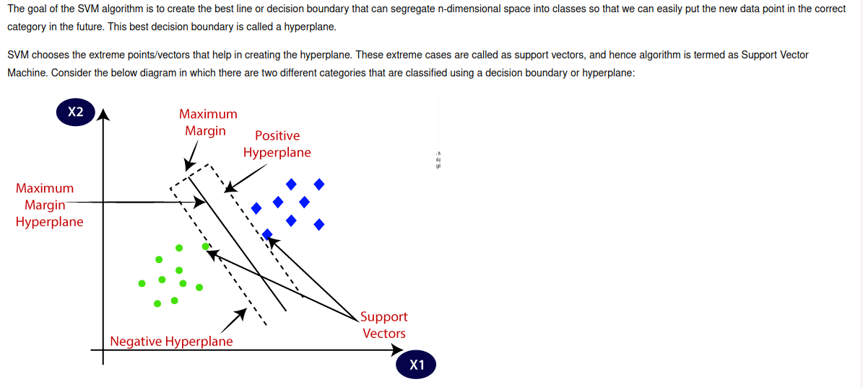
SVM

Slide 12
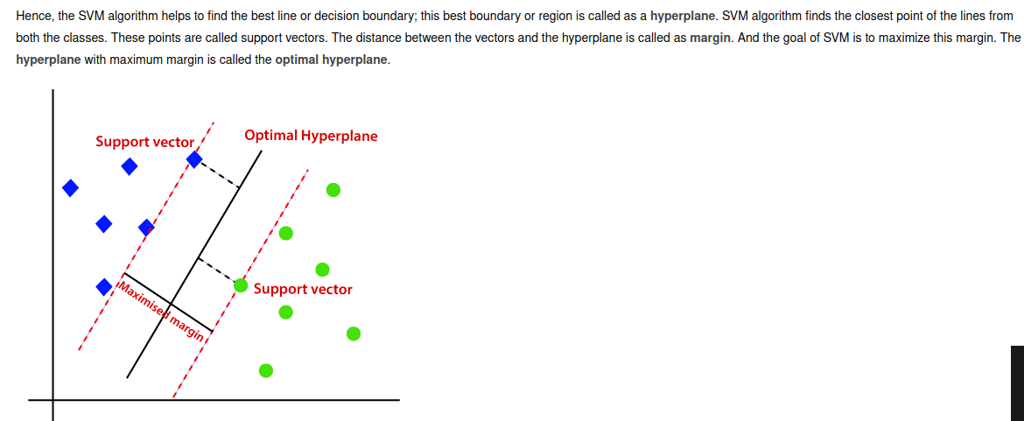
Linear SVM

Slide 13
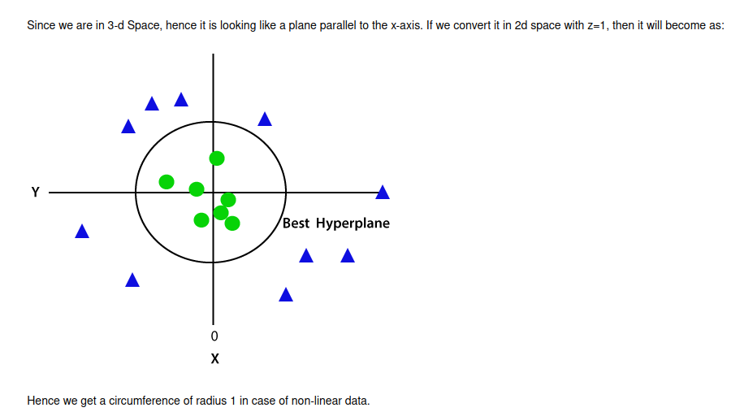
Non-Linear SVM

Slide 14
