Slide 1
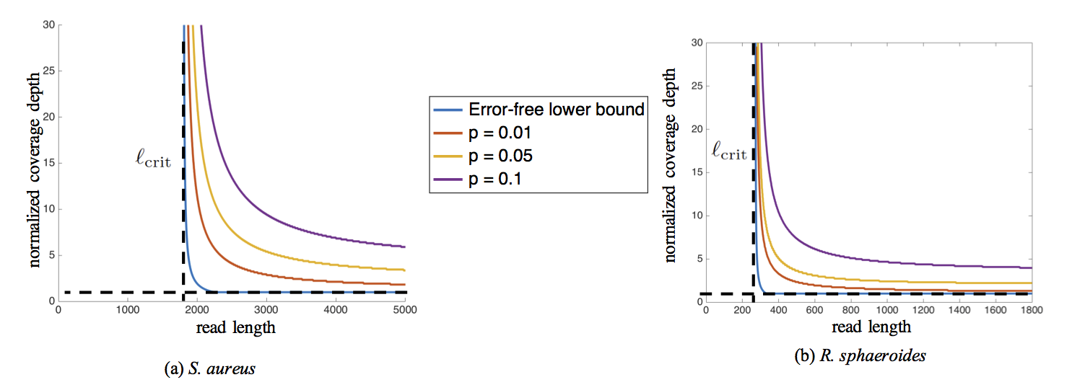

Slide 2
(a)
(b)

Slide 3
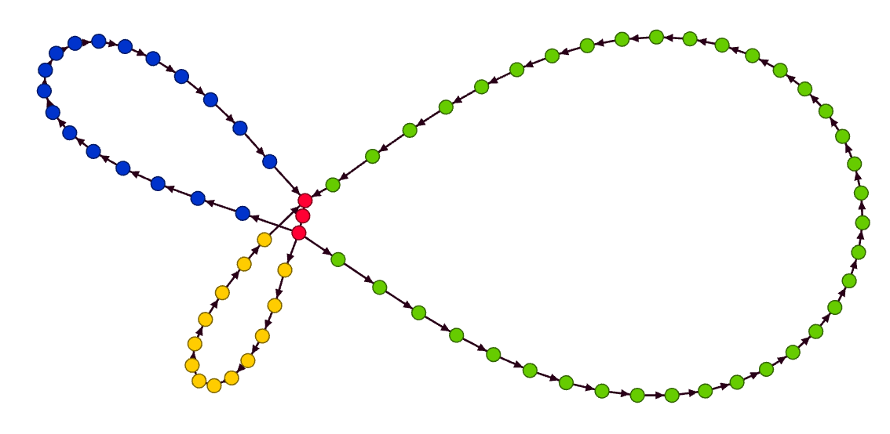



(a)
(b)
$$N/N_{LW}=2.5$$
$$N/N_{LW}=5$$
$$N/N_{LW}=10$$
Lower bound
(nats)

Slide 4
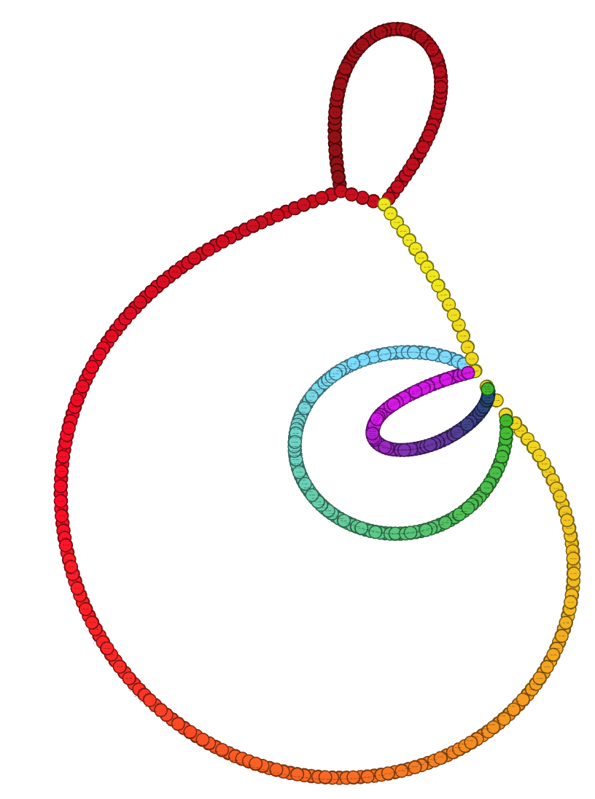
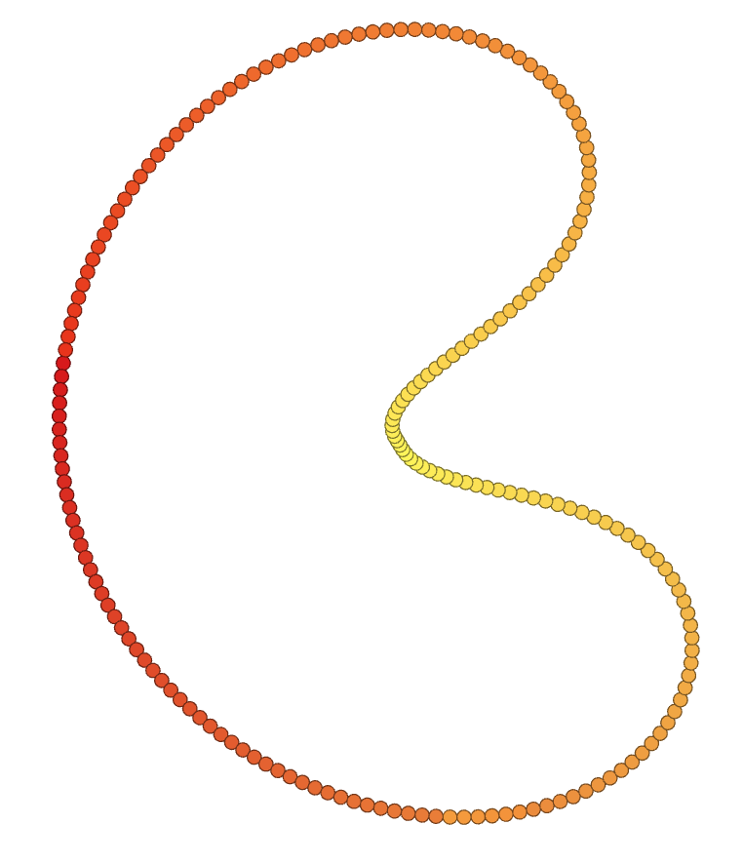

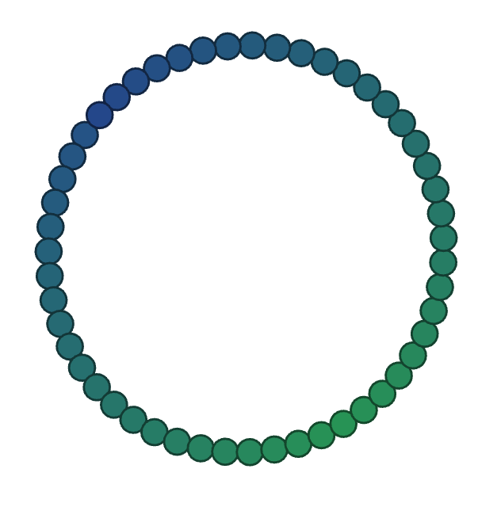
(a)
(b)
HGAP
HINGE
HINGE
3 Mbp
HGAP
1 Mbp
0.7 Mbp
K. pneumoniae

Slide 5
K. pneumoniae
(a)
(b)
unbridged repeat
bridged repeat
HINGE
u₂
u₁
u₁
v₁
v₂
z₁
u₂
v₁
v₂
v₁
u₁
z₁
u₁
v₁
u₂
v₂
v₂
u₂
3 Mbp
u₁
v₁
z₁
u₂
v₁
HGAP
1 Mbp
u₁
v₁
0.7 Mbp
u₂
v₂
u₂
v₂

Slide 6
K. pneumoniae
HINGE
HGAP
3 Mbp
1 Mbp
0.7 Mbp

Slide 7
K. pneumoniae

