Slide 1

Building an Infrastructure as a Service
on the Amazon Web Service Cloud

Slide 2
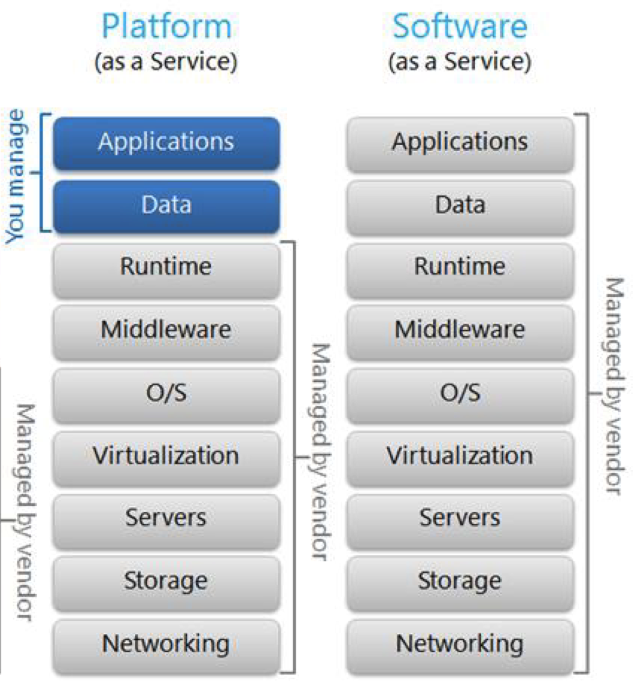
Infrastructure as a Service (IaaS)
Form of cloud computing
Delivers compute, network and storage resources to consumers on-demand
User manages:
Applications
Data
Runtime
Middleware
Vendor Manages:
O/S
Virtualization
Servers
Storage
Networking

Slide 3




The Cluster on AWS
EC2
EBS
Main node acts as NFS server
t2.micro 1 vCPU 1GiB RAM
2 worker nodes for executing jobs
t2.small 2 vCPU 2 GiB RAM
CentOS 8
US East (N. Virginia)
us-east-1b allowing private communication
30 GiB
MN
NFS
WN 1
WN 1
WN 2
WN 2

Slide 4

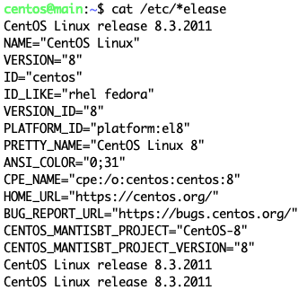
8
NB: ssh -i ~/.ssh/my_key.pem centos@<public_ip>

Slide 5

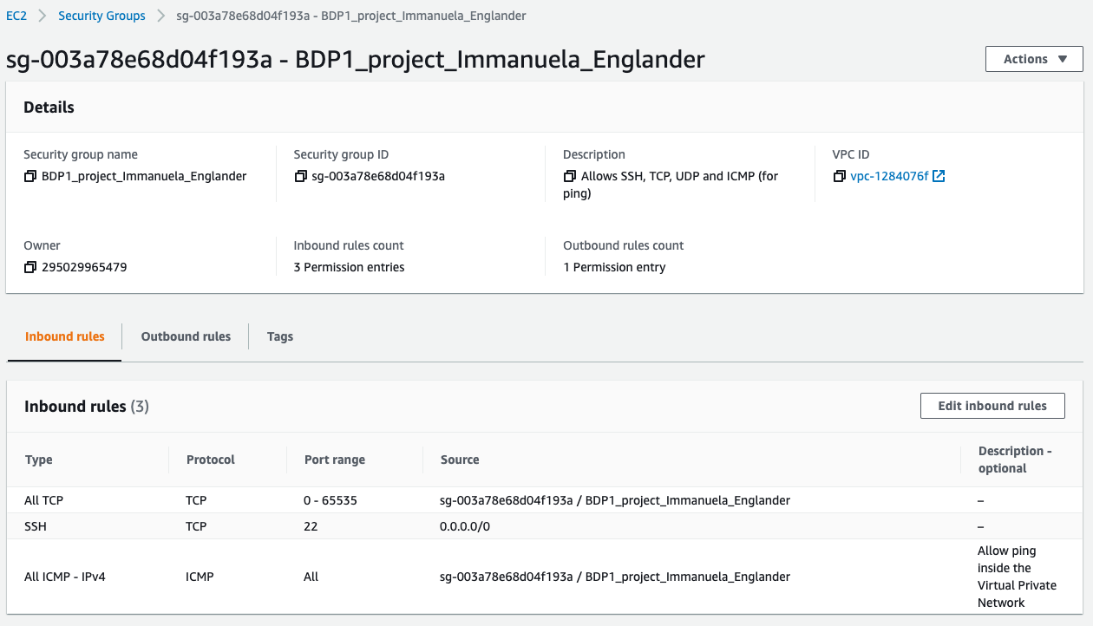
Configuring the Security Groups

Slide 6
Configuring the Security Groups
All Transmission Control Protocol (TCP) within same security group
Notes:
All Transfer Control Protocol → everything I send will arrive
Different from UDP → very fast but might lose data

Slide 7
Configuring the Security Groups
All Transmission Control Protocol (TCP) within same security group
All Secure Shell Protocol (SSH) from port 22
Provided the user has a key
Notes:
SSH from every where std p. 22

Slide 8
Configuring the Security Groups
All Transmission Control Protocol (TCP) within same security group: For NFS
All Secure Shell Protocol (SSH) from port 22
Provided the user has a key
All Internet Control Message Protocol (ICMP)
For ping and debugging

Slide 9

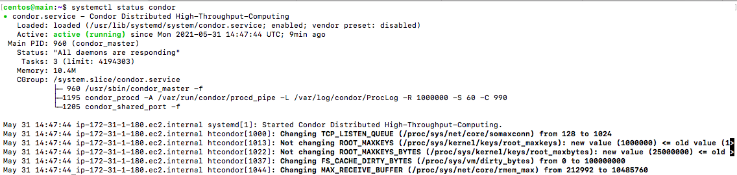
MN & WN: Setting up HTCodondor
Changed the prompt
Set up HTCondor and dependencies
High-throughput computing software
Correct functioning was verified:

Slide 10
MN & WN: Setting up HTCodondor
Modified global condor configuration files:
/etc/condor/condor_config
Main node config:
Worker node config:
# Main Node IP CONDOR_HOST = <Main_Node_private_IP> # Main Node config DAEMON_LIST = COLLECTOR, MASTER, NEGOTIATOR, SCHEDD HOSTALLOW_READ = * HOSTALLOW_WRITE = * HOSTALLOW_ADMINISTRATOR = *
# Main Node IP
CONDOR_HOST = <Main_Node_private_IP>
# Worker Node config
DAEMON_LIST = MASTER, STARTD
HOSTALLOW_READ = *
HOSTALLOW_WRITE = *
HOSTALLOW_ADMINISTRATOR = *

Slide 11
Main Node: Creating DAS
EBS
Attaching a new volume: Elastic Block Storage (EBS)
EC2 console: Volumes > Create Volume: 30 GiB, same availability zone us-east-1b
Actions > Attach Volume
Added volume via the terminal to the partition list:
fdisk /dev/<my_new_volume>
Formatted new partition as ext4 FS: mkfs.ext4 /dev/<my_partition>
Created a new directory /data; set as mount point for new volume on boot by adding the following line to /etc/fstab file:
/dev/<newly_formatted_partition> /data ext4 defaults 00
30 GiB
MN
NFS

Slide 12
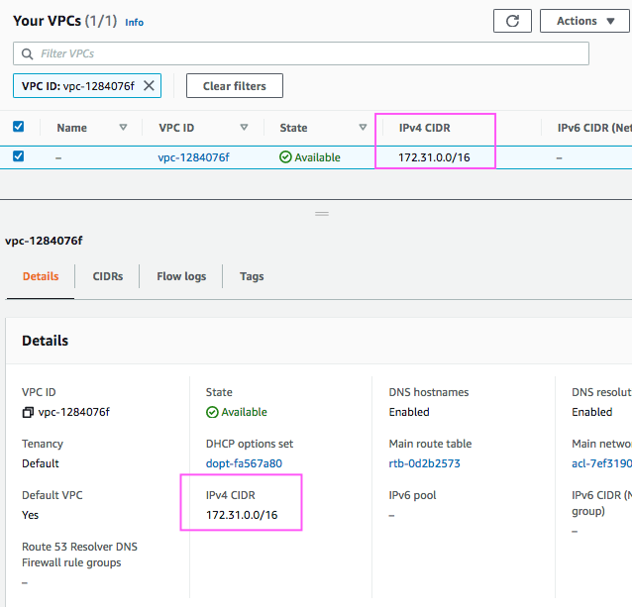
Main Node: Installing Network File System
NFS is a protocol to access remote FS
Allows main node to expose FS to worker nodes
Configuring the /etc/exports to expose /data to all nodes within the same VPC
/data 172.31.0.0/16(rw,sync,no_wdelay)

Slide 13

Worker Node Configuration
Installed NFS
Configuring the /etc/fstab to mount /data upon boot:
<private_IP_of_MAIN_node>:/data /data nfs defaults 0 0
Installed libsvm - a library for Support Vector Machines (SVM)
Notes:
Set up NFS /ect/fstab → mount /data check
libsvm

Slide 14
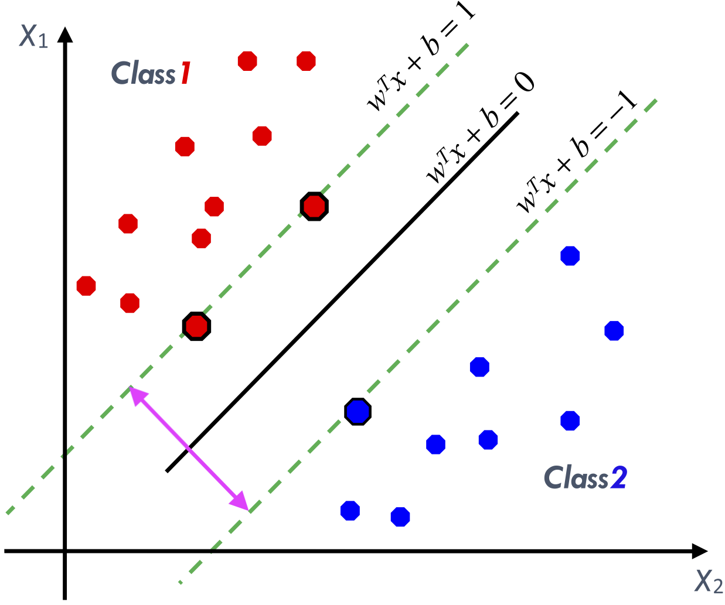
libsvm SVM Library by Chang & Lin
Support Vector Machine (SVM) learning approach for classification
Training model for prediction of protein secondary structure from primary sequence
Two programs:
svm-train
svm-predict
Image: modified from Gholami, R. & Fakhari, N. en. in Handbook of Neural Computation (eds Samui, P., Sekhar, S. & Balas, V. E.) 515–535 (Academic Press, Jan. 2017). isbn: 978-0-12-811318-9

Slide 15
What’s the Goal?
Considered only 3 super-classes of protein secondary structure (H,E,C)
Input: Labeled protein primary sequences
Output: Model capable of generalizing to unseen data.
Model predicts secondary structure from primary sequence
Image: modified from Gholami, R. & Fakhari, N. en. in Handbook of Neural Computation (eds Samui, P., Sekhar, S. & Balas, V. E.) 515–535 (Academic Press, Jan. 2017). isbn: 978-0-12-811318-9

Slide 16
Why this use-case?
Need to find optimal values for the hyperparameters: C and ɣ
C hypermeter in SVM to control error - low C = low error
Gamma decides that how much curvature we want in a decision boundary.
This takes a long time
libsvm does not support multiple threads
Gridsearch: run svm-train
for several different values of C and ɣ
Optimized hyper parameters give best model
Image: modified from Gholami, R. & Fakhari, N. en. in Handbook of Neural Computation (eds Samui, P., Sekhar, S. & Balas, V. E.) 515–535 (Academic Press, Jan. 2017). isbn: 978-0-12-811318-9
Notes:
SKIP too long

Slide 17
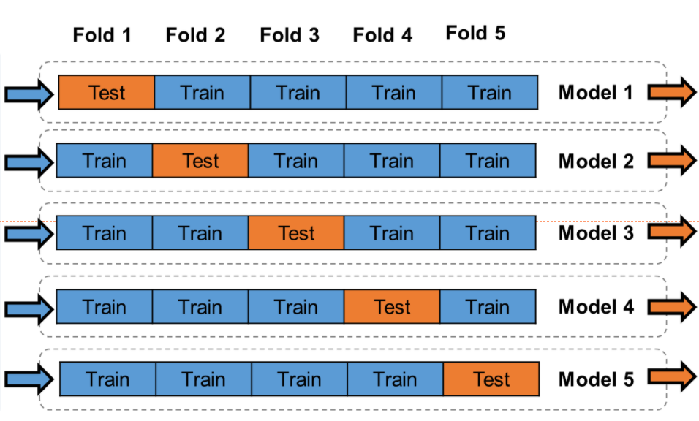
Non-Trivial Application
Grid search: 10 combinations of C and ɣ
Do a 5-fold cross validation for each of these value pairs:
C 1 , ɣ1
Evaluate

Slide 18
Non-Trivial Application
Grid search: 10 combinations of C and ɣ
Do a 5-fold cross validation for each of these value pairs:
C 2 , ɣ2
Evaluate

Slide 19
Non-Trivial Application
Grid search: 10 combinations of C and ɣ
Do a 5-fold cross validation for each of these value pairs:
10 x 5 = 50 job instances
C 10 , ɣ10
Evaluate

Slide 20
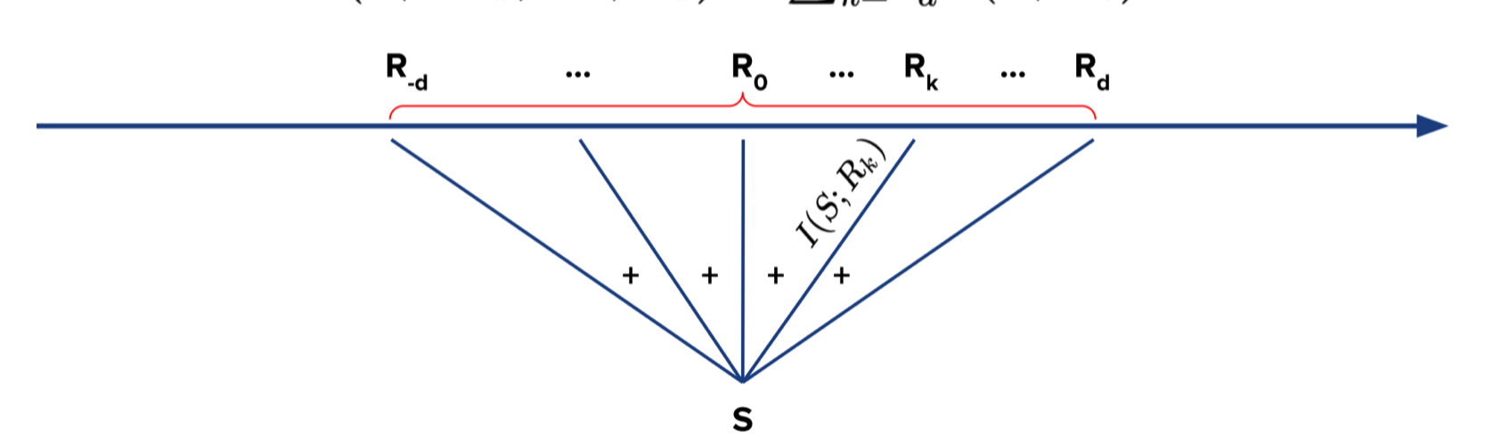
Test jobs
Input file numerical vector of 340 features (sequence profile window 17 x 20, d=8)
Notes:
SKIP too long

Slide 21
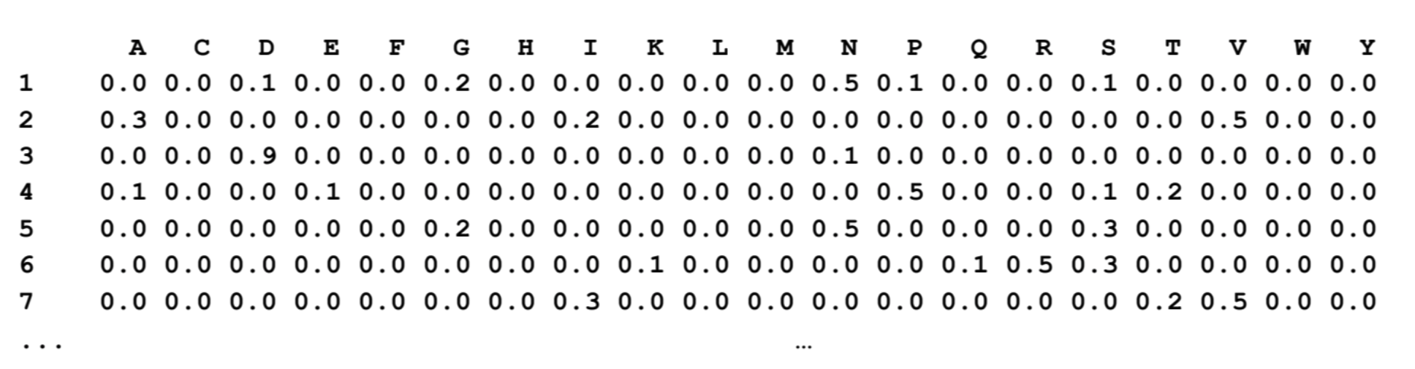
Test jobs
Input file numerical vector of 340 features (sequence profile window 17 x 20, d=8)
Each is assigned to a class H → 1 ; E → 2; C → 3
-8
-7
-6
-5
-4
-3
-2
-1
0
1
2
3
4
5
6
7
8
Notes:
SKIP too long

Slide 22
Test jobs
Input file numerical vector of 340 features
Each is assigned to a class H → 1 ; E → 2; C → 3
-8
-7
-6
-5
-4
-3
-2
-1
0
1
2
3
4
5
6
7
8
sequence profile window 17 x 20, d=8
Notes:
SKIP too long

Slide 23
Test jobs
Input file for training:
5 files of increasing sizes
centos@main:~/BDP-projcect-aws-main/in_train_tiny$ ll -h *.svm
-rw-rw-r--. 1 centos centos 5.1M Jun 16 16:44 train0.svm
-rw-rw-r--. 1 centos centos 11M Jun 16 16:47 train1.svm
-rw-rw-r--. 1 centos centos 16M Jun 16 16:50 train2.svm
-rw-rw-r--. 1 centos centos 21M Jun 16 16:52 train3.svm
-rw-rw-r--. 1 centos centos 26M Jun 16 16:53 train4.svm
-rw-rw-r--. 1 centos centos 31M Jun 16 16:54 train5.svm
Notes:
5 - M to 31 M

Slide 24
Running Test Jobs on Cluster via HTCondor
####################################################
Executable = svm_test_predict_exec.sh
####################################################
# Allocating resources
####################################################
request_memory = 1024
request_cpus = 1
############ Input Sandbox ###########################################################################
Input = /home/centos/BDP-projcect-aws-main/in_train_tiny/train$(Process).svm
transfer_input_files = /home/centos/BDP-projcect-aws-main/in_train_tiny/test_data.svm
Arguments = "train$(Process).svm /data/svm_outputs/train/train$(Process).model test_data.svm prediction$(Process).out"
###### Output Sandbox #################################################################################
Log = condor_out/train$(Process).log
Output = condor_out/train$(Process).out
Error = condor_out/train$(Process).error
transfer_output_remaps = "prediction$(Process).out=out_predict_tiny/prediction$(Process).out" # not in same dir as log, out, err
should_transfer_files = YES
when_to_transfer_output = ON_EXIT
Universe = vanilla
Queue 6
Notes:
Transferring more than 1 input file per job instance → transfer_input_files

Slide 25
Running Test Jobs the Executable
#!/usr/bin/bash
#################################################
# Run svm-train then svm-predict
#################################################
#################################################
# 1 arg: <path_to_input_parameter>/train0.svm
# 2 arg: <path_to_output_parameter>/svm_outputs/train/train0.model
# 2 arg: serves also as input to svm-predict
# 3 arg: <path_to_input_parameter>/in_predict_tiny/test0.svm
# 4 arg: <path_to_output_parameter>/svm_outputs/predict/prediction0.out
#################################################
# Measure time of each jobinstance
SECONDS=0
svm-train -c 2 -g 0.5 -m 1024 $1 $2 && \
svm-predict $3 $2 $4
echo "Duration" $SECONDS

Slide 26
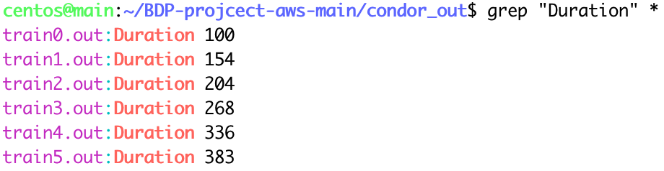
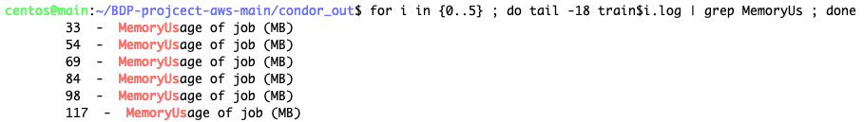
Jobs Measurement

Slide 27

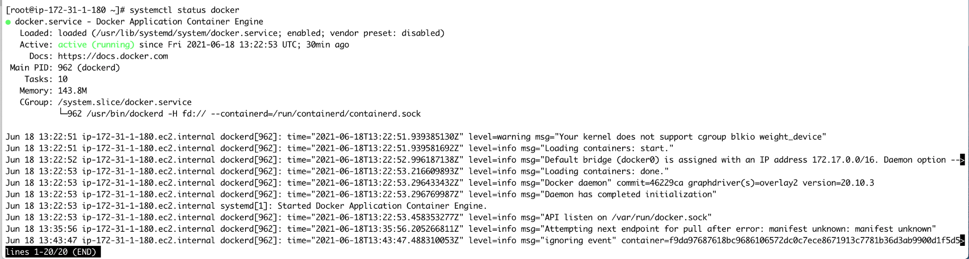
Setting up Docker on the Cluster

Slide 28
Setting up HTCondor to use Docker
Modified condor configuration file /etc/condor/condor_config
Bind mounting /data
Worker node config:
##--------------------------------------------------------------------
## Docker Volume Config
##--------------------------------------------------------------------
# Defining only one docker volume
DOCKER_VOLUMES = SHARED_DATA
# Assigning the /data directory to docker volume
DOCKER_VOLUME_DIR_SHARED_DATA = /data
# Mount SHARED_DATA volume in all containers handled by HTcondor
DOCKER_MOUNT_VOLUMES = SHARED_DATA
[root@ip~]# condor_status -l | grep -i docker

Slide 29
Creating Docker Image on Local Machine
Docker file:
FROM centos:8
RUN yum install -y epel-release
RUN yum install -y libsvm
i$ docker build -t ilante/centos8_libsvm:1.0.0
i$ docker push ilante/centos8_libsvm:1.0.0
The push refers to repository [docker.io/ilante/centos8_libsvm]
d86f07b0b8d9: Pushed
6a016089002c: Pushed
2653d992f4ef: Pushed
1.0.0: digest: sha256:c92ae898ac81f930e60f095e9c258d9f86388517b3f2c76701db16d28d2fc107 size: 953
https://hub.docker.com/repository/docker/ilante/centos8_libsvm/

Slide 30
Running Test Jobs on Cluster via HTCondor
Executable = svm_test_predict_exec.sh
docker_image = ilante/centos8_libsvm:1.0.0
request_memory = 1024
request_cpus = 1
Input = /home/centos/BDP-projcect-aws-main/in_train_tiny/train$(Process).svm
transfer_input_files = /home/centos/BDP-projcect-aws-main/in_train_tiny/test_data.svm
Arguments = "train$(Process).svm /data/svm_outputs/train/train_docker$(Process).model test_data.svm prediction$(Process).out"
Log = condor_out_docker/train$(Process).log
Output = condor_out_docker/train$(Process).out
Error = condor_out_docker/train$(Process).error
transfer_output_remaps = "prediction$(Process).out=out_predict_tiny/prediction$(Process).out"
should_transfer_files = YES
when_to_transfer_output = ON_EXIT
Universe = docker
Queue 6
Notes:
Transferring more than 1 input file per job instance → transfer_input_files

Slide 31
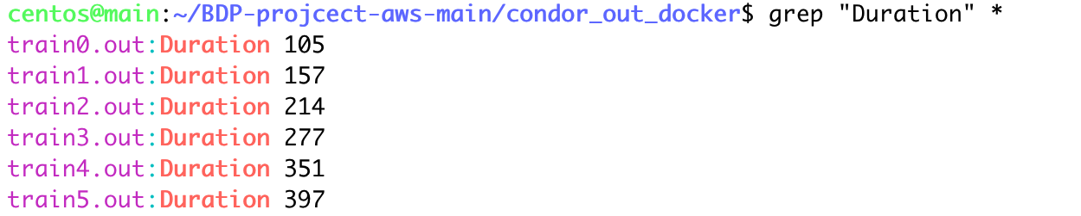
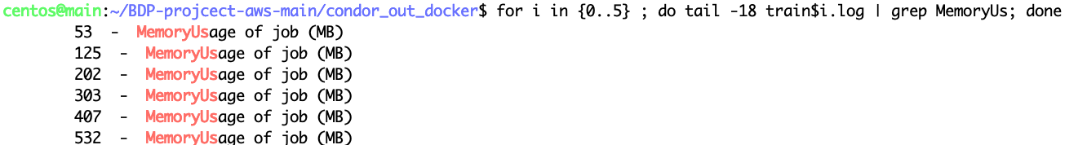
Docker Jobs Measurement

Slide 32
Native Docker
Docker adds another layer of abstraction to the VM in the cluster
Dockerized jobs ran slower
Time is money

Slide 33
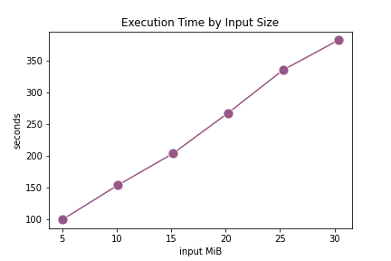
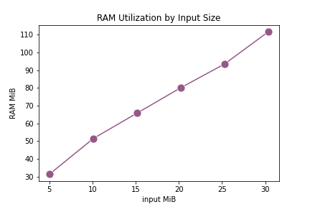
libsvm Scales Linearly with Respect to Input Size
EC2

Slide 34
Cluster for non-Trivial Application
EC2
Grid search: 10 combinations of C and ɣ
Do a 5-fold cross validation for each of these value pairs
Train 50 models
2 models per WN
WN 1
WN 5
WN 10
WN 15
MN
NFS
EBS
WN 20
30 GiB
WN 25

Slide 35
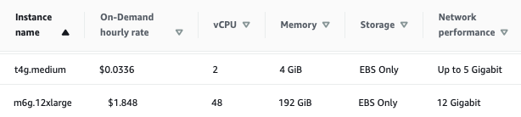
Non-Trivial Application
EC2
26 nodes of type: t4g_medium
Why so many?
If only a few jobs fail
Autoscaler shuts down idle instances
Pay only the ones that need to re-run
MN
NFS
EBS

Slide 36
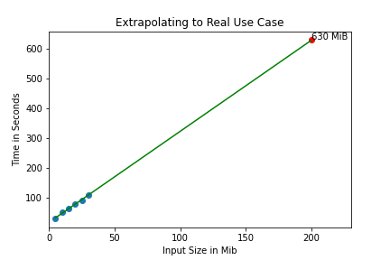
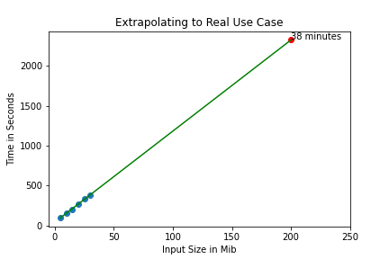
Extrapolating to Input Size 200 MiB
EC2

Slide 37
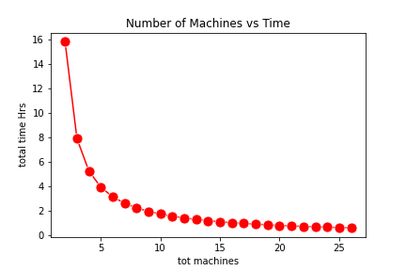
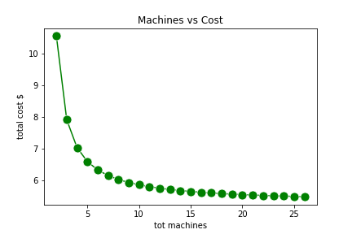
Non-Trivial Application
EC2
26 nodes of type: t4g_medium
2 vCPU 4 GiB RAM
Cost $ 0.0336 / hr

Slide 38
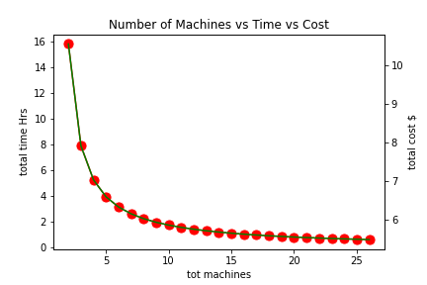
Non-Trivial Application
EC2
Price plateaus from about 20 nodes
Ranges between $ 5.534 and $ 5.492

Slide 39
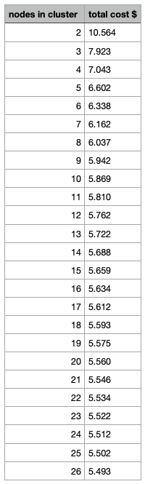
Non-Trivial Application
EC2
Price plateaus from about 20 nodes
Rangs between $ 5.534 and $ 5.492
Notes:
Might use Docker if I had time to implement the multithreaded version

Slide 40
References
Chang, C.-C. & Lin, C.-J. LIBSVM: A library for support vector machines. ACM Transactions on Intelligent Systems and Technology 2, 27:1–27:27 (2011).
Gholami, R. & Fakhari, N. en. in Handbook of Neural Computation (eds Samui, P., Sekhar, S. & Balas, V. E.) 515–535 (Academic Press, Jan. 2017). isbn: 978-0-12-811318-9. http://www.sciencedirect.com/ science/article/pii/B9780128113189000272 (2021).
Cerf, V. & Kahn, R. A Protocol for Packet Network Intercommunication. IEEE Transactions on Commu- nications 22. Conference Name: IEEE Transactions on Communications, 637–648. issn: 1558-0857 (May 1974).
Thain, D., Tannenbaum, T. & Livny, M. Distributed computing in practice: the Condor experience. Concurrency - Practice and Experience 17, 323–356 (2005).
Merkel, D. Docker: lightweight linux containers for consistent development and deployment. Linux journal 2014, 2 (2014).
Docker Hub https://hub.docker.com/ (2021).
11
7. Cortes, C. & Vapnik, V. Support-vector networks. en. Machine Learning 20, 273–297. issn: 1573-0565. https://doi.org/10.1007/BF00994018 (2021) (Sept. 1995).
8. Bottou, L., Chapelle, O., DeCoste, D. & Weston, J. Support Vector Machine Solvers in (2007).
9. Drozdetskiy, A., Cole, C., Procter, J. & Barton, G. J. JPred4: a protein secondary structure prediction server. Nucleic Acids Research 43, W389–W394. issn: 0305-1048. https://doi.org/10.1093/nar/gkv332
(2020) (July 2015).
10. EC2 On-Demand Instance Pricing – Amazon Web Services https://aws.amazon.com/ec2/pricing/on- demand/ (2021).

