Slide 1



Slide 1
MARCH DATA CRUNCH MADNESS
2019 CHAMPION PREDICTION
Team Wonder Women
Ao Li
Katie Cao
Ila Srivastava
Sravya Katta

Slide 2




Slide 9
MODEL PROCESS OUTLINE
ANALYSIS
FINAL FOUR
FEATURE TRANSFORMATION
FEATURE SELECTION
DATA PREPROCESSING
MODEL BUILDING
2

Slide 3
FEATURE TRANSFORMATION
Contrast the variable differences between 2 teams in each game, instead of analyzing each individual team
Transform all the features of 2 teams
in each game into Difference and Quotient
Difference = Team 1 Feature n - Team 2 Feature n
Quotient =
Team 1 Feature n
Team 2 Feature n
Ignore the similar features of each team such as Team1_blockpct, Team2_blockpct, etc. because those are immaterial in a single game
3

Slide 4
Slide 5
DATA PREPROCESSING
1
2
3
4
SHUFFLE
THE DATA
CREATE
NEW VARIABLES
REPLACE VALUE
‘0’ WITH ‘0.1’
FILL UP
MISSING VALUES
Shuffle the data so that Team 1 is not the winner as per ‘outcome’ every time to generate prediction accuracy for the model
Created ‘distance’ variables as a calculation of Team1 and Team2 latitude and longitude.
Replace all 0 with 0.1 so that we can later divide two variables without missing values during feature engineering
For ‘ap_preseason’, ‘ap_final’, ‘coaches_preseason’, ‘coaches_before_final’ variables, we filled up all missing values with 45
4

Slide 5
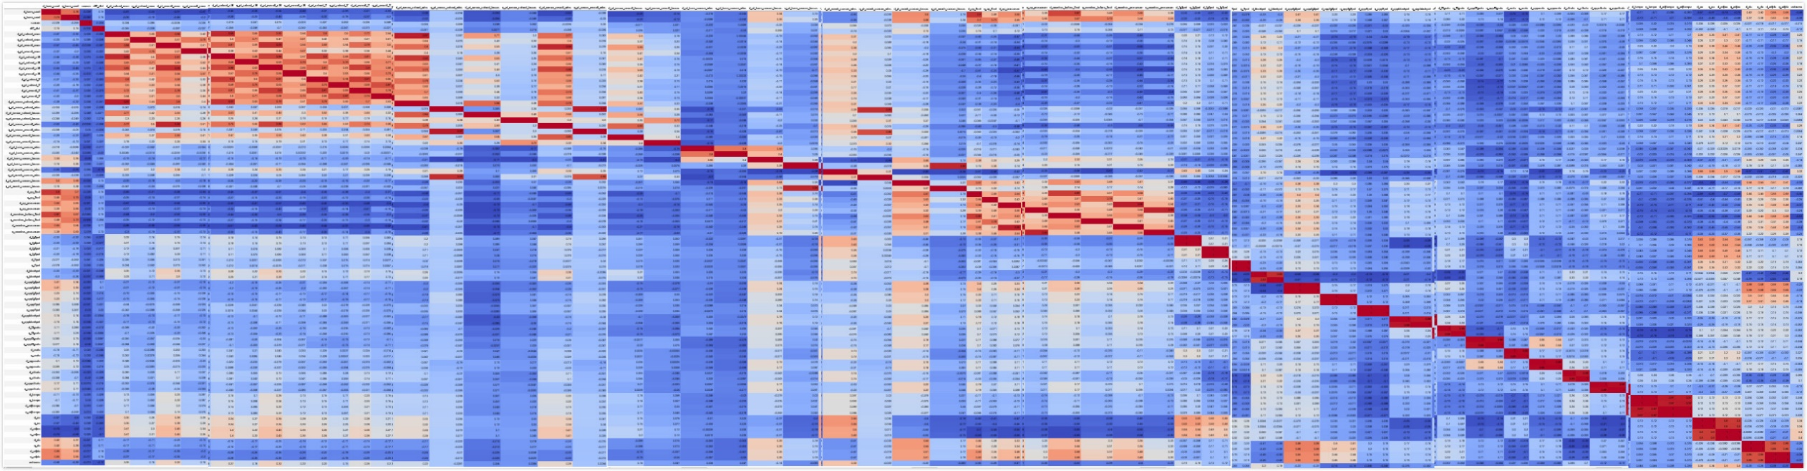
FEATURE SELECTION
1
Generate Correlation Matrix
If correlation coefficient is > 0.9 or < -0.9 between 2 variables, keep only one feature among them
This is done to avoid multicollinearity
5

Slide 6
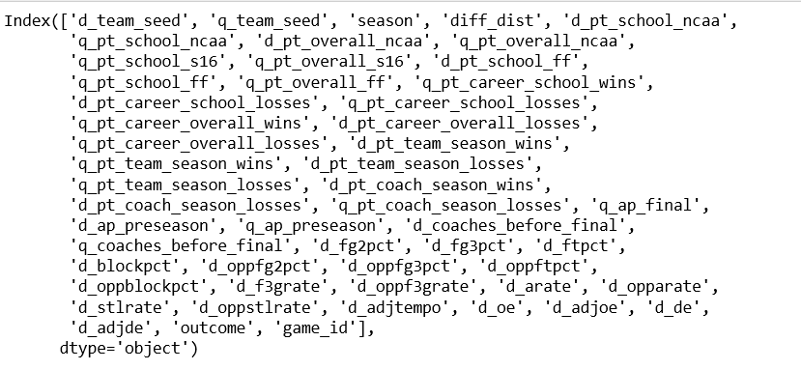
FEATURE SELECTION
After deleting variables with correlation higher than 0.9, the remaining features are as follows
6

Slide 7
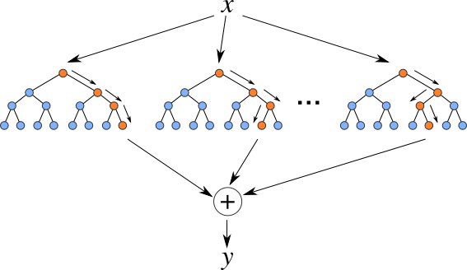
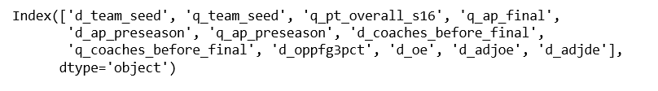
2
Use Random Forest Classifier to perform feature selection
12 variables are selected based on their variable importance
7

Slide 8
SELECTED FEATURES
d_team_seed: Team seed in the tournament. There are 4 brackets of teams seeded 1 through 16 [difference]
q_team_seed: Team seed in the tournament. There are 4 brackets of teams seeded 1 through 16 [quotient]
q_pt_overall_s16: Career overall number of NCAA Sweet Sixteen appearances 16 [quotient]
q_ap_final: The final AP Poll ranking of each team (top 25 only) 16 [quotient]
d_ap_preseason: The preseason AP Poll ranking of each team (top 25 only) [difference]
q_ap_preseason: The preseason AP Poll ranking of each team (top 25 only) 16 [quotient]
d_coaches_before_final: The most recent Coaches Poll rankings before the final [difference]
q_coaches_before_final: The most recent Coaches Poll rankings before the final 16 [quotient]
d_oppfg3pct: Opponent’s shooting percentage on 3 point field goals [difference]
d_oe: Points scored per 100 offensive possessions [difference]
d_adjoe: An estimate of the offensive efficiency (points scored per 100 possessions) a team would have against the average D-I defense [difference]
d_adjde: An estimate of the defensive efficiency (points allowed per 100 possessions) a team would have against the average D-I offense [difference]
8

Slide 9
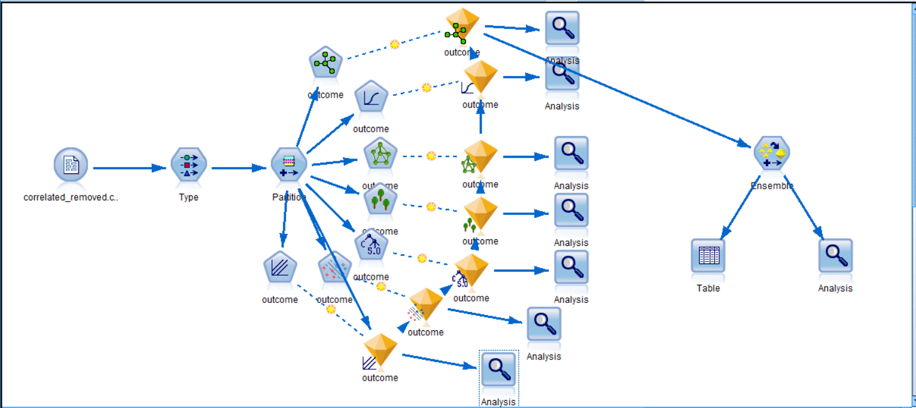
ANALYSIS
Logistic Regression
Random Forest
Ensemble: combining all analyses + machine learning methods
Results
SVM
XGBoost
Neural Network
9

Slide 10
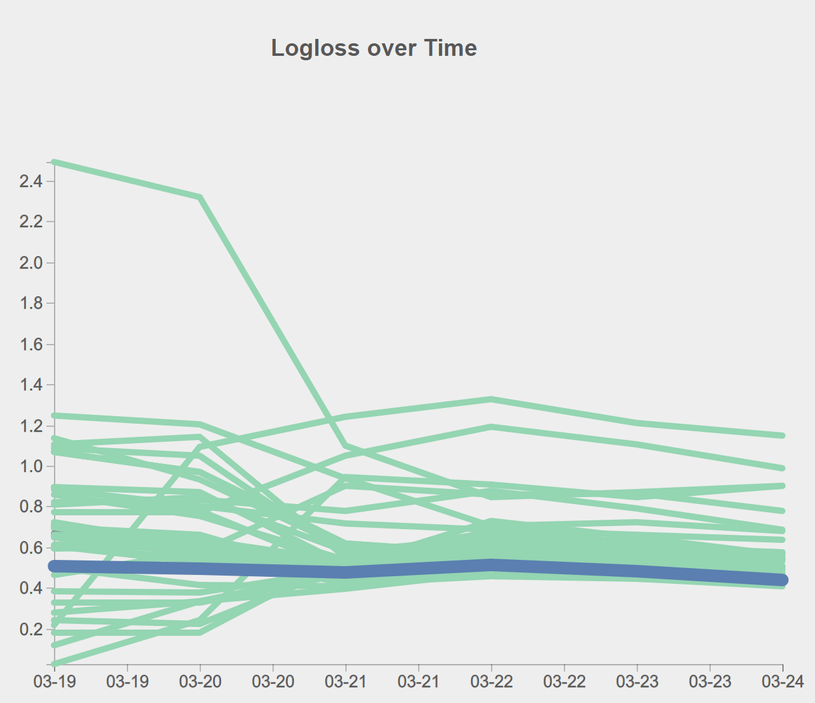
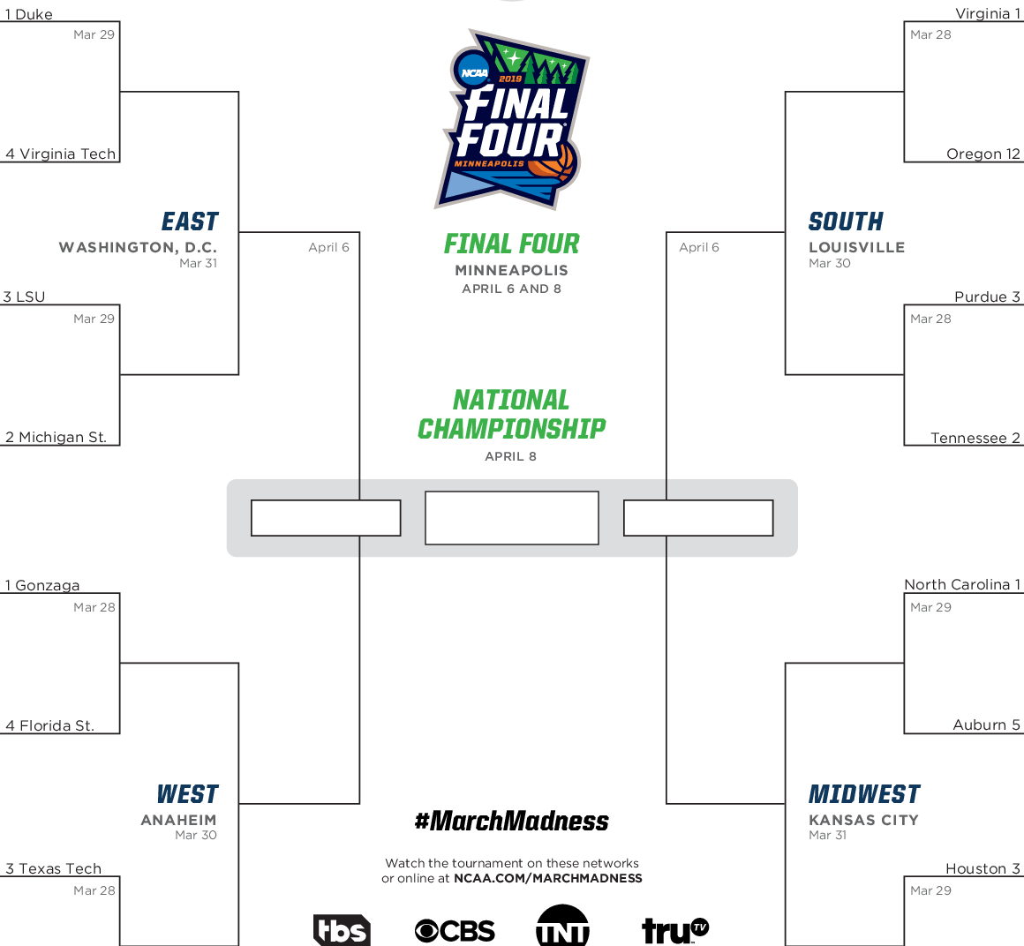
Slide 11
Final Four
Duke
Virginia
Gonzaga
Gonzaga
Virginia
Wonder Women
Summary
North Carolina
Gonzaga
0.44
Current Log Loss
Accuracy
72.22%
10

