Slide 1

Exploring The Cost Effectiveness Of The United States Medicare Program
Spring 2019 - BIG DATA ANALYTICS (BYGB-7990-003) Professor Yilu Zhou, Ph.D.
Group 15: Ila Srivastava, Katie Linh Cao
Lakshmi Sravya Katta, Tudor Tarina

Slide 2

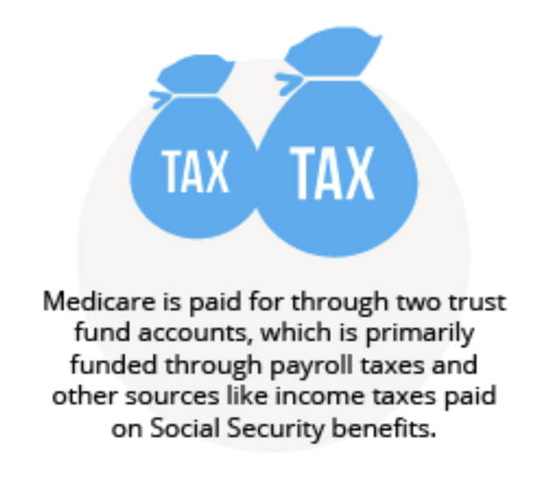



Background & Dataset
Dataset
13 GB public dataset created by the Centers for Medicare & Medicaid Services
summarize the utilization and payments for procedures, services and prescription drugs provided to Medicare beneficiaries by hospitals, physicians, and other suppliers.

Slide 3
Methodology and Goals
Data Preprocessing
Analysis
Recommendation
Identify 3 project goals
Evaluate the performance of the predictive analysis
Descriptive analytics
Select and query necessary data and columns from different tables
Start
End
Join tables ‘Inpatient Charge’ and ‘Outpatient Charge’
Predictive analytics
Use the results to give policy recommendations
Join tables from 2011-2015 to perform time-series analysis
Goals
1
Inpatient and Outpatient treatment
compare the average cost for inpatient and outpatient treatment in each city and state.
3
Average payments
explore the average payments for these conditions in these cities and how they compare to the national average
2
Each diagnostic condition by city
explore the cities with the most number of cases for each diagnostic condition

Slide 4
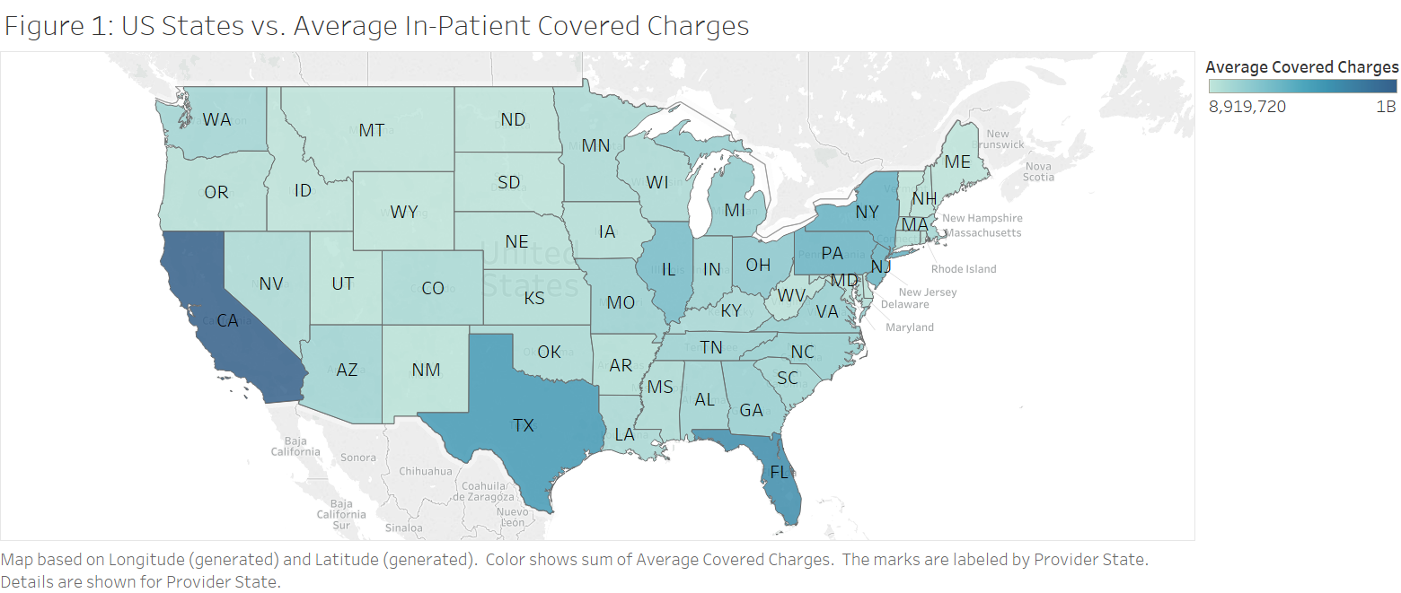
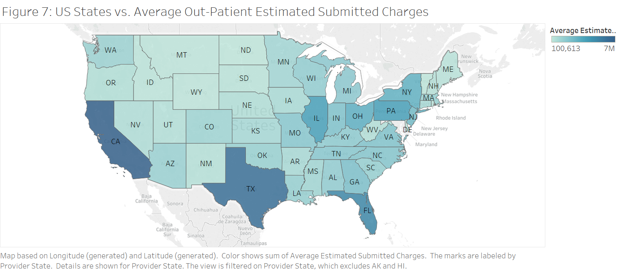
Results – Descriptive Analytics

Slide 5
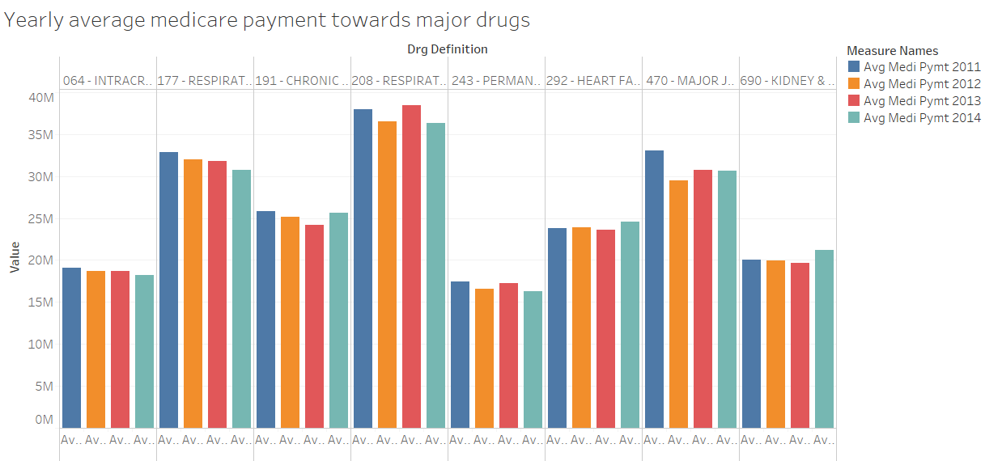
Results – Descriptive Analytics
Query 1: Variation in total average medicare payment for each provider with specific drug for inpatients over year

Slide 6
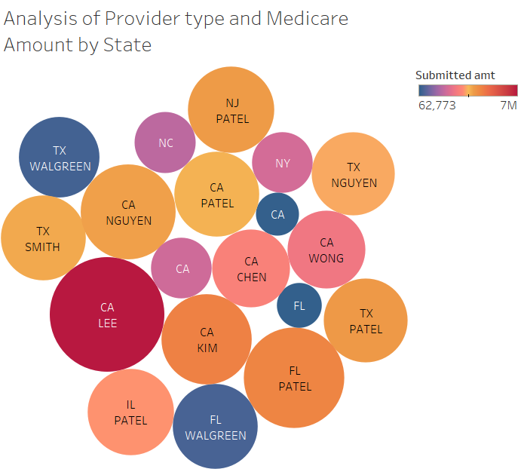
Results – Descriptive Analytics
Top 50 provider names along with state and corresponding year with total medicare submitted amount for each type of provider for that state and organization name

Slide 7
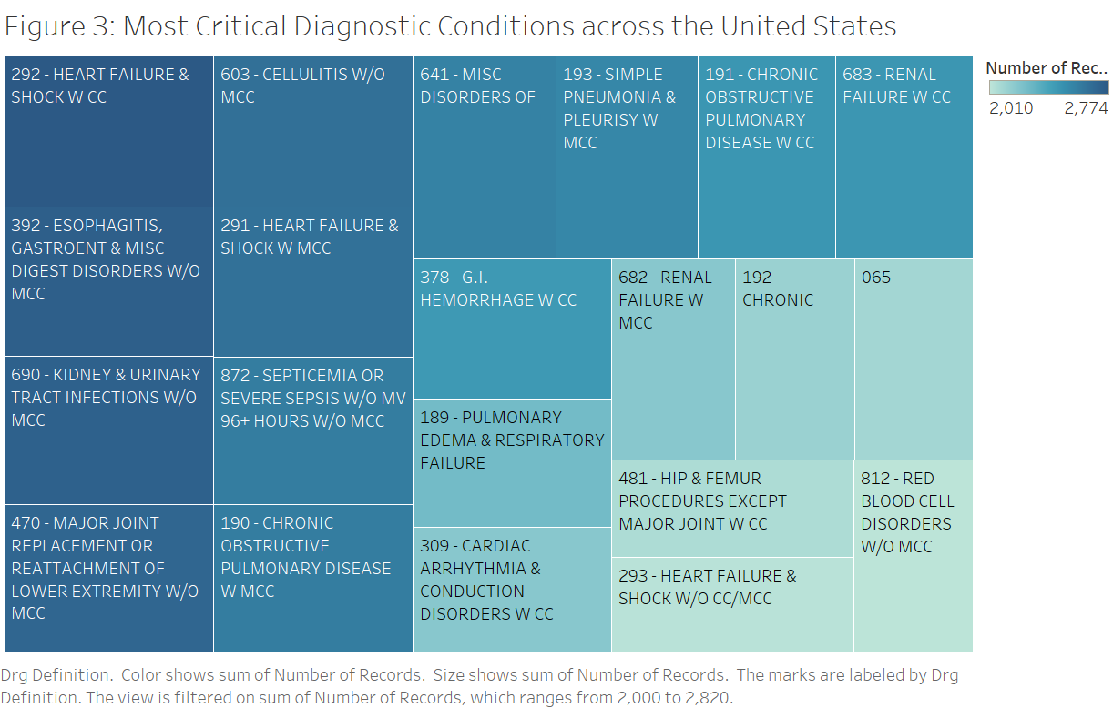
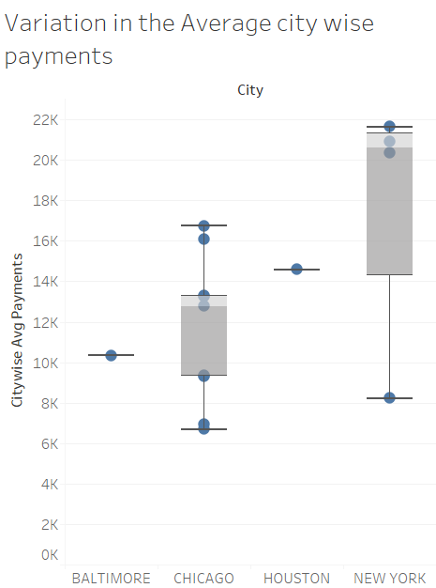
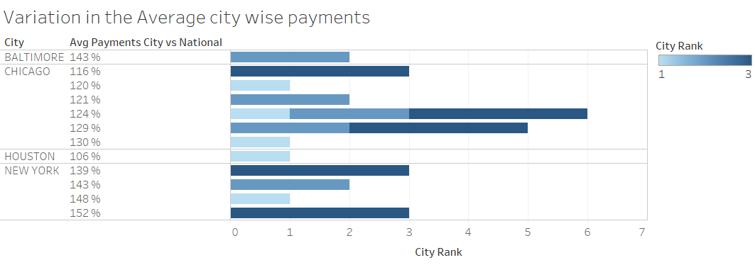
Results – Descriptive Analytics

Slide 8
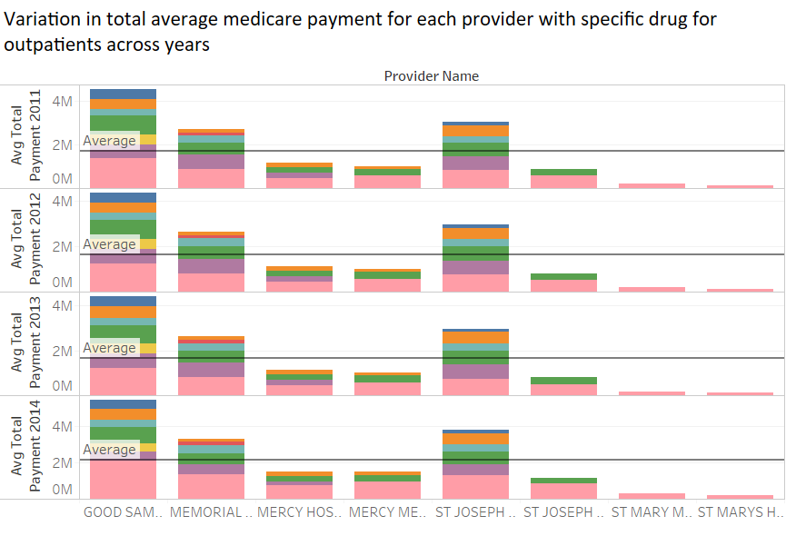
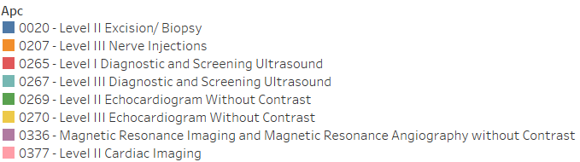
Results – Descriptive Analytics

Slide 9
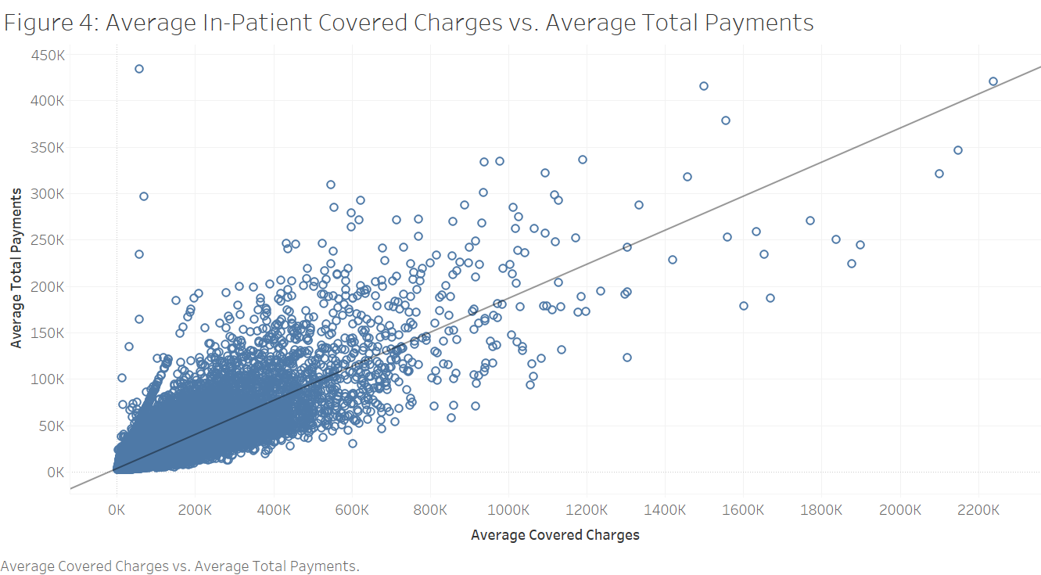
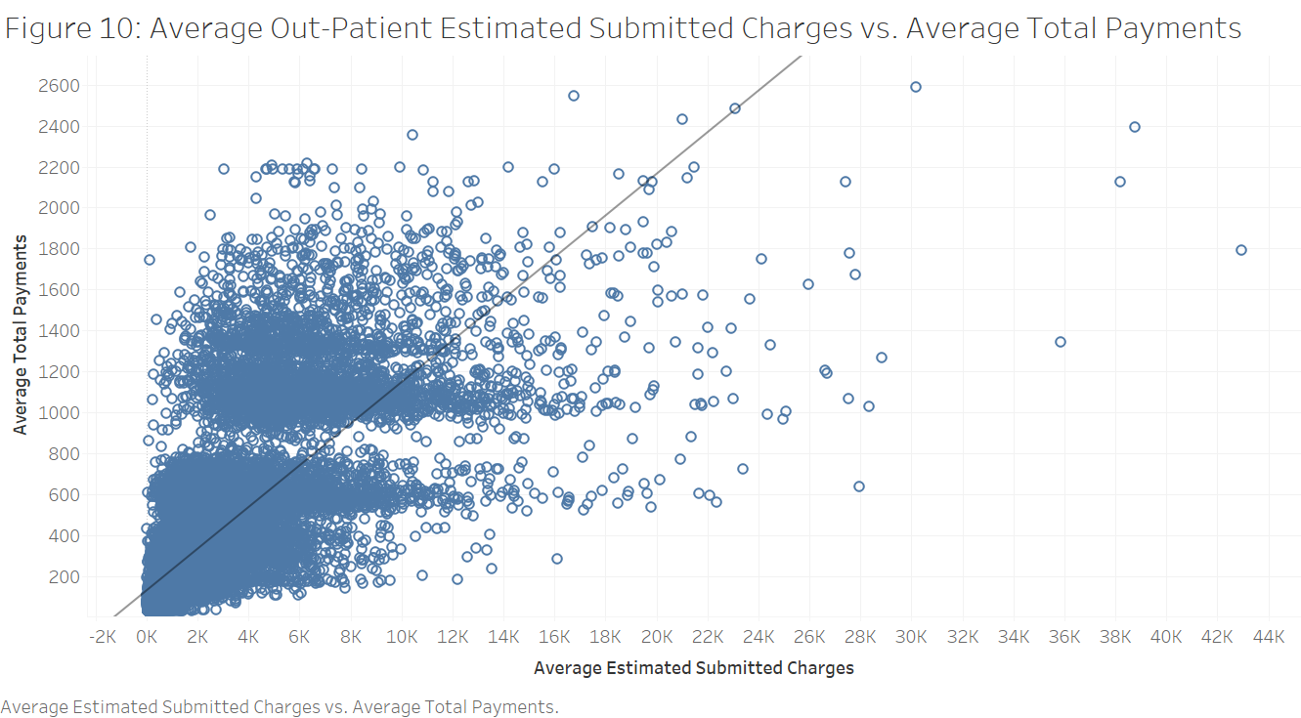
Results – Predictive Analytics

Slide 10
Recommendations & Conclusion
1
Medical cost is higher for both inpatient and outpatient in the west and east coast
2
There is a large variance in spending in metropolitan compared to national average
3
Use total payment to predict and forecast inpatient covered charges in outpatient submitted charges
Notes:
The outcome of the project will have a strong business orientation, delineating the available data, policy impact, solutions and recommendations:
Descriptive analytics will be the main component of this project, and it will be summarized in a series of ranked lists and visualization charts of cities and states with the most number of cases for each diagnostic condition. For example, we will visualize our data on the US geographical map, with colors and spikes representing different values.
Through descriptive analytics we should then be able to assess the current US Medicare program to provide policy recommendations to the US federal government and business recommendations to private insurance companies.
We could also identify the major components of US Medicare spending, as well as the areas lacking funds.

Slide 11
References
https://www.kaggle.com/cms/cms-medicare
https://www.healthmarkets.com/resources/medicare/medicare-vs-medicaid-infographic/
https://www.census.gov/data/datasets/time-series/demo/popest/2010s-state-total.html

