Slide 1
Microservices - WebApi
Prezentare Fii Practic

Slide 2
Introduction
Recap
Microservices
GIT
Web API

Slide 3
MICROSERVICES ADVANTAJES
Each microservice is relatively small
Each service can be deployed independently of other services
Microservice architecture makes it easier to scale development
Microservice architecture also improves fault isolation
The microservice architecture eliminates any long-term commitment to a technology stack

Slide 4
MICROSERVICES Disadvantages
Developers must deal with the additional complexity of creating a distributed system. Developers must implement an inter-process communication mechanism
The microservice architecture also introduces significant operational complexity. There are many more moving parts – multiple instances of different types of service – that must be managed in production.
Deploying features that span multiple services requires careful coordination between the various development teams.
Deciding at what point during the lifecycle of the application you should use this architecture. When developing the first version of an application, you often do not have the problems that this architecture solves. Moreover, using an elaborate, distributed architecture will slow down development.

Slide 5
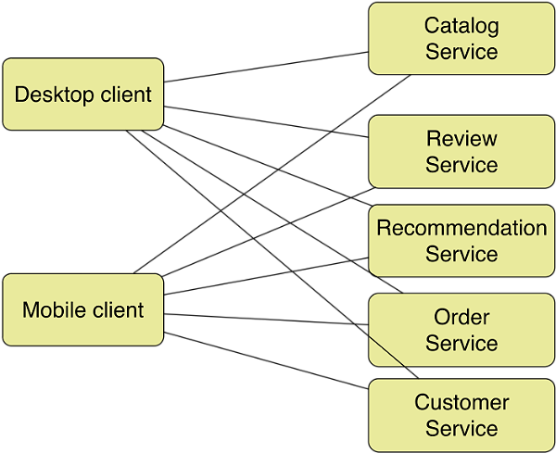
Communication mechanisms
http://www.infoq.com/articles/microservices-intro

Slide 6
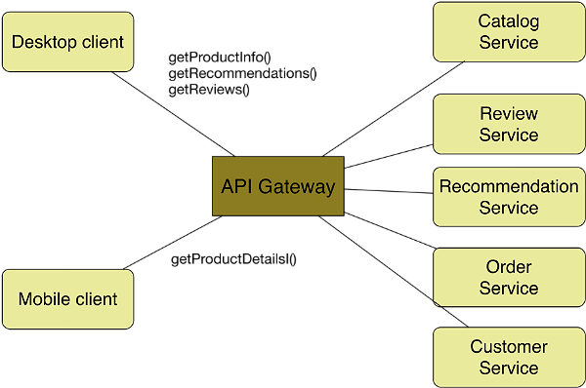
API GATEWAY
http://www.infoq.com/articles/microservices-intro

Slide 7
Git
https://github.com/tudort99/FiiPractic2016.git
Install GitHubDesktop or SourceTree or GitExtensions
Git Commands:
Clone
Pull
Push
Commit
Branch

Slide 8
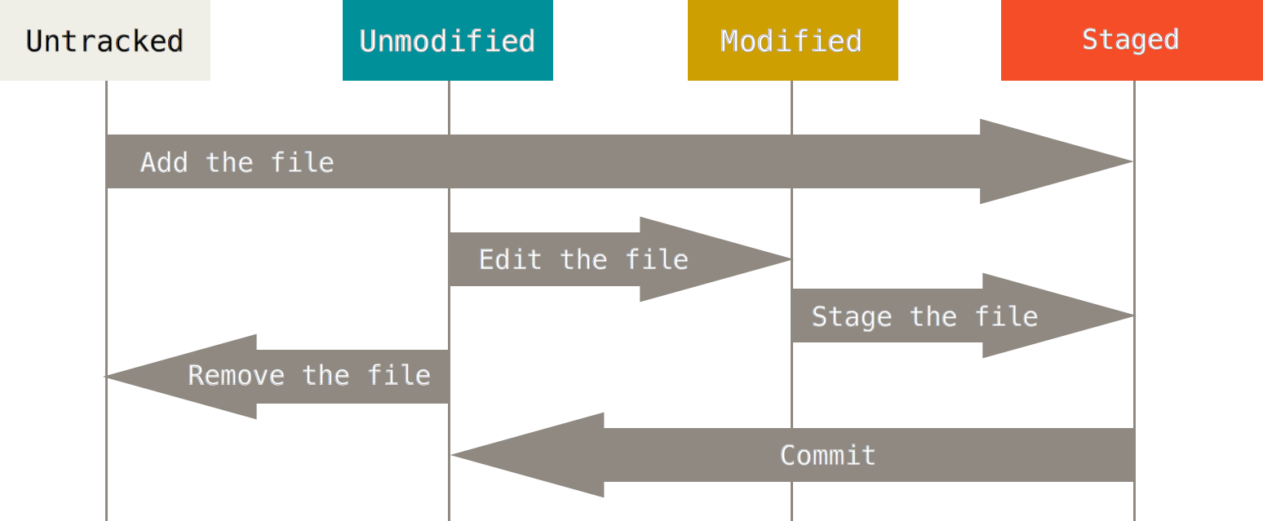
Git

Slide 9
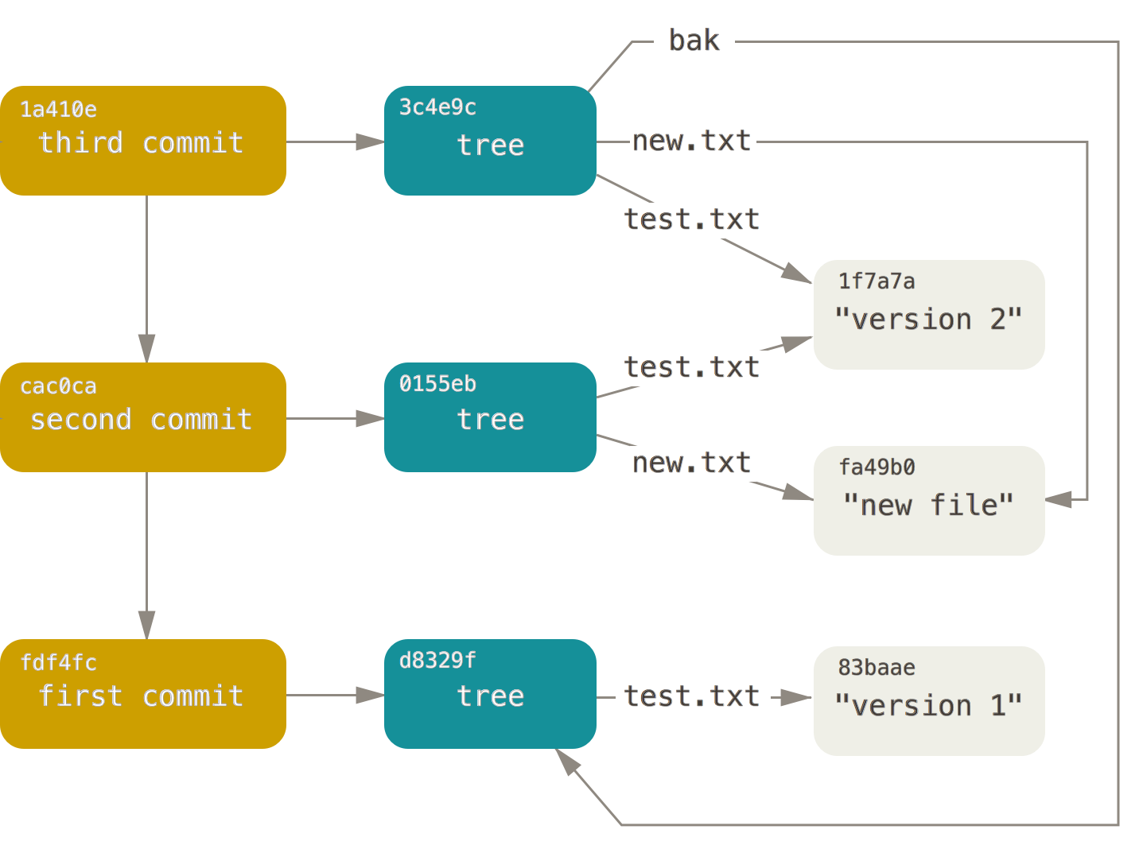
Git

Slide 10
GIT - DEMO
Demo

Slide 11
WEB API
WebAPI is defined as:
RESTful services
Use a modern HTTP programming model
Obey ASP.Net routes
Built-in content negotiation
Support ModelBinding and Validation

Slide 12
REST
REST stands for Representational State Transfer
Stateless
Cacheable
Embrace the HTTP protocol\Use the HTTP verbs GET, PUT, POST, DELETE
Return standard HTTP Response Codes

Slide 13
PROGRAMMING MODEL
Content is delivered through ApiController constructs
ActionMethods named after HTTP methods
Routing
Proper use of HTTP Response codes

Slide 14
Content Negotiation
The type of content you request, WebAPI will output if it understands that content type
Accept: application/json
Accept: text/xml

Slide 15
WEBAPI - DEMO
Demo

Slide 16
One Common Goal

