Slide 1
Microservices - QUEUE
Prezentare Fii Practic

Slide 2
Introduction
Recap
Web Api
Routes
Client
Inter process communication
Microservices
Queue
Communication using Message Queues

Slide 3
communication
 | One-to-One | One-to-Many
Synchronous | Request/response | —
Asynchronous | Notification | Publish/subscribe
 | Request/async response | Publish/async responses

Slide 4
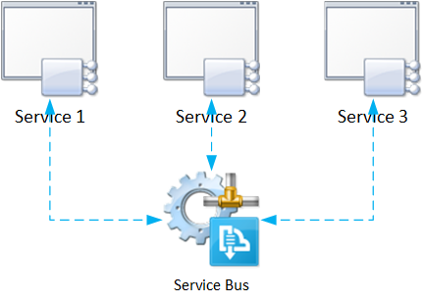
Introduction
Microservice Architecture core concept
insidethecpu.com

Slide 5
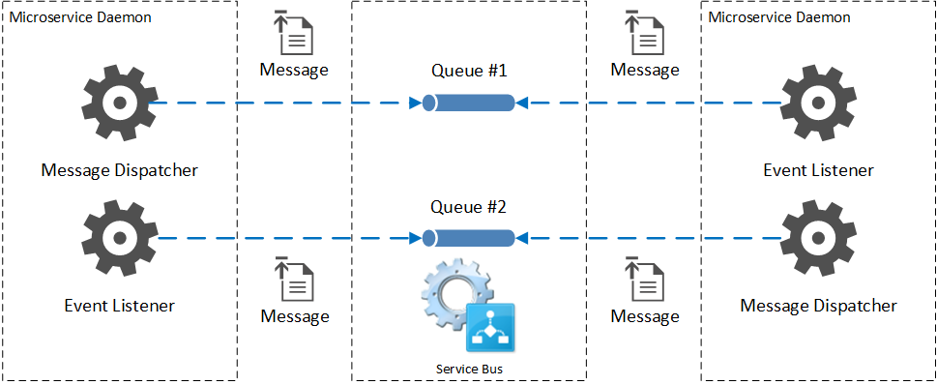
THE QUEUE
insidethecpu.com

Slide 6
PREREQUISITES
RabbitMQ - https://www.rabbitmq.com/
open source message broker software (sometimes called message-oriented middleware) that implements the Advanced Message Queuing Protocol (AMQP).
Daishi.AMQP - NuGet package

Slide 7
DEMO

Slide 8
One Common Goal

