Slide 1
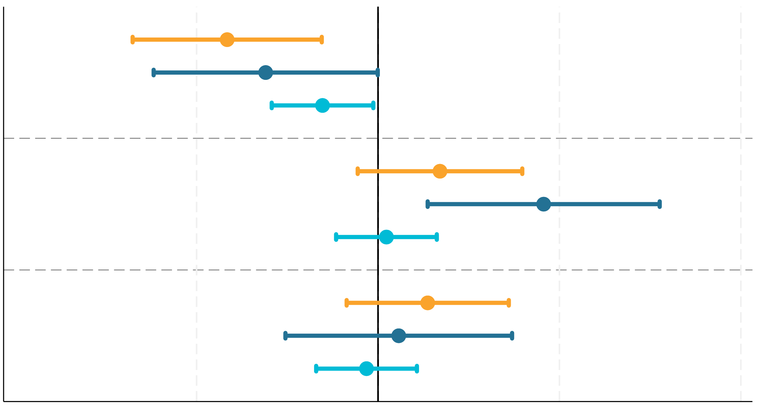
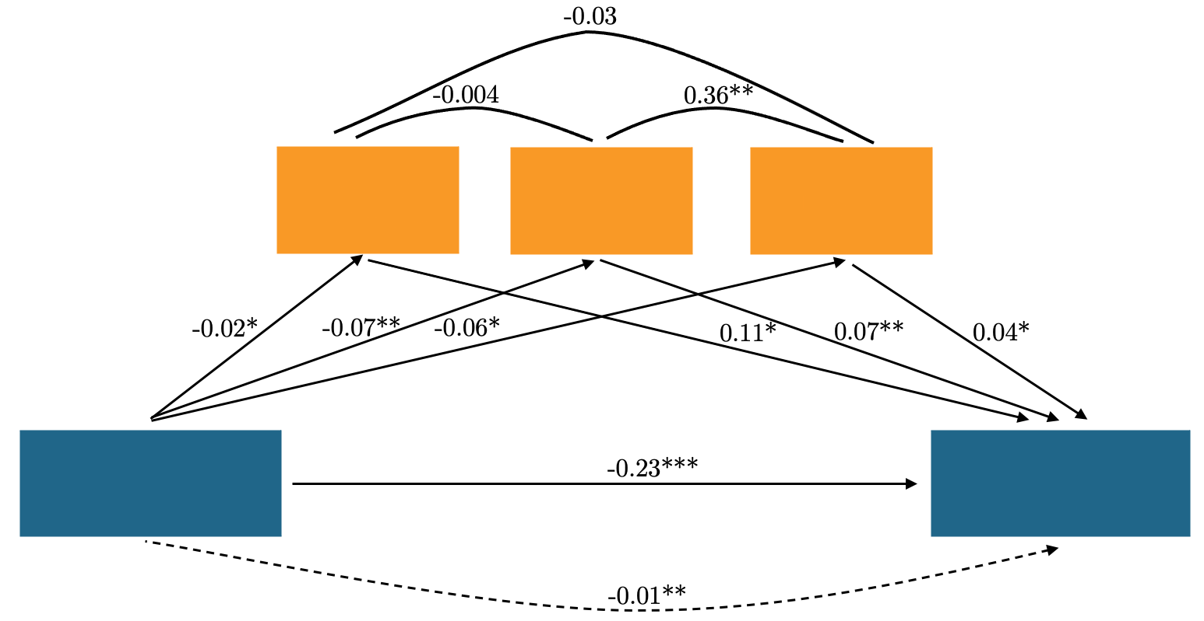
Statements of Denial of Responsibility by Armed Actors and
Public Perceptions of Government’s Credibility
Ilayda B. Onder
Research Question
Methods and Data
Discussion
RQ1: How do statements of denial by armed groups affect public perceptions of their involvement in violence and the credibility of government attributions?
RQ2: What role do emotional responses play in mediating this relationship?
Nationally representative sample of 2,016 U.S. adults recruited on Lucid
Vignette survey experiment: News story describing a fictional attack in a shopping mall in the suburbs of Kansas City
Government attributes the attack to a fictional group called the International Resistance Movement
Control Group: Perpetrators remains silent
Treatment Group 1 (Denial): Perpetrators deny responsibility in a social media posting
Treatment Group 2 (Claim): Perpetrators claim the attack in a social media posting
Treatment Group 3 (Competing Claims): Two different groups claim the attack in separate social media postings
3 different post-treatment attention checks
Measurement
DV Question 1 (Involvement): How likely or unlikely is it that the international Resistance Movement is indeed responsible for the attack?
DV Question 2 (Credibility): Do you think the government correctly identified the perpetrator of the group?
Statements of denial convince individuals that the armed group publishing the statement played no role in the attack.
By refuting responsibility for an attack attributed to them by the government, armed groups can cast public doubt on the government’s credibility.
Emotional responses to violence partially mediate these relationships: statements of denial reduce the outrage and disgust, which consequently reduces people’s trust in government’s credibility.
Introduction and Literature Review
Armed actors publish statements of denials, disclaiming, disowning, or dissociating from violent acts. This is contradictory to the logic of costly signaling.
If acts of political violence are meant to serve as costly signals, why would they deny their involvement in such acts?
Conclusion
Additional strategic incentives shaping armed groups’ public communication efforts, extending beyond mere efforts at avoiding public backlash
Importance of manipulating the public’s emotional responses to violent events
Implications for studying armed actors’ use of non-armed instruments to shape public opinion in their favor (Johnson and Gillooly 2023)
Existing literature suggests that statements of denial are aimed at avoiding public backlash (Kearns et al. 2014) but would statements from potentially untrustworthy actors achieve their intended effect?
Theoretical Expectations
Statements of denial can reduce emotional distress by reassuring individuals that the alleged perpetrators are not actively planning attacks and that no imminent threat is present. By presenting a less threatening narrative, denials help people regulate emotions, making the alternative narrative more palatable.
Denials also simplify the narrative, reducing cognitive load (Haynes and Hayes 2010). This allows individuals to avoid the discomfort associated with cognitive overload, making the alternative narrative provided by the statement of denial more readily accepted.
H1: Statements of denial of responsibility diminish individuals' conviction in the group's involvement in the attack.
When the group denies involvement after the government attributes the attack to them, the denial can create a perception of government deception, or inefficacy (Miller and Robinson 2019). Individuals may interpret the denial as evidence that the government knowingly misled the public.
H2: Statements of denial of responsibility reduce individuals' conviction in the government's credibility in handling acts of political violence.
The denial might introduce doubt and uncertainty about the attribution of the attack (Pischedda et al. 2020). Uncertainty can lead individuals to question their initial emotional response.
H3: Statements of denial of responsibility reduces the outrage that individuals feel following a violent attack.
Results
Denial by group
Logit Models
Party affiliation
News consumption
Social media usage
Demographics (e.g., gender, age, income, education, race, religion)
U.S. Region
Time spent reading the treatment vignettes
Claim by group
Claims by two groups
-2 -1 0 1 2
Group’s Involvement
Government’s Credibility
Outrage
Trust in gov. effectiveness
Outrage
Disgust
Mediation Analysis
Denial by the
group
Credibility of Government
References
Haynes, Chris S., and Thomas J. Hayes. 2010. “Cognitive Load and Policy Evaluation: Evidence from an Experimental Design.” Paper presented at the APSA Meeting in Washington, D.C.
Johnson, Philip L. and Shauna N. Gillooly. 2023. “Grammar of Threat: Governance and Order in Public Threats by Criminal Actors.” Comparative Political Studies 56 (10): 1567-1596.
Kearns, Erin M., Brendan Conlon, and Joseph K. Young. 2014. “Lying about Terrorism.” Studies in Conflict & Terrorism 37 (5): 422-439.
Miller, David, and Piers Robinson. 2019. “Propaganda, Politics and Deception.” In: Docan-Morgan, T. (eds) The Palgrave Handbook of Deceptive Communication. Palgrave Macmillan, Cham.
Pischedda, Constantino, Andrew Cheon, and Sara B. Moller. 2020. “Can You Have It Both Ways? Plausible Deniability and Attribution in Anonymous Coercive Bargaining.” Working Paper.

