Slide 1
FFT/IFFT
by
Ilayda & Allan

Slide 2
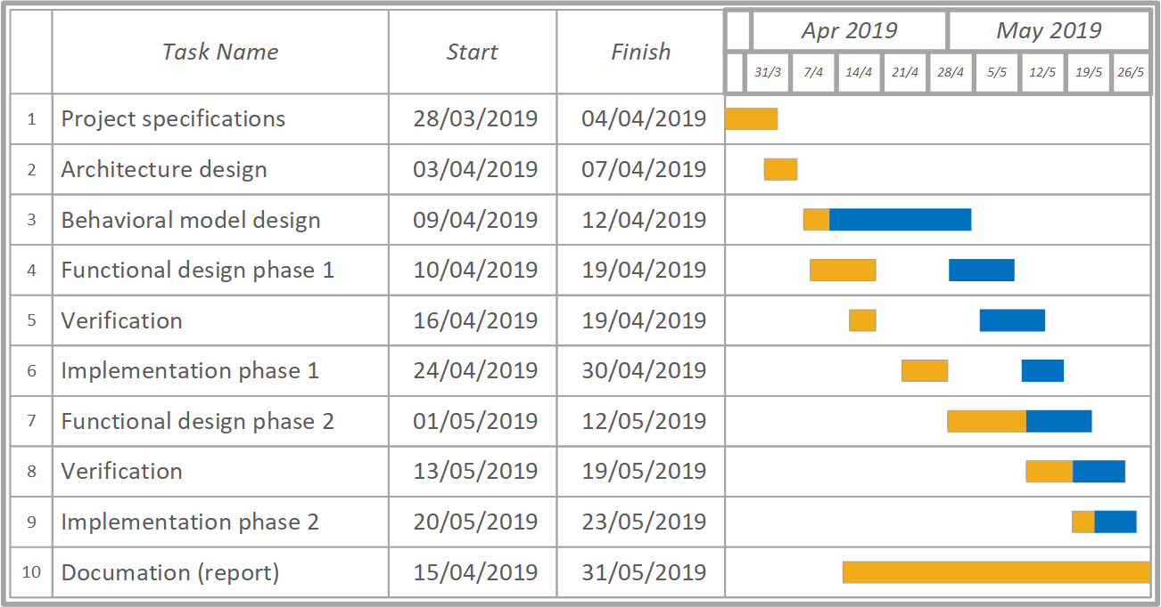
Project Schedule

Slide 3
Requirements
Completed tasks
    Research
    Architecture
    Behavioral model (Matlab)
    Functional design (VHDL)

Slide 4
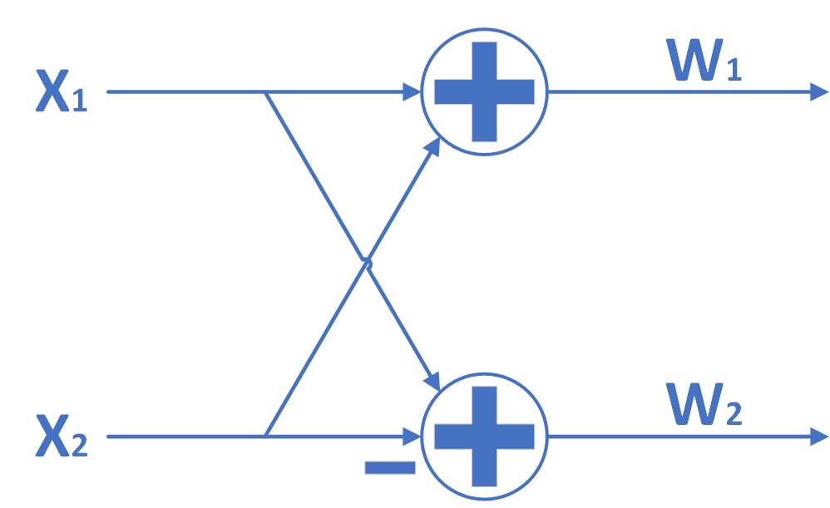
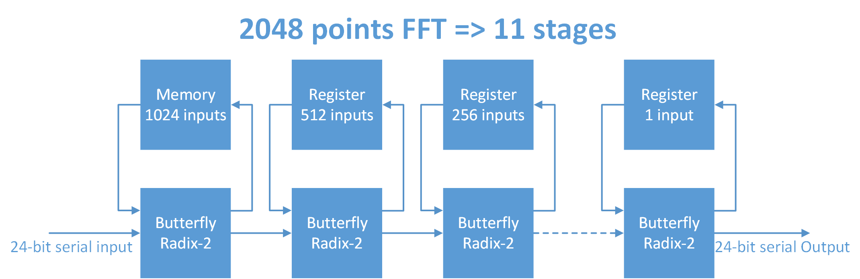
Architecture

Slide 5
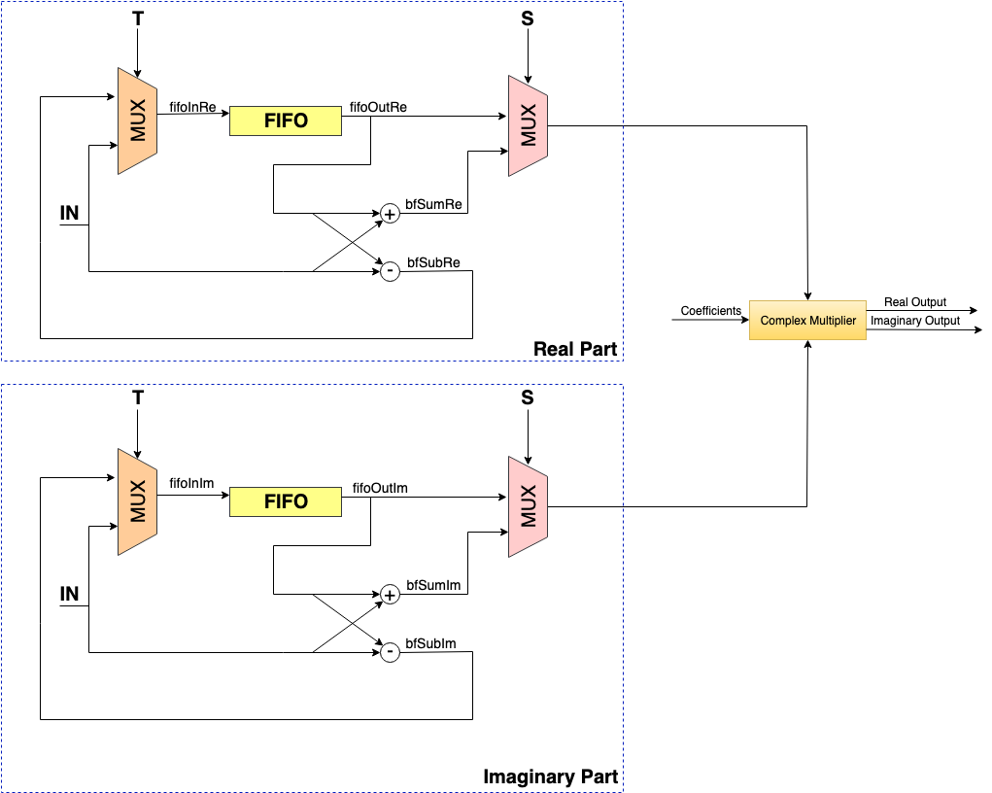
SDF Architecture

Slide 6
Verification
Simulation in progress using Vivado comparing with the Matlab model.
Random input data is generated in Matlab ranging from -1 to 1(fractional numbers).

Slide 7
Synthesis Results
Total Area (Cell + Physical + Net) => 1.227981040 mm^2
Time slack => +2040ps
Clock Frequency => 100MHz
Highest possible clock frequency
Bottleneck (critical path) => inside the fifo module, between readPointer and regfile

Slide 8
Initial Layout

