Slide 1

IMDb Map-Reduce Project
Functional Programing in Concurrent Distributed Systems
Ilay Nuriel & Omer Luxembourg

Slide 2

Project Goals
The project’s goal is to learn how to use Erlang programming language to maintain a system which is distributed and parallel
In addition, the goal is to get familiar with Map-Reduce algorithm and implement it in the system.

Slide 3
Problem Definition
How to design a multi-client multi-server system?
What are the components of the system?
How the communication between each one should be down?
How to distribute data between nodes, and what kind of information should be transferred?

Slide 4

Project Definition
With IMDb movie records, we created a query-system to achieve relevant information from.
The system is using multiple-clients which sends a query to the master.
The master will distribute the movie records across all the servers connected to the net, and send queries to each one of them.
The query will return to the client and will be represented with additional statistics.

Slide 5
Design
Multiple client system. Each client can query the master and deliberately be answered about. The answer is represented in client’s GUI.
Multiple server system. Each server will get an equal portion of the data, and when needed will do a procedure of map-reduce algorithm, according to the asked query (asked from client).
One Master. The master will handle all calls from clients and server together. Each call will be handled by special process.
Server1
(gen_server)
Server2
(gen_server)
…
ServerN
(gen_server)
Client1
(wx-gui)
Client2
(wx-gui)
…
ClientM
(wx-gui)
Master (gen_server)

Slide 6

Implementation Problems
Master and servers can be down for any reason →
Thus we maintain the system distributed fault- tolerance.
Vary kind of answers (different categories, etc.) →
GUI is generic-implemented. Future updated are easily possible.
Data distribution needs to be updated when a node is down →
Maintaining an automatic system of distributing the data, by the nodedown/nodeup messages from connected nodes.

Slide 7
Conclusions
Working with multiple-nodes is a complicated job, even if using gen_server template.
Fault-tolerant system solves the major of the problems, letting the system dynamically adjust exceptions without stopping.
Map-reduce algorithm is very effective on large data. Performance may improve as there are more servers available to work.

Slide 8

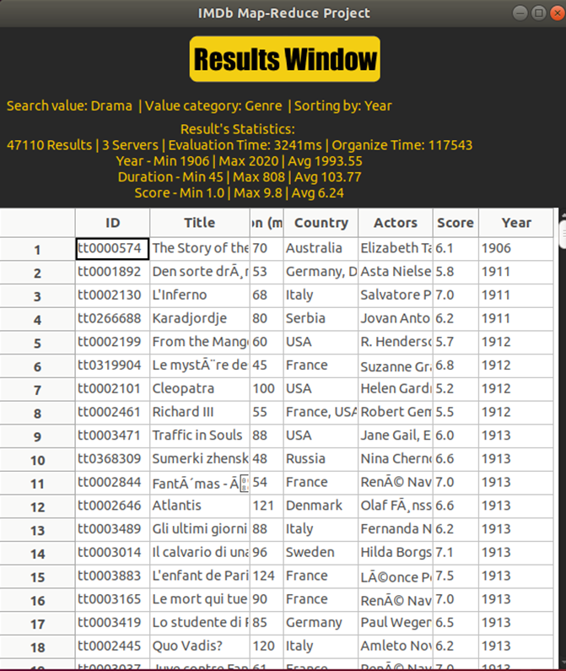
Results
Results Window:
Table of the answer with relevant statistics
Main window is the ‘Query Window’

Slide 9
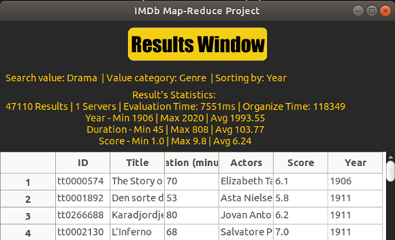
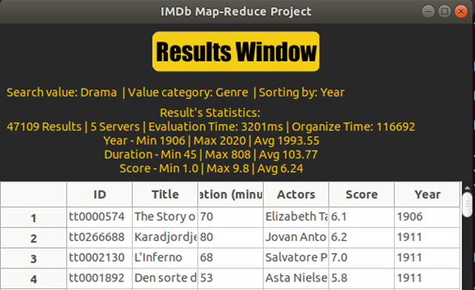
Results
1 server has evaluation time of 7.5 seconds 5 servers has evaluation time of 3.7 seconds
We can conclude that distributed programming has a direct connection to
The efficiency and runtime of the program.

Slide 10

Instructions
Compilation
Need to compile all project files. Do it by writing the following command to the terminal:
> erl
> c(master). c(server). c(wxclient). c(parse_csv). c(dataDistributor).
System adjustments
Insert the nodes that you will set on your system: servers in “serverslist.txt”,
master and clients in “clientslist.txt” (in that order!)
serverlists.txt clientslists.txt
server1@Host/IP master@Host/IP example: IP = 192.168.1.101
server2@Host/IP client1@Host/IP Host = ubuntu
server#@Host/IP client#@Host/IP
Run the system
To run the system, you need at least 1 server and 1 client, and single master (always).
Server: > erl -name server# -setcookie a -run server start_link
Client: > erl -name client# -setcookie a -run wxclient start
Master: > erl -name master -setcookie a -run master start_link
*for client you may need to open shell “erl -name client -setcookie a”, and write “wxclient:start()”

