Slide 1
WSL
Windows Subsystem For Linux
BY Jack Hammons
https://blogs.msdn.microsoft.com/wsl/

Slide 2
What is WSL?
Compatibility layer for running native Linux ELF64 binaries on Windows
Provides a Linux-compatible kernel interface containing no Linux kernel code

Slide 3
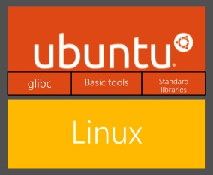
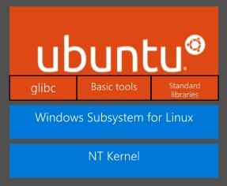
What is WSL?

Slide 4
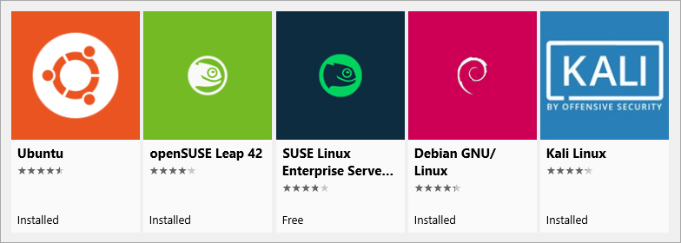
Supported Linux Distributions

Slide 5
Outline
Windows NT Subsystems
WSL Architectural Overview
Minimal and Pico Processes
Pico Provider Interface
LXSS Components
Challenges
System Calls
File System

Slide 6
Subsystems
The interface between user mode applications and the kernel functions is called a “Subsystem"
Windows NT Kernel supported 3 subsystems at launch (1993)
OS/2 (IBM)
POSIX
Win32

Slide 7
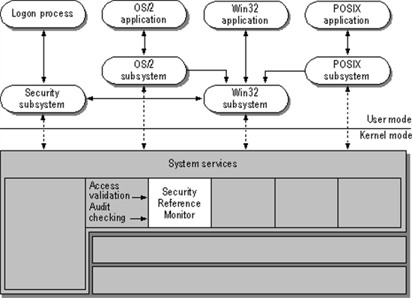
Subsystems

Slide 8
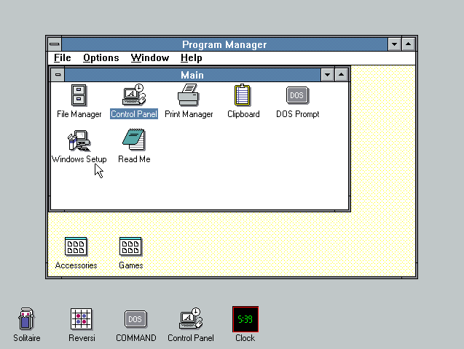
OS/2

Slide 9
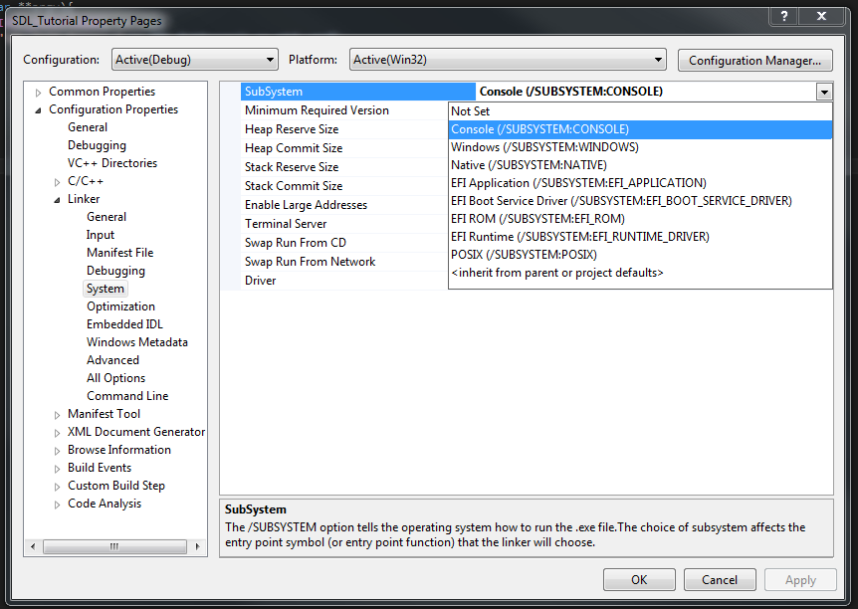
POSIX

Slide 10
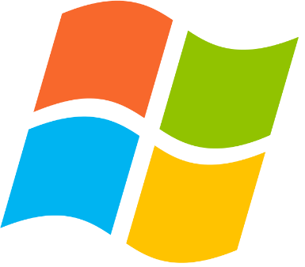
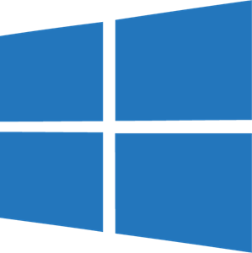
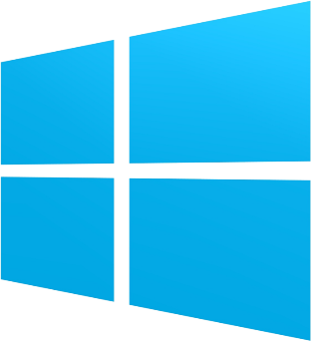
Subsystems
Windows XP dropped support for OS/2
Windows 8.1 dropped support for POSIX (UWIN)
Windows 10 RS1 introduced “Windows Subsystem for Linux”

Slide 11
Minimal Processes
New to Windows 10
Creation from kernel only
Process address space is empty
No ntdll.dll or subsystem DLLs
No PEB or TEBs
Example: Memory Compression
EPROCESS.Minimal == 1

Slide 12
Pico Processes
Minimal processes with a supporting driver
Pico Provider intercepts all operations requiring kernel handling
System calls
exception dispatching
used for the WSL implementation
EPROCESS.PicoContext is != NULL

Slide 13
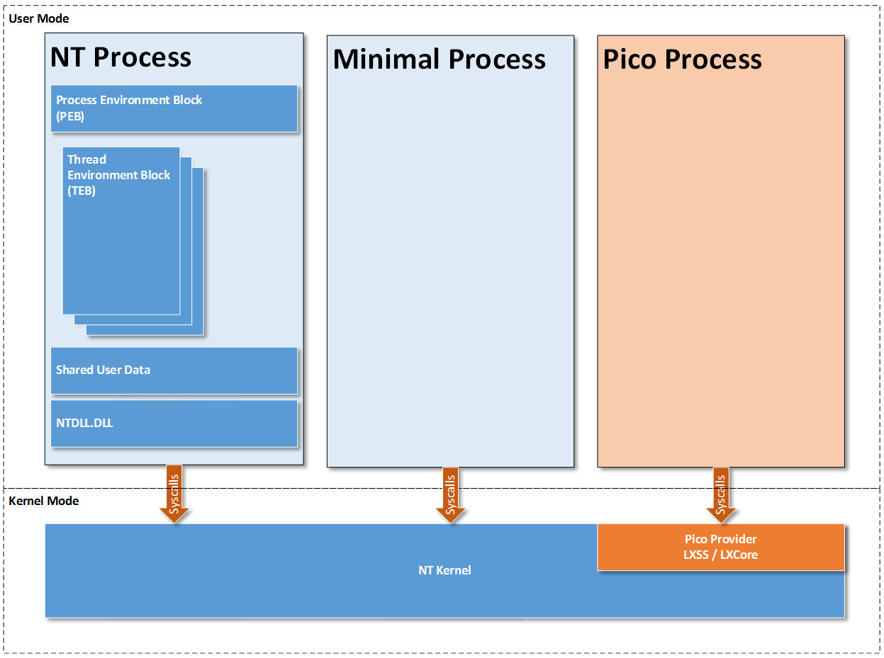
Processes Overview

Slide 14
WSL COMPONENTS
Pico Provider driver LXSS.SYS / LXCORE.SYS
User-mode service LxssManager -(COM interface)
A Linux “init” daemon
Windows launcher service <distro>.exe

Slide 15
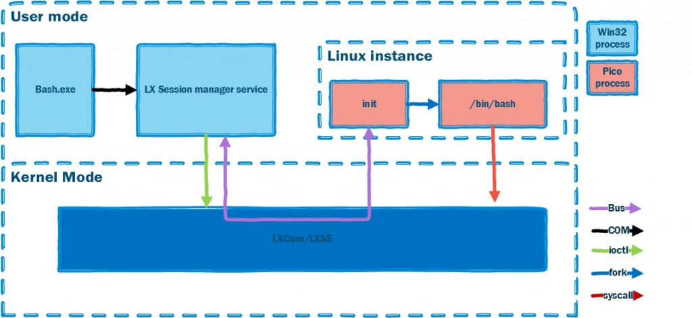
WSL OVERVIEW

Slide 16
Demo

Slide 17
SYSTEM CALLS
A syscall is a service provided by the kernel that can be called from user mode
Explicit contract between user mode and kernel mode called an Application Binary Interface (ABI)
Common usages:
access files on disk
handle network requests
create processes\threads
and other operations.

Slide 18
SYSCALLS: Linux VS Windwos
Expose different syscalls
Linux: fork, open, and kill
Windwos: NtCreateProcess, NtOpenFile, and NtTerminateProcess
Different Application Binary Interface (ABI)
Calling conventions

Slide 19
SYSTEM CALLS
getdents(fd, buffer, size);
NtQueryDirectoryFile(Foo, Bar, Baz);
Getdents | NtQueryDirectoryFile
mov rax, __NR_getdents64 | mov rax, #NtQueryDirectoryFile
mov rdi, Fd | mov rcx, Foo
mov rsi, Buffer | mov rdx, Bar
mov rdx, sizeof(Buffer) | mov r8, Baz
syscall | syscall
cmp rax, 0xFFFFFFFFFFFFF001 // return 1 | test eax, eax // return 1

Slide 20
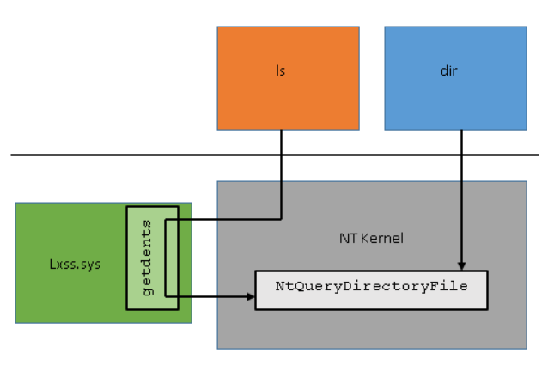
SYSTEM CALLS

Slide 21
Another Example - Fork
The Linux fork syscall has no documented equivalent for Windows
lxss.sys calls internal NT APIs to create the process
Create a thread with an identical register context
Finish copying the process and resumes the new process

Slide 22
File System
Windows and NTFS support case sensitivity, behavior is disabled by default
WSL has a VFS component that is modeled after the VFS on Linux
VoIFs support - Linux permissions, symbolic links, FIFOs, sockets, and device files
VolFs requests the Object Manager to treat paths as case sensitive

Slide 23
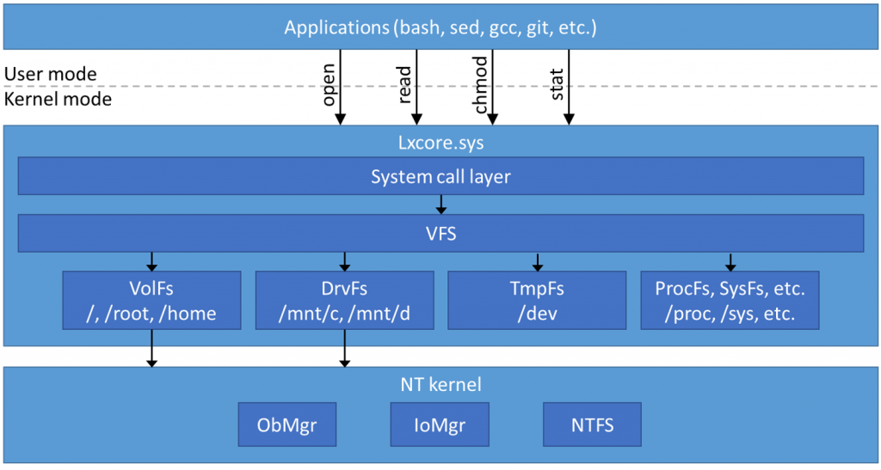
File System

Slide 24
