Slide 1
GCF Quasi-Elastic Event Generators + GENIE FSI : technical details

Slide 2
Common Montecarlo to all generators
• All four generators share one importance-sampling engine.
• Each trial starts weight=1; every sampled variable multiplies weight by its interval volume.
• Physics factors multiplied in: structure/density function, e-N cross section, energy-conservation Jacobians.
• Kinematically invalid trial -> weight=0, discarded. Surviving events + weights -> ROOT TTree (weight-summed cross sections).
• Beam: electron along z, fixed energy 6GeV.
• e-N cross section sigma_eN: De Forest CC1 (default) or CC2 off-shell, or on-shell Rosenbluth.
• Form factors: Kelly (default); dipole or Ye (Galster for neutron electric) optional.

Slide 3
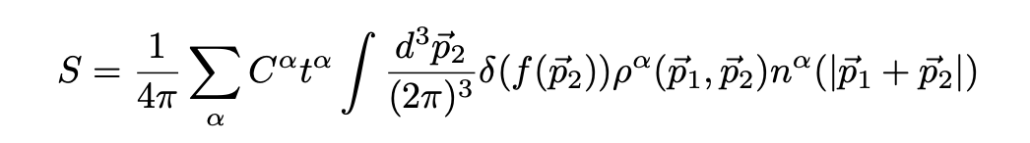
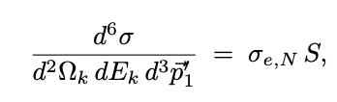
2N SRC generator (GCF)
• Scattering off one nucleon of a short-range-correlated pair. (generate_event)
• Assign pair isospin lead+recoil 50/50, weight x4 (pp/pn/np/nn).
• CM momentum from 3D Gaussian (sigma_CM ~ 0.10-0.15 GeV/c).
• Relative momentum: uniform in direction, magnitude uniform in [pRel_min, pRel_max].
Initial Weight x phase space x pRel^2 x S(pRel)/(2 pi)^3, with S = C_ij |phi_ij(pRel)|^2
i.e contact coefficient C x universal pair function phi tabulated per NN model: AV18, AV4, N2LO
• Momenta: p1=CM/2+pRel (struck), pRec=CM/2-pRel; (A-2) recoils -(p1+pRec).
Struck off-shell: E1=mA-E(A-2)-Erec.
spectral function used
spectral function
contacts, combinatorics
2-body density
cm distribution

Slide 4
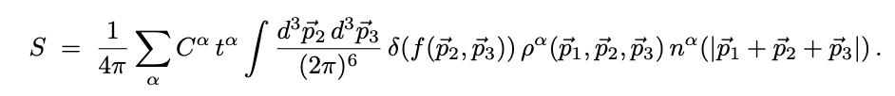
3N SRC generator
• e + A -> e' + N1 + N2 + N3 + (A-3)*; scattering off one nucleon of a correlated triplet.
(see attached document for more details)
• Key change vs 2N: contact x universal function -> pre-computed 3-body density matrix 3He.
• ppn triplets only: start all protons, flip one (uniform among 3) to neutron, weight x3.
• Target/residual masses configurable, use 12C by default
• 3-body CM momentum from 3-D Gaussian
Each nucleon +P_CM/3; residual -P_CM.
• Orientation: 3 Euler angles uniform, weight x 8 pi^2.
• Internal Jacobi vars sampled in 'primed' wavefunction frame: p_a=|neutron|, p_b=|pp rel /2|, theta_ab; weight x volume.
-------
spectral function used
spectral function
contacts, combinatorics
3-body density
cm distribution

Slide 5
Mean-Field (single-nucleon) generator
• Quasi-elastic knockout of one uncorrelated nucleon from a Fermi gas.
•Pick struck-nucleon isospin p/n 50/50, weight x2; no correlated partner.
• Sample initial momentum from a Fermi gas: isotropic direction, |p| uniform in [0, kF].
- Currently only Global fermi gas: uniform-sphere n(p)=3/(4 pi kF^3).
• (A-1) residual: tabulated ground-state mass, recoils with -p1.
• Struck nucleon off-shell: E1 = mA - E(A-1) by energy conservation.
• Lepton vertex solved (shared solver); FSI transports the nucleon through (A-1).

Slide 6
GENIE FSI
• Post-processing of the bare PWIA event.
• Residual medium traversed: A-1 (MF), A-2 (2N), A-3 (3N). Each nucleon is independently transported through the residual medium.
• GENIE recommends A_res > 6.
• Common vertex for the correlated nucleons, sampled from rho^n(r) r^2:
- n=1 (MF single), n=2 (pair), n=3 (triplet); rho from GENIE density model.

Slide 7
GENIE FSI
• Per nucleon: build GENIE record in lepton-nucleus mode
• Target = residual ion (A_res,Z_res)
• Run INTRANUKE 2018 cascade: hN (full cascade, default) or hA (effective single step).
• Follow chain to surviving stable nucleon (highest-energy if several): updates 4-momentum and species (captures charge exchange).
• Other stable products recorded as secondaries (pi+/pi0/pi- counted). Full absorption -> weight=0.
• Pauli blocking: any final |p| < Fermi momentum (default 220 MeV/c) -> weight=0.

Slide 8
Plots and results

Slide 9






3N-SRC configurations
We look at the distribution of opening angles of 3N SRCs initial state [assuming $p_{CM}=0$].
$$p_{1}$$
Lead nucleon
$$p_{3}$$
$$θ_{13}$$
$$θ_{23}$$
$$θ_{12}$$
$$p_{2}$$

Slide 10
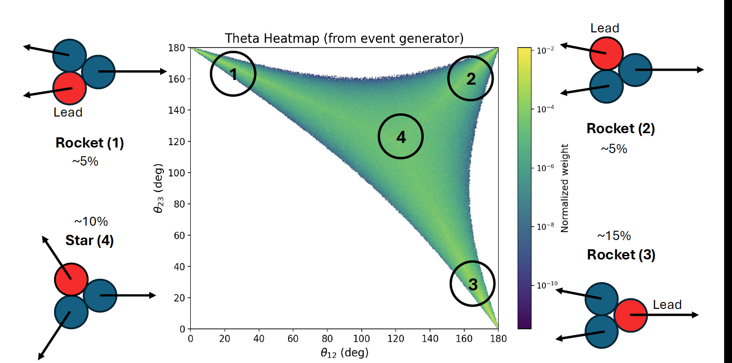
3N-SRC configurations with NO FSI
Opening Angle Distribution (3N SRCs)
[reflection around dashed symmetry lines=permutations of nucleons]
precentages are result of integrating in an arbitrary circle around each region

Slide 11
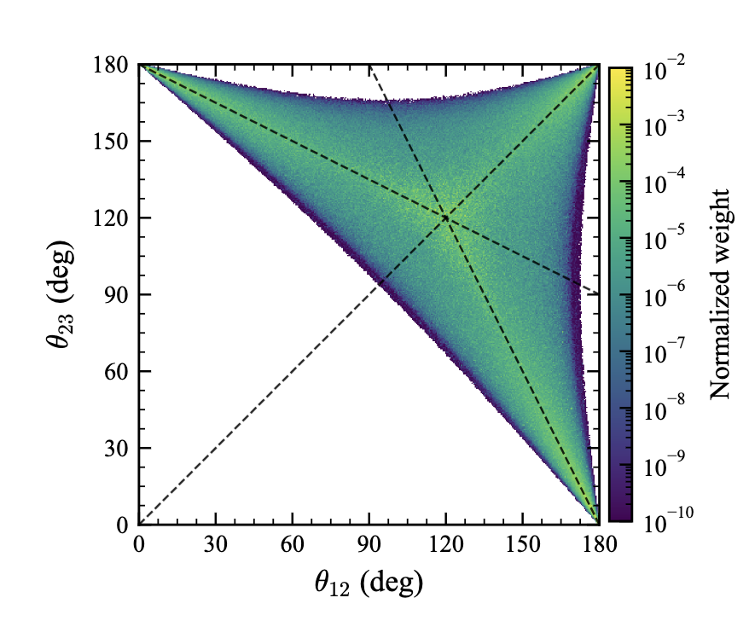
same plot without circles and lines

Slide 12
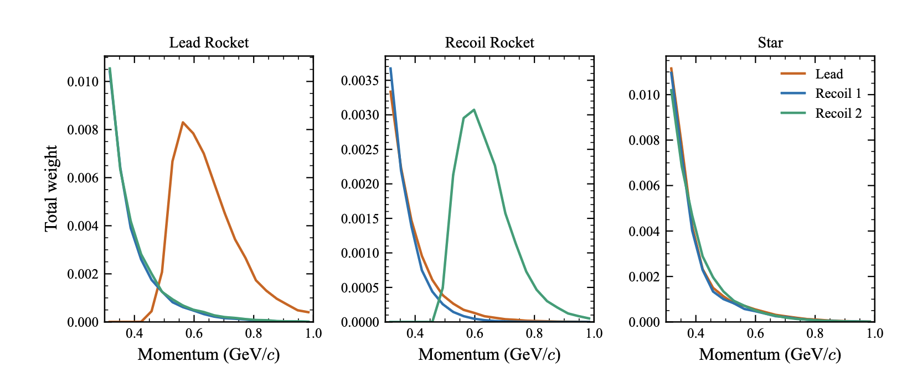
momentum distributions of 3N in different configs.

Slide 13
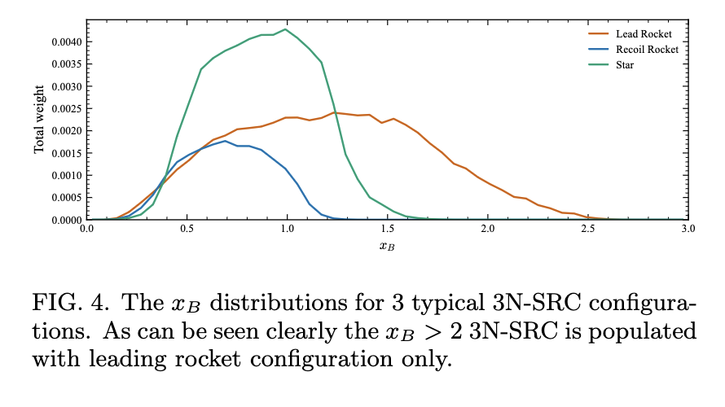
xB distribution
xB>2: Only Lead Rocket
Star and other rocket: xB~1

Slide 14
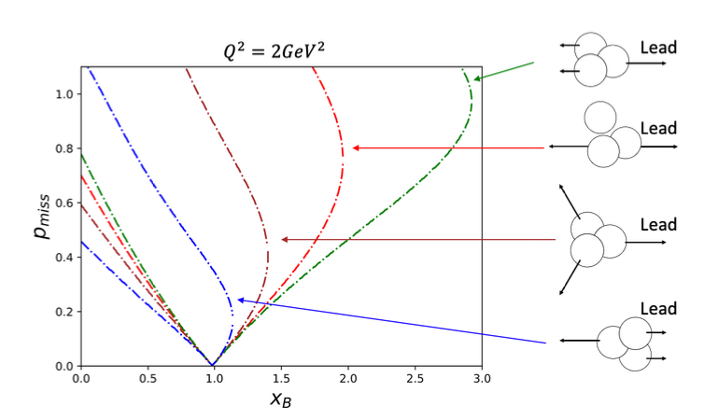
andrew’s plot

Slide 15


when measuring only 2 nucleons and reconstructing the 3rd
We look at the distribution of opening angles of 2N SRCs,
where a 3rd nucleon is reconstructed.
$$p_{1}$$
Lead nucleon
reconstructed
$$p_{3}≡−\left(p_{1}+p_{2}\right)$$
$$p_{3}$$
$$θ_{13}$$
$$[p_{1}=p_{lead,detected}−q]$$
$$θ_{23}$$
$$θ_{12}$$
from detected nucleons
$$p_{2}$$

Slide 16
3N + FSI
[low statistics]
2N + FSI
only events that satisfy:
$θ_{e}∈\left[8,45\right], Q^{2}≥1GeV^{2},∠\left(p_{Lead},q\right)<12$

Slide 17
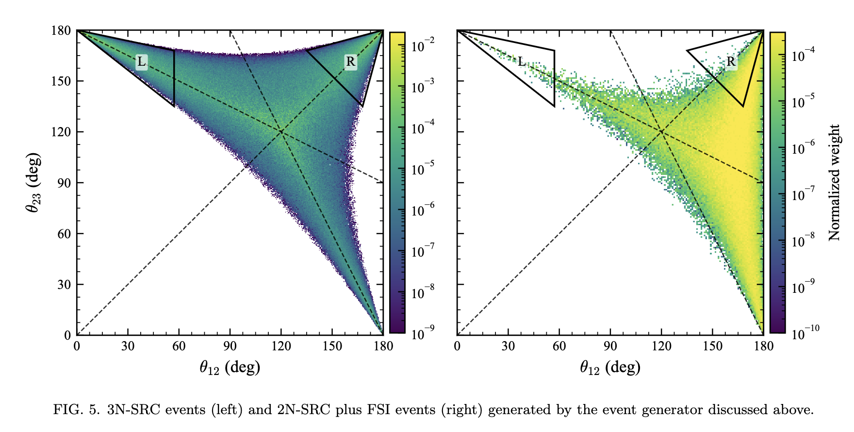
Same comparison between 3N and 2N, only here 3N is WITHOUT FSI

Slide 18
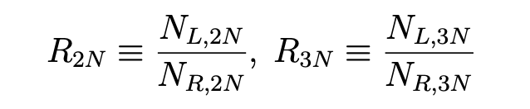
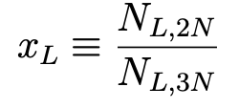
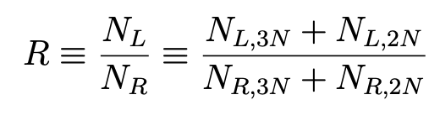
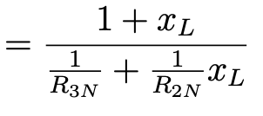
Data-driven Signal to Background ratio extraction
Calculated from generator
~1
Unknown (FSI contamination of left region)
Measurable

Slide 19
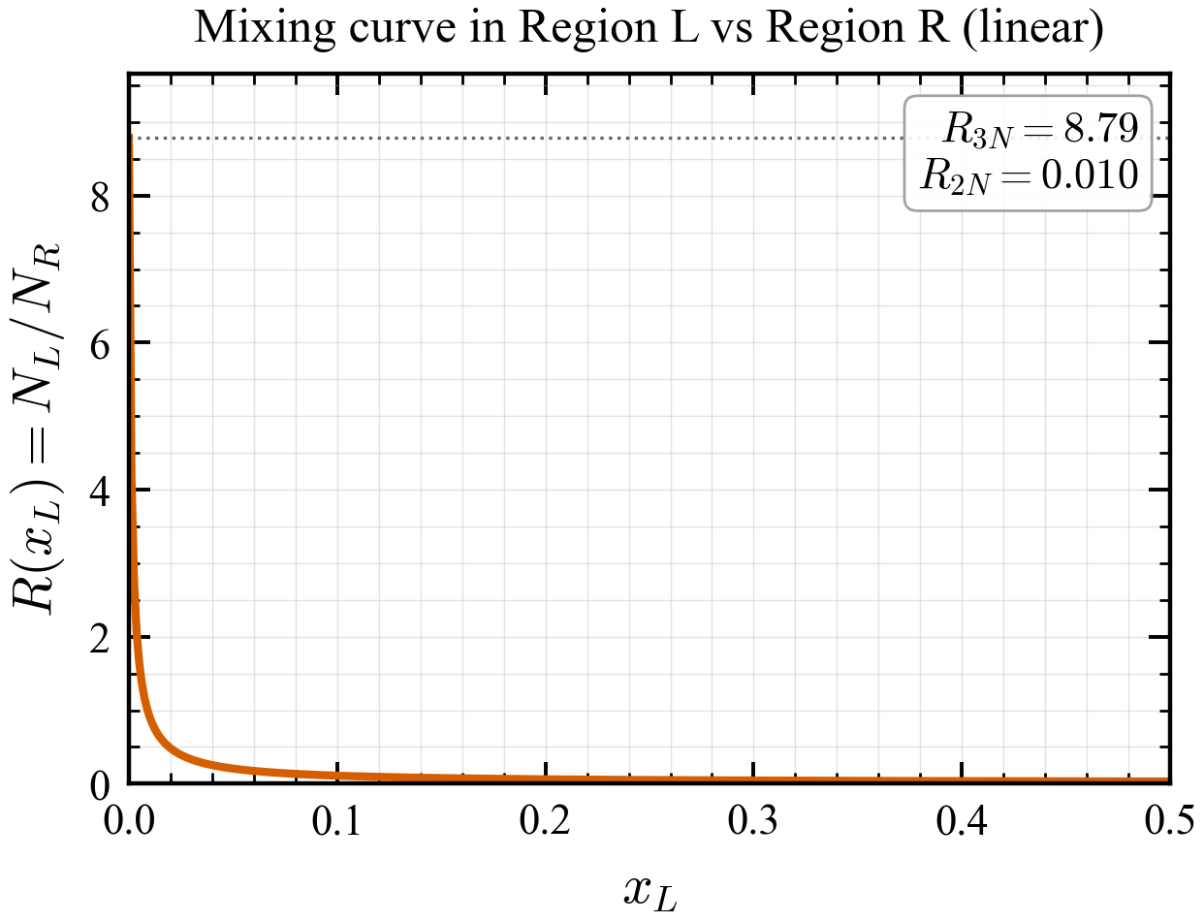
R is very sensitive to 3N

Slide 20
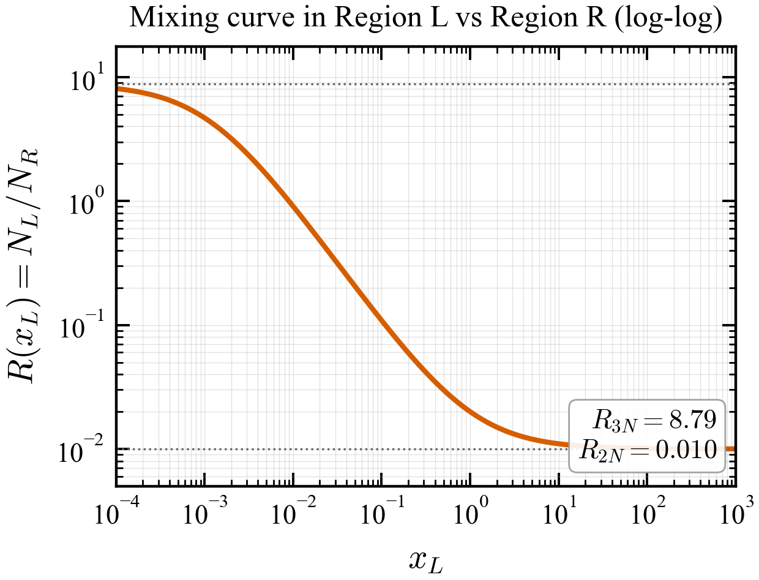
log-log version
=2N/3N in region L

