Slide 1
Swagger UI Presentation
Presenters:
Raz Cohen
Ilay Zeidman

Slide 2
Agenda
Introduction.
What is Swagger UI?
Swagger demonstration.
Swagger documentation.
Swagger design – UML Diagrams.
Challenges for Swagger UI project.
Competitors comparison.
Swagger UI contributors.

Slide 3
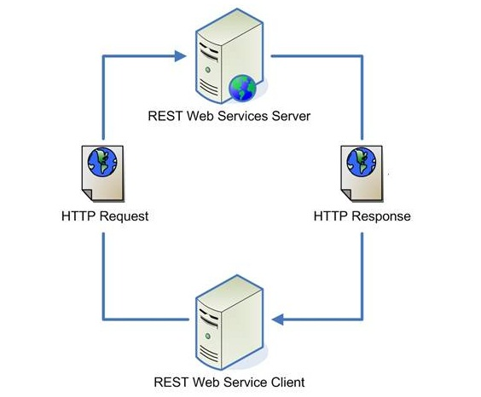
Introduction
Representational state transfer(REST) is a software architecture style consisting of guidelines and best practices for creating scalable web services.

Slide 4

Introduction
Problem: describing the different APIs url and parameters.
Solution:

Slide 5
What is Swagger UI?
Define a standard interface for describing APIs.
Allows both humans and computers to discover and understand the capabilities of the service without access to source code.
Similar to what interfaces have done for lower-level programming, Swagger removes the guesswork in calling the service.

Slide 6
What is Swagger UI?
Swagger is made up of three components:
Server: hosts the REST APIs that you want to use.
Swagger Server: holds the API specification.
Swagger UI Client: Reads a description of the APIs from the Swagger Server and renders it as a web-page and an interactive sandbox to play with the APIs.

Slide 7
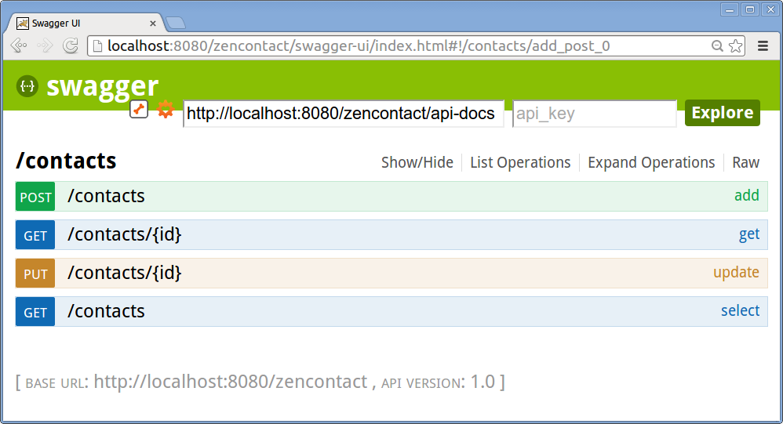
Swagger demonstration
Demo

Slide 8
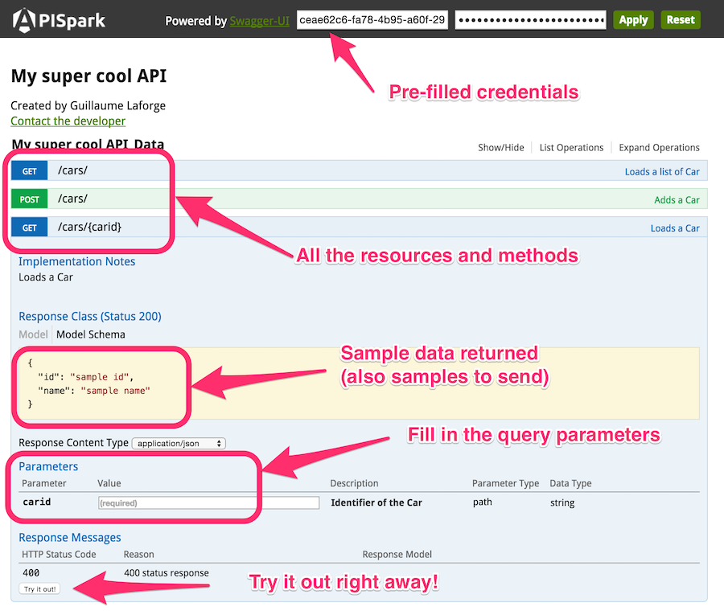
Swagger demonstration

Slide 9
Swagger documentation
Swagger specification repository – provides references for swagger related documentation and tools.
Repository – src/main/html/index.html - the main swagger ui html page.
Src/main/javascript/Swaggerui.js – the main javascript file for swagger.

Slide 10
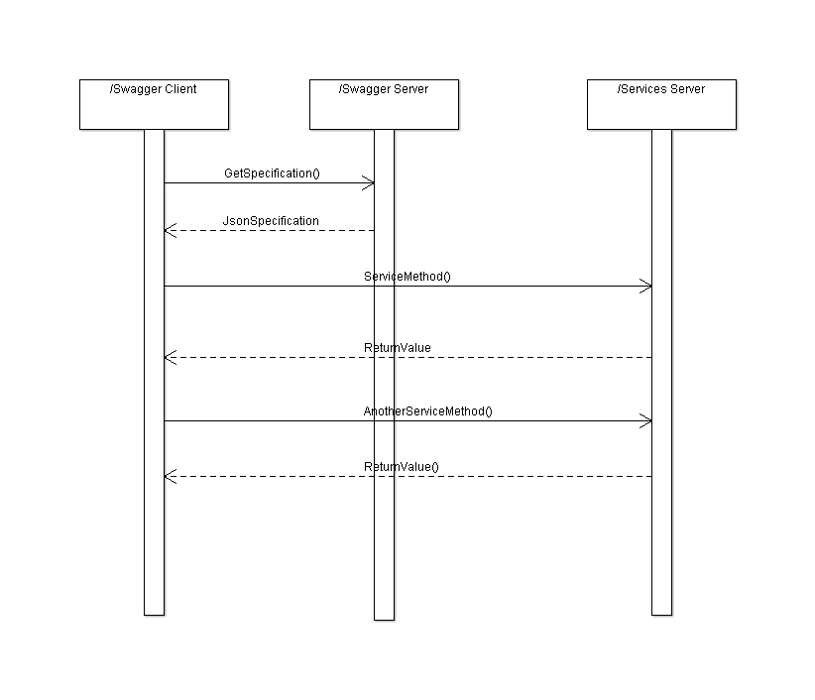
Swagger design – Sequence Diagram

Slide 11
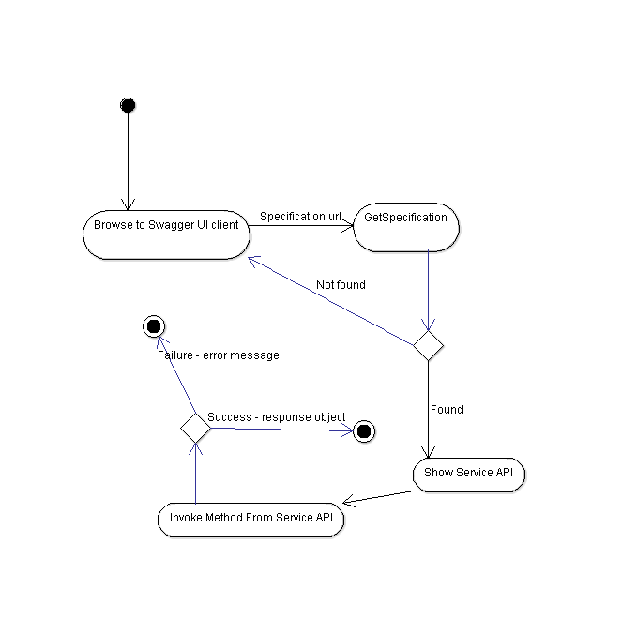
Swagger design – Activity Diagram

Slide 12
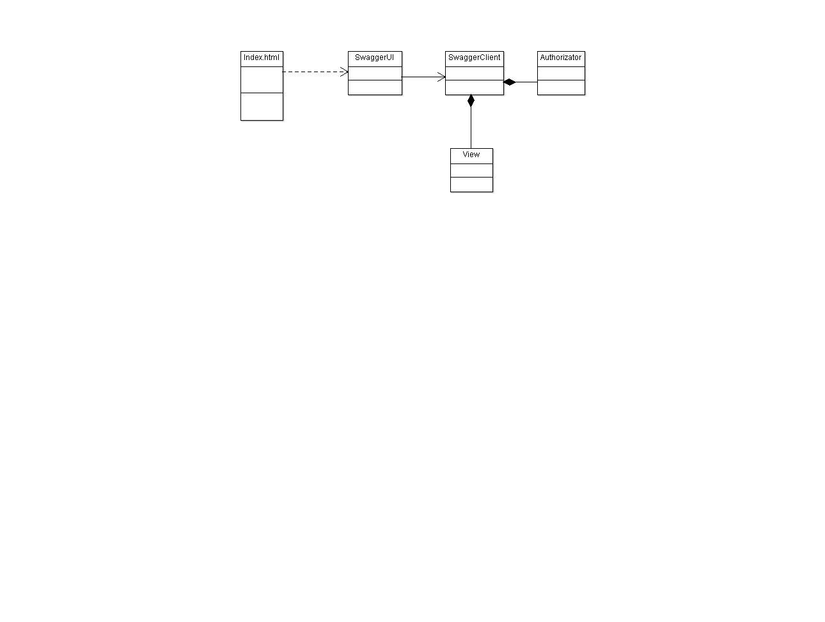
Swagger design – Class Diagram

Slide 13
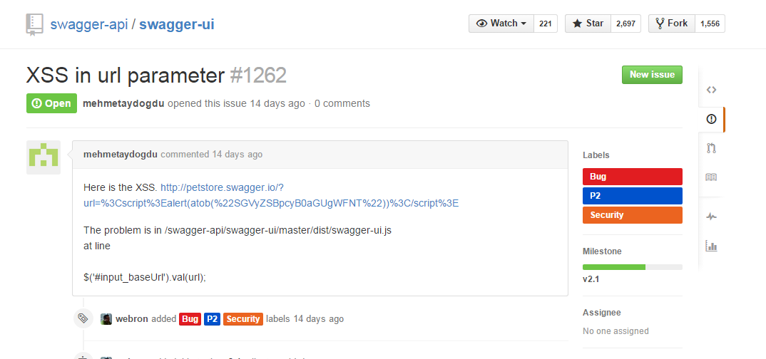
Challenges for Swagger UI project
Security Bugs: Cross Site Scripting(XSS).
enables attackers to inject client side script into web pages viewed by other users.

Slide 14
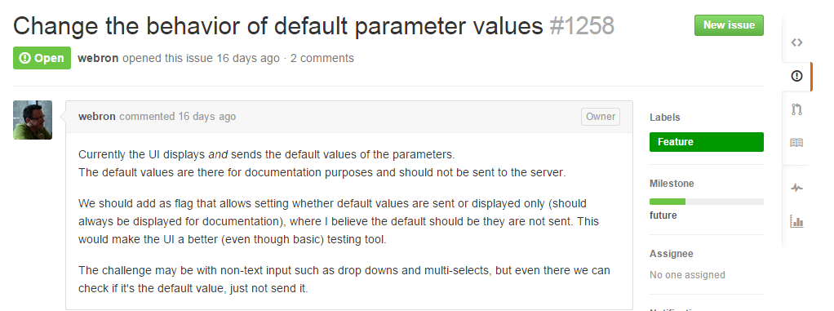
Challenges for Swagger UI project
Additional Features:
add a flag that allows setting whether default values are sent or displayed only.

Slide 15
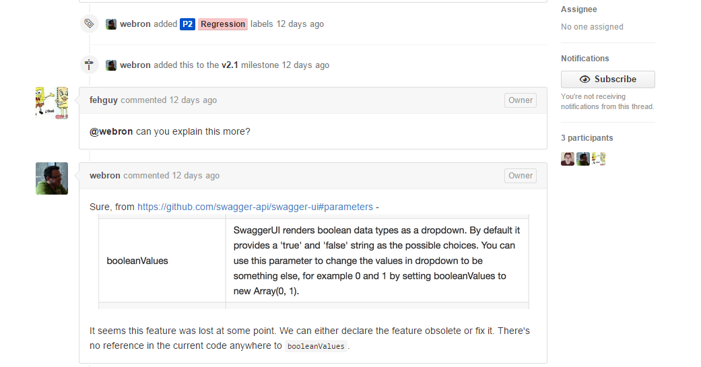
Challenges for Swagger UI project
Regression - config for booleanValues gone.

Slide 16

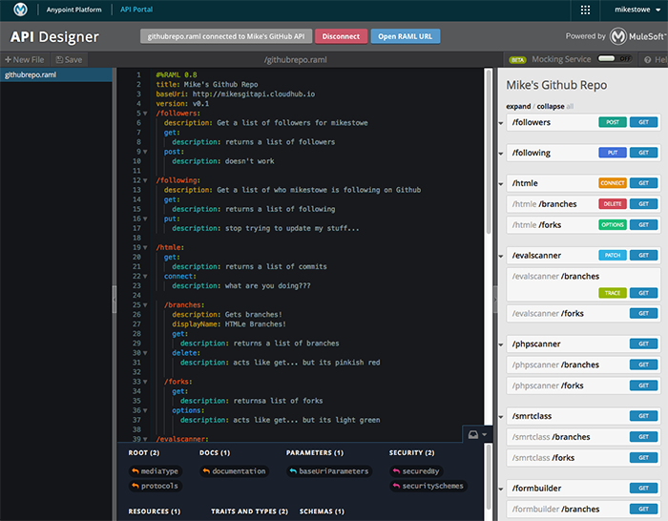
Competitors comparison

Slide 17
Competitors comparison
Not open source – can’t change the code to your needs.
Cost money.
Smaller community – need to wait sometimes couple of days for support from the support team.
Better UI.
Integration with more MuleSoft components.
Dedicated support team.

Slide 18
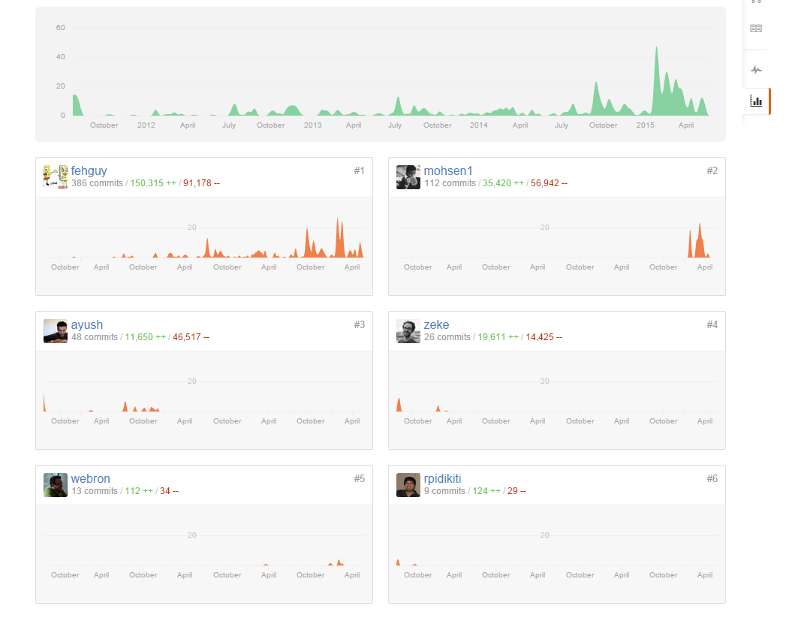
Swagger UI main contributors
Overall 81 contributors in 4 years

