Slide 1

Python in PHP: Applications
Jon Parise <jon@php.net>
2002 International PHP Conference
Frankfurt, Germany
November 6, 2002

Slide 2
About This Session
Overview of the Python extension for PHP application developers
Familiarity with PHP development practices is expected.
Python knowledge is not required, but familiarity will be helpful.
November 6, 2002
Python in PHP: Applications

Slide 3
About Me
Bachelor of Science in Information Technology from the Rochester Institute of Technology
Completing Masters of Entertainment Technology at Carnegie Mellon University
Software engineer at Maxis on The Sims Online
Long history of involvement with PHP, PEAR, and The Horde Project
Co-author of Professional PHP4 Programming
Long-time Pythonista!
November 6, 2002
Python in PHP: Applications

Slide 4
Ground Rules
Questions
  Ask for clarification at any time.
  Please save scope-expanding questions until the end.
Pacing
  Ask me to slow down if I move too quickly.
  I’m from New Jersey.
November 6, 2002
Python in PHP: Applications

Slide 5
Session Agenda
Overview
Benefits
Python Basics
Python in PHP Primer
Case Study: Mailman
PHP From Python
Goals and Considerations
Questions
November 6, 2002
Python in PHP: Applications

Slide 6
Confessions
No documentation currently exists on this subject aside from these slides.
An official release of the Python extension has yet to be made.
Build configuration still needs work.
November 6, 2002
Python in PHP: Applications

Slide 7
What Is The Python Extension?
Embedded Python interpreter
Interface handled by PHP extension
Python-to-PHP object proxy
Handles type conversions
Exposes PHP environment to Python
November 6, 2002
Python in PHP: Applications

Slide 8
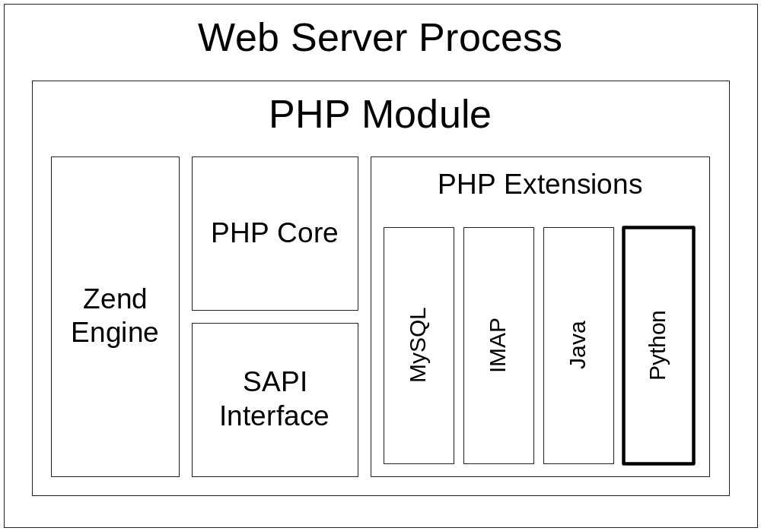
PHP Extension Architecture
November 6, 2002
Python in PHP: Applications

Slide 9
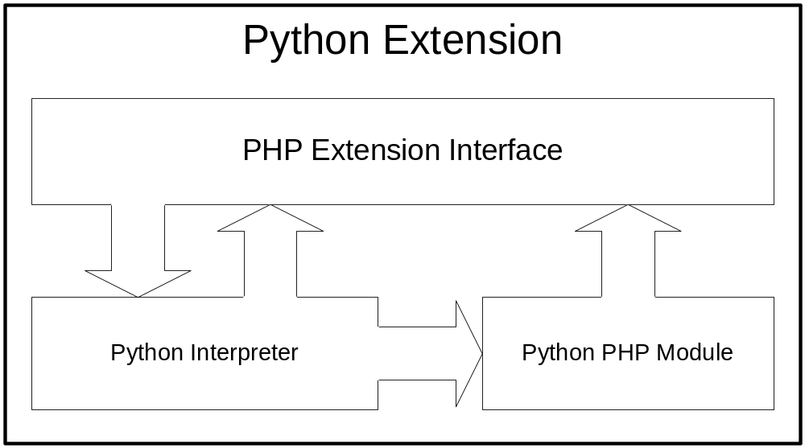
Python Extension Architecture
November 6, 2002
Python in PHP: Applications

Slide 10
Benefits
Integration
  PHP and Python can share common objects in the same system
Component Reuse
  Existing Python implementations don't need to be rewritten in PHP
Python Excels
  Python simply does some things better
November 6, 2002
Python in PHP: Applications

Slide 11
About Python
Python is an interpreted scripting language.
Python supports procedural, functional, and object-oriented techniques.
Like Java, nearly everything in Python is an object.
Python is actively developed.
Python is clean and comfortable.
November 6, 2002
Python in PHP: Applications

Slide 12
Python Basics – Indentation
Code blocks controlled by indentation
PHP:
if (condition) {
statement;
statement;
}
Python:
if condition:
statement
statement
November 6, 2002
Python in PHP: Applications

Slide 13
Python Basics – Variables
PHP:
$someInteger = 1;
$someFloat = 3.14;
$someString = 'Hello, Frankfurt!';
Python:
someInteger = 1
someFloat = 3.14
someString = 'Hello, Frankfurt!'
November 6, 2002
Python in PHP: Applications

Slide 14
Python Basics – Sequences
PHP:
$someList = array(0, 1, 2, 3);
Python:
someTuple = (0, 1, 2, 3)
someList = [0, 1, 2, 3]
November 6, 2002
Python in PHP: Applications

Slide 15
Python Basics – Mappings
PHP:
$someDict = array('one' => 1, 'two' => 2);
Python:
someDict = {'one' => 1, 'two' => 2}
November 6, 2002
Python in PHP: Applications

Slide 16
Python Basics – Functions
PHP:
function someFunction($arg1, $arg2)
{
echo "$arg1 and $arg2";
return $arg2;
}
Python:
def someFunction(arg1, arg2):
print arg1, 'and', arg2
return arg2
November 6, 2002
Python in PHP: Applications

Slide 17
Python Basics – Classes
PHP:
class someClass extends parentClass
{
function someClass()
{
echo "Constructor";
}
}
Python:
class someClass(parentClass):
def __init__(self):
print "Constructor"
November 6, 2002
Python in PHP: Applications

Slide 18
Python Basics – Modules
All variables, functions, and classes in a file belong to the same "module"
Similar to Java's "package" system
Python:
import sys
from math import sin, cos
November 6, 2002
Python in PHP: Applications

Slide 19
Python in PHP Primer
All Python execution happens from within the PHP process
  Same permissions as PHP
The Python environment persists for the life of the PHP request
Type conversion is handled by the Python extension
November 6, 2002
Python in PHP: Applications

Slide 20
Executing Python Code
Python:
print "Hello, Frankfurt!"
PHP:
echo py_eval('print "Hello, Frankfurt!"');
Output:
Hello, Frankfurt!
November 6, 2002
Python in PHP: Applications

Slide 21
Executing More Python Code
Python:
fruits = ['apples', 'oranges', 'pears']
for fruit in fruits:
print fruit
PHP:
$code = <<<END
fruits = ['apples', 'oranges', 'pears']
for fruit in fruits:
print fruit
END;
py_eval($code);
November 6, 2002
Python in PHP: Applications

Slide 22
Calling Python Functions
Python:
import math
print math.cos(0)
PHP:
echo py_call('math', 'cos', array(0));
Output:
1
November 6, 2002
Python in PHP: Applications

Slide 23
PHP to Python Type Conversion
PHP
Boolean
Long (Integer)
Double (Float)
String
Array
Object
Null
Python
Integer
Long
Double
String
Dictionary
Dictionary
None
November 6, 2002
Python in PHP: Applications

Slide 24
Python to PHP Type Conversion
Python
Integer
Long
Float
String
Sequence
Mapping
Object
None
PHP
Long
Long
Double
String
Array
Associative Array
PHP Python Object
NULL
November 6, 2002
Python in PHP: Applications

Slide 25
About Python Objects
The Python extension proxies Python objects
Python objects are represented as instances of a "python" class in PHP
PHP:
object(python)(1) {
[0]=>
int(4)
}
November 6, 2002
Python in PHP: Applications

Slide 26
Creating Python Objects
Python objects are creating using the Python() object constructor
Python (test.py):
class TestClass:
def __init__(self, s):
print 'TestClass:', s
PHP:
$test = new Python('test', 'TestClass',
array('Test Argument'));
November 6, 2002
Python in PHP: Applications

Slide 27
Manipulating Python Objects
Python objects work like PHP objects
Python (test.py):
class TestClass:
def __init__(self):
self.name = 'Testing'
def get_name(self):
return self.name
PHP:
$test = new Python('test', 'TestClass');
echo $test->name;
echo $test->get_name();
November 6, 2002
Python in PHP: Applications

Slide 28

Case Study – Mailman
Mailman is a popular mailing list manager
Mailman is written in Python
Let's build a PHP interface to Mailman!
November 6, 2002
Python in PHP: Applications

Slide 29
Mailman – Retrieving the Lists
/* Add Mailman paths to sys.path. */
py_path_prepend('/usr/local/mailman');
py_path_prepend('/usr/local/mailman/pythonlib');
/* Import the Mailman.MailList module. */
py_import('Mailman.MailList');
/* Retrieve a list of all know mailing lists. */
$names = py_call('Mailman.Utils', 'list_names');
November 6, 2002
Python in PHP: Applications

Slide 30
Mailman – Displaying Details
foreach ($names as $name) {
/* Create a new MailList object. */
$list = new Python('Mailman.MailList',
'MailList',
array($name, 0));
/* Display the list details. */
echo "Name: $name\n";
echo "Desc: $list->description\n";
echo "Link: $list->web_page_url\n";
echo "\n";
}
November 6, 2002
Python in PHP: Applications

Slide 31
Mailman – Sample Output
Name: mailman
Desc: Mailman Administration
Link: http://lists.indelible.org/mailman/
Name: test
Desc: Test Mailing List
Link: http://lists.indelible.org/mailman/
Name: pip
Desc: Python in PHP Mailing List
Link: http://lists.indelible.org/mailman/
November 6, 2002
Python in PHP: Applications

Slide 32
The PHP Python Module
Allows access to the PHP environment from within the embedded Python environment
Functionality is still very limited!
PHP:
$test = 'This is a test';
Python:
import php
print php.var('test')
November 6, 2002
Python in PHP: Applications

Slide 33
Python Extension INI Options
python.prepend_path
  Prepends a list of paths to sys.path
  Just like py_path_prepend()
python.append_path
  Appends a list of paths to sys.path
  Just like py_path_append()
November 6, 2002
Python in PHP: Applications

Slide 34
Building the Python Extension
$ cd pear/PECL/python
$ pear build
running: phpize
PHP Api Version : 20020307
Zend Module Api No : 20020429
Zend Extension Api No : 20021010
Python installation directory? [autodetect] :
building in /var/tmp/pear-build-jon/python-0.1
running: /home/jon/src/pear/PECL/python/configure --with-python
running: make
python.so copied to /home/jon/src/pear/PECL/python/python.so
November 6, 2002
Python in PHP: Applications

Slide 35
Goals and Considerations
Performance
  Multiple interpreters
  Threading
Exception Handling
Security
  File system restrictions
  Execution restrictions
  sys.path modification
November 6, 2002
Python in PHP: Applications

Slide 36
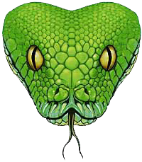

Questions
November 6, 2002
Python in PHP: Applications

Slide 37
References
Presentation Slides
http://www.csh.rit.edu/~jon/pres/
Python in PHP
http://www.csh.rit.edu/~jon/projects/pip/
Python
http://www.python.org/
November 6, 2002
Python in PHP: Applications

