Slide 1

Pokédex
Andrew Moffett and Ian Turner

Slide 2
Background
Intent
Work with and gain experience using JS, nodeJS, reactJS, and API functionality
Design and implement a working pokedex for both fun, and for personal use while playing the pokemon games

Slide 3
Team Member Intro
Andrew Moffett
Senior, Computer Science Major
Ian Turner
Senior, Computer Science Major

Slide 4
Technologies Used
ReactJS
NodeJS
HTML
CSS

Slide 5
Testbed Setup
OS: Windows 10
Browser: Chrome/Firefox
NodeJS version: v16.18.0
ReactJS version: 18.2.0

Slide 6
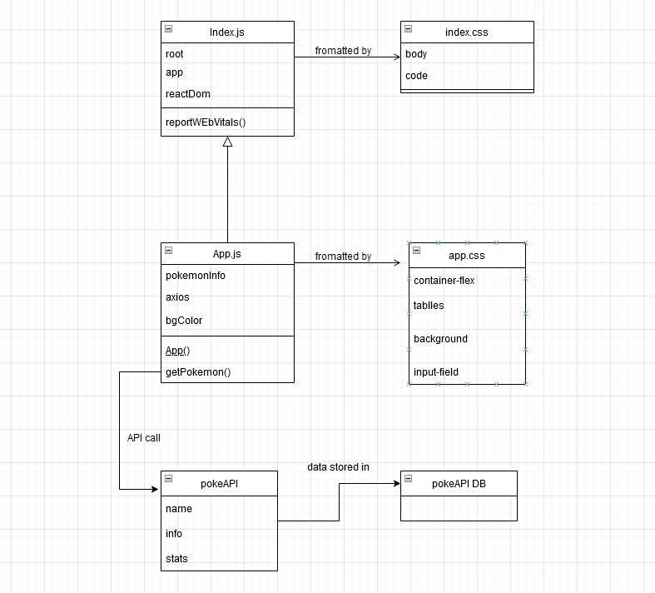
System Design

Slide 7
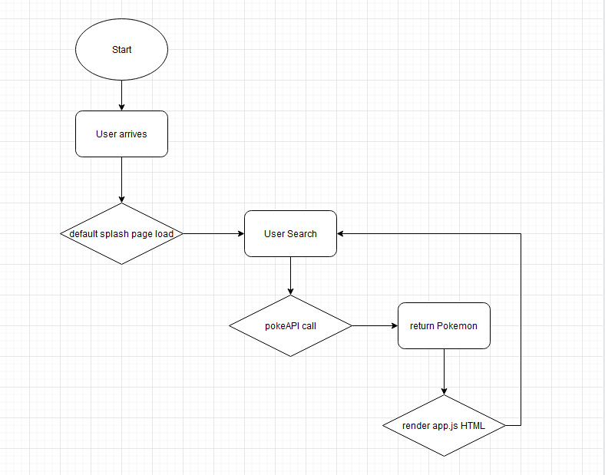
Workflow

Slide 8
Implementation Details
Installed nodeJS
Created base ReactJS app
npx create-react-app "appname"
Following documentation from pokeAPI, created a function to fetch pokemon data
Returns Mapped-collection, render HTML using JS to present the pokemon data
Manipulated css and HTML tags to 'beautify' app

Slide 9
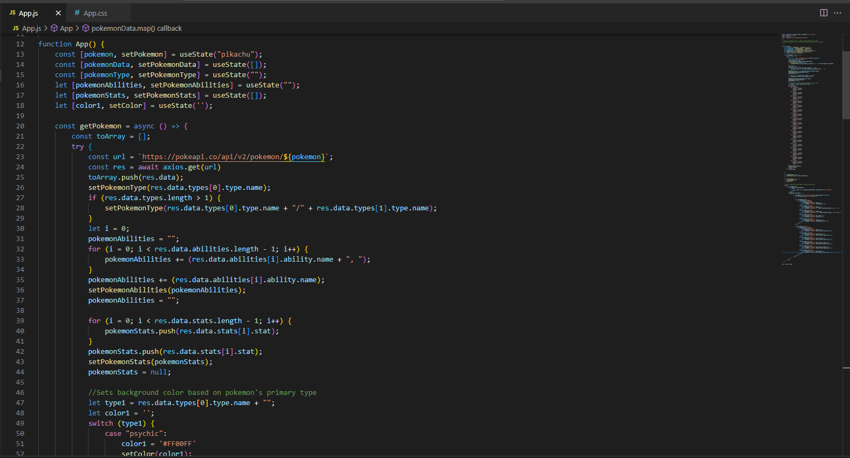

Slide 10
Demo

Slide 11
Conclusion
Experience working with JS
Experience designing a front-end for an application
Experience working with API calls

