Slide 1

HOW TO
WRITE BITCOIN
SMART CONTRACTS
Feb 28, 2019
BitcoinPHL meetup
ildarmgt@gmail.com

Slide 2
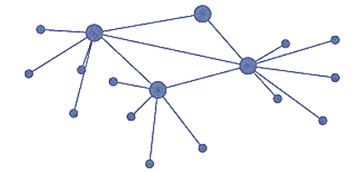

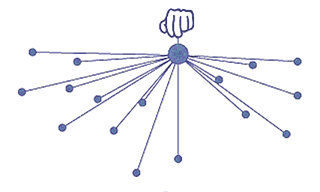
What is Bitcoin?
- Primary economic unit (coins) tracked on Bitcoin network
- Software protocols used to run the Bitcoin network
- Global public permissionless consensus network with control distributed to unlimited independent parties
Twitter owned servers
Bitcoin nodes
clients
Centralized
Twitter control
Decentralized
Bitcoin control
2.28.2019
BitcoinPHL
ildarmgt@gmail.com
2 of 15

Slide 3
Bitcoin basics:
Hash function: irreversible conversion to unique fixed size data (often smaller)
Space: the final frontier. These are the voyages of the starship Enterprise. Its continuing mission: to explore strange new worlds. To seek out new life and new civilizations. To boldly go where no one has gone before!
HASH( )
f9c5d4b228e5bd10f02e62f6c181f7bfd9d4572181531827108831db10d468ef
Encryption:
reversible conversion. Uses a key or a key pair.
encrypt( )( )
Alice’s public key
JVv8+4YtL9No4SPrzUknf9zzrV6nmYP5q6ETlsU3uP9a+sJUnFmt4n8noI2v3I3TEysCv1c=
MY GARAGE KEY IS 5588
2.28.2019
BitcoinPHL
ildarmgt@gmail.com
decrypt( )( )
Alice’s private key
3 of 15

Slide 4
Signatures:
prove a message was signed by a key pair owner
Send 10 Bitcoins
owned by
to Bob
Hash
function
Sign (encrypt) with
304502206e21798a42fae0e854281abd38bacd1aeed3ee3738d9e1446618c4571d1090db02210
9f59ab3f6d35d5c5a23760e37c476358c63293699477db3eb902d2effd84d078
Alice’s private key
Alice’s public key
reversible
Alice’s broadcast lets all see the message and its matching signature
Send 10 Bitcoins
owned by
to Bob
✓
Decrypt via
304502206e21798a42fae0e854281abd38bacd1aeed3ee3738d9e1446618c4571d1090db02210
Hash of
==
Alice’s public key
Alice’s public key
Anyone can check message was signed by Alice’s private key w/o seeing private key
2.28.2019
BitcoinPHL
ildarmgt@gmail.com
Classic Bitcoin protocol requires signature proof to allow spending
4 of 15

Slide 5
What is a smart contract?
Computerized transaction protocol that executes the terms of a contract
- Nick Szabo (1994)
Observability:
Verifiability:
Privity:
participants can observe any actions done to contract
protocol can prove what happens to participants
contract is protected from unspecified third parties
Szabo, N., First Monday, 1997, 2 (9)
Bitcoin is an example of a popular smart contract!
2.28.2019
BitcoinPHL
ildarmgt@gmail.com
5 of 15

Slide 6
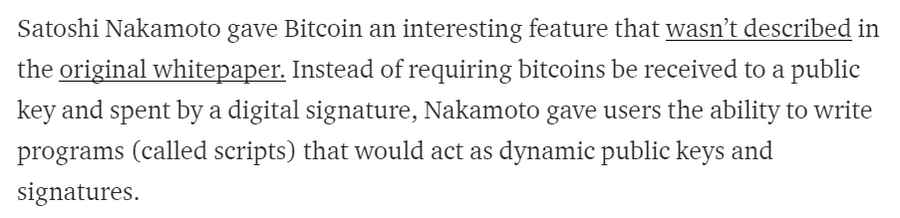

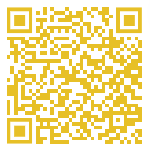
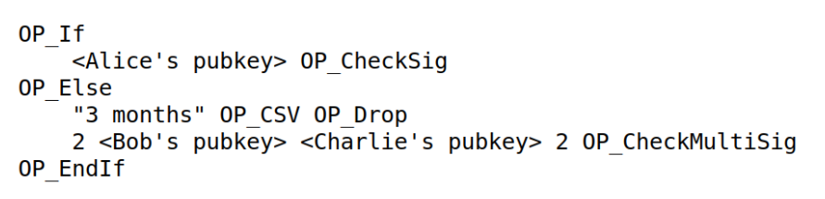
Custom Smart Contracts on Bitcoin
Conditions of contract
Bitcoin script example
Sole participants
specified via signature match
2.28.2019
BitcoinPHL
ildarmgt@gmail.com
Opcodes descriptions e.g. https://en.bitcoin.it/wiki/Script#Opcodes
6 of 15

Slide 7
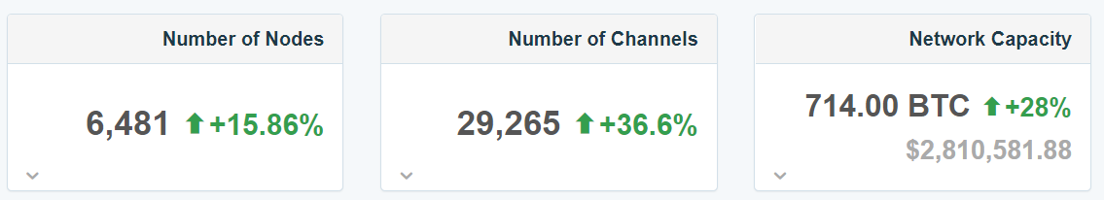
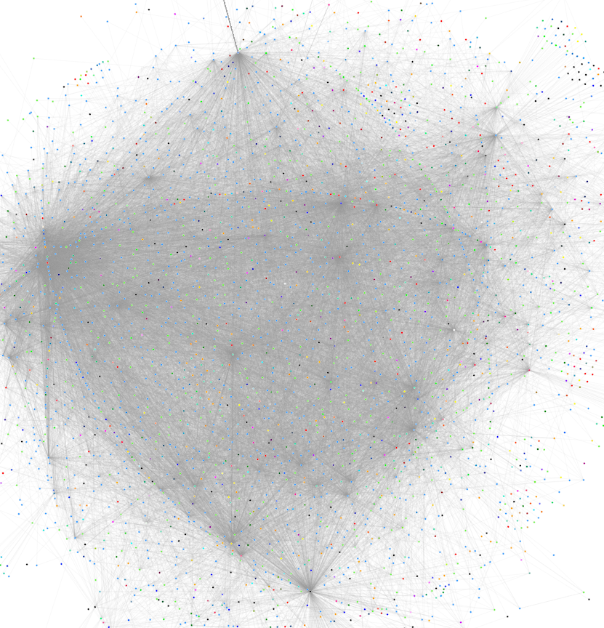
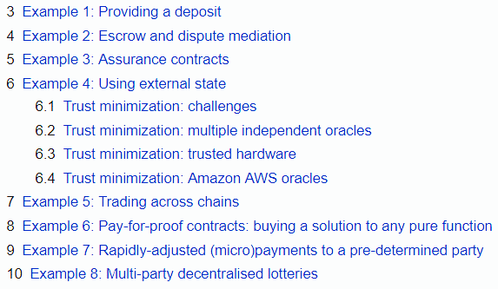

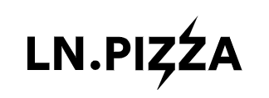
What has been done with Bitcoin scripts?
(atomic swaps)
https://1ml.com/
https://graph.lndexplorer.com/
Many other various examples online
(e.g. https://en.bitcoin.it/wiki/Contract)
2.28.2019
BitcoinPHL
ildarmgt@gmail.com
7 of 15

Slide 8
Decide what you need the contract to do
“I want to create a contract for access to my Bitcoins with my key. But, if I don’t move Bitcoins for 1 year,
my family inherits access with their own key”
Lets write it out in an easy to read pseudo-code
When claiming to be me:
Provide my signature or it fails
When claiming to be family:
Fail if 1 year has not passed.
Also provide family’s signature or it fails
2.28.2019
BitcoinPHL
ildarmgt@gmail.com
8 of 15

Slide 9
Two parts to running Bitcoin script contracts
Unchangeable script instructs execution of custom calculations on memory values
Values in memory come from the script or from user accessing the script
Examples:
if, add, check signature, verify if equal
Examples:
5, “banana”, Alice’s signature
Values in memory are in a stack, similar to an array of items:
[ 5, “banana”, Alice’s signature, TRUE ]
If script doesn’t fail early & last / top value is TRUE, the script will allow spending
2.28.2019
BitcoinPHL
ildarmgt@gmail.com
9 of 15

Slide 10
Let’s walk through the script for me
MEMORY STACK
mySignature, TRUE
Me =>
Bitcoin Contract
mySignature, TRUE
mySignature
IF
<myPublicKey> CHECKSIG
ELSE
<1 year> CHECKSEQUENCEVERIFY
DROP
<famPublicKey> CHECKSIG
ENDIF
mySignature, <myPublicKey>
TRUE
At end of script, if top value is TRUE, spending allowed
2.28.2019
BitcoinPHL
ildarmgt@gmail.com
10 of 15

Slide 11
Let’s walk through the script for my fam’
MEMORY STACK
family =>
famSignature, FALSE
Bitcoin Contract
famSignature, FALSE
IF
<myPublicKey> CHECKSIG
ELSE
<1 year> CHECKSEQUENCEVERIFY
DROP
<famPublicKey> CHECKSIG
ENDIF
famSignature
famSignature, <1 year>
famSignature, <famPublicKey>
TRUE
2.28.2019
BitcoinPHL
ildarmgt@gmail.com
At end of script, top value is TRUE, so spending allowed
11 of 15

Slide 12
Easiest ways to start
Creating transactions from scratch is hard, so many rely on helpful libraries
Examples
Python :
C++ :
Node.js :
JavaScript :
https://github.com/petertodd/python-bitcoinlib
https://github.com/libbitcoin/libbitcoin-system
https://github.com/bitcoinjs/bitcoinjs-lib
https://github.com/davidapple/bitcoinjs-lib-for-browsers
There’s always risk when using someone else’s code or nodes.
Quality of randomness in implementations varies
For quick and dirty simple example demo
I’ll use a JavaScript library and others’ nodes
Demo only using:
Modern browser
Text editor
Internet
Intended for demo only!!!
2.28.2019
BitcoinPHL
ildarmgt@gmail.com
12 of 15

Slide 13
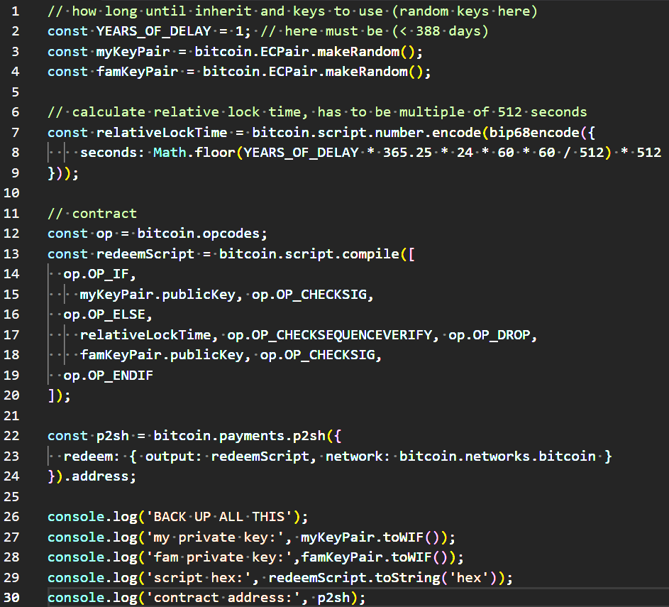
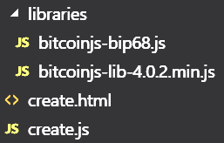
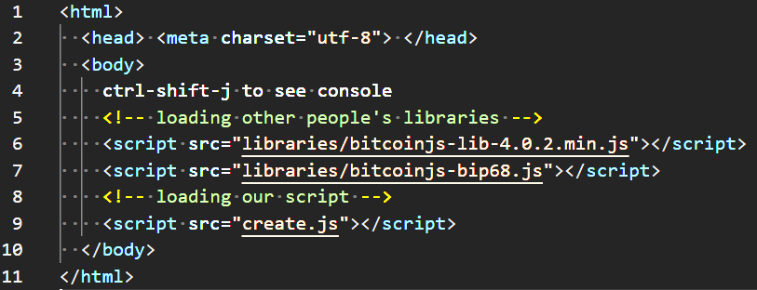
Calculate the contract address
(Code is on github)
Created create.js, create.html files and libraries/ folder
Grabbed browser-friendly library files from github
4. Filled out create.js
Custom
keys &
delay
3. Filled out create.html
Bitcoin Script
Links create.js to create.html
13 of 15

Slide 14
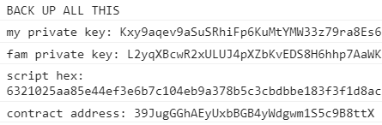
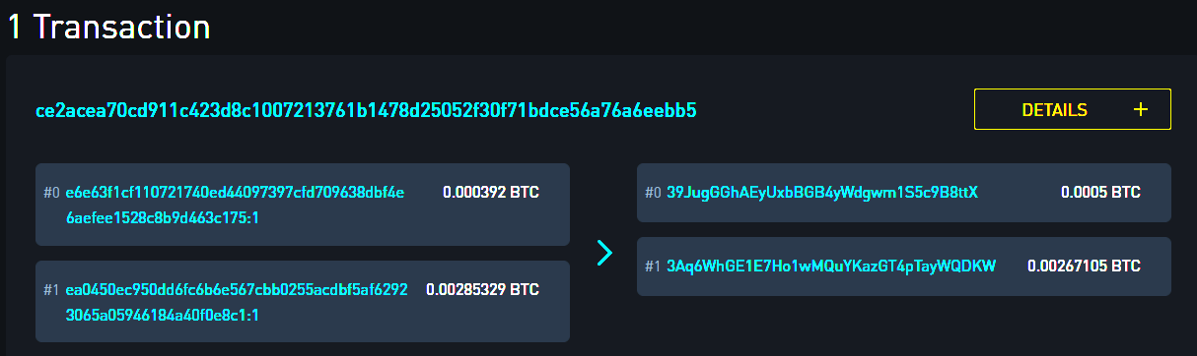
Funding contract & Finding contract UTXO
Opened create.html with Chrome & opened console (Ctrl-Shift-J)
6. The new unspent output “UTXO” in the contract can be identified by this txid & #0 vout
SECRETS
5. Funded the address from random phone wallet
blockstream.info/address/39JugGGhAEyUxbBGB4yWdgwm1S5c9B8ttX
Spending from P2SH output
will need w/e script required like
signing with private keys
+ output to spend (txid & vout)
+ entire original script itself
Transaction id
vout
14 of 15

Slide 15
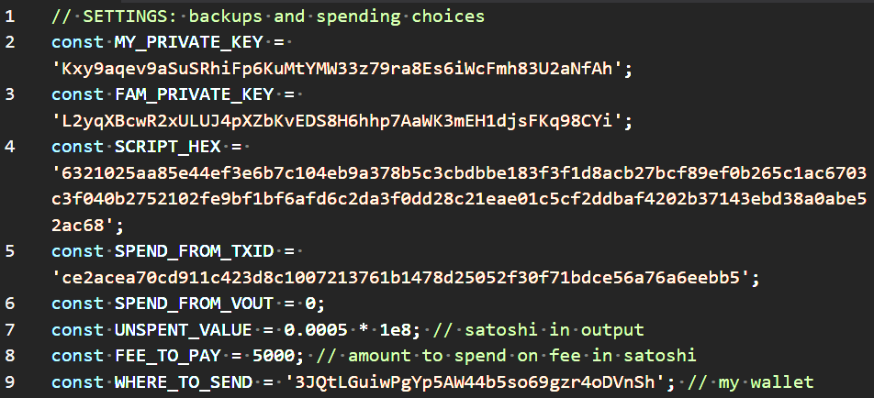
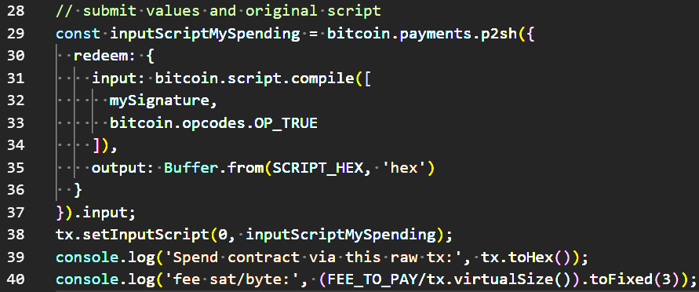
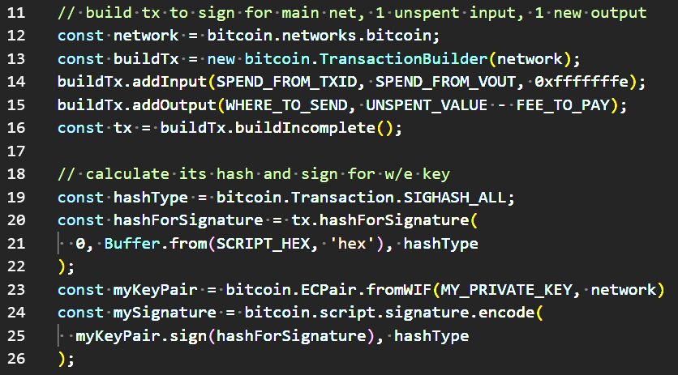

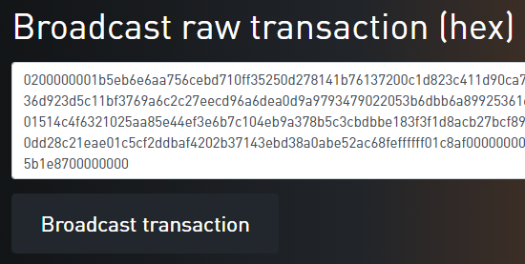
Code to spend the contract output
(Code is on github)
Need new spend.html & spend.js files in same folder, linked like before
User submitted values
Backed up data, from-to info, and amounts
Add values to submit & display raw tx
spend.html in Chrome
blockstream.info/tx/push
When ready, broadcast raw tx. Done.
Assembling & signing (standard steps)
15 of 15

Slide 16
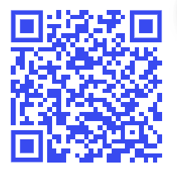
These slides
All code used (demo use only & possible typos)
github.com/ildarmgt/client-side-bitcoin-contract-demo
take a picture if no QR code reader like Google Lens
2.28.2019
BitcoinPHL
ildarmgt@gmail.com

