Slide 1

ANKARA UNIVERSITY
DEPARTMENT
OF
COMPUTER ENGINEERING
Dog Breed Identification
Using Convolutional Neural Networks
Students’ Number: 21290256-20290346
Students’ Name SURNAME: Tarık KOÇAK-İldeha KALE
Advisor Name SURNAME : Assoc. Prof. Dr. Yılmaz AR

Slide 2

CONTENTS
1. INTRODUCTION
1.1. Problem Definition
1.2. Project’s Goal
1.3. Challenges in Field
2. LITERATURE
3. MATERIALS AND METHODS
3.1. Materials
3.2. Methods
4. IMPLEMENTATION
5. CONCLUSION
6. FUTURE WORKS
7. REFERENCES

Slide 3
1. INTRODUCTION
1.1. Problem Definition
The classification of dog breeds based on visual features poses significant challenges due to the high similarity in physical characteristics among certain breeds and the extensive variability within large datasets. These factors make it difficult for models to differentiate between breeds with subtle differences while maintaining accuracy across diverse examples.
1.2. Project’s Goal
The primary goal of the project is to achieve the highest accuracy by experimenting with existing CNN models for dog breed classification and to evaluate the suitability of these models for practical applications. Additionally, the project includes the following sub-goals:
Analyzing the performance of deep learning models on a dataset containing various dog breeds.
Comparing the accuracy rates of different models on the dataset.
Visualizing and interpreting the results to report the overall performance of the project.

Slide 4
1. INTRODUCTION
1.3. Challenges in Field
Visual Similarity: Many breeds share similar physical traits, making classification challenging. For example, distinguishing between Golden Retrievers and Labrador Retrievers can be difficult
Imbalanced Datasets: Some breeds may have significantly fewer images, leading to biased model predictions. Researchers address this issue through oversampling, augmentation, or weighted loss functions.
Data Quality: Poor image quality, occlusions, or varying lighting conditions may affect classification accuracy.

Slide 5
2. LITERATURE
Many previous studies have used deep learning techniques to solve the problem of dog breed classification.
In the study titled "Breakthrough Conventional Based Approach for Dog Breed Classification Using CNN with Transfer Learning“ the CNN model trained with transfer learning achieved an accuracy rate of 96.75%. (https://people.csail.mit.edu/khosla/papers/fgvc2011.pdf)
Another study, “Dog Identification using Soft Biometrics and Neural Networks,” identified dog breeds using soft biometric features and neural networks and achieved 93% accuracy. (https://ieeexplore.ieee.org/abstract/document/8851971)
Moreover, The classification made with traditional methods (HOG and LBP) provided an accuracy rate of 79.25%. This project aims to integrate these methods and further increase their accuracy rates. (https://ieeexplore.ieee.org/abstract/document/8929955)
CNN-based methods have shown promise in dog breed classification, with pretrained models providing strong baselines. However, challenges like dataset diversity and breed similarity require innovative solutions, such as ensemble methods or domain-specific fine-tuning, for further improvement

Slide 6
3. MATERIALS AND METHODS
3.1. Materials
In this study, the Stanford Dogs Dataset was used to classify dog breeds. This dataset consists of images of 120 unique dog breeds, with a total of 20,580 data points. The dataset is divided into two main folders: "train" (training) and "test" (testing). The training set contains 12,000 images used for model training, while the test set includes 8,580 images used for model evaluation. The dataset includes multiple images of each dog breed taken from various angles, providing a rich source of data that helps the model perform accurate classifications under different conditions. The images are labeled with the corresponding dog breed, making it ideal for supervised learning tasks.
Other materials used in this study:
Software: Python programming language and machine learning libraries (such as TensorFlow, Keras, scikit-learn) were used.
Hardware: The training and modeling processes were conducted on Google Colab, utilizing its A100 GPU capabilities for faster computation.
Dataset: https://www.kaggle.com/datasets/miljan/stanford-dogs-dataset-traintest/data

Slide 7
3. MATERIALS AND METHODS
3.2. Methods
In this study, deep learning models were employed to classify dog breeds using the Stanford Dogs Dataset. The following models were used for image classification:
ResNet50: The ResNet50 model, a deep residual network with 50 layers, was used for its ability to address the vanishing gradient problem and its success in image classification tasks. It was fine-tuned using the pre-trained weights from ImageNet, and the model was trained on the dog breed dataset.
VGG19: The VGG19 model, known for its simplicity and depth, was used for its effectiveness in feature extraction from images. It consists of 19 layers, and similar to ResNet50, it was fine-tuned using pre-trained weights from ImageNet.
MobileNetV2: MobileNetV2 was chosen for its efficiency in mobile and edge computing environments. It is a lightweight model with a smaller number of parameters, making it suitable for faster training and inference while still providing good accuracy in image classification tasks.
Xception: Xception, an extension of the Inception architecture, was used for its high performance in image recognition tasks. It uses depthwise separable convolutions, making it more efficient in terms of both computation and model size

Slide 8
4. IMPLEMENTATION
In our dataset, we have two folders: "train" and "test." The "train" folder contains 12,000 data points, while the "test" folder has 8,580 data points, which is an unnecessarily large number for testing. To address this issue, we merged all the data points into a single dataset and then shuffled them. After shuffling, we split the dataset into 10 components, each containing 2,058 data points. For training and validation, we used 8 components (7 for training and 1 for validation), while the remaining 2 components were reserved for testing.
As mentioned before, we used pretrained models such as ResNet50, VGG19, Xception, and MobileNetV2, each fine-tuned to our specific task by modifying the final layer to match the number of classes in our dataset. These models were trained using a combination of the AdamW optimizer and cross-entropy loss. To further enhance our model's performance, we implemented an early stopping mechanism during training to prevent overfitting and ensure that the model does not continue training once the validation loss stops improving. The Early Stopping class monitors the validation loss, and if it doesn't improve after a specified number of epochs (patience), the training is halted. Throughout the training process, we tracked the training and validation loss and accuracy, visualizing the results with plots that help in understanding the model's learning progress.
This setup, along with early stopping, allowed us to save the best-performing model, which was later used for testing and evaluation.

Slide 9
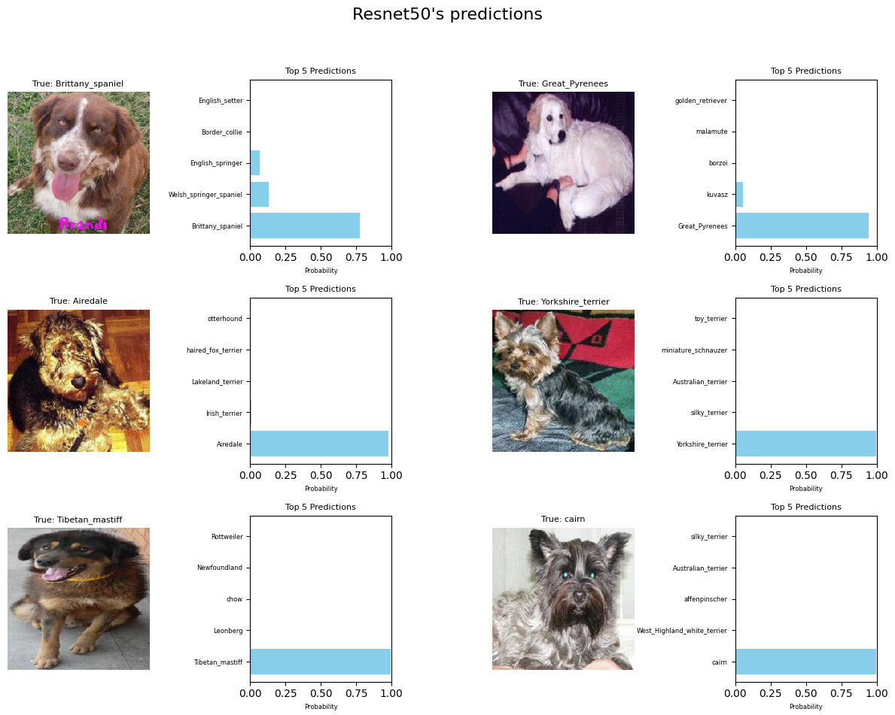
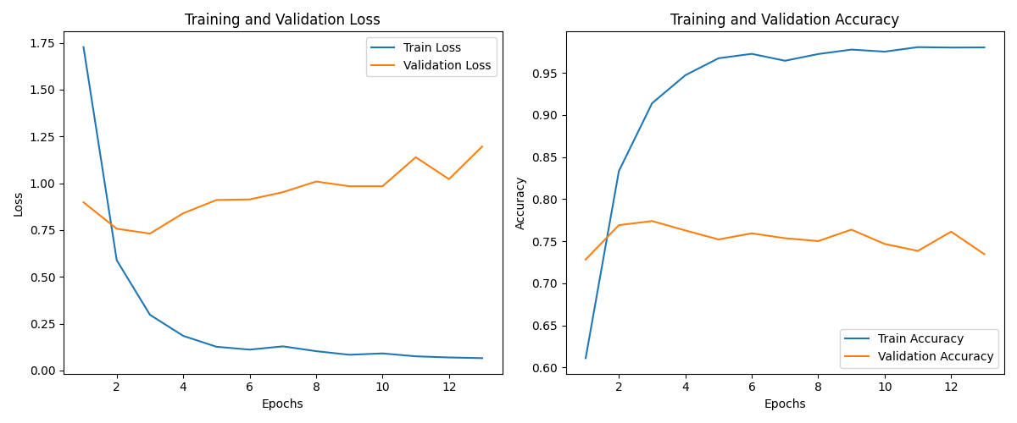
4. IMPLEMENTATION
Resnet50 model’s Best Result:
Train Loss: 0.2975, Train Acc: 0.9141
Val Loss: 0.7313, Val Acc: 0.7741
Test Loss: 0.7209, Test Accuracy: 0.7903

Slide 10
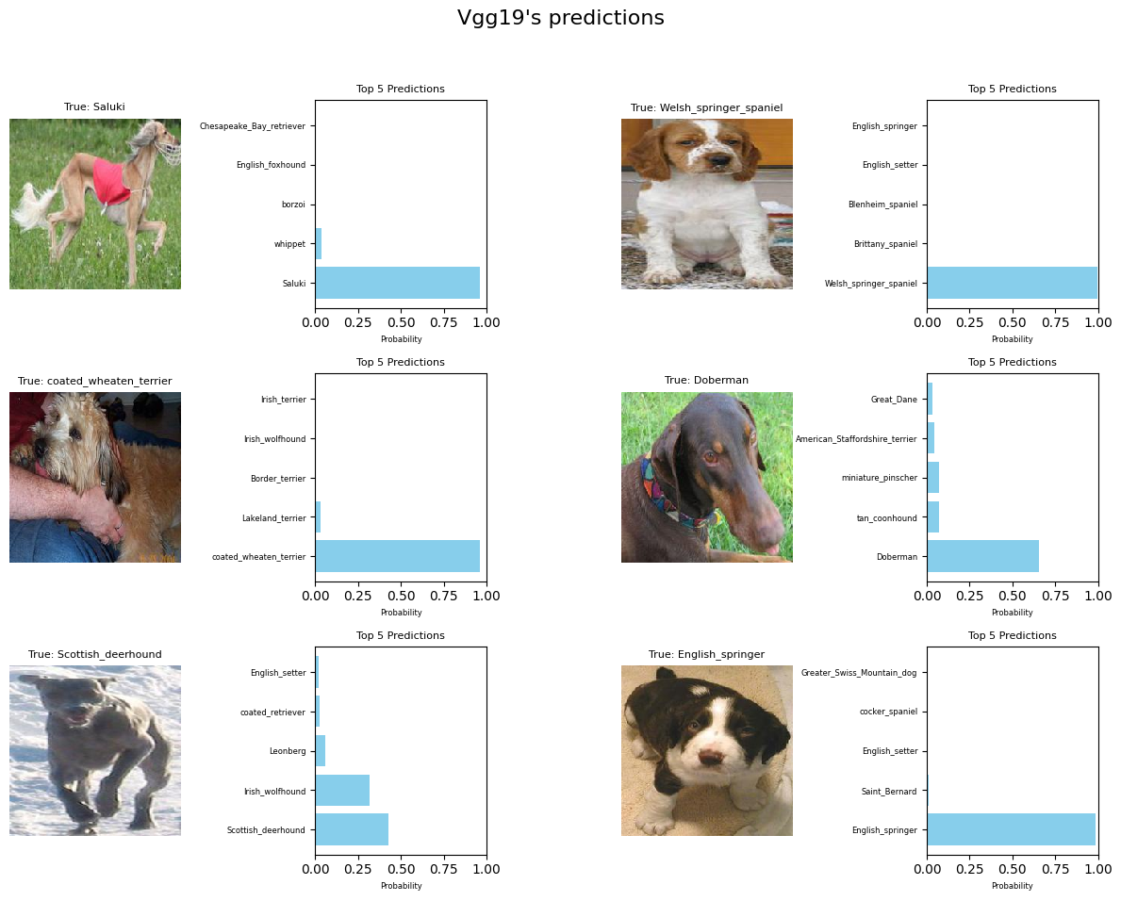
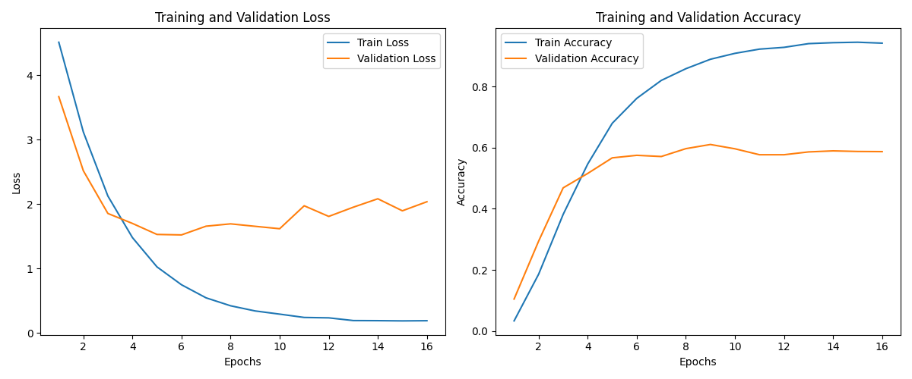
4. IMPLEMENTATION
VGG19 model’s Best Result:
Train Loss: 0.7501, Train Acc: 0.7613
Val Loss: 1.5236, Val Acc: 0.5748
Test Loss: 1.4794, Test Accuracy: 0.5850

Slide 11
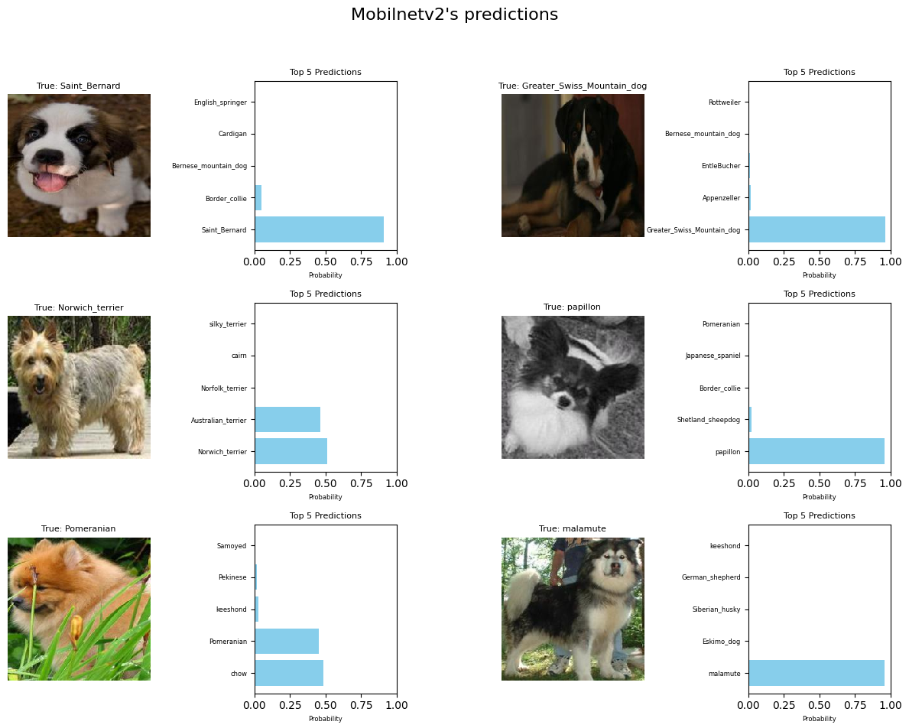
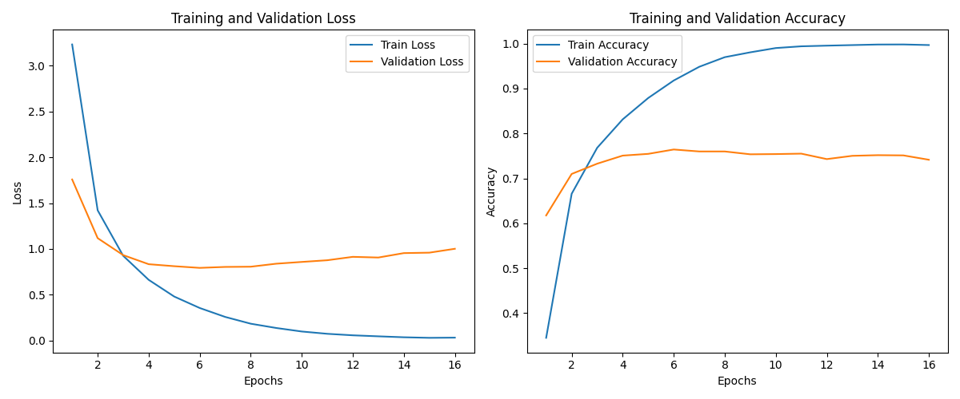
4. IMPLEMENTATION
MobilnetV2 model’s Best Result:
Train Loss: 0.3540, Train Acc: 0.9179
Val Loss: 0.7924, Val Acc: 0.7643
Test Loss: 0.7566, Test Accuracy: 0.7607

Slide 12
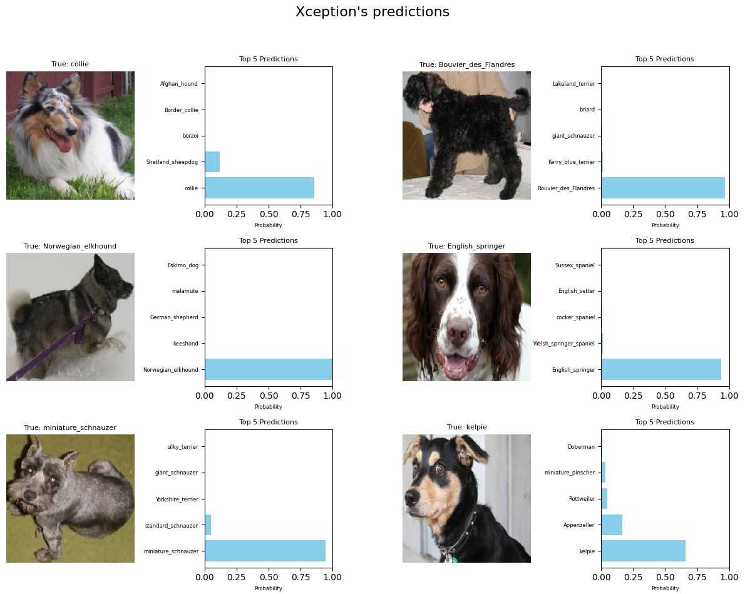
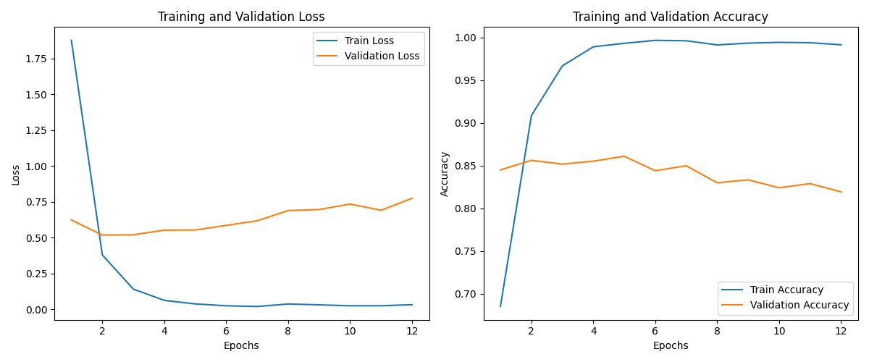
4. IMPLEMENTATION
Xception model’s Best Result:
Train Loss: 0.1404, Train Acc: 0.9669
Val Loss: 0.5193, Val Acc: 0.8518
Test Loss: 0.5050, Test Accuracy: 0.8469

Slide 13
5. CONCLUSION
Xception stands out as the top performer, achieving the highest training and test accuracy, demonstrating excellent generalization. ResNet50 also delivers strong results, with impressive performance and good generalization capabilities. MobileNetV2 provides competitive results, though slightly lower than ResNet50 and Xception. In contrast, VGG19 underperforms significantly, particularly in terms of test accuracy, suggesting it may not be the optimal choice for this specific task.

Slide 14
6. FUTURE WORKS
The following strategies can be applied for further improvements:
Improving model performance: Exploring new deep learning architectures, such as Transformer-based models or advanced CNN structures, could improve generalization and accuracy. Additionally, leveraging transfer learning from larger models and combining multiple models through ensemble methods like bagging or boosting can enhance performance, especially with limited data
Data improvements: Enhancing model performance can be achieved through data augmentation techniques (such as rotation, flipping, or color adjustments), collecting more data—especially from underrepresented classes—to address class imbalances, and improving data labeling to ensure accuracy and reduce errors.
Model Optimization: Improving performance can be achieved through hyperparameter tuning, including refining the learning rate, batch size, and optimization algorithm. Exploring alternative optimization algorithms like SGD or RMSprop, along with a more thorough search for optimal hyperparameters, can further enhance model performance

Slide 15
REFERENCES
[1] He, K., Zhang, X., Ren, S., & Sun, J. (2016). Deep Residual Learning for Image Recognition. Proceedings of the IEEE Conference on Computer Vision and Pattern Recognition, 770-778.
[2] Simonyan, K., & Zisserman, A. (2015). Very Deep Convolutional Networks for Large-Scale Image Recognition. International Conference on Learning Representations.
[3] Chollet, F. (2017). Xception: Deep Learning with Depthwise Separable Convolutions. Proceedings of the IEEE Conference on Computer Vision and Pattern Recognition, 1251-1258.
[4] Sandler, M., Howard, A., Zhu, M., Zhmoginov, A., & Chen, L. C. (2018). MobileNetV2: Inverted Residuals and Linear Bottlenecks. Proceedings of the IEEE Conference on Computer Vision and Pattern Recognition, 4510-4520.
[5] Krizhevsky, A., Sutskever, I., & Hinton, G. E. (2012). Imagenet Classification with Deep Convolutional Neural Networks. Advances in Neural Information Processing Systems (NeurIPS), 1097-1105.
[6] Eryigit, Recep, Yilmaz Ar, and Bulent Tugrul. "Classification of Trifolium Seeds by Computer Vision Methods." WSEAS Transactions on Systems, vol. 22, 2023, p. 34.
[7] Kadari, Sneha I., Shubhada S. Kulkarni, and Sharada G. Kulkarni. "Dog Breed Prediction Using Convolutional Neural Network." International Journal of Computer Applications, vol. 9, no. 5, June 2020, pp. 1-6

Slide 16

ANKARA UNIVERSITY
DEPARTMENT
OF
COMPUTER ENGINEERING
THANK YOU
Students’ Number: 21290256-20290346
Students’ Name SURNAME: Tarık KOÇAK-İldeha KALE
Advisor Name SURNAME : Assoc. Prof. Dr. Yılmaz AR
Şifa ÖZSARI ozsaris@ankara.edu.tr

