Slide 1
净值
 | 权益 | 净值
2018/1/15 | 9,836,736 | 0.9837
2018/1/16 | 9,743,676 | 0.9744
2018/1/17 | 9,685,921 | 0.9686
2018/1/18 | 9,704,061 | 0.9704
2018/1/19 | 9,729,899 | 0.9730

Slide 2
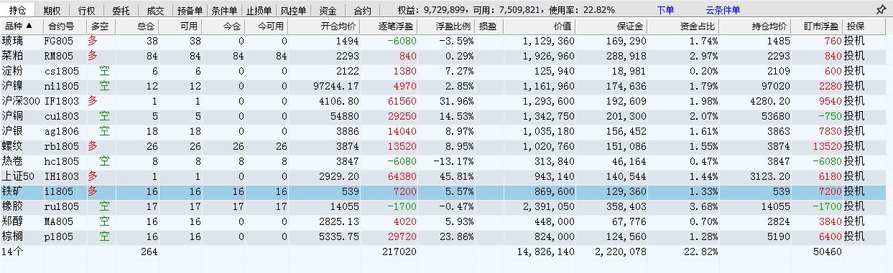
期末持仓

Slide 3
开仓日 | 合约 | 开仓 | 开仓价 | 平仓价 | 平仓日 | 盈亏 | 收盘价 | 持仓盈亏
2018/1/16 | CU1803 | -5 | 54880 |  |  |  | 53710 | 29250
2018/1/19 | RB1805 | 26 | 3874 |  |  |  | 3926 | 13520
2018/1/17 | AG1806 | -18 | 3886 |  |  |  | 3836 | 13500
2018/1/18 | NI1805 | -12 | 97244.17 |  |  |  | 96830 | 4970.04
2018/1/17 | MA805 | -16 | 2825.125 |  |  |  | 2800 | 4020
2018/1/17 | CS1805 | -6 | 2122 |  |  |  | 2097 | 1500
2018/1/19 | RM805 | 84 | 2293 |  |  |  | 2294 | 840
2018/1/19 | RU1805 | -17 | 14055 |  |  |  | 14065 | -1700
2018/1/19 | HC1805 | -8 | 3847 |  |  |  | 3923 | -6080
2018/1/18 | FG805 | 38 | 1494 |  |  |  | 1485 | -6840
2018/1/19 | I1805 | 16 | 539 |  |  |  | 543.5 | 7200
2018/1/16 | RM805 | 72 | 2269 | 2270 | 2018/1/19 | 720
2018/1/18 | RU1805 | 1 | 14180 | 14170 | 2018/1/19 | -100
2018/1/17 | BU1805 | 3 | 2738 | 2734 | 2018/1/17 | -120
2018/1/17 | M1805 | -33 | 2761 | 2762 | 2018/1/17 | -330
2018/1/17 | BU1806 | 10 | 2768 | 2764 | 2018/1/18 | -400
2018/1/17 | BU1805 | 9 | 2732 | 2726 | 2018/1/17 | -540
2018/1/17 | PP1805 | 36 | 9389.917 | 9385 | 2018/1/17 | -885
2018/1/17 | V1805 | -34 | 6570 | 6575.588 | 2018/1/17 | -950
2018/1/17 | FG805 | 61 | 1478 | 1477 | 2018/1/18 | -1220
2018/1/17 | RU1805 | 6 | 14244.17 | 14215 | 2018/1/17 | -1750
2018/1/17 | RU1805 | 6 | 14229.17 | 14190 | 2018/1/17 | -2350
2018/1/15 | CU1803 | 6 | 55030 | 54950 | 2018/1/16 | -2400
2018/1/17 | V1805 | -34 | 6570 | 6585 | 2018/1/17 | -2550
2018/1/17 | RU1805 | -7 | 14200 | 14240 | 2018/1/17 | -2800
2018/1/17 | PP1805 | 36 | 9438.139 | 9421.944 | 2018/1/17 | -2915
2018/1/17 | AU1806 | 7 | 281.65 | 281.15 | 2018/1/17 | -3500
2018/1/17 | AG1806 | -17 | 3880 | 3895 | 2018/1/17 | -3825
2018/1/15 | RM805 | 64 | 2271 | 2265 | 2018/1/15 | -3840
2018/1/19 | RU1805 | -17 | 14155 | 14185 | 2018/1/19 | -5100
2018/1/17 | RB1805 | -31 | 3804.935 | 3826 | 2018/1/17 | -6530
2018/1/15 | SF805 | -51 | 6444 | 6472 | 2018/1/15 | -7140
2018/1/17 | RU1805 | -16 | 14129.69 | 14175 | 2018/1/18 | -7250
2018/1/15 | CS1805 | 89 | 2150 | 2137 | 2018/1/15 | -11570
2018/1/17 | CS1805 | 133 | 2132 | 2123 | 2018/1/17 | -11970
2018/1/15 | ZC805 | 30 | 633 | 629 | 2018/1/15 | -12000
2018/1/15 | CU1803 | -10 | 54520 | 54826 | 2018/1/15 | -15300
2018/1/12 | RB1805 | -30 | 3781.333 | 3834 | 2018/1/17 | -15800
2018/1/15 | FG805 | 50 | 1491 | 1472 | 2018/1/17 | -19000
2018/1/15 | IC1803 | 1 | 6293.6 | 6196 | 2018/1/15 | -19520
2018/1/15 | TA805 | 76 | 5680 | 5624 | 2018/1/17 | -21280
2018/1/16 | AG1806 | 32 | 3927 | 3879 | 2018/1/17 | -23040
2018/1/12 | V1805 | 40 | 6795 | 6640 | 2018/1/17 | -31000
2018/1/15 | NI1805 | 19 | 99620 | 97180 | 2018/1/17 | -46360
成交和持仓收益

Slide 4
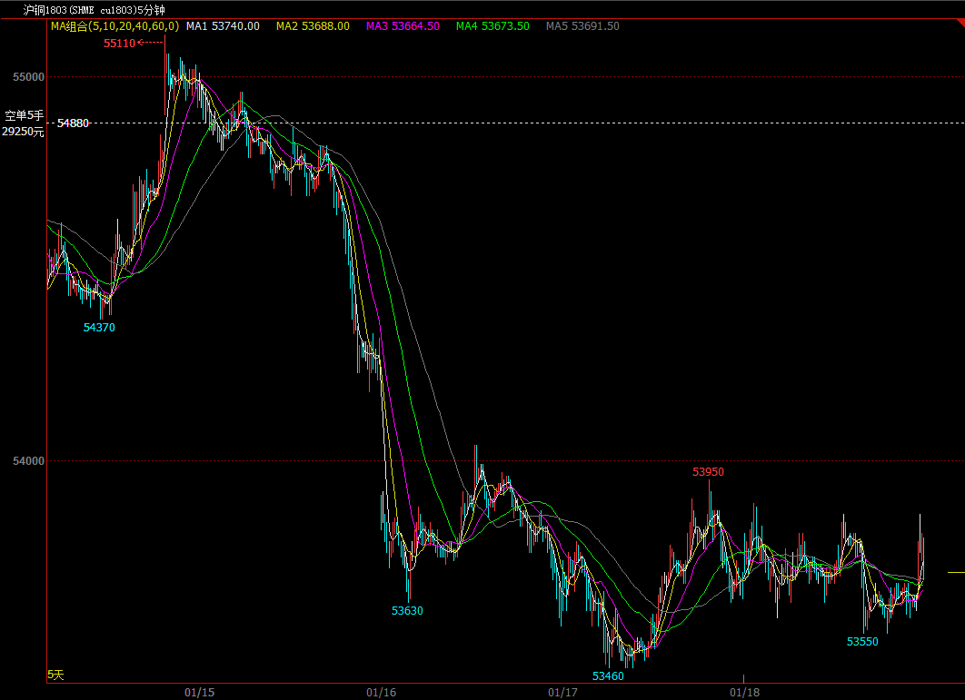
盈利代表

Slide 5
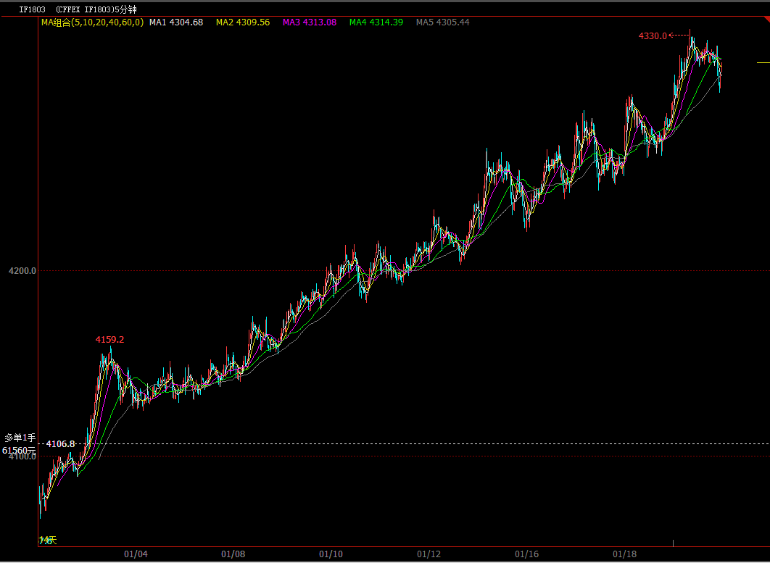

Slide 6
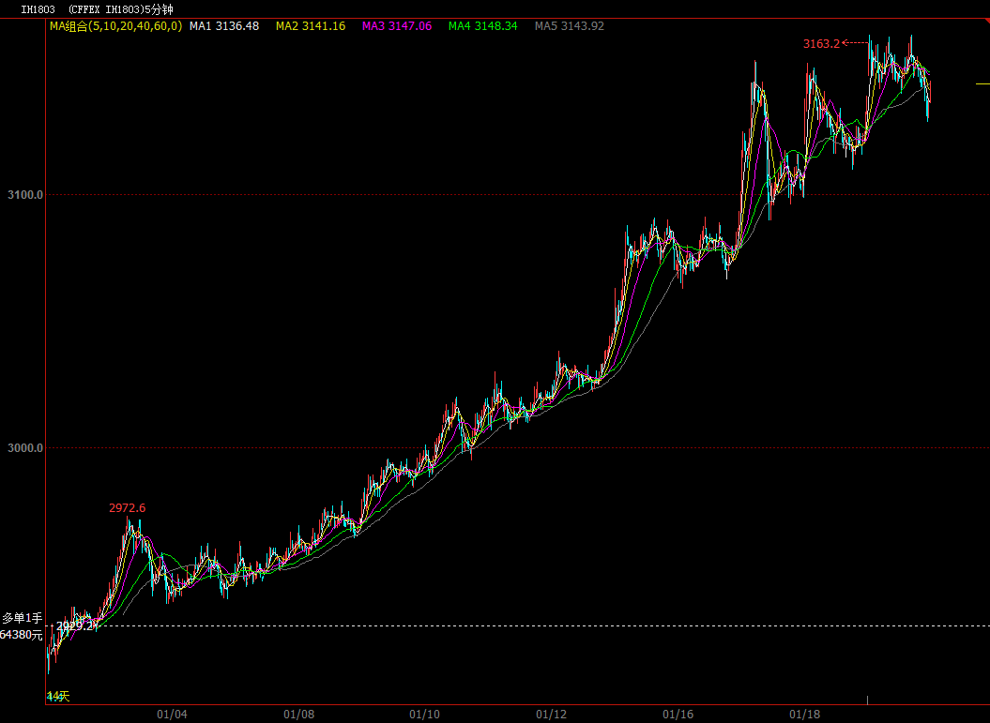

Slide 7
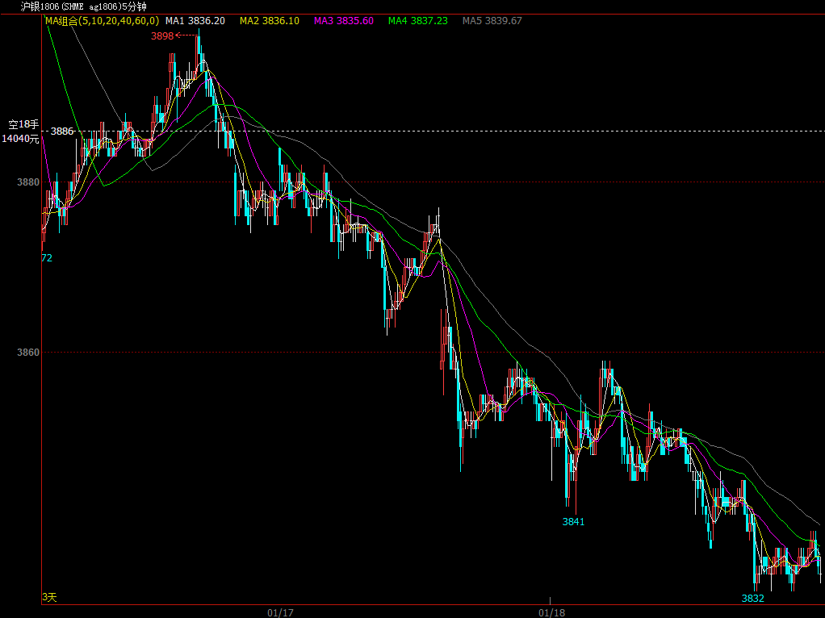

Slide 8
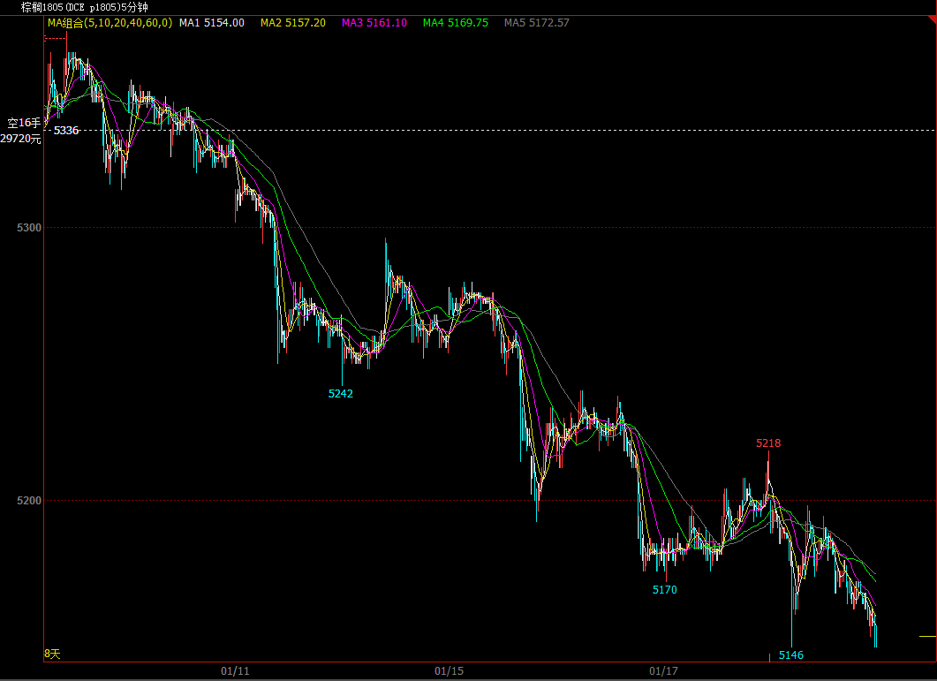

Slide 9
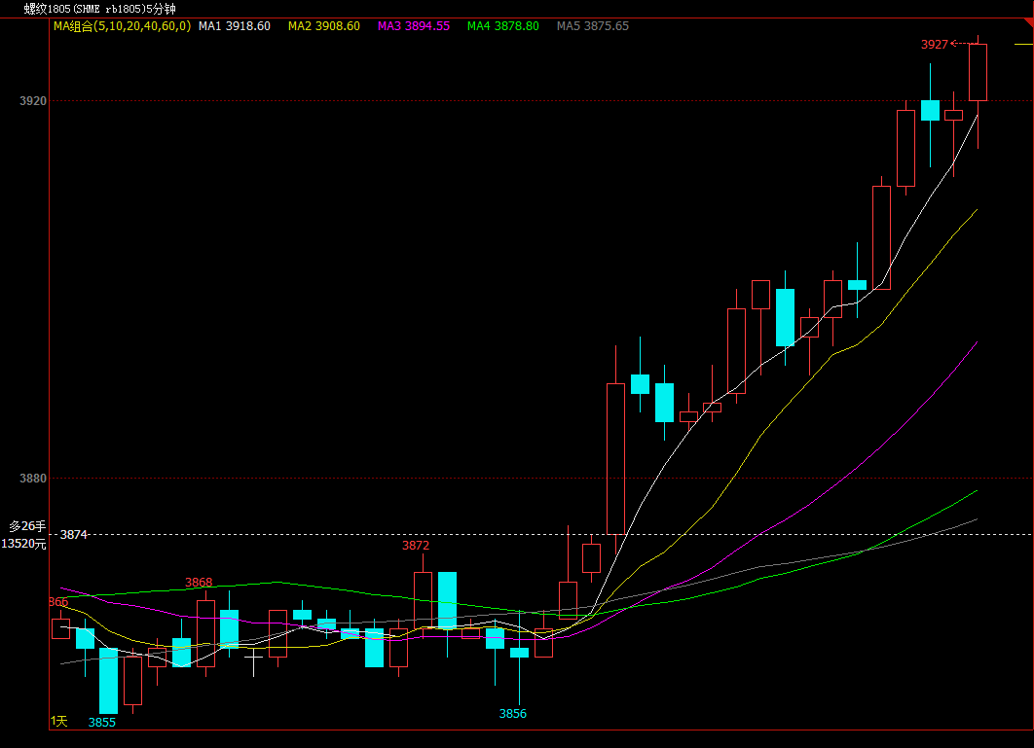

Slide 10
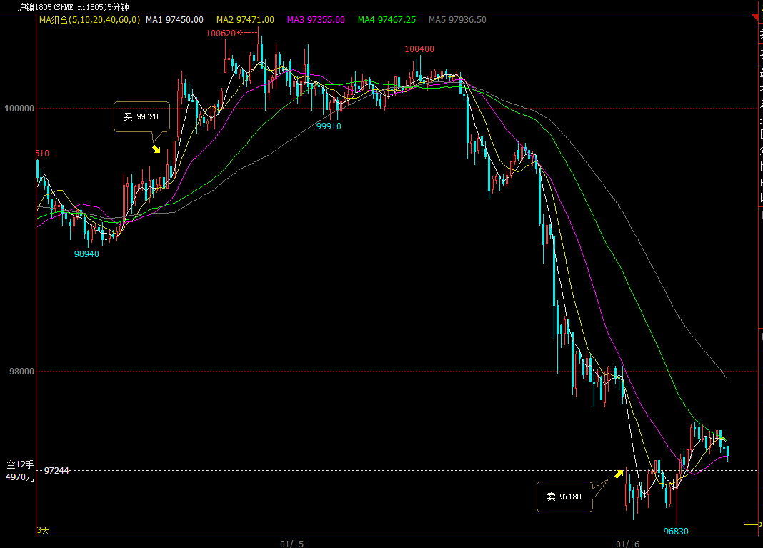
亏损代表

Slide 11
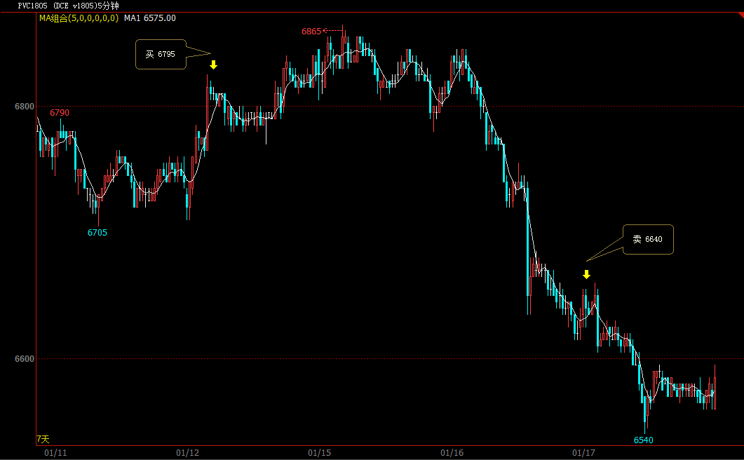

Slide 12
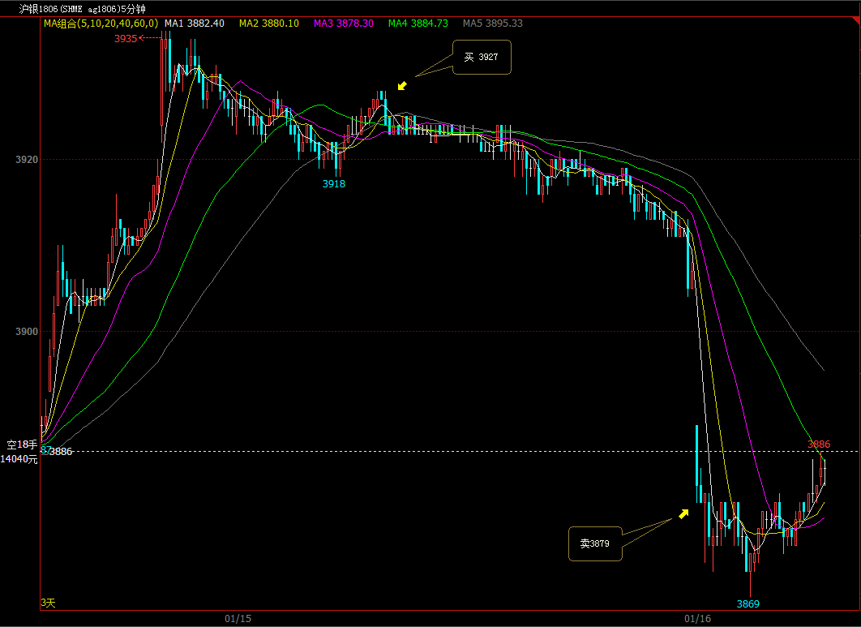

Slide 13
