Slide 1
2018/2/5 | 5,558,068 | 0.9917
2018/2/6 | 5,556,305 | 0.9914
2018/2/7 | 5,551,055 | 0.9905
2018/2/8 | 5,546,532 | 0.9897
2018/2/9 | 5,554,791 | 0.9911
2018/2/12 | 5,550,851 | 0.9904
2018/2/13 | 5,537,479 | 0.9881
2018/2/14 | 5,517,289 | 0.9845
2018/2/22 | 5,511,469 | 0.9834
2018/2/23 | 5,519,409 | 0.9848
2018/2/26 | 5,512,178 | 0.9835
2018/2/27 | 5,493,539 | 0.9802
2018/2/28 | 5,502,709 | 0.9818
2018/3/1 | 5,455,160 | 0.9734
2018/3/2 | 5,528,341 | 0.9864232
2018/3/5 | 5,594,705 | 0.9983
2018/3/6 | 5,574,198 | 0.9946
2018/3/7 | 5,604,871 | 1.0001
2018/3/8 | 5,725,125 | 1.0215
2018/3/9 | 5,787,555 | 1.0327
2018/3/12 | 5,823,430 | 1.0391

Slide 2
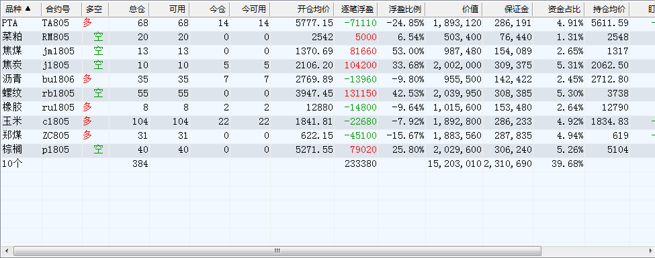

Slide 3
 | 多 |  |  |  |  | 空
2018/3/5 | BU 83 | C 62 | ZC 18 | TA 79 | RU 5 | J 6 | RB 31 | P 48 | I 23 | JM 15
2018/3/6 | BU 50 | C 72 | ZC 22 | TA 93 | RU 5 | J 3 | RB 38 | P 57 | Y 26 | JM 9
2018/3/7 | BU 34 | C 99 | ZC 30 | TA 65 | RU 7 | J 3 | RB 37 | P 57 | Y 26 | JM 9
2018/3/8 | BU 35 | C 62 | ZC 31 | TA 66 | RU 7 | J 6 | RB 64 | P 48 | RM 24 | JM 8
2018/3/9 | BU 28 | C 82 | ZC 49 | TA 54 | RU 6 | J 6 | RB 60 | P 45 | RM 23 | JM 15
2018/3/12 | BU 35 | C 104 | ZC 31 | TA 68 | RU 8 | J 10 | RB 55 | P 40 | RM 20 | JM 13

Slide 4
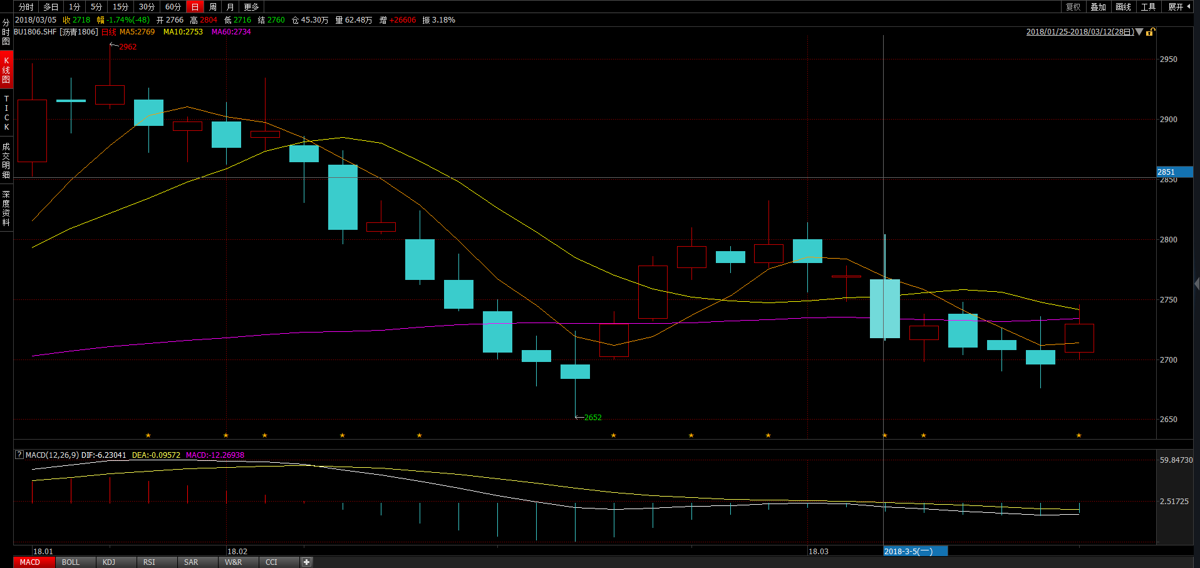
 | 多 |  |  |  |  | 空
2018/3/5 | BU 83 | C 62 | ZC 18 | TA 79 | RU 5 | J 6 | RB 31 | P 48 | I 23 | JM 15
2018/3/6 | BU 50 | C 72 | ZC 22 | TA 93 | RU 5 | J 3 | RB 38 | P 57 | Y 26 | JM 9
2018/3/7 | BU 34 | C 99 | ZC 30 | TA 65 | RU 7 | J 3 | RB 37 | P 57 | Y 26 | JM 9
2018/3/8 | BU 35 | C 62 | ZC 31 | TA 66 | RU 7 | J 6 | RB 64 | P 48 | RM 24 | JM 8
2018/3/9 | BU 28 | C 82 | ZC 49 | TA 54 | RU 6 | J 6 | RB 60 | P 45 | RM 23 | JM 15
2018/3/12 | BU 35 | C 104 | ZC 31 | TA 68 | RU 8 | J 10 | RB 55 | P 40 | RM 20 | JM 13

Slide 5
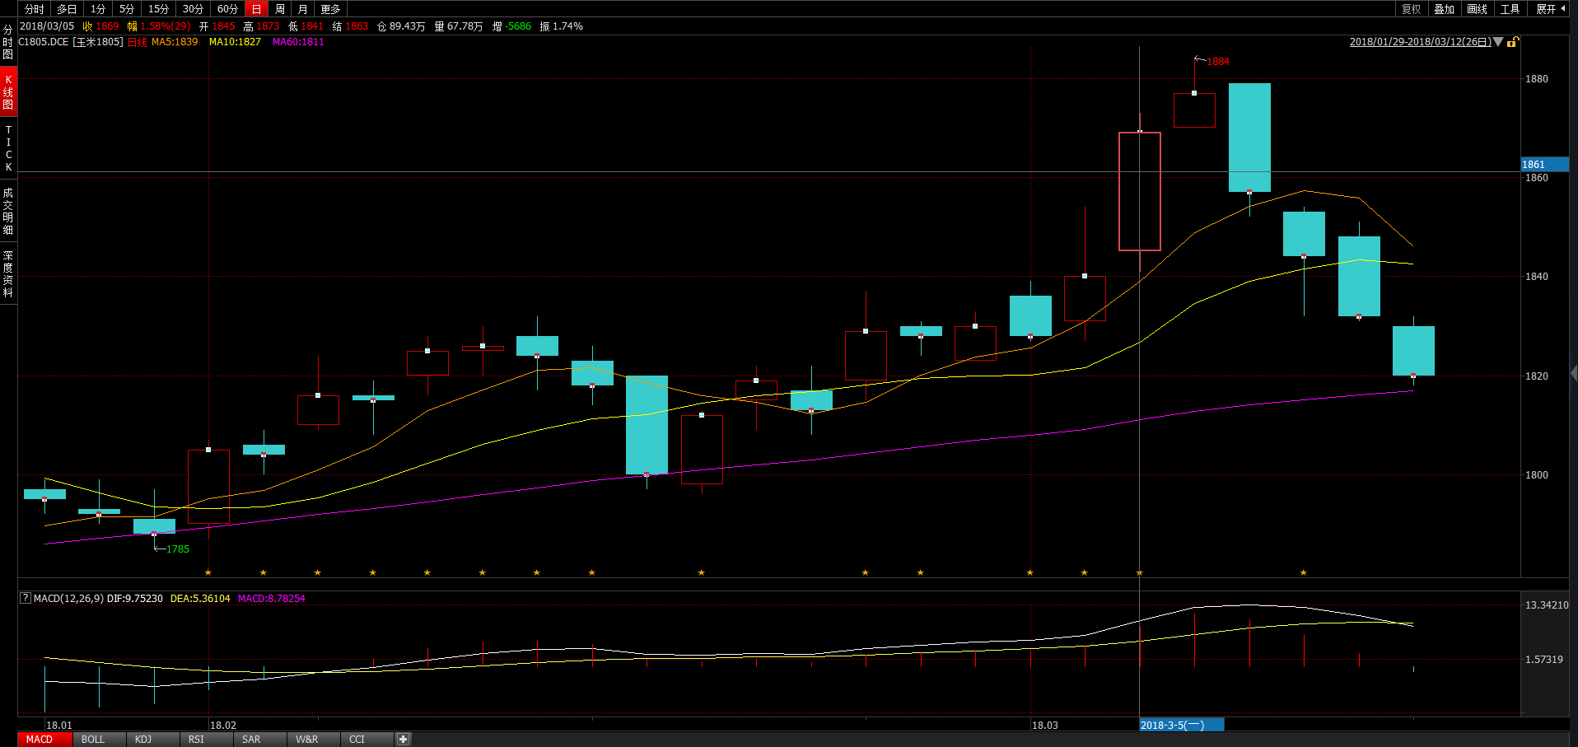
 | 多 |  |  |  |  | 空
2018/3/5 | BU 83 | C 62 | ZC 18 | TA 79 | RU 5 | J 6 | RB 31 | P 48 | I 23 | JM 15
2018/3/6 | BU 50 | C 72 | ZC 22 | TA 93 | RU 5 | J 3 | RB 38 | P 57 | Y 26 | JM 9
2018/3/7 | BU 34 | C 99 | ZC 30 | TA 65 | RU 7 | J 3 | RB 37 | P 57 | Y 26 | JM 9
2018/3/8 | BU 35 | C 62 | ZC 31 | TA 66 | RU 7 | J 6 | RB 64 | P 48 | RM 24 | JM 8
2018/3/9 | BU 28 | C 82 | ZC 49 | TA 54 | RU 6 | J 6 | RB 60 | P 45 | RM 23 | JM 15
2018/3/12 | BU 35 | C 104 | ZC 31 | TA 68 | RU 8 | J 10 | RB 55 | P 40 | RM 20 | JM 13

Slide 6
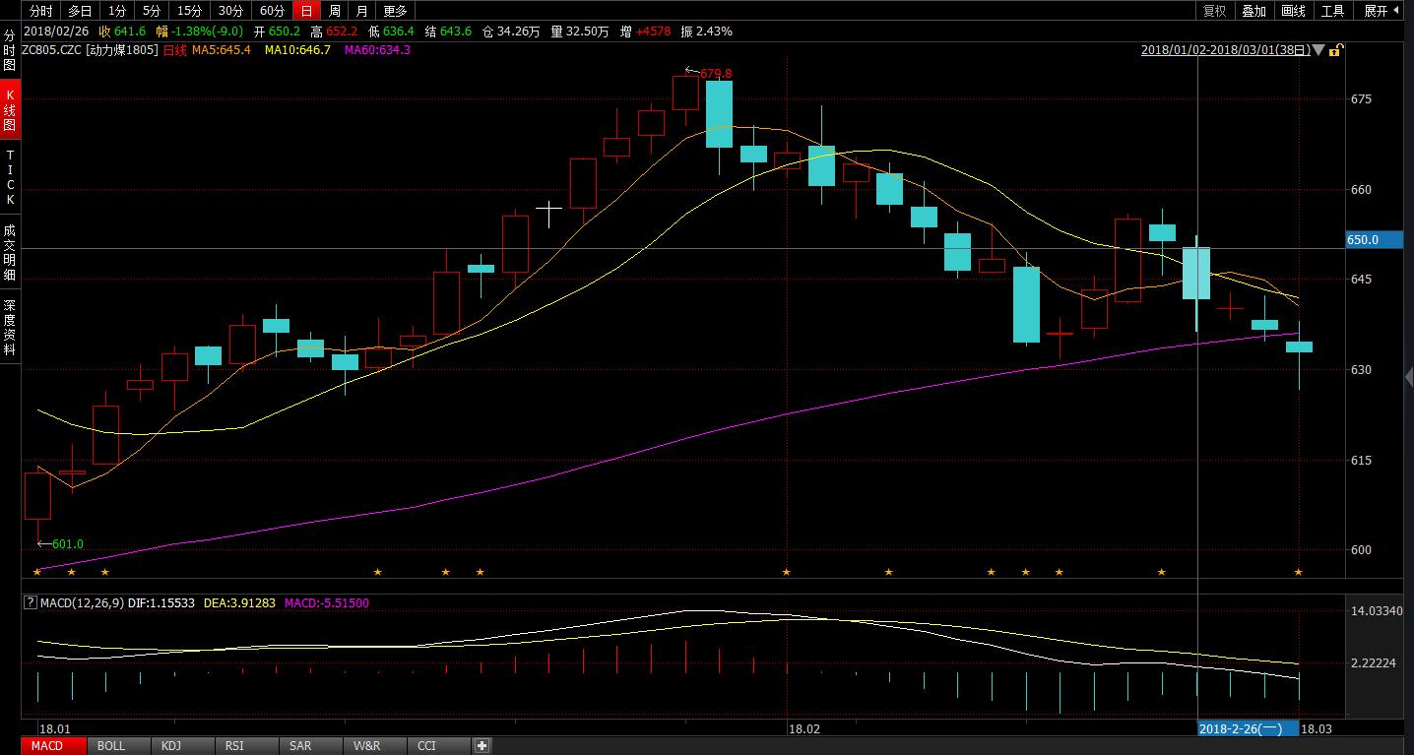
 | 多 |  |  |  |  | 空
2018/3/5 | BU 83 | C 62 | ZC 18 | TA 79 | RU 5 | J 6 | RB 31 | P 48 | I 23 | JM 15
2018/3/6 | BU 50 | C 72 | ZC 22 | TA 93 | RU 5 | J 3 | RB 38 | P 57 | Y 26 | JM 9
2018/3/7 | BU 34 | C 99 | ZC 30 | TA 65 | RU 7 | J 3 | RB 37 | P 57 | Y 26 | JM 9
2018/3/8 | BU 35 | C 62 | ZC 31 | TA 66 | RU 7 | J 6 | RB 64 | P 48 | RM 24 | JM 8
2018/3/9 | BU 28 | C 82 | ZC 49 | TA 54 | RU 6 | J 6 | RB 60 | P 45 | RM 23 | JM 15
2018/3/12 | BU 35 | C 104 | ZC 31 | TA 68 | RU 8 | J 10 | RB 55 | P 40 | RM 20 | JM 13

Slide 7
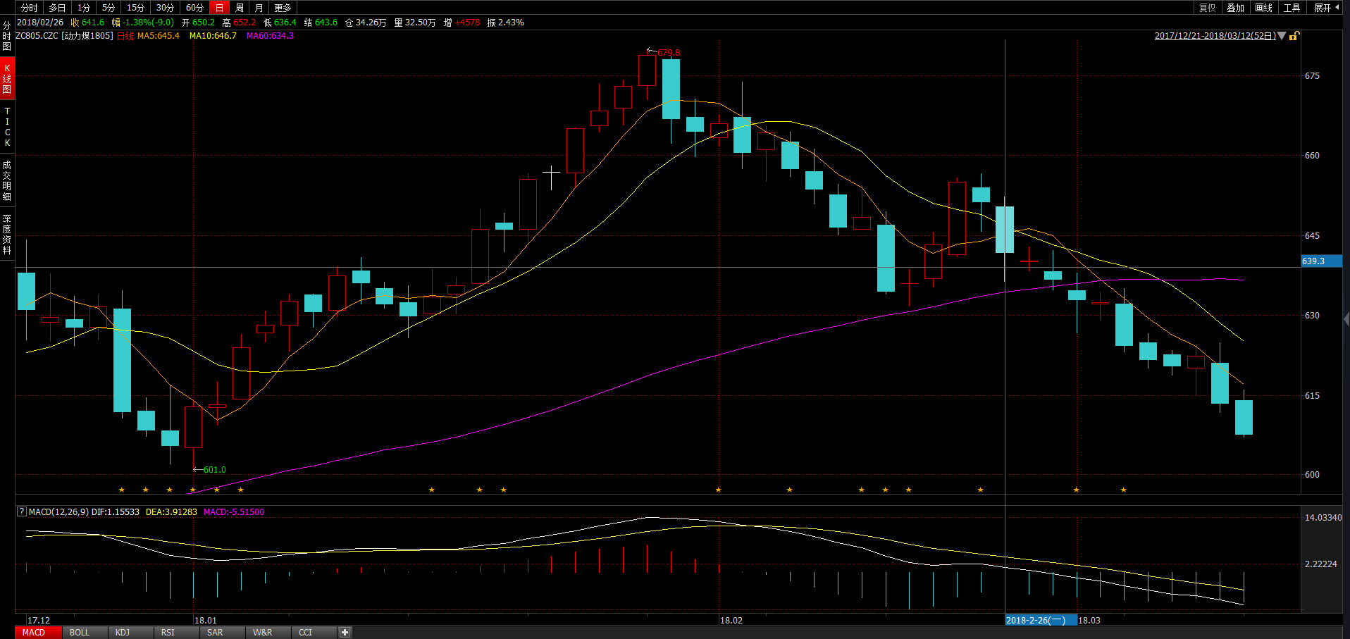
 | 多 |  |  |  |  | 空
2018/3/5 | BU 83 | C 62 | ZC 18 | TA 79 | RU 5 | J 6 | RB 31 | P 48 | I 23 | JM 15
2018/3/6 | BU 50 | C 72 | ZC 22 | TA 93 | RU 5 | J 3 | RB 38 | P 57 | Y 26 | JM 9
2018/3/7 | BU 34 | C 99 | ZC 30 | TA 65 | RU 7 | J 3 | RB 37 | P 57 | Y 26 | JM 9
2018/3/8 | BU 35 | C 62 | ZC 31 | TA 66 | RU 7 | J 6 | RB 64 | P 48 | RM 24 | JM 8
2018/3/9 | BU 28 | C 82 | ZC 49 | TA 54 | RU 6 | J 6 | RB 60 | P 45 | RM 23 | JM 15
2018/3/12 | BU 35 | C 104 | ZC 31 | TA 68 | RU 8 | J 10 | RB 55 | P 40 | RM 20 | JM 13

Slide 8
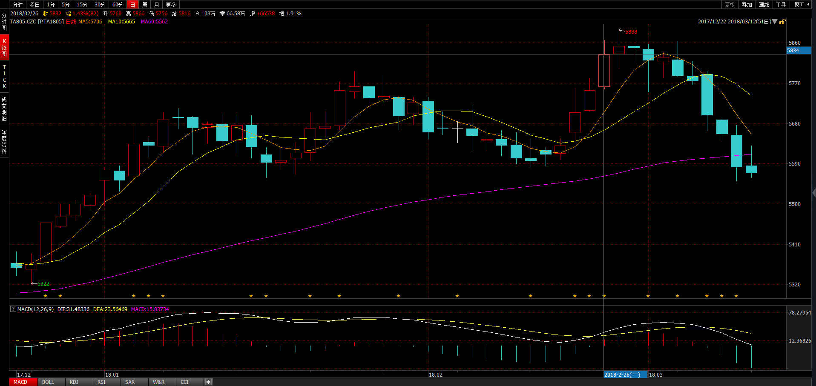
 | 多 |  |  |  |  | 空
2018/3/5 | BU 83 | C 62 | ZC 18 | TA 79 | RU 5 | J 6 | RB 31 | P 48 | I 23 | JM 15
2018/3/6 | BU 50 | C 72 | ZC 22 | TA 93 | RU 5 | J 3 | RB 38 | P 57 | Y 26 | JM 9
2018/3/7 | BU 34 | C 99 | ZC 30 | TA 65 | RU 7 | J 3 | RB 37 | P 57 | Y 26 | JM 9
2018/3/8 | BU 35 | C 62 | ZC 31 | TA 66 | RU 7 | J 6 | RB 64 | P 48 | RM 24 | JM 8
2018/3/9 | BU 28 | C 82 | ZC 49 | TA 54 | RU 6 | J 6 | RB 60 | P 45 | RM 23 | JM 15
2018/3/12 | BU 35 | C 104 | ZC 31 | TA 68 | RU 8 | J 10 | RB 55 | P 40 | RM 20 | JM 13

Slide 9
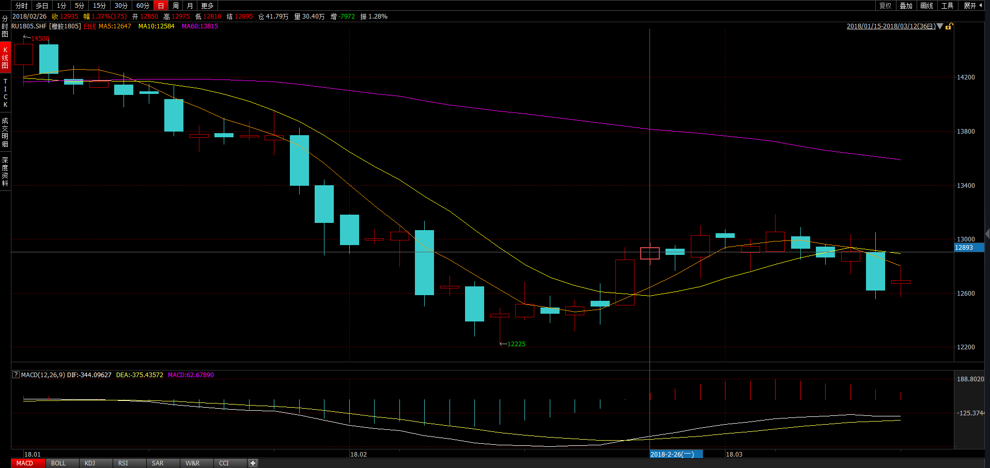
 | 多 |  |  |  |  | 空
2018/3/5 | BU 83 | C 62 | ZC 18 | TA 79 | RU 5 | J 6 | RB 31 | P 48 | I 23 | JM 15
2018/3/6 | BU 50 | C 72 | ZC 22 | TA 93 | RU 5 | J 3 | RB 38 | P 57 | Y 26 | JM 9
2018/3/7 | BU 34 | C 99 | ZC 30 | TA 65 | RU 7 | J 3 | RB 37 | P 57 | Y 26 | JM 9
2018/3/8 | BU 35 | C 62 | ZC 31 | TA 66 | RU 7 | J 6 | RB 64 | P 48 | RM 24 | JM 8
2018/3/9 | BU 28 | C 82 | ZC 49 | TA 54 | RU 6 | J 6 | RB 60 | P 45 | RM 23 | JM 15
2018/3/12 | BU 35 | C 104 | ZC 31 | TA 68 | RU 8 | J 10 | RB 55 | P 40 | RM 20 | JM 13

Slide 10
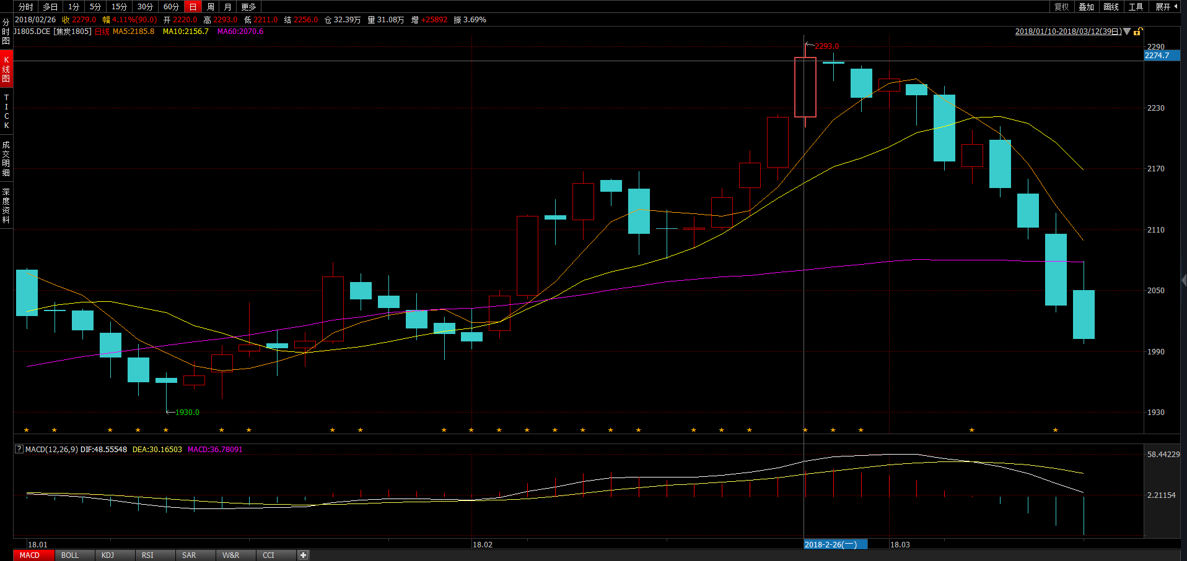
 | 多 |  |  |  |  | 空
2018/3/5 | BU 83 | C 62 | ZC 18 | TA 79 | RU 5 | J 6 | RB 31 | P 48 | I 23 | JM 15
2018/3/6 | BU 50 | C 72 | ZC 22 | TA 93 | RU 5 | J 3 | RB 38 | P 57 | Y 26 | JM 9
2018/3/7 | BU 34 | C 99 | ZC 30 | TA 65 | RU 7 | J 3 | RB 37 | P 57 | Y 26 | JM 9
2018/3/8 | BU 35 | C 62 | ZC 31 | TA 66 | RU 7 | J 6 | RB 64 | P 48 | RM 24 | JM 8
2018/3/9 | BU 28 | C 82 | ZC 49 | TA 54 | RU 6 | J 6 | RB 60 | P 45 | RM 23 | JM 15
2018/3/12 | BU 35 | C 104 | ZC 31 | TA 68 | RU 8 | J 10 | RB 55 | P 40 | RM 20 | JM 13

Slide 11
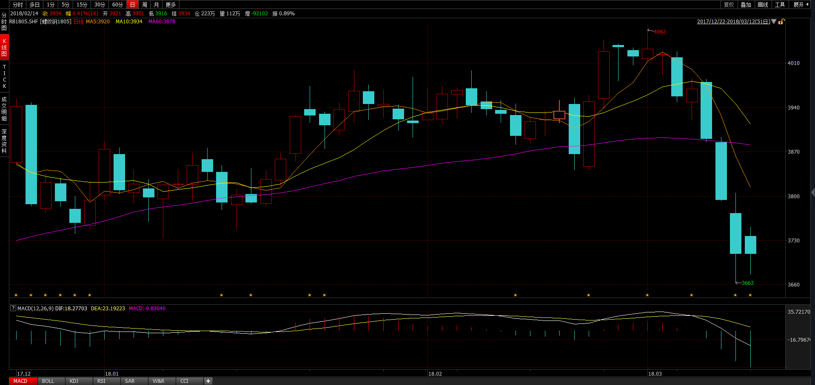
 | 多 |  |  |  |  | 空
2018/3/5 | BU 83 | C 62 | ZC 18 | TA 79 | RU 5 | J 6 | RB 31 | P 48 | I 23 | JM 15
2018/3/6 | BU 50 | C 72 | ZC 22 | TA 93 | RU 5 | J 3 | RB 38 | P 57 | Y 26 | JM 9
2018/3/7 | BU 34 | C 99 | ZC 30 | TA 65 | RU 7 | J 3 | RB 37 | P 57 | Y 26 | JM 9
2018/3/8 | BU 35 | C 62 | ZC 31 | TA 66 | RU 7 | J 6 | RB 64 | P 48 | RM 24 | JM 8
2018/3/9 | BU 28 | C 82 | ZC 49 | TA 54 | RU 6 | J 6 | RB 60 | P 45 | RM 23 | JM 15
2018/3/12 | BU 35 | C 104 | ZC 31 | TA 68 | RU 8 | J 10 | RB 55 | P 40 | RM 20 | JM 13

Slide 12
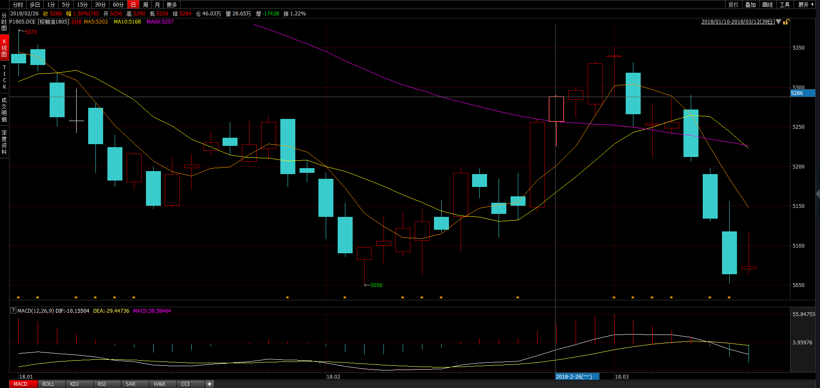
 | 多 |  |  |  |  | 空
2018/3/5 | BU 83 | C 62 | ZC 18 | TA 79 | RU 5 | J 6 | RB 31 | P 48 | I 23 | JM 15
2018/3/6 | BU 50 | C 72 | ZC 22 | TA 93 | RU 5 | J 3 | RB 38 | P 57 | Y 26 | JM 9
2018/3/7 | BU 34 | C 99 | ZC 30 | TA 65 | RU 7 | J 3 | RB 37 | P 57 | Y 26 | JM 9
2018/3/8 | BU 35 | C 62 | ZC 31 | TA 66 | RU 7 | J 6 | RB 64 | P 48 | RM 24 | JM 8
2018/3/9 | BU 28 | C 82 | ZC 49 | TA 54 | RU 6 | J 6 | RB 60 | P 45 | RM 23 | JM 15
2018/3/12 | BU 35 | C 104 | ZC 31 | TA 68 | RU 8 | J 10 | RB 55 | P 40 | RM 20 | JM 13

Slide 13
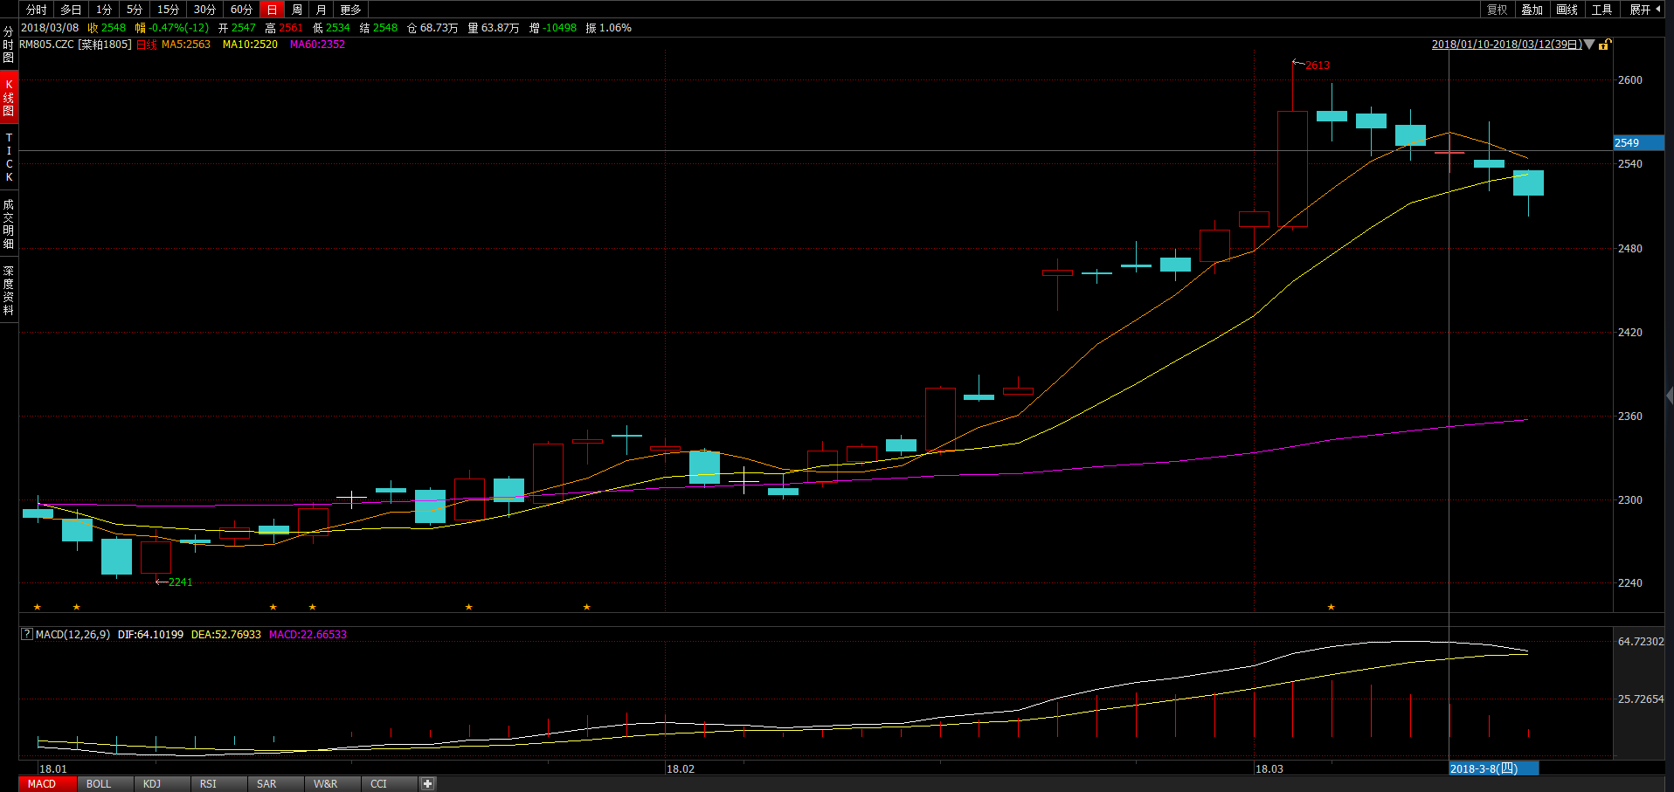
 | 多 |  |  |  |  | 空
2018/3/5 | BU 83 | C 62 | ZC 18 | TA 79 | RU 5 | J 6 | RB 31 | P 48 | I 23 | JM 15
2018/3/6 | BU 50 | C 72 | ZC 22 | TA 93 | RU 5 | J 3 | RB 38 | P 57 | Y 26 | JM 9
2018/3/7 | BU 34 | C 99 | ZC 30 | TA 65 | RU 7 | J 3 | RB 37 | P 57 | Y 26 | JM 9
2018/3/8 | BU 35 | C 62 | ZC 31 | TA 66 | RU 7 | J 6 | RB 64 | P 48 | RM 24 | JM 8
2018/3/9 | BU 28 | C 82 | ZC 49 | TA 54 | RU 6 | J 6 | RB 60 | P 45 | RM 23 | JM 15
2018/3/12 | BU 35 | C 104 | ZC 31 | TA 68 | RU 8 | J 10 | RB 55 | P 40 | RM 20 | JM 13

Slide 14
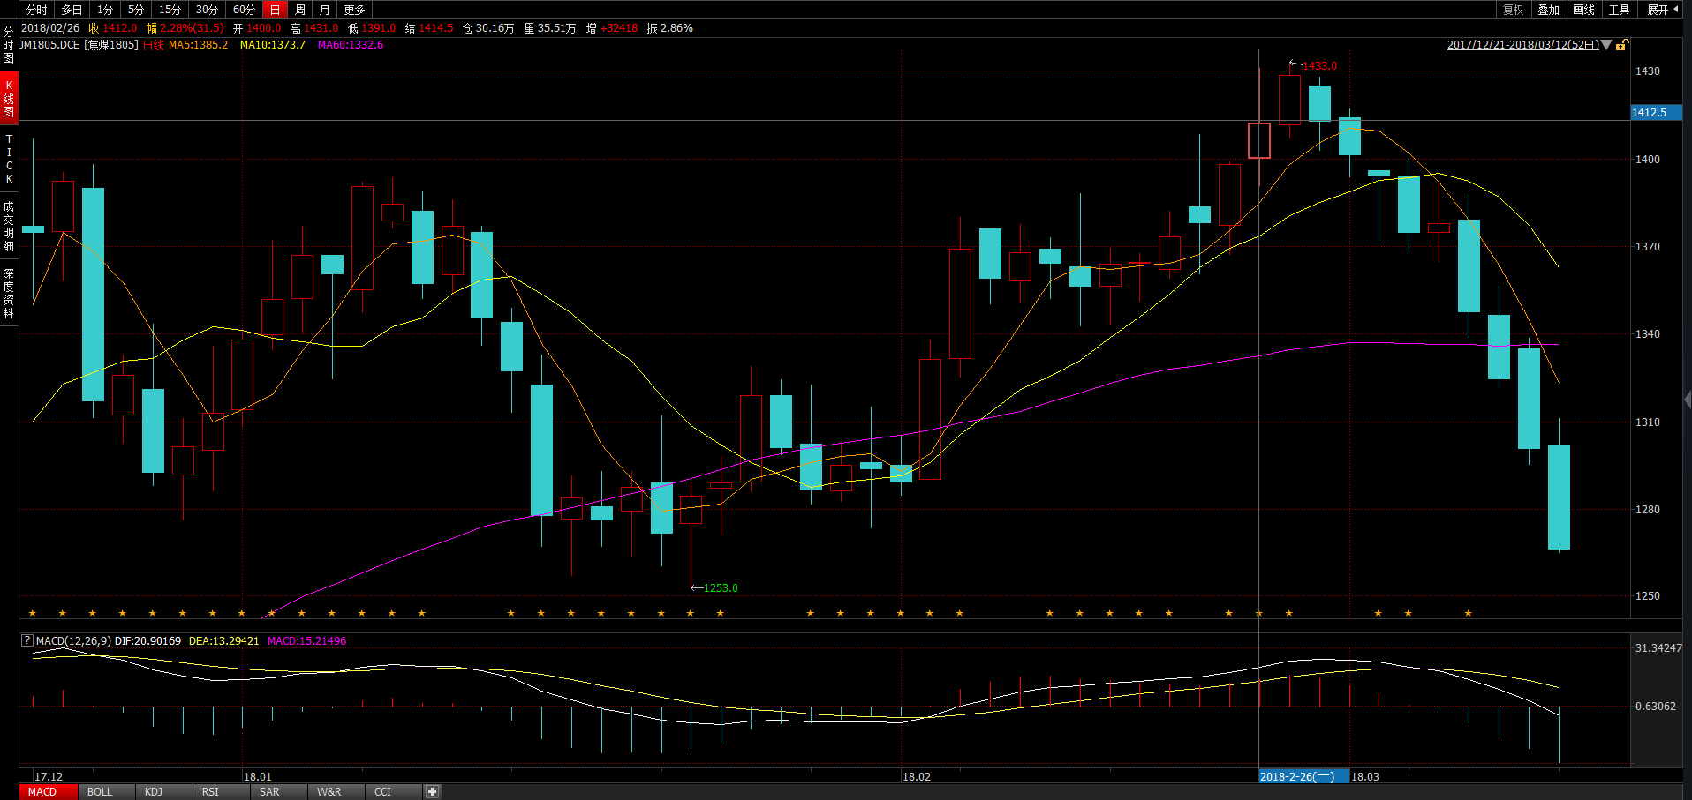
 | 多 |  |  |  |  | 空
2018/3/5 | BU 83 | C 62 | ZC 18 | TA 79 | RU 5 | J 6 | RB 31 | P 48 | I 23 | JM 15
2018/3/6 | BU 50 | C 72 | ZC 22 | TA 93 | RU 5 | J 3 | RB 38 | P 57 | Y 26 | JM 9
2018/3/7 | BU 34 | C 99 | ZC 30 | TA 65 | RU 7 | J 3 | RB 37 | P 57 | Y 26 | JM 9
2018/3/8 | BU 35 | C 62 | ZC 31 | TA 66 | RU 7 | J 6 | RB 64 | P 48 | RM 24 | JM 8
2018/3/9 | BU 28 | C 82 | ZC 49 | TA 54 | RU 6 | J 6 | RB 60 | P 45 | RM 23 | JM 15
2018/3/12 | BU 35 | C 104 | ZC 31 | TA 68 | RU 8 | J 10 | RB 55 | P 40 | RM 20 | JM 13

