Slide 1
2018/2/1 | 5,579,241 | 0.9955
2018/2/2 | 5,557,681 | 0.9917
2018/2/5 | 5,558,068 | 0.9917
2018/2/6 | 5,556,305 | 0.9914
2018/2/7 | 5,551,055 | 0.9905
2018/2/8 | 5,546,532 | 0.9897
2018/2/9 | 5,554,791 | 0.9911
2018/2/12 | 5,550,851 | 0.9904
2018/2/13 | 5,537,479 | 0.9881
2018/2/14 | 5,517,289 | 0.9845
2018/2/22 | 5,511,469 | 0.9834
2018/2/23 | 5,519,409 | 0.9848
2018/2/26 | 5,512,178 | 0.9835
2018/2/27 | 5,493,539 | 0.9802
2018/2/28 | 5,451,121 | 0.9726
2018/3/1 | 5,455,160 | 0.9734
2018/3/2 | 5,528,341 | 0.9864

Slide 2
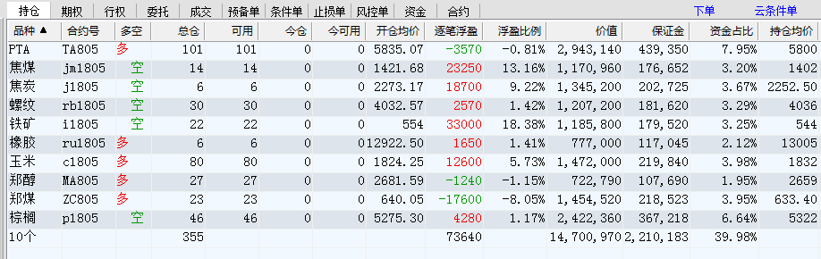

Slide 3
 | 多 |  |  |  |  | 空
2018/2/23 | MA 6 | C 19 | ZC 11 | A 10 | RU 1 | J 1 | RB 15 | RM 11 | I 6 | JM 3
2018/2/26 | CU 6 | C 55 | ZC 31 | TA 69 | RU 4 | J 5 | RB 31 | P 47 | I 22 | JM 14
2018/2/27 | MA 23 | C 67 | ZC 38 | TA 84 | RU 5 | J 6 | RB 31 | P 46 | I 22 | JM 14
2018/2/28 | MA 27 | C 80 | ZC 23 | TA 101 | RU 6 | J 6 | RB 31 | P 46 | I 22 | JM 14
2018/3/1 | MA 27 | C 80 | ZC 23 | TA 101 | RU 6 | J 6 | RB 31 | P 46 | I 22 | JM 14
2018/3/2 | MA 27 | C 80 | ZC 23 | TA 101 | RU 6 | J 6 | RB 31 | P 46 | I 22 | JM 14

Slide 4
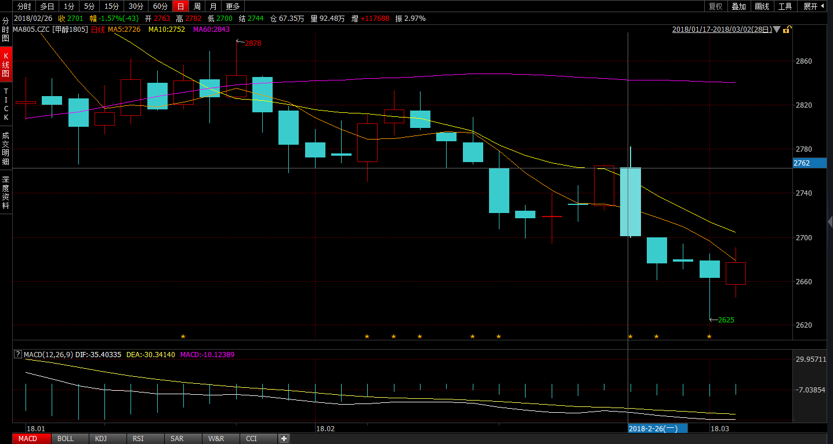
 | 多 |  |  |  |  | 空
2018/2/23 | MA 6 | C 19 | ZC 11 | A 10 | RU 1 | J 1 | RB 15 | RM 11 | I 6 | JM 3
2018/2/26 | CU 6 | C 55 | ZC 31 | TA 69 | RU 4 | J 5 | RB 31 | P 47 | I 22 | JM 14
2018/2/27 | MA 23 | C 67 | ZC 38 | TA 84 | RU 5 | J 6 | RB 31 | P 46 | I 22 | JM 14
2018/2/28 | MA 27 | C 80 | ZC 23 | TA 101 | RU 6 | J 6 | RB 31 | P 46 | I 22 | JM 14
2018/3/1 | MA 27 | C 80 | ZC 23 | TA 101 | RU 6 | J 6 | RB 31 | P 46 | I 22 | JM 14
2018/3/2 | MA 27 | C 80 | ZC 23 | TA 101 | RU 6 | J 6 | RB 31 | P 46 | I 22 | JM 14

Slide 5
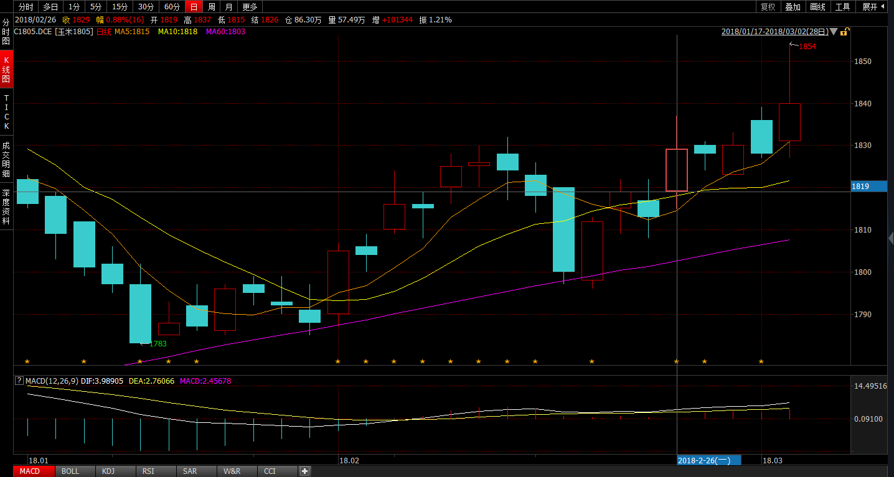
 | 多 |  |  |  |  | 空
2018/2/23 | MA 6 | C 19 | ZC 11 | A 10 | RU 1 | J 1 | RB 15 | RM 11 | I 6 | JM 3
2018/2/26 | CU 6 | C 55 | ZC 31 | TA 69 | RU 4 | J 5 | RB 31 | P 47 | I 22 | JM 14
2018/2/27 | MA 23 | C 67 | ZC 38 | TA 84 | RU 5 | J 6 | RB 31 | P 46 | I 22 | JM 14
2018/2/28 | MA 27 | C 80 | ZC 23 | TA 101 | RU 6 | J 6 | RB 31 | P 46 | I 22 | JM 14
2018/3/1 | MA 27 | C 80 | ZC 23 | TA 101 | RU 6 | J 6 | RB 31 | P 46 | I 22 | JM 14
2018/3/2 | MA 27 | C 80 | ZC 23 | TA 101 | RU 6 | J 6 | RB 31 | P 46 | I 22 | JM 14

Slide 6
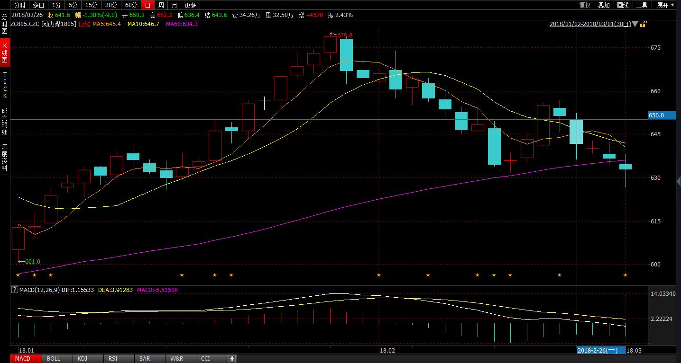
 | 多 |  |  |  |  | 空
2018/2/23 | MA 6 | C 19 | ZC 11 | A 10 | RU 1 | J 1 | RB 15 | RM 11 | I 6 | JM 3
2018/2/26 | CU 6 | C 55 | ZC 31 | TA 69 | RU 4 | J 5 | RB 31 | P 47 | I 22 | JM 14
2018/2/27 | MA 23 | C 67 | ZC 38 | TA 84 | RU 5 | J 6 | RB 31 | P 46 | I 22 | JM 14
2018/2/28 | MA 27 | C 80 | ZC 23 | TA 101 | RU 6 | J 6 | RB 31 | P 46 | I 22 | JM 14
2018/3/1 | MA 27 | C 80 | ZC 23 | TA 101 | RU 6 | J 6 | RB 31 | P 46 | I 22 | JM 14
2018/3/2 | MA 27 | C 80 | ZC 23 | TA 101 | RU 6 | J 6 | RB 31 | P 46 | I 22 | JM 14

Slide 7
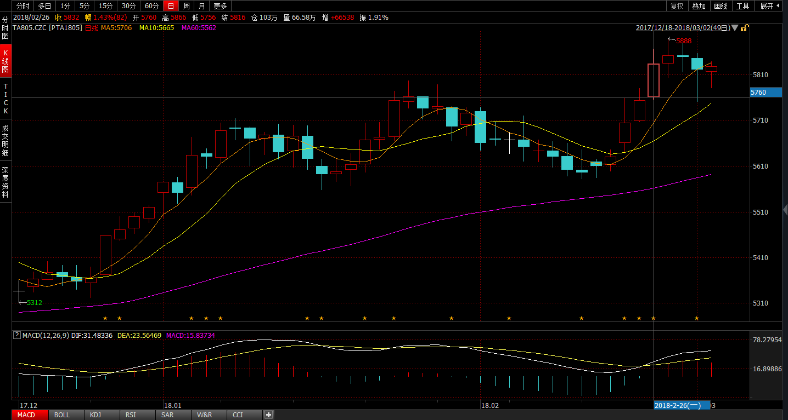
 | 多 |  |  |  |  | 空
2018/2/23 | MA 6 | C 19 | ZC 11 | A 10 | RU 1 | J 1 | RB 15 | RM 11 | I 6 | JM 3
2018/2/26 | CU 6 | C 55 | ZC 31 | TA 69 | RU 4 | J 5 | RB 31 | P 47 | I 22 | JM 14
2018/2/27 | MA 23 | C 67 | ZC 38 | TA 84 | RU 5 | J 6 | RB 31 | P 46 | I 22 | JM 14
2018/2/28 | MA 27 | C 80 | ZC 23 | TA 101 | RU 6 | J 6 | RB 31 | P 46 | I 22 | JM 14
2018/3/1 | MA 27 | C 80 | ZC 23 | TA 101 | RU 6 | J 6 | RB 31 | P 46 | I 22 | JM 14
2018/3/2 | MA 27 | C 80 | ZC 23 | TA 101 | RU 6 | J 6 | RB 31 | P 46 | I 22 | JM 14

Slide 8
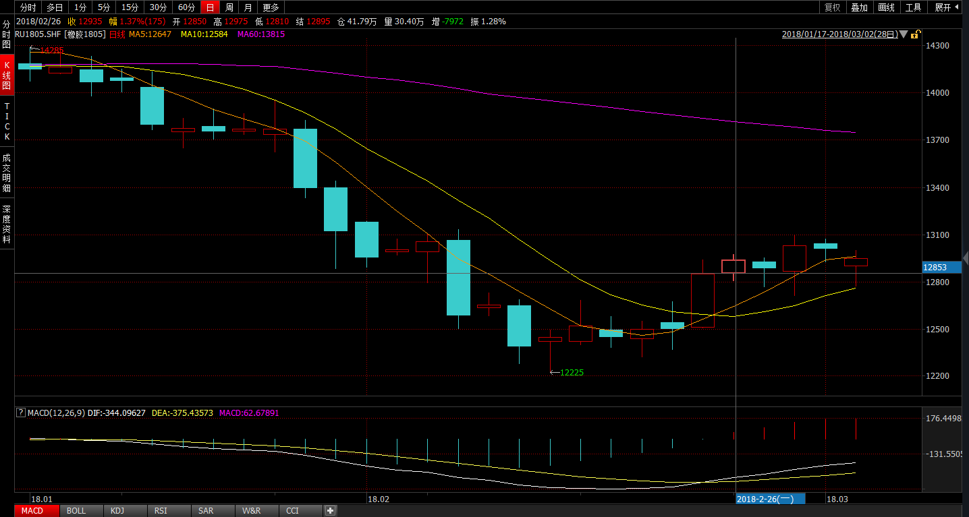
 | 多 |  |  |  |  | 空
2018/2/23 | MA 6 | C 19 | ZC 11 | A 10 | RU 1 | J 1 | RB 15 | RM 11 | I 6 | JM 3
2018/2/26 | CU 6 | C 55 | ZC 31 | TA 69 | RU 4 | J 5 | RB 31 | P 47 | I 22 | JM 14
2018/2/27 | MA 23 | C 67 | ZC 38 | TA 84 | RU 5 | J 6 | RB 31 | P 46 | I 22 | JM 14
2018/2/28 | MA 27 | C 80 | ZC 23 | TA 101 | RU 6 | J 6 | RB 31 | P 46 | I 22 | JM 14
2018/3/1 | MA 27 | C 80 | ZC 23 | TA 101 | RU 6 | J 6 | RB 31 | P 46 | I 22 | JM 14
2018/3/2 | MA 27 | C 80 | ZC 23 | TA 101 | RU 6 | J 6 | RB 31 | P 46 | I 22 | JM 14

Slide 9
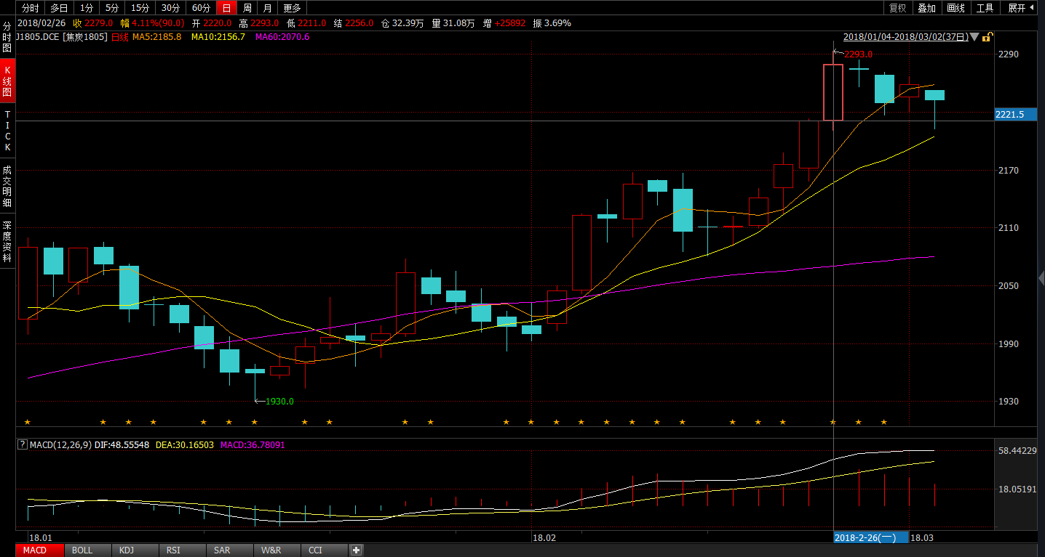
 | 多 |  |  |  |  | 空
2018/2/23 | MA 6 | C 19 | ZC 11 | A 10 | RU 1 | J 1 | RB 15 | RM 11 | I 6 | JM 3
2018/2/26 | CU 6 | C 55 | ZC 31 | TA 69 | RU 4 | J 5 | RB 31 | P 47 | I 22 | JM 14
2018/2/27 | MA 23 | C 67 | ZC 38 | TA 84 | RU 5 | J 6 | RB 31 | P 46 | I 22 | JM 14
2018/2/28 | MA 27 | C 80 | ZC 23 | TA 101 | RU 6 | J 6 | RB 31 | P 46 | I 22 | JM 14
2018/3/1 | MA 27 | C 80 | ZC 23 | TA 101 | RU 6 | J 6 | RB 31 | P 46 | I 22 | JM 14
2018/3/2 | MA 27 | C 80 | ZC 23 | TA 101 | RU 6 | J 6 | RB 31 | P 46 | I 22 | JM 14

Slide 10
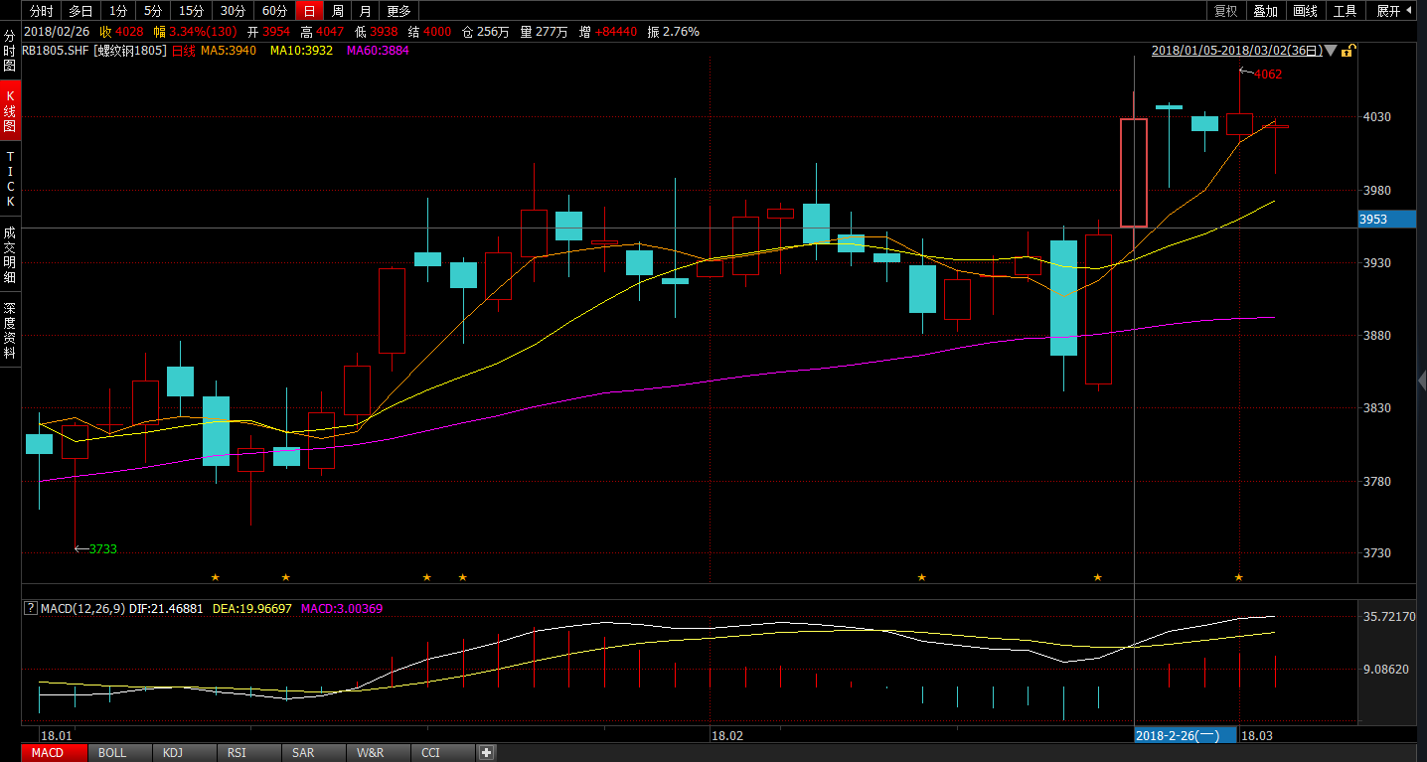
 | 多 |  |  |  |  | 空
2018/2/23 | MA 6 | C 19 | ZC 11 | A 10 | RU 1 | J 1 | RB 15 | RM 11 | I 6 | JM 3
2018/2/26 | CU 6 | C 55 | ZC 31 | TA 69 | RU 4 | J 5 | RB 31 | P 47 | I 22 | JM 14
2018/2/27 | MA 23 | C 67 | ZC 38 | TA 84 | RU 5 | J 6 | RB 31 | P 46 | I 22 | JM 14
2018/2/28 | MA 27 | C 80 | ZC 23 | TA 101 | RU 6 | J 6 | RB 31 | P 46 | I 22 | JM 14
2018/3/1 | MA 27 | C 80 | ZC 23 | TA 101 | RU 6 | J 6 | RB 31 | P 46 | I 22 | JM 14
2018/3/2 | MA 27 | C 80 | ZC 23 | TA 101 | RU 6 | J 6 | RB 31 | P 46 | I 22 | JM 14

Slide 11
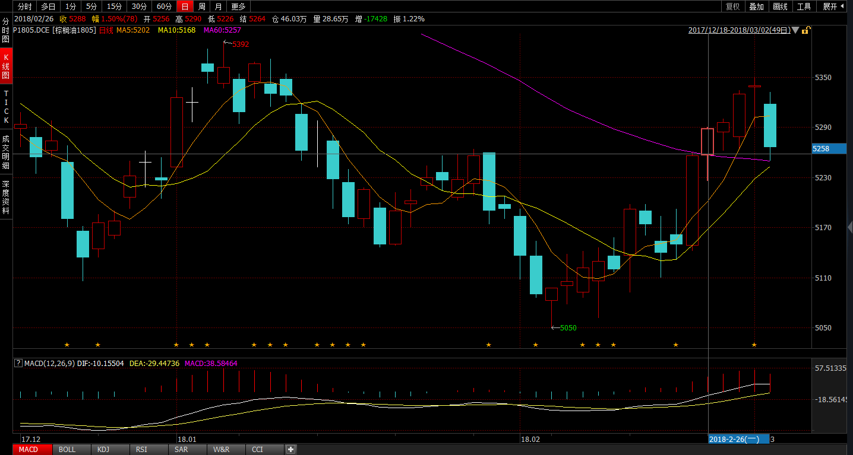
 | 多 |  |  |  |  | 空
2018/2/23 | MA 6 | C 19 | ZC 11 | A 10 | RU 1 | J 1 | RB 15 | RM 11 | I 6 | JM 3
2018/2/26 | CU 6 | C 55 | ZC 31 | TA 69 | RU 4 | J 5 | RB 31 | P 47 | I 22 | JM 14
2018/2/27 | MA 23 | C 67 | ZC 38 | TA 84 | RU 5 | J 6 | RB 31 | P 46 | I 22 | JM 14
2018/2/28 | MA 27 | C 80 | ZC 23 | TA 101 | RU 6 | J 6 | RB 31 | P 46 | I 22 | JM 14
2018/3/1 | MA 27 | C 80 | ZC 23 | TA 101 | RU 6 | J 6 | RB 31 | P 46 | I 22 | JM 14
2018/3/2 | MA 27 | C 80 | ZC 23 | TA 101 | RU 6 | J 6 | RB 31 | P 46 | I 22 | JM 14

Slide 12
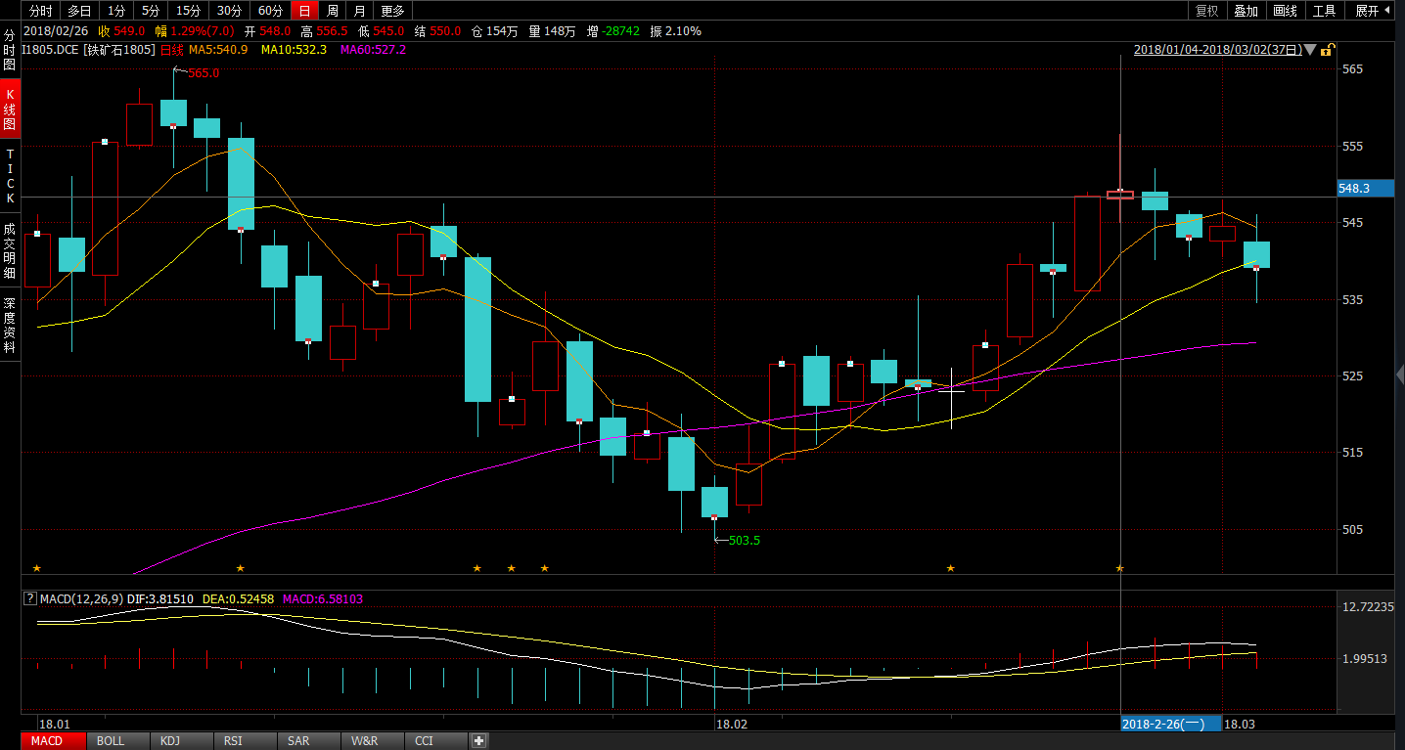
 | 多 |  |  |  |  | 空
2018/2/23 | MA 6 | C 19 | ZC 11 | A 10 | RU 1 | J 1 | RB 15 | RM 11 | I 6 | JM 3
2018/2/26 | CU 6 | C 55 | ZC 31 | TA 69 | RU 4 | J 5 | RB 31 | P 47 | I 22 | JM 14
2018/2/27 | MA 23 | C 67 | ZC 38 | TA 84 | RU 5 | J 6 | RB 31 | P 46 | I 22 | JM 14
2018/2/28 | MA 27 | C 80 | ZC 23 | TA 101 | RU 6 | J 6 | RB 31 | P 46 | I 22 | JM 14
2018/3/1 | MA 27 | C 80 | ZC 23 | TA 101 | RU 6 | J 6 | RB 31 | P 46 | I 22 | JM 14
2018/3/2 | MA 27 | C 80 | ZC 23 | TA 101 | RU 6 | J 6 | RB 31 | P 46 | I 22 | JM 14

Slide 13
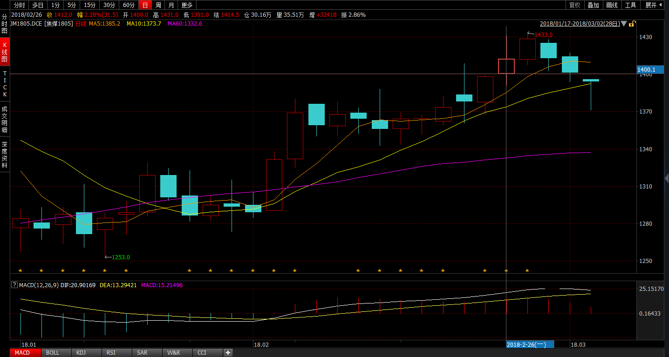
 | 多 |  |  |  |  | 空
2018/2/23 | MA 6 | C 19 | ZC 11 | A 10 | RU 1 | J 1 | RB 15 | RM 11 | I 6 | JM 3
2018/2/26 | CU 6 | C 55 | ZC 31 | TA 69 | RU 4 | J 5 | RB 31 | P 47 | I 22 | JM 14
2018/2/27 | MA 23 | C 67 | ZC 38 | TA 84 | RU 5 | J 6 | RB 31 | P 46 | I 22 | JM 14
2018/2/28 | MA 27 | C 80 | ZC 23 | TA 101 | RU 6 | J 6 | RB 31 | P 46 | I 22 | JM 14
2018/3/1 | MA 27 | C 80 | ZC 23 | TA 101 | RU 6 | J 6 | RB 31 | P 46 | I 22 | JM 14
2018/3/2 | MA 27 | C 80 | ZC 23 | TA 101 | RU 6 | J 6 | RB 31 | P 46 | I 22 | JM 14

