Slide 1
2018/2/5 | 5,558,068 | 0.9917
2018/2/6 | 5,556,305 | 0.9914
2018/2/7 | 5,551,055 | 0.9905
2018/2/8 | 5,546,532 | 0.9897
2018/2/9 | 5,554,791 | 0.9911
2018/3/1 | 5,455,160 | 0.9734
2018/3/2 | 5,528,341 | 0.9864232
2018/3/5 | 5,594,705 | 0.9983
2018/3/6 | 5,574,198 | 0.9946
2018/3/7 | 5,604,871 | 1.0001
2018/3/8 | 5,725,125 | 1.0215
2018/3/9 | 5,787,555 | 1.0327
2018/3/12 | 5,823,430 | 1.0391
2018/3/13 | 5,837,690 | 1.0416
2018/3/14 | 5,771,800 | 1.0299
2018/3/15 | 5,797,110 | 1.0344
2018/3/16 | 5,823,900 | 1.0392
2018/3/19 | 5,944,660 | 1.0607
2018/3/20 | 5,890,890 | 1.0511
2018/3/22 | 5,771,330 | 1.0298
2018/3/23 | 5,889,394 | 1.050846
2018/3/26 | 5,866,400 | 1.0467
2018/3/27 | 5,825,510 | 1.0394
2018/3/28 | 5,813,110 | 1.0372
2018/3/29 | 5,832,010 | 1.0406

Slide 2
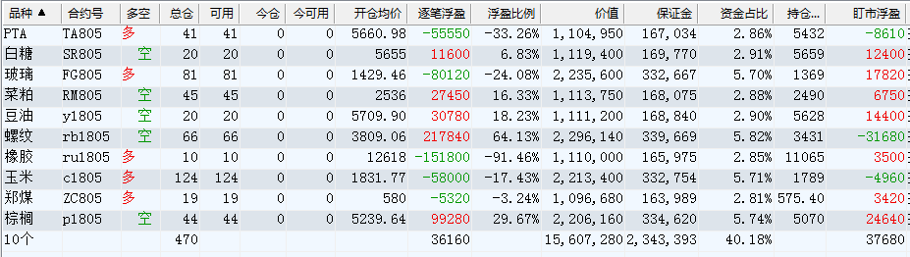

Slide 3
 | 多 |  |  |  |  | 空
2018/3/23 | FG 46 | C 143 | ZC 22 | TA 46 | RU 9 | J 10 | RB 53 | P 38 | JM 13 | Y 17
2018/3/26 | FG 81 | C 124 | ZC 19 | TA 41 | RU 10 | SR 20 | RB 66 | P 44 | RM 45 | Y 20
2018/3/27 | FG 81 | C 124 | ZC 19 | TA 41 | RU 10 | SR 20 | RB 66 | P 44 | RM 45 | Y 20
2018/3/28 | FG 81 | C 124 | ZC 19 | TA 41 | RU 10 | SR 20 | RB 66 | P 44 | RM 45 | Y 20
2018/3/29 | FG 81 | C 124 | ZC 19 | TA 41 | RU 10 | SR 20 | RB 66 | P 44 | RM 45 | Y 20

Slide 4
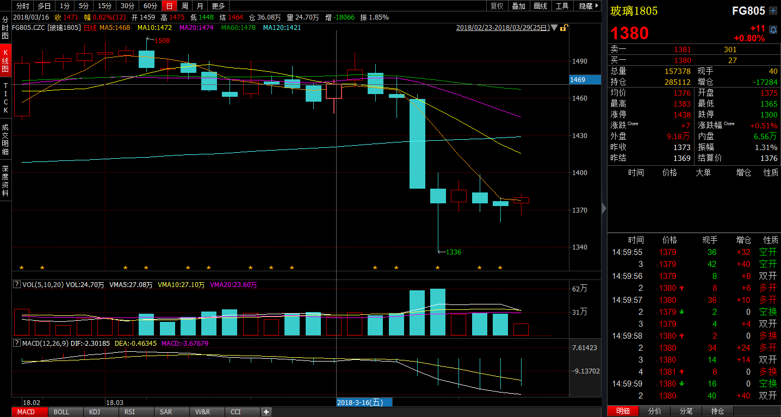
 | 多 |  |  |  |  | 空
2018/3/23 | FG 46 | C 143 | ZC 22 | TA 46 | RU 9 | J 10 | RB 53 | P 38 | JM 13 | Y 17
2018/3/26 | FG 81 | C 124 | ZC 19 | TA 41 | RU 10 | SR 20 | RB 66 | P 44 | RM 45 | Y 20
2018/3/27 | FG 81 | C 124 | ZC 19 | TA 41 | RU 10 | SR 20 | RB 66 | P 44 | RM 45 | Y 20
2018/3/28 | FG 81 | C 124 | ZC 19 | TA 41 | RU 10 | SR 20 | RB 66 | P 44 | RM 45 | Y 20
2018/3/29 | FG 81 | C 124 | ZC 19 | TA 41 | RU 10 | SR 20 | RB 66 | P 44 | RM 45 | Y 20

Slide 5
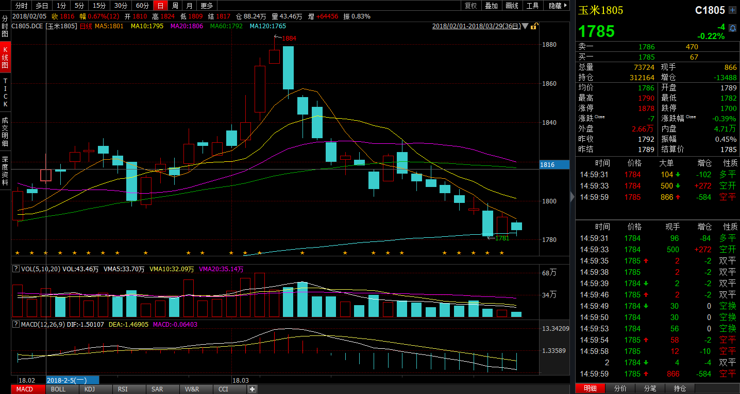
 | 多 |  |  |  |  | 空
2018/3/23 | FG 46 | C 143 | ZC 22 | TA 46 | RU 9 | J 10 | RB 53 | P 38 | JM 13 | Y 17
2018/3/26 | FG 81 | C 124 | ZC 19 | TA 41 | RU 10 | SR 20 | RB 66 | P 44 | RM 45 | Y 20
2018/3/27 | FG 81 | C 124 | ZC 19 | TA 41 | RU 10 | SR 20 | RB 66 | P 44 | RM 45 | Y 20
2018/3/28 | FG 81 | C 124 | ZC 19 | TA 41 | RU 10 | SR 20 | RB 66 | P 44 | RM 45 | Y 20
2018/3/29 | FG 81 | C 124 | ZC 19 | TA 41 | RU 10 | SR 20 | RB 66 | P 44 | RM 45 | Y 20

Slide 6
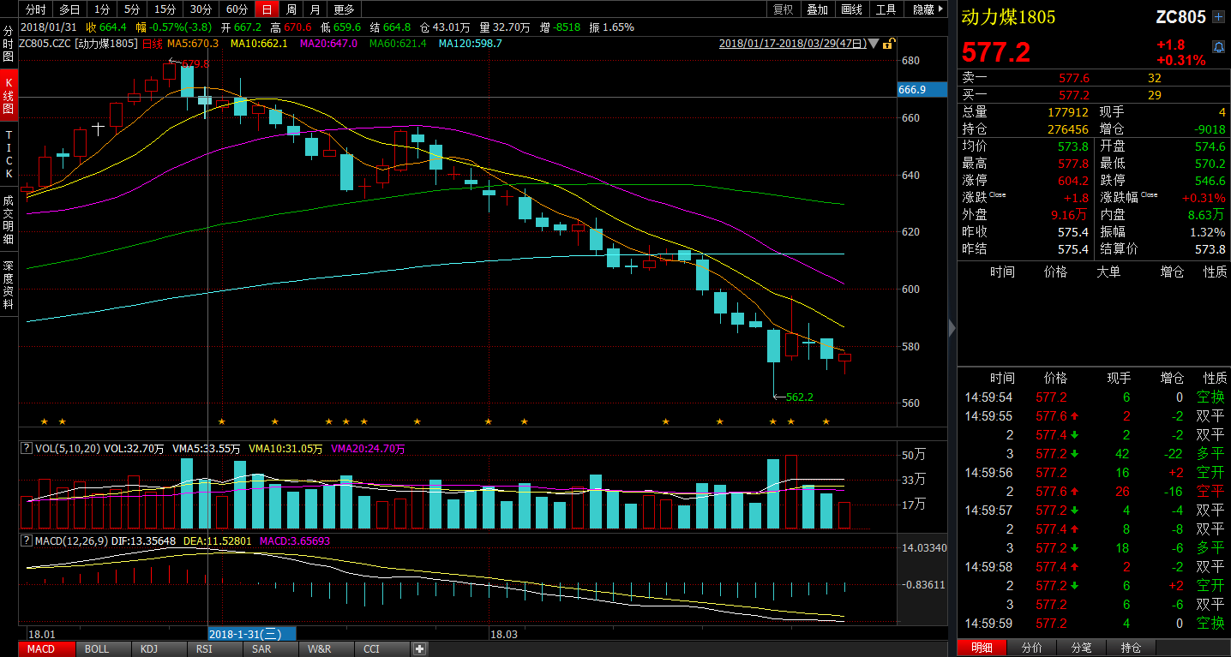
 | 多 |  |  |  |  | 空
2018/3/23 | FG 46 | C 143 | ZC 22 | TA 46 | RU 9 | J 10 | RB 53 | P 38 | JM 13 | Y 17
2018/3/26 | FG 81 | C 124 | ZC 19 | TA 41 | RU 10 | SR 20 | RB 66 | P 44 | RM 45 | Y 20
2018/3/27 | FG 81 | C 124 | ZC 19 | TA 41 | RU 10 | SR 20 | RB 66 | P 44 | RM 45 | Y 20
2018/3/28 | FG 81 | C 124 | ZC 19 | TA 41 | RU 10 | SR 20 | RB 66 | P 44 | RM 45 | Y 20
2018/3/29 | FG 81 | C 124 | ZC 19 | TA 41 | RU 10 | SR 20 | RB 66 | P 44 | RM 45 | Y 20

Slide 7
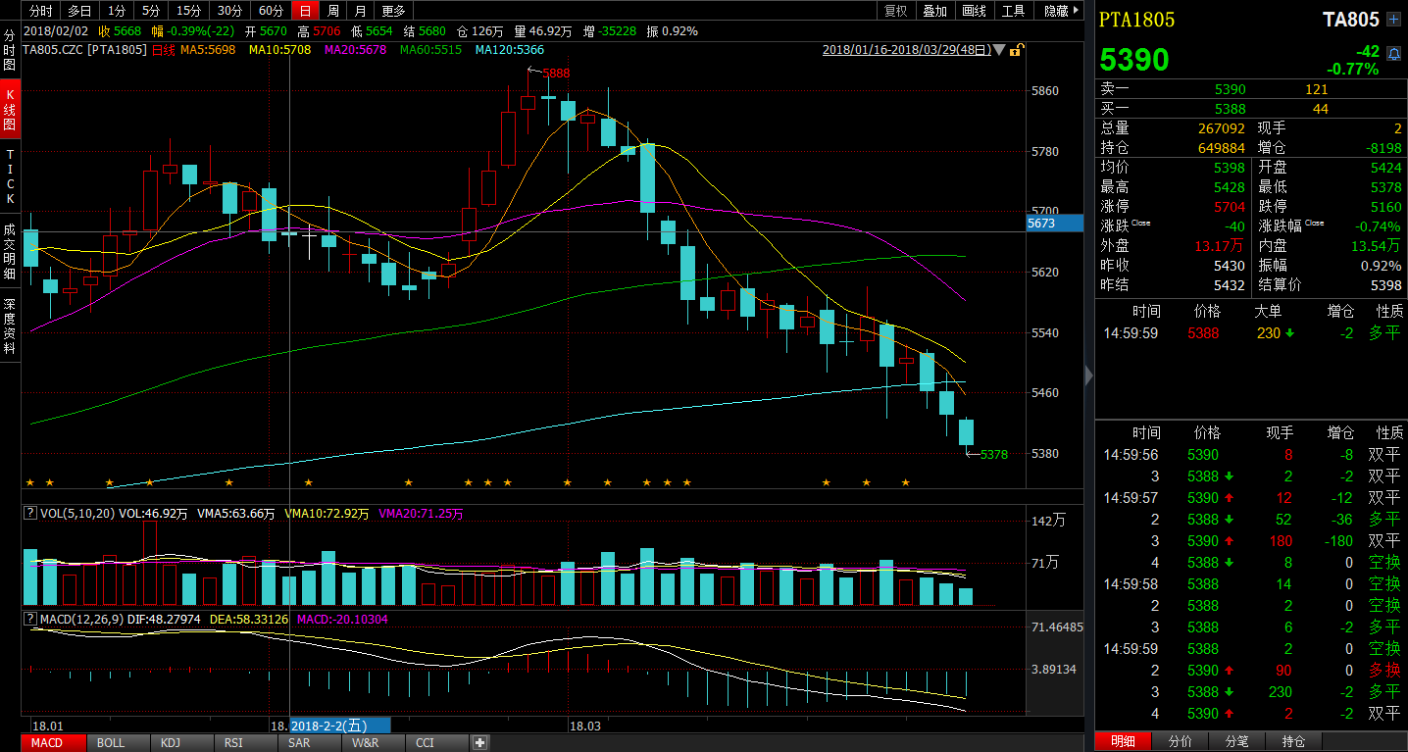
 | 多 |  |  |  |  | 空
2018/3/23 | FG 46 | C 143 | ZC 22 | TA 46 | RU 9 | J 10 | RB 53 | P 38 | JM 13 | Y 17
2018/3/26 | FG 81 | C 124 | ZC 19 | TA 41 | RU 10 | SR 20 | RB 66 | P 44 | RM 45 | Y 20
2018/3/27 | FG 81 | C 124 | ZC 19 | TA 41 | RU 10 | SR 20 | RB 66 | P 44 | RM 45 | Y 20
2018/3/28 | FG 81 | C 124 | ZC 19 | TA 41 | RU 10 | SR 20 | RB 66 | P 44 | RM 45 | Y 20
2018/3/29 | FG 81 | C 124 | ZC 19 | TA 41 | RU 10 | SR 20 | RB 66 | P 44 | RM 45 | Y 20

Slide 8
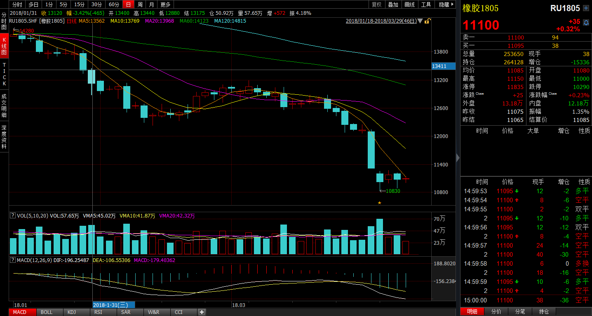
 | 多 |  |  |  |  | 空
2018/3/23 | FG 46 | C 143 | ZC 22 | TA 46 | RU 9 | J 10 | RB 53 | P 38 | JM 13 | Y 17
2018/3/26 | FG 81 | C 124 | ZC 19 | TA 41 | RU 10 | SR 20 | RB 66 | P 44 | RM 45 | Y 20
2018/3/27 | FG 81 | C 124 | ZC 19 | TA 41 | RU 10 | SR 20 | RB 66 | P 44 | RM 45 | Y 20
2018/3/28 | FG 81 | C 124 | ZC 19 | TA 41 | RU 10 | SR 20 | RB 66 | P 44 | RM 45 | Y 20
2018/3/29 | FG 81 | C 124 | ZC 19 | TA 41 | RU 10 | SR 20 | RB 66 | P 44 | RM 45 | Y 20

Slide 9
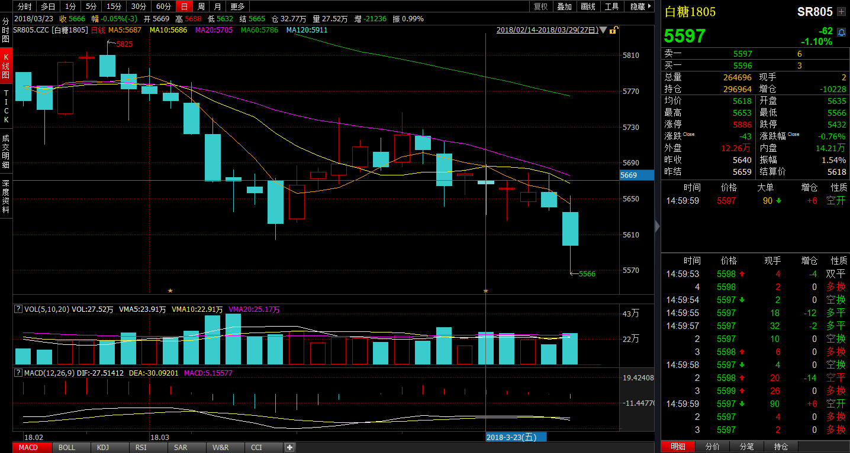
 | 多 |  |  |  |  | 空
2018/3/23 | FG 46 | C 143 | ZC 22 | TA 46 | RU 9 | J 10 | RB 53 | P 38 | JM 13 | Y 17
2018/3/26 | FG 81 | C 124 | ZC 19 | TA 41 | RU 10 | SR 20 | RB 66 | P 44 | RM 45 | Y 20
2018/3/27 | FG 81 | C 124 | ZC 19 | TA 41 | RU 10 | SR 20 | RB 66 | P 44 | RM 45 | Y 20
2018/3/28 | FG 81 | C 124 | ZC 19 | TA 41 | RU 10 | SR 20 | RB 66 | P 44 | RM 45 | Y 20
2018/3/29 | FG 81 | C 124 | ZC 19 | TA 41 | RU 10 | SR 20 | RB 66 | P 44 | RM 45 | Y 20

Slide 10
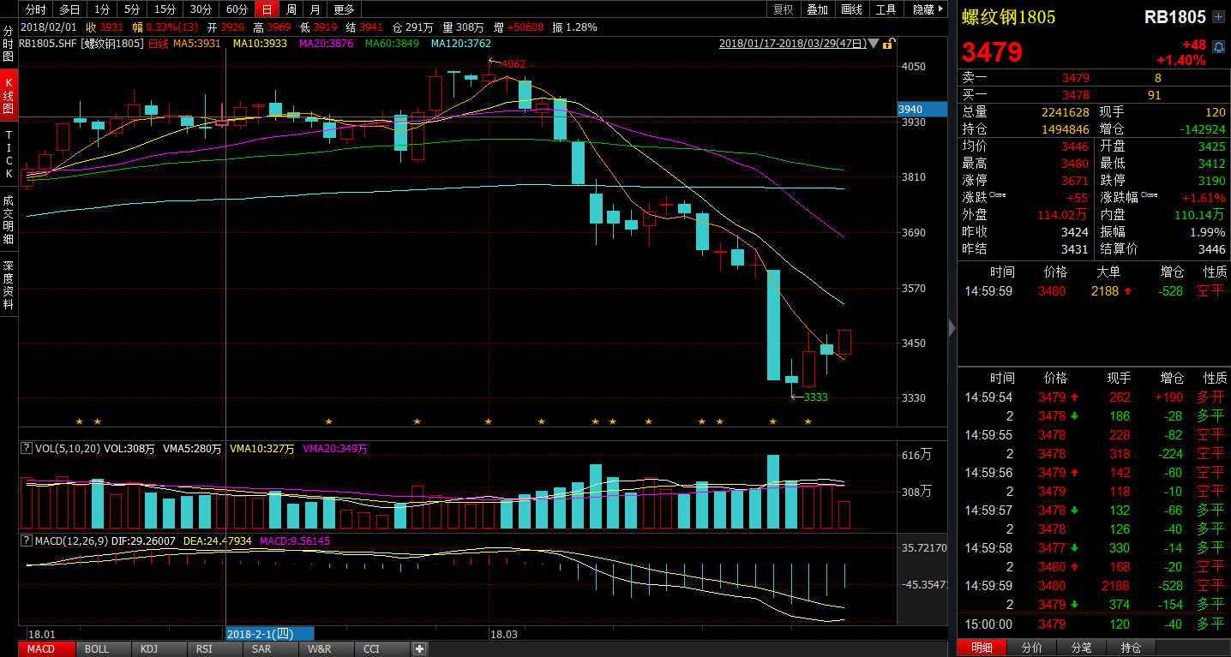
 | 多 |  |  |  |  | 空
2018/3/23 | FG 46 | C 143 | ZC 22 | TA 46 | RU 9 | J 10 | RB 53 | P 38 | JM 13 | Y 17
2018/3/26 | FG 81 | C 124 | ZC 19 | TA 41 | RU 10 | SR 20 | RB 66 | P 44 | RM 45 | Y 20
2018/3/27 | FG 81 | C 124 | ZC 19 | TA 41 | RU 10 | SR 20 | RB 66 | P 44 | RM 45 | Y 20
2018/3/28 | FG 81 | C 124 | ZC 19 | TA 41 | RU 10 | SR 20 | RB 66 | P 44 | RM 45 | Y 20
2018/3/29 | FG 81 | C 124 | ZC 19 | TA 41 | RU 10 | SR 20 | RB 66 | P 44 | RM 45 | Y 20

Slide 11
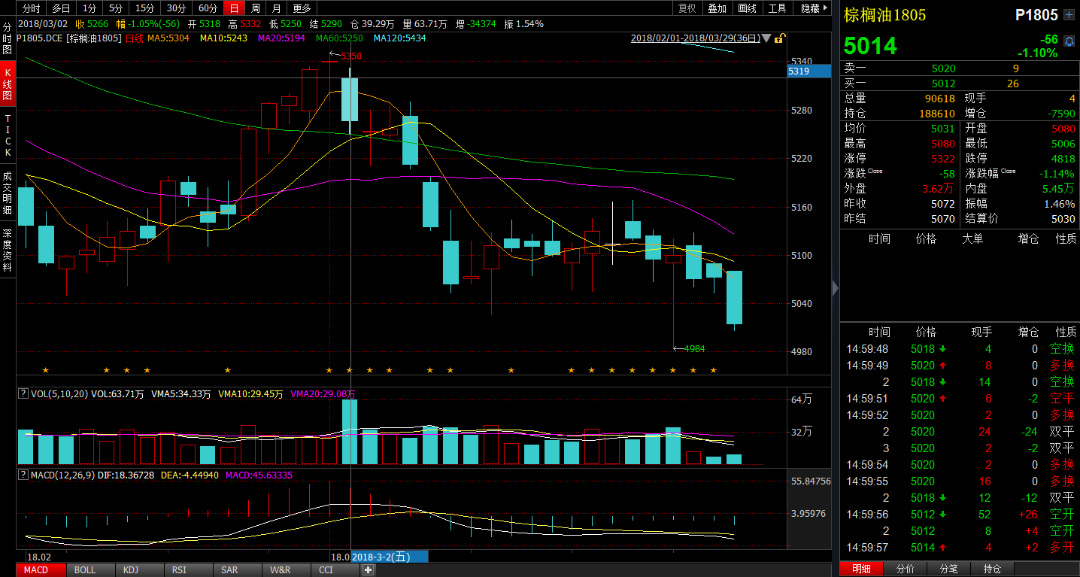
 | 多 |  |  |  |  | 空
2018/3/23 | FG 46 | C 143 | ZC 22 | TA 46 | RU 9 | J 10 | RB 53 | P 38 | JM 13 | Y 17
2018/3/26 | FG 81 | C 124 | ZC 19 | TA 41 | RU 10 | SR 20 | RB 66 | P 44 | RM 45 | Y 20
2018/3/27 | FG 81 | C 124 | ZC 19 | TA 41 | RU 10 | SR 20 | RB 66 | P 44 | RM 45 | Y 20
2018/3/28 | FG 81 | C 124 | ZC 19 | TA 41 | RU 10 | SR 20 | RB 66 | P 44 | RM 45 | Y 20
2018/3/29 | FG 81 | C 124 | ZC 19 | TA 41 | RU 10 | SR 20 | RB 66 | P 44 | RM 45 | Y 20

Slide 12
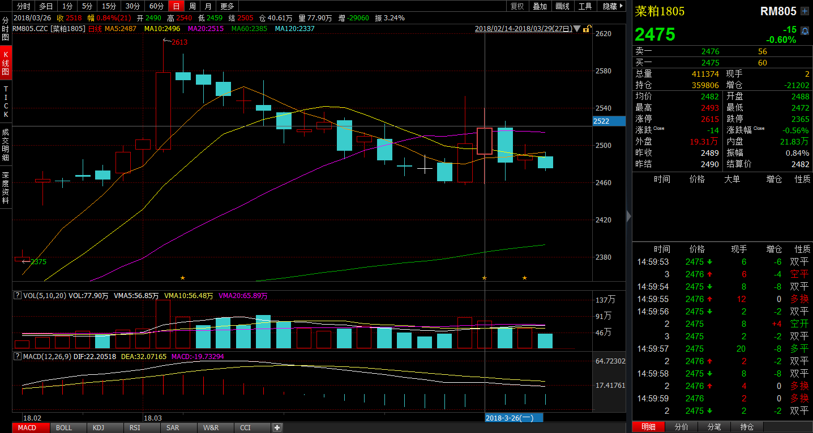
 | 多 |  |  |  |  | 空
2018/3/23 | FG 46 | C 143 | ZC 22 | TA 46 | RU 9 | J 10 | RB 53 | P 38 | JM 13 | Y 17
2018/3/26 | FG 81 | C 124 | ZC 19 | TA 41 | RU 10 | SR 20 | RB 66 | P 44 | RM 45 | Y 20
2018/3/27 | FG 81 | C 124 | ZC 19 | TA 41 | RU 10 | SR 20 | RB 66 | P 44 | RM 45 | Y 20
2018/3/28 | FG 81 | C 124 | ZC 19 | TA 41 | RU 10 | SR 20 | RB 66 | P 44 | RM 45 | Y 20
2018/3/29 | FG 81 | C 124 | ZC 19 | TA 41 | RU 10 | SR 20 | RB 66 | P 44 | RM 45 | Y 20

Slide 13
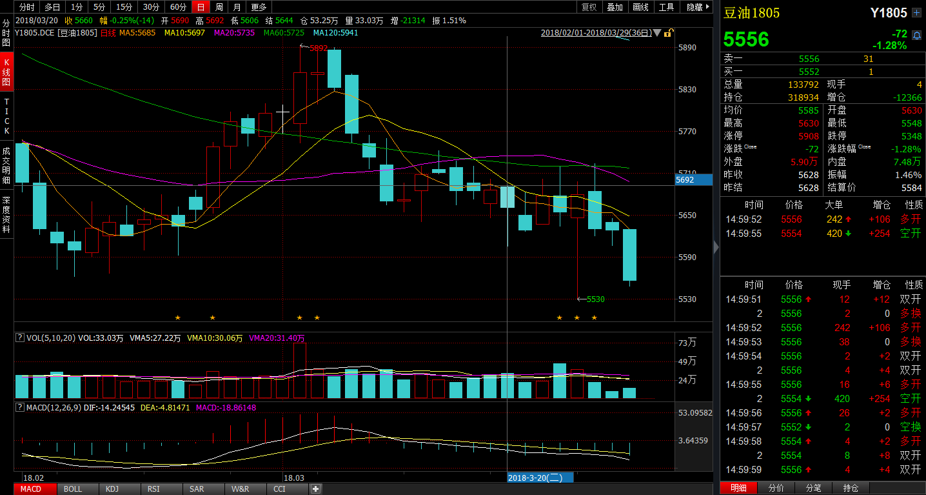
 | 多 |  |  |  |  | 空
2018/3/23 | FG 46 | C 143 | ZC 22 | TA 46 | RU 9 | J 10 | RB 53 | P 38 | JM 13 | Y 17
2018/3/26 | FG 81 | C 124 | ZC 19 | TA 41 | RU 10 | SR 20 | RB 66 | P 44 | RM 45 | Y 20
2018/3/27 | FG 81 | C 124 | ZC 19 | TA 41 | RU 10 | SR 20 | RB 66 | P 44 | RM 45 | Y 20
2018/3/28 | FG 81 | C 124 | ZC 19 | TA 41 | RU 10 | SR 20 | RB 66 | P 44 | RM 45 | Y 20
2018/3/29 | FG 81 | C 124 | ZC 19 | TA 41 | RU 10 | SR 20 | RB 66 | P 44 | RM 45 | Y 20

