Slide 1
2018/3/2 | 5,528,341 | 0.9864232
2018/3/5 | 5,594,705 | 0.9983
2018/3/6 | 5,574,198 | 0.9946
2018/3/7 | 5,604,871 | 1.0001
2018/3/8 | 5,725,125 | 1.0215
2018/3/9 | 5,787,555 | 1.0327
2018/3/12 | 5,823,430 | 1.0391
2018/3/13 | 5,837,690 | 1.0416
2018/3/14 | 5,771,800 | 1.0299
2018/3/15 | 5,797,110 | 1.0344
2018/3/16 | 5,823,900 | 1.0392
2018/3/19 | 5,944,660 | 1.0607
2018/3/20 | 5,890,890 | 1.0511
2018/3/22 | 5,771,330 | 1.0298
2018/3/23 | 5,889,394 | 1.050846
2018/3/26 | 5,866,400 | 1.0467
2018/3/27 | 5,825,510 | 1.0394
2018/3/28 | 5,813,110 | 1.0372
2018/3/29 | 5,832,010 | 1.0406
2018/3/30 | 5,739,062 | 1.0240222
2018/4/2 | 5,635,522 | 1.0055
2018/4/3 | 5,635,782 | 1.0056
2018/4/4 | 5,635,010 | 1.0055
2018/4/9 | 5,571,170 | 0.9941
2018/4/10 | 5,541,500 | 0.9888
2018/4/11 | 5,657,488 | 1.0095
2018/4/12 | 5,736,958 | 1.0236
2018/4/13 | 5,692,698 | 1.0157495
2018/4/16 | 5,707,472 | 1.0184
2018/4/17 | 5,679,702 | 1.0134
2018/4/18 | 5,643,232 | 1.0069
2018/4/19 | 5,596,932 | 0.9987
2018/4/20 | 5,682,267 | 1.0139
2018/4/23 | 5,531,137 | 0.9869
2018/4/24 | 5,561,897 | 0.9924
2018/4/25 | 5,617,247 | 1.0023
2018/4/26 | 5,586,567 | 0.9968

Slide 2
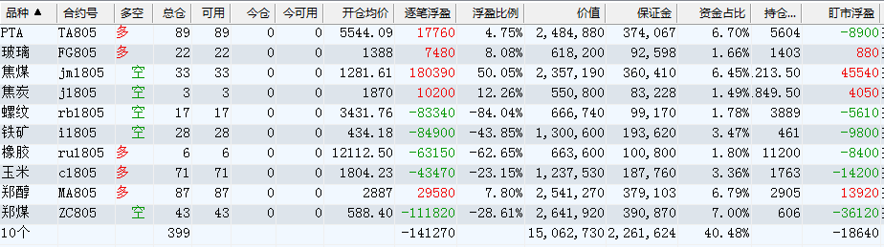

Slide 3
 | 多 |  |  |  |  | 空
2018/4/4 | FG 30 | C 97 | BU 119 | TA 31 | RU 8 | J 11 | RB 28 | I 47 | RM 19 | JM 27
2018/4/16 | FG 27 | C 87 | BU 108 | TA 56 | RU 7 | J 11 | RB 26 | I 43 | HC 25 | JM 25
2018/4/20 | FG 22 | C 71 | MA 87 | TA 89 | RU 6 | J 3 | RB 17 | I 27 | ZC 43 | JM 33

Slide 4
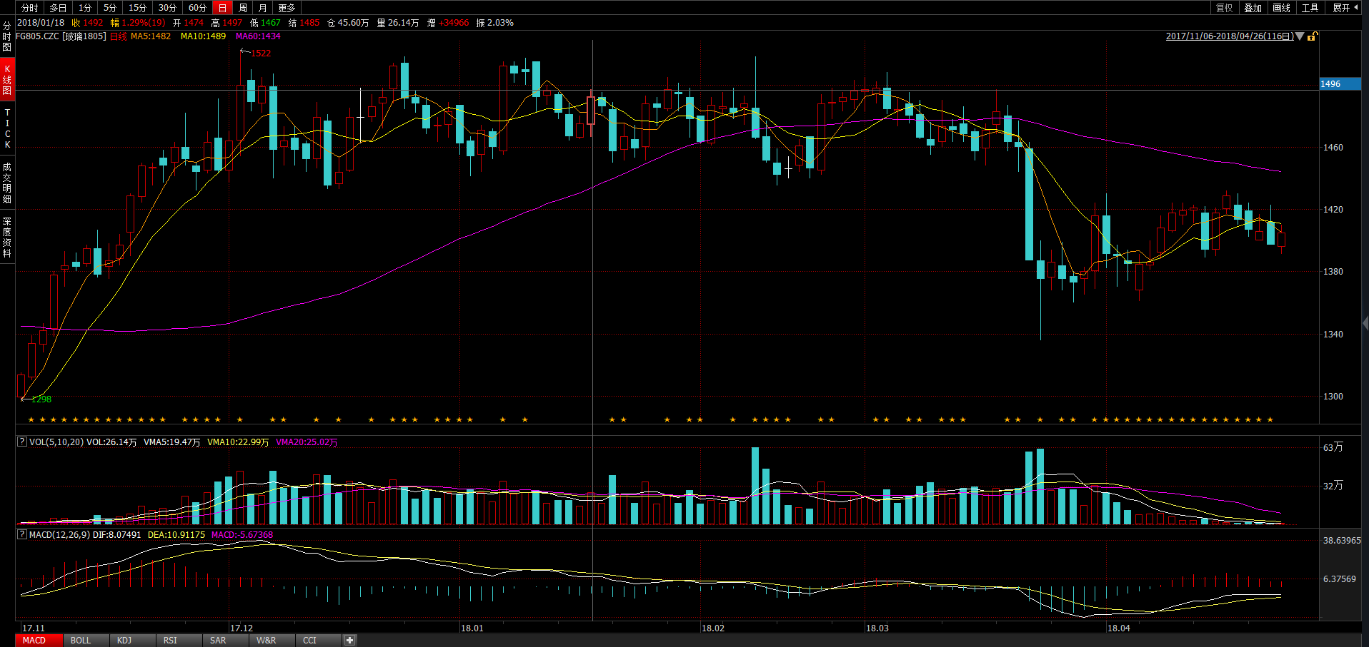
 | 多 |  |  |  |  | 空
2018/4/4 | FG 30 | C 97 | BU 119 | TA 31 | RU 8 | J 11 | RB 28 | I 47 | RM 19 | JM 27
2018/4/16 | FG 27 | C 87 | BU 108 | TA 56 | RU 7 | J 11 | RB 26 | I 43 | HC 25 | JM 25
2018/4/20 | FG 22 | C 71 | MA 93 | TA 89 | RU 6 | J 3 | RB 17 | I 27 | ZC 42 | JM 33

Slide 5
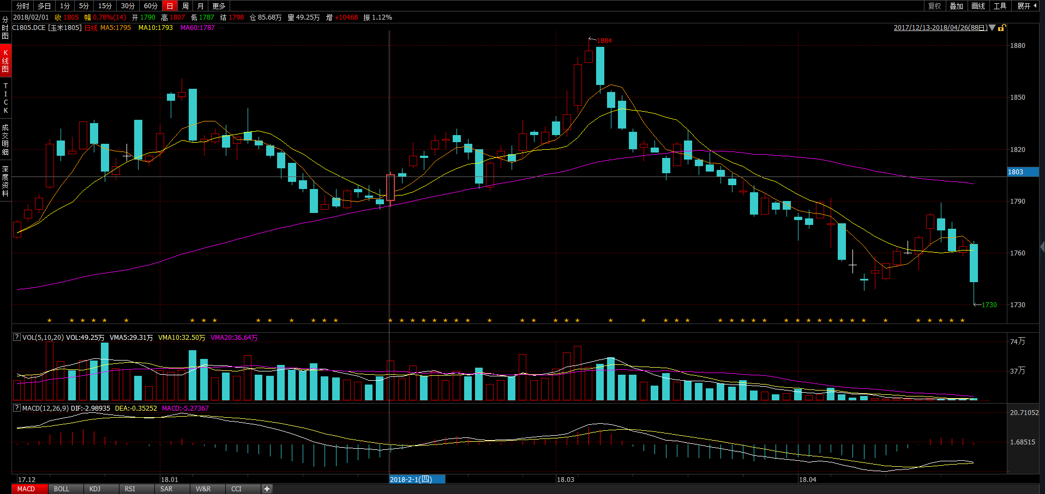
 | 多 |  |  |  |  | 空
2018/4/4 | FG 30 | C 97 | BU 119 | TA 31 | RU 8 | J 11 | RB 28 | I 47 | RM 19 | JM 27
2018/4/16 | FG 27 | C 87 | BU 108 | TA 56 | RU 7 | J 11 | RB 26 | I 43 | HC 25 | JM 25
2018/4/20 | FG 22 | C 71 | MA 93 | TA 89 | RU 6 | J 3 | RB 17 | I 27 | ZC 42 | JM 33

Slide 6
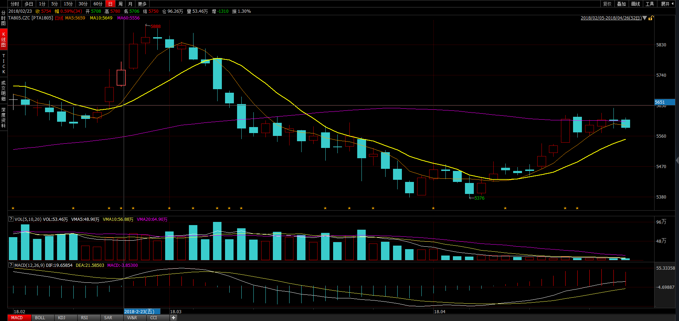
 | 多 |  |  |  |  | 空
2018/4/4 | FG 30 | C 97 | BU 119 | TA 31 | RU 8 | J 11 | RB 28 | I 47 | RM 19 | JM 27
2018/4/16 | FG 27 | C 87 | BU 108 | TA 56 | RU 7 | J 11 | RB 26 | I 43 | HC 25 | JM 25
2018/4/20 | FG 22 | C 71 | MA 93 | TA 89 | RU 6 | J 3 | RB 17 | I 27 | ZC 42 | JM 33

Slide 7
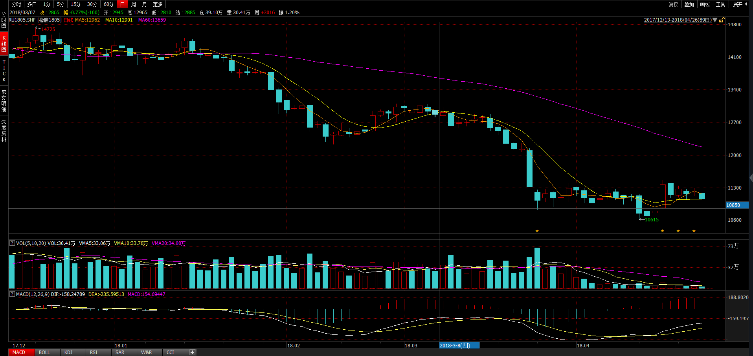
 | 多 |  |  |  |  | 空
2018/4/4 | FG 30 | C 97 | BU 119 | TA 31 | RU 8 | J 11 | RB 28 | I 47 | RM 19 | JM 27
2018/4/16 | FG 27 | C 87 | BU 108 | TA 56 | RU 7 | J 11 | RB 26 | I 43 | HC 25 | JM 25
2018/4/20 | FG 22 | C 71 | MA 93 | TA 89 | RU 6 | J 3 | RB 17 | I 27 | ZC 42 | JM 33

Slide 8
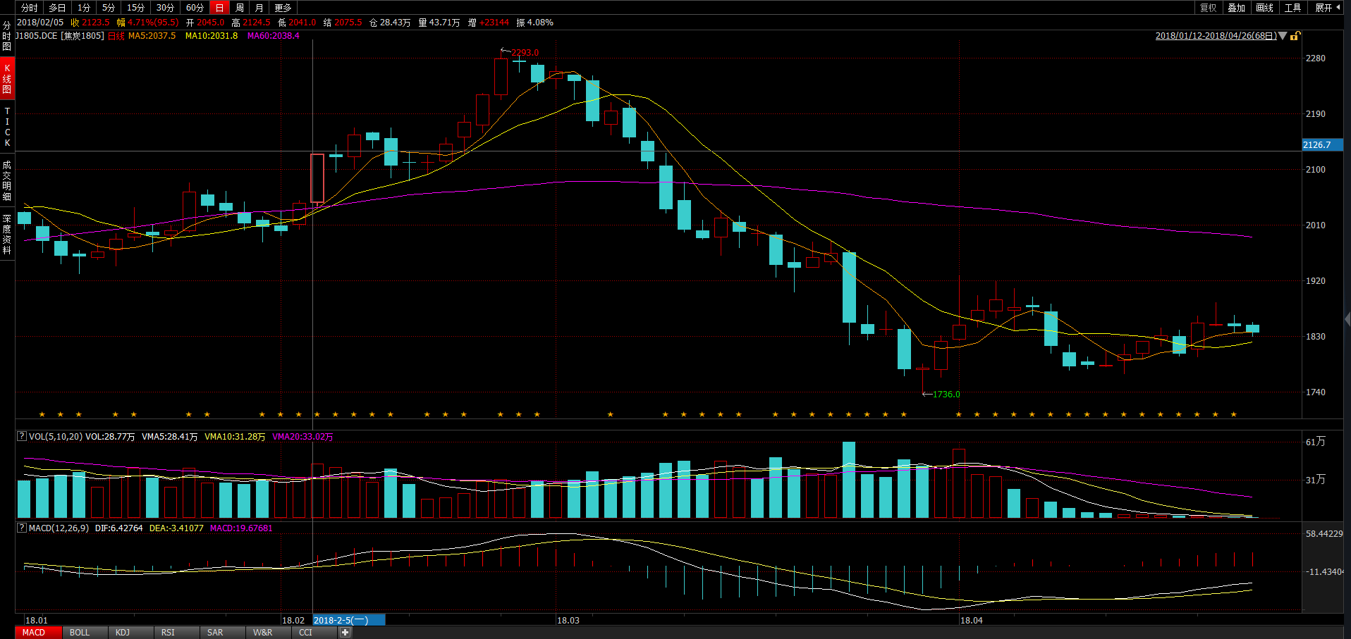
 | 多 |  |  |  |  | 空
2018/4/4 | FG 30 | C 97 | BU 119 | TA 31 | RU 8 | J 11 | RB 28 | I 47 | RM 19 | JM 27
2018/4/16 | FG 27 | C 87 | BU 108 | TA 56 | RU 7 | J 11 | RB 26 | I 43 | HC 25 | JM 25
2018/4/20 | FG 22 | C 71 | MA 93 | TA 89 | RU 6 | J 3 | RB 17 | I 27 | ZC 42 | JM 33

Slide 9
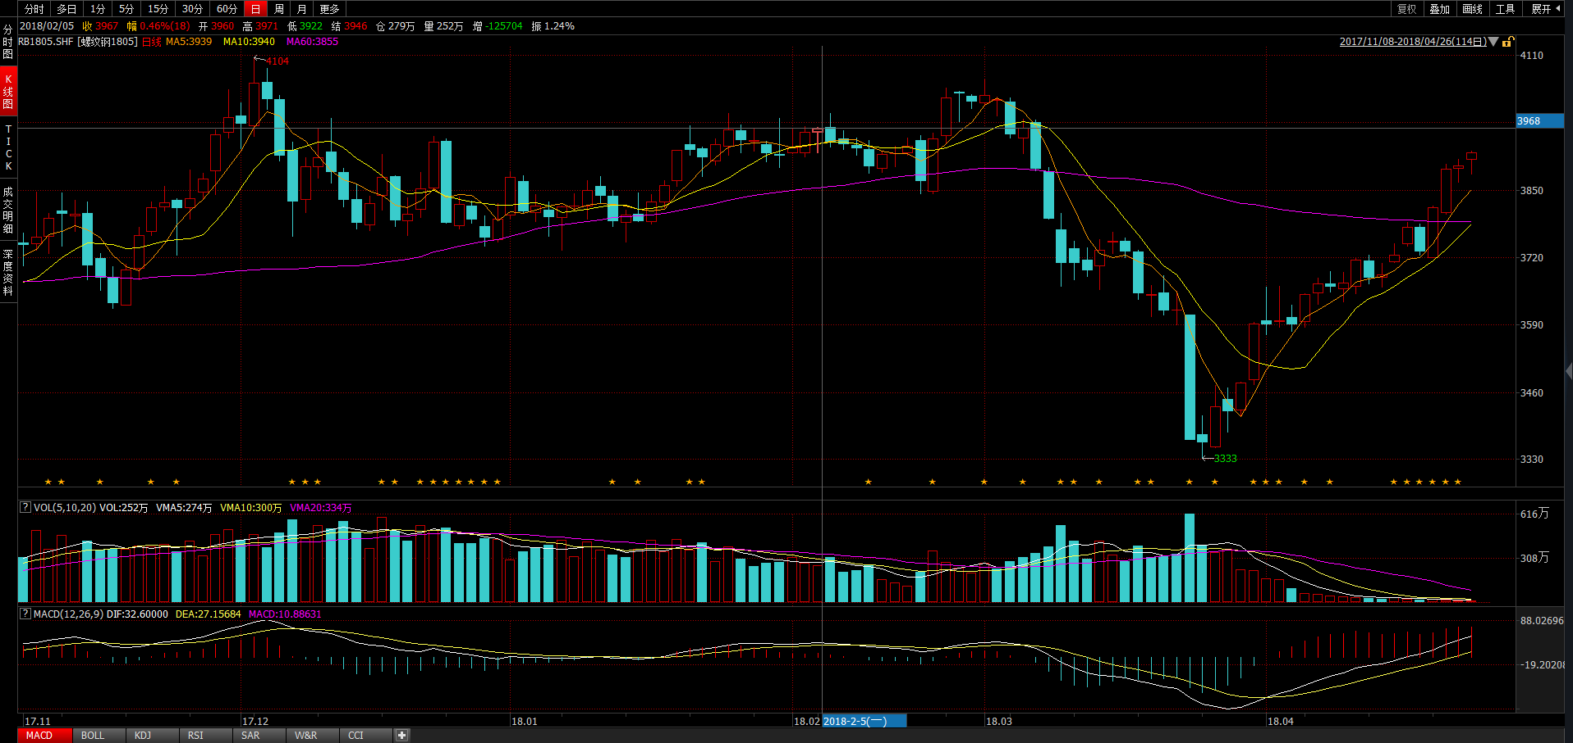
 | 多 |  |  |  |  | 空
2018/4/4 | FG 30 | C 97 | BU 119 | TA 31 | RU 8 | J 11 | RB 28 | I 47 | RM 19 | JM 27
2018/4/16 | FG 27 | C 87 | BU 108 | TA 56 | RU 7 | J 11 | RB 26 | I 43 | HC 25 | JM 25
2018/4/20 | FG 22 | C 71 | MA 93 | TA 89 | RU 6 | J 3 | RB 17 | I 27 | ZC 42 | JM 33

Slide 10
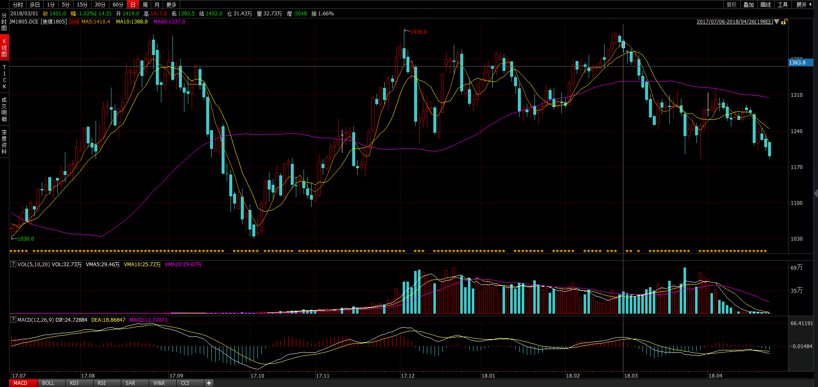
 | 多 |  |  |  |  | 空
2018/4/4 | FG 30 | C 97 | BU 119 | TA 31 | RU 8 | J 11 | RB 28 | I 47 | RM 19 | JM 27
2018/4/16 | FG 27 | C 87 | BU 108 | TA 56 | RU 7 | J 11 | RB 26 | I 43 | HC 25 | JM 25
2018/4/20 | FG 22 | C 71 | MA 93 | TA 89 | RU 6 | J 3 | RB 17 | I 27 | ZC 42 | JM 33

Slide 11
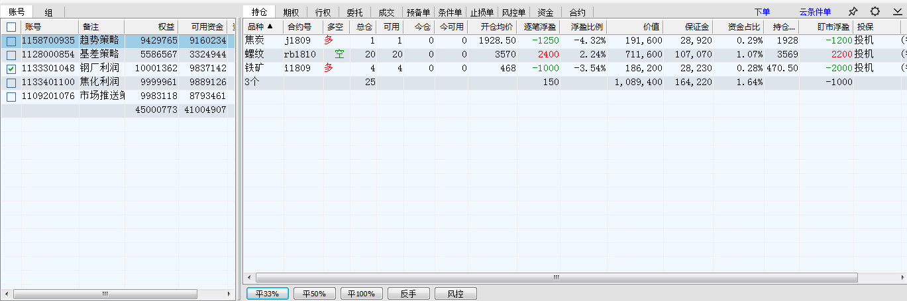
做空钢厂利润

Slide 12
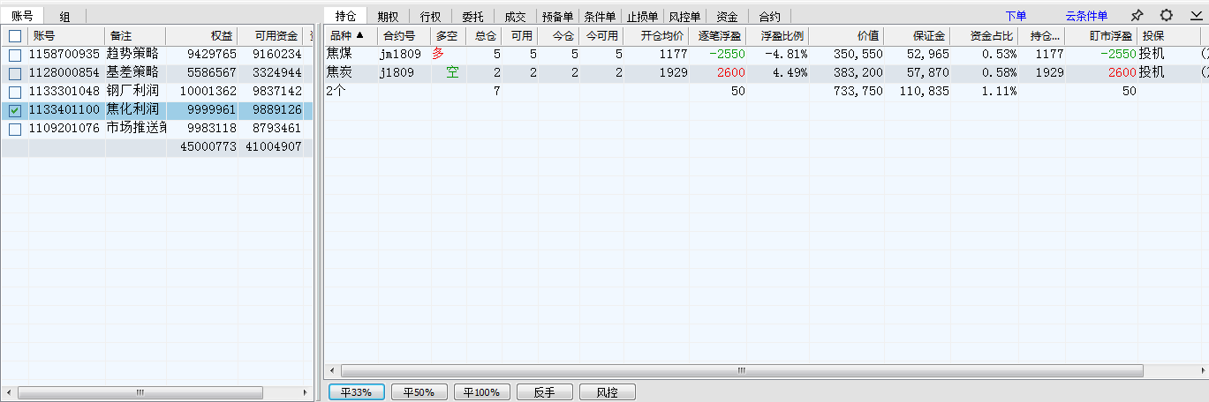
做空焦化利润

Slide 13
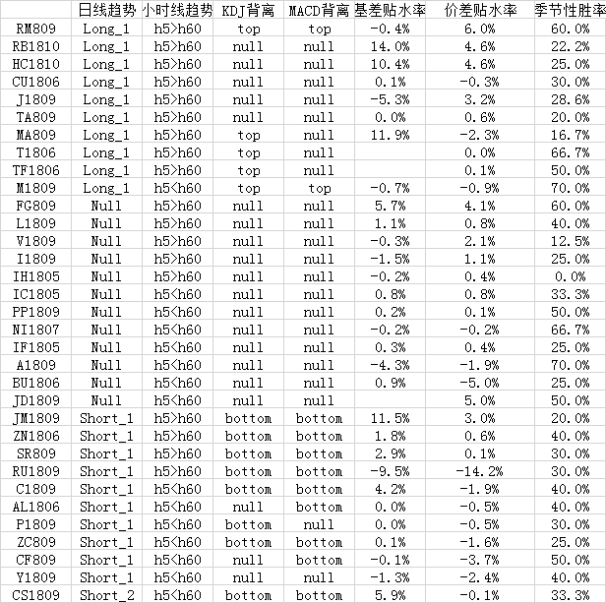
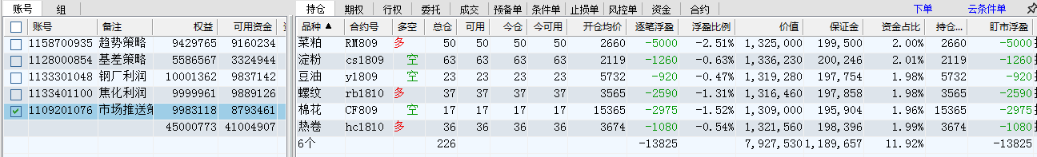
市场推送策略

