Slide 1
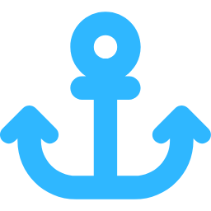
GLOBAL MARINE SALVAGE CONTRACTOR
Ship Salvage & Wreck Removal
Up to 3,000 t · Cutting · Dewatering · Recycling
15+ YEARS · 120+ PROJECTS · WORLDWIDE

Slide 2
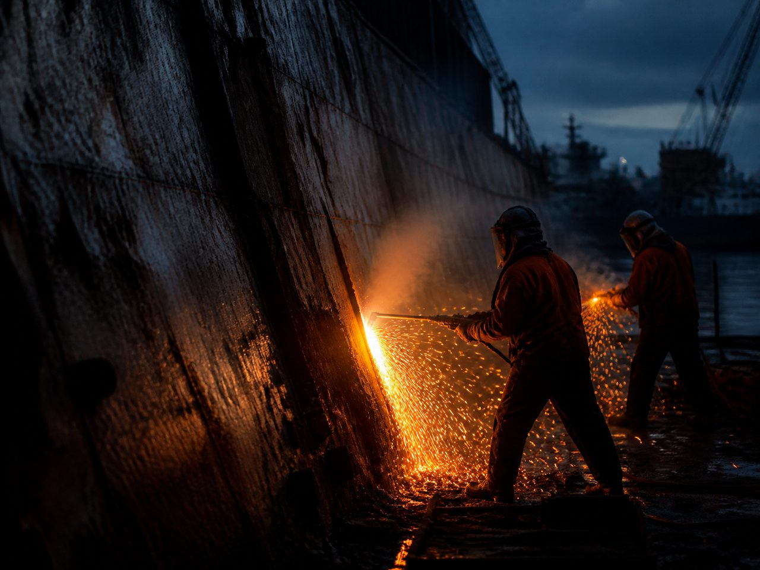
ABOUT US
15+ YEARS OF SALVAGE EXPERIENCE
Our team began in Primorsky Krai — the Russian Far East — one of the most demanding maritime regions in the world. The ports of Vladivostok and Nakhodka shaped our approach: strong currents, cold waters, tight schedules.
Today we operate internationally — salvage, wreck removal and metal recycling for shipping companies, ports, insurers and government agencies.
15+
120+
3,000 t
10+
YEARS OF EXPERIENCE
PROJECTS COMPLETED
MAX LIFTING CAPACITY
COUNTRIES SERVED

Slide 3

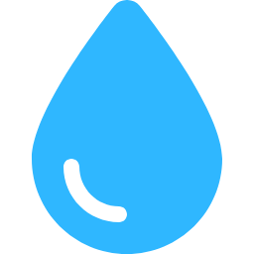

WHAT WE DO
OUR SERVICES
SHIP LIFTING
UNDERWATER CUTTING
DEWATERING
METAL RECYCLING
UP TO 3,000 TONNES
AND PUMPING
AND PROCESSING
Pontoons, cranes and airbags for sunken and grounded vessels.
AND DISMANTLING
High-capacity pumping of flooded compartments and holds.
Eco-compliant removal and recycling of vessel metals.
Cutting and hull demolition by certified diving teams.

Slide 4
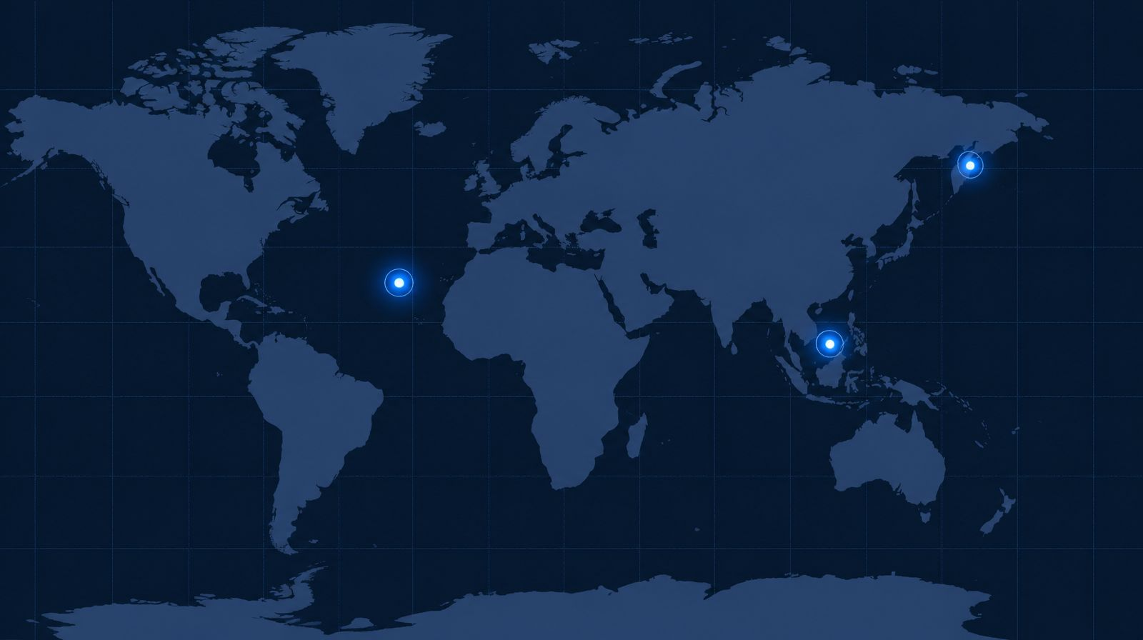
WHERE WE WORK
GLOBAL REACH, FAR EAST ROOTS
RUSSIAN FAR EAST
Home base — Primorye.
SOUTHEAST ASIA
Active region for projects.
ATLANTIC
Global coverage.
AREAS OF OPERATION — ILLUSTRATIVE MAP

Slide 5
CAPABILITIES
FLEET AND EQUIPMENT
01
PONTOONS & AIRBAGS
02
HEAVY CRANES
Flotation systems for lifts.
Deck and harbour cranes.
03
ROV SYSTEMS
04
DIVING TEAMS
Remote inspection, survey.
Certified divers, full gear.

Slide 6
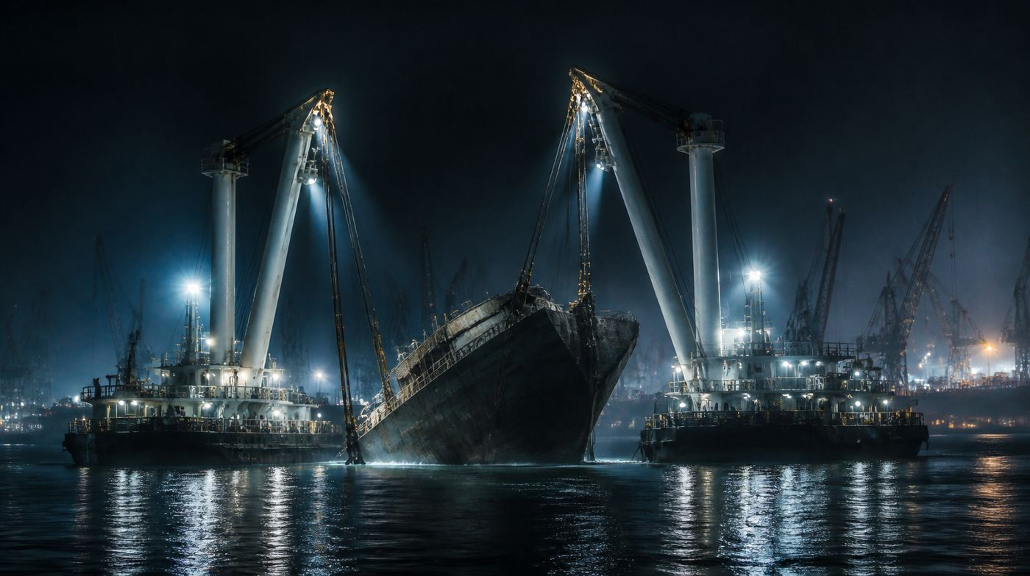
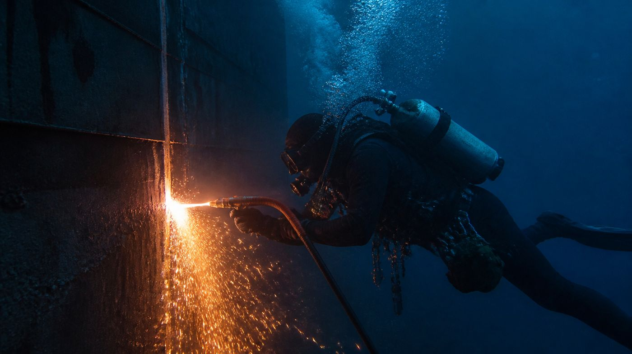
REFERENCE PROJECTS
CASES AND OPERATIONS
ILLUSTRATIVE IMAGERY
VESSEL LIFTING — 2,800 t CARGO SHIP
UNDERWATER CUTTING — GROUNDED HULL
Pontoons and deck cranes; vessel refloated, stabilised and towed to the yard for recycling.
Divers and ROV sectioned the hull in shallow water; steel removed and processed on site.
Illustrative imagery
Illustrative imagery

Slide 7
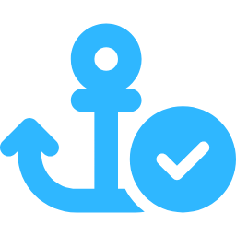



ADVANTAGES
WHY CHOOSE US
PROVEN EXPERIENCE
SAFETY FIRST
24/7 RESPONSE
CERTIFIED TEAM
15+ years in the Far East and international waters.
Certified procedures and diving standards on every project.
Rapid mobilisation for emergency salvage.
Marine engineers certified to international standards.

Slide 8
TRUST
PARTNERS AND CLIENTS
ILLUSTRATIVE PARTNER LOGOS
PACIFIC PORTS ALLIANCE
BALTIC MARINE GROUP
FAR EAST SHIPPING CO.
PARTNER
PARTNER
PARTNER
NORDIC SALVAGE & TOWAGE
GLOBAL MARINE INSURERS
SUEZ MARITIME SERVICES
PARTNER
PARTNER
PARTNER

Slide 9
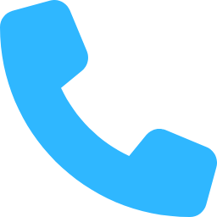


CONTACT US
GET IN TOUCH
PHONE
+7 (977) 017-04-27
24/7 emergency line
EMAIL
ildus650@gmail.com
Response within 24 hours
TELEGRAM
@Sudopodembot
t.me/Sudopodembot — fastest channel

Slide 10
READY WHEN YOU ARE
CONTACT US FOR A CONSULTATION
We respond within 24 hours.
TELEGRAM · EMAIL · PHONE
CALL +7 (977) 017-04-27 · @Sudopodembot

