Slide 1
Extracting Randomness from Samplable Distributions, Revisited
Marshall Ball (NYU)
Dana Dachman-Soled (UMP)
Eli Goldin (NYU)
Saachi Mutreja (Columbia)
Notes:
Hey everyone, I’m Eli, today I will be talking about extracting randomness from samplable distributions. This is joint work with Marshall Ball, Dana Dachman-Soled, and Saaachi Mutreja.

Slide 2

How can you flip a coin if the universe is weakly random?
Notes:
The main philosophical question of this work is the following: if there is no true (i.e. uniform) randomness naturally appearing in the universe, is it still possible to generate our own true randomness (i.e. flip an unbiased coin).

Slide 3
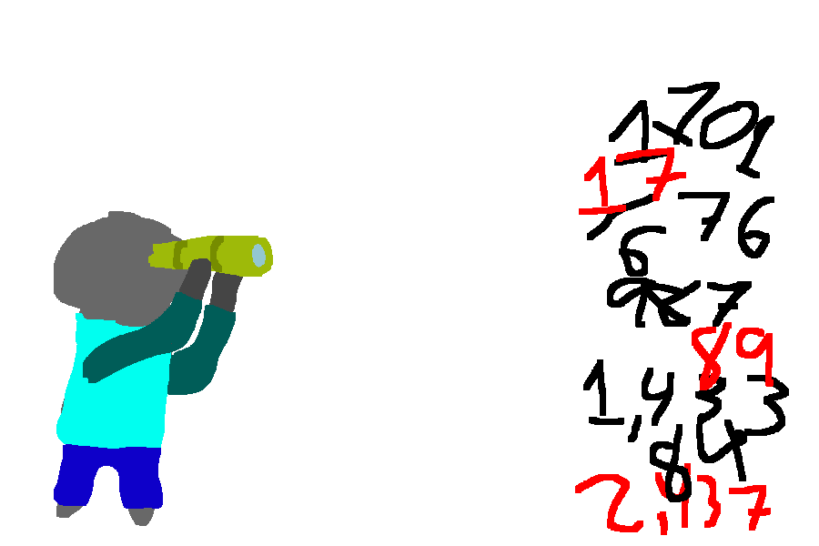

We need randomness!
Randomized Algorithms
Cryptography
Notes:
I don’t think I need to motivate to you all that (true) randomness is really important. It can be used for everything from *click* randomized algorithms to *click* crpytography.

Slide 4


But where do we get it?
Notes:
But in practice, we need to get this randomness from somewhere. The typical approach is to pull from randomized natural sources. For example, the timing of interrupts on a hard disk, or the frequency of solar flares, or the perturbations of lava in a lava lamp.
*click* Unfortunately, none of these natural sources are uniformly random. In fact, we do not know if there even EXISTS a natural uniform source.

Slide 5

Randomness extraction
[von Neumann ‘51]
Notes:
To solve this conundrum, von Neumann in 1951 proposed the idea of randomness extraction.
A randomness extractor informally is a process which takes in a somewhat random source and outputs uniform randomness.
In reality, we have no clue what the distribution of perturbations of a lava lamp might be. Therefore, we would really like our randomness extractor to work for any underlying source.

Slide 6





Randomness extraction
Ideal: For all X, Ext(X) is close to uniform
Ext deterministic, efficient
Notes:
More formally, a randomness extractor is a deterministic, efficient function such that, on input any sufficiently random source, the output is uniformly random.
It is easy to show that extractors are only possible if we assume the input source has SOME amount of randomness. Typically, the amount of randomness in a source is classified by something called min-entropy, which I will not define here.

Slide 7

Key point
To get randomness extraction, we need an additional assumption about the high-entropy source X.
Notes:
Unfortunately, it can be shown that randomness extractors do not exist in full generality, even allowing for the entropy requirement on the source.
The main way to get around this barrier is to simply make additional assumptions about the source of randomness X.

Slide 8


Known extractors
Two-source Extractors
Seeded Extractors
[Chor Goldreich ‘88]
[Nisan Zuckerman ‘96]
Notes:
In particular, we know how to do randomness extraction for several important classes of sources.
We know extractors for when X is the concatenation of two independent sources of randomness, this is known as a two-source extractor.
We also know how to do randomness extraction if we are given some small amount of uniform randomness to work with. Extractors given some uniform randomness are known as seeded extractors, and are often what most people mean when they say randomness extractor. However, we will focus on the seedless, deterministic case.
Note that these extractors are very useful for theoretic applications, but philosophically they do not exactly apply to randomness coming from the real world. There is no way to confirm that two physical sources of randomness are independent, and we know of no way to physically sample the random seed used for a seeded extractor.

Slide 9
Big (Math) Question
What is the most general restriction we can put on X and still get randomness extraction?
Notes:
In particular, we would like to build a randomness extractor that works for all sources that we may come across in the real world. This leads to our big (math) question:

Slide 10
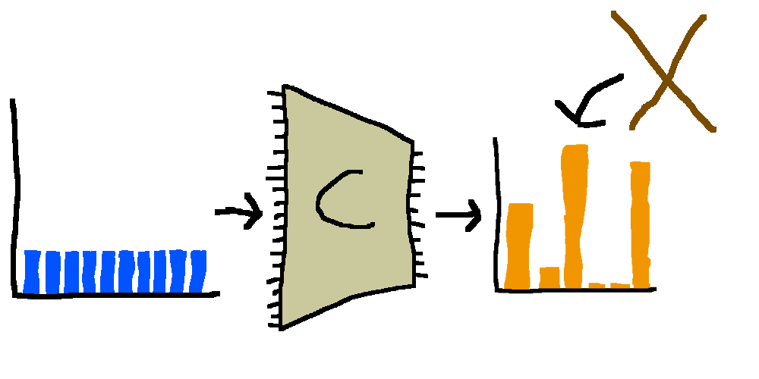
Samplable sources
X is samplable by size-s circuits if there exists C of size s with Pr_{r}[C(r)=x] = Pr[X → x]
[Levin ’86]
[Trevisan Vadhan ‘00]
Notes:
Towards this end, Levin, Trevisan, and Vadhan developed the notion of a samplable source. A samplable source X is any distribution resulting from applying a small circuit C to the uniform distribution.

Slide 11
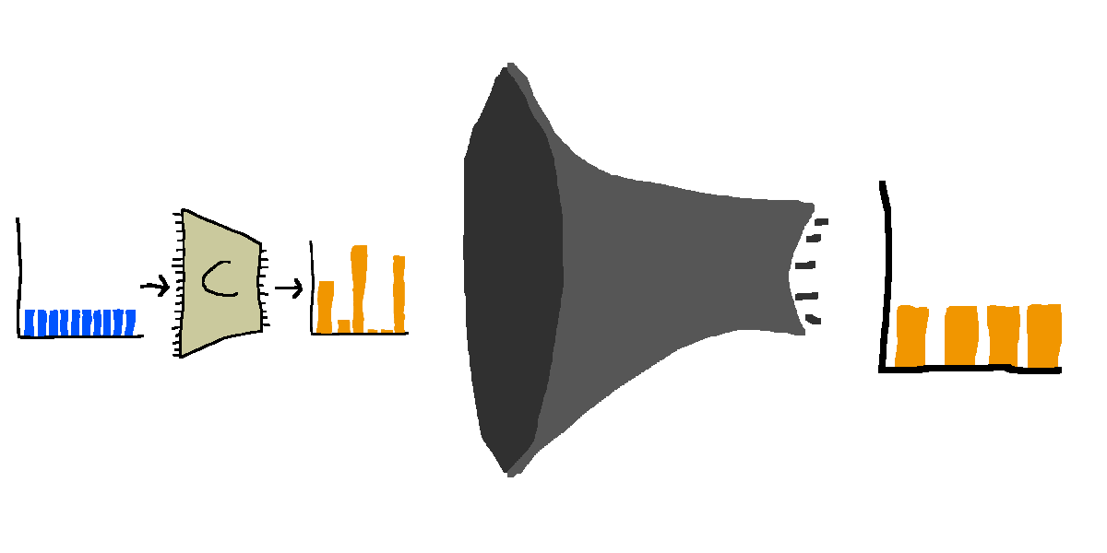
Extractors for samplable sources
Informal Theorem: Modulo a complexity assumption, there exist “efficient” extractors for samplable sources.
[Trevisan Vadhan ‘00]
Notes:
Fortunately, Trevisan and Vadhan in 2000 showed that modulo some complexity assumption, extractors for samplable sources DO exist. This in some sense solves our question, since we can argue that samplable sources ARE the most general assumption we can make.
Why is this the case?

Slide 12

Church-Turing thesis (strong, extended)
Notes:
Well, because of the Church-Turing thesis. The Church-Turing thesis says that every physical process in the universe can be simulated by a small classical circuit.
This implies that any physical source of randomness in the universe can be modeled as a samplable source. But there’s one problem

Slide 13

Church-Turing thesis (strong, extended)
Notes:
There is a reasonable chance that the Church-Turing thesis is flat-out wrong.

Slide 14

Quantum CT thesis (strong, extended)
Notes:
In particular, many physicists believe that the universe is quantum, and that quantum mechanics can do things more efficiently than any classical algorithm. Thus, in order to simulate any physical process, we should really need to use some small QUANTUM circuit. This natural idea goes by the name of the Quantum Church Turing Thesis

Slide 15
Our Results
Notes:
So what do we do in our work?

Slide 16
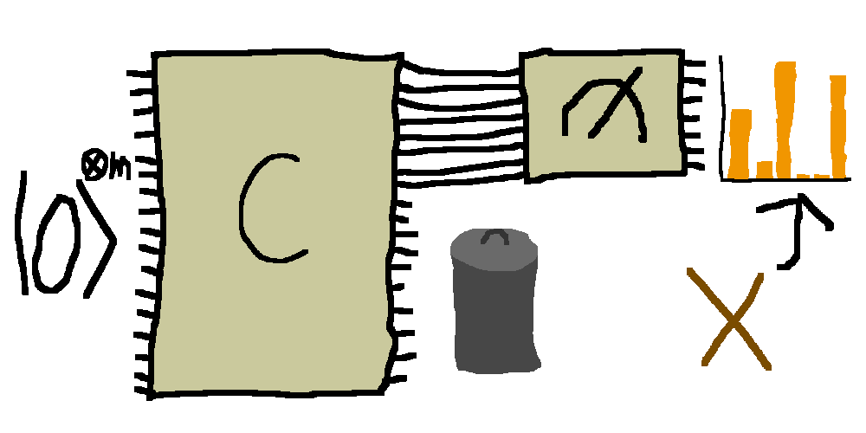
Quantum samplable sources
X is samplable by size-s quantum circuits if there exists quantum C of size s with Pr[C → x]=Pr[X → x]
Notes:
First of all, we give a natural definition quantum samplable sources. We say that a classical distribution X is samplable by quantum circuits if there exists a quantum circuit C such that when you measure its output register you get the distribution X.

Slide 17

Quantum extractor
Informal Theorem: Modulo a complexity assumption, there exist “efficient” classical extractors for quantum samplable sources.
Notes:
We then manage to extend Trevisan-Vadhan’s result to our new definition. In particular, we prove that modulo some (different) complexity assumption, extractors for quantum samplable sources exist.
Notably, our extractor is itself classical. This means that our results are still relevant even if we never build quantum computers. All that is necessary to get physical extractors is that physical sources can be MODELED as quantum circuits.

Slide 18
Classical improvement
[TV00]: Builds extractors for samplable sources from a strong hardness assumption.
We significantly weaken the assumption.
Notes:
And along the way, we improve Trevisan-Vadhan’s extractor for classically samplable sources by weakening their complexity assumption.

Slide 19
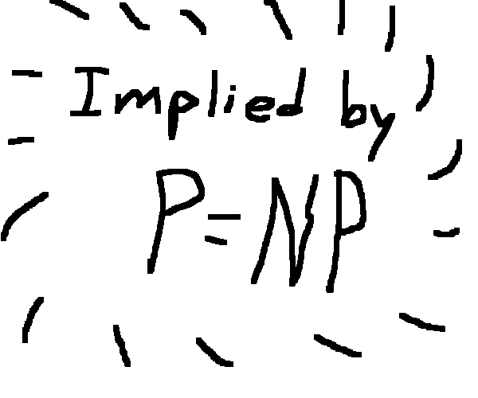
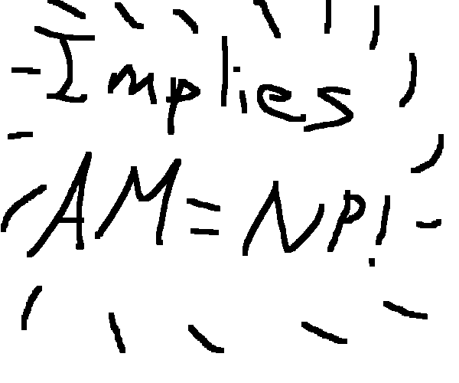
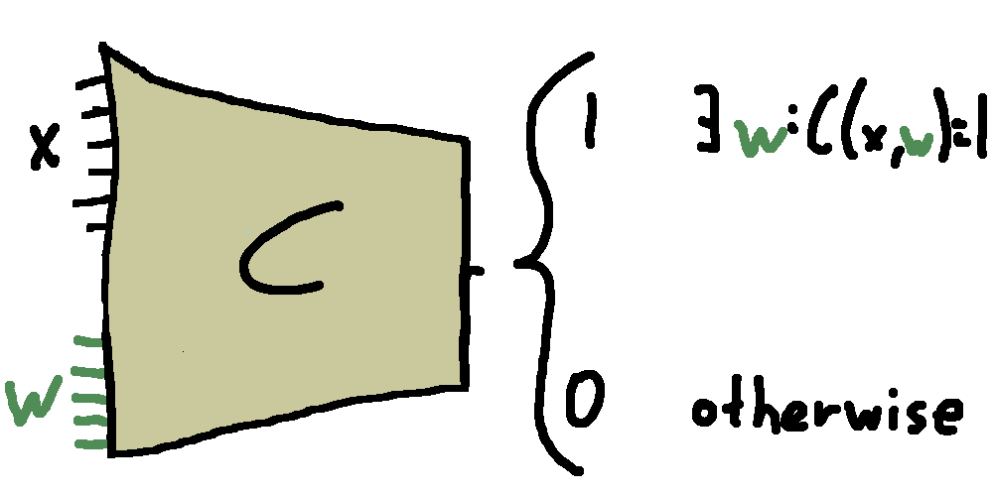
Assumptions
Classical Assumption: E=DTIME[2^{O(n)}] requires nondeterministic circuits of size 2^{Ω(n)}
“nondeterminism and
nonuniformity don’t
speed up all computation”
Notes:
So what are the assumptions we use?
In the classical settings, we assume that E requires nondeterministic circuits of exponential size. E is the class of all problems solvable in time 2^O(n), and nondeterministic circuits are a circuit-version of NP.
*click* Intuitively, this assumption says that nondeterminism combined with nonuniformity does not speed up all computation.
*click* This assumption has been used elsewhere for derandomization in the nondeterministic setting.
*click* And it is also implied by P = NP. This gives us a win-win situation where if somebody breaks our assumption then they must also show P!=NP.

Slide 20
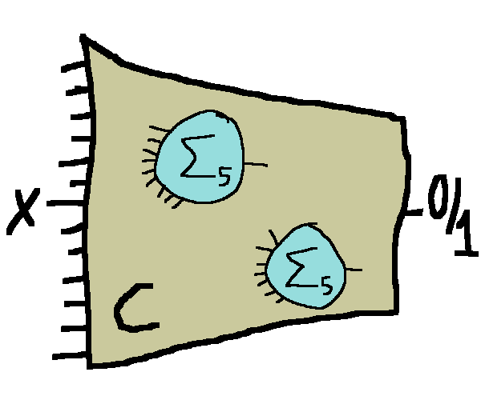
Assumptions
[TV 2000] Assumption: E=DTIME[2^{O(n)}] requires Σ₅-circuits of size 2^{Ω(n)}
“Σ₅-oracles and
nonuniformity don’t
speed up all computation”
Notes:
In comparison, Trevisan and Vadhan originally assumed that E was hard for circuits with oracle access to a complete problem for the Sigma_5, the fifth level of the poly hierarchy. And so our result improves the result by Trevisan and Vadhan by approximately 4 and a half levels of the polynomal hierarchy, whatever that means.

Slide 21
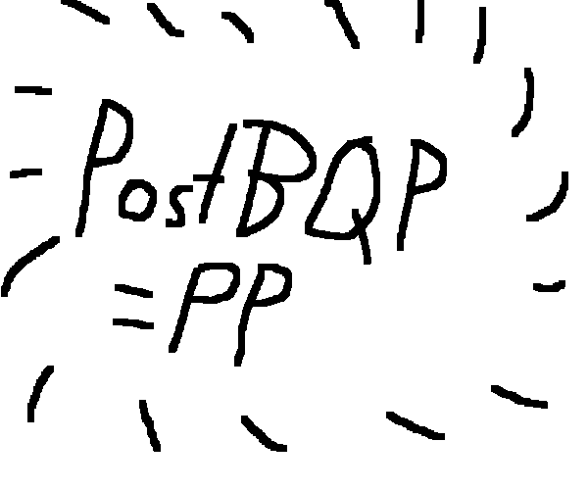
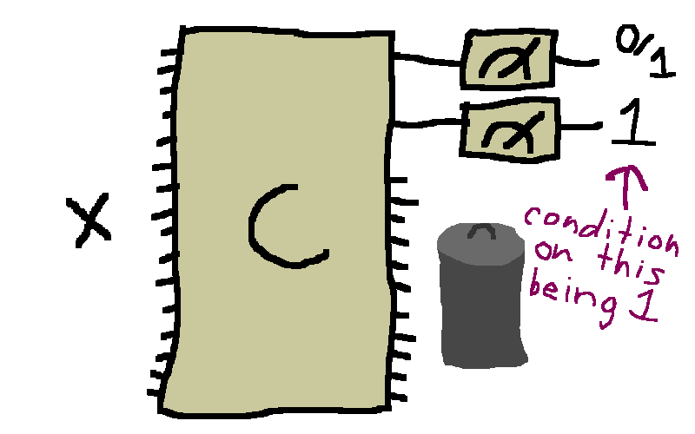
Assumptions
Quantum Assumption: E=DTIME[2^{O(n)}] requires postselecting circuits of size 2^{Ω(n)}
“quantum computing,
postselection, and
nonuniformity don’t
speed up all computation”
Notes:
In the quantum setting we need a stronger assumption. Namely that E is hard for exponential size postselecting quantum circuits.
A postselecting circuit is a quantum circuit with the ability to postselect, that is conditionally sample. More formally, it has the ability to choose the result of its measurements and acquire the residual state.
*click* Intuitively, this assumption states that quantum computation, postselection, and nonuniformity don’t together speed up all computation.
*click* Note that Aaronson showed that PostBQP (the class of efficient quantum computation with the ability to postselect) is equal to PP, an interesting complexity class lying below PSPACE. This means that this assumption is strictly weaker than assuming E requires exponential size PP circuits.

Slide 22
Techniques
Notes:
Now, I will discuss our techniques, beginning with a high level overview of TV’s proof that there is an extractor for classically samplable sources.

Slide 23
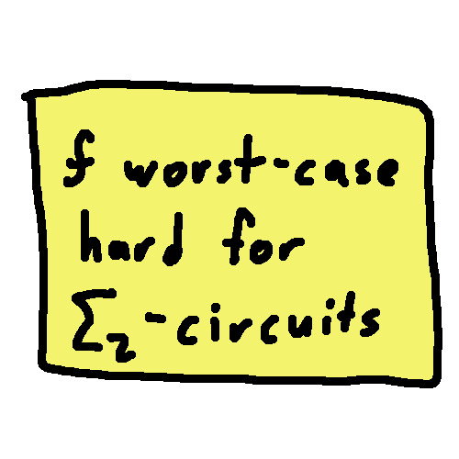

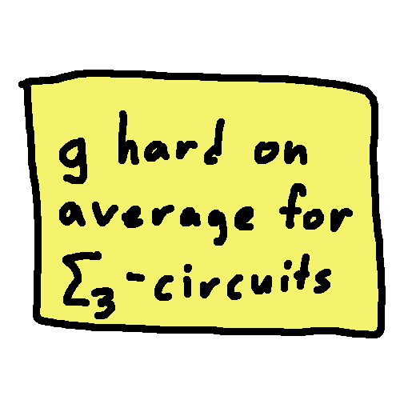
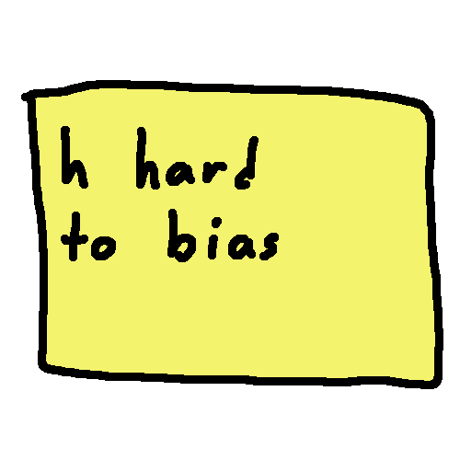




TV: Worst-case hardness
Notes:
TV build an extractor in two steps.
First, they show that if f is worst case hard for Sigma_2 circuits, then there is a function g which is very hard on average.
*click* Then, they show that if g is very hard on average for Sigma_3 circuits, there exists an h which is hard to bias. *click* That is, an extractor.
Note that there is a gap here. Since we have g hard on average for classical circuits and we want g hard on average for Sigma_3 circuits.
However, the polynomial hierarchy has the nice property that we can “step up” reductions.

Slide 24








TV: Worst-case hardness
Notes:
That is, the same techniques show that if f is hard for Sigma_5 circuits, then there exists a g hard on average for Sigma_3 circuits.
This then gives that if f is worst case hard for Sigma_5 circuits, then we can transform it into an extractor h.
*click* Note that for those curious, the top reduction is a low-degree extension and the bottom reduction uses a Hadamard encoding. Its totally ok for the rest of this talk if you know what neither of those things are.

Slide 25
Quantum worst-case
Problem: no natural way to “step up” hardness against postselecting circuits.
Notes:
However, quantumly, there is no equivalent to “stepping up” the polynomial hierarchy, and so we end up stuck with the same gap as before.
So what do we do?

Slide 26
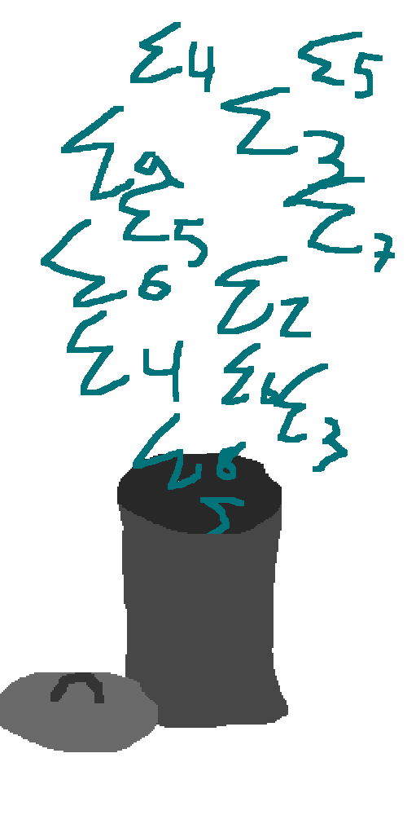
Quantum worst-case
Solution: Get rid of all the Σ’s!
(i.e. better reduction)
Notes:
Just toss out all the Sigma’s! That is, we improve the reduction so that we no longer need to do any stepping up.

Slide 27
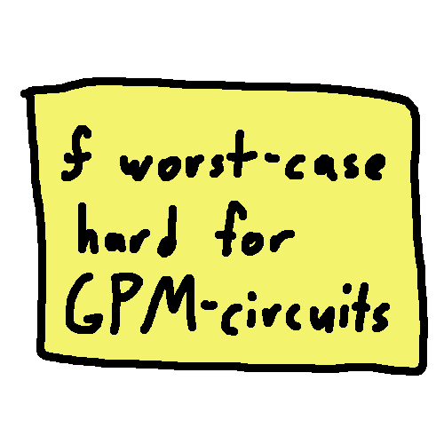
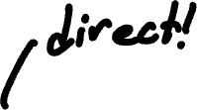
Quantum worst-case
Key tool: Gap Probability Maximization (GPM)
Notes:
In particular, we define a new problem, called Gap Probability Maximization. We show then that if f is worst-case hard for GPM-circuits, it directly gives an h which is hard to bias.

Slide 28
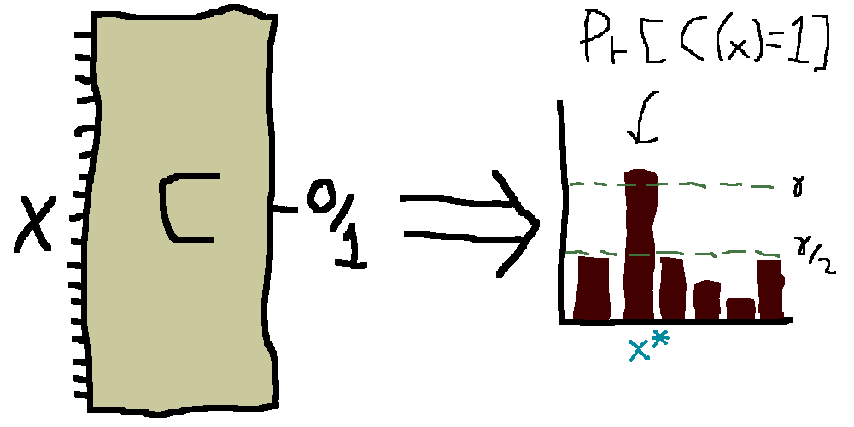


















Gap probability maximization (GPM)
Notes:
So what is GPM? You are given a randomized circuit C such that there is a special input x* where C accepts x* with twice the probability it accepts other input. The task is then to find x*.
*click* In particular, if you look at the the histogram of the probabilities that C accepts each x, the height of x* should be twice that of any other input.
*click* This comes in two flavors. One where C is a randomized circuit, and the other where C is a quantum circuit.
NOTE: clean up and add that its promise

Slide 29
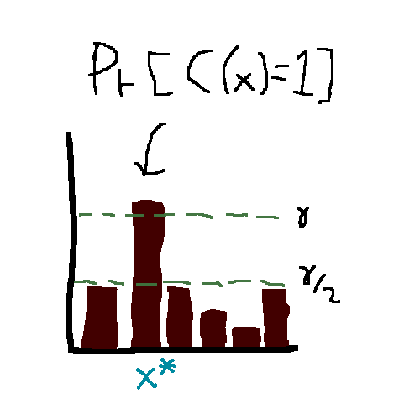
We can solve GPM
For classical circuits:
with an NP-oracle (hashing trick)
For quantum circuits:
using postselection
Notes:
It turns out, that GPM can be solved using nondeterminism.
In particular, we can solve GPM for classical circuits using a hashing trick I will not go into here.
And we can solve GPM for quantum circuits using postselection.

Slide 30
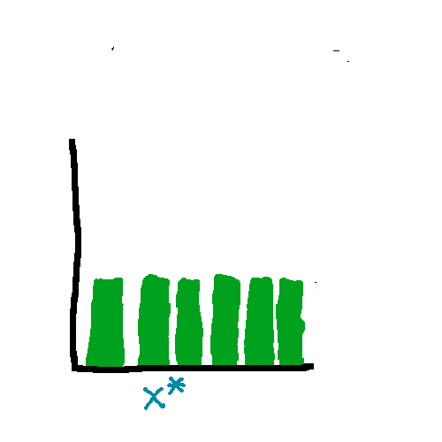
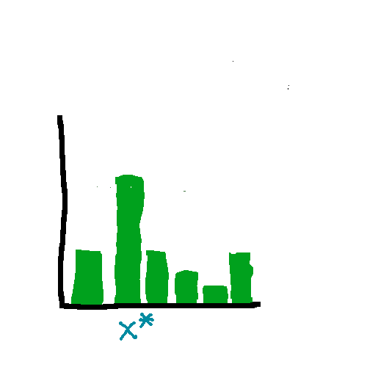
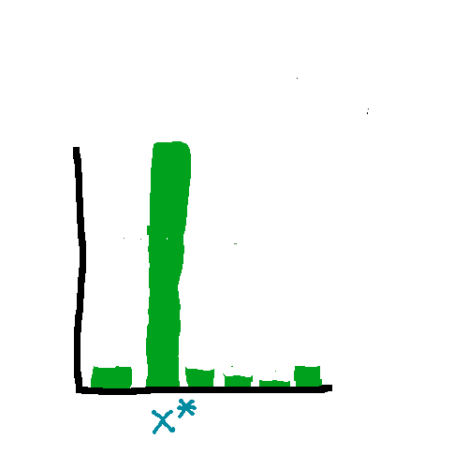

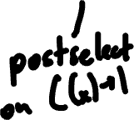



Quantum GPM solving
Notes:
I’ll briefly run through now how to solve GPM using postselection. Note that you don’t need any quantum to understand this, all you need to know is that postselection means “conditionally sample”.
We will begin by taking the uniform distribution over all inputs.
*click* We will then postselect on our circuit accepting x. This gives us a pdf which is proportional to the histogram in the bottom right. That is, the probability we will output x* will be twice that of any other input.
*click* Then, we just repeat n times. So then the probability we output x* will be 2^n times that of any other input, and so sampling from this distribution will give us x* with high probability.

Slide 31





Final result
Theorem: If f is hard for (nondeterministic/postselecting quantum) circuits, then h is an extractor for (classical/quantum) samplable sources.
Notes:
So putting together our reduction with the fact that GPM can be solved by nondeterministc or postselecting circuits, we get that if f is hard for nondeterministic or postselecting circuits, then we get an extractor for classical or quantum samplable sources respectively.
Assuming hardness for E then gives us our main theorem.

Slide 32
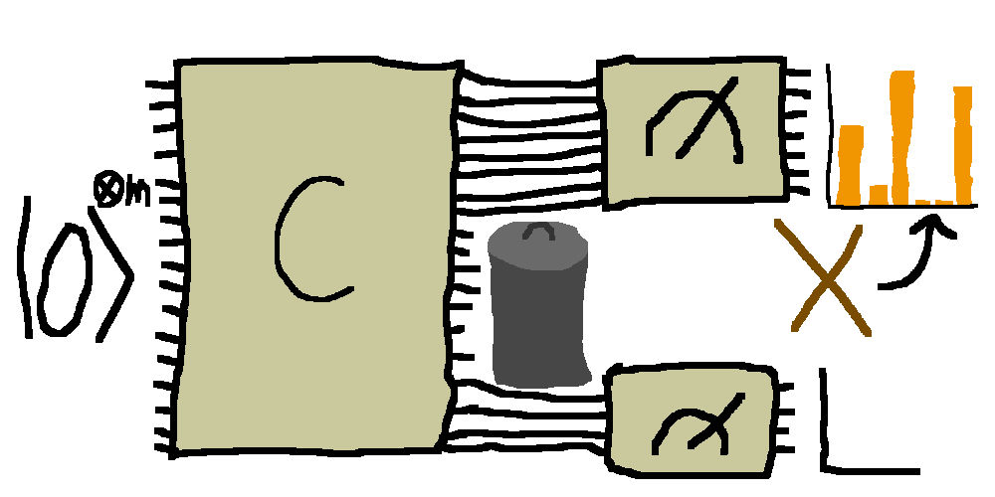
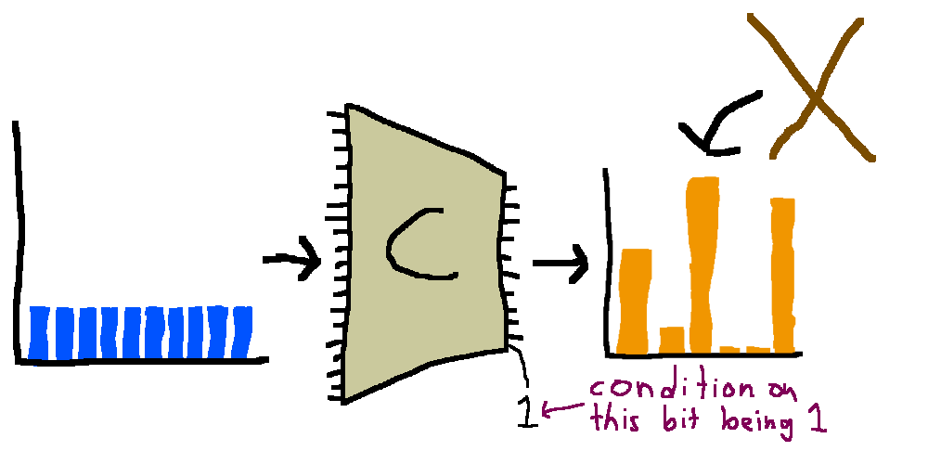
Additional results
Leakage-resilience
Postselecting samplers
Notes:
In addition to our main result, we have two extra results that follow.
We show that our extractors are secure against classical leakage on the source.
We also show that our extractors work for a much richer class of samplable sources. That is, sources where the samplers themselves have the ability to postselect. For those who are know what these are, this generalizes both samplable and recognizable sources.

Slide 33
Open questions
1) Are our assumptions minimal?
2) Our error is 1/poly, can we get negligible?
3) We require H_{min}(X)=Ω(n), can we do better? H_{min}(X)=log^{O(1)}(n)?
4) Other places we can use this technique (GPM)?
Notes:
I will end on 4 open questions.
Number 1, are our assumptions minimal? Do we need to assume hardness for nondeterministic circuits to get extraction?
Number 2, the error of our extractor (i.e. how close its output is to uniform) is 1/poly. Is it possible to improve this to negligible?
Number 3, We require that the min entropy of the source is linear in its length. Is it possible to do better? Can we match the logarithmic lower bound.
Number 4, are there other places where this gap probability maximization problem is relevant? Perhaps in nondeterministic derandomization settings?

Slide 34
Thank you!
Full paper available at
eligoldin.com

