Slide 1
DIPLOMA PROJECT
STUDENT:
Ileana VASILICA
SCIENTIFIC COORDINATOR:
Prof. Univ. Dr. Ing. Mihai MOCANU

Slide 2
Orientation and organization App
Intelligent system for orientation and flexible organization of student and teacher schedule
4. FIND A FREE CLASSROOM
3. ADD NEW ACTIVITY FOR TEACHER USERS TYPE
5.VIEW SCHEDULE
2.USERS TYPE
1.SEARCH CERTAIN CLASSROOM
Notes:
This is the title of my diploma project; it is a very long one and in order to understand the purpose and theme of the project we will discuss it a little.
The first purpose of this application was to help students with a solution to find a classroom easier. Now, this option already exist on ace.ucv.ro platform
so, I can say that my idea was shattered.
Now we have 2 main types of users: student and teacher. To these is added an admin user, but we'll talk about that later.
Because we want to do something that not exist yet in our faculty, or at least I don't know about it, I added the possibility for the teacher to add a new activity.
through activity I mean a laboratory, course, seminary ..
After add a new activity a list with free classrooms will appear.

Slide 3
TABLE OF CONTENTS
01
04
Tools, technologies and frameorks
Use-Case diagrams
02
05
System arhitecture
Requirements
03
06
Database
Conclusions

Slide 4






Tools, technologies and frameoworks
RESTful API
MAVEN & LOMBOK
*IDE : integrated development environment
Notes:
Backend part:
Java 8 – programming language and IntelliJ IDEA
RESTful API – in order to access the data via HTTP requests
Maven – as build tool
Lombok – is a java library that automatically plugs into your editor and build tools
For database:
SQL relation database and
MySQL workbench as tool for database architecture
For frontend:
HTML,CSS and JS with
thymeleaf which help me to integrate the HTML pages in with Java

Slide 5
SYSTEM ARHITECTURE

Slide 6
PRESENTATION LAYER
PRESENTATION LAYER:
is the top layer of the spring boot architecture. It consists of endpoints (views)
BUSINESS LAYER:
contains all the business logic. It consists of services classes
PERSISTENCE LAYER:
contains all the database storage logic. It is responsible for converting business objects to the database row and vice-versa
DATABASE:
contains all the databases such as MySql or MongoDB
BUSINESS LAYER
PERSISTENCE LAYER
DATABASE

Slide 7
DATABASE

Slide 8
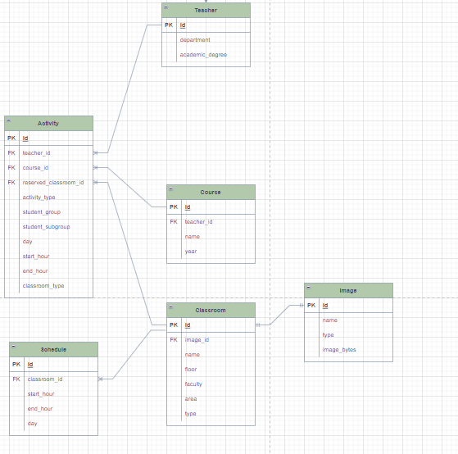
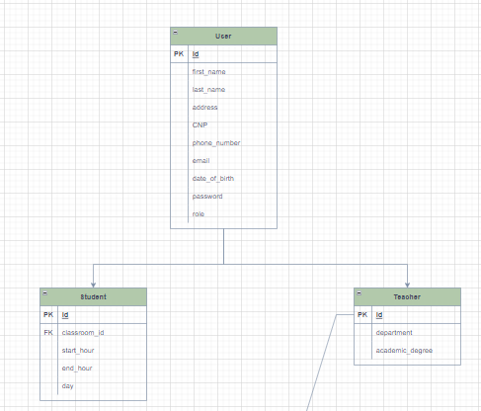
Database structure

Slide 9
USE–CASE DIAGRAMS

Slide 10




View profile
Edit profile
Login
View schedule
Search classroom
STUDENT
Edit activity
Login
ADD new activity
Chose classroom for activity
TEACHER
CRUD on student
CRUD on teacher
Login
CRUD on classroom
CRUD on activity
ADMIN

Slide 11
REQUIREMENTS

Slide 12
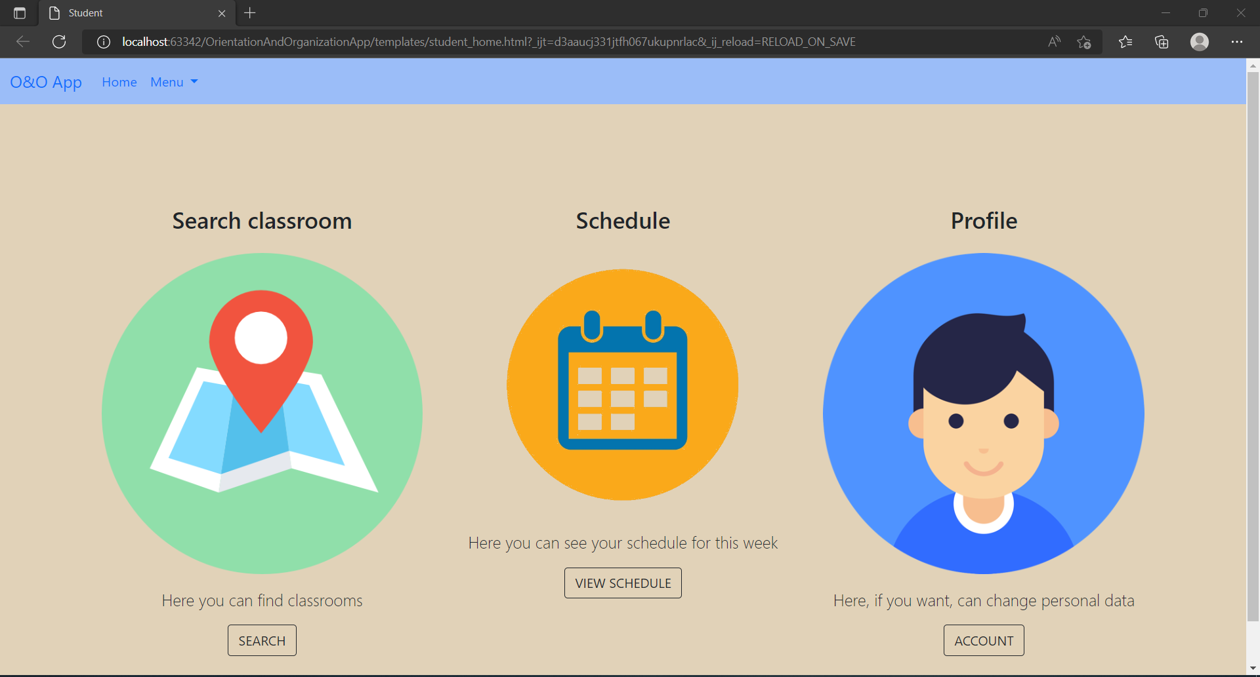
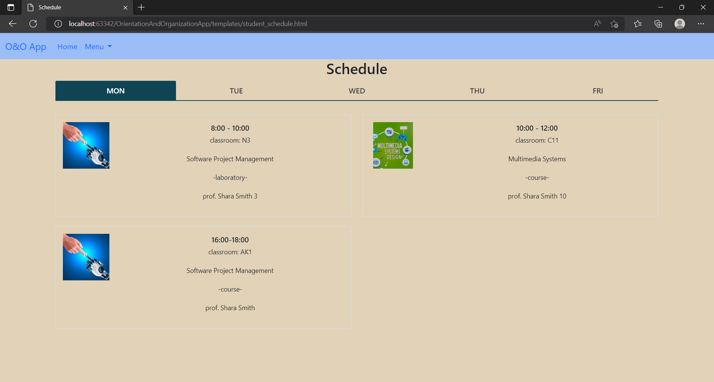
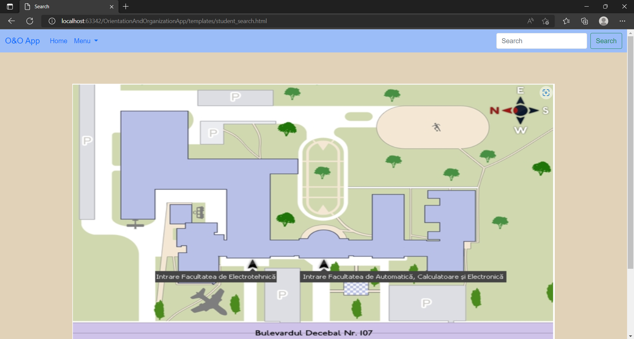
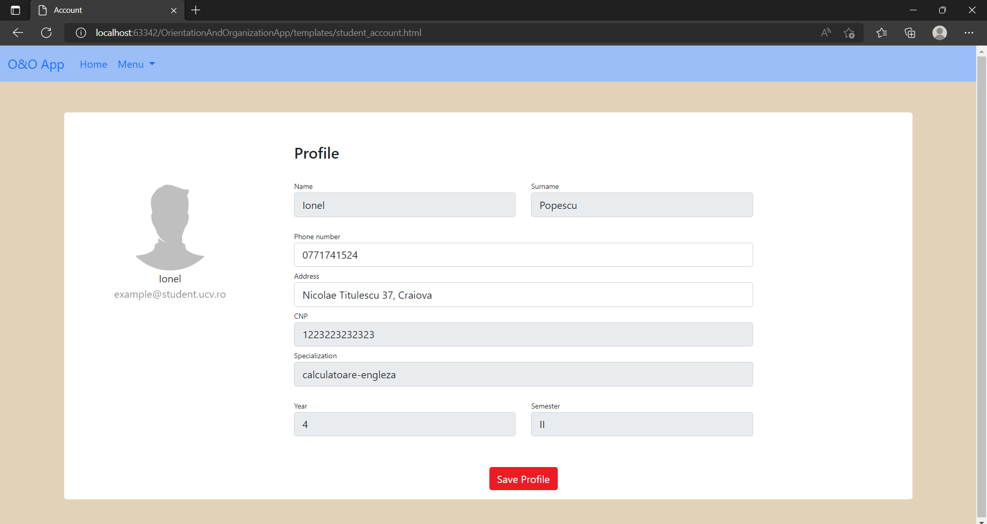
STUDENT

Slide 13
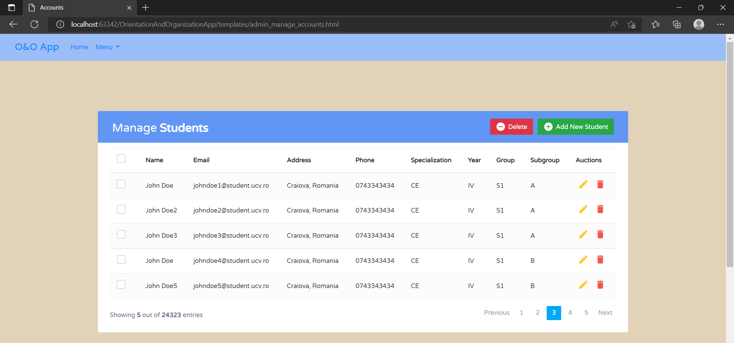
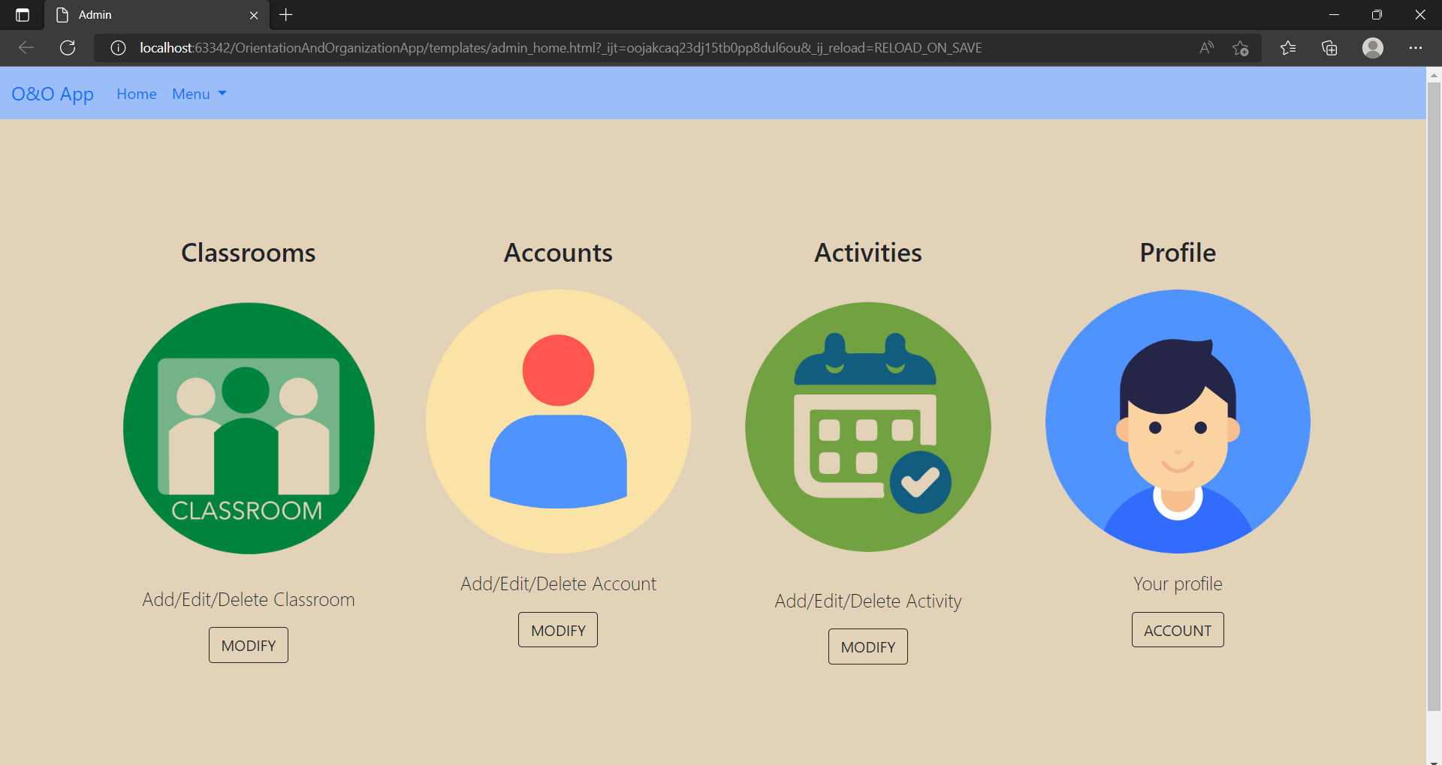
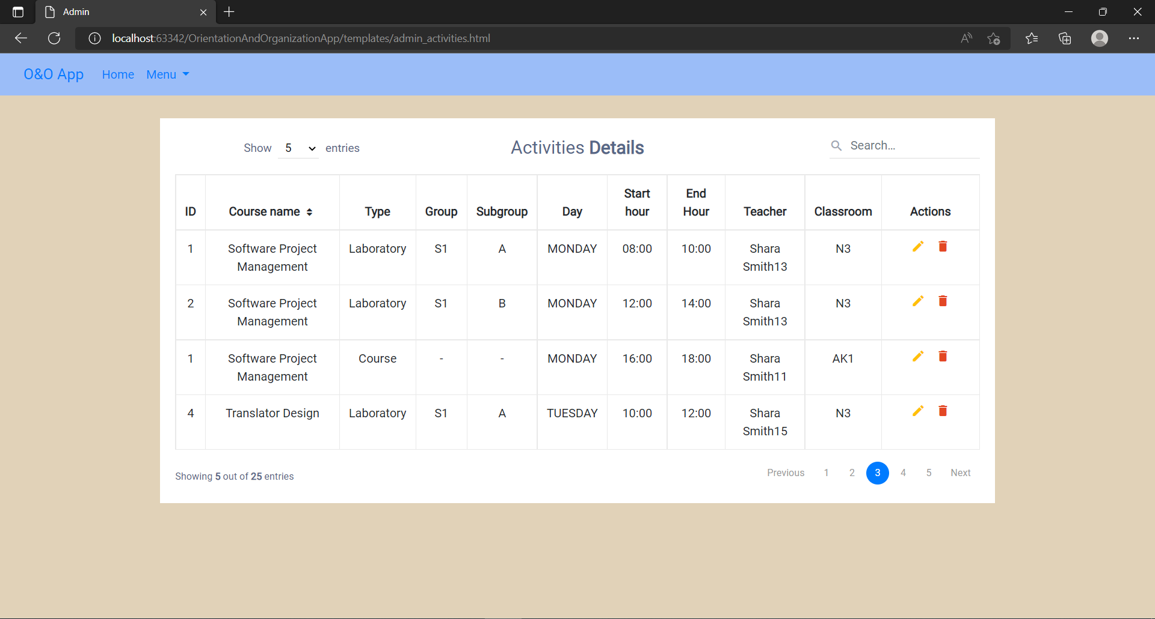
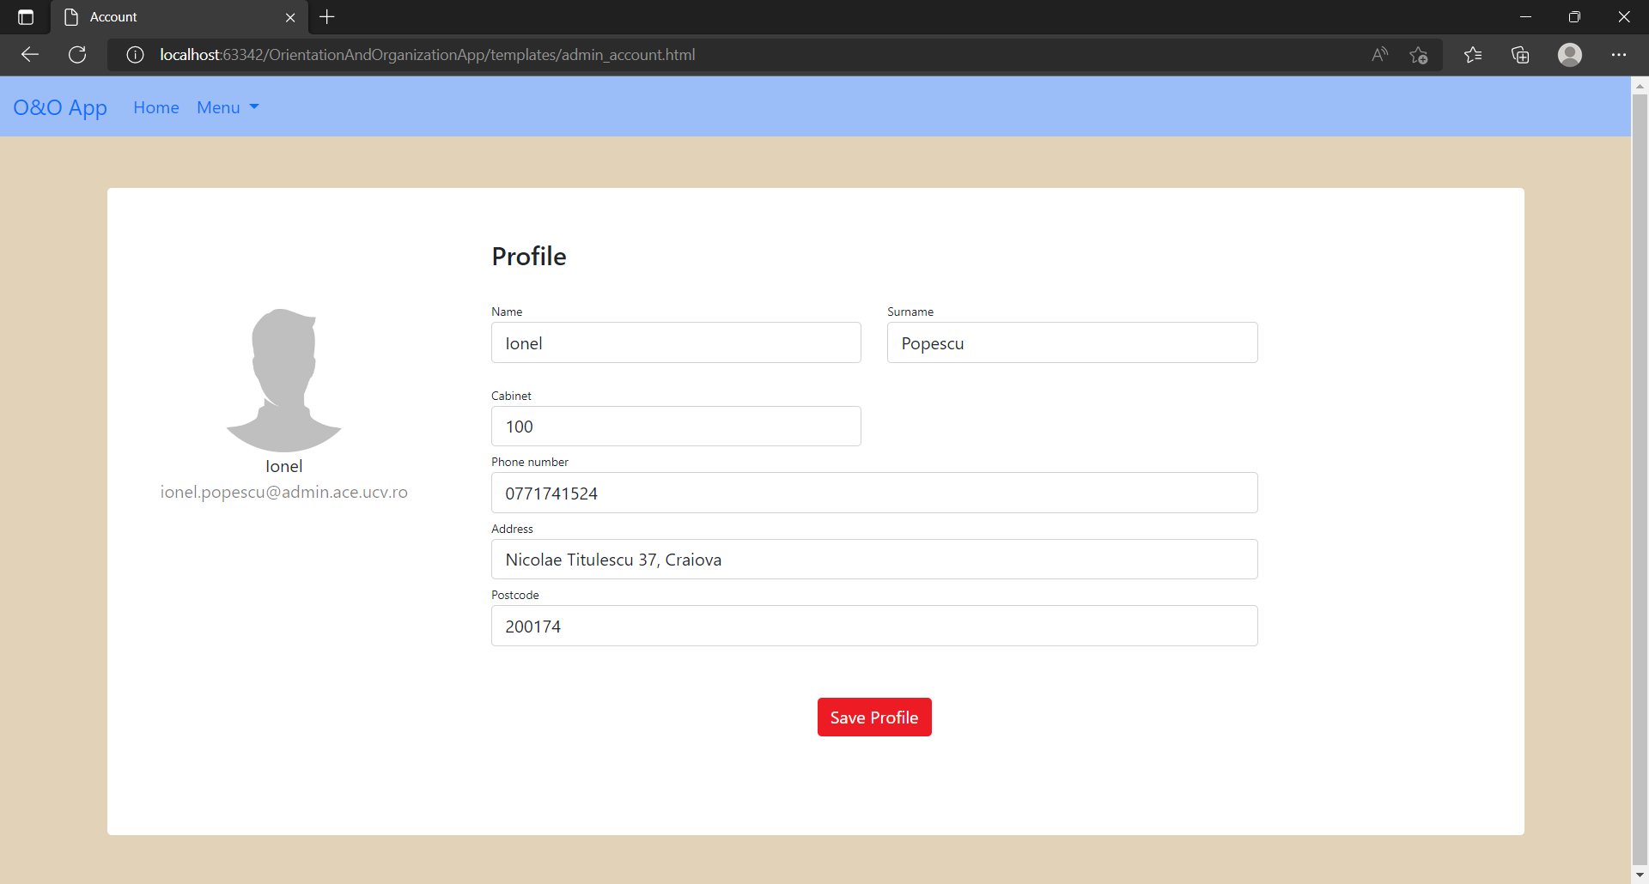
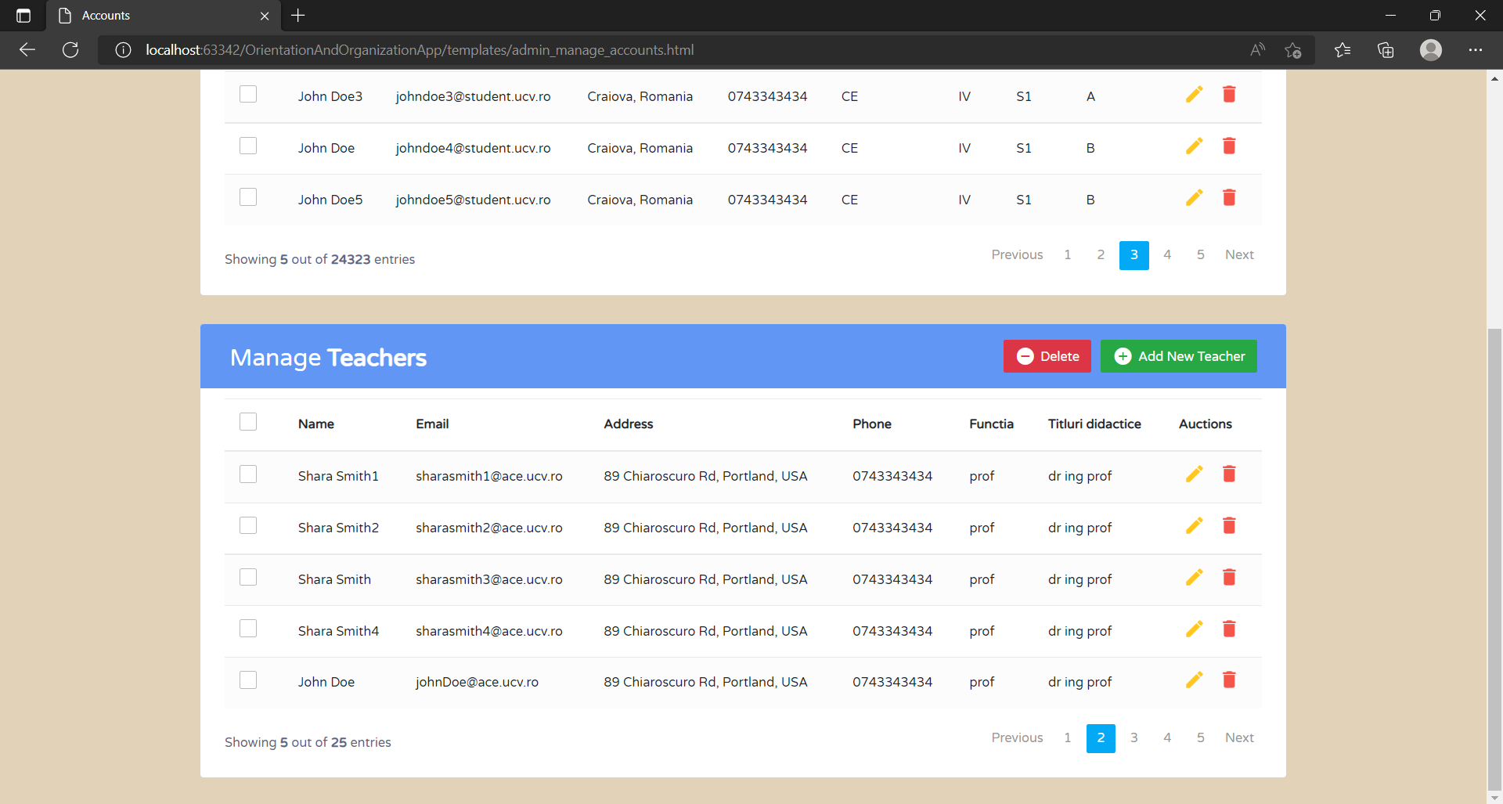
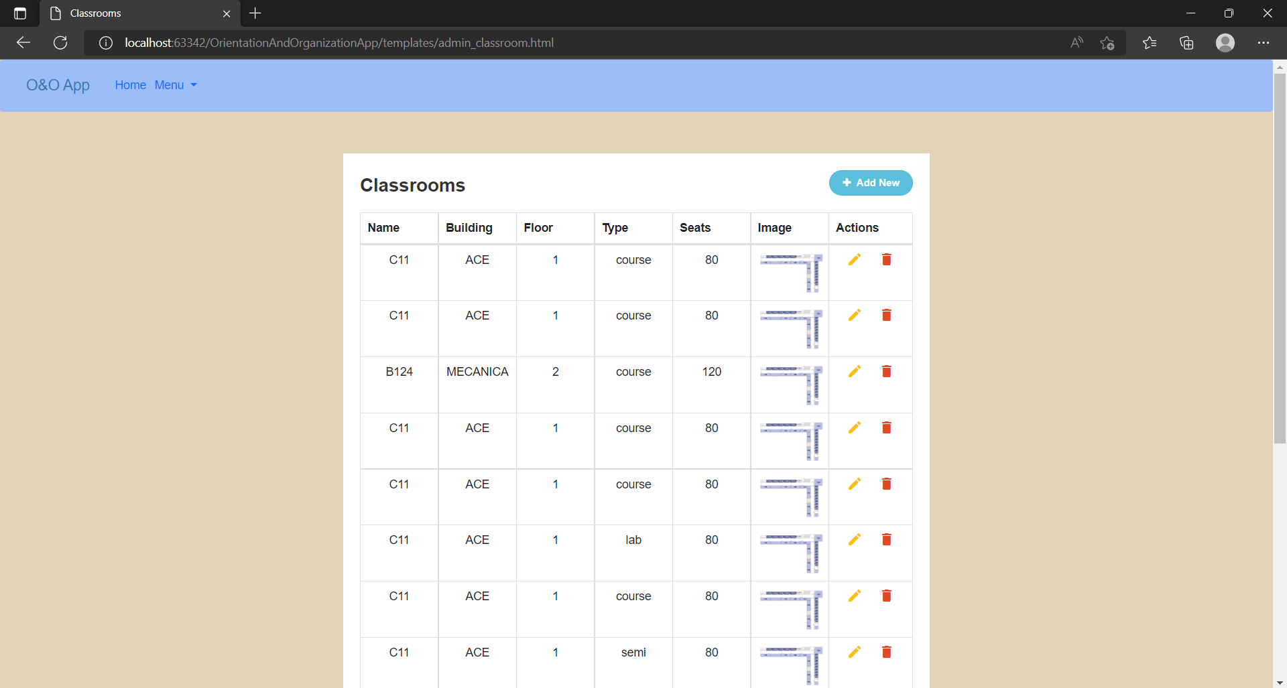
ADMIN

Slide 14
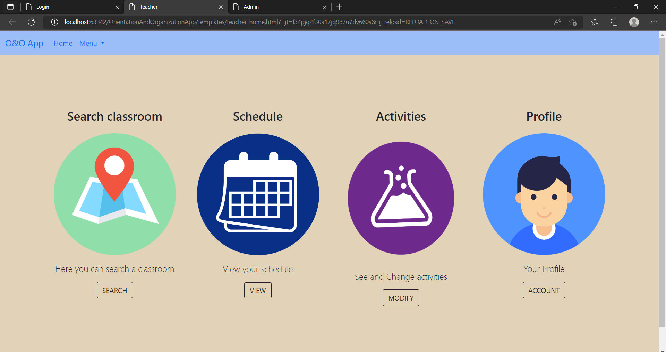
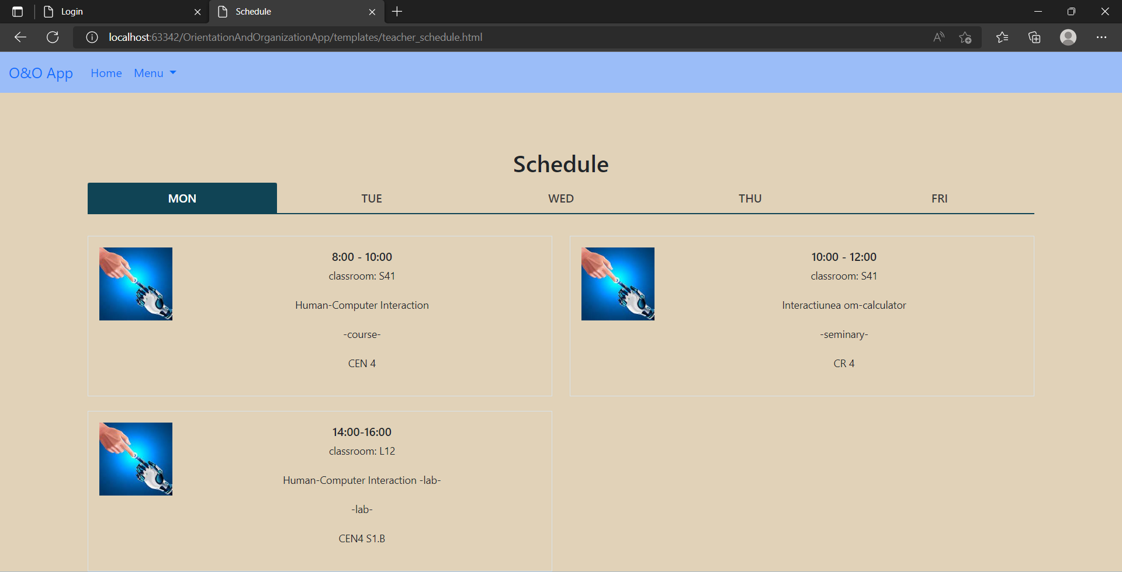
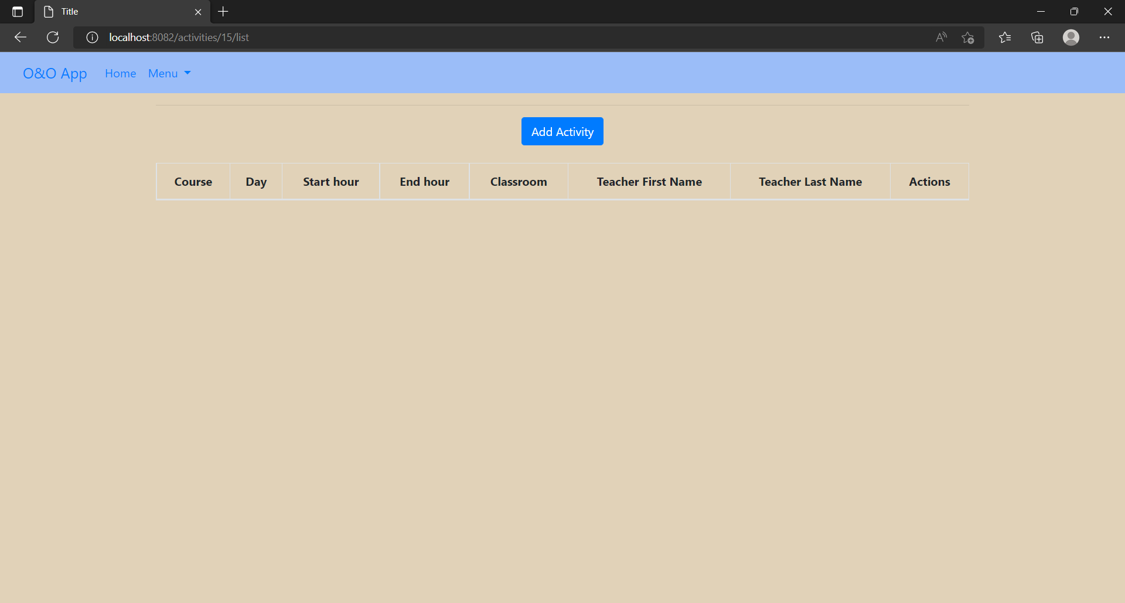
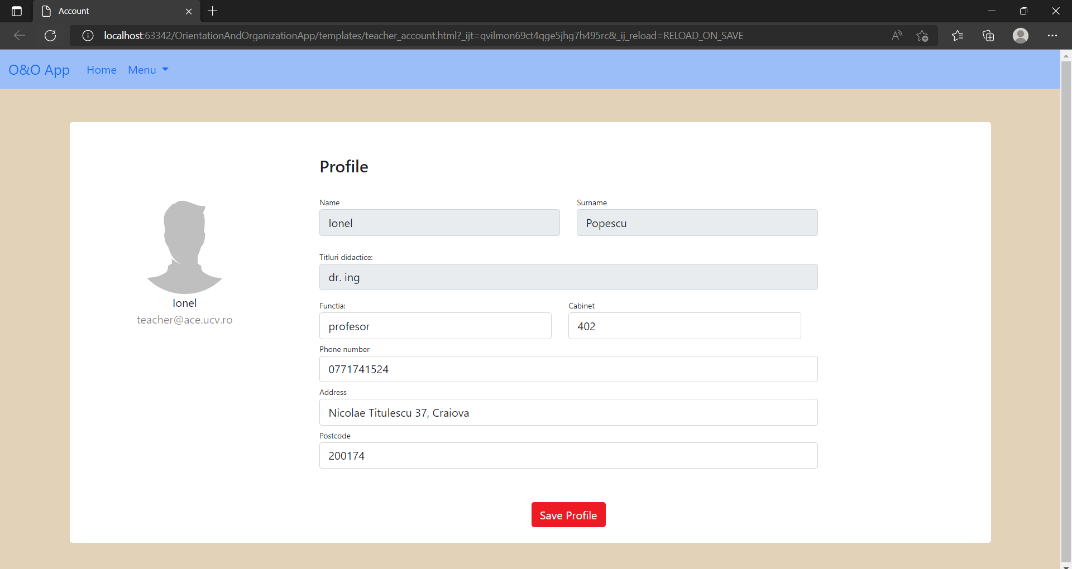
TEACHER

Slide 15
CONCLUSIONS

Slide 16
Improvements:
Security – store passwords encrypted
Use model mapper
Add back button on pages
New features:
Profile picture for users
More CRUD operations for other entities (for admin)

Slide 17
THANK YOU!
Does anyone have any question?
addyouremail@freepik.com
https://www.linkedin.com/in/ileanavasilică/

