Slide 1
On Predicting Microstructural Evolution from the Dependence of Phase Gibbs Free Energy on the Thermal Gradient
Prof. Ivaldo Leão Ferreira
Faculty of Mechanical Engineering, Federal University of Pará, UFPA
Augusto Corrêa Avenue 1
66075-110, Belém, PA, Brazil

Slide 2
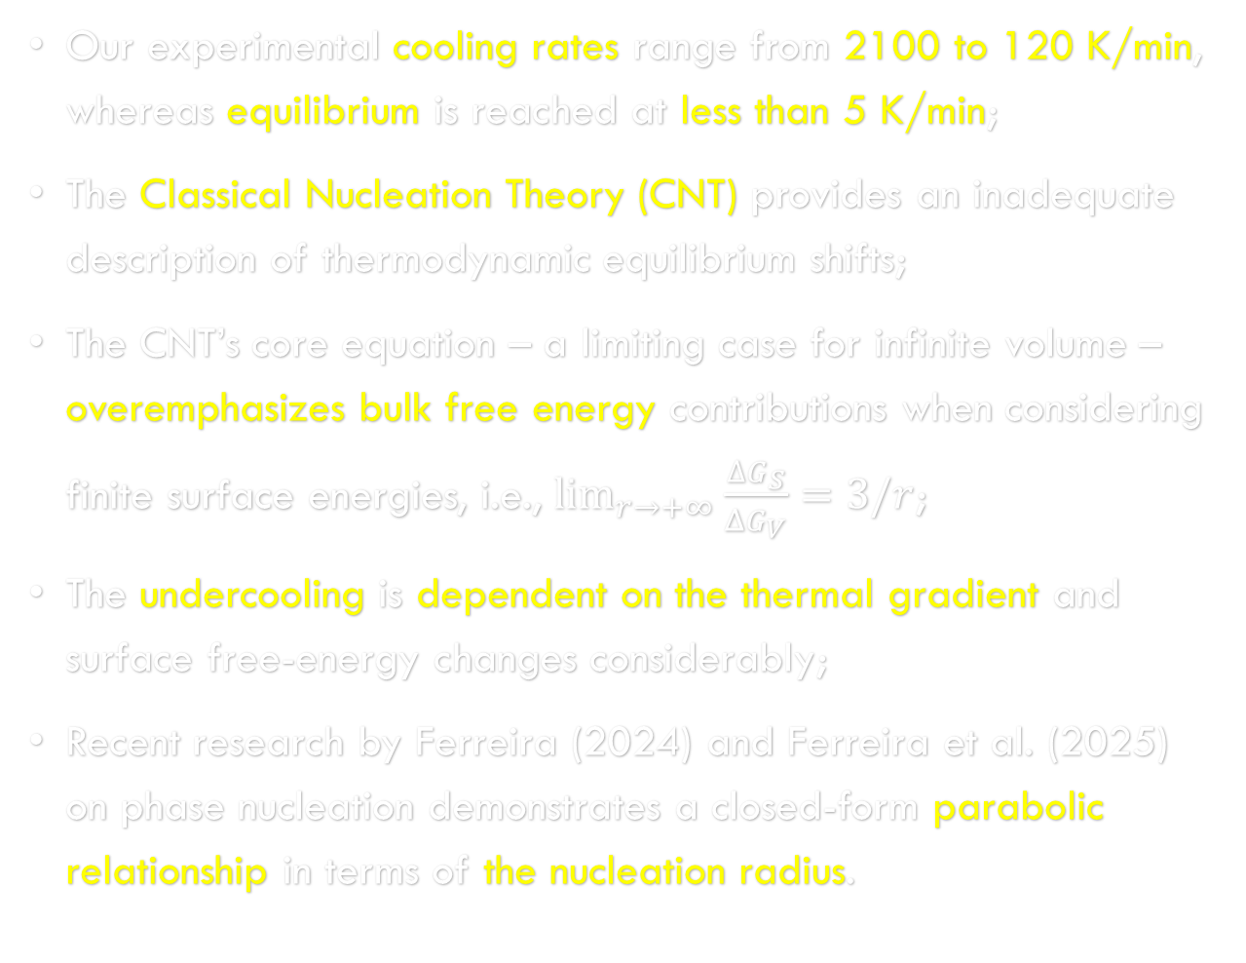
Motivation
Our experimental cooling rates range from 2100 to 120 K/min, whereas equilibrium is reached at less than 5 K/min;
The Classical Nucleation Theory (CNT) provides an inadequate description of thermodynamic equilibrium shifts;
The CNT’s core equation – a limiting case for infinite volume – overemphasizes bulk free energy contributions when considering finite surface energies, i.e., $\lim_{r→+∞}{\frac{∆G_{S}}{ΔG_{V}}=3/r}$;
The undercooling is dependent on the thermal gradient and surface free-energy changes considerably;
Recent research by Ferreira (2024) and Ferreira et al. (2025) on phase nucleation demonstrates a closed-form parabolic relationship in terms of the nucleation radius.

Slide 3
OBjectives
Remain in the continuum mechanics scale to easily calculate the surface stress tensor and make DTA/DSC experiments for equilibrium conditions;
Derive a general phase transformation equation within this domain by combining the First and Second Laws of Thermodynamics;
Present a novel formulation of phase nucleation;
Apply fundamental thermodynamic variables and functions to analyze this new field;
Investigate the effects of thermal gradients on free Energies;

Slide 4
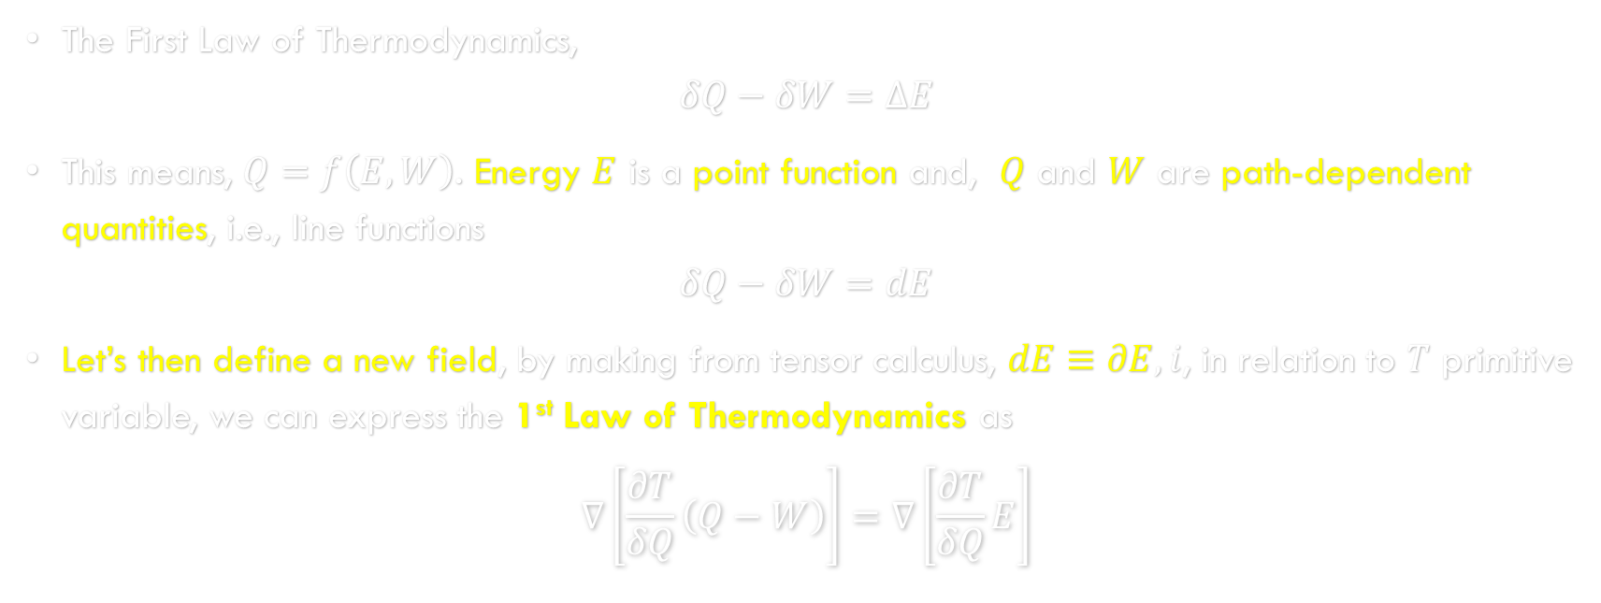
A Proper Field for Phase Transformation
The First Law of Thermodynamics,
$$δQ−δW=ΔE$$
This means, $Q=f\left(E,W\right)$. Energy $E$ is a point function and, $Q$ and $W$ are path-dependent quantities, i.e., line functions
$$δQ−δW=dE$$
Let’s then define a new field, by making from tensor calculus, $dE≡∂E,i$, in relation to $T$ primitive variable, we can express the 1st Law of Thermodynamics as
$$∇\left[\frac{∂T}{δQ}\left(Q−W\right)\right]=∇\left[\frac{∂T}{δQ}E\right]$$

Slide 5
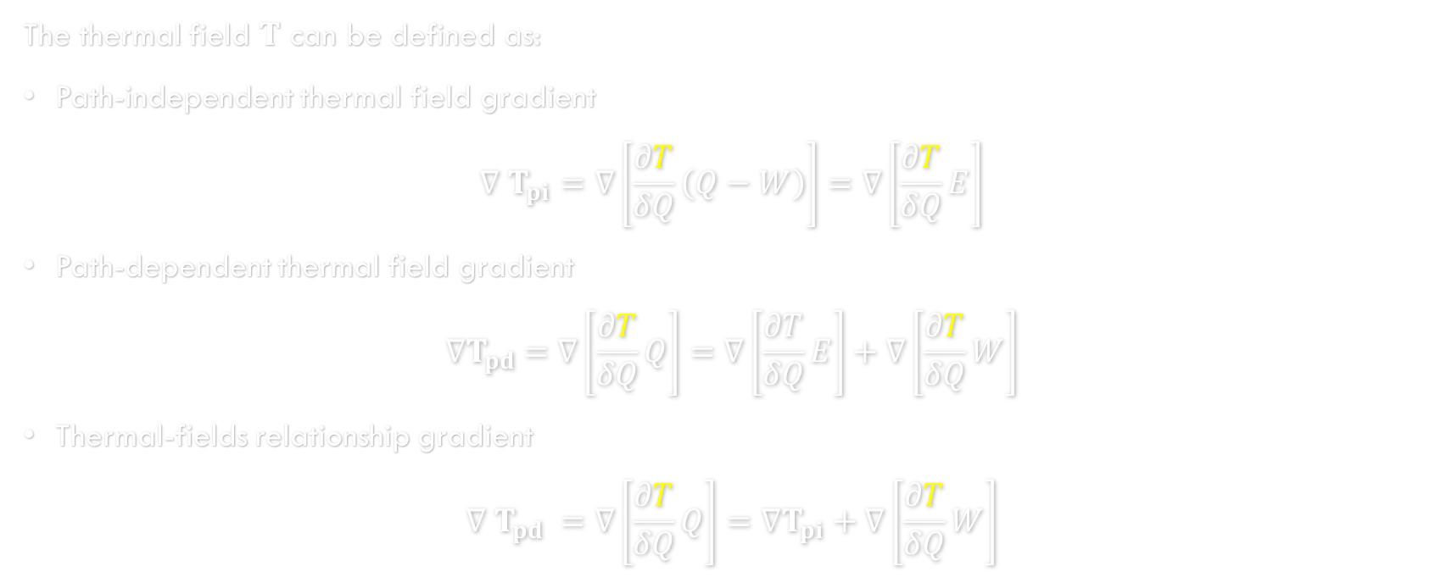
A Proper Field for Phase Transformation
The thermal field $T$ can be defined as:
Path-independent thermal field gradient
$$∇ T_{pi}=∇\left[\frac{∂T}{δQ}\left(Q−W\right)\right]=∇\left[\frac{∂T}{δQ}E\right]$$
Path-dependent thermal field gradient
$${∇T}_{pd} =∇\left[\frac{∂T}{δQ}Q\right]=∇\left[\frac{∂T}{δQ}E\right]+∇\left[\frac{∂T}{δQ}W\right]$$
Thermal-fields relationship gradient
$$∇ T_{pd} =∇\left[\frac{∂T}{δQ}Q\right]=∇T_{pi}+∇\left[\frac{∂T}{δQ}W\right]$$

Slide 6
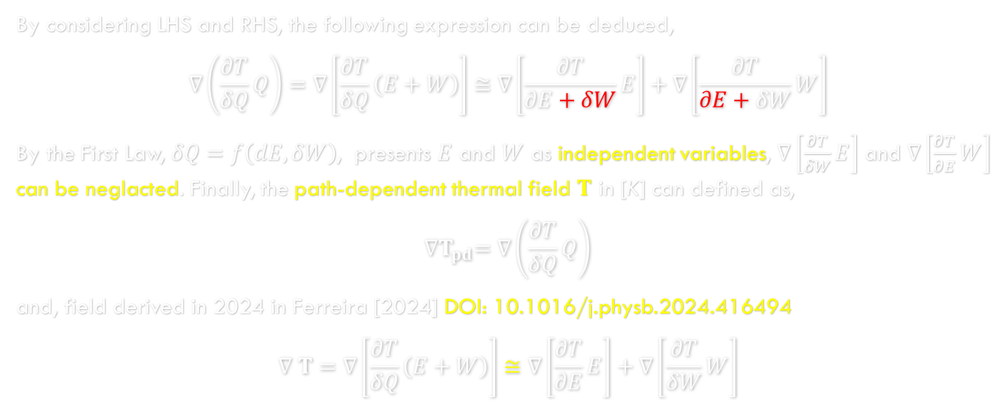
A Proper Field for Phase Transformation
By considering LHS and RHS, the following expression can be deduced,
$$∇\left(\frac{∂T}{δQ}Q\right)=∇\left[\frac{∂T}{δQ}\left(E+W\right)\right]≅∇\left[\frac{∂T}{∂E+δW}E\right]+∇\left[\frac{∂T}{∂E+δW}W\right]$$
By the First Law, $δQ=f\left(dE,δW\right)$, presents $E$ and $W$ as independent variables, $∇\left[\frac{∂T}{δW}E\right]$ and $∇\left[\frac{∂T}{∂E}W\right]$ can be neglacted. Finally, the path-dependent thermal field $T$ in [K] can defined as,
$${∇T}_{pd}=∇\left(\frac{∂T}{δQ}Q\right)$$
and, field derived in 2024 in Ferreira [2024] DOI: 10.1016/j.physb.2024.416494
$$∇ T=∇\left[\frac{∂T}{δQ}\left(E+W\right)\right]≅∇\left[\frac{∂T}{∂E}E\right]+∇\left[\frac{∂T}{δW}W\right]$$

Slide 7
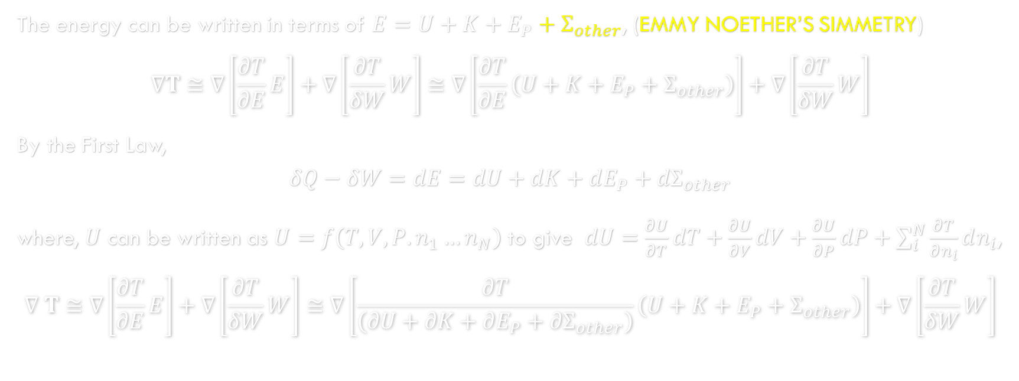
A Proper Field for Phase Transformation
The energy can be written in terms of $E=U+K+E_{P}+Σ_{other}$, (Emmy Noether’s SIMMETRY)
$$∇T≅∇\left[\frac{∂T}{∂E}E\right]+∇\left[\frac{∂T}{δW}W\right]≅∇\left[\frac{∂T}{∂E}\left(U+K+E_{P}+Σ_{other}\right)\right]+∇\left[\frac{∂T}{δW}W\right]$$
By the First Law,
$$δQ−δW=dE=dU+dK+dE_{P}+{dΣ}_{other}$$
where, $U$ can be written as $U=f\left(T,V,P.n_{1}…n_{N}\right)$ to give $dU=\frac{∂U}{∂T}dT+\frac{∂U}{∂V}dV+\frac{∂U}{∂P}dP+\sum_{i}^{N}{\frac{∂T}{∂n_{i}}}dn_{i}$,
$$∇ T≅∇\left[\frac{∂T}{∂E}E\right]+∇\left[\frac{∂T}{δW}W\right]≅∇\left[\frac{∂T}{\left(∂U+∂K+∂E_{P}+{∂Σ}_{other}\right)}\left(U+K+E_{P}+Σ_{other}\right)\right]+∇\left[\frac{∂T}{δW}W\right]$$

Slide 8
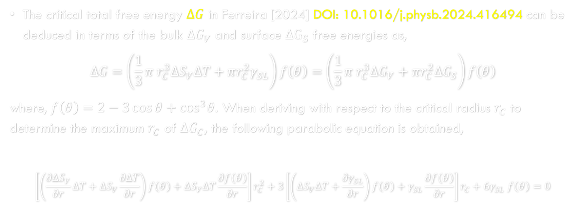
A Novel Phase Nucleation Formulation
The crítical total free energy $ΔG$ in Ferreira [2024] DOI: 10.1016/j.physb.2024.416494 can be deduced in terms of the bulk $ΔG_{V}$ and surface $ΔG_{S}$ free energies as,
$$ΔG=\left(\frac{1}{3}π r_{C}^{3}ΔS_{V}ΔT+πr_{C}^{2}γ_{SL}\right)f\left(θ\right)=\left(\frac{1}{3}π r_{C}^{3}ΔG_{V}+πr_{C}^{2}{ΔG}_{S}\right)f\left(θ\right)$$
where, $f\left(θ\right)=2−3\cos{θ}+\cos^{3}θ$. When deriving with respect to the critical radius $r_{C}$ to determine the maximum $r_{C}$ of $ΔG_{C}$, the following parabolic equation is obtained,
$$\left[\left(\frac{∂ΔS_{V}}{∂r}ΔT+ΔS_{V}\frac{∂ΔT}{∂r}\right)f\left(θ\right)+ΔS_{V}ΔT\frac{∂f\left(θ\right)}{∂r}\right]r_{C}^{2}+3\left[\left(ΔS_{V}ΔT+\frac{{∂γ}_{SL}}{∂r}\right)f\left(θ\right)+γ_{SL}\frac{∂f\left(θ\right)}{∂r}\right]r_{C}+6γ_{SL} f\left(θ\right)=0$$

Slide 9
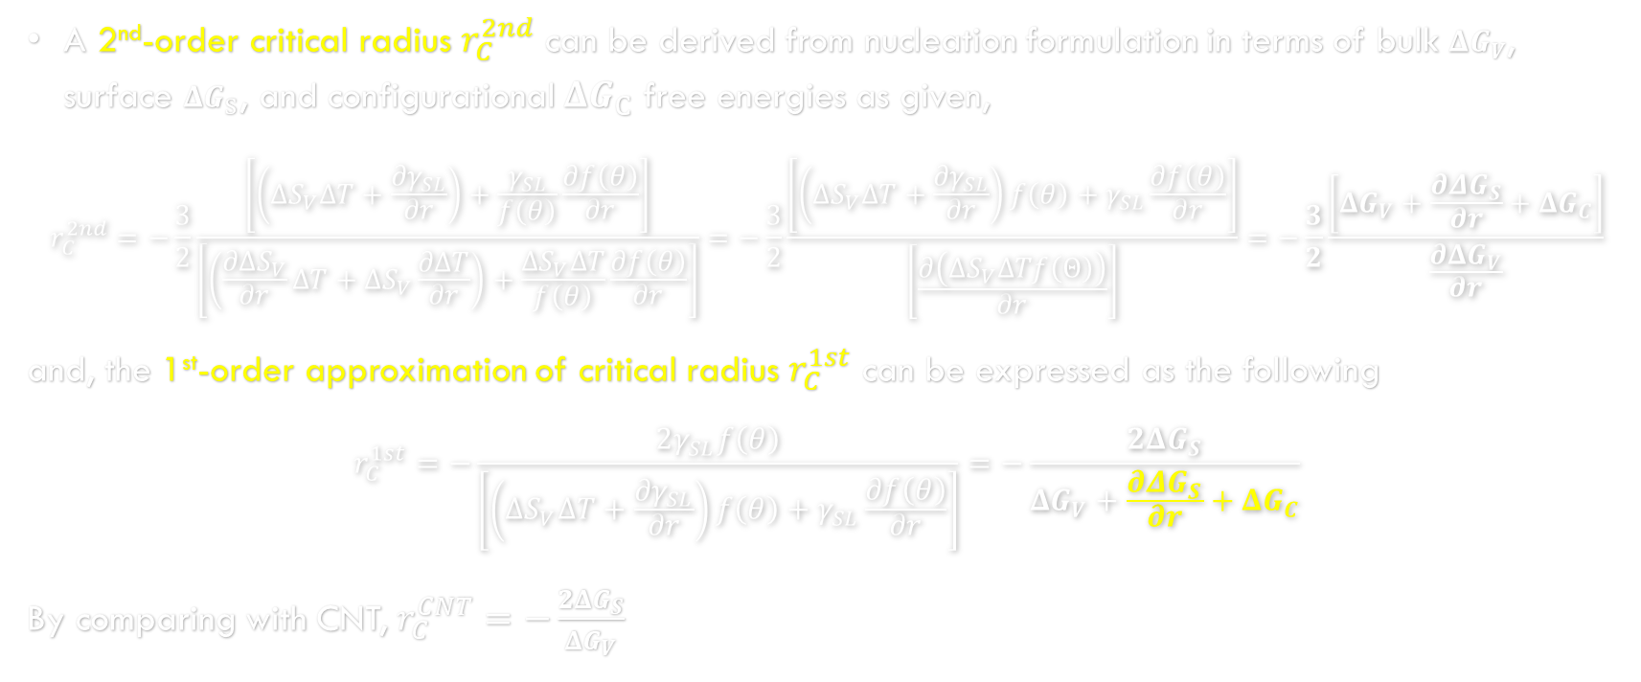
A Novel Phase Nucleation Formulation
A 2nd-order critical radius $r_{C}^{2nd}$ can be derived from nucleation formulation in terms of bulk $ΔG_{V}$, surface $ΔG_{S}$, and configurational $ΔG_{C}$ free energies as given,
$$r_{C}^{2nd}=−\frac{3}{2}\frac{\left[\left(ΔS_{V}ΔT+\frac{{∂γ}_{SL}}{∂r}\right)+\frac{γ_{SL}}{f\left(θ\right)}\frac{∂f\left(θ\right)}{∂r}\right]}{\left[\left(\frac{∂ΔS_{V}}{∂r}ΔT+ΔS_{V}\frac{∂ΔT}{∂r}\right)+\frac{ΔS_{V}ΔT}{f\left(θ\right)}\frac{∂f\left(θ\right)}{∂r}\right]}=−\frac{3}{2}\frac{\left[\left(ΔS_{V}ΔT+\frac{{∂γ}_{SL}}{∂r}\right)f\left(θ\right)+γ_{SL}\frac{∂f\left(θ\right)}{∂r}\right]}{\left[\frac{∂\left(ΔS_{V}ΔTf\left(Θ\right)\right)}{∂r}\right]}=−\frac{3}{2}\frac{\left[ΔG_{V}+\frac{{∂ΔG}_{S}}{∂r}+ΔG_{C}\right]}{\frac{∂ΔG_{V}}{∂r}}$$
and, the 1st-order approximation of critical radius $r_{C}^{1st}$ can be expressed as the following
$$r_{C}^{1st}=−\frac{2γ_{SL}f\left(θ\right)}{\left[\left(ΔS_{V}ΔT+\frac{{∂γ}_{SL}}{∂r}\right)f\left(θ\right)+γ_{SL}\frac{∂f\left(θ\right)}{∂r}\right]}=−\frac{2ΔG_{S}}{ΔG_{V}+\frac{{∂ΔG}_{S}}{∂r}+ΔG_{C}}$$
By comparing with CNT, $r_{C}^{CNT}=−\frac{2ΔG_{S}}{ΔG_{V}}$

Slide 10
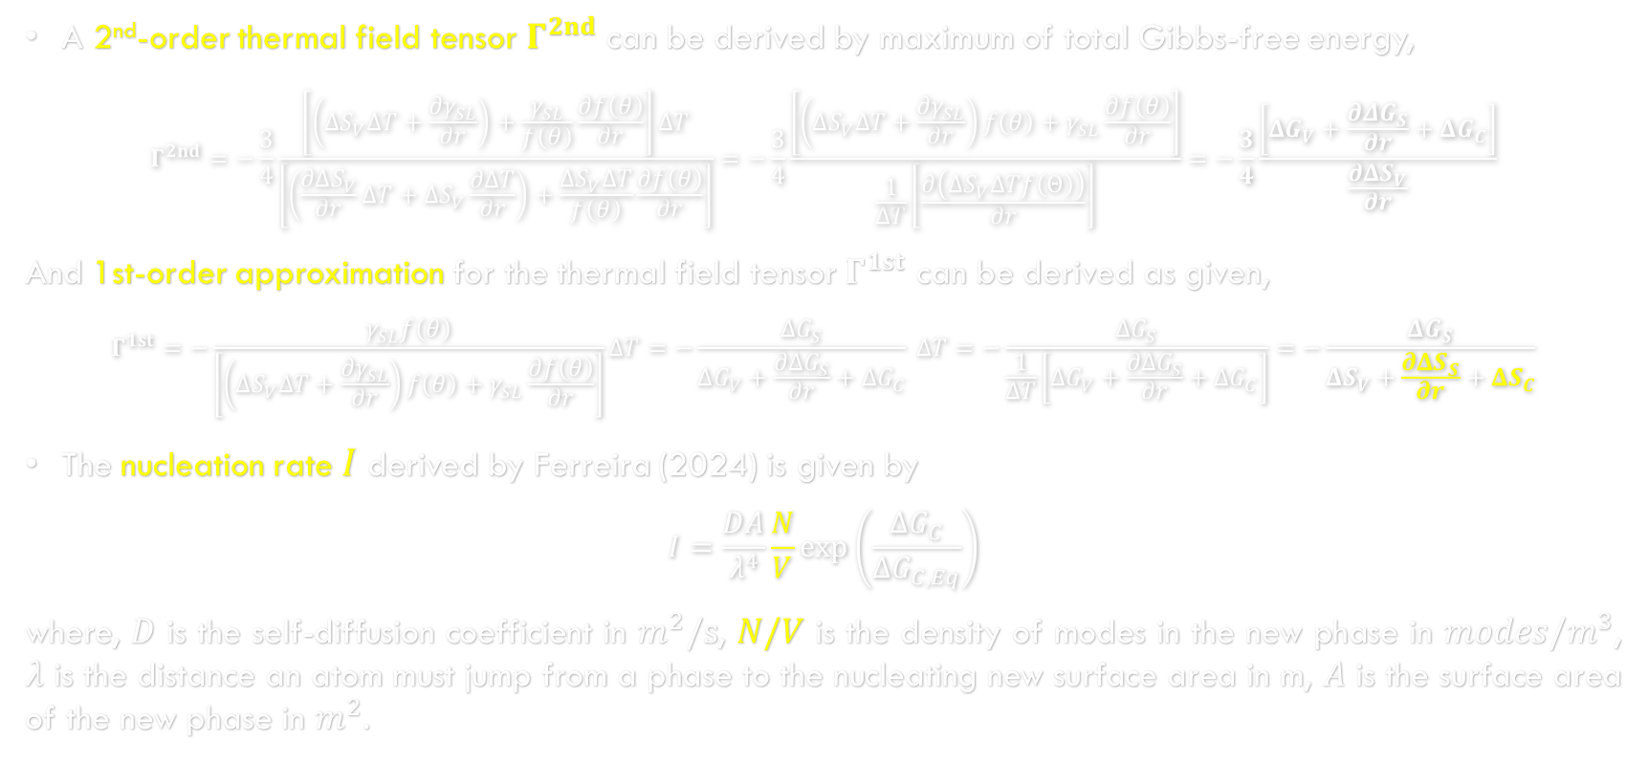
A Novel Phase Nucleation Formulation
A 2nd-order thermal field tensor $Γ^{2nd}$ can be derived by maximum of total Gibbs-free energy,
$$Γ^{2nd}=−\frac{3}{4}\frac{\left[\left(ΔS_{V}ΔT+\frac{{∂γ}_{SL}}{∂r}\right)+\frac{γ_{SL}}{f\left(θ\right)}\frac{∂f\left(θ\right)}{∂r}\right]ΔT}{\left[\left(\frac{∂ΔS_{V}}{∂r}ΔT+ΔS_{V}\frac{∂ΔT}{∂r}\right)+\frac{ΔS_{V}ΔT}{f\left(θ\right)}\frac{∂f\left(θ\right)}{∂r}\right]}=−\frac{3}{4}\frac{\left[\left(ΔS_{V}ΔT+\frac{{∂γ}_{SL}}{∂r}\right)f\left(θ\right)+γ_{SL}\frac{∂f\left(θ\right)}{∂r}\right]}{\frac{1}{ΔT}\left[\frac{∂\left(ΔS_{V}ΔTf\left(Θ\right)\right)}{∂r}\right]}=−\frac{3}{4}\frac{\left[ΔG_{V}+\frac{{∂ΔG}_{S}}{∂r}+ΔG_{C}\right]}{\frac{∂ΔS_{V}}{∂r}}$$
And 1st-order approximation for the thermal field tensor $Γ^{1st}$ can be derived as given,
$$Γ^{1st}=−\frac{γ_{SL}f\left(θ\right)}{\left[\left(ΔS_{V}ΔT+\frac{{∂γ}_{SL}}{∂r}\right)f\left(θ\right)+γ_{SL}\frac{∂f\left(θ\right)}{∂r}\right]}ΔT=−\frac{ΔG_{S}}{ΔG_{V}+\frac{{∂ΔG}_{S}}{∂r}+ΔG_{C}} ΔT=−\frac{ΔG_{S}}{\frac{1}{ΔT}\left[ΔG_{V}+\frac{{∂ΔG}_{S}}{∂r}+ΔG_{C}\right]}=−\frac{ΔG_{S}}{ΔS_{V}+\frac{{∂ΔS}_{S}}{∂r}+ΔS_{C}}$$
The nucleation rate $I$ derived by Ferreira (2024) is given by
$$I=\frac{DA}{λ^{4}}\frac{N}{V}\exp\left(\frac{ΔG_{C}}{ΔG_{C,Eq}}\right)$$
where, $D$ is the self-diffusion coefficient in $m^{2}/s$, $N/V$ is the density of modes in the new phase in $modes/m^{3}$, $λ$ is the distance an atom must jump from a phase to the nucleating new surface area in m, $A$ is the surface area of the new phase in $m^{2}$.

Slide 11
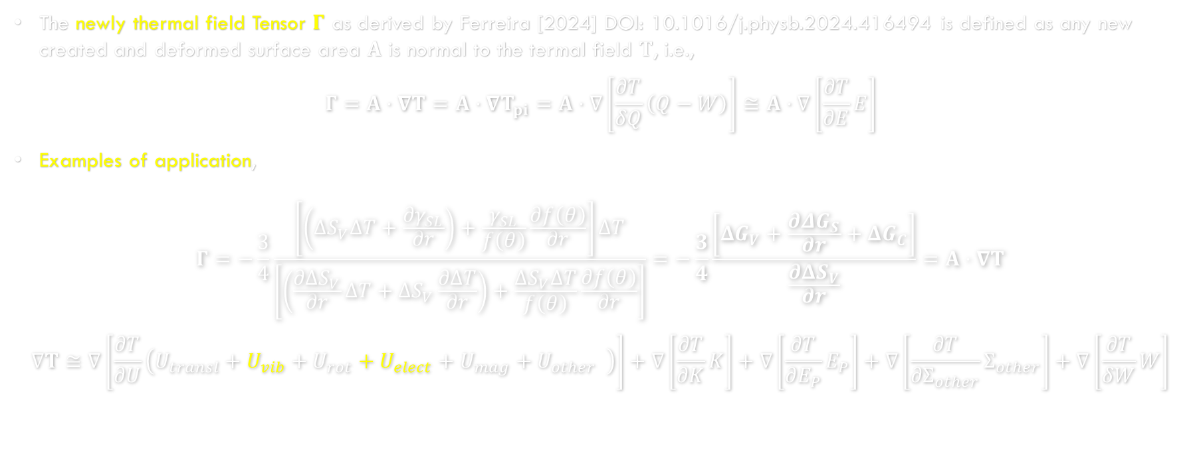
A General Phase Transformation Equation
The newly thermal field Tensor $Γ$ as derived by Ferreira [2024] DOI: 10.1016/j.physb.2024.416494 is defined as any new created and deformed surface area $A$ is normal to the termal field $T$, i.e.,
$$Γ=A⋅∇T=A⋅∇T_{pi}=A⋅∇\left[\frac{∂T}{δQ}\left(Q−W\right)\right]≅A⋅∇\left[\frac{∂T}{∂E}E\right]$$
Examples of application,
$$Γ=−\frac{3}{4}\frac{\left[\left(ΔS_{V}ΔT+\frac{{∂γ}_{SL}}{∂r}\right)+\frac{γ_{SL}}{f\left(θ\right)}\frac{∂f\left(θ\right)}{∂r}\right]ΔT}{\left[\left(\frac{∂ΔS_{V}}{∂r}ΔT+ΔS_{V}\frac{∂ΔT}{∂r}\right)+\frac{ΔS_{V}ΔT}{f\left(θ\right)}\frac{∂f\left(θ\right)}{∂r}\right]}=−\frac{3}{4}\frac{\left[ΔG_{V}+\frac{{∂ΔG}_{S}}{∂r}+ΔG_{C}\right]}{\frac{∂ΔS_{V}}{∂r}}=A⋅∇T$$
$$∇T≅∇\left[\frac{∂T}{∂U}\left(U_{transl}+U_{vib}+U_{rot}+U_{elect}+U_{mag}+U_{other} \right)\right]+∇\left[\frac{∂T}{∂K}K\right]+∇\left[\frac{∂T}{∂E_{P}}E_{P}\right]+∇\left[\frac{∂T}{{∂Σ}_{other}}Σ_{other}\right]+∇\left[\frac{∂T}{δW}W\right]$$

Slide 12
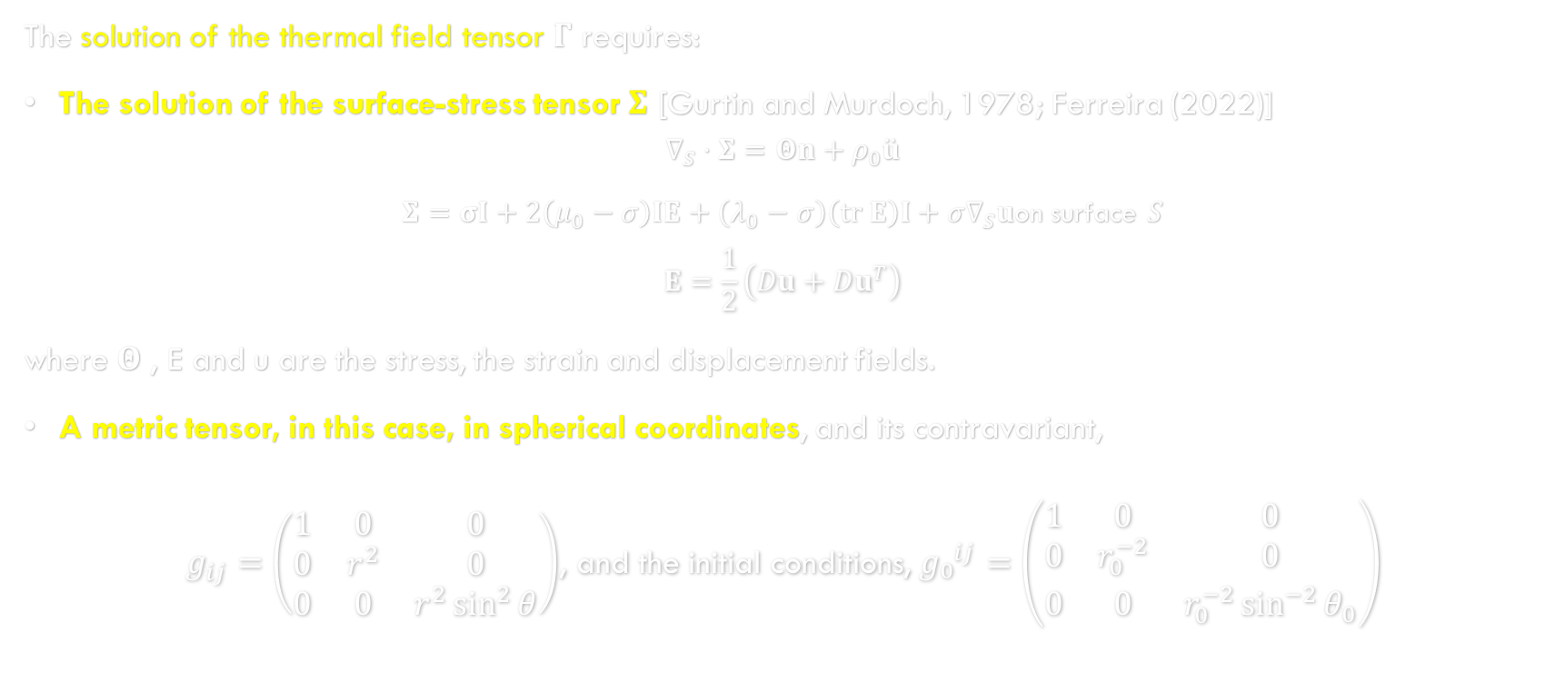
Application of Fundamental Thermodynamics Variables and Functions to this New Field
The solution of the thermal field tensor $Γ$ requires:
The solution of the surface-stress tensor $Σ$ [Gurtin and Murdoch, 1978; Ferreira (2022)]
$$∇_{S}⋅Σ=Θn+ρ_{0}\ddot{u}$$
$Σ=σI+2\left(μ_{0}−σ\right)IE+\left(λ_{0}−σ\right)\left(tr E\right)I+σ∇_{S}u$on surface $S$
$$E=\frac{1}{2}\left(Du+Du^{T}\right)$$
where $Θ$ , E and u are the stress, the strain and displacement fields.
A metric tensor, in this case, in spherical coordinates, and its contravariant,
$g_{ij}=\left(\begin{matrix}1 & 0 & 0 \\ 0 & r^{2} & 0 \\ 0 & 0 & r^{2}\sin^{2}{θ}\end{matrix}\right)$, and the initial conditions, ${g₀}^{ij}=\left(\begin{matrix}1 & 0 & 0 \\ 0 & r_{0}^{−2} & 0 \\ 0 & 0 & r_{0}^{−2}\sin^{−2}{θ_{0}}\end{matrix}\right)$

Slide 13
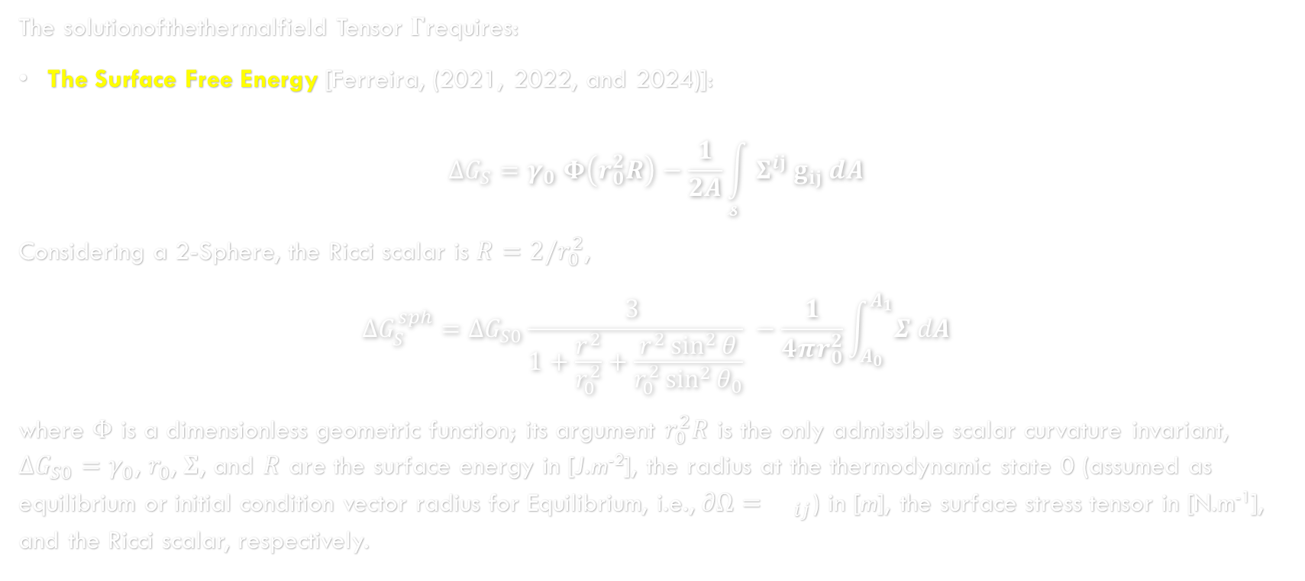
Application of Fundamental Thermodynamics Variables and Functions to this New Field
The solutionofthethermalfield Tensor $Γ$requires:
The Surface Free Energy [Ferreira, (2021, 2022, and 2024)]:
$$ΔG_{S}=γ_{0} Φ\left(r_{0}^{2}R\right)−\frac{1}{2A}\int_{𝓼}{Σ^{ij} g_{ij} dA}$$
Considering a 2-Sphere, the Ricci scalar is $R=2/r_{0}^{2}$,
$$ΔG_{S}^{sph}={ΔG}_{S0}\frac{3 }{1+\frac{r^{2}}{r_{0}^{2}}+\frac{r^{2}\sin^{2}{θ}}{r_{0}^{2}\sin^{2}{θ_{0}}}} −\frac{1}{4πr_{0}^{2}}\int_{A_{0}}^{A_{1}}{Σ dA}$$
where $Φ$ is a dimensionless geometric function; its argument $r_{0}^{2}R$ is the only admissible scalar curvature invariant, ${ΔG}_{S0}=γ_{0}$, $r_{0}$, $Σ$, and $R$ are the surface energy in [J.m⁻²], the radius at the thermodynamic state 0 (assumed as equilibrium or initial condition vector radius for Equilibrium, i.e., $∂Ω={}_{ij}$) in [m], the surface stress tensor in [N.m⁻¹], and the Ricci scalar, respectively.

Slide 14
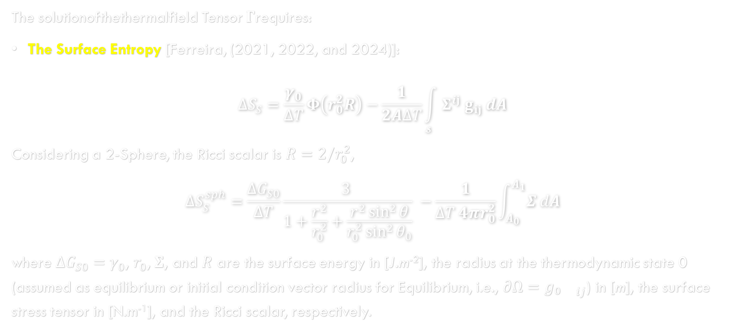
Application of Fundamental Thermodynamics Variables and Functions to this New Field
The solutionofthethermalfield Tensor $Γ$requires:
The Surface Entropy [Ferreira, (2021, 2022, and 2024)]:
$$ΔS_{S}=\frac{γ_{0}}{ΔT}Φ\left(r_{0}^{2}R\right)−\frac{1}{2AΔT}\int_{𝓼}{Σ^{ij} g_{ij} dA}$$
Considering a 2-Sphere, the Ricci scalar is $R=2/r_{0}^{2}$,
$$ΔS_{S}^{sph}=\frac{{ΔG}_{S0}}{ΔT}\frac{3 }{1+\frac{r^{2}}{r_{0}^{2}}+\frac{r^{2}\sin^{2}{θ}}{r_{0}^{2}\sin^{2}{θ_{0}}}} −\frac{1}{ΔT {4πr}_{0}^{2}}\int_{A_{0}}^{A_{1}}{Σ dA}$$
where ${ΔG}_{S0}=γ_{0}$, $r_{0}$, $Σ$, and $R$ are the surface energy in [J.m⁻²], the radius at the thermodynamic state 0 (assumed as equilibrium or initial condition vector radius for Equilibrium, i.e., $∂Ω=g₀{}_{ij}$) in [m], the surface stress tensor in [N.m⁻¹], and the Ricci scalar, respectively.

Slide 15
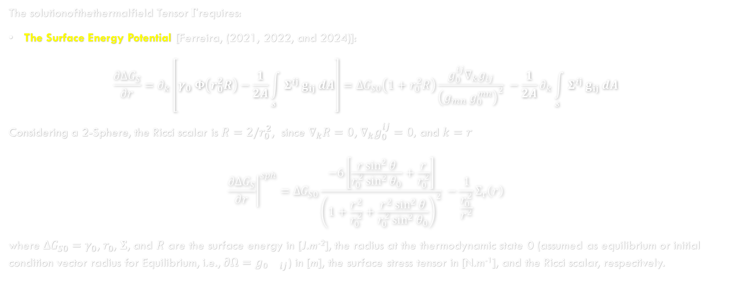
Application of Fundamental Thermodynamics Variables and Functions to this New Field
The solutionofthethermalfield Tensor $Γ$requires:
The Surface Energy Potential [Ferreira, (2021, 2022, and 2024)]:
$$\frac{∂ΔG_{S}}{∂r}=∂_{k}\left[γ_{0} Φ\left(r_{0}^{2}R\right)−\frac{1}{2A}\int_{𝓼}{Σ^{ij} g_{ij} dA}\right]={ΔG}_{S0}\left(1+r_{0}^{2}R\right)\frac{g_{0}^{ij}∇_{k}g_{ij}}{{\left(g_{mn}{ g}_{0}^{mn}\right)}^{2}} −\frac{1}{2A}∂_{k}\int_{𝓼}{Σ^{ij} g_{ij} dA}$$
Considering a 2-Sphere, the Ricci scalar is $R=2/r_{0}^{2}$, since $∇_{k}R=0$, $∇_{k}g_{0}^{ij}=0,$ and $k=r$
$${\left.\frac{∂ΔG_{S}}{∂r}\right|}^{sph}={ΔG}_{S0}\frac{−6\left[\frac{r\sin^{2}{θ}}{r_{0}^{2}\sin^{2}{θ_{0}}}+\frac{r}{r_{0}^{2}}\right]}{{\left(1+\frac{r^{2}}{r_{0}^{2}}+\frac{r^{2}\sin^{2}{θ}}{r_{0}^{2}\sin^{2}{θ_{0}}}\right)}^{2}} −\frac{1}{\frac{r_{0}^{2}}{r^{2}}}Σ_{r}\left(r\right)$$
where ${ΔG}_{S0}=γ_{0}$, $r_{0}$, $Σ$, and $R$ are the surface energy in [J.m⁻²], the radius at the thermodynamic state 0 (assumed as equilibrium or initial condition vector radius for Equilibrium, i.e., $∂Ω=g₀{}_{ij}$) in [m], the surface stress tensor in [N.m⁻¹], and the Ricci scalar, respectively.

Slide 16
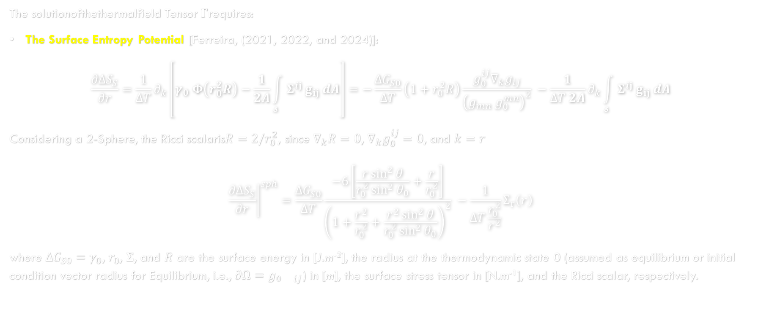
Application of Fundamental Thermodynamics Variables and Functions to this New Field
The solutionofthethermalfield Tensor $Γ$requires:
The Surface Entropy Potential [Ferreira, (2021, 2022, and 2024)]:
$$\frac{∂ΔS_{S}}{∂r}=\frac{1}{ΔT}∂_{k}\left[γ_{0} Φ\left(r_{0}^{2}R\right)−\frac{1}{2A}\int_{𝓼}{Σ^{ij} g_{ij} dA}\right]=−\frac{{ΔG}_{S0}}{ΔT}\left(1+r_{0}^{2}R\right)\frac{g_{0}^{ij}∇_{k}g_{ij}}{{\left(g_{mn}{ g}_{0}^{mn}\right)}^{2}} −\frac{1}{ΔT 2A}∂_{k}\int_{𝓼}{Σ^{ij} g_{ij} dA}$$
Considering a 2-Sphere, the Ricci scalaris$R=2/r_{0}^{2}$, since $∇_{k}R=0$, $∇_{k}g_{0}^{ij}=0$, and $k=r$
$${\left.\frac{∂ΔS_{S}}{∂r}\right|}^{sph}=\frac{{ΔG}_{S0}}{ΔT}\frac{−6\left[\frac{r\sin^{2}{θ}}{r_{0}^{2}\sin^{2}{θ_{0}}}+\frac{r}{r_{0}^{2}}\right]}{{\left(1+\frac{r^{2}}{r_{0}^{2}}+\frac{r^{2}\sin^{2}{θ}}{r_{0}^{2}\sin^{2}{θ_{0}}}\right)}^{2}} −\frac{1}{ΔT\frac{r_{0}^{2}}{r^{2}}}Σ_{r}\left(r\right)$$
where ${ΔG}_{S0}=γ_{0}$, $r_{0}$, $Σ$, and $R$ are the surface energy in [J.m⁻²], the radius at the thermodynamic state 0 (assumed as equilibrium or initial condition vector radius for Equilibrium, i.e., $∂Ω=g₀{}_{ij}$) in [m], the surface stress tensor in [N.m⁻¹], and the Ricci scalar, respectively.

Slide 17
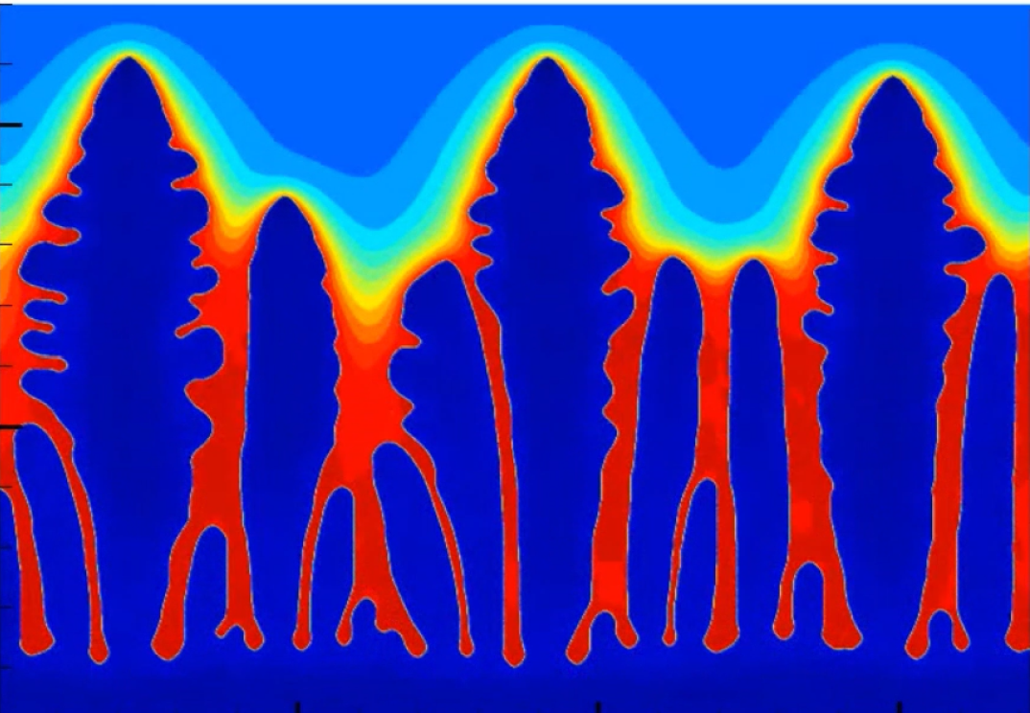

Experimental Validation, $Γ=f\left(∇T\right)$: SDAS
SDAS
PDAS

Slide 18



Application Example 1
Experimental validation [Ferreira et al. (2025)]:
SDAS can be calculated in terms of Gibbs-Thomson which is the Thermal Field Tensor $Γ$ as,
$SDAS=5.5 {\left(M∙t_{SL}\right)}^{\frac{1}{3}}$
$$M=\frac{−Γ\sum_{j=1}^{n}{w_{j}β_{ j}}}{\sum_{j=1}^{n}{{m_{j}\left(1−\frac{k_{ j}}{k_{j}+\left(1−k_{j}\right)\exp\left(\frac{−ν δ_{j}}{D_{j}}\right)}\right)\left(c_{f, j}−c_{0, j}\right)}/{D_{j}}}}\ln\left[\frac{\sum_{j=1}^{n}{{m_{j}\left(1−\frac{k_{ j}}{k_{j}+\left(1−k_{j}\right)\exp\left(\frac{−ν δ_{j}}{D_{j}}\right)}\right)c_{f, j}}/{D_{j}}}}{\sum_{j=1}^{n}{{m_{j}\left(1−\frac{k_{ j}}{k_{j}+\left(1−k_{j}\right)\exp\left(\frac{−ν δ_{j}}{D_{j}}\right)}\right)c_{0, j}}/{D_{j}}}}\right]$$

Slide 19
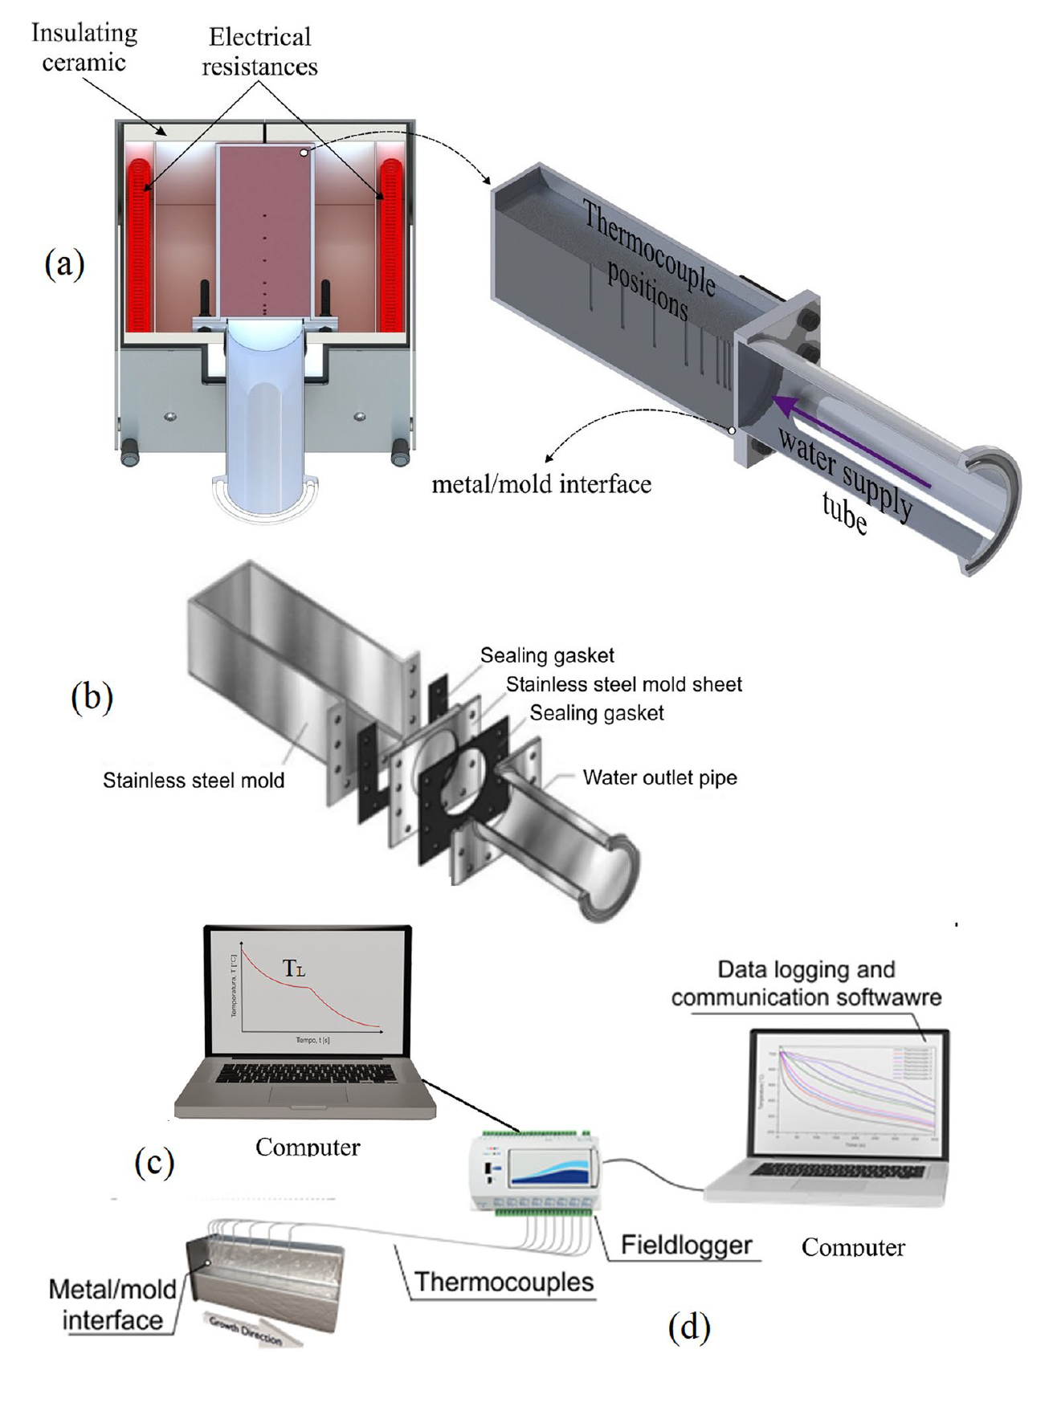
Application Example 1
Experimental validation [Mendes et al. (2023)]:
Figure 1 Schematic representation of transient horizontal solidification experiment.

Slide 20
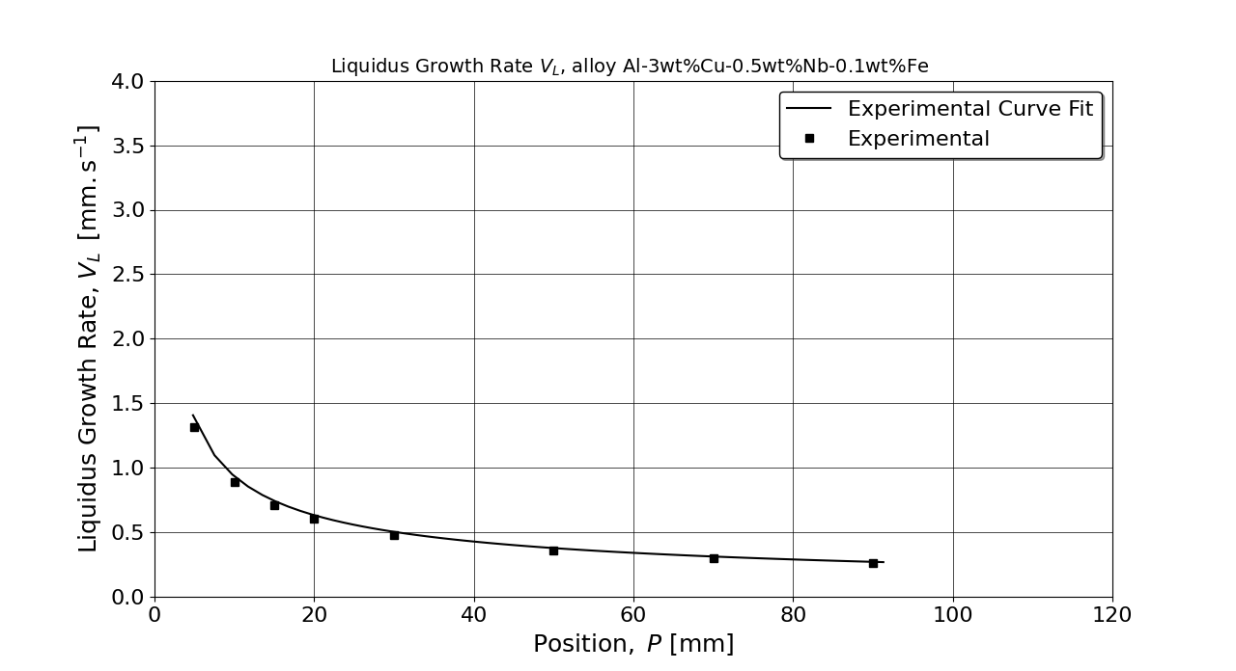
Application Example 1
Experimental validation [Mendes et al. (2023)]:
Figure 2 Experimental data from transient solidification measurements yielded (A) dendrite tip growth rates, (B) liquidus thermal gradients, and (C) dendrite tip cooling rates.
( A )

Slide 21
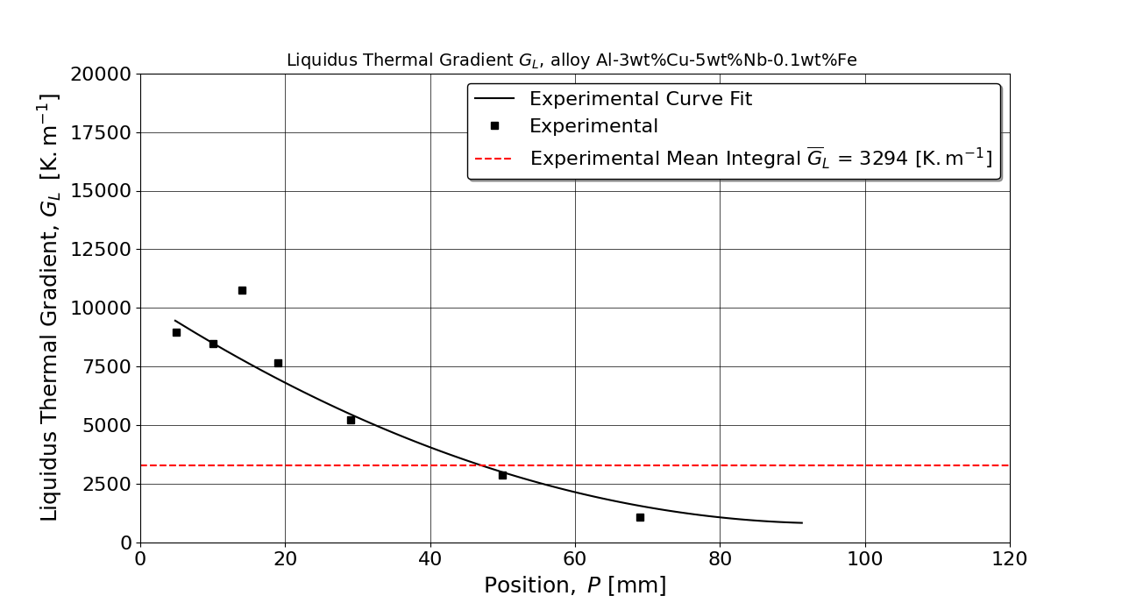
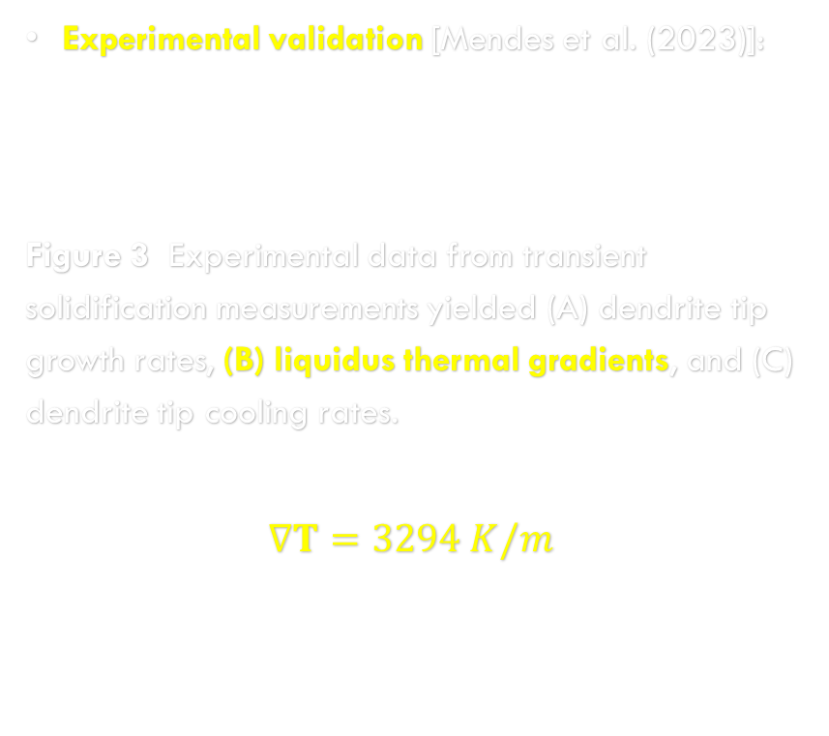
Application Example 1
Experimental validation [Mendes et al. (2023)]:
Figure 3 Experimental data from transient solidification measurements yielded (A) dendrite tip growth rates, (B) liquidus thermal gradients, and (C) dendrite tip cooling rates.
$$∇T=3294 K/m$$
( B )

Slide 22
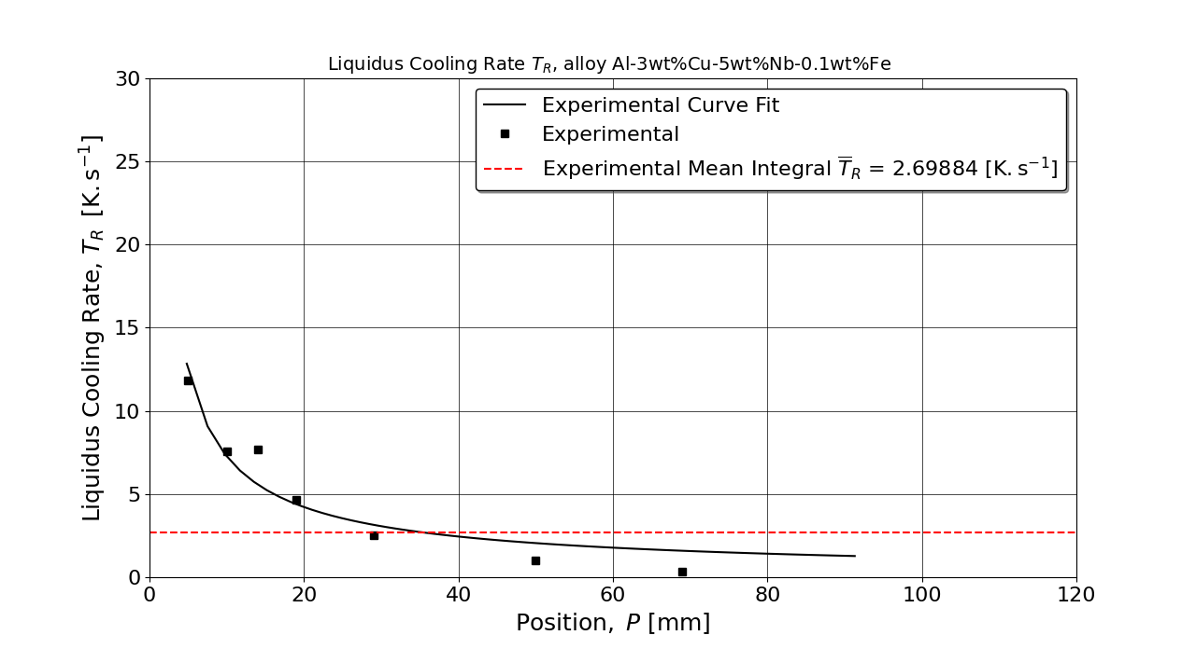
Application Example 1
Experimental validation [Mendes et al. (2023)]:
Figure 4 Experimental data from transient solidification measurements yielded (A) dendrite tip growth rates, (B) liquidus thermal gradients, and (C) dendrite tip cooling rates.
( C )

Slide 23
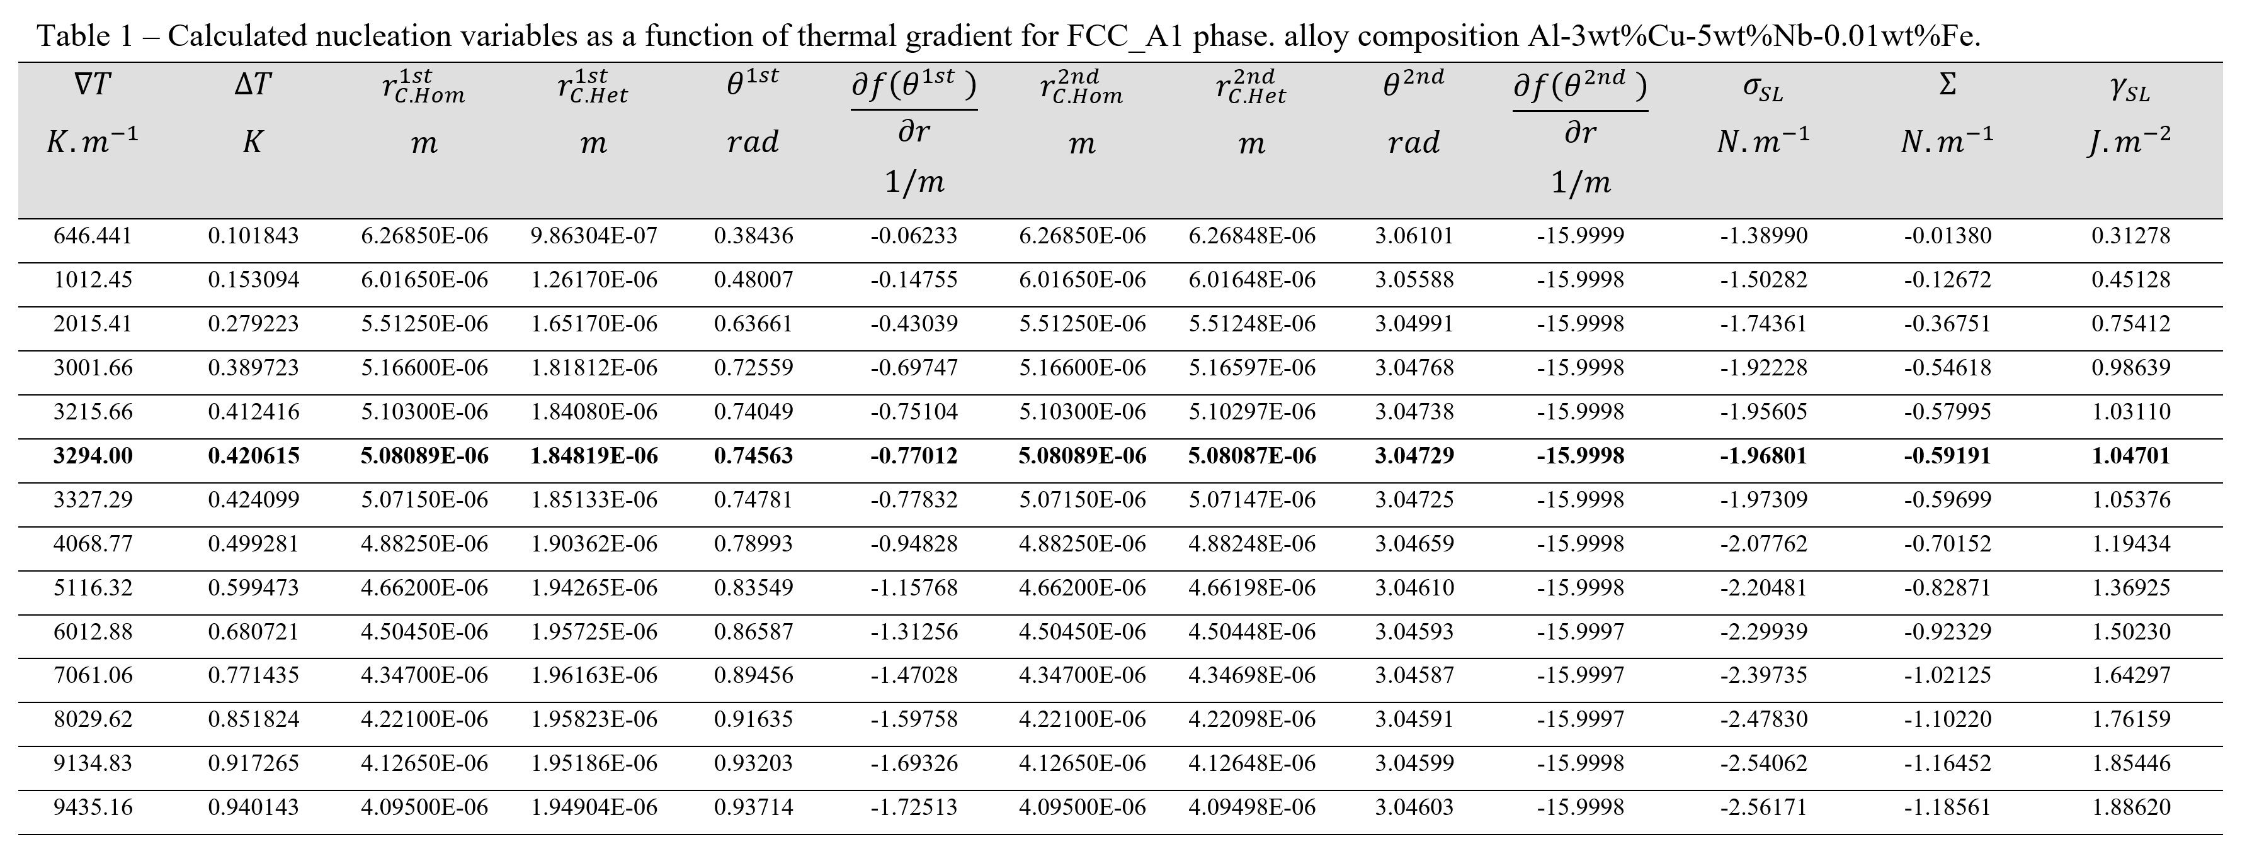
Application Example 1
Results of Nucleation Calculation [Present work]:

Slide 24
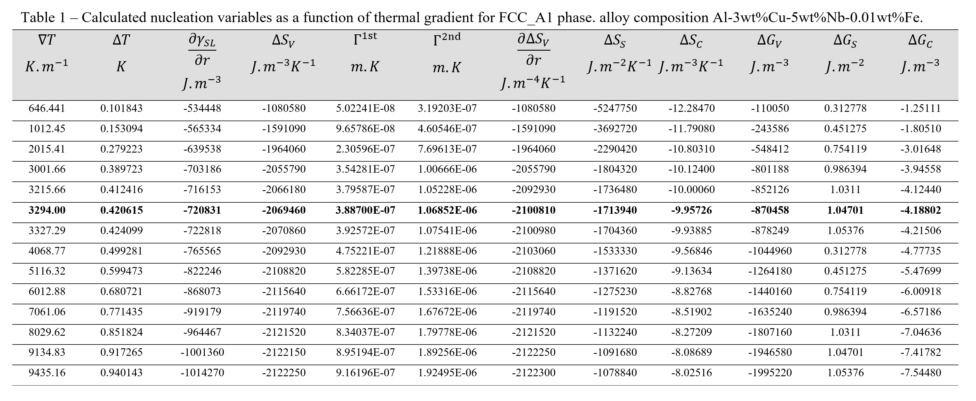
Application Example 1
Results of Nucleation Calculation [Present work]:

Slide 25
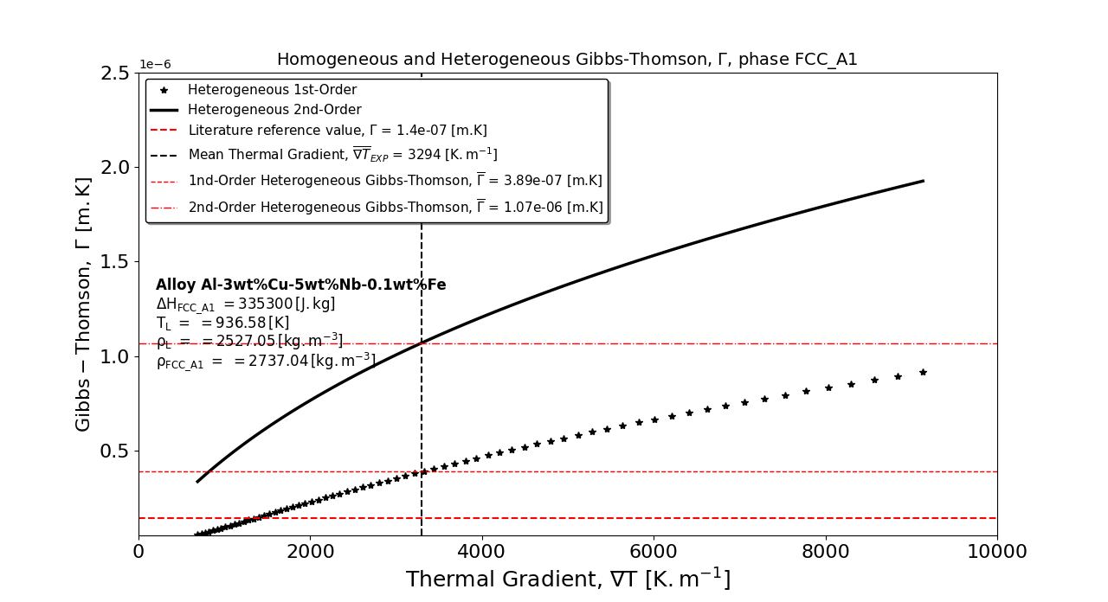
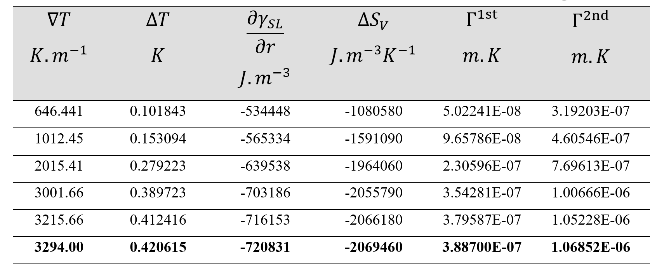
Application Example 1
Experimental validation [Present work]:
Figure 5 Thermal field tensor (Gibbs-Thomson) function of thermal gradient.
( A )

Slide 26

Application Example 1
Experimental validation [Ferreira et al. (2025)]:
SDAS can be calculated in terms of Gibbs-Thomson which is the Thermal Field Tensor $Γ$ as,
$SDAS=5.5 {\left(M∙t_{SL}\right)}^{\frac{1}{3}}$
$$M=\frac{−Γ\sum_{j=1}^{n}{w_{j}β_{ j}}}{\sum_{j=1}^{n}{{m_{j}\left(1−\frac{k_{ j}}{k_{j}+\left(1−k_{j}\right)\exp\left(\frac{−ν δ_{j}}{D_{j}}\right)}\right)\left(c_{f, j}−c_{0, j}\right)}/{D_{j}}}}\ln\left[\frac{\sum_{j=1}^{n}{{m_{j}\left(1−\frac{k_{ j}}{k_{j}+\left(1−k_{j}\right)\exp\left(\frac{−ν δ_{j}}{D_{j}}\right)}\right)c_{f, j}}/{D_{j}}}}{\sum_{j=1}^{n}{{m_{j}\left(1−\frac{k_{ j}}{k_{j}+\left(1−k_{j}\right)\exp\left(\frac{−ν δ_{j}}{D_{j}}\right)}\right)c_{0, j}}/{D_{j}}}}\right]$$

Slide 27
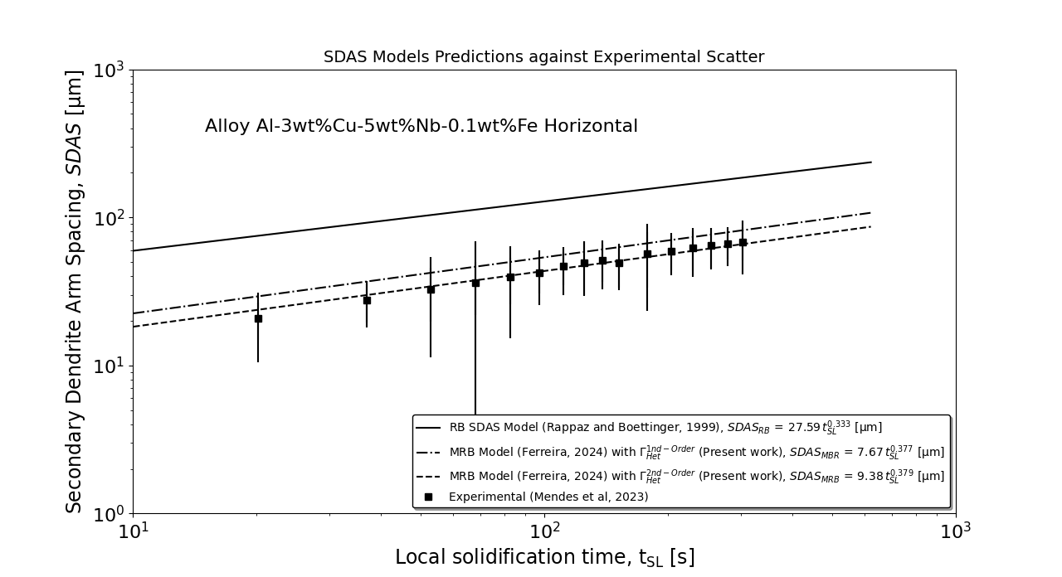
Application Example 1
Experimental validation [Present work]:
Figure 6 Comparison between secondary arm-spacing models and experimental scatter.
( A )

Slide 28
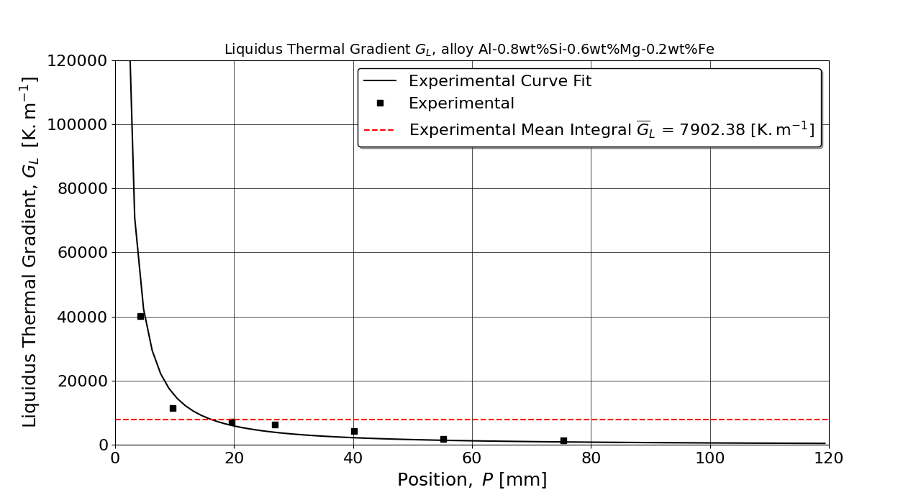
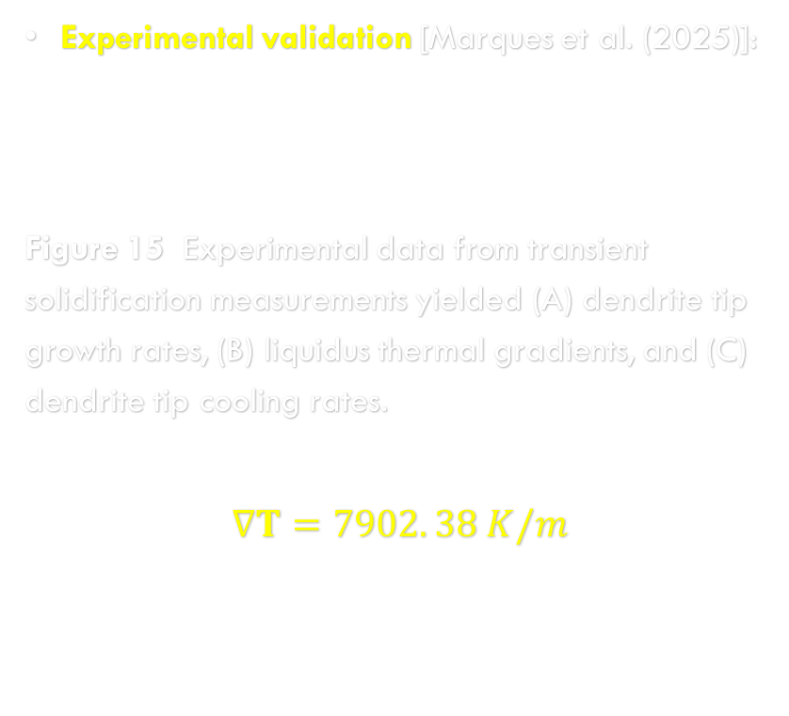
Application Example 2
Experimental validation [Marques et al. (2025)]:
Figure 15 Experimental data from transient solidification measurements yielded (A) dendrite tip growth rates, (B) liquidus thermal gradients, and (C) dendrite tip cooling rates.
$$∇T=7902. 38 K/m$$
( B )

Slide 29
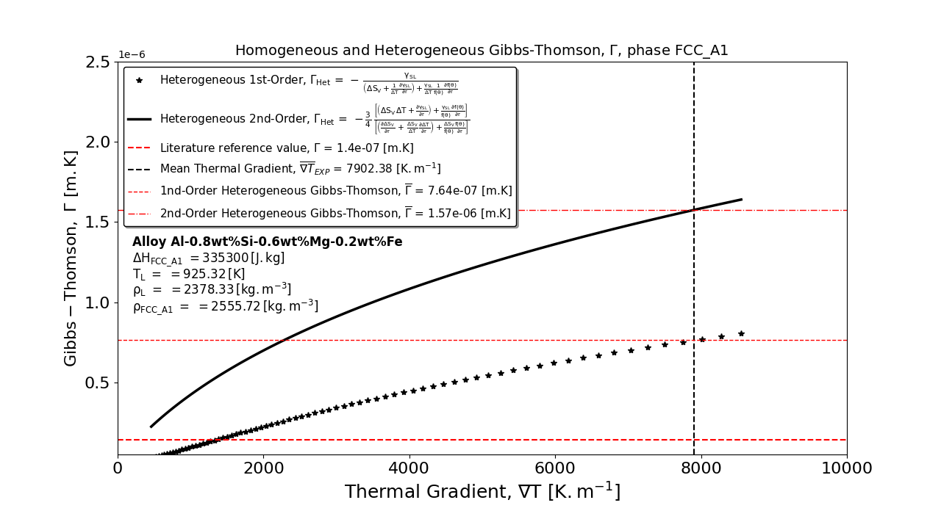
Application Example 2
Experimental validation [Marques et al. (2025)]:
Figure 16 Thermal field tensor (Gibbs-Thomson) function of thermal gradient.

Slide 30
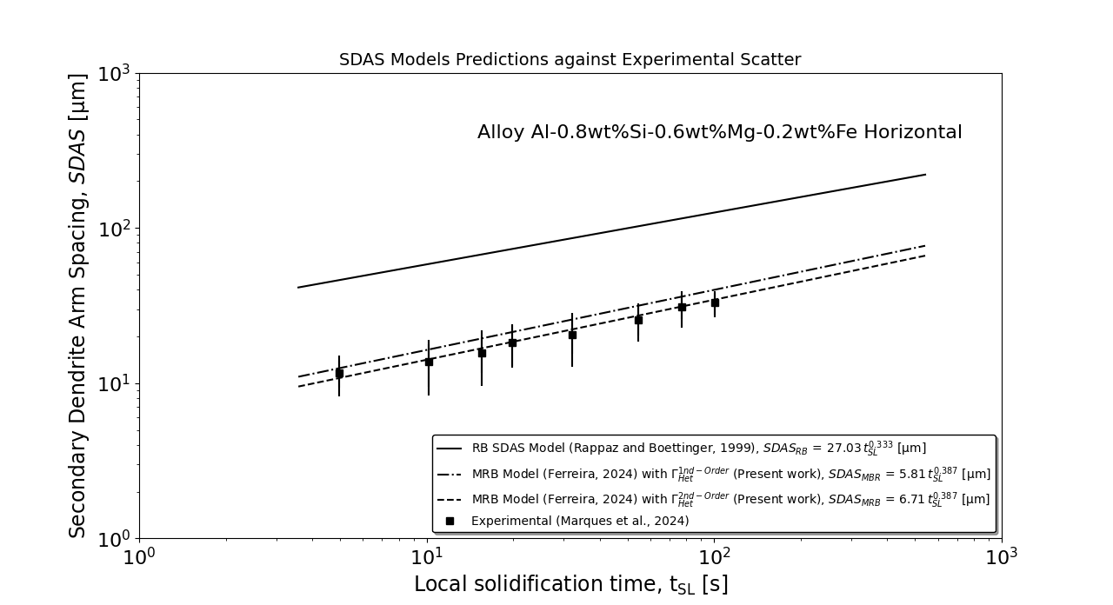
Application Example 2
Experimental validation [Marques et al. (2025)]:
Figure 17 Comparison between secondary arm-spacing models and experimental scatter.
( A )

Slide 31
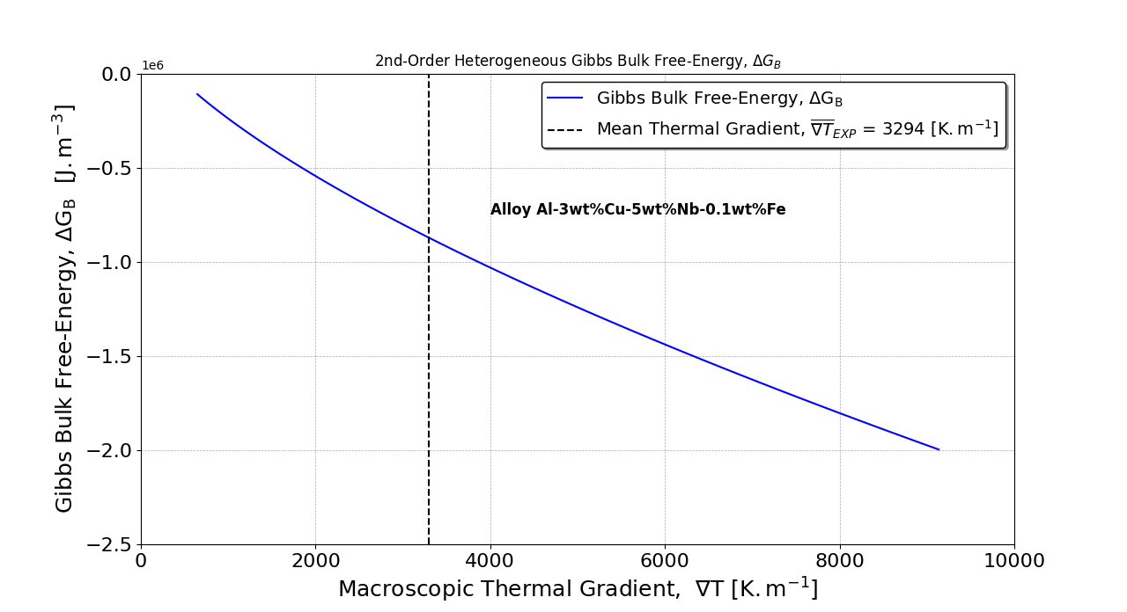
Application Example 1
Experimental validation [Ferreira et al. (2025)]:
Figure 7 Gibbs bulk free-energy as a function of thermal gradient.
( A )

Slide 32
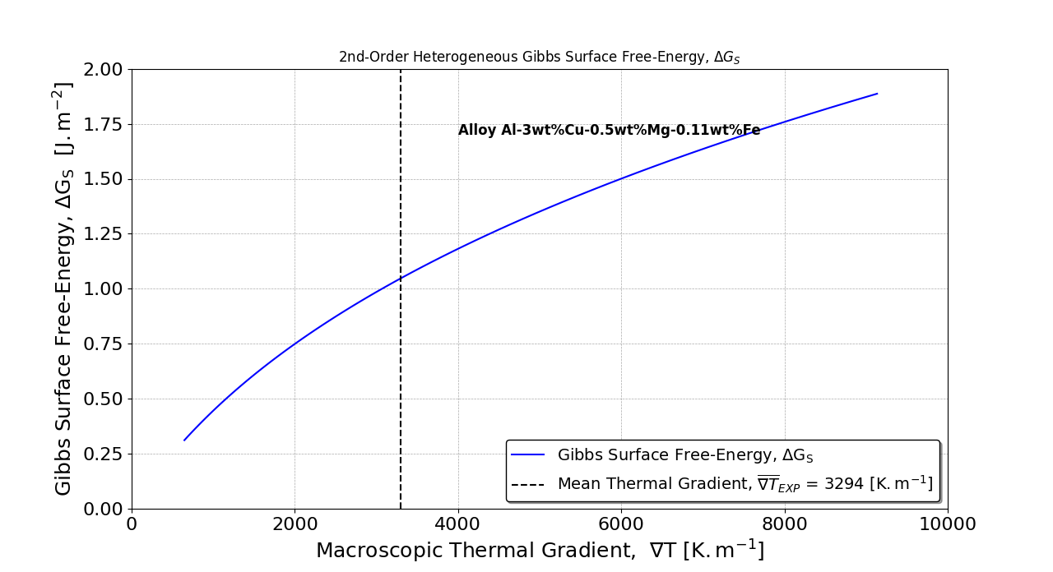
Application Example 1
Experimental validation [Present work]:
Figure 8 Gibbs surface free-energy as a function of thermal gradient.
( A )

Slide 33
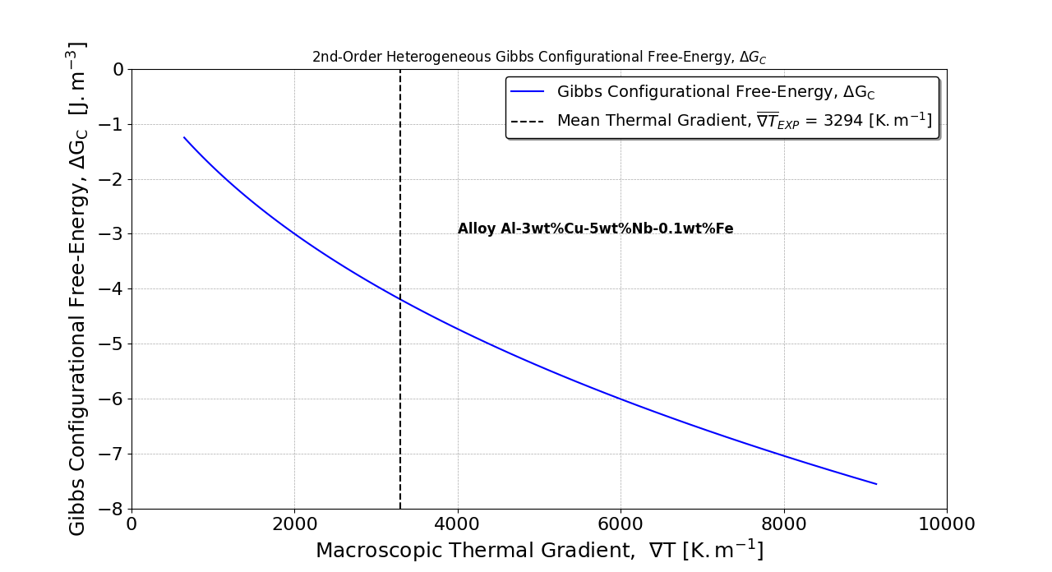
Application Example 1
Experimental validation [Present Work]:
Figure 9 Gibbs configurational free-energy as a function of thermal gradient.
( A )

Slide 34
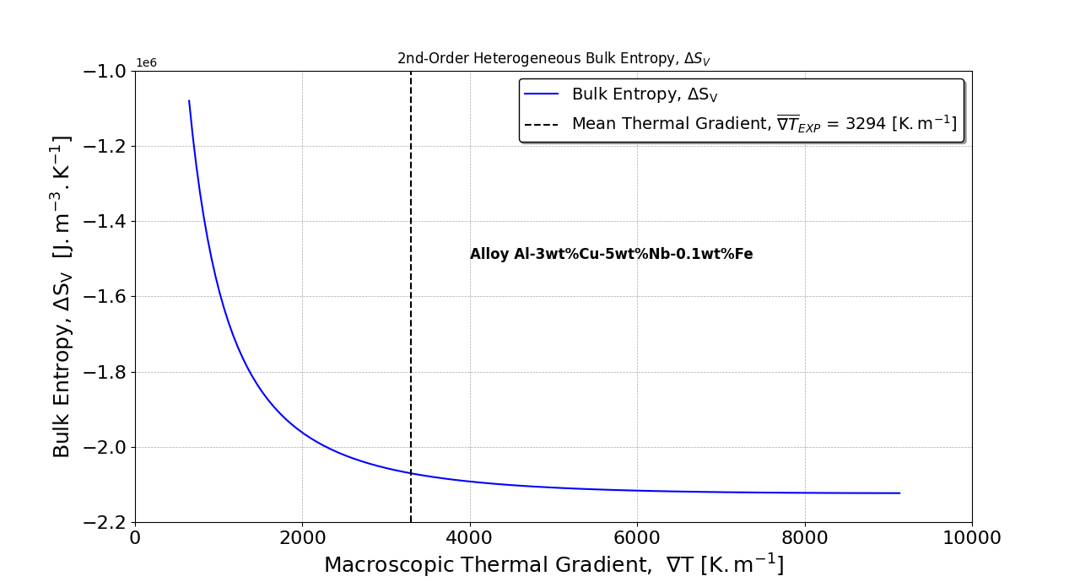
Application Example 1
Experimental validation [Present work]:
Figure 10 Bulk entropy as a function of thermal gradient.
( A )

Slide 35
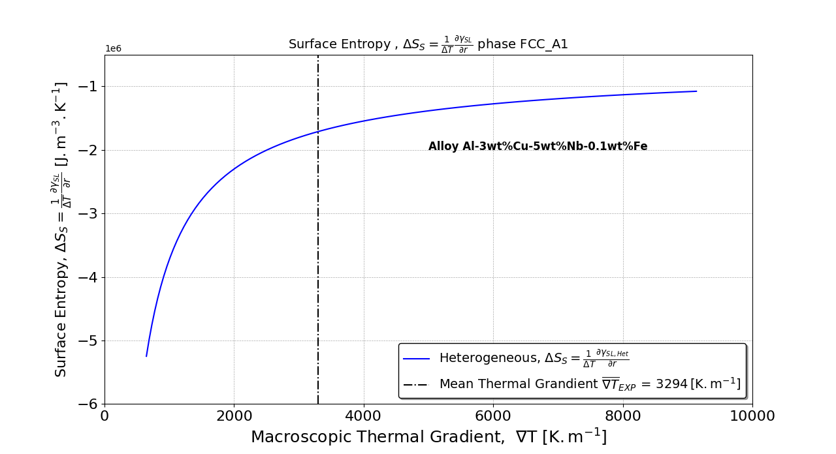
Application Example 1
Experimental validation [Present work]:
Figure 11 Surface entropy as a function of thermal gradient.
( A )

Slide 36
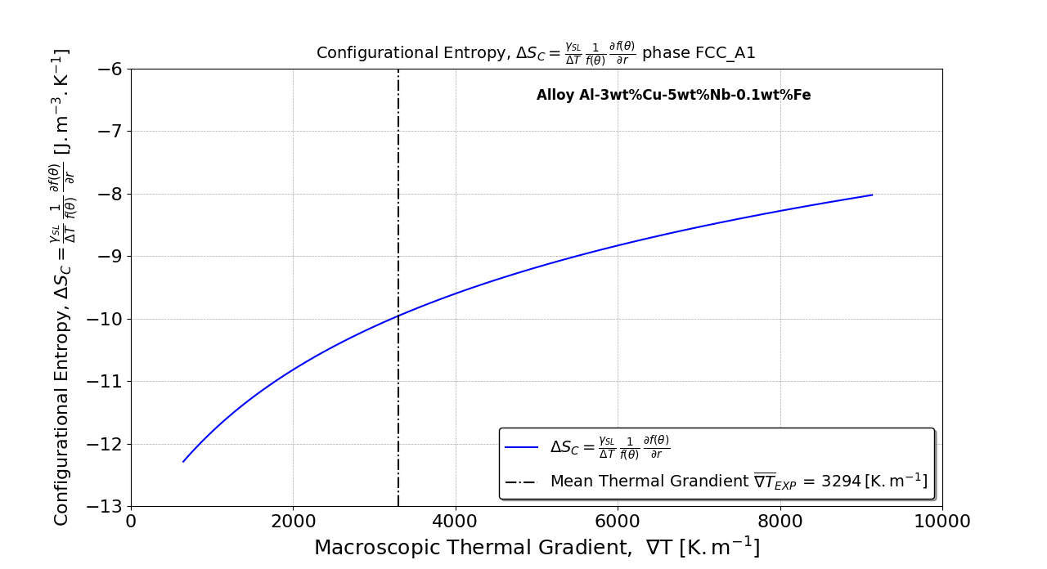
Application Example 1
Experimental validation [Present work]:
Figure 12 Configurational entropy as a function of thermal gradient.
( A )

Slide 37
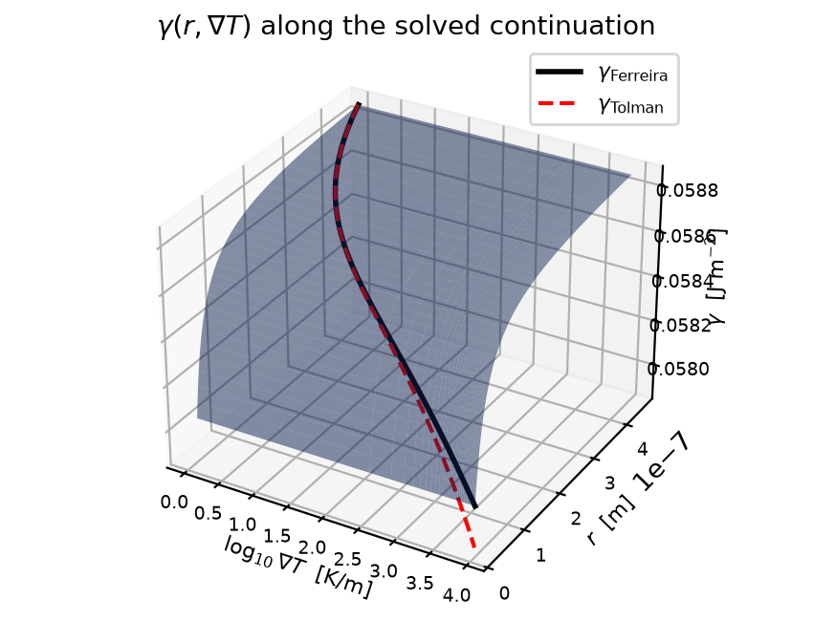
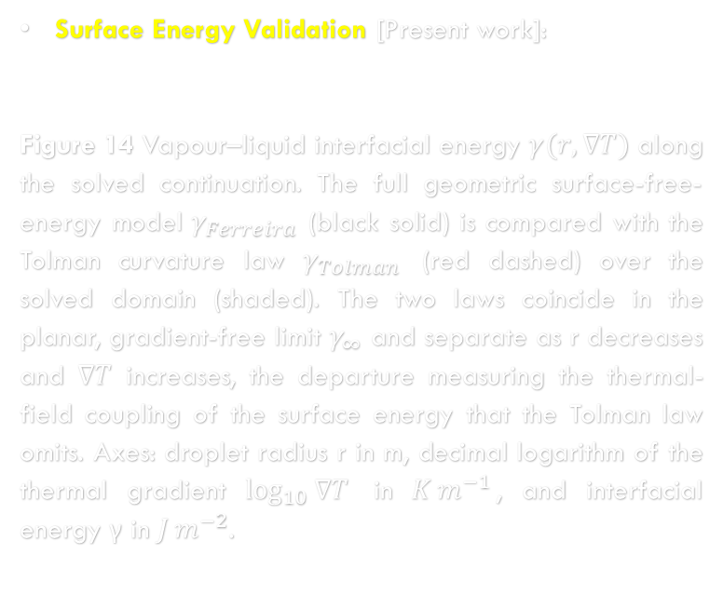
Application Example 3
Surface Energy Validation [Present work]:
Figure 14 Vapour–liquid interfacial energy $γ(r,∇T)$ along the solved continuation. The full geometric surface-free-energy model $γ_{Ferreira}$ (black solid) is compared with the Tolman curvature law $γ_{Tolman}$ (red dashed) over the solved domain (shaded). The two laws coincide in the planar, gradient-free limit $γ_{∞}$ and separate as r decreases and $∇T$ increases, the departure measuring the thermal-field coupling of the surface energy that the Tolman law omits. Axes: droplet radius r in m, decimal logarithm of the thermal gradient $\log_{10}{∇T}$ in $K m^{−1}$, and interfacial energy γ in $J m^{−2}$.

Slide 38
Conclusions
1. The second-order nucleation formulation, in relation to the critical radius, was validated and experimentally confirmed as a valid scientific theory;
2. The nucleation process analyzed has shown quadratic behavior in terms of nucleation radius;
3. Bulk and configurational free energies exhibit opposing signs relative to surface free energy;
4. Because the substrate’s contribution aims to minimize local free energy, the configurational and bulk free energies share the same sign.

Slide 39
References
[1] I.L. Ferreira Physica B: Condensed Matter. 695 (2024) 416494.
[2] I.L. Ferreira: Materials. (2026) in press.
[3] Y.-B. Kang, Calphad: Comput. Coupling Ph. Diagr. Thermochem. 50 (2015) 23
[4] L.P. Marques et al. Mater. Res., 28 (2025) e20250045-7.
[5] I.L. Ferreira et al. Mater. Res., 28 (2025) e20250069.

Slide 40



Thanks for Watching!
Funding: The Authors acknowledge the financial support provided by CAPES (Coordenação de Aperfeiçoamento de Pessoal de Nível Superior - Brazil) Finance Code 001 and Grant 88881.707312/2022-01, and CNPq (National Council for Scientific and Technological Development - Brazil) Grant 301502/2022-6, and FAPESPA (Fundação Amazônia de Amparo a Estudos e Pesquisas).
Special thanks to Project “Energy Recovery from Agricultural and Forestry Waste in the States of Amazonas, Pará, and Mato Grosso: Sustainable Production of HVO, Biogas, Biometane, and Green Hydrogen for Use in Internal Combustion Engines”, CNPq Grant 445608/2024-2.

Slide 41
