Slide 1
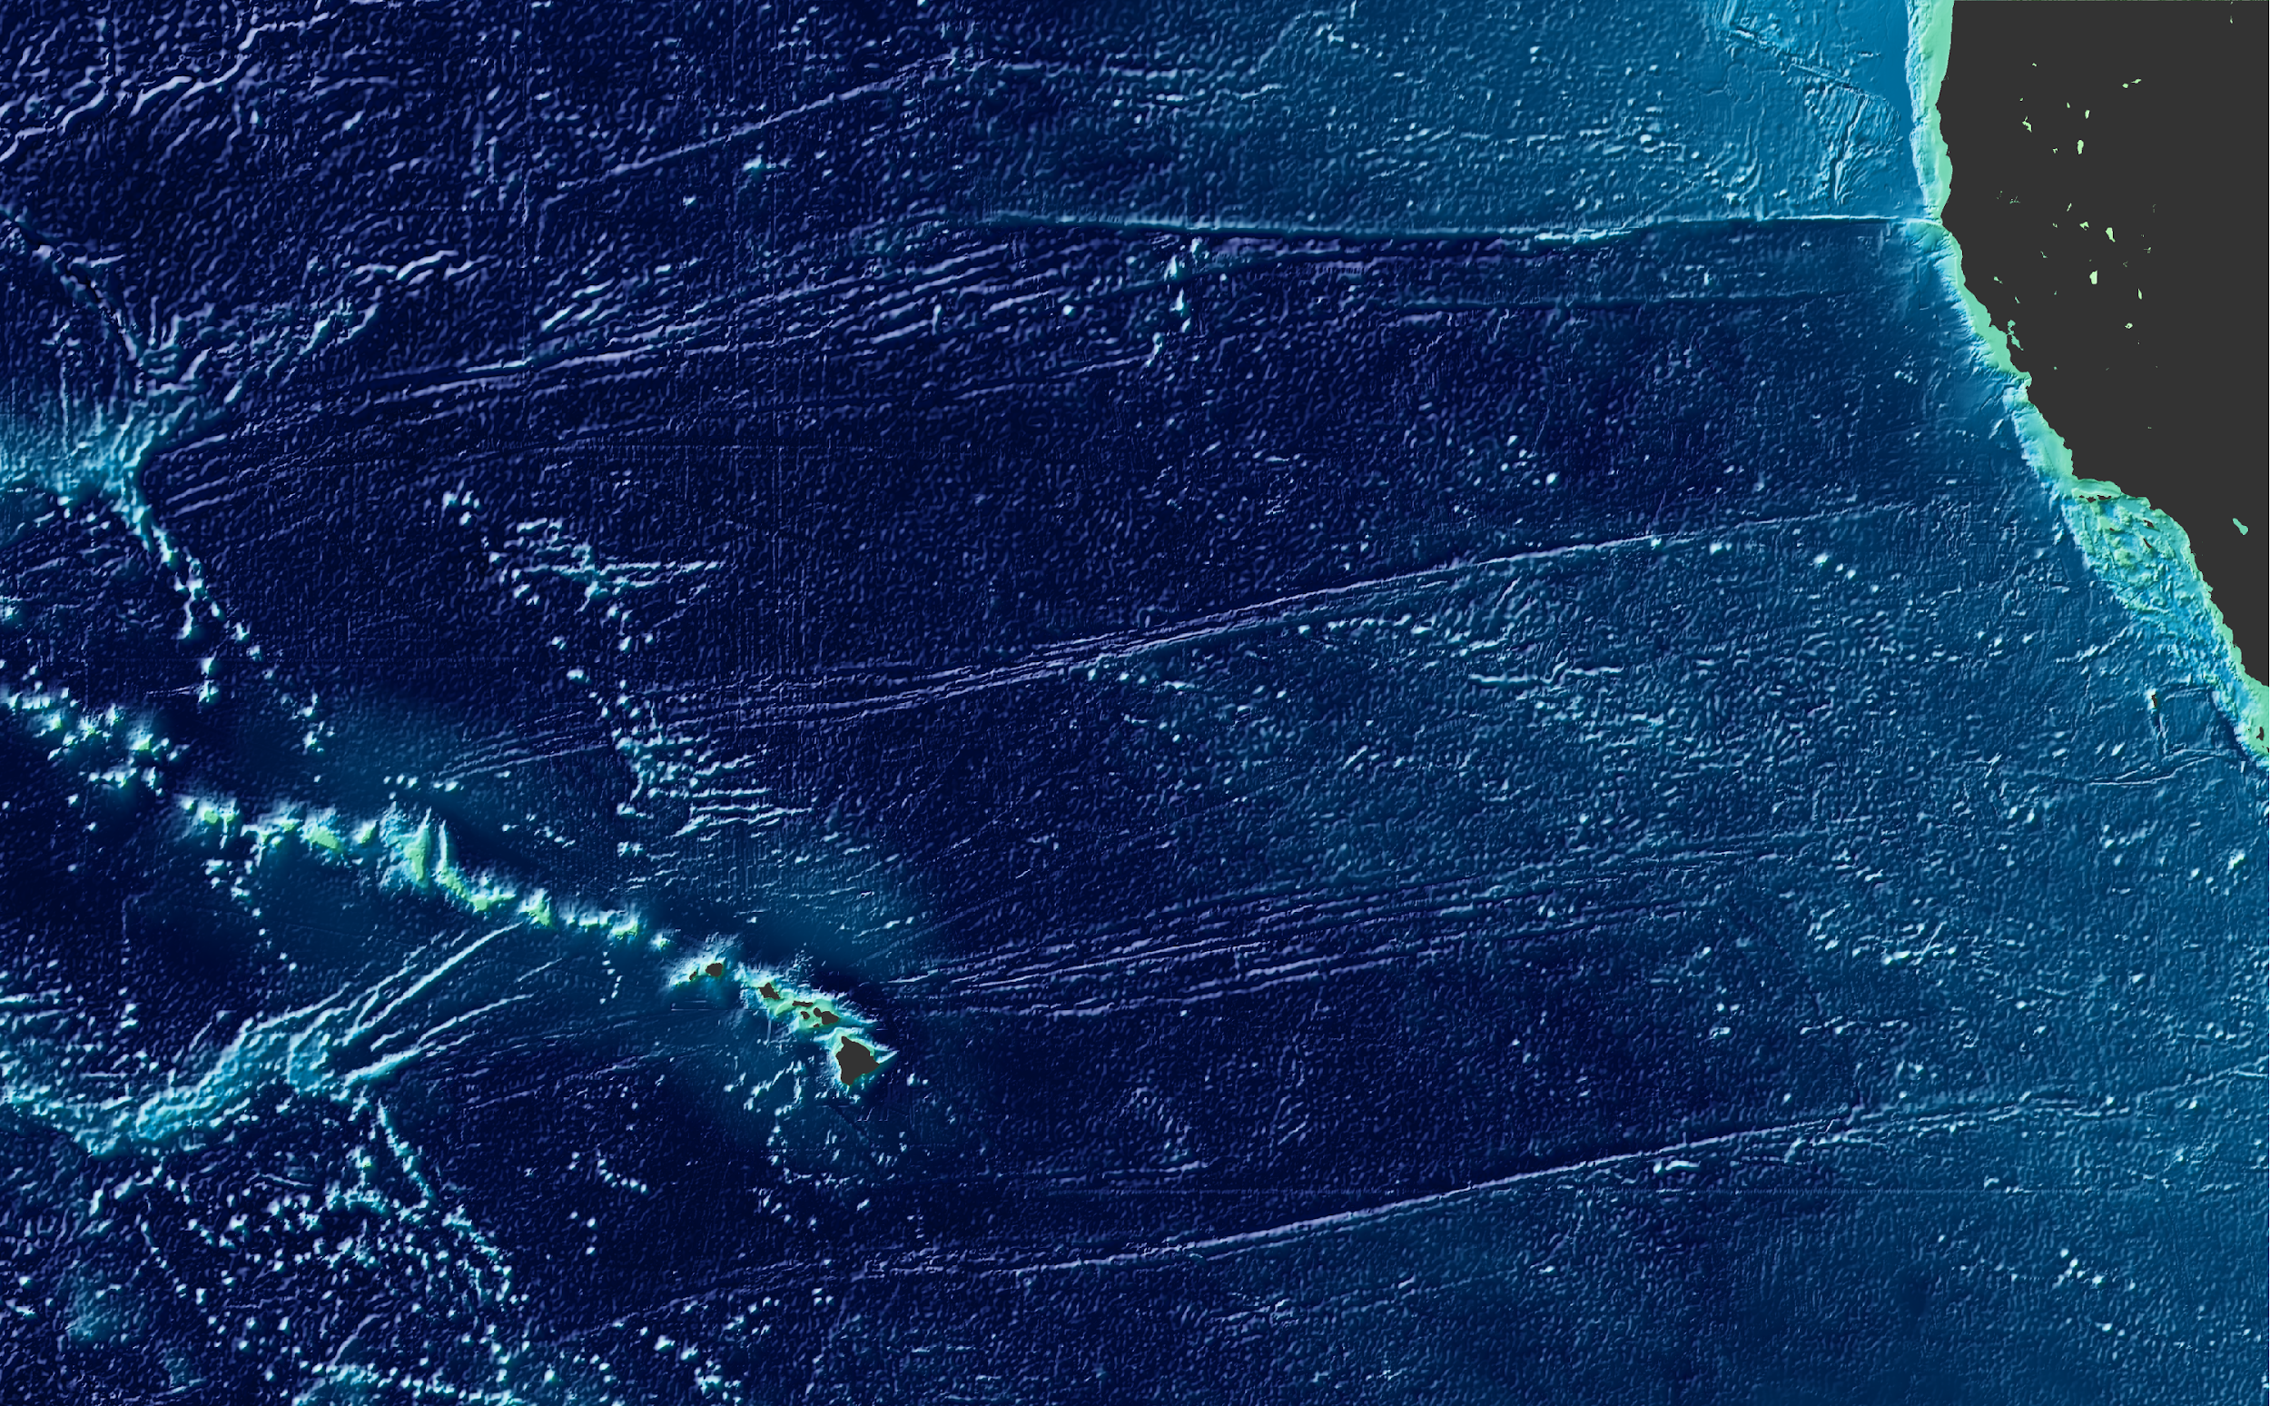

Building an Object-Oriented Python interface for the Generic Mapping Tools
Leonardo Uieda and Paul Wessel
@leouieda
Department of Geology and Geophysics, SOEST, University of Hawaii at Manoa
Feel free to photograph and share this presentation.
Scipy2018 - 2018/07/13

Slide 2
GMT

Slide 3
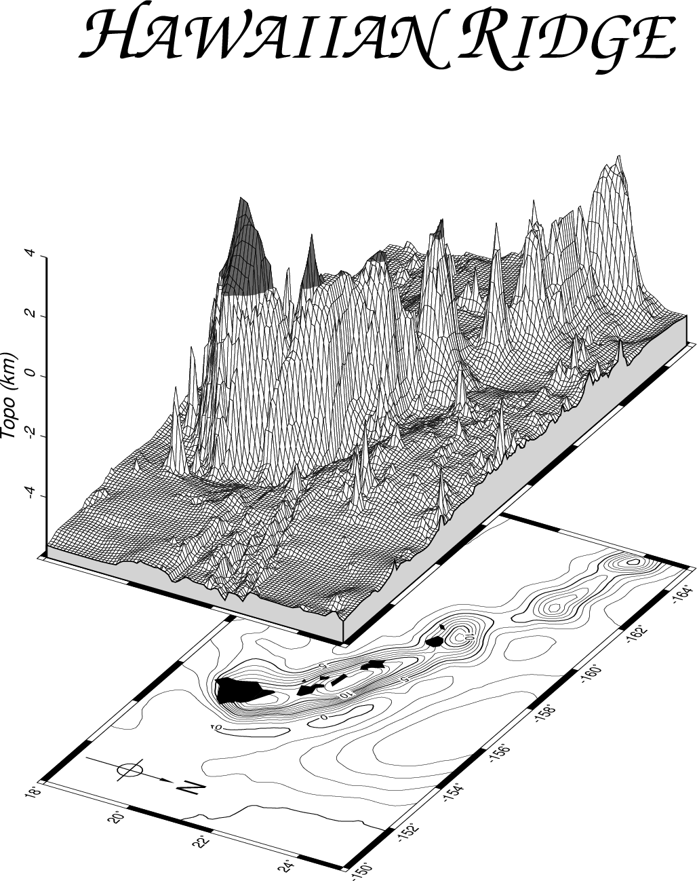
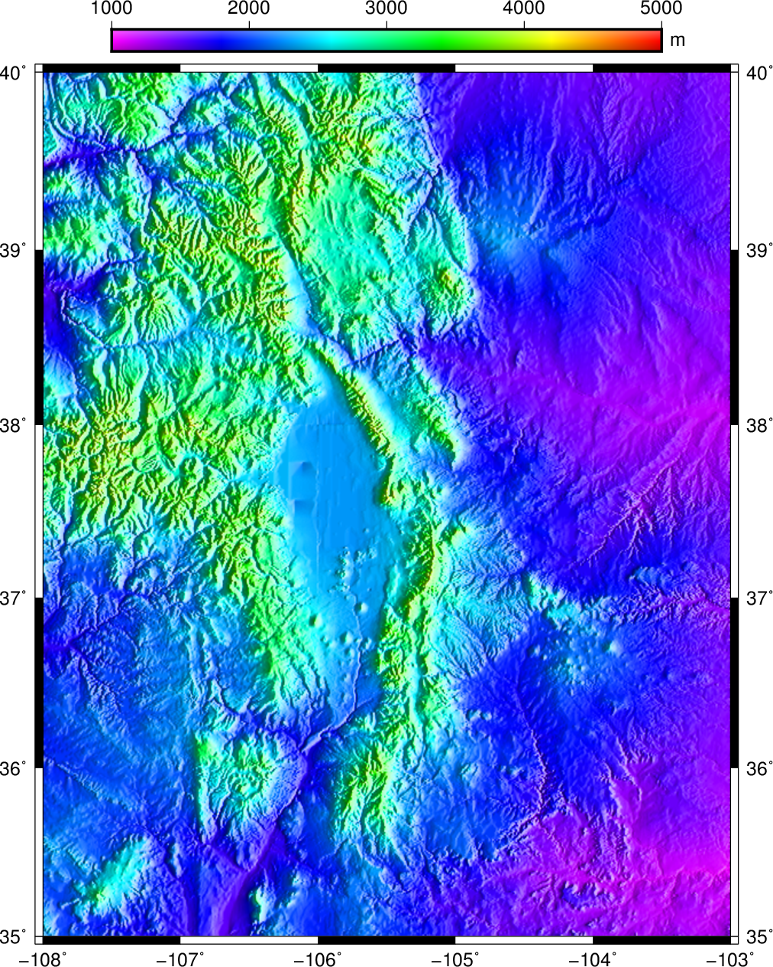
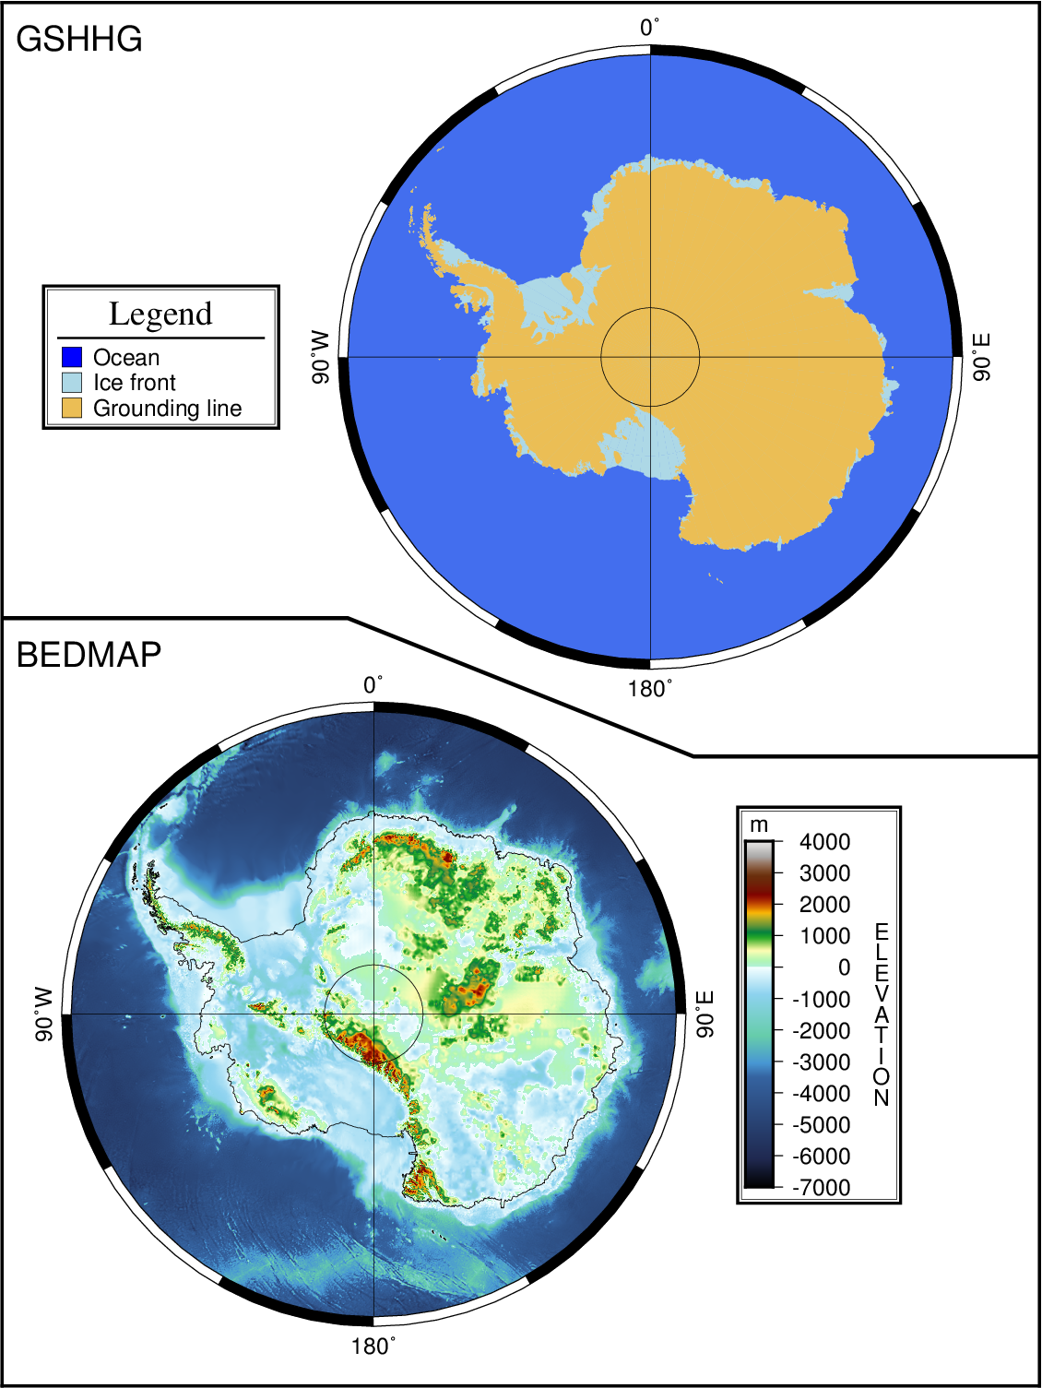
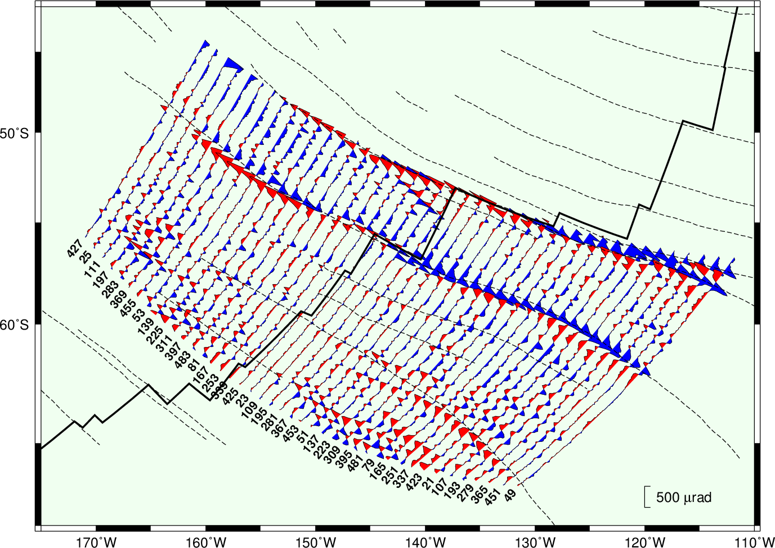
Notes:
Briefly talk about what GMT does.

Slide 4
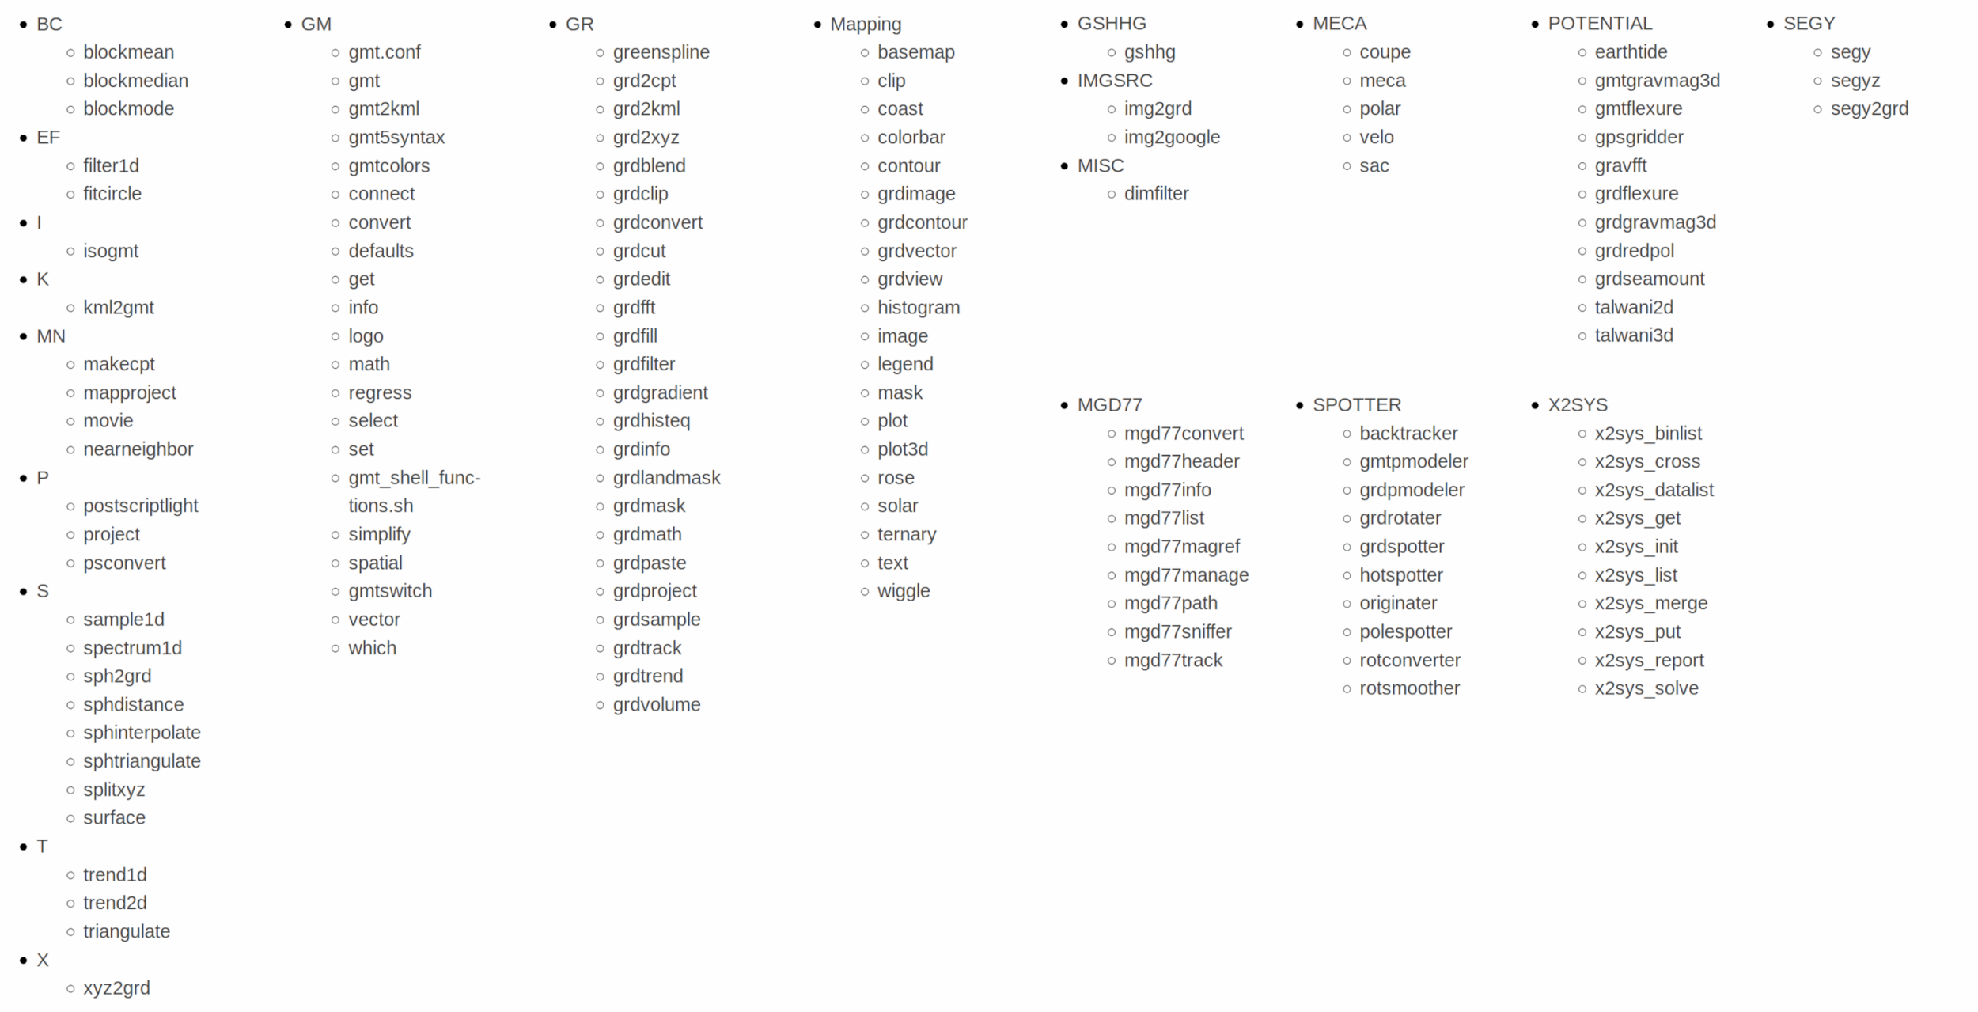

Slide 5
Project Goals
Make GMT more accessible
Python wrapper that looks like Python
Integration with the Scipy stack
Comprehensive documentation

Slide 6
Demo
try.gmtpython.xyz

Slide 7
After Scipy 2017:
Mac conda packages for GMT (Mike Hearne, Filipe Fernandes) gmt.Figure class
Figure.savefig -> pytest-mpl
Input numpy arrays, pandas Series, and xarray DataArray gmt-plot:: sphinx extension
Many changes and fixes upstream

Slide 8
Challenges

Slide 9
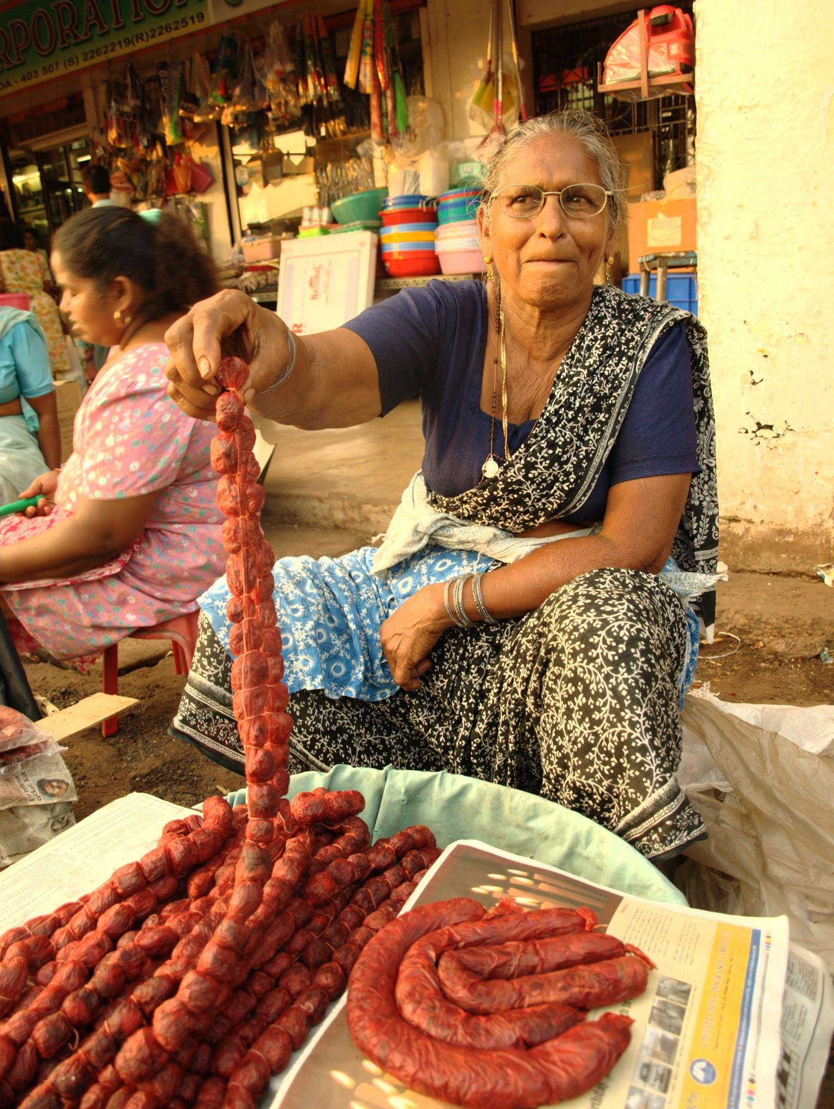
src/gmt_api.c
@Fredericknoronha
CC-BY-SA 4.0

Slide 10
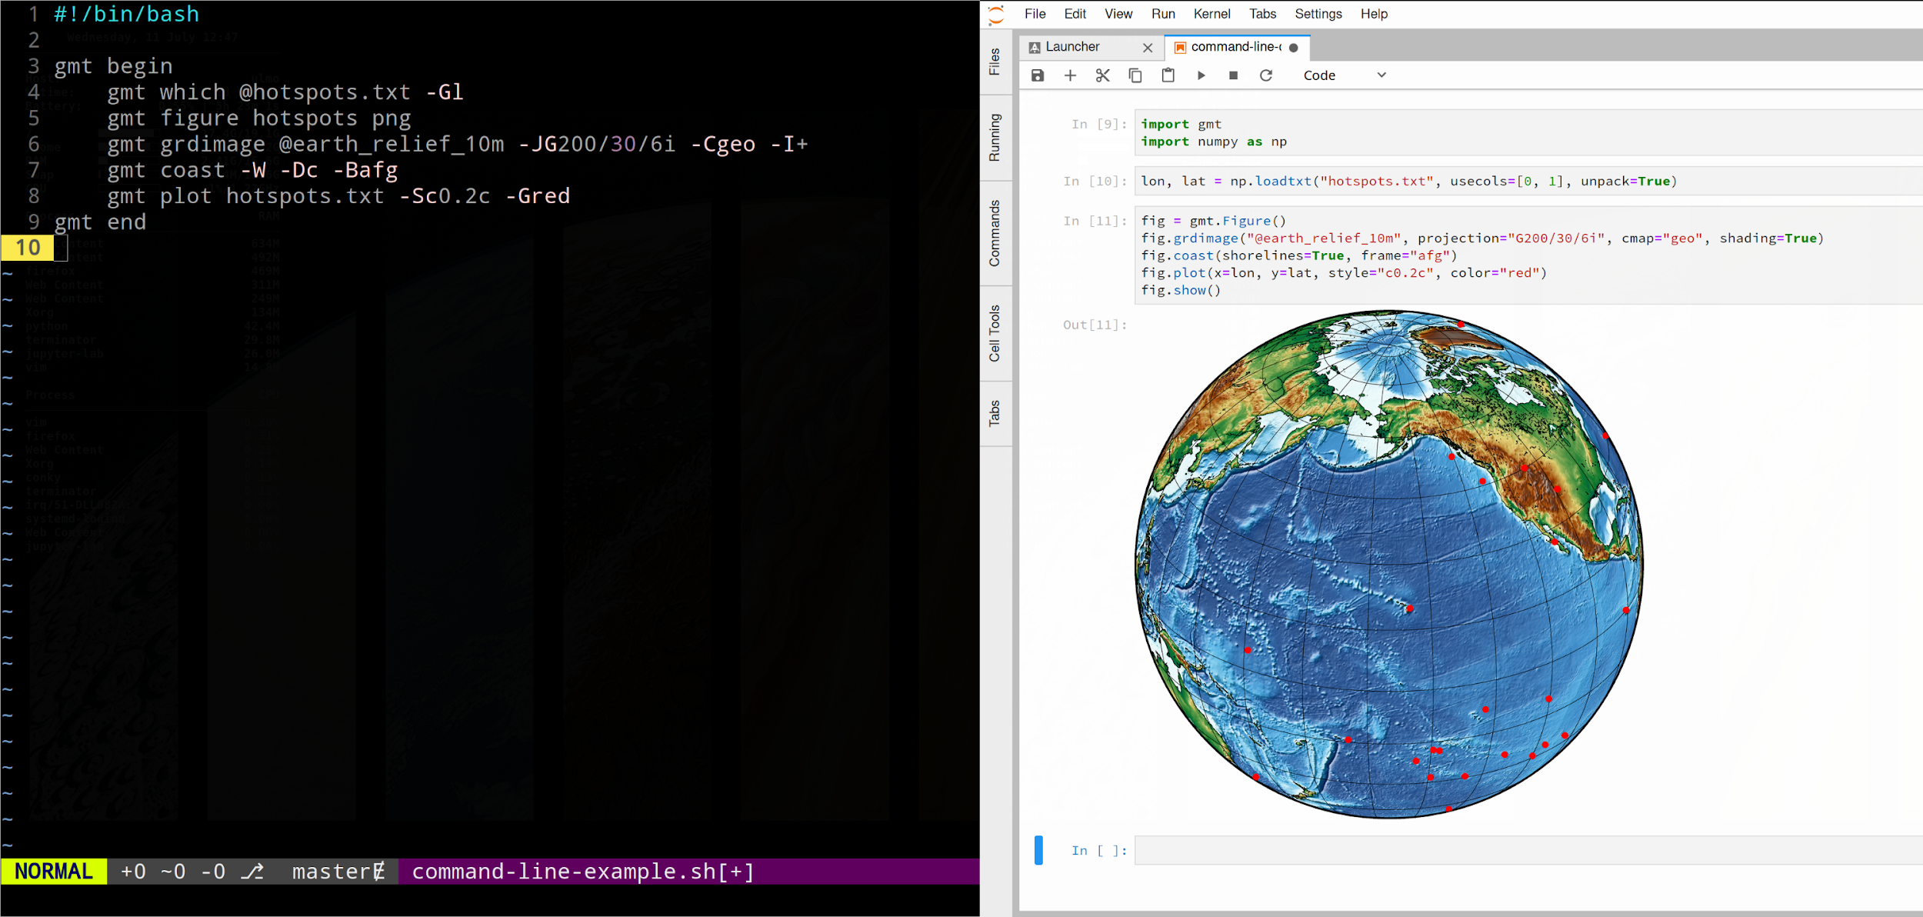

Slide 11
Keeping
“conda install gmt” alive.

Slide 12
Success

Slide 13
context managers
🚀

Slide 14
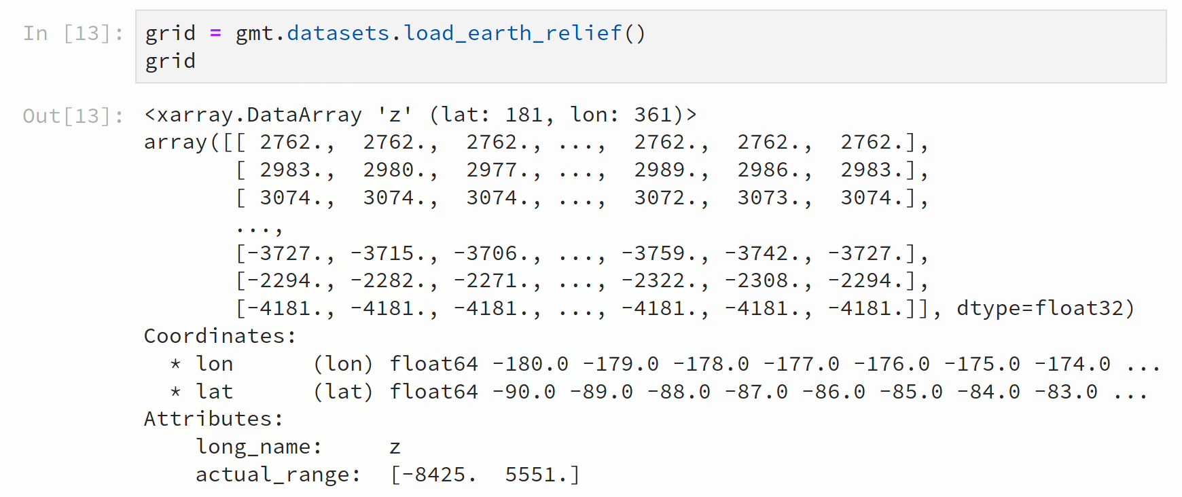

Slide 15
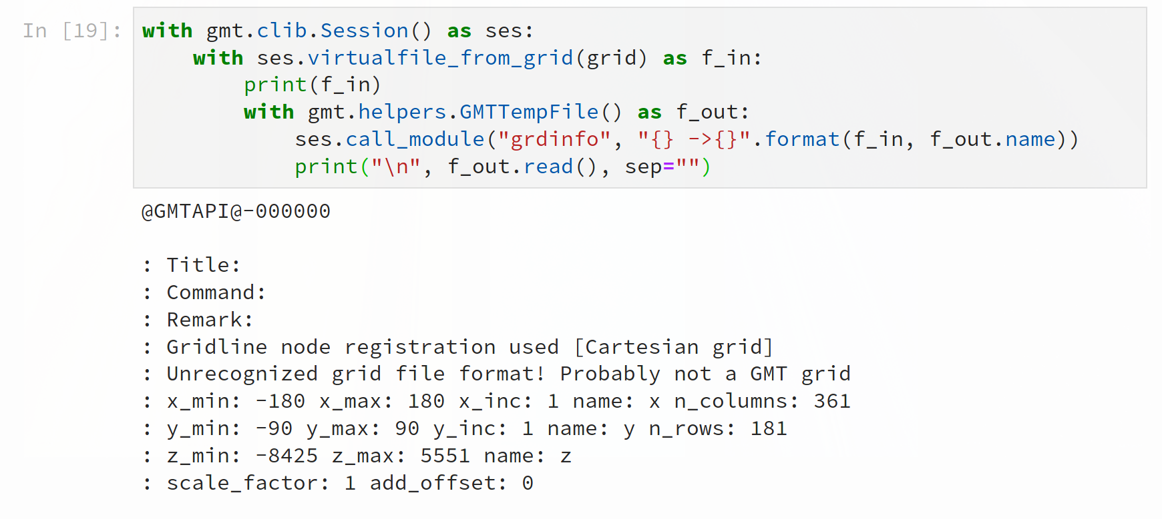

Slide 20
numpy + ctypes
💖

Slide 21
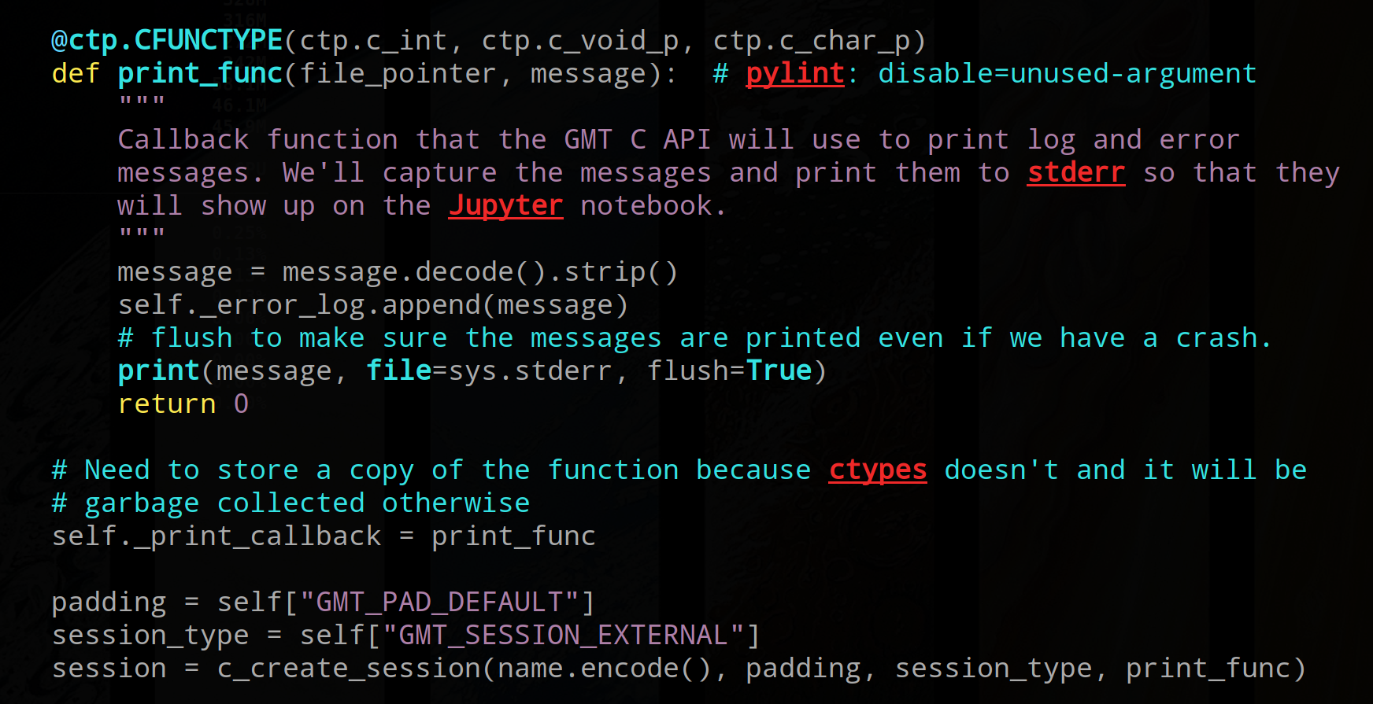

Slide 25
Conclusion

Slide 26
Working out kinks in the GMT API
Experimenting with the Python API
Improvements to docs (gmt-plot, sphinx-gallery)
Help with conda-forge Windows build

Slide 27
GMT API is more robust (but still needs work).
GMT 6 release at the end of the year (hopefully).
Stabilize C API so we can move forward.
Welcome community involvement.

Slide 28
Acknowledgements
Thanks to Dongdong Tian (@seisman) for contributions.
This project is supported by NSF grant OCE-1558403.
Download slides + demo code: leouieda.com
Project website: gmtpython.xyz
Feel free to photograph and share this presentation.

