Slide 1
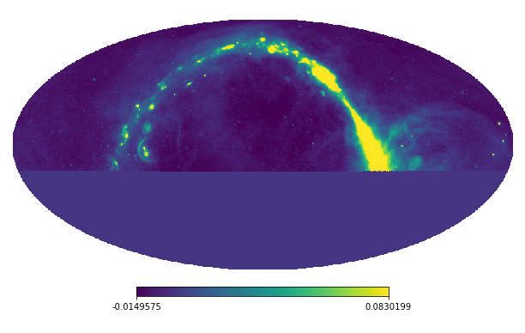
Reducing Pixel Artifacts Around Point Sources in C-BASS Maximum Likelihood Maps
Isabel Leatherman
Supervised by Prof Jonathan Sievers
Notes:
Group: just kind of me and Prof Sievers

Slide 2
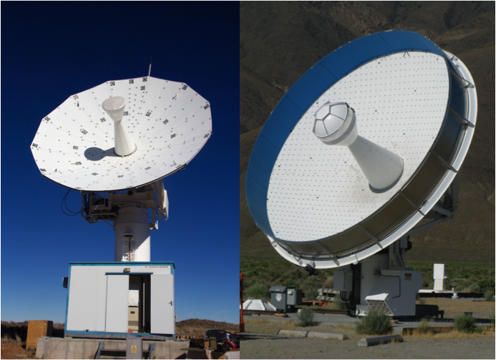
C-BASS: The C-Band All-Sky Survey
Southern Telescope: Karoo Desert, South Africa
Northern Telescope: Owens Valley Radio Observatory (OVRO), California
Specifications:
5GHz Frequency Range
Resolution of 0.73 degrees
Measures intensity and polarization
https://www2.physics.ox.ac.uk/research/c-bass
Notes:
C-BASS: The C-Band All Sky Survey
It consists of two telescopes, the northern telescope (right) that finished taking data in 2015, and the southern telescope, which is still taking data.
It measures intensity and polarization of the entire sky in the 5Ghz frequency range, with the overall goal of improving foreground radiation maps to subtract from Cosmic Microwave Background measurements.
This frequency was chosen because most of the emissions in this frequency range are from our own galaxy, and the CMB radiation is subdominant.
/////////////////////////////
Goal: Improve foreground radiation subtraction from Cosmic Microwave Background (CMB) radiation measurements
In this frequency range, synchotron radiation dominant, but unaffected by Faraday Rotation (rotates the polarization)
most emissions from our own galaxy, want to subtract this from CMB maps
Northern Telescope on the right, took data from 2013-2015, now decommissioned. this is the data i used.
Southern telescope is still taking data

Slide 3
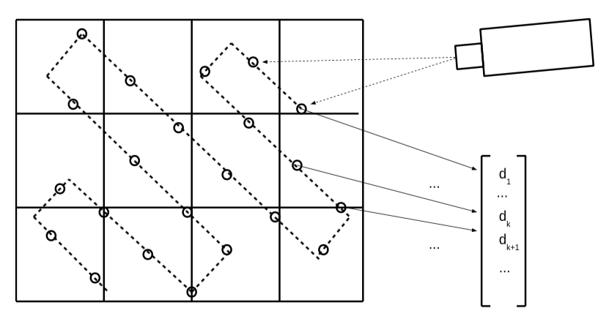
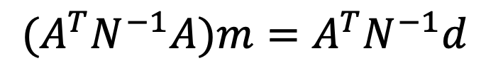
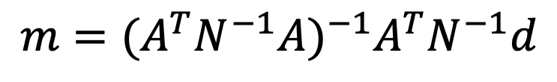


Maximum Likelihood Mapping of Time-Oriented Data (TOD)
$$d=Am+n$$
$$Χ^{2}={\left(d−Am\right)}^{T}N^{−1}\left(d−Am\right)$$
$$m={(A}^{T}N^{−1}A)^{−1}A^{T}N^{−1}d$$
$${(A}^{T}N^{−1}A)m=A^{T}N^{−1}d$$
ref: Piazzo, 2017
Notes:
The telescopes, represented in this diagram by the ”camera”, sweeps across the sky, taking measurements at a constant time interval, resulting in this vector of time-oriented data.
The sky itself itself is divided into individual pixels, represented here by this grid.
The data then needs to be mapped from the time-domain into the pixel domain.
We do this using a maximum likelihood mapping.
The data can be modeled using this equation. [click]
Here, d is the vector of time-oriented data, n is the vector of noise associated with each data sample, m is the vector of each pixel in the map, with each entry being the value of the intensity or polarization at that pixel. A is the pointing matrix that encodes the position and subsequent pixelization of each data sample.
Maximum likelihood is just minimizing the chi-squared of the model. [click]
N is the covariance matrix associated with n.
Minimizing this leads to this map [click]. However, A transpose N inverse A is often not invertible.
Thus we solve this equivalent system [click], using the faster iterative Preconditioned Conjugate Gradient method.

Slide 4
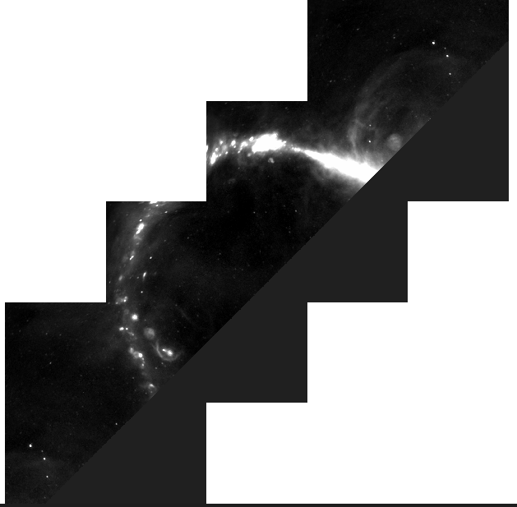
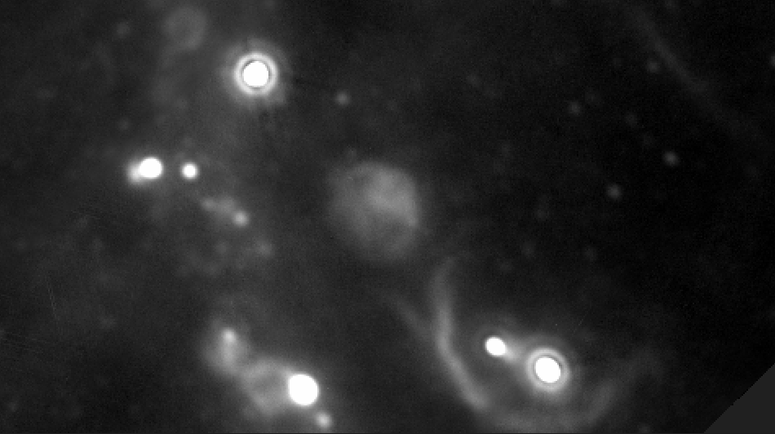
Notes:
However, there are problems with this mapping that arise from the model not accurately predicting the pixelized data.
The maximum likelihood estimation is particularly problematic when predicting the pixel data near areas with large gradients, such as bright point sources with very high noise surrounded by regions of lower noise.
As the noise vector n is the only term in the maximum likelihood solution that can account for these errors, the correlation of the noise covariance matrix spreads these errors out to surrounding pixels.
These show up in the finished maps as Xes. [click]
Previous solutions to this problem required previous knowledge about the position and intensity of these point sources, such as subtracting the point sources directly out of the data, or allowing for extra degrees of freedom around the point sources.
However instead, we can also account for this extra noise in the data model itself.

Slide 5
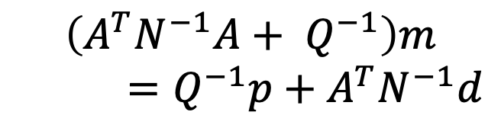

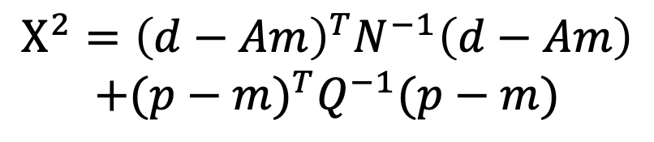

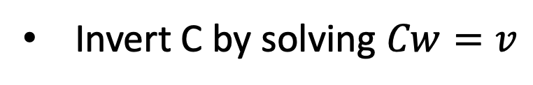
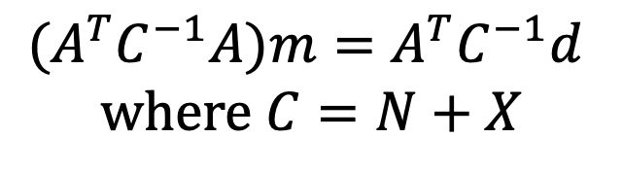
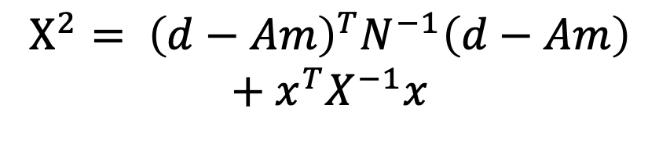
Accounting for Model Error
Pixel Noise Estimate (XGLS)
Piazzo, 2017
Our approach
$$d=Am+n+x$$
$$d=Am+x+n$$
$$Χ^{2}= {\left(d−Am\right)}^{T}N^{−1}\left(d−Am\right)$$
$$+ x^{T}X^{−1}x$$
$${(A}^{T}C^{−1}A)m=A^{T}C^{−1}d$$
$$\text{where} C=N+X$$
$$Χ^{2}={\left(d−Am\right)}^{T}N^{−1}\left(d−Am\right)$$
$$+(p−m)^{T}Q^{−1}(p−m)$$
Invert C by solving $Cw=v$
$$\left(A^{T}N^{−1}A+ Q^{−1}\right)m$$
$=Q^{−1}p+A^{T}N^{−1}d$
Notes:
The pixel Noise Estimate was developed by Lorenzo Piazzo for application to the to Photodetector Array Camera and Spectrometer instrument or (PACS) data.
in this estimate, an extra term x is added to the data model. in this method, x is treated as part of the total noise, with corresponding noise covariance matrix X.
This then has a total noise covariance matrix C = N + X.
Again, C is often not invertible, so we can again circumvent this by solving for an equivalent system using the iterative PCG.
However, this leads to a nested PCG, which requires an entire run of the inner PCG for every iteration of the outer PCG.
This takes about 20x longer than ordinary maximum likelihood, so this method is very computationally expensive for larger datasets.
Professor Sievers’ approach, however, still has the extra term x in the data model. The key difference is that x is treated as part of the solution itself, instead of another noise term.
Adding a term to the noise covariance matrix is mathematically equivalent to simply solving for that term in the solution itself. They both lead to the same minimum chi-squared and the same maximum likelihood surface.
This leads to an extra part in the Chi-squared, which can be focused on the regions of higher gradient.
We solve for that term by including a prior solved map using the original ML mapping, p, and a zeroed matrix of the pixel covariances, Q.
Q is the npix x npix diagonal matrix, where each entry is the covariance of each pixel, and so it is very easy to invert.
Therefore this method takes about the same time as the original ML mapping.
The work that I did was to build Q from the pixel gradients, and then implement and run the python pipeline of this approach that was developed by Prof Sievers on the C-BASS northern telescope data.

Slide 6
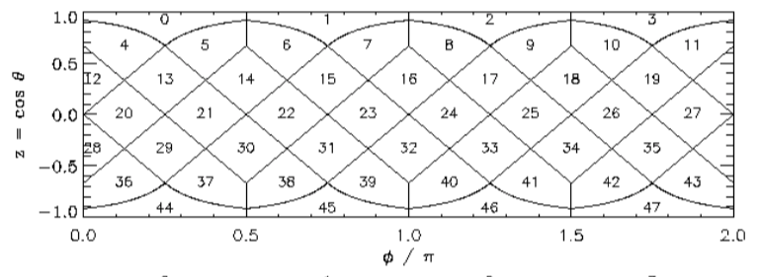
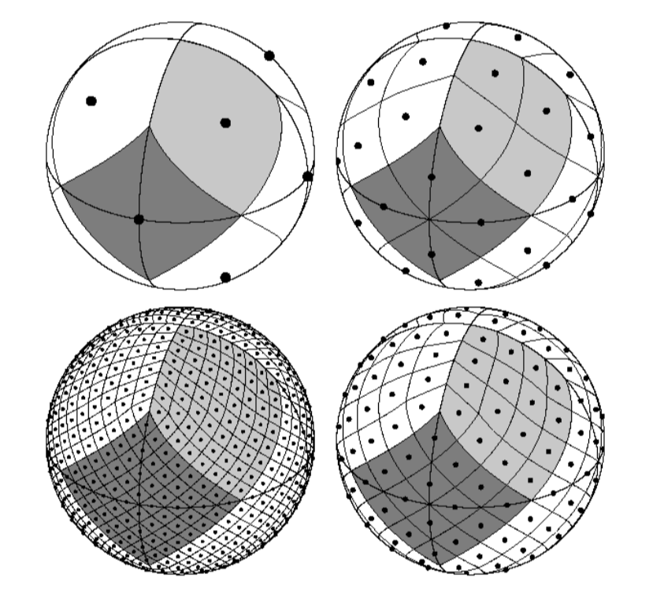




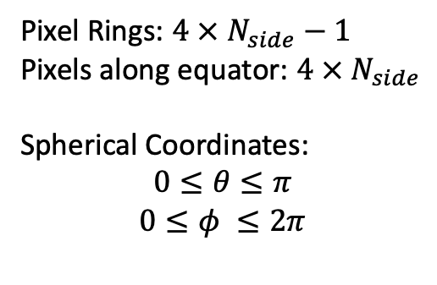
HEALPix Structure Hierarchical Equal Area isoLatitude Pixelization
$$N_{side}= 1$$
$$N_{side} = 2$$
nside = 2
Pixel Rings: $4 × N_{side}−1$
Pixels along equator: $4 × N_{side}$
Spherical Coordinates:
$$0≤θ≤π$$
$$0≤φ ≤2π$$
$$N_{side}= 8$$
$$N_{side}= 4$$
Notes:
In python, the maps are represented as 1d arrays, but the sky is 2 dimensional and (as i hope you all know) spherical.
the Hierarchical Equal Area Isolatitude Pixelization, or HealPix for short, is a framework that discretizes functions on the sphere, and provides a structure to convert from the 1d arrays to the 2d maps and back.
In this structure, the sphere is divided into 12 base resolution pixels of equal area in 3 rings around the sphere, as seen in the upper left sphere.
The resolution of the map is defined by the Nside parameter, which is the amount of pixels along one side of a base pixel. C-BASS maps has an Nside of 512, which leads to a total amount of a little over 3 million pixels.
There are 2 methods of numbering the pixels into the 1d array, the one used by the C-BASS data is ring ordering, where pixels are counted along the isolatitude rings from top to bottom. the other method is called Nest ordering, but is too complicated to explain right now.
HEALPix has functionality to convert the maps into spherical harmonics, which is a complete set of orthogonal functions defined on the surface of a sphere, which can then be used to represent any other function defined on the sphere, such as the intensity of each pixel.
From this we can calculate the gradient of each pixel in the spherical coordinates theta and phi directions, which can be converted from radians to pixels using the amount of pixel rings along the theta direction, and the amount of pixels along the phi direction.
///////////////////////////////
too long
In python, the maps are represented by 1D numpy arrays, but sky is 2D and (as i hope you all know) spherical
Converted to 2D spherical topology using the Healpix framework, developed by JPL
Discretizes functions on the sphere – allow us to calculate the gradient of intensity between pixels in spherical 2D by converting to spherical harmonics
--complete set of orthogonal functions defined on the surface of a sphere
-- can then represent any other function that’s defined on the sphere, namely, change in intensity of a map
Left: nside = 1 is the base resolution of 12 equal area pixels
nside is the resolution parameter that specifies how many divisions along one side of the base-resolution pixel [show lines] are needed to reach the desired resolution. The pixels still all have equal area. For C-BASS, the nside is 512. = little over 3 million pixels
In total, there are [PIXEL RINGS] isometric pixel rings from top to bottom, and [PIXEL NUM] pixels along the equatorial ring
These will become important when calculating the gradient
RING ordering of pixels counts along the rings from top to bottom, this is how it goes from 2D to the 1D representation

Slide 7
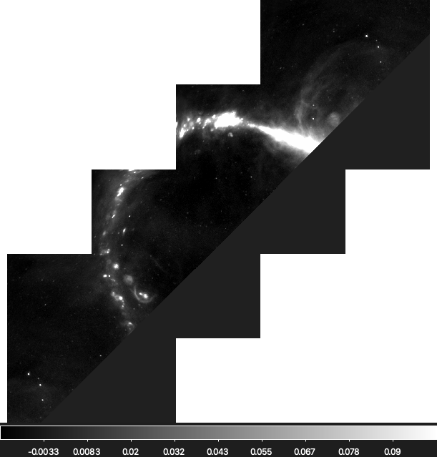
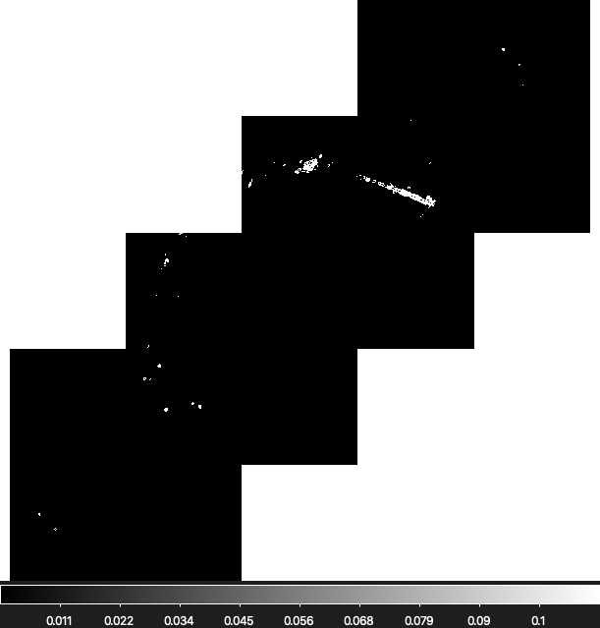
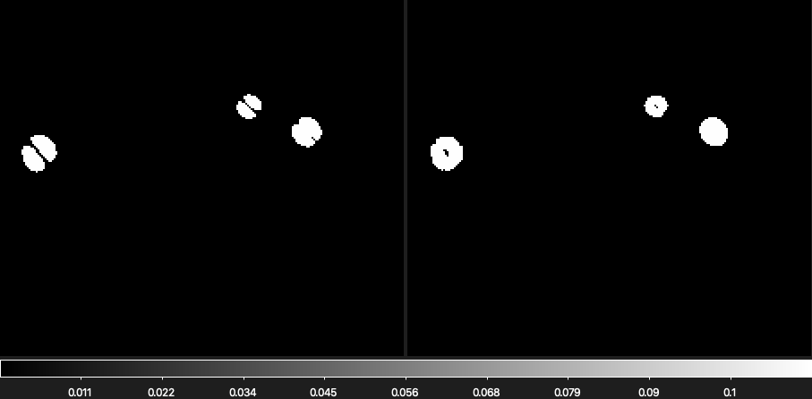
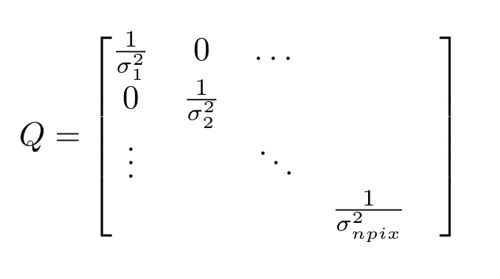

Building Q from pixel gradient
Q = $\left[\begin{matrix}\begin{matrix}\frac{1}{σ_{1}^{2}} & 0 \\ 0 & \frac{1}{σ_{2}^{2}}\end{matrix} & \begin{matrix}⋯ & \\ & \end{matrix} \\ \begin{matrix}⋮ & \\ & \end{matrix} & \begin{matrix}⋱ & \\ & \frac{1}{σ_{npix}^{2}}\end{matrix}\end{matrix}\right]$
Notes:
Using a prior map solved using maximum likelihood to calculate the gradient vector for each pixel using spherical harmonics, I then built Q.
Because it’s per pixel, there is no correlation between values.
The point sources correspond to areas with steep gradients, so to isolate them, I zeroed all gradients that fell within 3 standard deviations from the mean gradient. This left only the steepest 0.3% of the data. [flick between maps]
So now that we have the prior map and Q, we can actually solve for the map.
In terms of the timescale of the program, there was about 2 years worth of data, it took a little less than an hour running 20 parallel processes spread across 4 nodes of the HIPPO supercomputing cluster from the University of KwaZulu-Natal in south africa

Slide 8
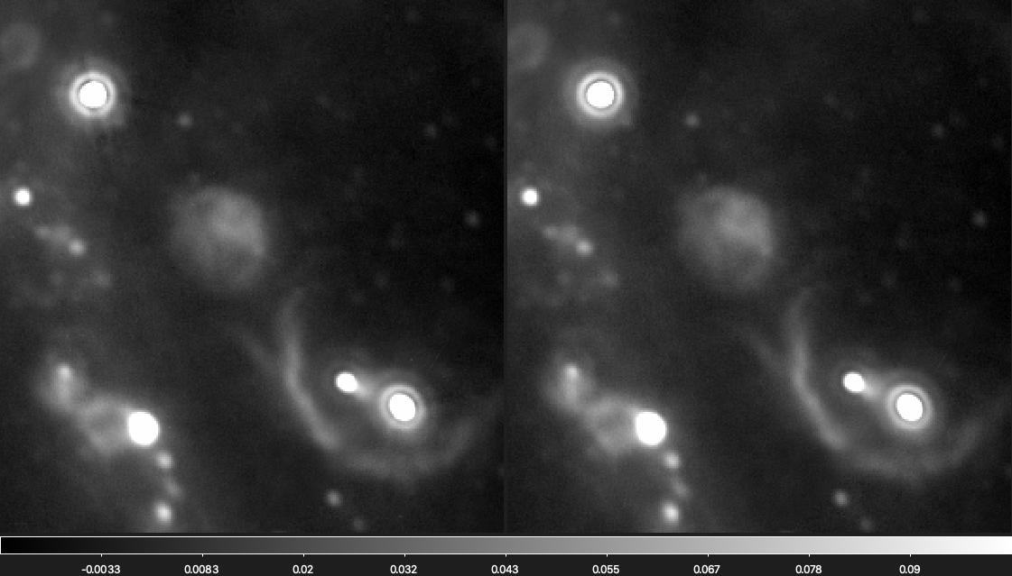
Prior
Result
Notes:
Here is a closeup of the same point sources from earlier, and you can see the drastic reduction of the artifact.
To further quantify this reduction, I also took the difference between the two maps.
/////////////////////////////
Can see the reduction in the Xes!
I also looked at the maps made by taking the difference between the two maps. LIterally subtracting one from the other

Slide 9
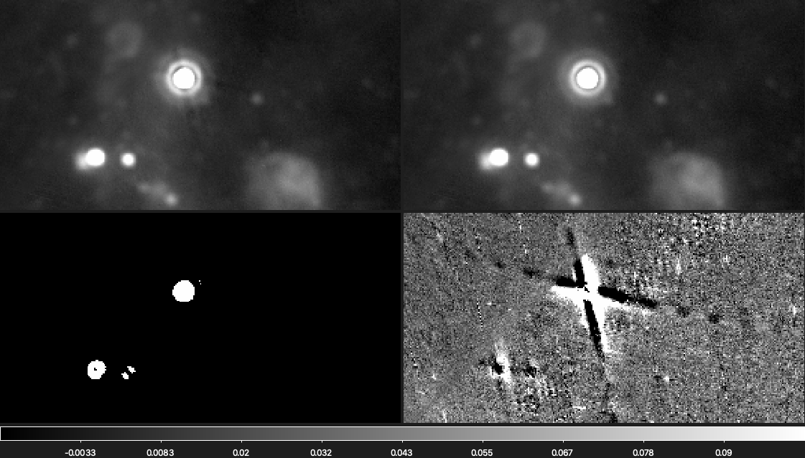
Prior
Result
Gradient
Difference
Notes:
Lower right corner is the difference map between the initial prior map and the new pipeline.
Lower left is the zeroed map of the gradients.
You can also see another X in the lower left corner, which isn’t visible in the prior map.
The difference map actually revealed more artifacts than can be seen in the prior maps

Slide 10
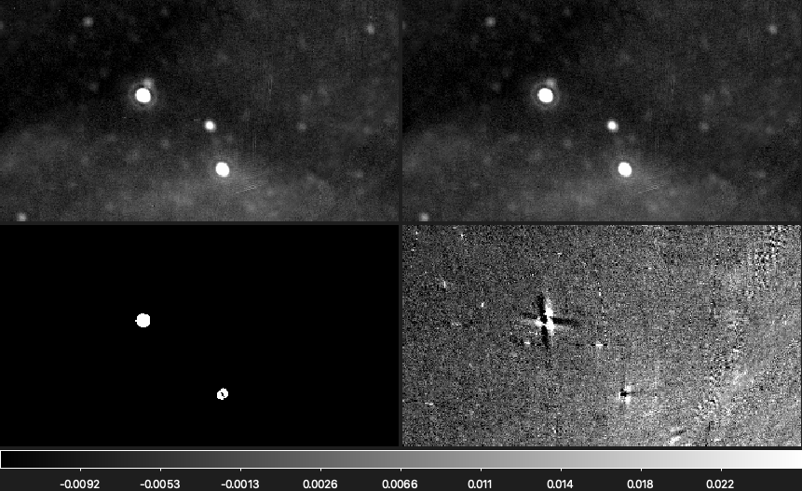
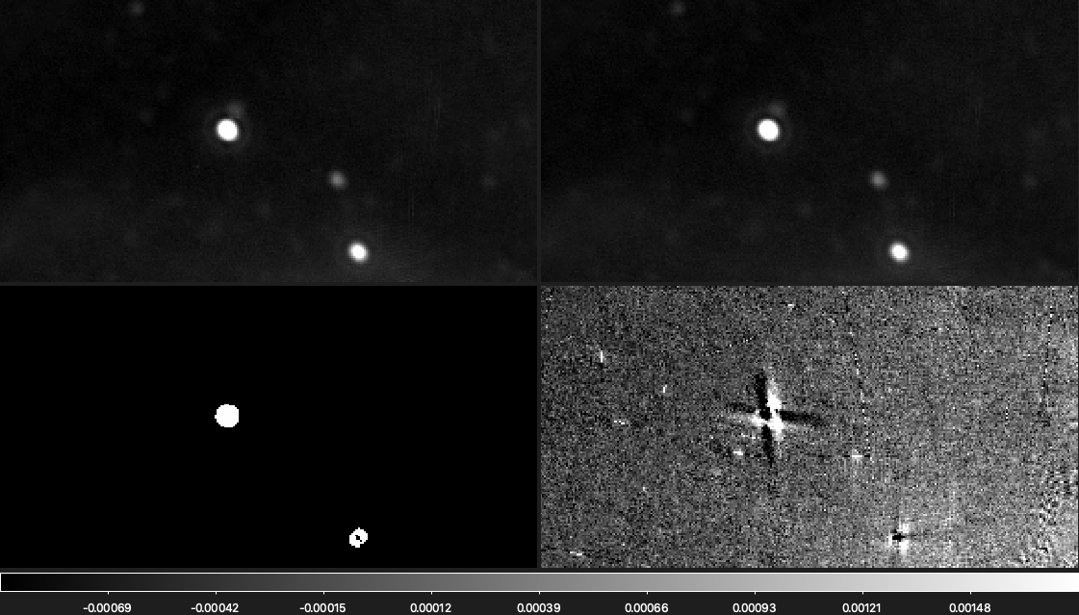
Prior
Result
Gradient
Difference
Notes:
Previously non visible Xes are apparent with the difference maps

Slide 11
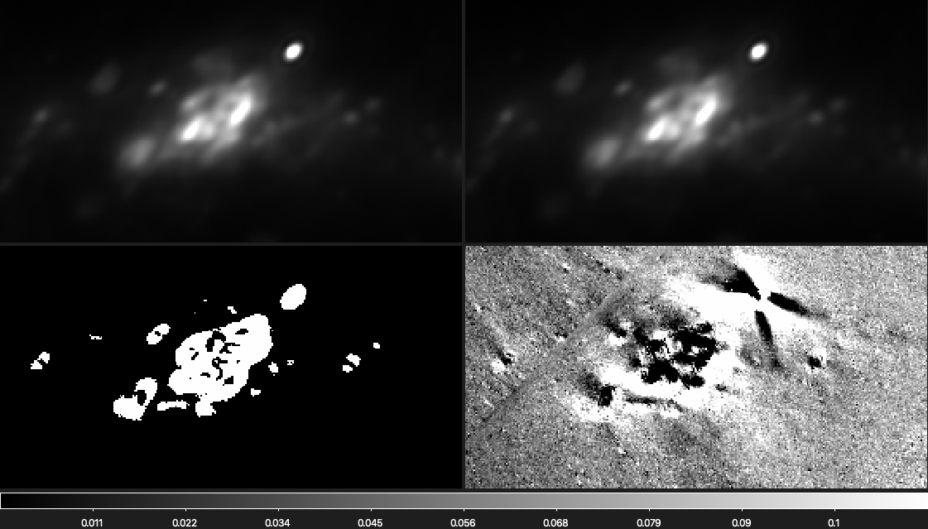
Prior
Result
Gradient
Difference
Notes:
The difference map can also offer some more clarity into changes in the higher density areas, like in the galactic plane.
This is this blob. [can go back and show map]
The top two maps are scaled so that you can better see the structure.
Can see a lot of stuff going on there, possibly just the overlap of multiple point sources.
//////////
more clarity into changes in high density areas
color in top two maps are scaled so that you can more easily see the structure that’s harder to see in the bright blob
the difference map also shows something going on there, but i have no idea what. it could be overlap of Xes from point sources that are closer together in the sky

Slide 12

Next Steps
Compare residuals between maps
Different gradient cutoffs
Compare the power spectrum between each mapping
Notes:
good initial confirmation that this pipeline works! however, there are more steps we can take to further justify this method.
residuals
-- pipeline supports transforming maps into the timestream domain
-- around point sources, new map would have smoother residuals than the old map
gradient cutoffs
-- potential time differences, relevant once southern telescope survey is done and full sky data doubles the amount of data
power spectrum
By running multiple simulations with very finely sampled input data, the recovered power spectrum could then be compared to the power spectrum of the input data.
simulated data
--knowing the exact equation for the signal will be able to show noise reduction
All in all, this is really promising when it comes to creating accurate foreground maps to improve the quality of CMB data, as this faster method can potentially be implemented on data with hundreds of times, if not thousands of times more samples than C-BASS data.
Thanks so much for your time.

